Slide 1
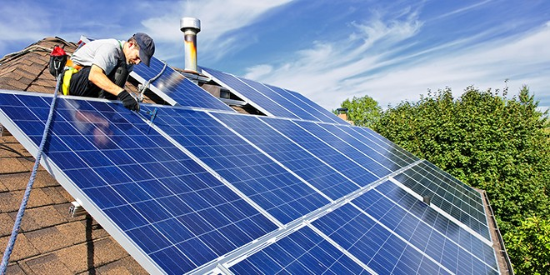

Final work for course “Energy”

Slide 2
1. Introduction
The purpose of my work is to compare two kinds of currently commercially available photovoltaic cells:
mc-Si and CdTe,
and see which will be best for use in settlement Beer Sheva (south of Israel).

Slide 3

2. Theoretical background

Slide 4
2.1 Photovoltaic effect
The photovoltaic effect, which is the physical basis for the change of electromagnetic into electrical energy, consists of the photo-generation, separation and collection of electronic charge (electrons and holes, i.e., missing electrons) in a given material medium, as a result of radiation absorption.

Slide 5
The Photovoltaic (PV) effect:
Generalized picture
Absorber
High
energy
state
e⁻
Metastable high and low energy states
Absorber transfers charges into high and low energy state
Driving force brings charges to contacts
Selective contacts
one electron energy
contact
contact
Low
energy
state
p⁺
space
    (1) cf. e.g., Green, M.A., Photovoltaic principles. Physica E, 14 (2002) 11-17

Slide 6
Semiconductor p / n junction:
work horse of photovoltaics today
it is necessary to modify the semiconductor, to allow separating the positive and negative charge carriers in the conduction band.
This separation occurs as a result of the carrier diffusion between the areas of different carrier concentrations, according to the chemical potential gradient, and also as a result of the charge drift in the internal electric field of the cell.
An example of such a medium is the semiconductor crystalline silicon with a p-n junction.

Slide 7
The formation of an area with p-type conductivity takes place as a result of doping with atoms of acceptor elements for Si, from group III of the periodic system, whereas an area with n-type conductivity is created as a result of doping with atoms of donor elements for Si, from group V of the periodic table.
If the above structure of the crystalline Si material is exposed to radiation whose quantum energy is higher than its energy gap Eg = 1,12 eV, then a result of the light absorption is the generation of electric charge carrier, electron-hole, pairs, which separate under the effect of the electric field present in the junction.
The consequence is an excess of electrons on the n-side and an excess of holes on the p-side, which results in the formation of electrical potential difference, voltage

Slide 8
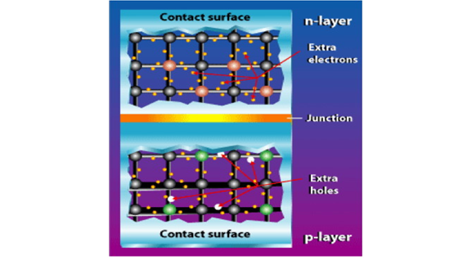
Formation of p-n junction

Slide 9

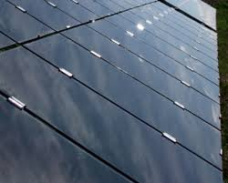
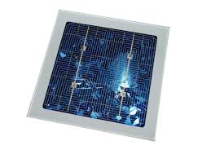
2.2 Which PV technologies are relevant today ?
Not all photovoltaic technology is the same: there are several PV technologies to convert sunlight into electricity.
Mono crystalline
Poly
(multi)crystalline
Thin layer

Slide 10
2.2 Which PV technologies are relevant today ?
Crystalline Si technology dominates the market and field for decades –around 90 % of all solar cells manufactured worldwide come into this category. In a manner of speaking, it is the “work-horse” of the photovoltaic industry –technically mature and reliable.

Slide 11
2.2 Which PV technologies are relevant today ?
The base product for the production of mono- and polycrystalline solar cells is silicon: this is melted into blocks, or so-called ingots. Silicon wafers are then cut from these blocks, which, in a number of steps, are then processed into active solar cells.
In doing so, chemical impurities are applied to the two sides of the wafer. By this means, the upper side of the cell is given a negative charge while the underside is given a positive charge, which allows the solar energy to flow.

Slide 12
2.2 Which PV technologies are relevant today ?
Thin-film technology relies on a completely different manufacturing process.
Although thin-film cells and crystalline silicon cells have the same function, nonetheless there are major differences in their composition and fabrication.
The most important difference is that the photoactive layer of thin-film cells is only a few thousandths of a millimeter –“thick "enough for the photovoltaic effect and around one hundred times “thinner "than on crystalline cells.

Slide 13
2.2 Which PV technologies are relevant today ?
A variety of manufacturing processes exist in relation to thin-film technology. These processes differ significantly depending on the semiconductor used.
In principle, the manufacturing process is similar in all cases: it consists of depositing the thin photoactive film as homogeneously as possible onto a substrate –in most cases glass as the carrier material –and permanently protecting it by way of suitable lamination.
The technical challenge lies in optimizing the production process: short cycle times with a high degree of homogeneity of the applied films to achieve high levels of efficiency on large substrate formats while maintaining consistent quality.

Slide 14
2.2 Which PV technologies are relevant today ?
From laboratory cell to industrially produced thin-film module is therefore an arduous route.
This is also the main reason why, although there are numerous interesting scientific approaches to thin-film photovoltaic, until now there are only a few marketable technologies and actually only three relevant ones in CI(G)S, CdTe and micro-amorphous cells. CI(G)S cells mostly use a copper-indium compound as a semiconductor, whereas CdTe cells use a cadmium-telluride compound.

Slide 15
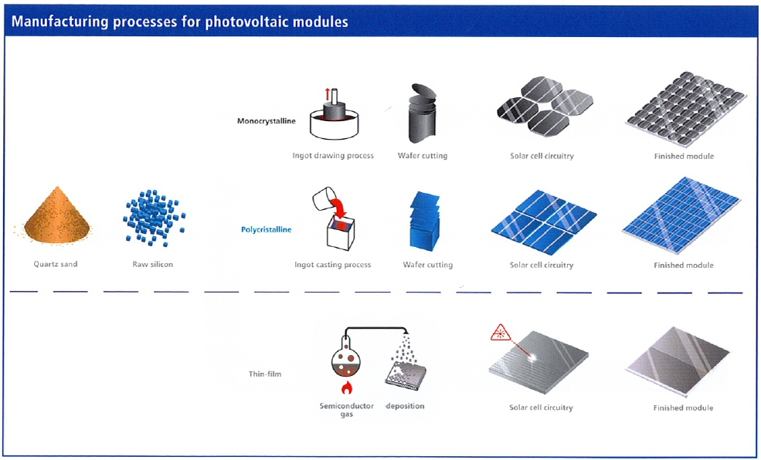
2.2 Which PV technologies are relevant today ?

Slide 16
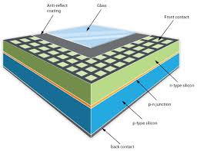
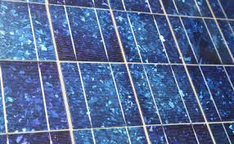
2.3 Polycrystalline Silicon Solar Cells
The first solar panels based on polycrystalline silicon, which also is known as polysilicon (p-Si) and multi-crystalline silicon (mc-Si), , were introduced to the market in 1981

Slide 17
2.3a How Are Polycrystalline Cells Made ?
The reason polycrystalline solar panels are less expensive than monocrystalline solar panels, is because of the way the silicon is made.
Basically, the molten silicon is poured into a cast instead of being made into a single crystal.

Slide 18
2.3a How Are Polycrystalline Cells Made ?
Although molding and using multiple silicon cells requires less silicon and reduces the manufacturing costs, it also reduces the efficiency of the solar panels.

Slide 19
2.3a How Are Polycrystalline Cells Made ?
This material can be synthesized easily by allowing liquid silicon to cool using a seed crystal of the desired crystal structure. Additionally, other methods for crystallizing amorphous silicon to form polysilicon exist such as high temperature chemical vapor deposition (CVD).
In the cast process, silicon pieces are melted in a ceramic crucible and then formed in a graphite mold to form an ingot. As the molten silicon is cooling a seed crystal of the desired crystal structure is introduced to facilitate formation.

Slide 20
2.3b Efficiency
Generally speaking, polycrystalline panels have an efficiency that is about 70% to 80% of a comparable monocrystalline solar panel.
One of the world records, which Mitsubishi Electric has now renewed for the third consecutive year, is a 19.3-percent efficiency rating for photoelectric conversion of a practically-sized polycrystalline silicon PV cell of 100 squared centimeters or larger, with the PV cell measuring approximately 15cm x 15cm x 200 micrometers. The rating is 0.2 points higher than the company's previous record of 19.1 percent.

Slide 21
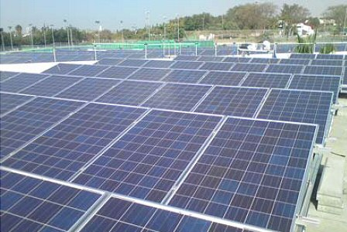
2.3b Efficiency
In Israel the efficiency of Si solar modules is about 16%
In November 2009, 2 polycrystalline cell systems (overall capacity = 100 kWp) were installed Maccabim’s Renanim Center

Slide 22
2.3c Benefits of Polycrystalline Solar Panels
1. Lower Per Panel Costs
mc-Si PV cells are much simpler to produce, and cost far less to manufacture than single crystal Si ones. This makes them much less expensive for buyers, especially those with small to medium sized roofs.
2. Durability and Longevity
The durability and longevity are comparable to those of their monocrystalline cousins – namely at least 25 years. Polycrystalline solar panel modules could put solar power into the hands of people who could not afford the monocrystalline cells.

Slide 23
2.3c Benefits of Polycrystalline Solar Panels
3. Environmental Enhancements
Besides being able to produce energy from the sun and thus help reduce greenhouse gases and related environmental problems of extracting fossil fuels (e.g., the BP oil spill, coal mining accidents, geo-political resource wars, etc.), some polycrystalline solar panel manufacturers (e.g., Mitsubishi) go the extra mile by inventing new technologies that eliminate expensive soldering (which also contains lead) making these panels even more environmentally friendly.
4. Lower Electric Bills
Any solar system can and probably will result in a lower electricity bill. Even though the amount of electricity produced from a polycrystalline solar panel is less than from a monocrystalline panel – so are the costs … so you have to fine tune your analysis to see which one has the better payback over the time frame of your analysis (e.g., 20 years in Europe – which is usually the time period of the Feed in Tariffs).

Slide 24
2.3d Disadvantages of Polycrystalline Solar Panels
1. Lower Efficiency
Polycrystalline solar modules are less efficient than those made from a single crystal.
2. Fragile
Polycrystalline solar panels are somewhat fragile, and can be broken if hit by a falling branch or reasonably heavy object flying through a strong wind.
3. Competitive
There is strong price competition between polycrystalline manufacturers, and this can be both a good thing (in that it tends to keep prices low) or a bad thing (some manufacturers may not be able to withstand the competition and won't be around to honor their product or performance warranties).

Slide 25
2.3e Current Market Overview
The current market for solar PV is dominated by crystalline silicon (c-Si) solar panels (around 80%), and c-Si solar technology is expected to continue to dominate in the residential and commercial rooftop markets due to higher efficiency and rapidly reducing costs.
There has been a 40% price reduction since the middle of 2009, largely as a result of the improved supply of polysilicon, which is the basis of c-Si-based panels. When supply was constrained by limited production of polysilicon, the price reached over $300/kg. Now, the cost has fallen to below $100/kg and supplies are readily available for mass production — driving a continuing decline in panel prices.
Lower cost c-Si panels support a key goal for solar known as grid parity, where it costs the same to generate power on their rooftops as it does to buy it from the grid. This point has already been reached during the peak demand period. According to the European Photovoltaic Technology Platform group, solar PV is expected to reach grid parity in most of Europe over the next 10 years.

Slide 26
2.4 Cadmium telluride photovoltaic- thin layer cells
Among the thin-layer solar cells, those of the greatest importance are currently the cells with a cadmium telluride base (CdTe), the latter having a simple energy gap Eg = 1,48 eV and a high value of the absorption coefficient α ~ 105 cm-1, within the wavelength range of 300 ÷ 820 nm, which makes the layer, only a few micrometers thick, provide the absorption of almost all the radiation in the above range

Slide 27
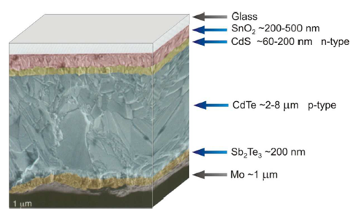
2.4 Cadmium telluride photovoltaic- thin layer cells
The above cells are made with the method of depositing successive layers on a glass base covered with a thin layer of a transparent conductive oxide (TCO). The rear contact is achieved through a thin layer of metal. The significant advantage of such cells is the possibility to produce their successive construction layers by means of such techniques as a chemical bath, vapour deposition, electrolysis, magnetron sputtering, spraying or close space sublimation (CSS). The structure deposited on the surface of the glass, which, at the same time, determines the size of the thin-layer module, is separated through laser cutting into single cells, which, connected in series, provide the proper value of the module’s voltage.

Slide 28
2.4a Performance advantage
Although typical crystalline silicon modules have an efficiency of 13%-20% and CdTe modules have an efficiency of approximately 13%; recent modules produced at First Solar and measured by NREL have shown CdTe modules with efficiencies at 16.1%.
Module efficiencies are obtained in laboratories at standard testing temperatures of 25°C, however in the field modules are often exposed to much higher temperatures.
CdTe PV modules have a proven performance advantage over conventional silicon modules in high temperature climates due to CdTe’s low temperature coefficient.
Although all PV semiconductors experience performance losses at temperatures above 25°C,CdTe PV modules experience half the reduction of crystalline silicon modules, resulting in an increased annual energy output of 5-9%.

Slide 29
2.4b Low Cost Manufacturing
The major advantage of this technology is that the panels can manufactured at lower costs than silicon based solar panels. “First Solar” company was the first manufacturer of Cadmium telluride panels to produced solar cells for less than $1.00 per watt.

Slide 30
CdTe panels have several advantages over traditional silicon technology. These include:
1. Ease of manufacturing: The necessary electric field, which makes turning solar energy into electricity possible, stems from properties of two types of cadmium molecules, cadmium sulfide and cadmium telluride. This means a simple mixture of molecules achieves the required properties, simplifying manufacturing compared to the multi-step process of joining two different types of doped silicon in a silicon solar panel.
2. Good match with sunlight: Cadmium telluride absorbs sunlight at close to the ideal wavelength, capturing energy at shorter wavelengths than is possible with silicon panels
3. Cadmium is abundant: Cadmium is abundant, produced as a by-product of other important industrial metals such as zinc, consequently it has not had the wider price swings that have happened in the past two years with silicon prices.

Slide 31
2.4c Cadmium telluride drawbacks
While price is a major advantage, there are some drawbacks to this type of solar panels, namely:
1. Lower efficiency levels: Cadmium telluride solar panels currently achieve an efficiency of 10.6%, which is significantly lower than the typical efficiencies of silicon solar cells.
2. Tellurium supply: While Cadmium is relatively abundant, Tellurium is not. Tellurium (Te) is an extremely rare element (1-5 parts per billion in the Earth's crust. According to USGS, global tellurium production in 2007 was 135 metric tons. Most of it comes as a by-product of copper, with smaller byproduct amounts from lead and gold. One gigawatt (GW) of CdTe PV modules would require about 93 metric tons (at current efficiencies and thicknesses), so the availability of tellurium will eventually limited how many panels can be produced with this material.

Slide 32
2.4c Cadmium telluride drawbacks
Since CdTe is now regarded as an important technology in terms of PV’s future impact on global energy and environment, the issue of tellurium availability is significant. Recently, researchers have added an unusual twist – astrophysicists identify tellurium as the most abundant element in the universe with an atomic number over 40. This surpasses, e.g., heavier materials like tin, bismuth, and lead, which are common. Researchers have shown that well-known undersea ridges (which are now being evaluated for their economic recoverability) are rich in tellurium and by themselves could supply more tellurium than we could ever use for all of our global energy. It is not yet known whether this undersea tellurium is recoverable, nor whether there is much more tellurium elsewhere that can be recovered.

Slide 33
2.4c Cadmium telluride drawbacks
3. Toxicity of Cadmium
Cadmium is one of the top 6 deadliest and toxic materials known. However, CdTe appears to be less toxic than elemental cadmium, at least in terms of acute exposure.
This is not to say it is harmless. Cadmium telluride is toxic if ingested, if its dust is inhaled, or if it is handled improperly (i.e. without appropriate gloves and other safety precautions). The toxicity is not solely due to the cadmium content. One study found that the highly reactive surface of cadmium telluride quantum dots triggers extensive reactive oxygen damage to the cell membrane, mitochondria, and cell nucleus. In addition, the cadmium telluride films are typically recrystallized in a toxic compound of cadmium chloride.

Slide 34
2.4c Cadmium telluride drawbacks
But!
Researchers from the U.S. Department of Energy's Brookhaven National Laboratory have found that large-scale use of CdTe PV modules does not present any risks to health and the environment, and recycling the modules at the end of their useful life resolves any environmental concerns. During their operation, these modules do not produce any pollutants, and furthermore, by displacing fossil fuels, they offer great environmental benefits. CdTe PV modules appear to be more environmentally friendly than all other current uses of Cd.

Slide 35
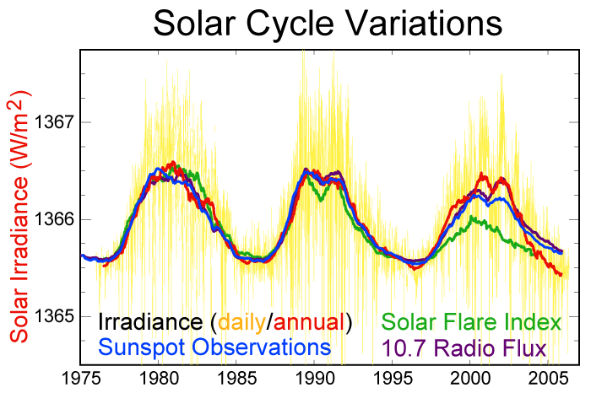
3. Data harvesting on energy generation/consumption in Israel

Slide 36
3. Data harvesting on energy generation/consumption in Israel

Slide 37
3. Data harvesting on energy generation/consumption in Israel

Slide 38
3. Data harvesting on energy generation/consumption in Israel
mc-Si photovoltaic panels

Slide 39
3. Data harvesting on energy generation/consumption in Israel

Slide 40
3. Data harvesting on energy generation/consumption in Israel

Slide 41
3. Data harvesting on energy generation/consumption in Israel

Slide 42
3. Data harvesting on energy generation/consumption in Israel
CdTe photovoltaic panels

Slide 43
3. Data harvesting on energy generation/consumption in Israel

Slide 44
3. Data harvesting on energy generation/consumption in Israel

Slide 45
3. Data harvesting on energy generation/consumption in Israel

Slide 46
4. Discussion on results and conclusions
Type of photovol-taic cells | Total area of photovoltaic cells on winter [Acres] | % area of Beer-sheva | Total area of photovoltaic cells on summer [Acres] | % area of Beer-sheva | Useful area of roofs for photovoltaic cells: [Acres] | % area of Beer-sheva
mc-Si | 21635 | 18% | 22802 | 19.4% | 8401 | 7%
CdTe | 40042 | 34% | 42206 | 36% | 8401 | 7%
As we can see, the total area of photovoltaic cells that need to provide energy is bigger than the useful area of roofs.

Slide 47
4. Discussion on results and conclusions
Conclusion:
We can’t use only photovoltaic cells to provide all energy because we don’t have enough area to install all photovoltaic cells that need.
But!
If will fill all useful area of roofs by mc-Si photovoltaic cells, we will produce about 37% of energy.
If will fill all useful area of roofs by CdTe photovoltaic cells, we will produce about 20% of energy.
2. mc-Si photovoltaic cells can provide more energy than CdTe photovoltaic cells.
But!
The major advantage of CdTe photovoltaic cells is that the panels can manufactured at lower costs than silicon based solar panels.

Slide 48
5. References
[1] K. Drabczyk, P. Panek, "Silicon-based solar cells: characteristics and production processes", Institute of Metallurgy and Materials Science, (2012).
[2] D. Cahan, "BASIC CONCEPTS OF Photovoltaics" presentation, (2013), p. 12.
[3] http://www.ralcoenergy.co.il/english/cat.asp?catalogid=175
[4] http://energyinformative.org/best-solar-panel-monocrystalline-polycrystalline-thin-film/
[5] http://www.solar-facts-and-advice.com/polycrystalline.html
[6] K. Drabczyk, P. Panek, "Silicon-based solar cells: characteristics and production processes", Institute of Metallurgy and Materials Science, (2012).
[7] http://www.solar-facts-and-advice.com/cadmium-telluride.html
[8]http://www.beersheva.muni.il/apps/hebrew/place.asp?TableName=MESSAGES&AppId=4&PlaceId=766&From=&CityId=53&CityName=&Filter=0
[9] http://www.nrg.co.il/online/54/ART2/341/857.html
[10] http://www.ims.gov.il/IMS/CLIMATE/LongTermRadiation/
[11]הלשכה המרכזית לסטטיסטיקה, "דוח המצב הדמוגרפי בישראל 2011", (2013)
[12] http://www.nrg.co.il/online/54/ART2/240/392.html
[13]http://he.wikipedia.org/wiki/%D7%9E%D7%A9%D7%A7_%D7%94%D7%97%D7%A9%D7%9E%D7%9C_%D7%91%D7%99%D7%A9%D7%A8%D7%90%D7%9C
[14] ד. פיימן, ד. פוירמן, פ. איבצון, "מערכות פוטו-וולטאיות בערי ישראל: איזה גודל מתאים?", המחלקה לאנרגית השמש ולפיזיקה סביבתית, אוניברסיטת בן גוריון בנגב, (2000), עמ' 4.
[15] http://www.sollan.co.il/sale.asp?pid=13681
[16] http://solar-panels.findthebest.com/l/206/First-Solar-FS-377

Slide 49

Thanks for your attention!

