Slide 1
Striclty for educational purposes
Final project in M.Sc. Course for teachers, in the framework of the Caesarea –Rothschild program of the Feinberg Grad School of the Weizmann inst. of Science.
Note that ppt may contain copy-righted material and as such any use that can violate such rights will require permission from the © holders.

Slide 2
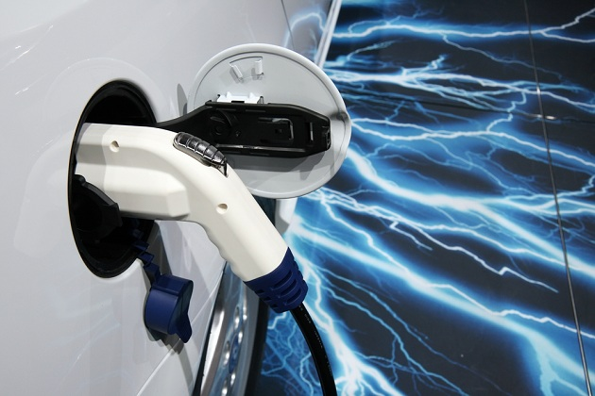
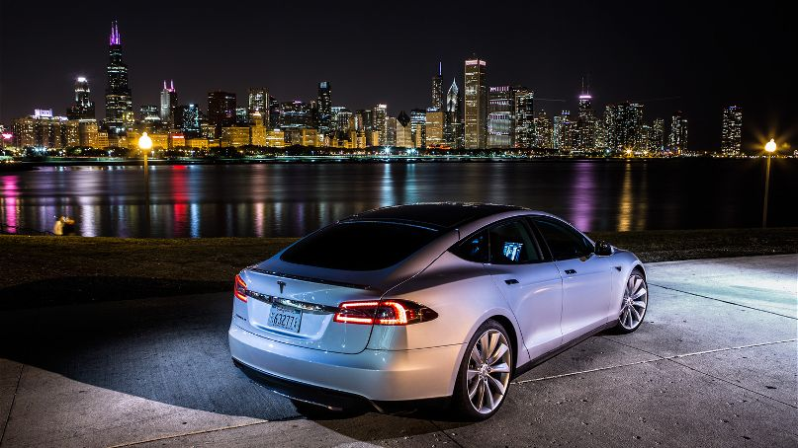
Better Place Unrealized Dream
© N. Baskin- Caesarea-Rothschild/ FGS Weizmann Inst.
By Nathalie Baskin

Slide 3
Table of Contents
© N. Baskin- Caesarea-Rothschild/ FGS Weizmann Inst.
Introduction
Technology
Calculations
Discussion

Slide 4
Introduction
© N. Baskin- Caesarea-Rothschild/ FGS Weizmann Inst.
Cars
Car’s Role: travel, quality of life –the private car has
huge impact on industrial and farm.
Why did I choose this subject?
1. Not familiar with this subject at all.
2. Israel started to construct very expensive infrastructure for electrical transport, but the electrical private cars failed.

Slide 5
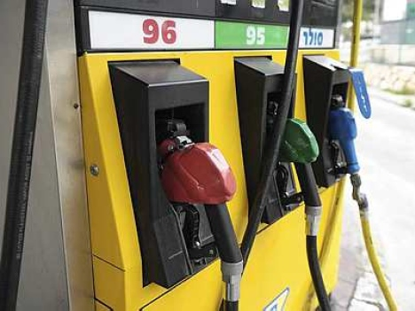
© N. Baskin- Caesarea-Rothschild/ FGS Weizmann Inst.
Technology
Ordinary Cars
Fuel is matter that releases a lot of energy when burned. Ordinary cars use fuel that originally comes from oil.
C₈H₁₈+12.5O₂→8CO₂+9H₂O
Fuel originally from oil
What’s the Problem?
The reaction is irreversible oxidation.
Byproducts:
CO, Hydrocarbons, Nitrogen oxides NOx, Sulfur oxides, smoke.
We breath the pollution in relatively high concentrations.
Source of Oil - finite
Amount of high CO2 can cause global warming of the Earth.
Environmental Noise near the residence

Slide 6
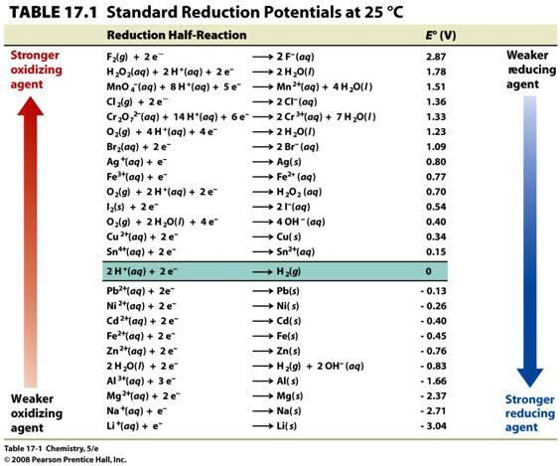
© N. Baskin- Caesarea-Rothschild/ FGS Weizmann Inst.
Technology
Electrical Car
Redox reaction:
The flow of electrons between the electrodes and their ∆{potential (=voltage)} causes electric current, which drives an electrical engine.
The result:
1. No need to use Oil
2. No pollution during use
3. No noise on the roads

Slide 7
Technology
© N. Baskin- Caesarea-Rothschild/ FGS Weizmann Inst.
Electrical Car
Electric battery
Electrochemical cell – Cell based on redox reversible reaction.
In a Battery, flow of electrons from cathode to anode, generates electricity.
To charge a Battery– flow of electrons from anode to cathode.
http://www.youtube.com/watch?v=J1ljxodF9_g
Requirements of car battery:
1.Low mass
2.High voltage
Best cathode will be made of Li (solid with lowest molar mass : 7 gm / mol and highest voltage 3.04 V).
http://www.fccj.us/chm2046/SampleTest/46M14eAnswer.htm

Slide 8
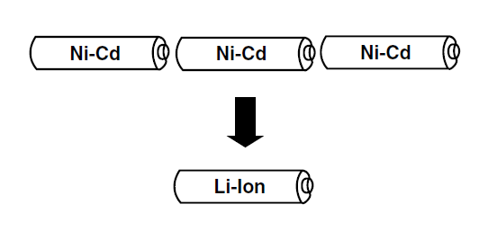
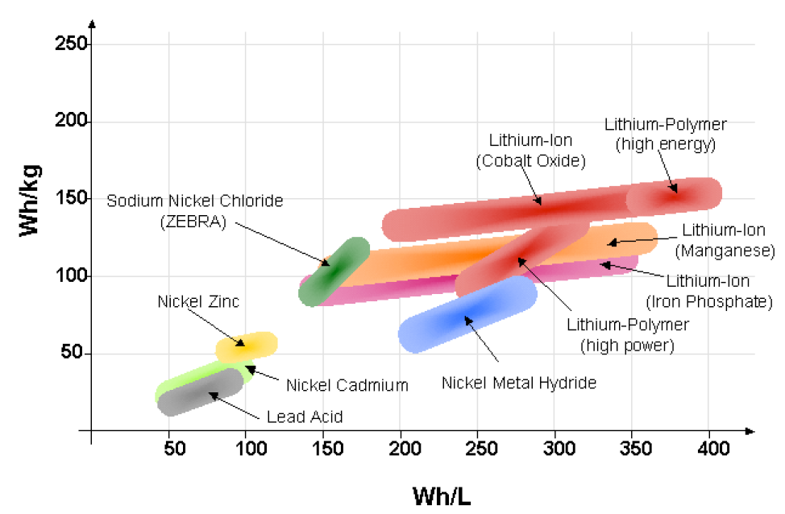
Battery's Energy Density
© N. Baskin- Caesarea-Rothschild/ FGS Weizmann Inst.
Energy density
Li ion batteries can generate relatively high voltage, with currents comparable to other batteries → very high energy density.
http://funginstitute.berkeley.edu/sites/default/files/The%20Electric%20Vehicle%20Battery%20Landscape%20-%20Opportunities%20and%20Challenges.pdf

Slide 9
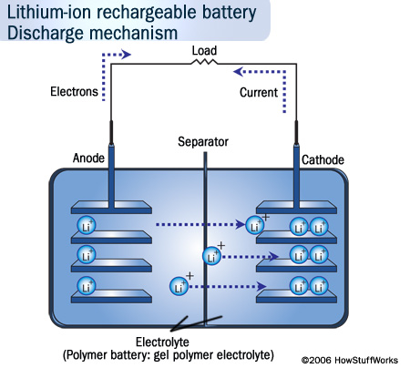
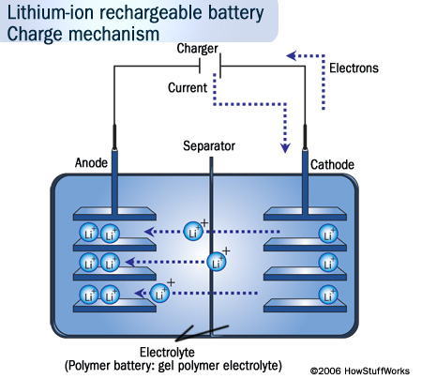
© N. Baskin- Caesarea-Rothschild/ FGS Weizmann Inst.
How do Li⁺ (Li ion) Batteries Work?
Flow of electrons
Discharge mechanism
Charge mechanism
engine
מנוע
Animations of the work of Li ion battery.
http://www.youtube.com/watch?v=2PjyJhe7Q1g
http://electronics.howstuffworks.com/everyday-tech/lithium-ion-battery1.htm
http://www.mpoweruk.com/chemistries.htm

Slide 10
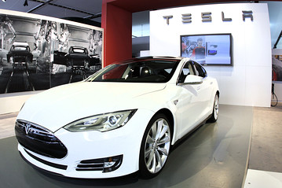
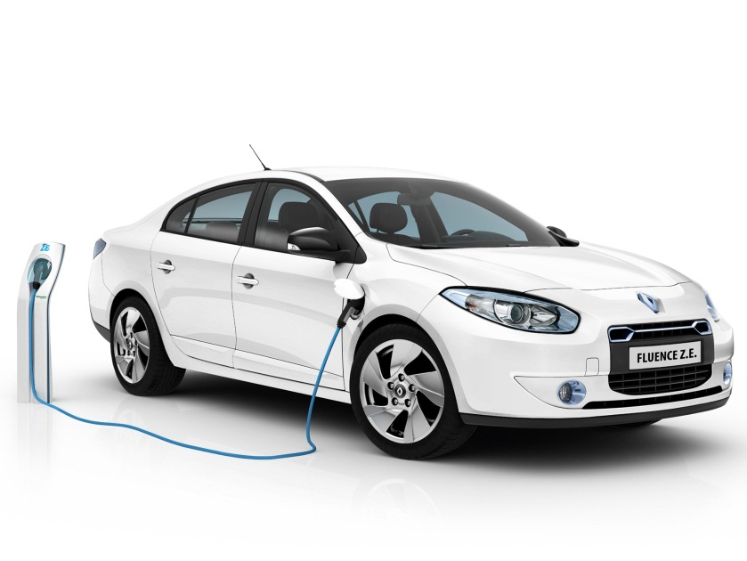
Car Batteries – Base Data
© N. Baskin- Caesarea-Rothschild/ FGS Weizmann Inst.
Is there a preferred battery?
Tesla cars use LiCoO2 batteries
Better Place used LiFePO4 batteries (came with its Renault Fluence Z.E. cars)
http://www-scf.usc.edu/~rzhao/LFP_study.pdf

Slide 11
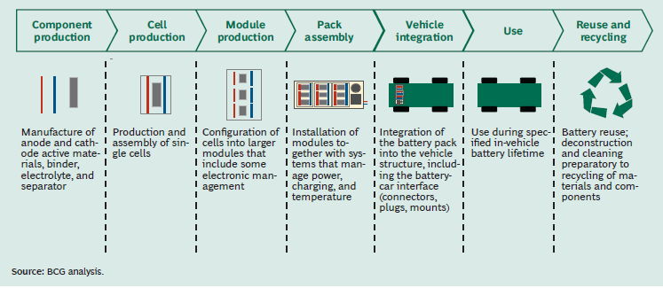
Lithium ion Batteries in an Electric Car.
Success of the electric car dependent of:
Now we will focus on battery itself
Batteries for Electric Cars – BCG research

Slide 12
Content of Lithium-Ion Battery LCO LiCoO2
© N. Baskin- Caesarea-Rothschild/ FGS Weizmann Inst.
No of Cells: 6831
11 modules
Each module consists of 9 bricks (99 cells in series)
Total of about 69 bricks in parallel
Each cell mass is 44.5 gm
Over-all voltage of the battery 375 V
The Chemical reaction that occurs in the cell:
Positive Electrode
Negative Electrode
E_{Cell} = E_{Cathode} − E_{Anode}
Cell voltage: 3.8 V
http://www.teslamotors.com/it_IT/forum/forums/technical-battery-discussion

Slide 13
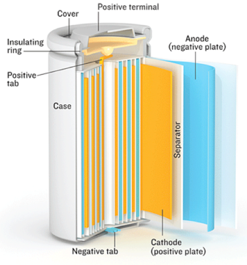
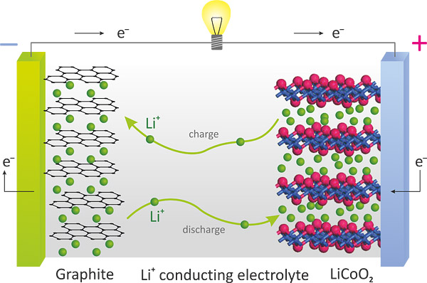
© N. Baskin- Caesarea-Rothschild/ FGS Weizmann Inst.
What is inside the LiCoO2 Li⁺ Battery ?
Standard Battery: 60 kWh – for range of 335 km costs 10,000 $
Improved Battery: 85 kWh – for range of 426 km costs 12,000 $
http://www.intechopen.com/books/metal-ceramic-and-polymeric-composites-for-various-uses/composite-cathode-material-for-li-ion-batteries-based-on-lifepo4-system-

Slide 14
Chemistry of the Battery
© N. Baskin- Caesarea-Rothschild/ FGS Weizmann Inst.
Limitations of battery: over-load or full discharge Irreversible reaction → spoils the battery.
Over-charge
Over-discharge
Co(III) → Co(IV) during charge
Co(IV) → Co(III) during discharge
The Cobalt electrode reaction is only reversible for n < 0.5
Cell Energy
ΔG°_{cell} = −nFE°_{cell}
Positive Electrode
Negative Electrode
http://en.wikipedia.org/wiki/Lithium-ion_battery

Slide 15
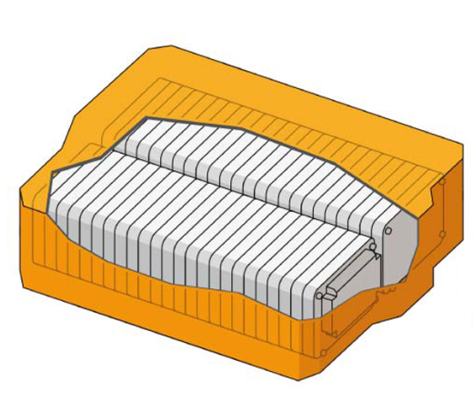
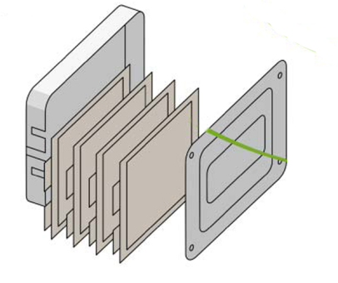
Content of Lithium-Ion Battery LFP LiFePO4
© N. Baskin- Caesarea-Rothschild/ FGS Weizmann Inst.
No of Cells: 192
3 stacks in which 16 modules
Each module consists of 4 cells
Capacity 65 Ah
Battery’s Voltage 398 V
Price - 45,000 $
http://www.renault.com/en/innovation/vehicule-electrique/pages/electro-techno.aspx
Renault Fluence ZE Technical Specifications
http://www.renault.com/en/innovation/gamme-mecanique/pages/batterie-moteur-electrique.aspx

Slide 16
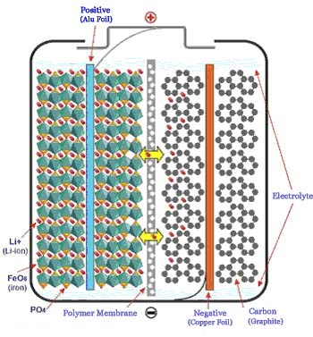
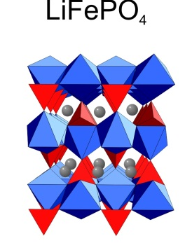
Lithium ion battery LiFePO4
© N. Baskin- Caesarea-Rothschild/ FGS Weizmann Inst.
http://www.pedaily.cn/Item.aspx?id=194151
http://www.intechopen.com/books/metal-ceramic-and-polymeric-composites-for-various-uses/composite-cathode-material-for-li-ion-batteries-based-on-lifepo4-system-

Slide 17
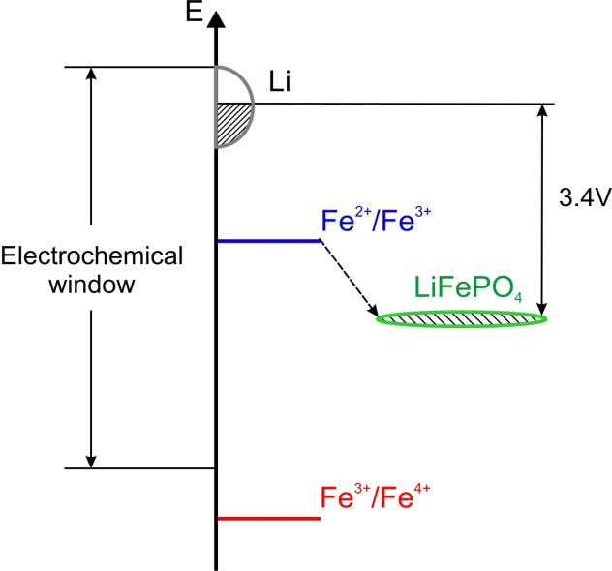
Chemistry of Battery
© N. Baskin- Caesarea-Rothschild/ FGS Weizmann Inst.
Cell voltage : 3.4 V
Cell Energy
ΔG°_{cell} = −nFE°_{cell}
http://www.intechopen.com/books/metal-ceramic-and-polymeric-composites-for-various-uses/composite-cathode-material-for-li-ion-batteries-based-on-lifepo4-system-

Slide 18
Lithium-ion Batteries in an Electric Car. Comparison
© N. Baskin- Caesarea-Rothschild/ FGS Weizmann Inst.
Battery LiCoO2
Battery LiFePO4
Recharging > 7000 times
Recharging 420 times
Efficiency 80%
Highest power density
Highest energy density
Cathode of battery is very expensive $ 35.32 /kg
Cathode of battery relatively inexpensive
$ 4.45 /kg
Cobalt is toxic
Overheating destroys battery
Can explode without known cause
Very safe against explosion; heat resistant
http://funginstitute.berkeley.edu/sites/default/files/The%20Electric%20Vehicle%20Battery%20Landscape%20-%20Opportunities%20and%20Challenges.pdf

Slide 19
Lithium ion batteries electric car. Comparison
© N. Baskin- Caesarea-Rothschild/ FGS Weizmann Inst.
We talked
about those
and continue
with these
Batteries for Electric Cars – BCG research

Slide 20
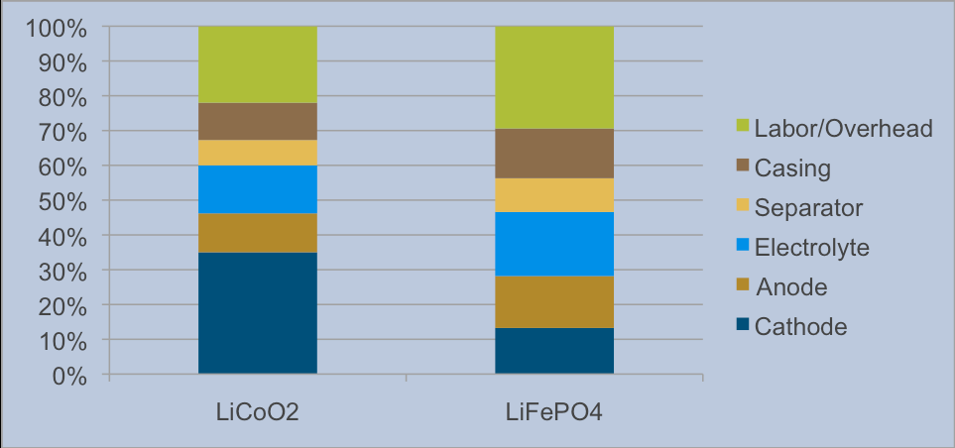
Cell cost break-down of the major components
© N. Baskin- Caesarea-Rothschild/ FGS Weizmann Inst.
Comparison of batteries containing 18650 cells with similar performance
The Electric Vehicle Battery Landscape: Opportunities and Challenges. Center for Entrepreneurship & Technology (CET). Technical Brief. Number: 2009.9.v.1.1.

Slide 21
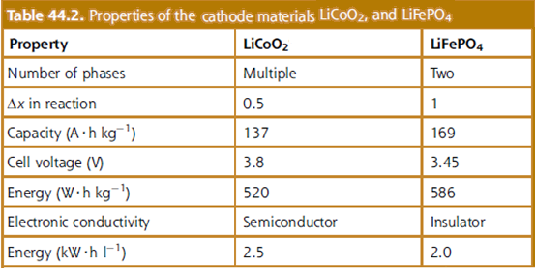
Lithium ion batteries in an electric car
© N. Baskin- Caesarea-Rothschild/ FGS Weizmann Inst.
Gasoline -6
LiFePO4 Battery’s Density
LiCoO2 Battery’s Density
Materials for Energy – Ginley and Cahen

Slide 22
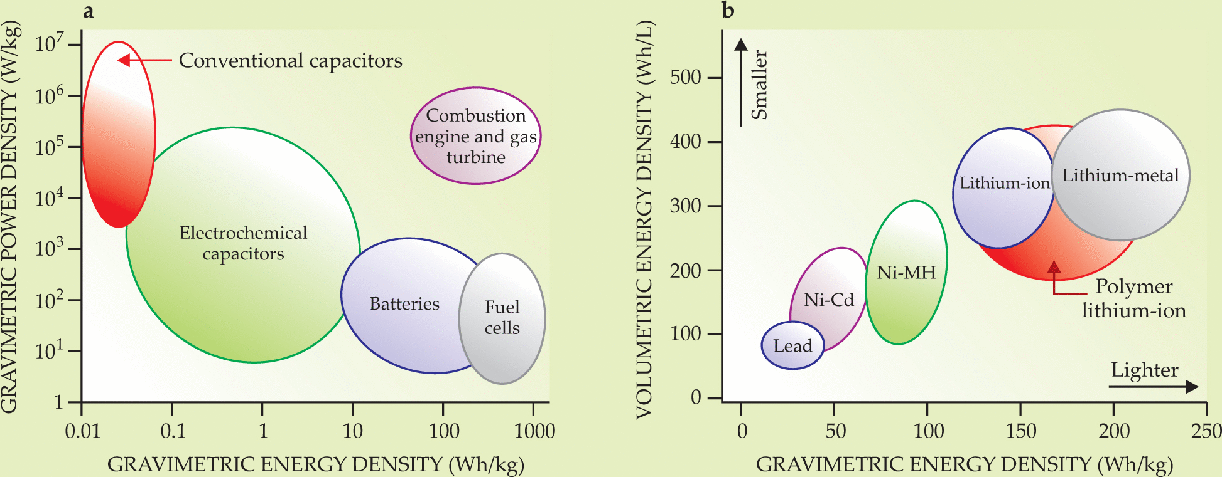
© N. Baskin- Caesarea-Rothschild/ FGS Weizmann Inst.
Energy and Power Densities of Batteries relative to those of Fuel
From the data can be seen that the differences between the two types of batteries are not very significant.
Materials for Energy – Ginley and Cahen

Slide 23
Transportation Energy Data 2012
© N. Baskin- Caesarea-Rothschild/ FGS Weizmann Inst.
Gasoline ~2.5 . 10⁶ tonne /year
Diesel oil ~2.5 . 10⁶ tonne /year
Overall ~5 .10⁶ tonne of fuel per year
Approximately -2.75 . 10⁶ motorized vehicles in Israel
1.8 tonne of fuel /vehicle – year
0.7 kg / liter - density of gasoline
0.85 kg / liter - diesel density
~2,500 liters of fuel /vehicle - year
Assume average fuel consumption (averaged city & intercity roads) –10 km/l and average distance driven/year 24,500 km.
Fuel consumption data - Ministry of National Infrastructures, Energy and Water, 2012
Motorized vehicles, by type - Central Bureau of Statistics

Slide 24
Average Israel ~24,000 km / year
© N. Baskin- Caesarea-Rothschild/ FGS Weizmann Inst.
Overall - 5 . 10⁶ tons of fuel / year
6.5 .10⁹ liters of fuel /year
which cost ~5.10¹⁰ NIS/year
The savings is 7 times the current price!
7 . 10⁹ NIS / yr
or 7 . 10⁵ tons of fuel / yr !
More practical:
Average includes all vehicles;
Here are calculation for private cars, that drive 16000 km/year
Annual savings in terms of Gasoline / car-year: 16,000 NIS
Notes:
6.5 .10⁶ liters of fuel /year
does not make sense
so, I changed it to 10**9
Check also the following
7 billion shekels per year or 700 thousand tons of fuel per year instead of 5000 tons!

Slide 25
Private car’s total fuel cost/year
© N. Baskin- Caesarea-Rothschild/ FGS Weizmann Inst.
Standard Car
Average distance Car a year – 16,000 km
1,600 liters of fuel
Assuming an average fuel consumption (both city and intercity roads) - 10 km / liter
Price per liter of gasoline – 7.70 NIS
Price per liter of diesel fuel – 6.13 NIS
(2012)
Fuel price about 12,320 NIS
Price per kWh at night – 0.3711 NIS
Price per kWh during peak hours – 1.2853 NIS
Tesla S
Electric Car
Renault Fluence Z.E.
Power consumption Manufacturer data:
0.175 kWh/km
Driving a Tesla car 16,000 km
requires 2,800 kWh.
Equivalent charging cost at night 1036 NIS
Power consumption Manufacturer data:
0.275 kWh/km
Driving a Renault car 16,000 km
requires 4,400 kWh.
Equivalent charging cost at night 1628 NIS
Notes:
How did we get from 24,000 km/yr to 16,000 km/yr

Slide 26
© N. Baskin- Caesarea-Rothschild/ FGS Weizmann Inst.

Slide 27
© N. Baskin- Caesarea-Rothschild/ FGS Weizmann Inst.
Price per kWh during peak hours – 1.2853 NIS

Slide 28
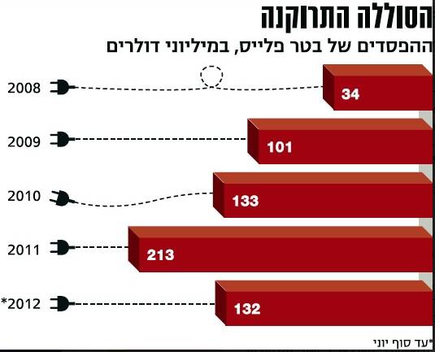
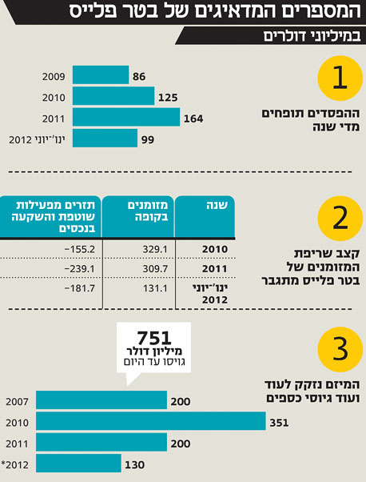
Better Place: Financial Loss
© N. Baskin- Caesarea-Rothschild/ FGS Weizmann Inst.
05.06.2013
http://www.themarker.com/dynamo/1.1865169
http://www.themarker.com/dynamo/1.2038520

Slide 29
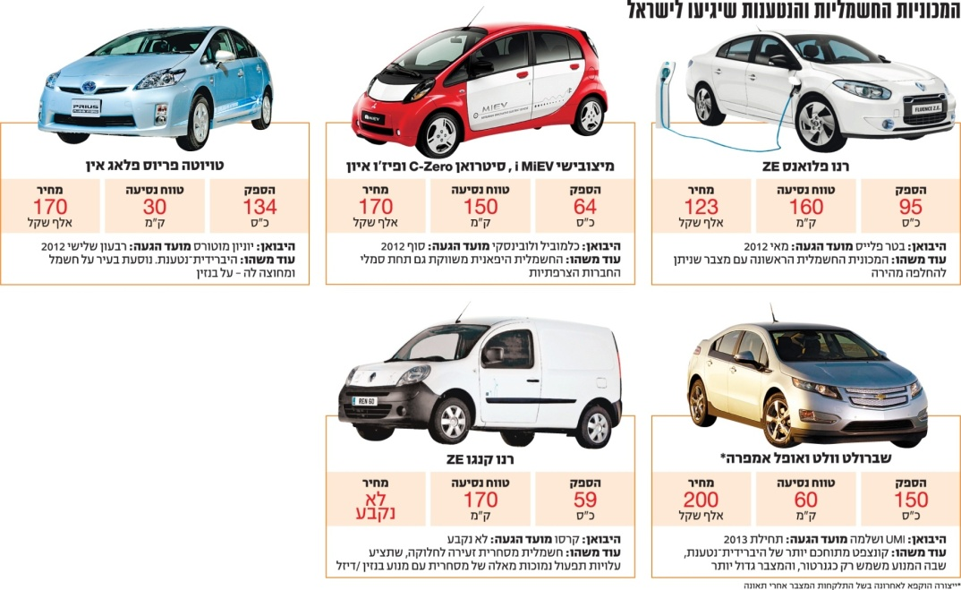
So how Better Place went bankrupt?
© N. Baskin- Caesarea-Rothschild/ FGS Weizmann Inst.
Misguided economic management
Infrastructure and ease of use
Technology fails
Battery is very expensive

Slide 30
© N. Baskin- Caesarea-Rothschild/ FGS Weizmann Inst.
Price of the car vs. distance at full tank (full Charge)
Price includes battery, domestic charging stand + 8 year service.
Excluding the price of the battery; car purchase requires subscription to battery and service.

Slide 31
Infrastructure - a standard car
© N. Baskin- Caesarea-Rothschild/ FGS Weizmann Inst.
Customer friendly gas stations
Approximately -2.761 million vehicles in Israel
 | No. of fuel stations in the country | place | Fueling time | No. of cars at a gas station
Gasoline and diesel | 2040 | Public space | 5 minutes | 1353 cars in one gas station
Only 900 cars in Israel
Infrastructure - electric cars
Type of station | No. of stations in the country | Place | Charging time (fastest) |  | No. of car charging stations
 |  |  | Better Place | Tesla
Charging | 1850 | Public spaces and individual stations | Fast: 30 minutes Standard: 6-8 hours | 66 sec | 2 docking stations for each vehicle
Swap | 38 | Public spaces | 5 minutes | 90 sec
Private parking is required for any electric car owner

Slide 32
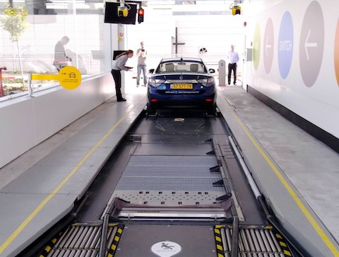
Electric Cars
© N. Baskin- Caesarea-Rothschild/ FGS Weizmann Inst.
09/02/2012
38 stations for quick replacement of batteries - Convenient and quick method.
http://www.globes.co.il/news/article.aspx?did=1000723370

Slide 33
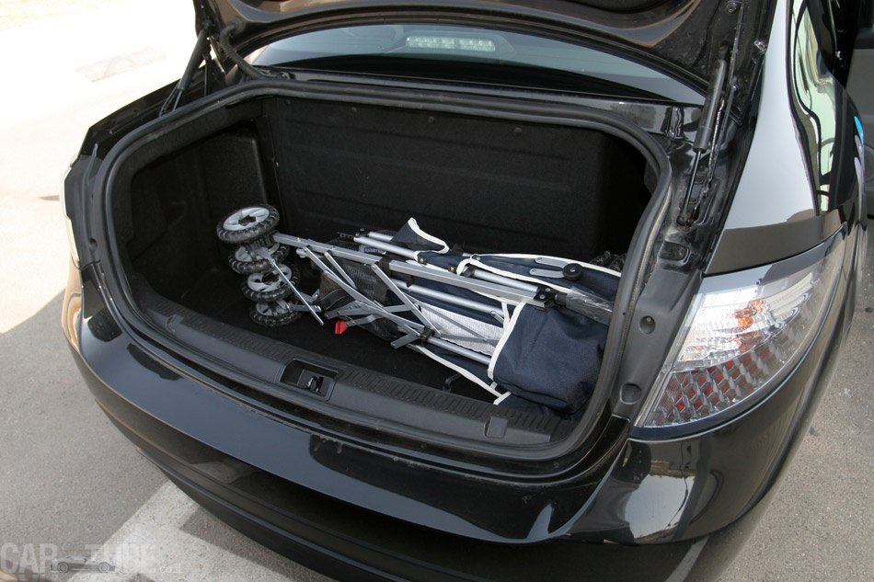
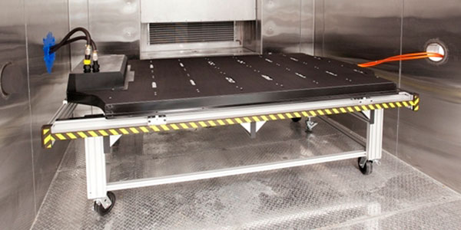
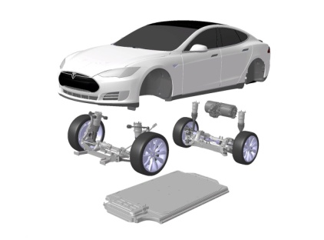
Weight and price
© N. Baskin- Caesarea-Rothschild/ FGS Weizmann Inst.
Type of battery | Price considering battery life time (NIS\km) | Car battery weight | Volume
LiFePO4 battery(better place) | 0.23 km/nis (long life time (validity)) Battery of 303 kg | 280 kg | 218 liters in trunk
LiCoO2 battery (Tesla) | 0.29km/nis (fast life time (validity)) Battery of 261 kg | 600 kg | Automobile belly
http://www.cartube.co.il/road-test/renault-road-test/%D7%A8%D7%A0%D7%95-%D7%A4%D7%9C%D7%95%D7%90%D7%A0%D7%A1-Z-E-%D7%9E%D7%91%D7%97%D7%9F-%D7%93%D7%A8%D7%9B%D7%99%D7%9D-%E2%80%93-%D7%A4%D7%9C%D7%95%D7%90%D7%A0%D7%A1-%D7%A2%D7%9D-%D7%A1%D7%95%D7%9C%D7%9C%D7%94-%D7%92%D7%93%D7%95%D7%9C%D7%94
http://www.mako.co.il/cars-road-tests/Article-36f2a0e81a57531006.htm
http://blog.truecar.com/2013/01/17/spotlight-on-technology-how-safe-are-lithium-ion-battery-packs/
Renault Fluence ZE
http://funginstitute.berkeley.edu/sites/default/files/The%20Electric%20Vehicle%20Battery%20Landscape%20-%20Opportunities%20and%20Challenges.pdf
Tesla S
http://www.caranddriver.com/reviews/2013-tesla-model-s-test-review
Notes:
YOU MIXED THEM UP I THINK!!!

Slide 34
© N. Baskin- Caesarea-Rothschild/ FGS Weizmann Inst.

Slide 35
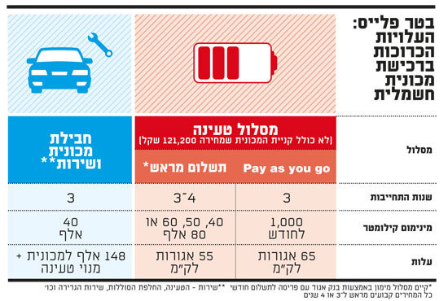
So where is the problem?...
© N. Baskin- Caesarea-Rothschild/ FGS Weizmann Inst.
13,080 NIS/yr subscription of 20,000 km(0.65 NIS/km)
Cost of “electric car km” is the equivalent of 0.65 NIS travel cost;
@ current fuel prices, a gasoline car consumes 11.8 km / liter.
Not worth to buy an electric car if there is no financial gain

Slide 36
So where is the problem?...
© N. Baskin- Caesarea-Rothschild/ FGS Weizmann Inst.
The travel time is very short at full-charge.
No financial gain using an electric car car from Better Place
Must always be prepared to search for a recharge station, not very many in the country.
Battery technology is very expensive.
Private parking is required
The battery does not provide a lot of energy

Slide 37
© N. Baskin- Caesarea-Rothschild/ FGS Weizmann Inst.
Is Electricity Really Not Polluting?
Possibility to monitor and manage the power plant’s pollutants is better than that for a lot of vehicles.
https://www.iec.co.il/environment/Documents/svivaty_iec_2011_hebrew.pdf
http://www.carpages.co.uk/co2/
Environmental Accountability 2011- IEC
http://europa.eu/legislation_summaries/environment/air_pollution/l28186_en.htm

Slide 38
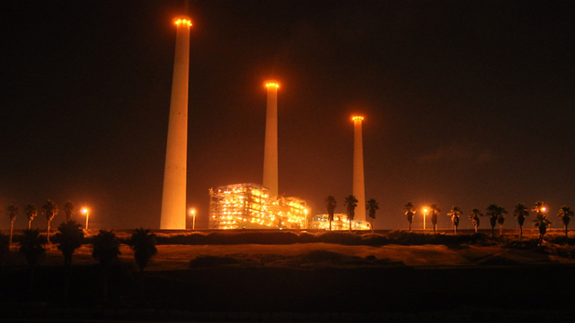
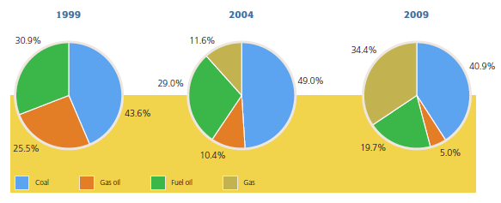
Is Electricity Really Not Polluting?
© N. Baskin- Caesarea-Rothschild/ FGS Weizmann Inst.
If in the future it will be possible to generate electricity not from coal – but from renewables, then we will reduce the amount of pollution significantly.
http://www.internationallawoffice.com/newsletters/detail.aspx?g=36990020-5a6a-4a82-9a15-35cfd96ac63c

