Slide 1

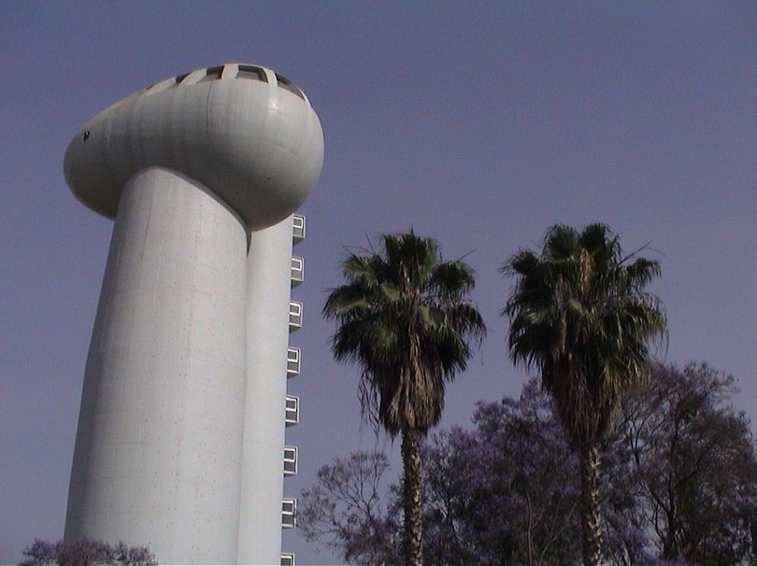
能源，全球的挑战 Energy, A Global Challenge
魏兹曼研究院的选择，可持续能源研究院 Weizmann Institute’s Alternative, Sustainable Energy Research Initiative

Slide 2
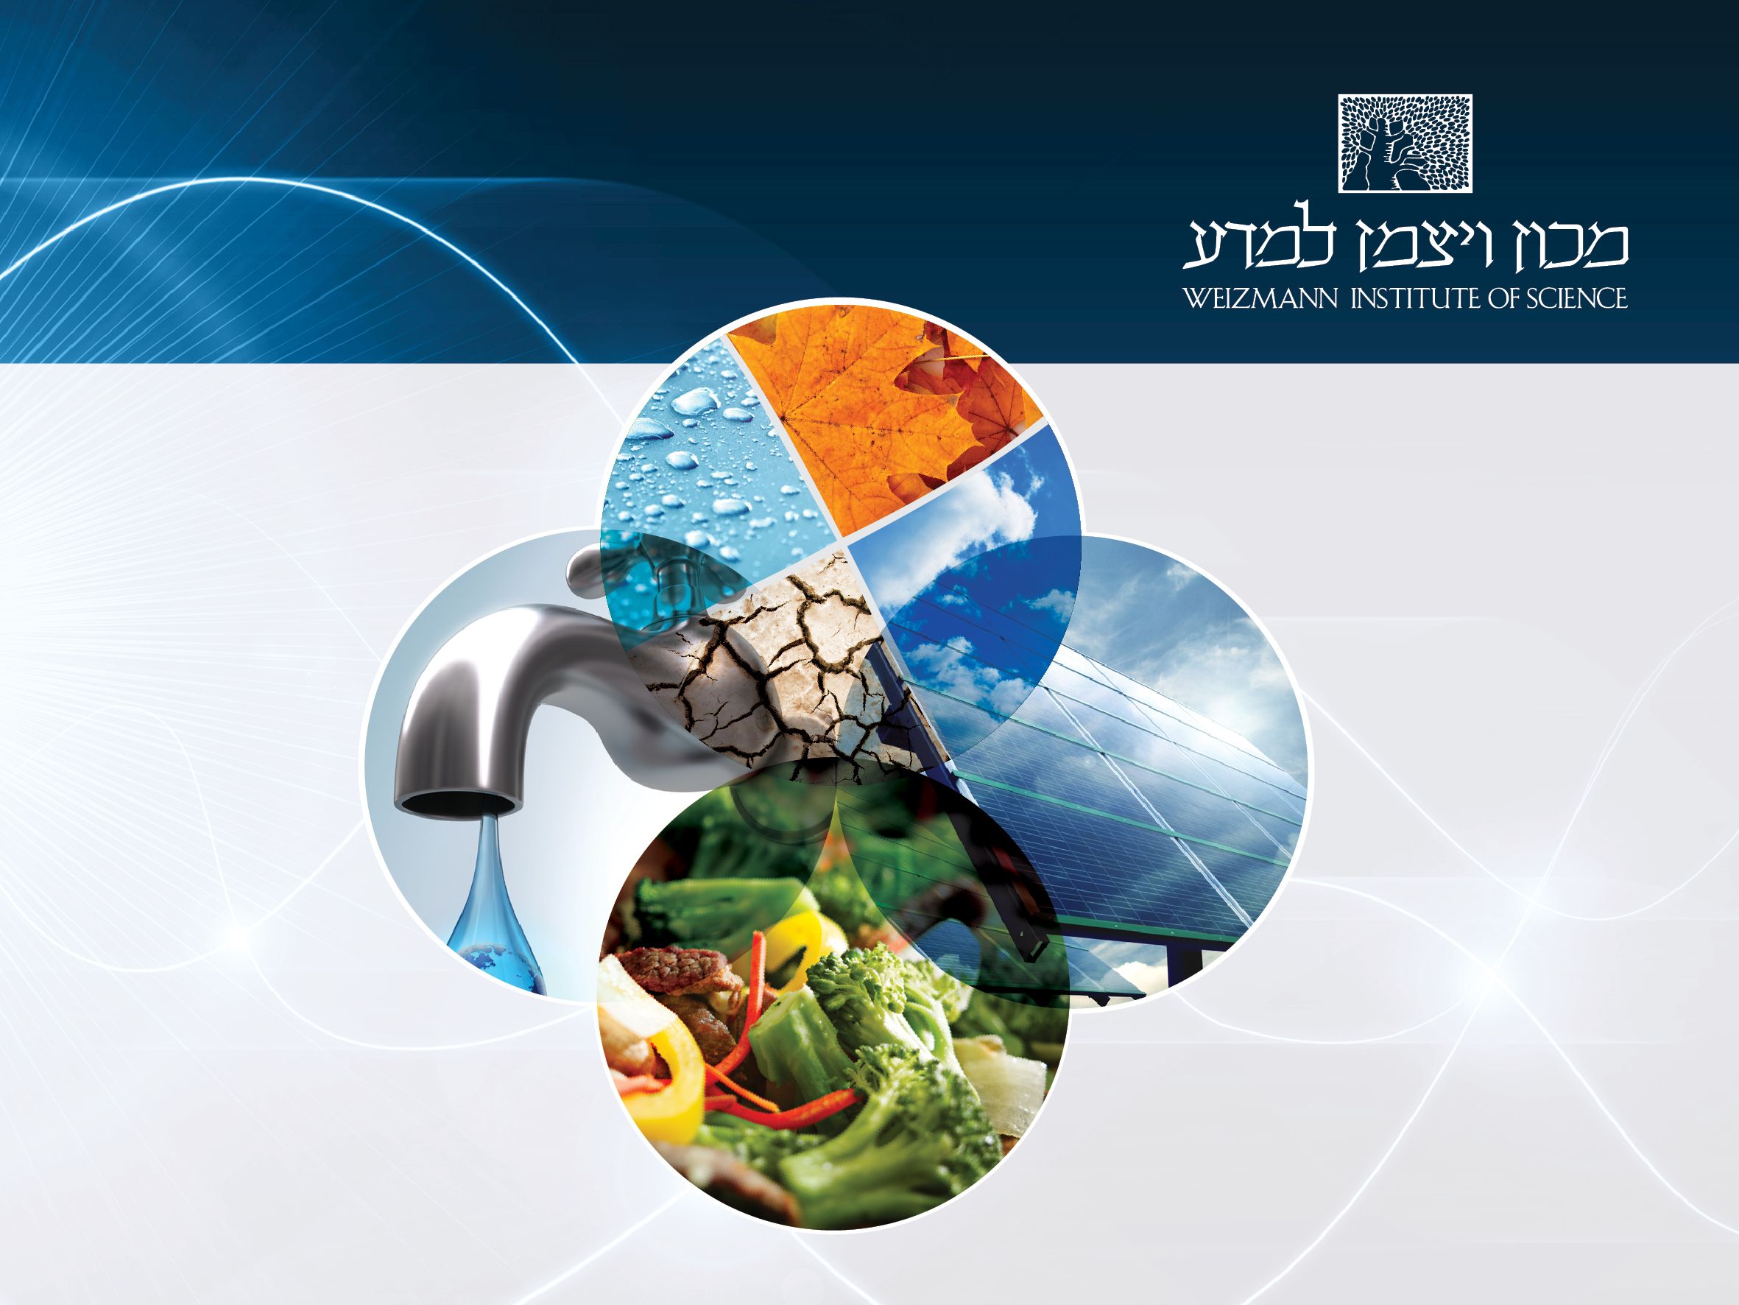
Weizmann Institute’s
Alternative, Sustainable Energy Research Initiative
climate
water
energy
food
David Cahen, July 24, 2011

Slide 3
为何使用魏兹曼学院的方法 Why use Weizmann Inst. approach?
能源研究是跨学科的
Energy Research is interdisciplinary.
→魏兹曼学院 → Weizmann Inst.
替代能源的突破要求基础科学的突破
Breakthroughs in alternative energy require basic science breakthroughs
基础科学正是魏兹曼的使命
and … basic science is the Weizmann’s mission!

Slide 4
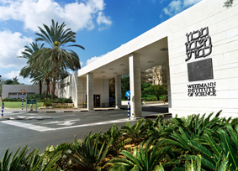
魏兹曼的优势 Some proven Weizmann strengths
魏兹曼首创的可替代的可持续能源研究
WIS’ Alternative, Sustainable Energy Research Initiative
基础科学BASIC SCIENCE
材料—纳米科学，表面材料
Materials nano-science, surface science molecular electronics
生命科学—基因与新陈代谢“工程”
Life Sciences genetic and metabolic ‘engineering’
物理学—等离子物理 现代光学
Physics plasma physics modern optics
化学—催化作用
Chemistry catalysis
----------------------------------
太阳能：光伏电池；集聚
Solar Energy: Photovoltaic Cells; Concentration

Slide 5
Some proven Weizmann strengths in
Weizmann Institute’s
Alternative, Sustainable Energy Research Initiative
Basic Multi-& Inter-Disciplinary Science
Materials -nano- and molecular-science; electronics phys/biol/chem
Life Sciences- Structural Biology, genetic engn., plant science chem/phys/math
Physics- plasma physics, optics
materials
Chemistry-catalysis phys/biol/math
------------------------
Solar Energy: Solar Cells (2nd & 3^{d} generation)
Photosynthesis (e.g., algae)
Concentrated Solar (tower)

Slide 6
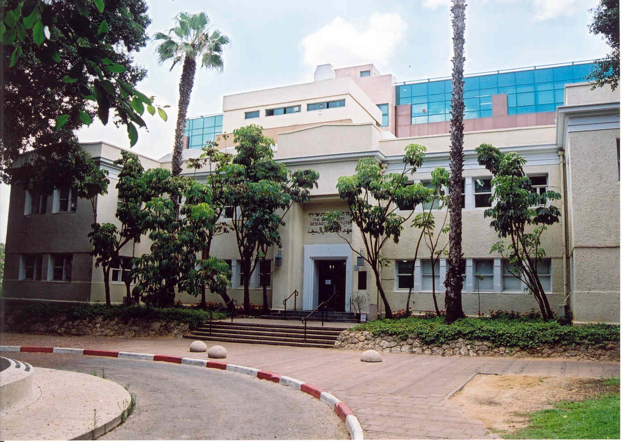
如何实现这些优势 How to put those strengths to work?
魏兹曼首创的可替代的可持续能源研究
WIS’ Alternative, Sustainable Energy Research Initiative
可替代能源的基础科学（数学、物理、化学、地球、环境与生命科学）BASIC SCIENCE FOR ALTERNATIVE ENERGY (math, physics, chemistry, geo-, environmental & llife sciences)
材料Materials -> （不同质的）催化剂、光学的、太阳能电池材料 (heterogeneous) catalyst-,optical-, solar cell-materials
生命科学Life Sciences -> 生物质能到生物燃料（光合作用）biomass to biofuel (photosynthesis)
物理学Physics -> 光学与电子学，核科学 optics & electronics, nuclear science,
化学Chemistry -> 燃料， CO2 固化，人工光合作用fuels, CO₂ fixation,
artificial photosynthesis
实际上，综合能源分析包括
Add, to stay honest,Total ENERGY ANALYSES
催化剂—光学—植物科学
使用数学、物理学、化学和生物学
CATALYSIS - OPTICS - PLANT SCIENCE
Use Math and Physics and Chemistry and Biology

Slide 7
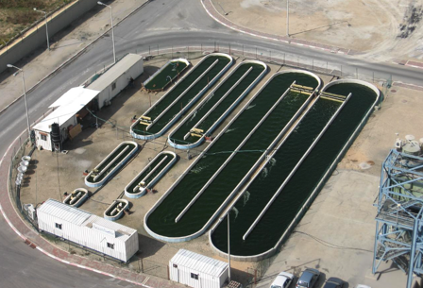
Artificial Photosynthesis Catalytic Conversion of Carbon Dioxide for “C-Neutral” Energy Chemical Storage of Electrical Energy via Carbon Monoxide Hybrid Systems for Solar Energy Conversion Biomass Genetic Engineering Green Algae for Biodiesel Cellulose biomass to biofuels Genetically Engineered Cyanobacteria--> Biomass and Hydrogen Nuclear Fusion Optimizing Energy Conversion in Implosion Systems
Weizmann Institute’s
Alternative, Sustainable Energy Research Initiative
AERI projects 2007/8

Slide 8
Solar Cells High-voltage semiconductor-sensitized nanoporous cells Self-Assembly of Molecules for Inverted Solar Cells Colloidal semiconductor quantum dots in solar cells Nuclear Fission Towards novel nuclear energy schemes & radioactive waste transmutation Energy Analysis & Sustainability Earth & energy numbers database; Environmental cost of products ------------------------------------------------------ Artificial Photosynthesis Biomass Modification of Natural Photosynthesis for Increased Efficiency Fusion
Weizmann Institute’s
Alternative, Sustainable Energy Research Initiative
AERI projects 2008/10

Slide 9
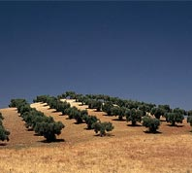
Biofuels Institute-wide consortium ------------ Solar Cells Self-Assembly of Molecules for Inverted Solar Cells High-voltage semiconductor-sensitized nanoporous cells Nuclear Fission Towards novel nuclear-energy schemes and radioactive waste transmutation Energy Analysis & Sustainability Earth & energy numbers database; Environmental cost of products
Weizmann Institute’s
Alternative, Sustainable Energy Research Initiative
AERI projects 2010/2011

Slide 10
Solar Cells Materials & device chemistry & physics of Solar cells Organic polymers for Solar Cells Solid-state Nano-crystalline Solar cells Simple optics to improve Solar cell efficiency; New Solar fluorescent concentrators ------------------------------ Thermoelectric Conversion, towards better materials Solar Thermal Conversion Various applied projects, incl. CO₂ reduction, biomass Photosynthesis Basic & applied studies in Natural Photosynthesis & other Plant Sciences
Some other Alternative Energy projects

Slide 11
We do research now to realize today’s dreams tomorrow:
Efficient, Affordable Artificial Photosynthesis
* Cheap, Efficient Solar Cells:
smart optics; solar paint …… ?
Smart Natural Photosynthesis:
genetic/metabolic engn.; synthetic biology …… ?
3-D (Holographic) Video-Conferencing
“Memory-shape” wind turbine blades
Clean(er) and Safe(r) Nuclear Energy
and …
to where Creativity & Curiosity lead us !

Slide 12
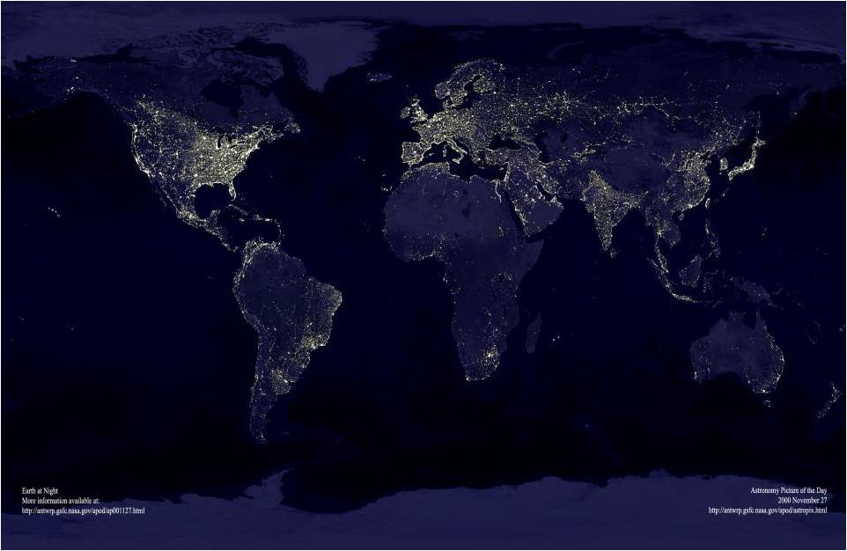
能源，一个全球的挑战 Energy, A Global Challenge
魏兹曼研究院的选择，可持续能源研究院
Weizmann Institute’s Alternative, Sustainable Energy Research Initiative
为了对应这个挑战，需要当今世界的社会，政府和产业的科学发展。
Meeting this challenge requires coordinated action of the world’s scientific community, government & industry.
寻找有效，经济的清洁能源产品，顶尖的科技研究成果
Finding ways for efficient, cost-effective production of clean fuels can be science’s most important breakthrough
但是
but…
为了帮助实现它，我们需要训练新一代的科学家，同时开展基础的科学研究
to help it happen, we need to train a new generation of scientists,
as well as start the basic, fundamental science
NOW

Slide 13
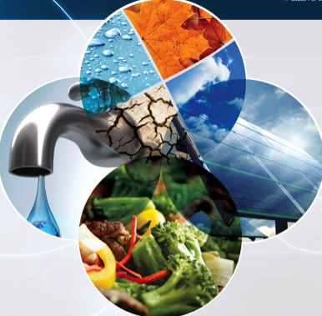
Energy, it’s the Global Challenge
Weizmann Institute’s
Alternative, Sustainable Energy Research Initiative
Meeting it requires scientists, engineers, business governments, & industry to work together
Rising to the ENERGY (TW) CHALLENGE
can be science’s most important breakthrough
but …
for that we need basic RESEARCH NOW!
Notes:
These four spots light define the Hawaiian Islands;
Nigeria produces little light though its population is almost half that of the united states
Ribbon of the light corresponds to the Nile river in Egypt
Reunion and Mauritious are small but prosperous while Madagasgar has 18 million is almost dark
South Korea is prosperously bright while North Korea only has its capital Pyongyang lit up;
Trans-Siberian railroad is a thin stretching form Moscow through the center of Asia to Vladivostok
Where Does The Energy Go?
Introduction
Human-made light is visible in this view of the Earth. The brightness of the light graphically illustrates local fossil fuel consumption. Brightness does not necessarily correspond to human population. For example, the Island of Madagasgar holds 18 million people yet it is almost totally dark.
Place your mouse on the yellow circles for additional information. earth at night
About Earth at Night
Hundreds of photographs taken over the course of a year were combined to make this picture. The photographs were made by a satellite on cloudless nights. Much larger and more detailed versions of this picture are available at:
http://visibleearth.nasa.gov/cgi-bin/viewrecord?5826

