Slide 1
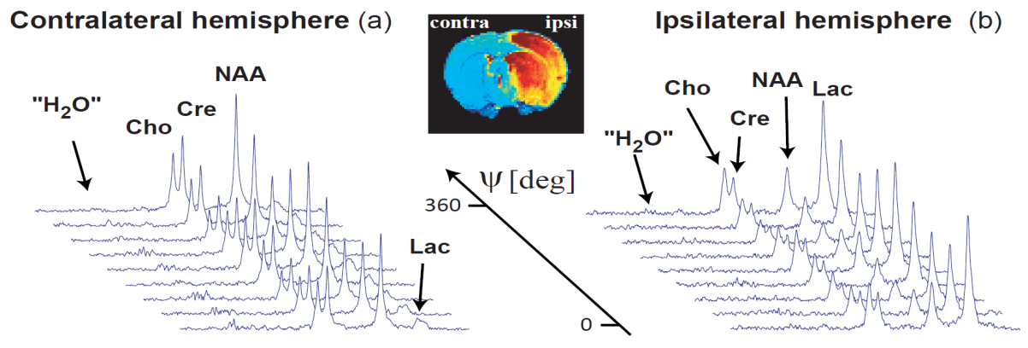




Resolving Cellular Specific Microarchitectures Using
Double Pulsed Field Gradient Weighted, Relaxation-Enhanced
Magnetic Resonance Spectroscopy
N. Shemesh¹, J.T. Rosenberg², J-N Dumez³, J.A. Muniz^{2,4}, L. Frydman^{2,3} & S.C. Grant^{2,4}
¹ Champalimaud Neuroscience Programme, Champalimaud Centre for the Unknown, Lisbon, Portugal
²The National High Magnetic Field Laboratory Tallahassee FL, USA
³ Chemical Physics, Weizmann Institute of Science, Rehovot, Israel
⁴Chemical & Biochemical Engineering Florida State University, Tallahassee FL, USA
Nature Communications 2014 (5): 4958

Slide 2

Declaration of
Financial Interests or Relationships
Speaker Name: Samuel C. Grant
I have no financial interests or relationships to disclose with regard to the subject matter of this presentation.

Slide 3
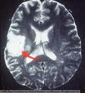

Stroke
Impacts on Public Health:
Leading cause of disability in the US
4th leading cause of mortality (1 of every 20 deaths)
  Annual cost > $73.3 billion
  Pathophysiology:
  Affected region depends on arterial blockage (ischemia) or rupture (hemorrhagic)
  Interruption of O₂ & nutrients leads to a cascade of detrimental events:
    Na⁺/K⁺ ATPase unable to maintain ionic homeostasis
    Release of toxic excitatory amino acids and enzymes
    Necrosis at the core but extended impacts in penumbral tissue
    Osmolytes & metabolites can serve as probes/biomarkers for severity and outcome

Slide 4
Diffusion MRS in Stroke
Restricted diffusion has central role in diagnosis & prognosis
Water-based diffusion weighted MRI is somewhat nonspecific
  Underlying diffusivity variations not understood
  Prevents probing of distinct cellular morphologies
Probing metabolic diffusion may tell another (better?) story
  Metabolites exhibit different, cell-specific compartmentalization
Eccentricity measurements by double Pulsed Field Gradients (dPFG) focusing on specific metabolites may provide unique information about cell-specific swelling with ischemia

Slide 5
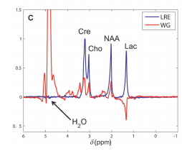
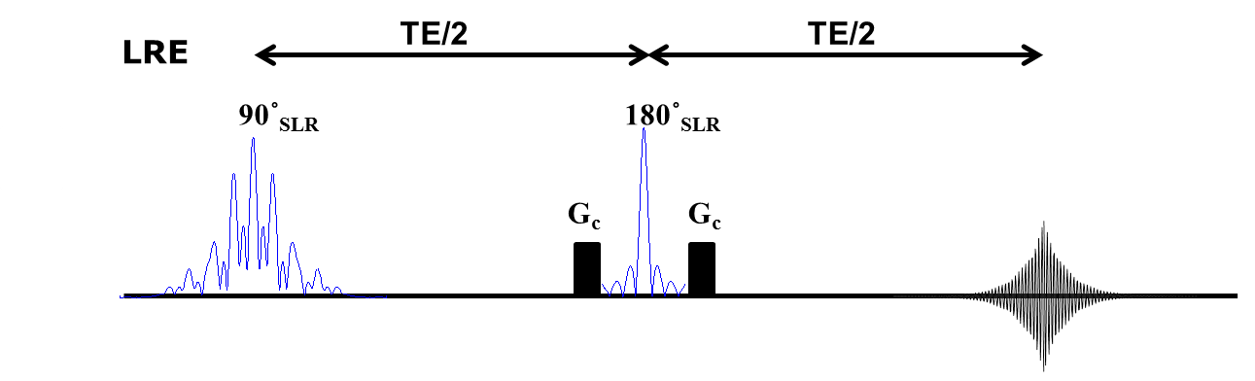
Novel approach to MRS
Selective excitation of metabolites
Overcomes many MRS limitations:
High SNR per unit time
Sensitivity via longitudinal relaxation enhancement (RE)
No J-modulations
No need to suppression the ~10,000x larger water peak
Red - Conventional water suppressed sequence
Blue – Selective excitation
Shemesh et al Chem Eur 2013

Slide 6
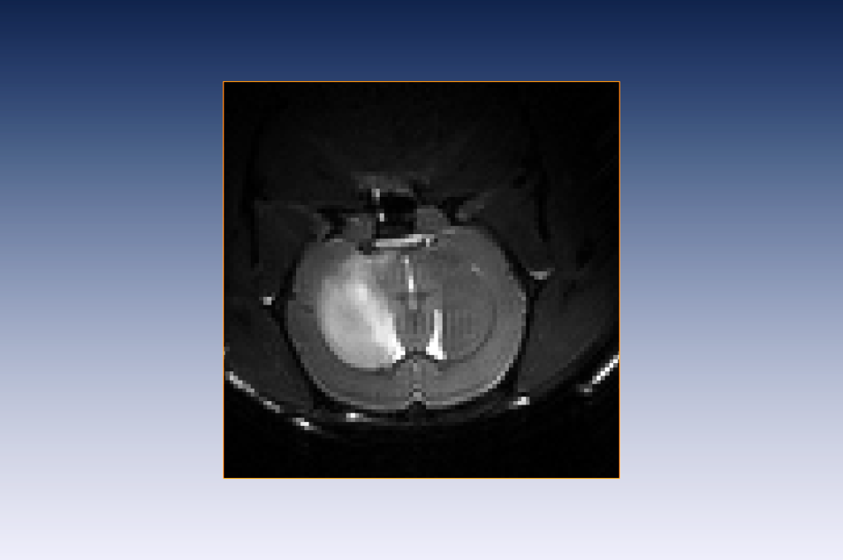
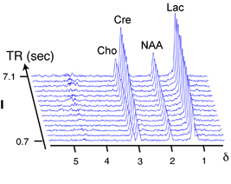
Novel approach to RE-MRS
Clean and undistorted spectra used for T₁ and T₂ measurements at 21.1 T
Contralateral
Ipsilateral
SNR_{tCho} = 29 ± 6
Cre
NAA
SNR_{tCho} = 19 ± 6 *
SNR_{tCre} = 60 ± 12
SNR_{tCre} = 39 ± 11 *
Lac
SNR_{NAA} = 58 ± 10
SNR_{NAA} = 29 ± 13 *
SNR_{Lac} = 9 ± 2
Cre
SNR_{Lac} = 25 ± 15 *
Cho
NAA
“H₂0”
Lac
“H₂0”
Cho
b
TE (ms)
254
T₁
T₂
58
“H₂0”
Cho
Cre
NAA
Lac
Nature Comm. 2014. 5: 4958 & J Cereb Blood Flow Metab. 2014. 34(11): 1810.
Notes:
Acquisition time!!

Slide 7
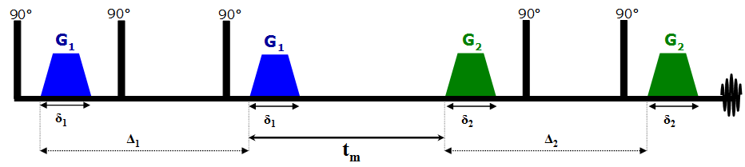
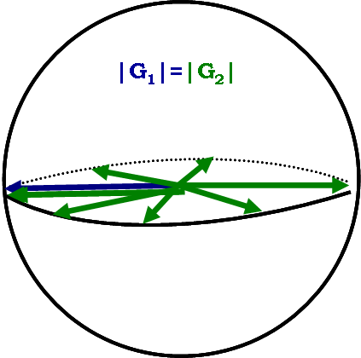
Double Diffusion Encoded MRS
Eccentricity measurements by dPFG
D-PFG principles:
  Pairs of diffusion sensitizing gradients G₁ and G₂ are applied and relative angle ψ is varied
First proposed by Cory (1990)
Employs 2nd diffusion gradient pair
Has a mixing time (t_{m})
Importantly, orientation of 2nd gradient is varied, not amplitude
Notes:
A double-PFG sequence. Note that two gradient pairs are applied in succession, with the timing between them defined as the mixing time (tm). In this specific sequence, the case of ψ = 180° is shown owing to the fourth and fifth 90° RF pulses. (G) The angular d-PFG methodology. Here, the gradient durations and amplitudes are set, along with the diffusion periods and the mixing time. What is varied is simply the relative angle between the gradient vectors, defined as ψ. Here, the experiment is shown in the X−Y

Slide 8
Double Diffusion Encoded MRS
At long t_{m} , the E(ψ) plots reflect pore eccentricity (L/r)
csA
csA
csA~0
csA
dPFG display modulation dependent on pore eccentricity
Evident even if compartments are randomly oriented
Angular DDE MRS could be used to infer
underlying microstructure
Özarslan, J. Magn. Reson. (2009)
Notes:
A double-PFG sequence. Note that two gradient pairs are applied in succession, with the timing between them defined as the mixing time (tm). In this specific sequence, the case of ψ = 180° is shown owing to the fourth and fifth 90° RF pulses. (G) The angular d-PFG methodology. Here, the gradient durations and amplitudes are set, along with the diffusion periods and the mixing time. What is varied is simply the relative angle between the gradient vectors, defined as ψ. Here, the experiment is shown in the X−Y
csA - Compartmetn shape Anisotropy

Slide 9
Metabolic DDE RE-MRS at 21.1 T
Objective:
Use selective excitation to probe in vivo microstructure and specific cell types through metabolic confinement

Slide 10
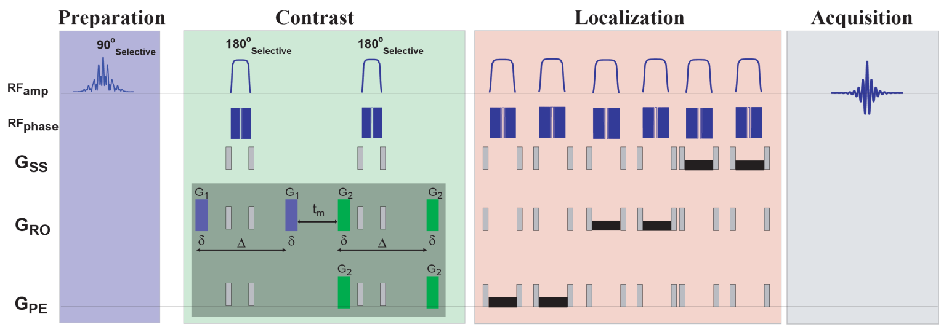
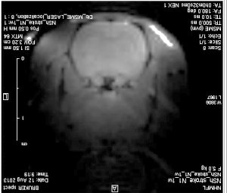
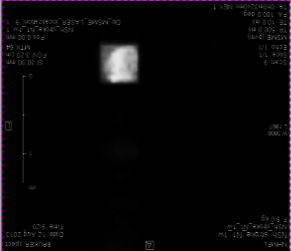
DDE RE-MRS Method
Implementation at 21.1 T
dPFG module
G₁ constant while varying G₂ orientation to generate the relative angle ψ
Localized DDE MRS acquired in controls and 24 hr post stroke
Acquisition from (5-mm)³ voxel localized via a LASER module in ipsilateral (ischemic) & contralateral hemispheres

Slide 11
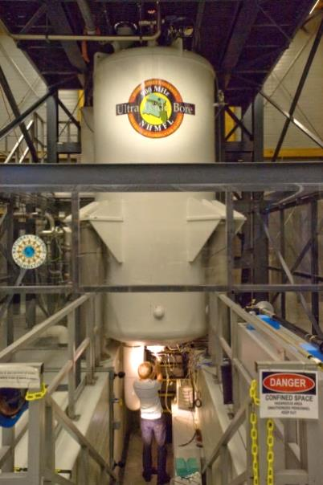
MRI & Animal Systems
MR Equipment for in vivo Experiments:
21.1-T UWB magnet and PV 5.1
Gated during acquisition
NA=160 -> 4 min scan per angle
TR/TE=1500/187 ms
36 min total for nine ψ values / hemisphere
User time available at:
www.nationalmaglab.org
Animal Model: Middle cerebral artery occlusion (MCAO)
(Longa et al. Stroke 1989; Uluç et al. J.Vis.Exp. 2011)
Animal work approved by FSU ACUC
Male Sprague Dawley rats ~250 g
Rubber coated filament through the external carotid artery (ECA)
1.5-hr occlusion following re-perfusion
Imaged 24-h post surgery

Slide 12
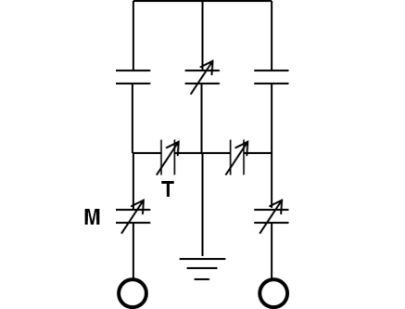
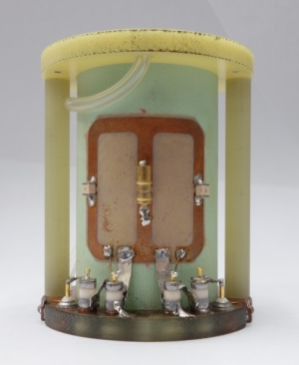
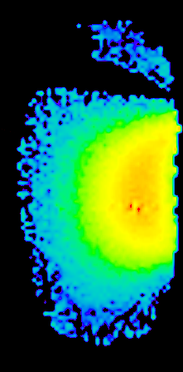
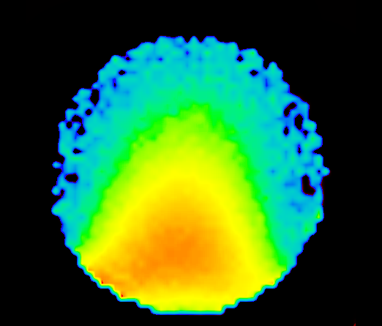
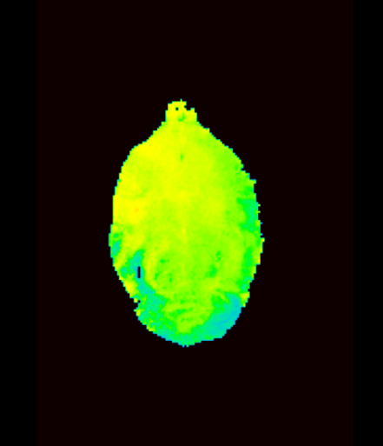
Quadrature Coil
Homemade surface coil: designed and built at the Maglab
  Provided the sensitivity and B₁ homogeneity over ROI
0.9 pF
0.9 pF
Sagittal
Axial
70°
In vivo axial
90°
60°
75°
45°
60°
45°
30°
30°
15°
15°
a
15 mm
b
15 mm
c
15 mm
0°
0°
B₁ flip map of a polyethylene glycol (PEG) and in vivo

Slide 13


Results
Clean and undistorted peaks for easy fitting of each metabolite and hemisphere
Signal intensity from S₀ and S(ψ) were fitted to:
S(ψ)/S₀ = A+B(cos(2ψ))
Amplitude modulation (B) was used to extract L/r ratios for each metabolite

Slide 14
Results
L/r ratios reveal increase eccentricity
NAA, Cre & Cho show significant increase 24-h post MCAO
  (P<0.05, N=6 and one-way ANOVA with Fisher post hoc test)
⇨Lac is diffusing in a less eccentric (more spherical) space after stroke compared to NAA
(P<0.05, N=6 and one-way ANOVA with Fisher post hoc test)
Metabolite | Contralateral | Ipsilateral
Lac | 9.7 ± 2.0 | 11.9 ± 0.9
NAA | 11.2 ± 0.9 | 12.7 ± 0.8*
Cre | 10.6 ± 0.9 | 12.5 ± 0.6*
Cho | 11.1 ± 0.8 | 12.1 ± 0.9*

Slide 15
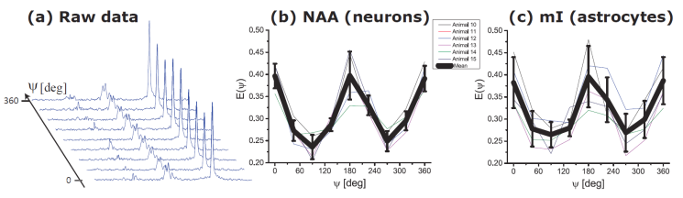
Cell-Specific Metabolic Confinement
DDE RE-MRS have been further modified to probe Neuronal (NAA) and Astrocytic (myoinositol) microstructure :
Both metabolites experience restricted diffusion
Show slightly different eccentricity ratios
⇨ Demonstrates potential for reporting microstructural features from cell-specific MRS signals
Angewandte Chemie Int. Ed. 2015 In Review

Slide 16
Conclusions
Selective excitation & RE provide high fidelity spectra & SNR needed for demanding dPFG studies
Long effective TE times predisposes DDE RE-MRS to long T₂ species
However, metabolic T₂s at 21.1 T are inherently long
Now able to probe metabolites confined to specific tissue
  NAA – neurons
  Myoinositol - astrocytes
  ⇨ 4 min scan provides SNR (NAA) = 250 at ψ=0°

Slide 17


Acknowledgments
Technical Support
Fabian Calixto Bejarano
Jose Muniz
Funding provided by:
The American Heart Association
NSF (DMR-1157490)
The Florida State University
Visiting Scientist grant and UCGP from NHMFL

Slide 18

Thank You!
User time available at:
www.nationalmaglab.org

