Slide 1
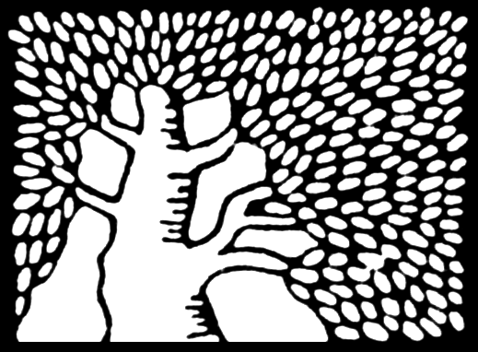
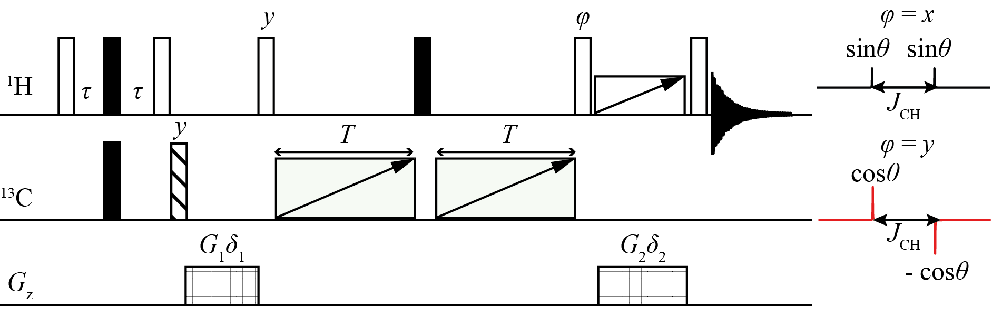
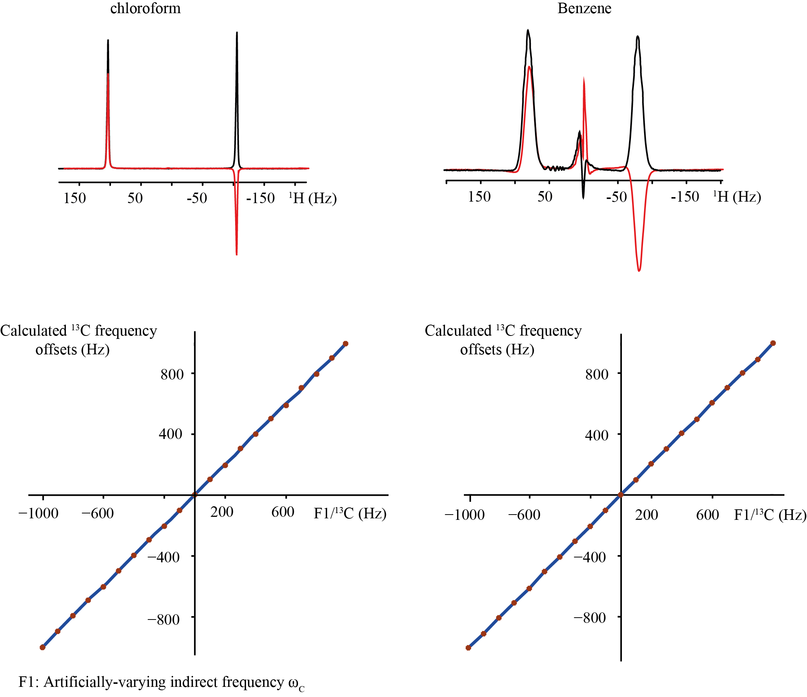
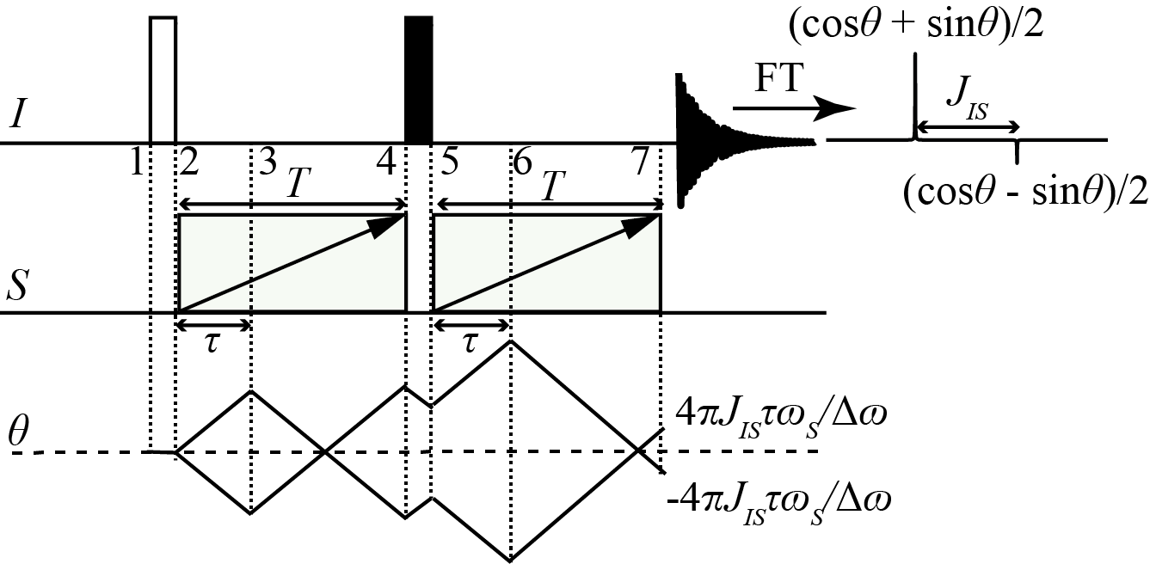
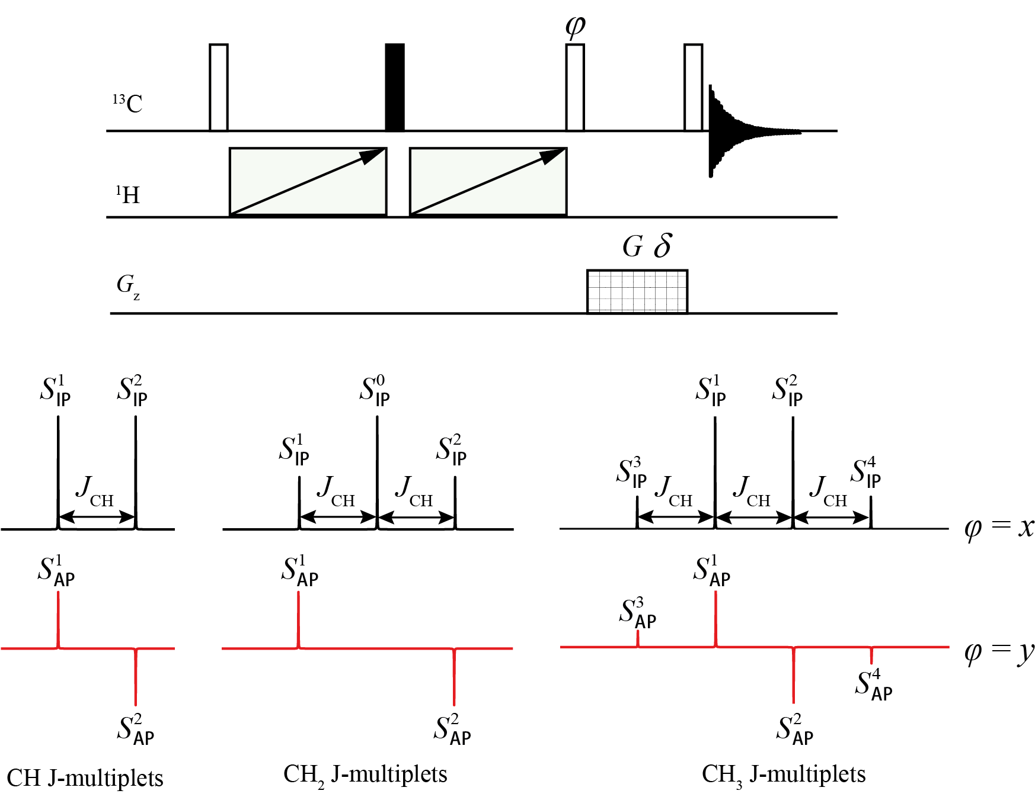
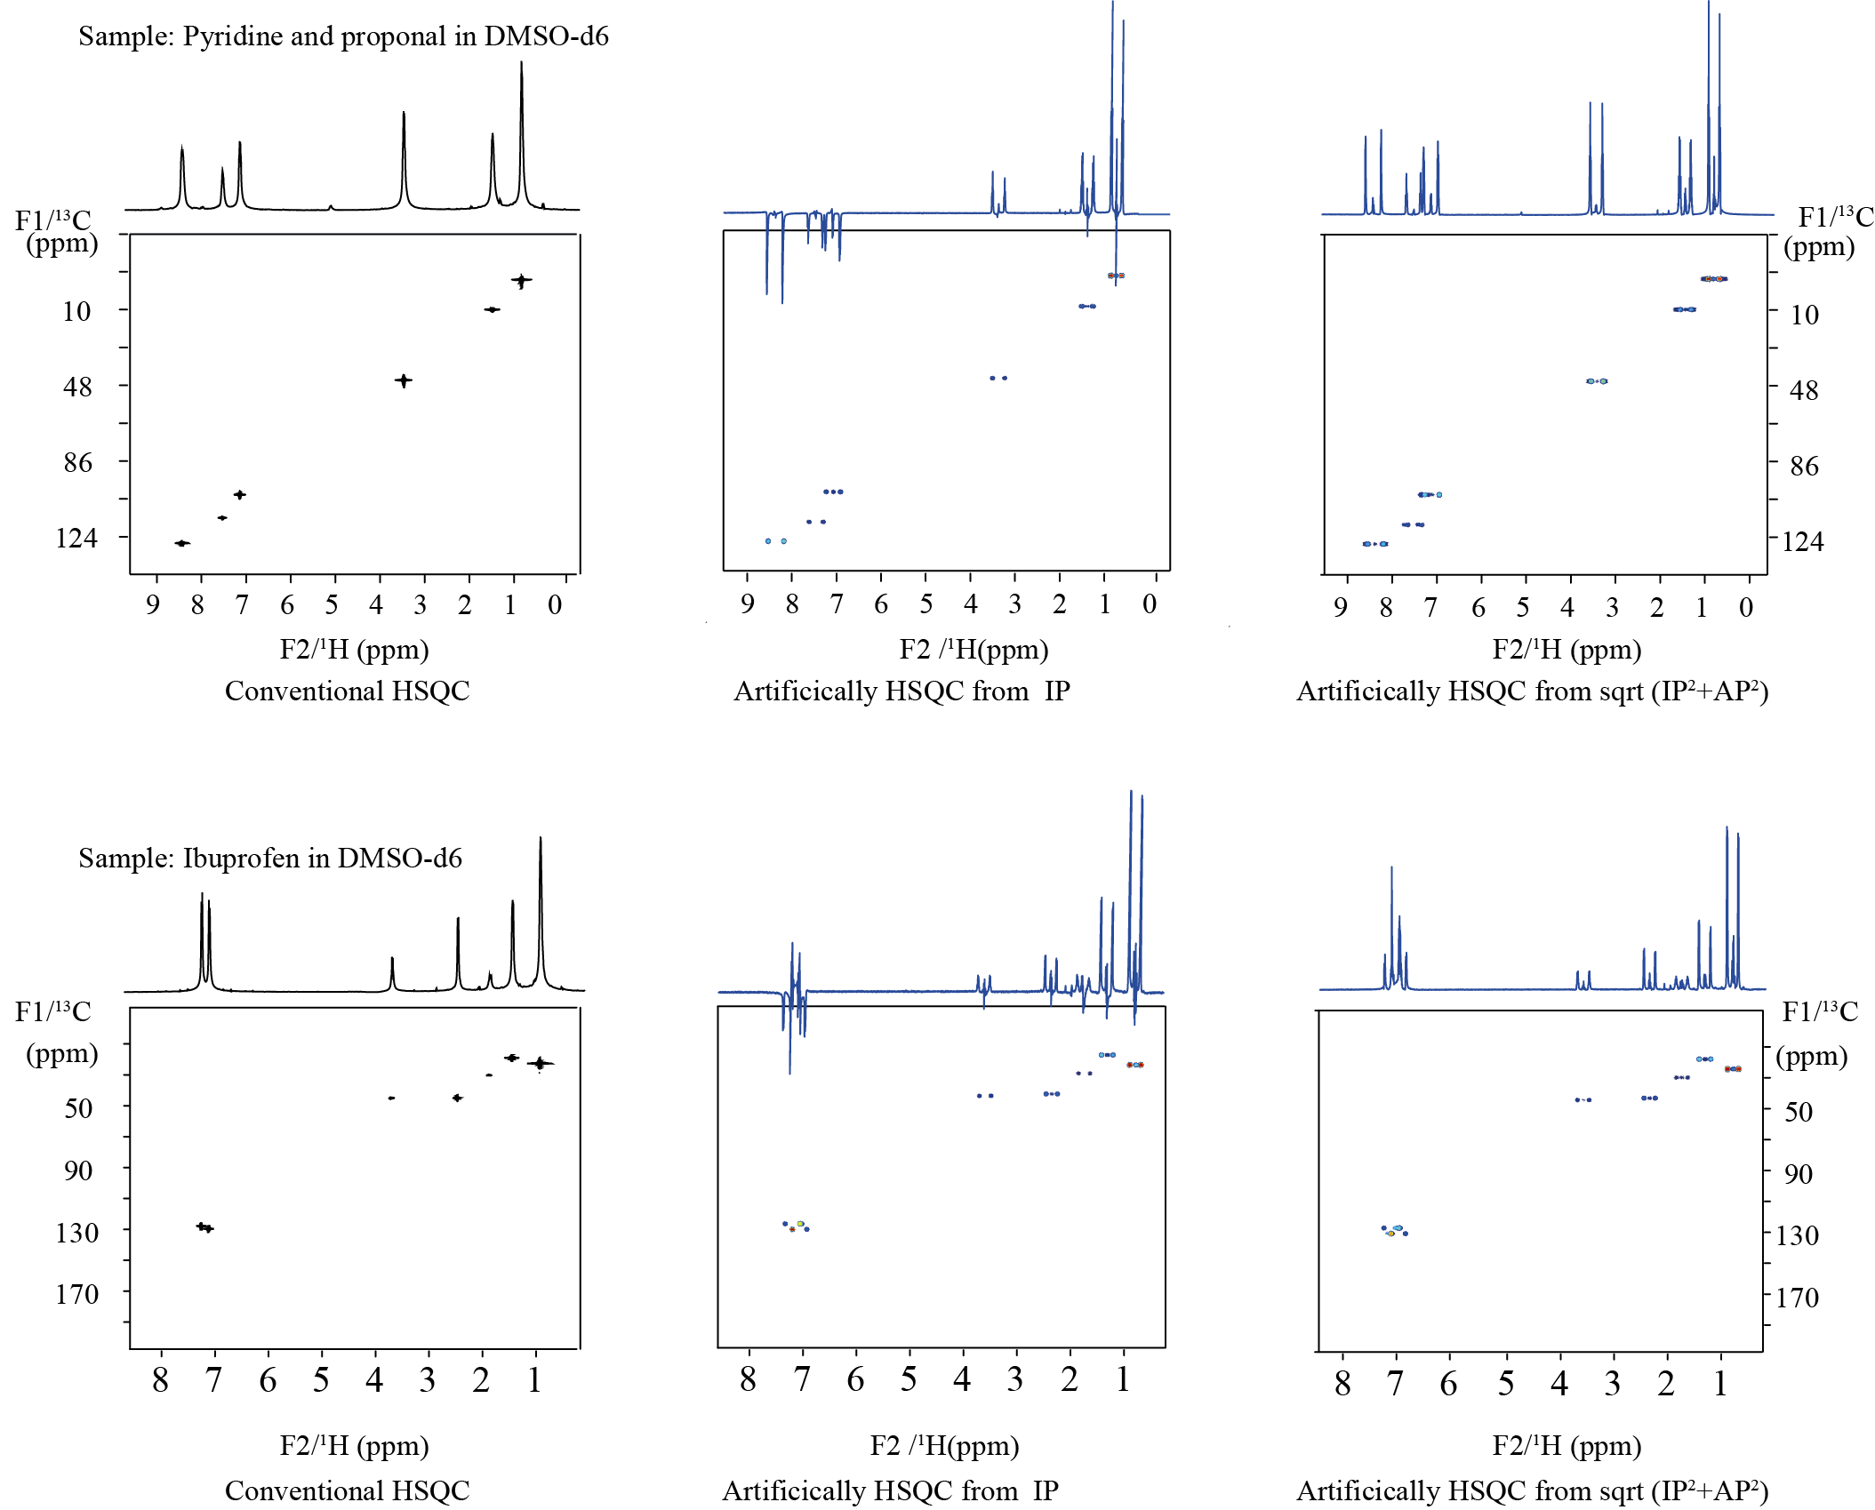
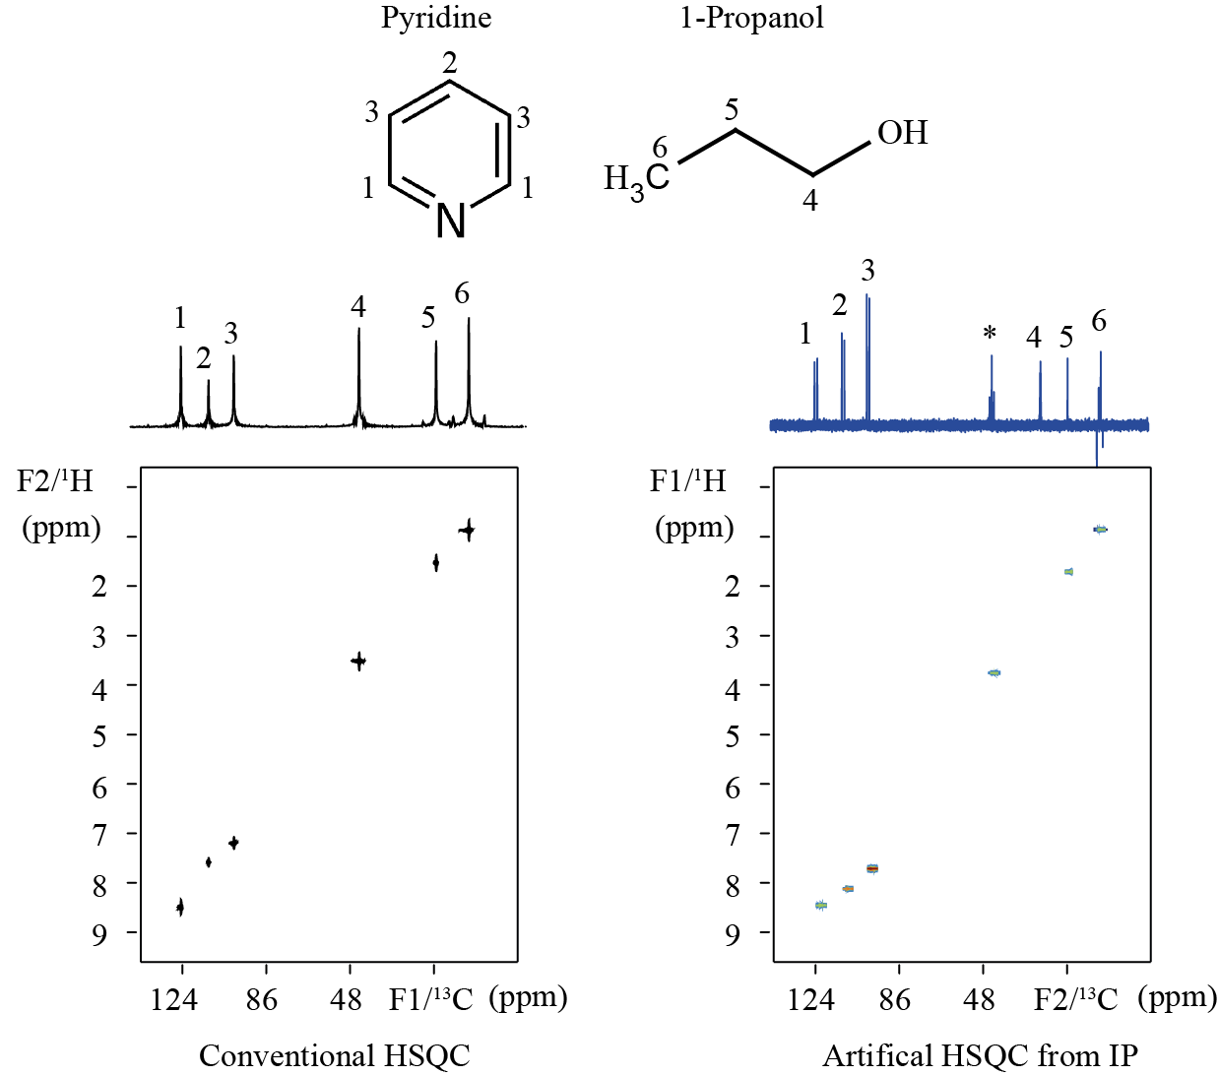
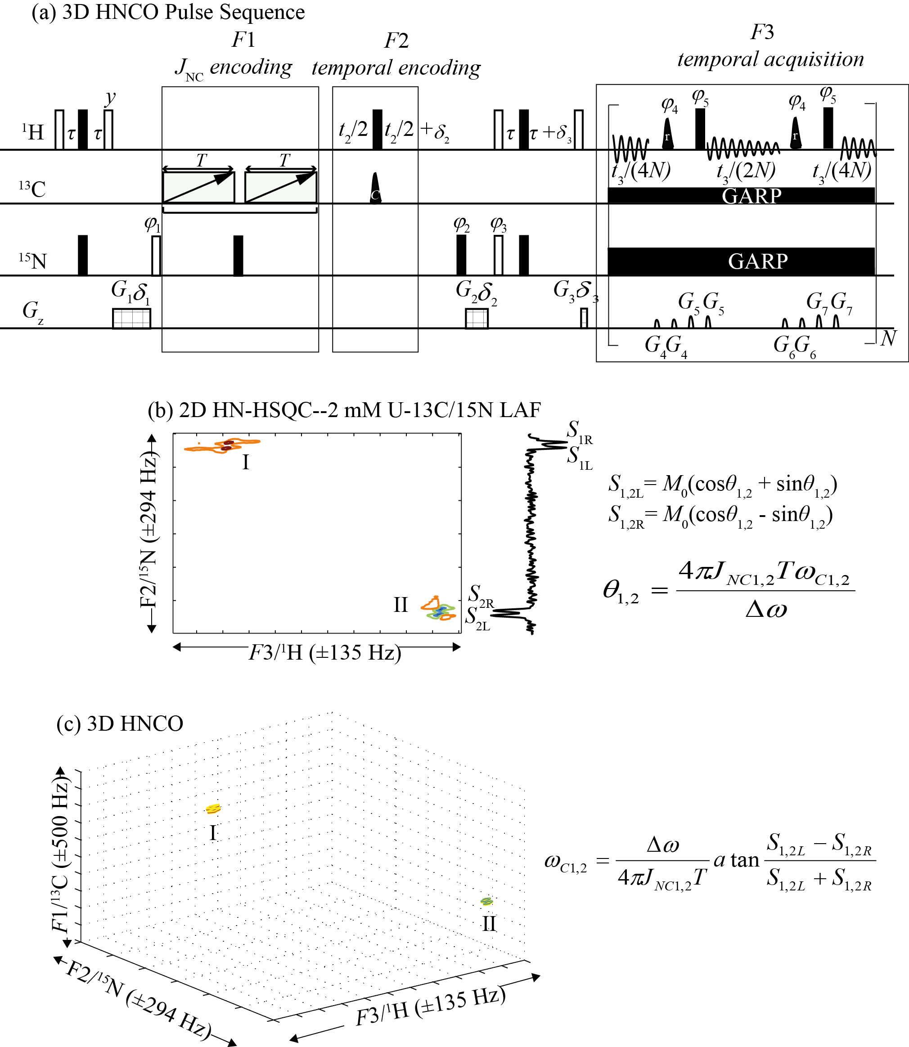
ESTABLISHNG TWO-DIMENSIONAL HETERONUCLEAR NMR CORRELATIONS BY OFFSET-SENSITIVE RECOUPLING
Yulan Lin^{1,2}, Adonis Lupulescu¹ and Lucio Frydman¹
¹Department of Chemical Physics, Weizmann Institute of Science, 76100 Rehovot, Israel
²Department of Electronic Science, Xiamen University, Xiamen, 361005, China
1. INTRODUCTION
3. Heteronuclear SOFER-based pseudo-2D correlations: ¹H-based observations”
Multi-dimensional correlations between bonded heteroatoms lie at the cornerstone of contemporary NMR. Improving the efficiency with which these multi-dimensional correlations are established is an important topic, and many alternatives have been developed over the last decade to speed up this kind of experiments. In particular, approaches have been proposed to forfeit multi-scan schemes altogether, and obtain complete full 2D correlations in a single shot. Here we explore and discuss a new, alternative method enabling the collection of such very fast –in principle, single-scan– acquisitions of nD heteronuclear correlations among bonded species, which operates on the basis of a partial reintroduction of J couplings. Similar approaches had been proposed in the past based on collecting coupled spectra for arrays of off-resonance decoupling values[1-3]; an alternative is here explored operating on the basis of applying frequency-swept pulses, incorporated into suitable spin-echo sequences. Thanks to the offset-dependent amplitude modulations of the in- and anti-phase J-modulated components that such sequences impart, chemical shifts of coupled but otherwise unobserved nuclear species, can be extracted from the relative intensities of the J-coupled multiplets observed in one-dimensional acquisitions. Pseudo-2D and -3D examples of these are described
¹H observation sequence. Executing the SOFER sequence in a natural abundance 1H-13C setting requires numerous refinements over the single-shot version, including an INEPT-type isotope filter selecting ¹³C-bound protons followed by a gradient purging pulse, and synthesizing all swept pulses using the Shinnar–Le Roux (SLR) algorithm [4]. For a cleaner cycling out of the residual ¹²C-bound signals these experiments were repeated twice, in the presence and absence of the 180◦ pulse shown in dashed. In order to avoid the phase distortion that prevent a clear separation of the IP and AP components, a 90◦ pulse with phase ϕ was added; ϕ = x delivered the IP component (black), while ϕ = y delivered the AP spectra (red). In order to remove modulations in these AP/IP components arising from the J_{HH} coupling, an adiabatic z-filter including a chirped 180◦ ¹H pulse applied simultaneously with the gradient G_{2,} was applied just before the last 90◦ pulse.
S_{AP} = cosθ , S_{IP} = sinθ
2.Heteronuclear I-S correlations via
Single-scan OFset-sEnsitive Recoupling (SOFER)
Relation between calculated frequency offsets and real indirect frequency offsets illustrated on model samples chloroform and benzene. Experiments were recorded at 500 or 600 MHz ¹H frequencies using Agilent spectrometers. For both samples the F1 (¹³C) carrier offsets were systematically incremented over 2 kHz in 100 Hz steps, and IP/AP spectral intensities were used to extract the shifts. Illustrative IP (black) and AP (red) ¹H spectral components, afforded by the aforementioned sequence for a particular offset. The center spike in C6H6 arises from residual ¹²C-bound protons. (Bottom) ¹³C offsets calculated as a function of an artificially-varying indirect frequency offset F1.
S₁ = (cosθ + sinθ)/2, S₂ = (cosθ - sinθ)/2
Basics of the sequence: The new approach presented for establishing single-scan 2D-like correlations between J-coupled heteronuclei, is illustrated above. In this simplest version the traditional t₁ evolution is replaced by a pair of linearly frequency swept adiabatic pulses possessing identical durations T and spectral sweep-widths Δω. The aim of this pair of pulses, together with a 180˚ I-spin pulse in their middle (black rectangle) is to introduce an offset-dependent recoupling of the I and S, described by a modulation phase θ. The simple calculation described above enables one to extract the offset of the coupled S-spin, from the intensities displayed by the S₁,S₂ J-split doublet.
4. Heteronuclear SOFER-based pseudo-2D correlations:
¹³C observations
¹³C observation sequence is simpler than its ¹H-observed counterpart, as it does not need to deal with suppression of the background ¹²C signal pairs. We only retain the separate observation of the IP and AP modulated components. On the other hand, it needs to deal with I-S_{n} multiplicities
2D examples: Conventional HSQC acquired in ≈23min using 256 t₁ and four scans per increment. Pseudo-2D SOFER spectra reconstructed from 23 s long acquisitions, showing recorded 1D spectra along the F2 dimension in different modes
Sample: Pyridine/propanol mixture in DMSO-d6
Reconstructed 2D Hetcor spectrum. ¹H-¹³C HSQC acquisitions exemplified on the solution of pyridine and propanol in DMSO-d6, recorded at 500 MHz ¹H frequency. (a) Conventional HSQC spectrum acquired in 26 min 22s, using 256 t₁ and four scans per increment. (b) Pseudo-2D correlation reconstructed from the results collected using the sequence above with ¹³C observation, in 6 min 4 s (32 scans).
5. Heteronuclear correlations: Extensions to pseudo-3D ¹H→¹⁵N→¹³C experiments
Pulse sequence assayed for the acquisition of 3D HNCO spectra, with a J_{NC}–enabled encoding of the ¹³C dimension, and ¹⁵N/¹H interactions monitored using a conventional temporal encoding. The sequence incorporates an off-resonance shifted laminar pulse on the C^{α} with a first null at ¹³CO for the sake of decoupling this homonuclear interaction; a BASH decoupling scheme during the ¹H detection period to remove the effects of the ¹H^{N}-¹H^{α} coupling; shaped pulses marked r as REBURP 180◦ inversions flipping solely ¹H^{N}. In order to get 2D HN-HSQC spectra with pure absorption mode lineshape, two HN-HSQC spectra with either cosine or sine amplitude modulation along t₂ dimension were acquired by setting ϕ₃ = x and y respectively. The direct-domain acquisition time t₃/4N = 16.8 ms, and the number of the acquisition blocks N = 6. (b) Experimental 2D HN-HSQC collected on 2 mM LAF peptide in DMSO-d6 at 600 MHz ¹H. 2D spectrum is shown in the phase-sensitive mode, and the projected 1D spectrum along the ¹⁵N dimension is shown on the right side of the 2D spectrum. The ¹⁵N dimension was sampled over 500 ms with 256 time increments; overall, 16 scans with a recycle delay of 2.0 s were accumulated. The total acquisition time was 6 hr, 28 min. (c) 3D HNCO spectrum reconstructed from the phase-modulation θ imposed on the spectrum in (b).
6. Conclusions
This study introduced a new approach to establish 2D NMR correlations, whereby offset sensitive recoupling can be translated into F1 shifts. This can be attained by the acquisition of the IP and AP components, which are subjected to amplitude modulation arising from the heteronuclear scalar coupling. Demonstrations of the technique on organic compounds suggest that it may prove especially valuable in monitoring of organic chemical reaction, extensions to high-dimensional acquisitions, and performing DNP-enhanced correlation experiments.
Acknowledgements
We are grateful to Dr. Korvin Walter for assistance in the initial stages of this study. This work was funded by the Israel Science Foundation grant 795/13, by the Kimmel Institute of Magnetic Resonance (Weizmann Institute), and by the generosity of the Perlman Family Foundation
REFERENCES
[1] R. Christy. R. Grace and R. Riek. J. Am. Chem. Soc. 2003 125 (51), 16104.
[2] Y. Liu, J. H. Prestegard.J. Magn. Reson. 2011 212 (2), 289.
[3] G. Zhang, F. Schilling, S. J. Glaser, and C. Hilty. Anal. Chem. 2013 85 (5), 2875
[4] Balchandani, P., J. Pauly, and D. Spielman. Magn. Reson. Med. 2010. 64(3): 843.

