Slide 1
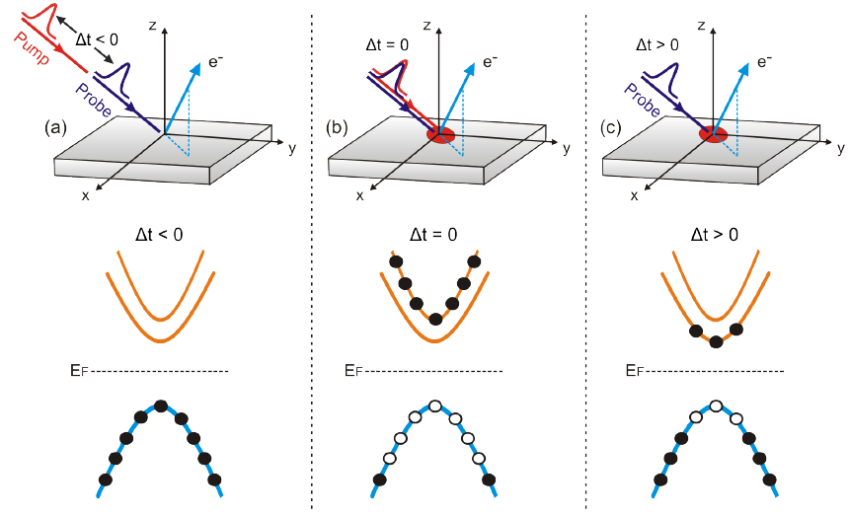
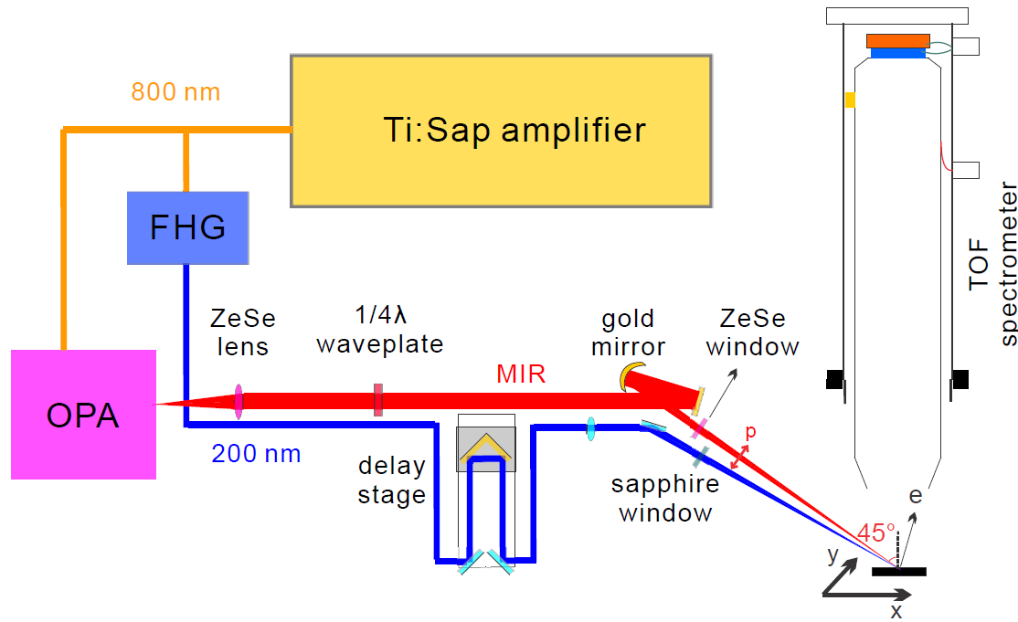
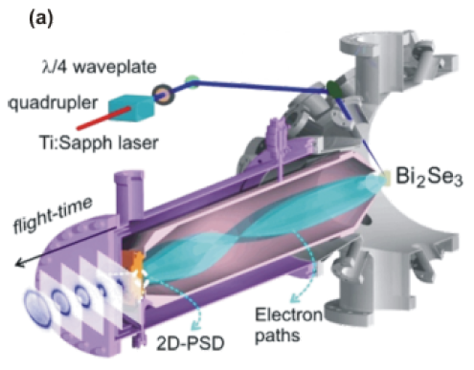
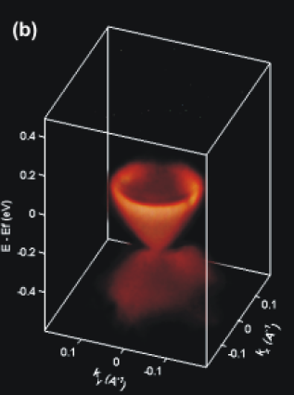
TrARPES
E = time of flight
k = 2D grid detector
Map unoccupied band structure
Advantages:
No need to rotate analyzer
or sample
Pump-probe expts.
Resolution:
Energy resolution set by length and pulse width.
Momentum resolution set by detector

Slide 2
SCIENCE 342 453-456 (2013)

Slide 3
Linearly polarized

Slide 4
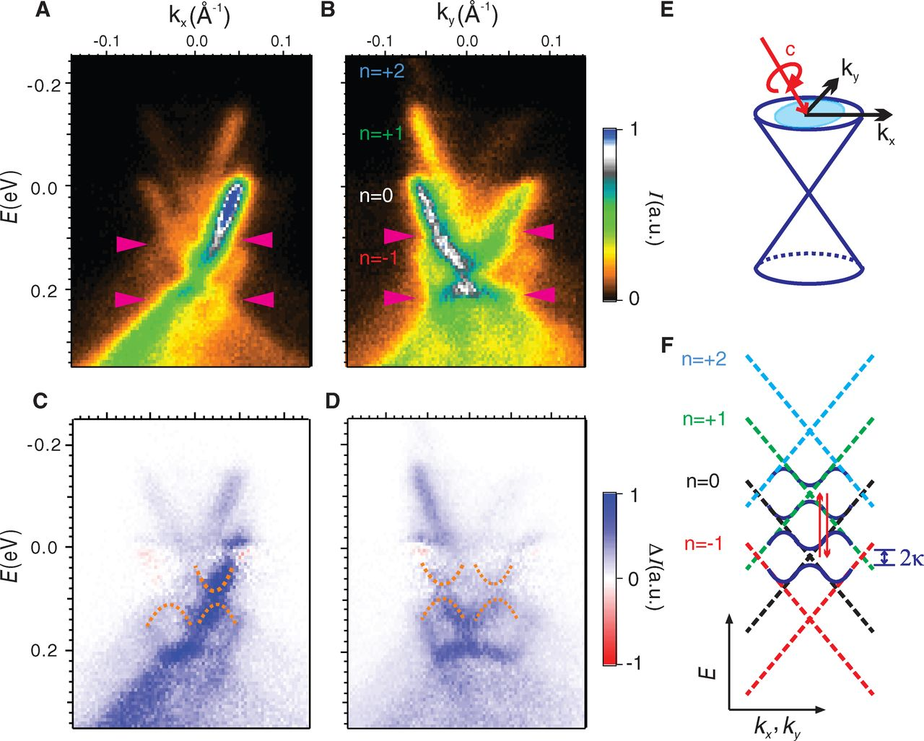
Circularly polarized

Slide 5
TRS breaking

