Slide 1


Slide 2
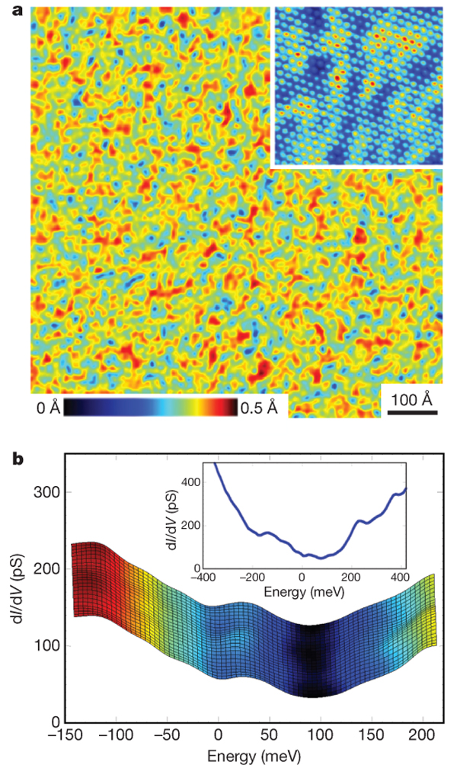
STM Bi_{0.92}Sb_{0.08} (111) Surface

Slide 3
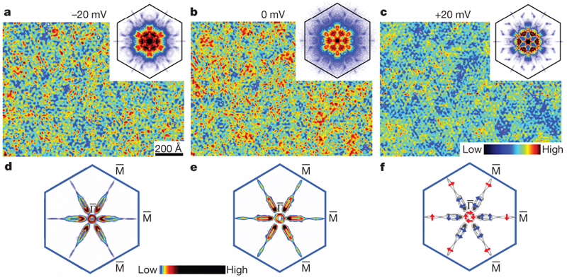
dI/dV map – QPI pattern

Slide 4
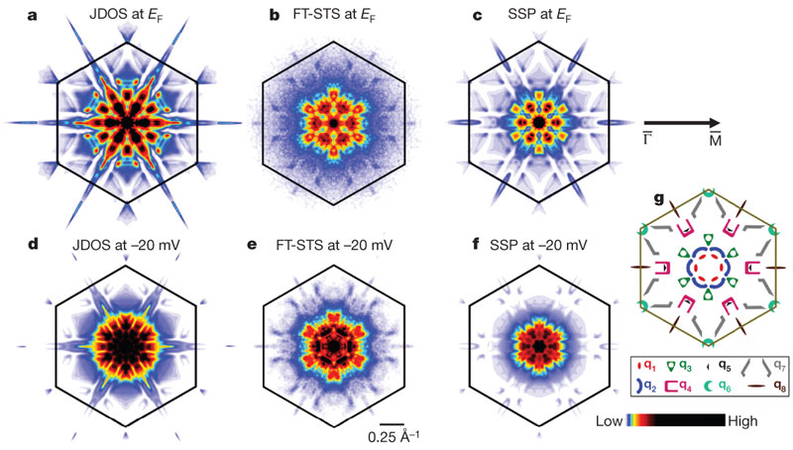
JDOS and SSP

Slide 5
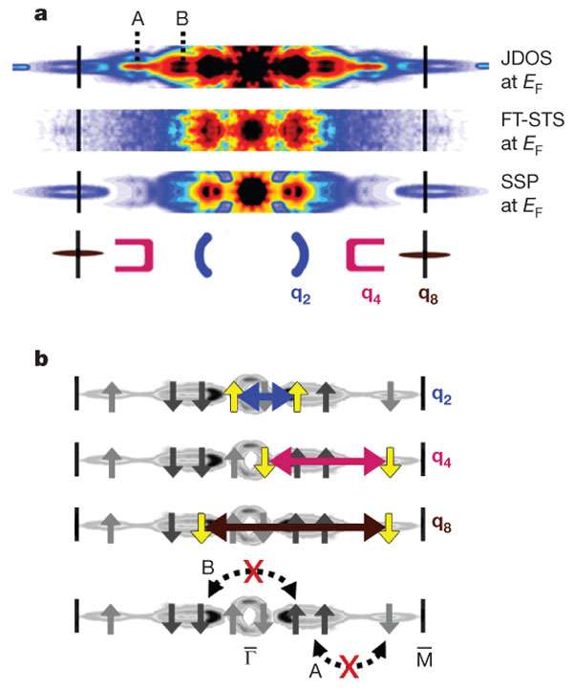
Spin Selection Probability Γ-M

Slide 6
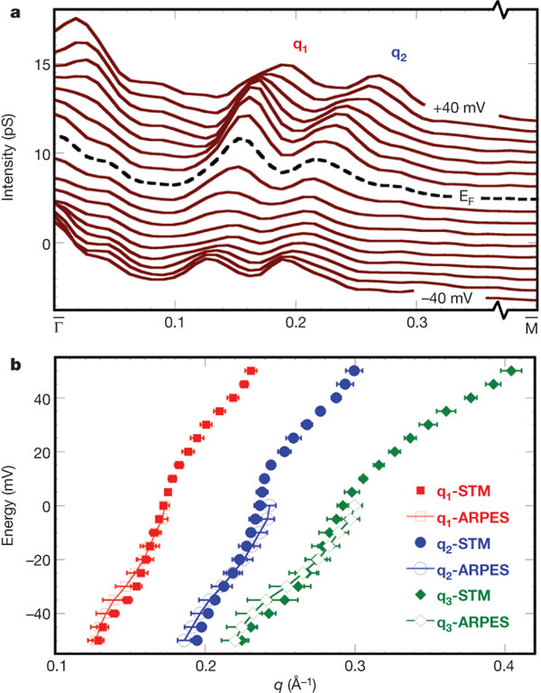
Dispersion – ARPES and FT-STS

Slide 7
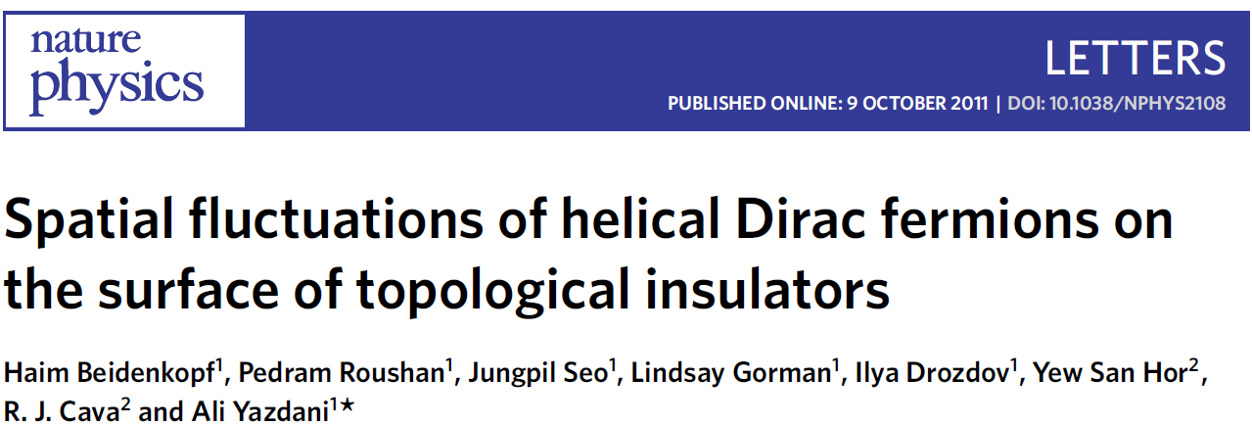
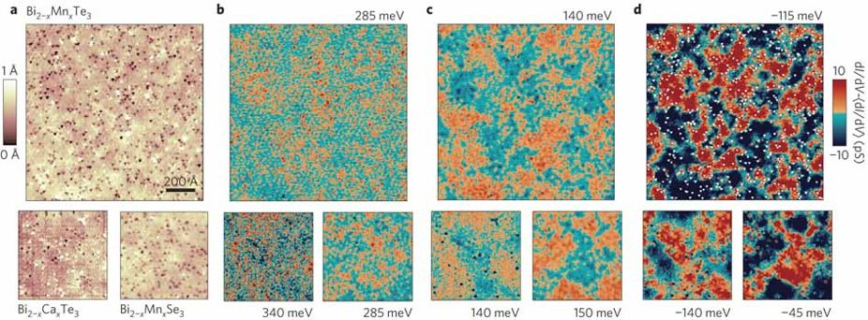

Slide 8
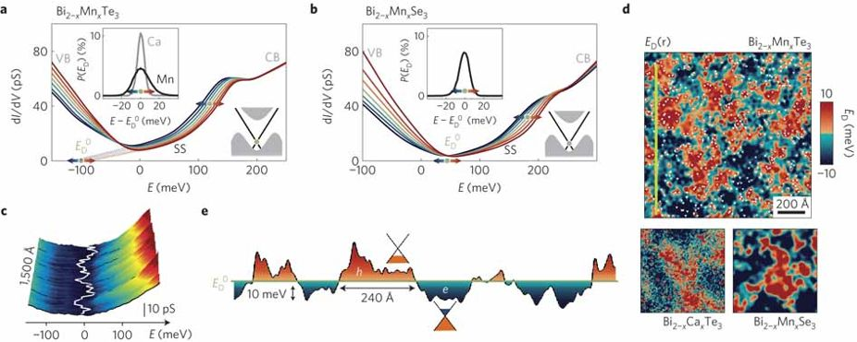
Charge Inhomogeneity

Slide 9
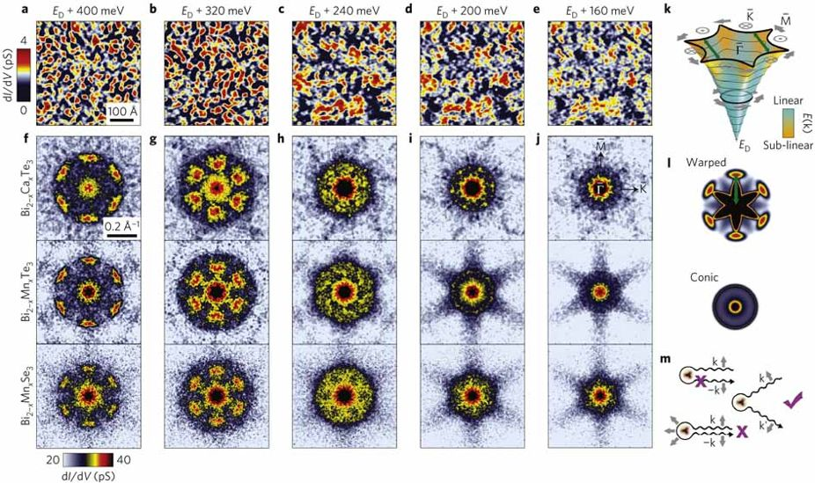
Scattering of Surface States

Slide 10
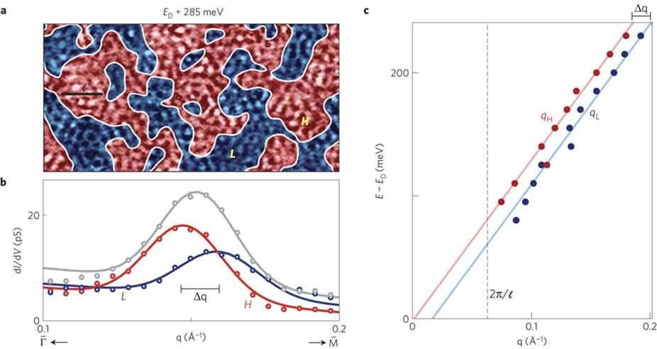
Spatial fluctuations of momentum

