Slide 1
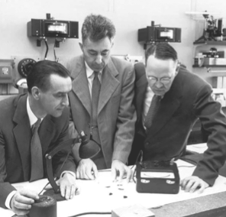


Photovoltaics:
Fundamental concepts and novel systems
First practical photovoltaic cell:
Chapin, Fuller, Pearson,
Bell Labs, 1954: 6% efficiency
THANKS TO
GARY H O D E S
& many others
Notes:
1

Slide 2
Outline
Energy levels → bands
Doping of semiconductors
Energy band alignments between different phases
Space charge layers
p-n junctions, Schottky barriers
p-n cells, Si cells, thin film cells
Schottky cells (solid and liquid junction)
p-i-n cells
Fundamental limits of photovoltaic cells
How to overcome/ bypass these limits
New generation cells (brief survey)
PV stability, efficiencies and economics
Notes:
1 (2)

Slide 3
From energy levels to bands
E
1 e⁻ energy
LUMO
HOMO
If E_{G} < ~100-150x kT_{B}
→ semiconductor
CB
E_{C}
E_{G}
E_{V}
VB
Notes:
4 (8)

Slide 4
Doping of semiconductors
B C N
Si
Si
Si
Si
Si
Si
Si
Si
Si
Si
Si
Si
Si
As
Si
Si
Al Si P
Si
Si
Si
Si
Si
Si
Si
Si
Si
Si
Si
Si
Si
Si
Si
Si
Ga Ge As
E
Free electrons in CB
• • • • • • • • • • •
E_{C}
E_{F} = Fermi level (~electrochemical
potential of electrons
+ + + + + + + + + + + +
As⁵⁺ ---> 4e⁻+ e⁻ donors (N_{D})
E_{G} 1.1 eV
n-type
E_{V}

Slide 5
Doping of semiconductors -2
B C N
Si
Si
Si
Si
Si
Si
Si
Si
Si
Si
Si
Si
Si
B
Si
Si
Al Si P
Si
Si
Si
Si
Si
Si
Si
Si
Si
Si
Si
Si
Si
Si
Si
Si
Ga Ge As
E_{C}
ΔE = kTln(N_{D}/N_{C})
10¹⁸
p-type
10¹⁶
1 e⁻ energy
10¹⁰
0 or
N_{D}=N_{A}
E_{F}
○        
E_{V}
Free holes
in VB
B³⁺ ---> 3e⁻ - e⁻
Acceptors (N_{A})
Notes:
7 (15)

Slide 6
Energy band alignments between different phases
E_{vac}
electron affinity
work function
e⁻
1 e⁻ energy
E_{F}
n-type
semiconductor
metal
space charge
layer
Formation of a metal - semiconductor junction
space charge layer
1 e⁻ energy
n-type
p-type
→ Formation of a p-n homojunction
space coordinate
Notes:
4 (19)

Slide 7
Space Charge layers
2εε₀V
1/2
Width of space charge layer inversely proportional
to [doping density]^{1/2}
W =
qN_{D(A)}
Typical widths of space charge layer:
N = 10²²/cc (metallic) Ångstroms (~ 1-2 atomic layers)
N = 10¹⁸/cc (heavily doped semiconductor) 10s of nm
N = 10¹⁶/cc (medium doped semiconductor) 100s of nm
N = 10¹⁴/cc (low doped semiconductor) few µm
space charge
layer
In a photovoltaic cell, the width of the space charge layer should be wide enough
to absorb most of the light in the E-field region –a few 100 nm in a typical cell.
Light absorption I = I₀e^{-αd}
Notes:
2 (21)

Slide 8
Basics of photovoltaic cells
hν
hν
Charge separation in space
e⁻
E_{C}
e⁻
1 e⁻ energy
1 e⁻ energy
Charge separation in energy
E_{F}
h⁺
E_{V}
h⁺
space coordinate

Slide 9
Basics of photovoltaic cells
hν
Amps
Volts
e⁻
V_{OC}
h⁺
@ open-circuit
@ short circuit
load
V
@maximum power

Slide 10
Dark- and Photo- I-V (current-voltage)
characteristics of a PV cell
Current
V_{OC}
Voltage
I_{SC}
max power
fill factor = (I _{mp} . V_{mp}) / (I _{SC} . V_{OC})
mp : max power
Notes:
8 (29)

Slide 11
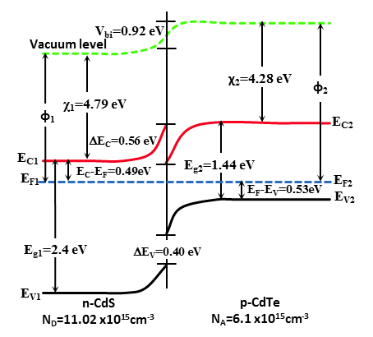
Other ways of creating a built-in field to separate charges
p-n heterojunction
CdTe/CdS
e⁻
CdTe
CdS
Silicon
homojunction
h⁺
TCO front contact
CdS
CdTe
back contact (Cu/Cu₂Te)

Slide 12
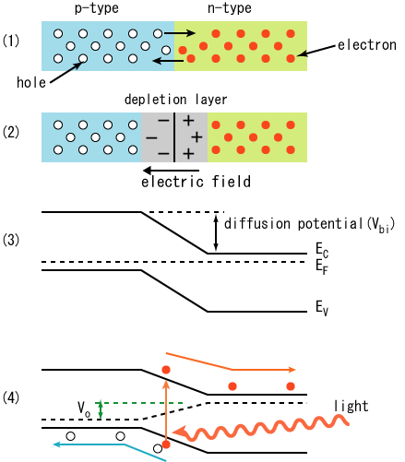
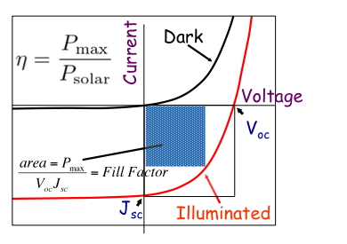
Summary of how p-n junction PV cell works
Absorb light
Absorbed light creates carriers
Carrier collection, by diffusion, drift
1 e⁻ energy
space
Ginley, Collins & Cahen in Ginley & Cahen,
Fundamentals of Materials for Energy…

Slide 13
Other ways of creating a built-in field to separate charges -2
E₀
electron affinity
work function
E_{F}
n-type
semiconductor
metal
space charge
layer
Metal-semiconductor junction
(with semiconductor/ liquid electrolyte junction →
photoelectrochemical cell [PEC], where E_{F} ≅ E_{Redox}

Slide 14
Other ways of creating a built-in field to separate charges -3
p-i-n (I = insulator) cell
E_{O}
E_{C}
E_{V}
N = 10¹⁸/cc (heavily doped semiconductor) 10s of nm
N = 10¹⁶/cc (medium doped semiconductor) 100s of nm
N = 10¹⁴/cc (low doped semiconductor) few µm
Reminder of
typical space charge layer widths
Notes:
6 (35)

Slide 15
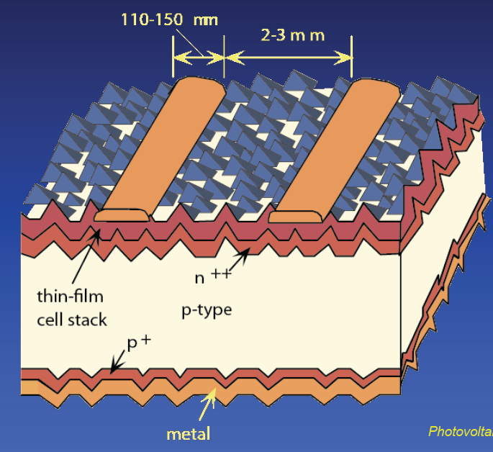
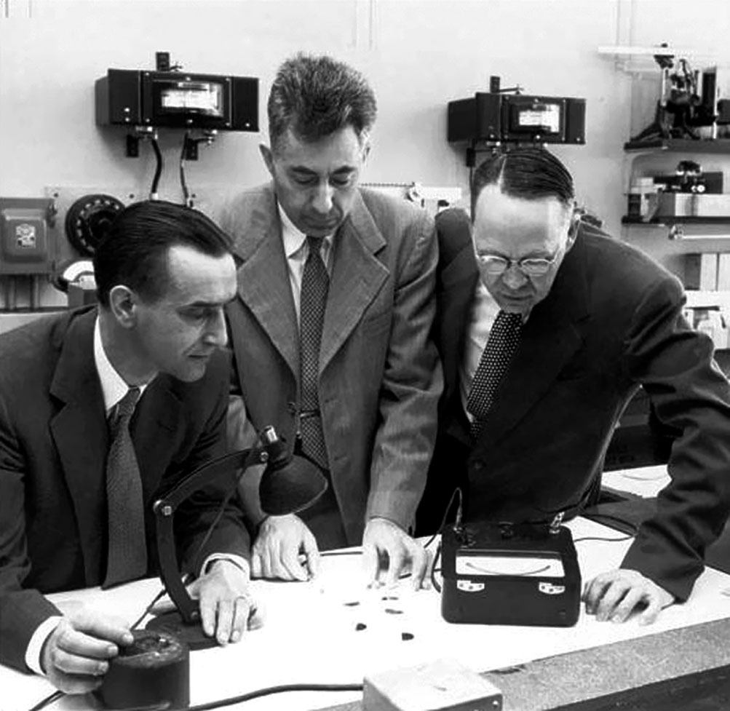
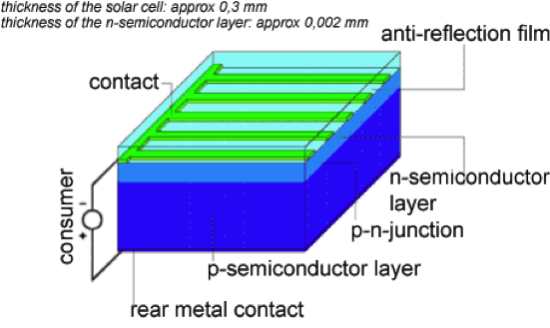
1954
2014
Chapin
Fuller
Pearson

Slide 16
Solar cell generations
Si (crystalline) cells : 1st generation cells
(thin film) CdTe, CIGS, α-Si : 2nd generation cells
Dye cells, organic cells and related ones : 3rd generation cells
There are newer ones and ‘generation number’ becomes fuzzy at this stage
Notes:
1 (44)

Slide 17
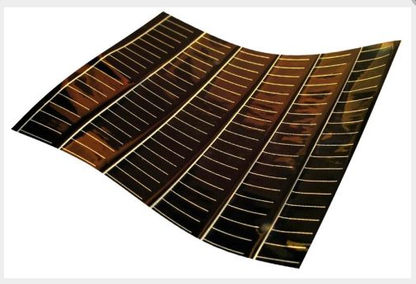
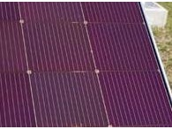
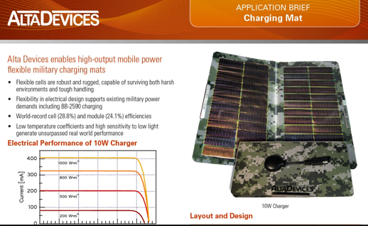
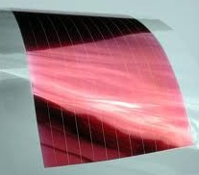
CdTe
“the single crystal divide”
GaAs
Organic

Slide 18
The Photovoltaic (PV) effect:
Generalized picture
Absorber
High
energy
state
e⁻
Metastable high and low energy states
Absorber transfers charges into high and low energy state
Driving force brings charges to contacts
Selective contacts
one electron energy
contact
contact
Low
energy
state
p⁺
space
(1) cf. e.g., Green, M.A., Photovoltaic principles. Physica E, 14 (2002) 11-17
Notes:
2 (4)

Slide 19
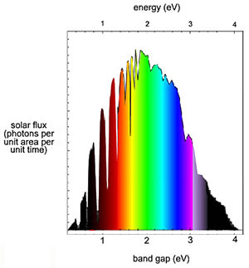
Fundamental losses in single junction solar cell
e
e
-
-
high energy photon – partial loss
Energy
e
e
-
-
h
n
h
n
-
p
useable photo
-
p
-
-
type
type
voltage (
voltage (
qV
qV
)
n
)
n
-
-
type
type
h
low energy photon – total loss
h
+
+
space
O. Niitsoo

Slide 20
All fundamental losses in PV cell
Etendu; Photon entropy –TD
~0.3eV @RT, lack of concentration
Carnot factor –TD
E_{g}
Emission loss- (current)
< E_{g}
not absorbed
Electrical power out
Current – Voltage Characteristics
>E_{g}
thermalized
After Hirst & Ekins-Daukes
Prog.Photovolt:Res:Appl. (2010)
Nayak, ……, Cahen., Energy Environ. Sci., 2012

Slide 21
Shockley-Queisser* (SQ) Limit
detailed balance,
photons-in = electrons-out + photons-out;
on earth, @ RT,
for single absorber / junction;
Prince, JAP 26 (1955) 534
Loferski, JAP 27 (1956) 777
Shockley & Queisser JAP (1961)
cf. also Duysens (1958) “The path of light in photosynthesis”; Brookhaven Symp. Biol.

Slide 22
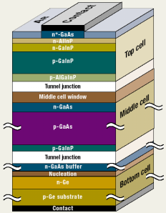
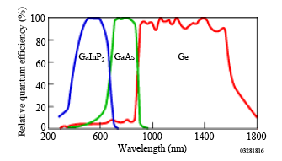
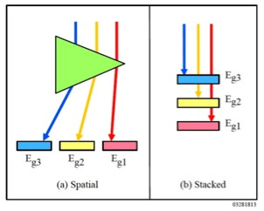
How to circumvent SQ and other losses?
Better utilization of sunlight: Photon management:
Multi-bandgap, multi-junction photovoltaics
GaInP₂ E_{g} = 1.8-1.9 eV up to 1.45 V V_{OC}
Notes:
8 (43)

Slide 23
Up-conversion for a single junction
How to circumvent these losses?
2 photons of energy 0.5 E_{g}< hν< E_{g}
are converted to 1 photon of hν> E_{g}

Slide 24
Down-conversion for a single junction
How to circumvent these losses?
1 photon of energy hν > 2E_{g}
is converted into 2 photons of hν > E_{g}

Slide 25
Other ways to beat the SQ limit
Multiple exciton generation
E_{C}*
e⁻
Hot electrons
e⁻
e⁻
E_{C}
E_{G}
E_{V}
h⁺
h⁺
h⁺
Intermediate bandgap

Slide 26
Other ways to beat the SQ limit
Multiple exciton generation
E_{C}*
e⁻
E_{F}
Hot electrons
e⁻
E_{C}
E_{F}
E_{G}
E_{V}
h⁺
Intermediate bandgap

Slide 27
Other ways to beat the SQ limit
Multiple exciton generation
E_{C}
e⁻
E_{G}
Hot electrons
e⁻
E_{i}
E_{V}
h⁺
Intermediate bandgap
Notes:
4 (for 3 slides) (71.5)

Slide 28
The principle of nanostructured cells
light absorption
depth
contact
E_{C}
hole
selective
contact
e⁻
e⁻
h⁺
e⁻
E_{V}
electron
selective
contact
h⁺
h⁺
^{light-absorbing}
^{semiconductor}
absorber
contact
electron conductor hole conductor
electron (hole) selective contact; conductor; transport medium
Advantage of high surface area: Allows the use of locally thin absorber and therefore poor quality
(wider range of) absorbers
Notes:
4 (48)

Slide 29
Organic photovoltaic cells OPV
Two problems of OPV:
Low diffusion lengths of electron/hole
2. Low dielectric constant – high binding energy
h⁺
e⁻

Slide 30
Two problems of OPV:
Low diffusion lengths of electron/hole
2. Low dielectric constant and high effective mass – high binding energy
e⁻
h⁺
effective mass of
electrons and holes
e⁻
e⁻
Binding energy of H atom =
me⁴
e⁻
e⁻
= 13.6 eV
2h²ε²
Binding energy of exciton ?
h⁺
dielectric constant
of material
h⁺
h⁺
Wannier-Mott excitons – extended; low BE few/tens meV
Frenkel excitons – localized; high BE hundreds meV

Slide 31
Notwithstanding these problems, OPV is now at ~ 11% conversion efficiency
Stability still not good enough for practical use, but improving
Advantages: Cheap (in capital and in energy)
Roll-to-roll manufacturing (large scale possible)
Notes:
8 (56)

Slide 32
Dye sensitized solar cell (DSC or DSSC)
light
e⁻
LUMO
e⁻
e⁻
dye
E_{C}
I⁻ + h⁺ ---> I
semiconductor
TiO₂
HOMO
h⁺
TiO₂
E_{V}
2I + I⁻ ---> I₃⁻ (I is soluble in I⁻)
Need single monolayer
dye on TiO₂
But then low absorption
At counter electrode, I is reduced back to I⁻
Important difference between this cell and “standard’ photovoltaic cells
or previous nanocrystalline cell:
Charge generation and charge separation occur in different phases:
recombination is inherently low.

Slide 33
Solution - use high surface area semiconductor
Early attempts increased surface area by roughening electrode - several times increase
Breakthrough: porous, nanocrystalline TiO₂
Made by sintering a colloid or suspension of TiO₂
O’Regan, B.; Grätzel, M. Nature 1991, 353, 737.
Dye molecule bonded to TiO₂
Only a monolayer of dye at most on each TiO₂

Slide 34
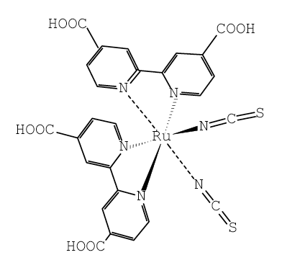
The most common dye: Ru(dcbpyH₂)₂(NCS)₂ or RuL₂(NCS)₂
cis-bis(4,4’-dicarboxy-2,2’-bipyridine)-bis(isothiocyanato)ruthenium(II)
O
e⁻
C
N
N=C=S
⁻O
Ru
h⁺
Ti
O
C
N
N=C=S
⁻O
Excitation of dye is a metal-to-ligand
charge transfer
Ti^{4+/3+}
ligand π* orbital
ca. 1.7 eV
Ru d-orbitals
Notes:
DSC 5 (61)

Slide 35
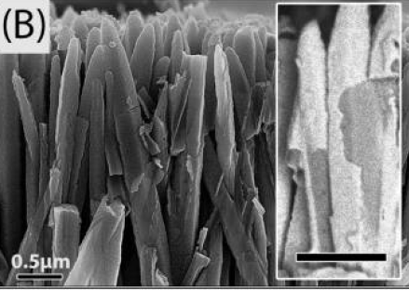
Change the dye in a DSC to a semiconductor
Semiconductor-sensitized solar cells (quantum dot cells)
ETA (extremely thin absorber) solar cells
Semiconductor does not have to be a single monolayer – typically few nm to few tens nm
Variations:
Hole conductor – liquid or solid (if solid, commonly called ETA cell)
Semiconductor may be in the form of quantum dots – increase in Eg
Notes:
2.5 (63.5)

Slide 36
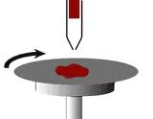
Hybrid Organic-Inorganic Perovskites
most common one- CH₃NH₃PbI₃
Preparation
CH₃NH₂+HI → CH₃NH₃I_{(solid)} in methanol, at 0˚C
CH₃NH₃X + PbI₂ → CH₃NH₃PbI₃ in organic solvent
Solution processable, easy to scale
Heat at ca. 100ºC
Another +: very high V_{OC} for CH₃NH₃PbI₃ E_{G} = 1.55 eV, V_{OC} up to 1.2 V
Notes:
4 (67.5)

Slide 37
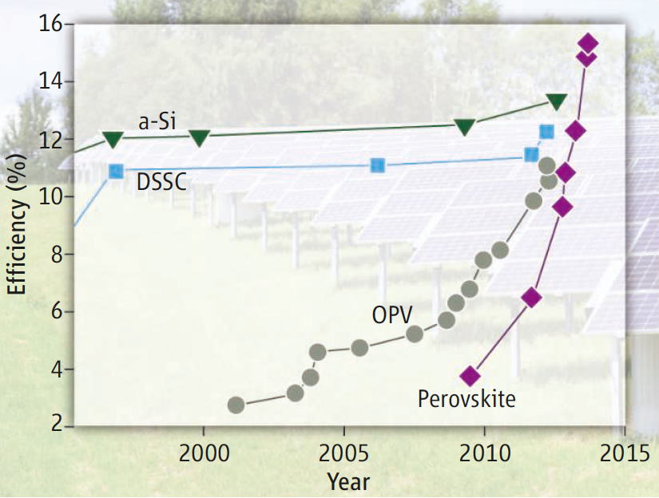
Evolution of hybrid I-O perovskite
solar cells

Slide 38
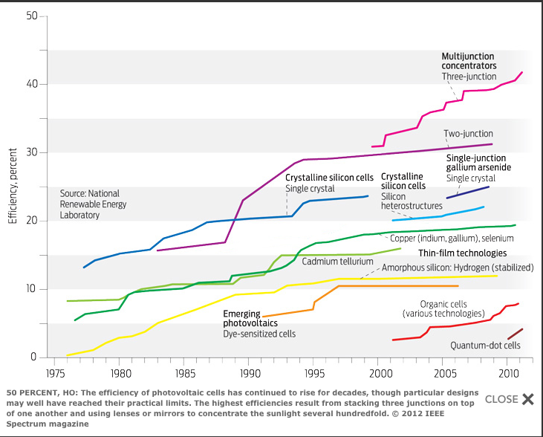
The three important parameters for commercial cells
1. Efficiency

Slide 39
→ Shockley-Queisser* (SQ) Limit

Slide 40
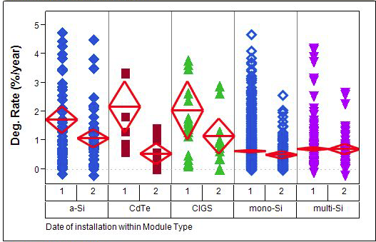
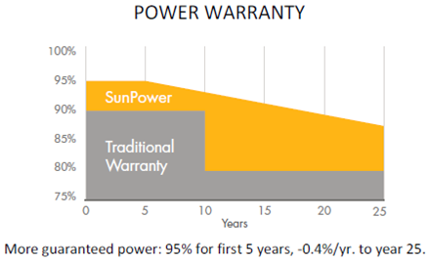
2. Stability Long term stability of PV modules/systems
mean
<2000 >2000 <2000 >2000 <2000 >2000 <2000 >2000 <2000 >2000
Jordan & Kurtz, 2011 (August), National Renewable Energy
Laboratory (NREL)
Photovoltaic degradation rates – An analytical review

Slide 41
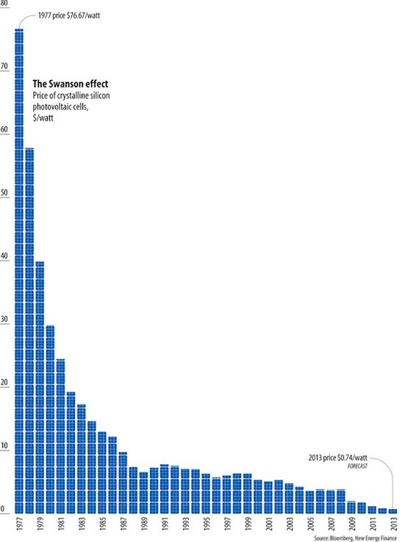
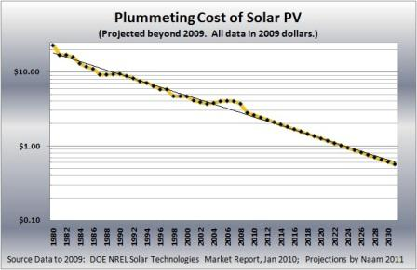
3. Cost (money and energy)
$/W_{P}
Energy payback time
Predicted cost
$0.6/W_{P} in 2030

Slide 42
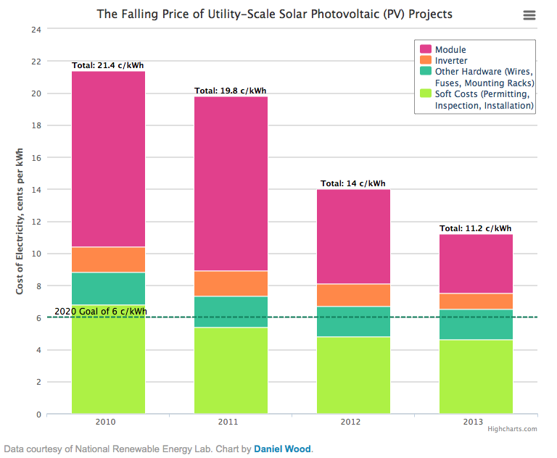
(US)

Slide 43
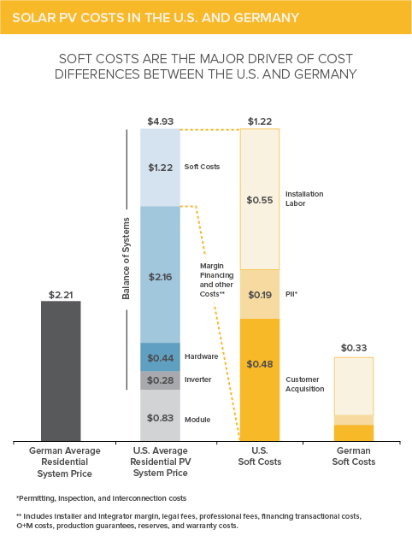
A C O L D S H O W E R
Solar PV Costs in the USA and Germany (2013)

Slide 44
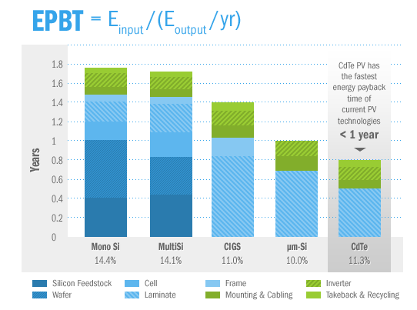
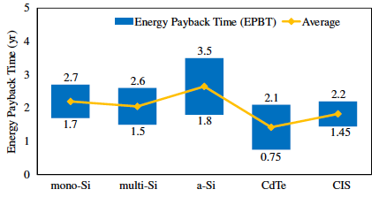
Estimated Solar Cell Energy Payback Times 2013
from
First Solar
website…
Peng, Lu, Yang,
Renew. Sustain. Energy Rev.
19 (2013) 255–274

Slide 45
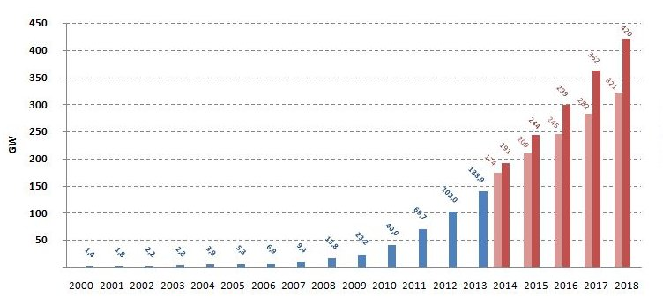
And finally, PV production history and forecast
Cumulative PV
Wikipedia
Notes:
10 (81.5)

Slide 46
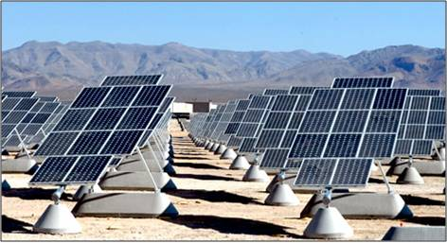
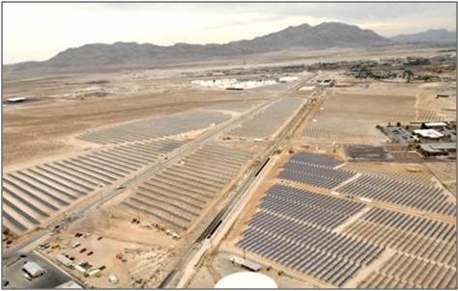
Solar Cell Power Stations TODAY
World’s Largest Solar-Electric Plant
0.55 GW_{p} (→ ~100 MW_{c}) Topaz Solar farm (CA, USA)
In 12/2014 Global Cumulative Installed PV Power ~ 0.15 TW_{p}
PRC goal >2012
≥ 0.01 TW_{p}/yr
30 TW_{p} (~ 6 TW_{C})
requires 1 such plant,
every HOUR, for
~ 12 years (+ storage…)
Notes:
PRC 2011 2 GWp solar (PV)

