Slide 1
Succinct Graph Structures and Their Applications Spring 2020
Class 5: Labeling Schemes

Slide 2

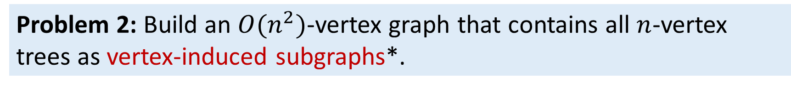
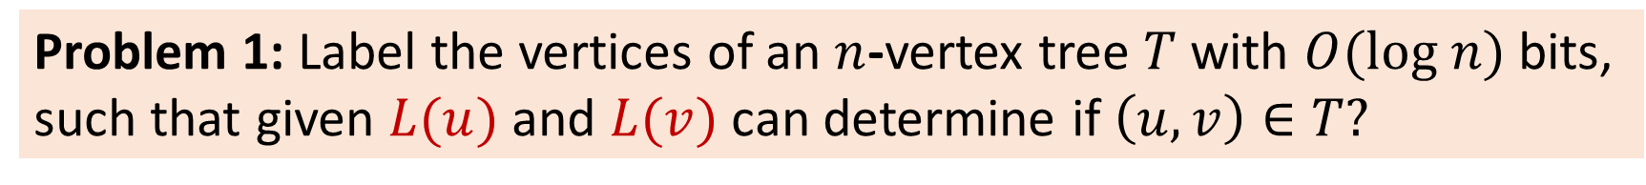
How to Represent a Graph?
Conventional approach: node-IDs e.g. $O(\log{n)}$-bit identifiers
Today: meaningful identifiers
Problem 1: Label the vertices of an $n$-vertex tree $T$ with $O(log n)$ bits,
such that given $L(u)$ and $L(v)$ can determine if $\left(u,v\right)∈T?$
Problem 2: Build an $O(n^{2})$-vertex graph that contains all $n$-vertex trees as vertex-induced subgraphs*.
* A subgraph $G^{′}=(V^{′},E^{′})⊆G$ is vertex-induced subgraph if $E′=\left(V^{′}×V^{′}\right)∩E(G)$

Slide 3
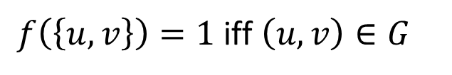
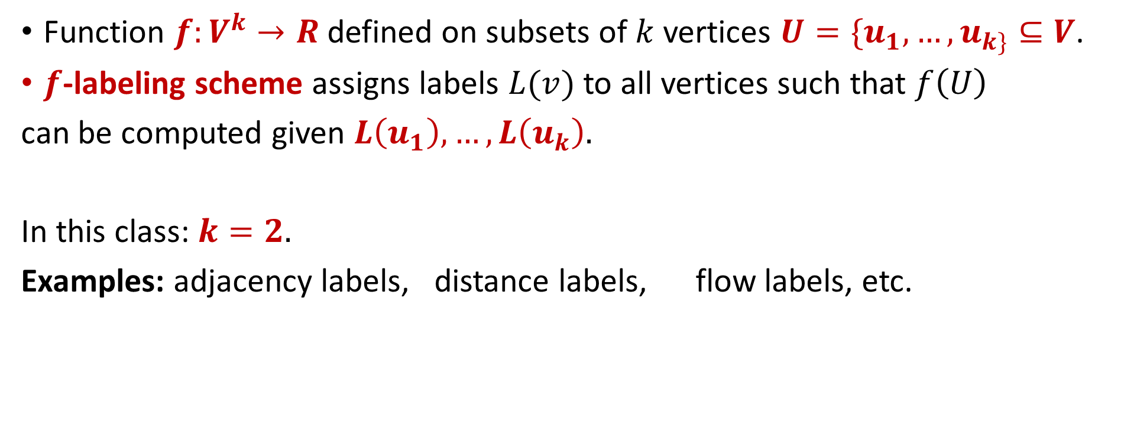


Informative Labeling Schemes
Function $f:V^{k}→R$defined on subsets of $k$ vertices $U=\{u_{1},…, u_{k\}}⊆V$.
$f$-labeling scheme assigns labels $L(v)$ to all vertices such that $f\left(U\right)$
can be computed given $L\left(u_{1}\right),…, L\left(u_{k}\right).$
In this class: $k=2.$
Examples: adjacency labels, distance labels, flow labels, etc.
$f\left(\left\{u,v\right\}\right)=1$iff $\left(u,v\right)∈G$
$$f\left(\left\{u,v\right\}\right)=d_{G}\left(u,v\right)$$
$$f\left(\left\{u,v\right\}\right)=flow_{G}\left(u,v\right)$$
Complexity measure: label size

Slide 4
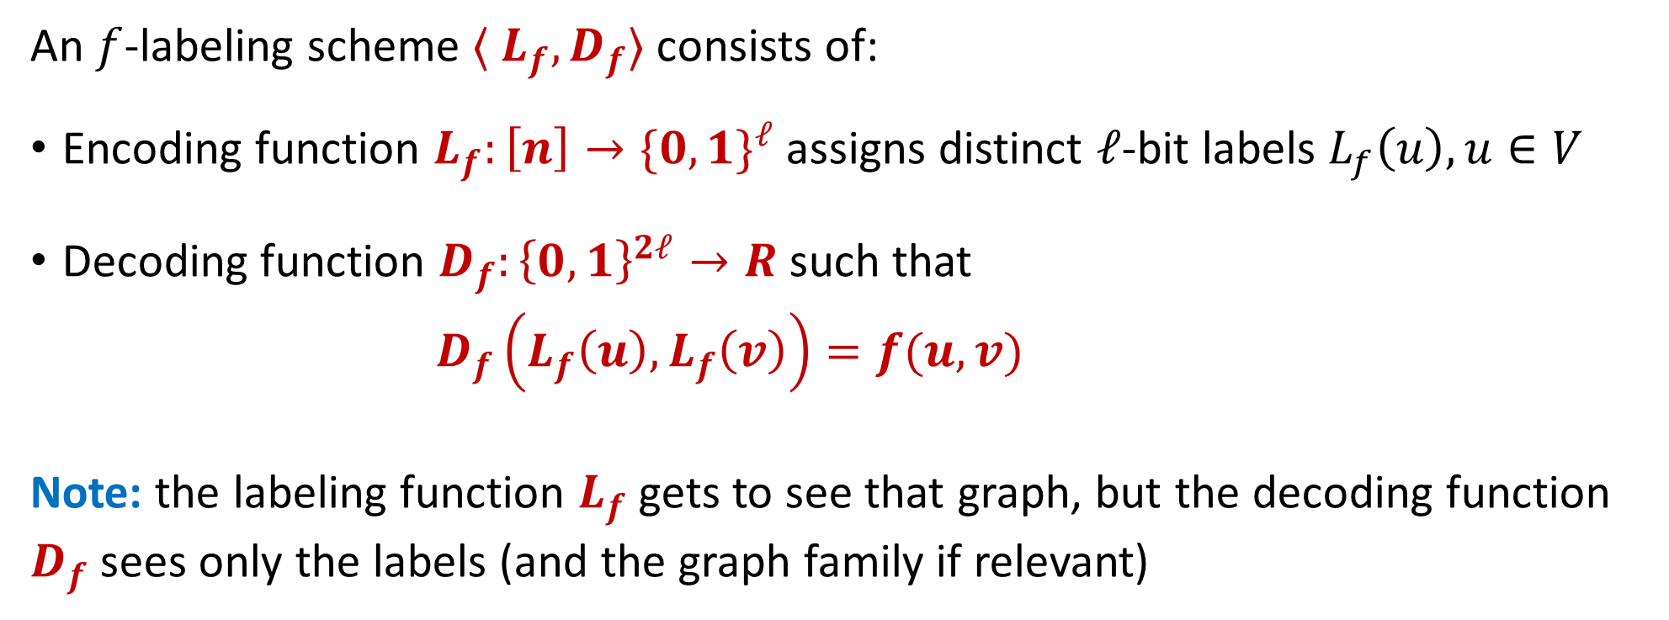
Informative Labeling Schemes
An $f$-labeling scheme $〈 L_{f}, D_{f}〉$ consists of:
Encoding function $L_{f}:\left[n\right]→\{{0,1\}}^{ℓ}$ assigns distinct $ℓ$-bit labels $L_{f}\left(u\right), u∈V$
Decoding function $D_{f}:{\left\{0,1\right\}}^{2ℓ}→R$ such that
$D_{f}\left(L_{f}\left(u\right), L_{f}\left(v\right)\right)=f(u,v)$
Note: the labeling function $L_{f}$ gets to see that graph, but the decoding function
$D_{f}$ sees only the labels (and the graph family if relevant)

Slide 5
Outline
Adjacency labeling schemes
Trees
Universal graph families
Distance labels for general graphs
Flow and connectivity labels
Distance labels for bounded-separator graphs

Slide 6
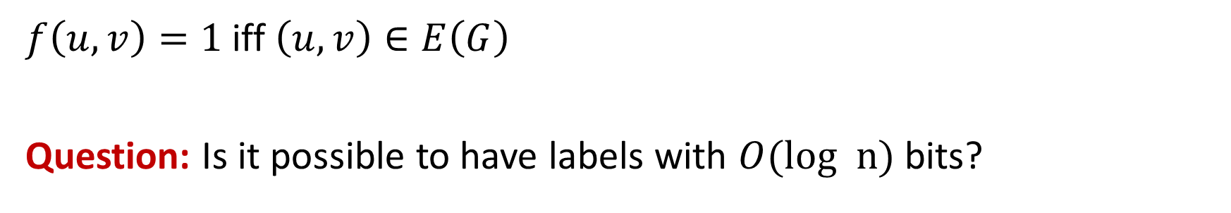
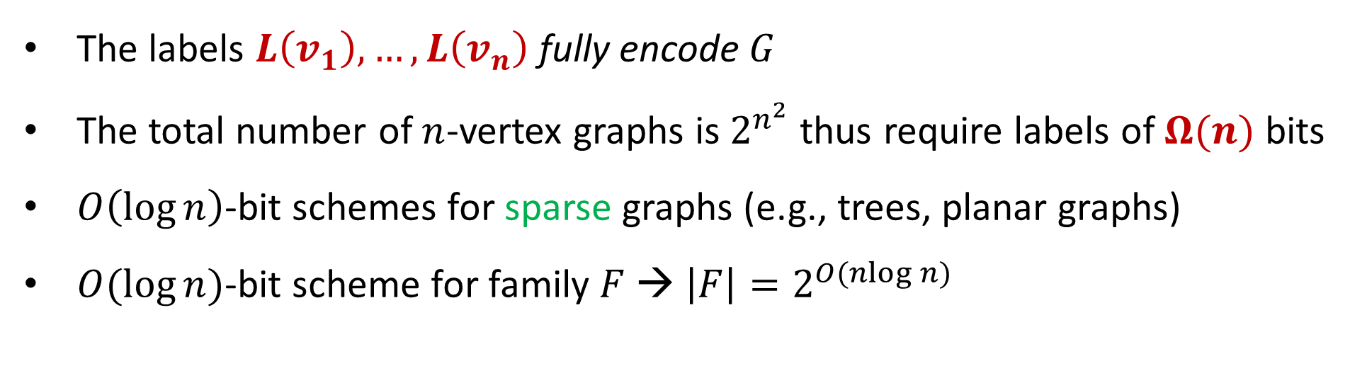
Adjacency Labeling Schemes
$f\left(u,v\right)=1$iff $\left(u,v\right)∈E\left(G\right)$
Question: Is it possible to have labels with $O(log n)$ bits?
No!
The labels $L\left(v_{1}\right), …, L\left(v_{n}\right)$ fully encode $G$
The total number of $n$-vertex graphs is $2^{n^{2}}$ thus require labels of $Ω(n)$ bits
$O\left(\log{n}\right)$-bit schemes for sparse graphs (e.g., trees, planar graphs)
$O(\log{n)}$-bit scheme for family $F$ → $\left|F\right|=2^{O(nlog n)}$

Slide 7











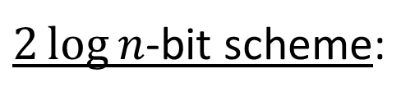



Adjacency Labeling Schemes for Trees
$2\log{n}$-bit scheme:
$$L\left(u\right)=〈ID\left(u\right), ID(π(u)〉$$
$$a$$
Cor.: planar graphs have $O(\log{n)}$-bit scheme
$$b$$
$$k$$
$$g$$
$$c$$
[Alstrup, FOCS’15]: $\log{n+o\left(1\right)}$bits
$$d$$
$$h$$
$$i$$
$$j$$
$$e$$
$$f$$
Why should we care so much about these constants?

Slide 8
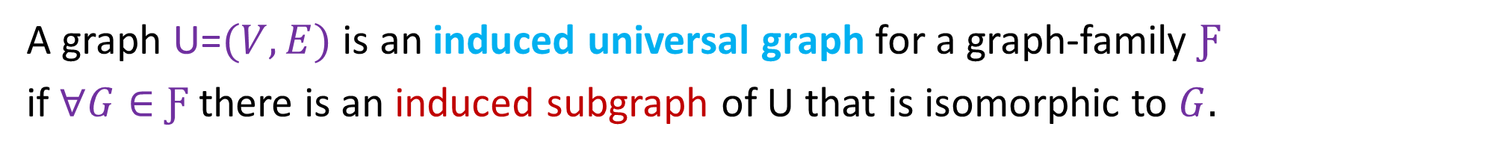
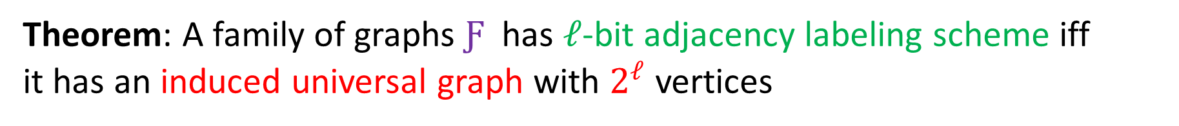

Induced Universal Graphs
A graph U=$(V,E)$ is an induced universal graph for a graph-family $Ƒ$
if $∀G∈$ $Ƒ$ there is an induced subgraph of U that is isomorphic to $G.$
$$∉$$
Theorem: A family of graphs $Ƒ$ has $ℓ$-bit adjacency labeling scheme iff
it has an induced universal graph with $2^{ℓ}$ vertices

Slide 9


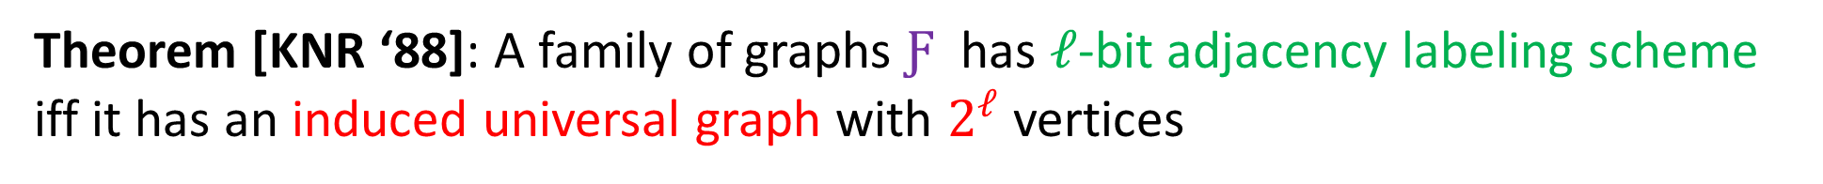
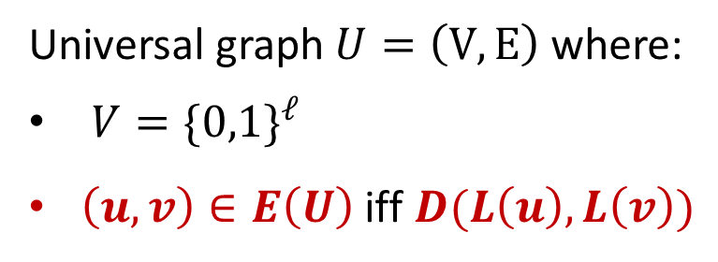
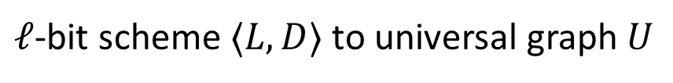
Theorem [KNR ‘88]: A family of graphs $Ƒ$ has $ℓ$-bit adjacency labeling scheme iff it has an induced universal graph with $2^{ℓ}$ vertices
$ℓ$-bit scheme $〈L,D〉$ to universal graph $U$
Universal graph $U=\left(V,E\right)$ where:
$V=\{{0,1\}}^{ℓ}$
$\left(u,v\right)∈E\left(U\right)$ iff $D(L\left(u\right),L\left(v\right))$
Assign IDs in $\left[{1,2}^{ℓ}\right]$ to $V\left(U\right)$
Given $G$, find $V^{′}⊂V\left(U\right)$ such that $G≅U[V^{′}]$
Assign labels to $V\left(G\right)$ based on mapping to $V′$
Universal graph $U$ to $ℓ$-bit scheme

Slide 10
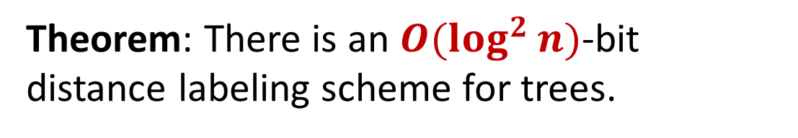

(Exact) Distance Labeling for Trees
Recup: heavy-light tree decomposition
Heavy child is the child of largest subtree
Key property: any path from root to node $u$
contains $O(\log{n)}$light edges
Theorem: There is an $O(\log^{2}{n)}$-bit
distance labeling scheme for trees.

Slide 11



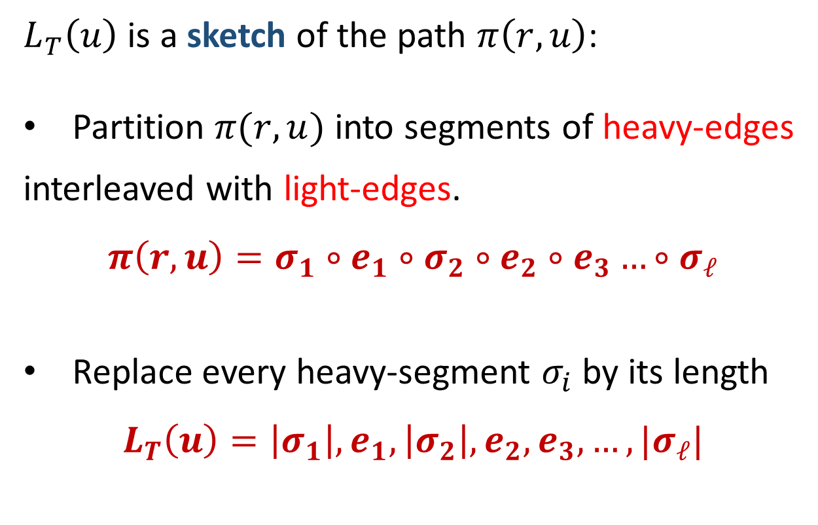
Theorem: There is an $O(\log^{2}{n)}$-bit distance labeling scheme for trees.
$$r$$
$L_{T}\left(u\right)$ is a sketch of the path $π\left(r,u\right)$:
Partition $π(r,u)$ into segments of heavy-edges
interleaved with light-edges.
$$π\left(r,u\right)=σ_{1}∘e_{1}∘σ_{2}∘e_{2}∘e_{3}…∘σ_{ℓ}$$
Replace every heavy-segment $σ_{i}$ by its length
$$L_{T}\left(u\right)=\left|σ_{1}\right|, e_{1},\left|σ_{2}\right|, e_{2},e_{3},…,|σ_{ℓ}|$$
$$u$$
Label size is $O(\log^{2}{n)}$bits

Slide 12

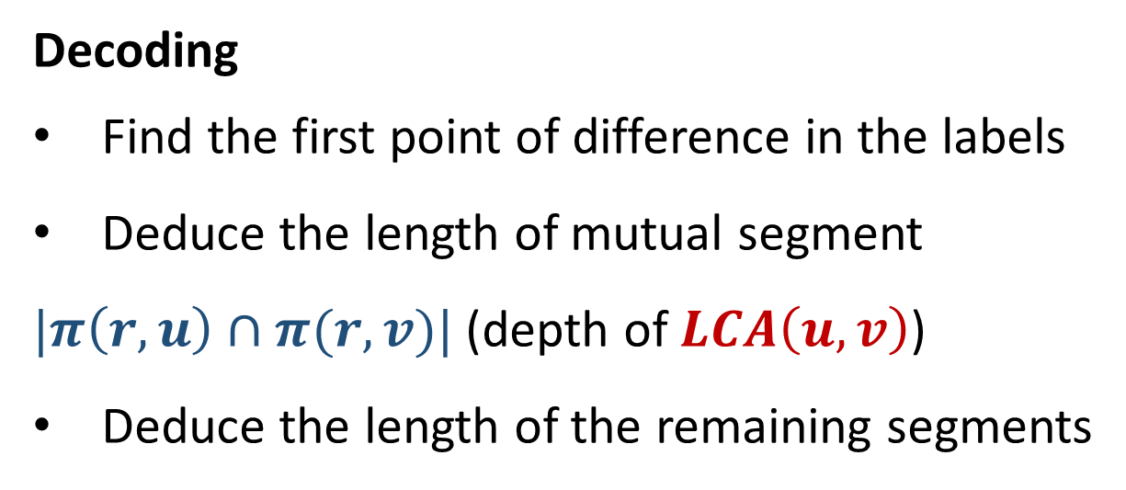

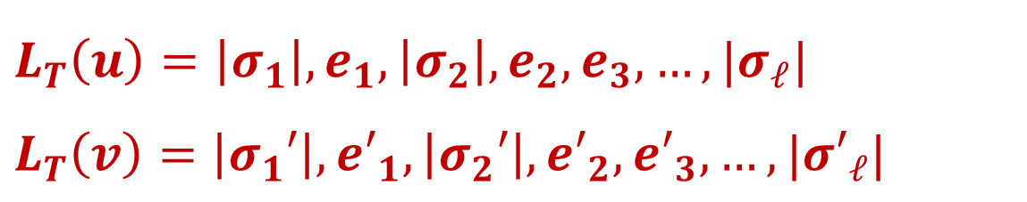
$$L_{T}\left(u\right)=\left|σ_{1}\right|, e_{1},\left|σ_{2}\right|, e_{2},e_{3},…,|σ_{ℓ}|$$
$$L_{T}\left(v\right)=\left|σ_{1}′\right|, {e′}_{1},\left|σ_{2}′\right|, {e′}_{2},{e′}_{3},…,|{σ′}_{ℓ}|$$
Decoding
Find the first point of difference in the labels
Deduce the length of mutual segment
$|π\left(r,u\right)∩π(r,v)|$ (depth of $LCA\left(u,v\right)$)
Deduce the length of the remaining segments
$$u$$
$$v$$

Slide 13
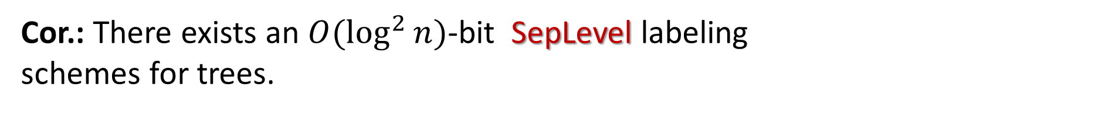



SepLevl Labels
Separation level of trees: $SepLevel\left(u,v\right)=Depth(LCA\left(u,v\right))$
$$LCA(u,v)$$
Cor.: There exists an $O(\log^{2}{n})$-bit SepLevel labeling
schemes for trees.
$$u$$
$$v$$

Slide 14
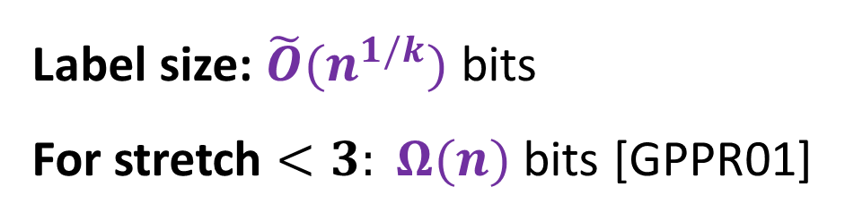
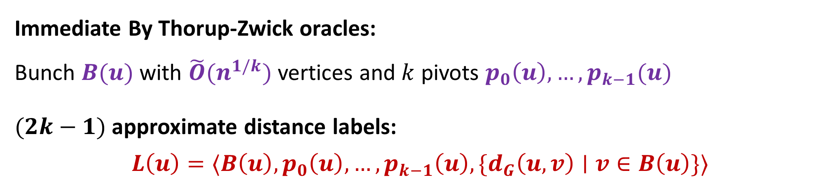
Approximate Labeling Scheme for Weighted Graphs
$t$-approximate labeling scheme $〈L,D〉:$ $D\left(L\left(u\right), L\left(v\right)\right)∈[ d_{G}\left(u,v\right), t⋅d_{G}\left(u,v\right)]$
Immediate By Thorup-Zwick oracles:
Bunch $B(u)$ with $\tilde{O}(n^{1/k})$ vertices and $k$ pivots $p_{0}\left(u\right),…,p_{k−1}(u)$
$(2k−1)$ approximate distance labels:
$$L\left(u\right)=〈B\left(u\right),p_{0}\left(u\right),…,p_{k−1}\left(u\right), \{d_{G}\left(u,v\right)∣v∈B\left(u\right)\}〉$$
Label size: $\tilde{O}(n^{1/k})$ bits
For stretch $<3: Ω(n)$ bits [GPPR01]

Slide 15
Bunches
A₀= A₁= A₂=
p₂(v)
v
p₁(v)
$$B_{i}\left(v\right)≔\{ w∈A_{i}−A_{i+1}∣d\left(v,w\right)<{d(v,p}_{i+1}\left(v\right))\}$$
*Slide taken from
Uri Zwick presentation

Slide 16
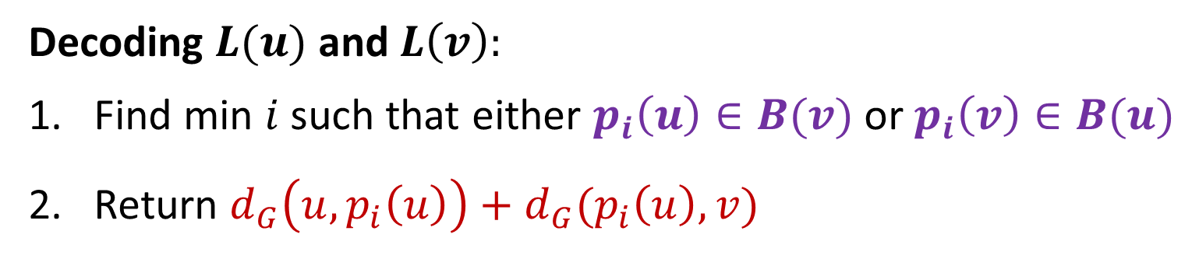



Approximate Labeling Scheme for Weighted Graphs
$$L\left(u\right)=〈B\left(u\right),p_{0}\left(u\right),…,p_{k−1}\left(u\right), \{d_{G}\left(u,v\right)∣v∈B\left(u\right)\}〉$$
Decoding $L(u)$ and $L\left(v\right):$
Find min $i$ such that either $p_{i}\left(u\right)∈B(v)$ or $p_{i}\left(v\right)∈B(u)$
Return $d_{G}\left(u,p_{i}\left(u\right)\right)+d_{G}(p_{i}\left(u\right), v)$
$$p_{i}(u)$$
$$v$$
$$u$$

Slide 17





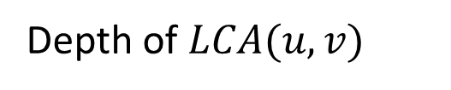




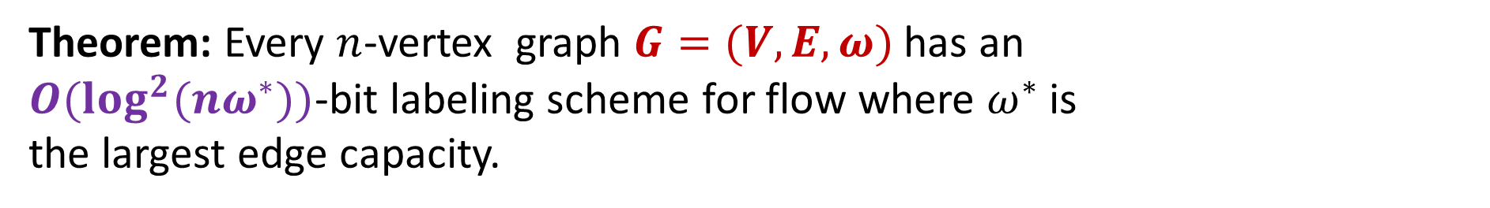




Labeling Scheme for Flow and Connectivity
Graph $G=(V,E,ω)$ where $ω:E→R$ capacity (edge multiplicity)
$Flow\left(u,v\right)≔$maximum number of edge-disjoint $u$-$v$paths
$$1$$
$$1$$
Theorem: Every $n$-vertex graph $G=(V,E,ω)$ has an
$O(\log^{2}{(nω^{∗}))}$-bit labeling scheme for flow where $ω^{∗}$is
the largest edge capacity.
$$2$$
$$5$$
$$1$$
$$3$$
$$4$$
$$1$$
$$5$$
Tool: Sep-Level labeling scheme for trees with $O(\log^{2}{n)}$ bits
$$5$$
$$5$$
$$6$$
Depth of $LCA(u,v)$

Slide 18

Labeling Scheme for Flow and Connectivity
``$x$ and $y$ admit a flow at least $k$” is an equivalence relation
Lemma: The relation $R_{k}=\{〈x,y〉∣x,y∈V, flow\left(x,y\right)≥k\}$ is an equivalence relation. E.g., $〈x,y〉,〈x,z〉∈R_{k}$ then $〈z,y〉∈R_{k}$
$R_{k}$ defines a collection of equivalence classes on V: $ℂ_{k}=\{C_{k}^{1}, C_{k}^{2}, …, C_{k}^{m_{k}}\}$ s.t:
$C_{k}^{i}∩C_{k}^{j}=∅$ and ${\bigcup_{i}{C_{k}^{i}}=V}_{}^{}$

Slide 19



















Labeling Scheme for Flow and Connectivity
$R_{k}$ defines a collection of equivalence classes on V: $ℂ_{k}=\{C_{k}^{1}, C_{k}^{2}, …, C_{k}^{m_{k}}\}$
Observation: $ℂ_{k}$ is a refinement of $ℂ_{k−1}$
$$ℂ_{1}=V$$
$$ℂ_{2}=\left\{1\right\}, \left\{2,3,4,5,6\right\}$$
$$ℂ_{3}=\left\{1\right\}, \left\{2,3\right\}, \{4,5,6\}$$
$$1$$
$$1$$
$$1,2,…,6$$
1
$$2$$
$$5$$
$$1$$
$$1$$
$$2,…,6$$
2
$$3$$
$$4$$
$$1$$
$$5$$
$$5$$
$$1$$
$$2,3$$
$$4,5,6$$
3
$$5$$
$$6$$

Slide 20
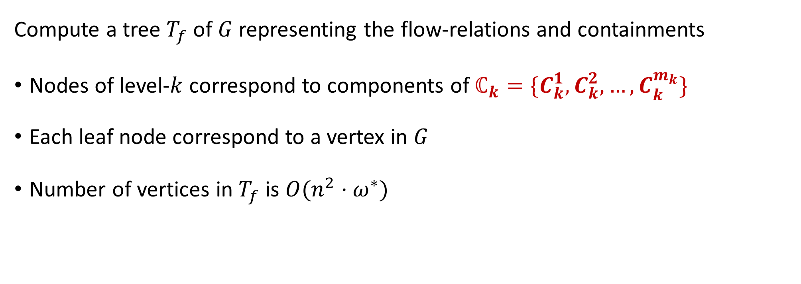
Labeling Scheme for Flow and Connectivity
Compute a tree $T_{f}$ of $G$ representing the flow-relations and containments
Nodes of level-$k$ correspond to components of $ℂ_{k}=\{C_{k}^{1}, C_{k}^{2}, …, C_{k}^{m_{k}}\}$
Each leaf node correspond to a vertex in $G$
Number of vertices in $T_{f}$ is $O(n^{2}⋅ω^{∗})$

Slide 21

















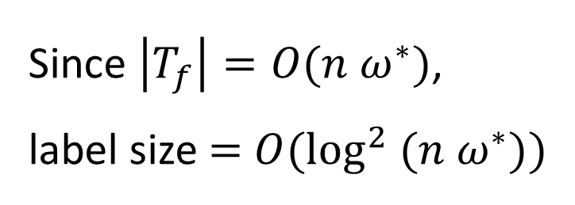













Level
$$Flow_{G}\left(u,v\right)=SepLeve{l_{T}}_{f}\left(ℓ\left(u\right), ℓ\left(v\right)\right)+1$$
$$1,2,…,6$$
1
Leaf node in $T_{f}$ that
corresponds to $u$
$$1$$
$$2,…,6$$
2
$$1$$
$$1$$
$$2,3$$
$$4,5,6$$
3
$$2$$
$$5$$
$$1$$
$$2,3$$
$$4,5,6$$
4
Since $\left|T_{f}\right|=O(n ω^{∗})$,
label size $=$ $O(\log^{2} (n ω^{∗}))$
$$3$$
$$4$$
$$1$$
$$5$$
$$5$$
$$2,3$$
$$4,5,6$$
5
$$5$$
$$6$$
6
$$2,3$$
$$4,5$$
$$6$$
7
$$2$$
$$3$$
$$4$$
$$5$$
$$6$$

Slide 22

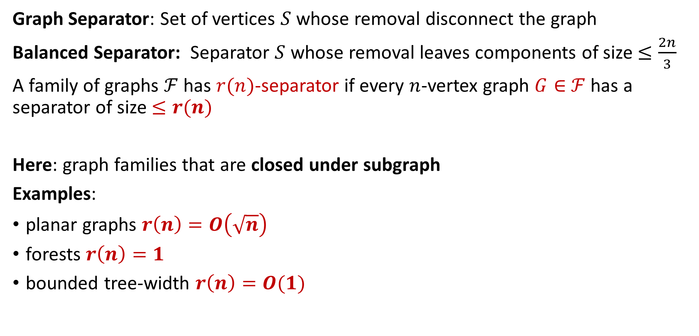
Distance Labeling and Separators
Graph Separator: Set of vertices $S$ whose removal disconnect the graph
Balanced Separator: Separator $S$ whose removal leaves components of size $≤\frac{2n}{3}$
A family of graphs $ℱ$ has $r(n)$-separator if every $n$-vertex graph $G∈$ $ℱ$ has a separator of size $≤r(n)$
Here: graph families that are closed under subgraph
Examples:
planar graphs $r\left(n\right)=O\left(\sqrt{n}\right)$
forests $r\left(n\right)=1$
bounded tree-width $r\left(n\right)=O(1)$
$$S$$

Slide 23
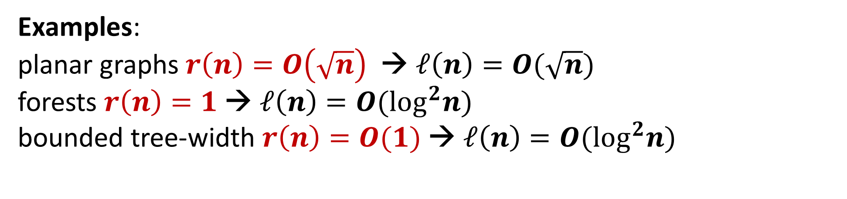
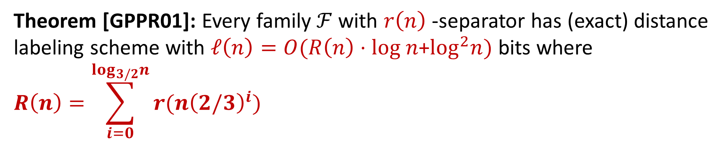

Distance Labeling and Separators
Theorem [GPPR01]: Every family $ℱ$ with $r\left(n\right)$-separator has (exact) distance labeling scheme with $ℓ\left(n\right)=O(R\left(n\right)⋅log n$+$\log^{2}n)$ bits where
$$R\left(n\right)=\sum_{i=0}^{\log_{3/2}n}{r(n{\left(2/3\right)}^{i})}$$
Open problem for
planar graphs:
$$ℓ\left(n\right)=Ω(n^{1/3})$$
Examples:
planar graphs $r\left(n\right)=O\left(\sqrt{n}\right)$ → $ℓ\left(n\right)=O(\sqrt{n})$
forests $r\left(n\right)=1$ → $ℓ\left(n\right)=O(\log^{2}n)$
bounded tree-width $r\left(n\right)=O(1)$ → $ℓ\left(n\right)=O(\log^{2}n)$

Slide 24

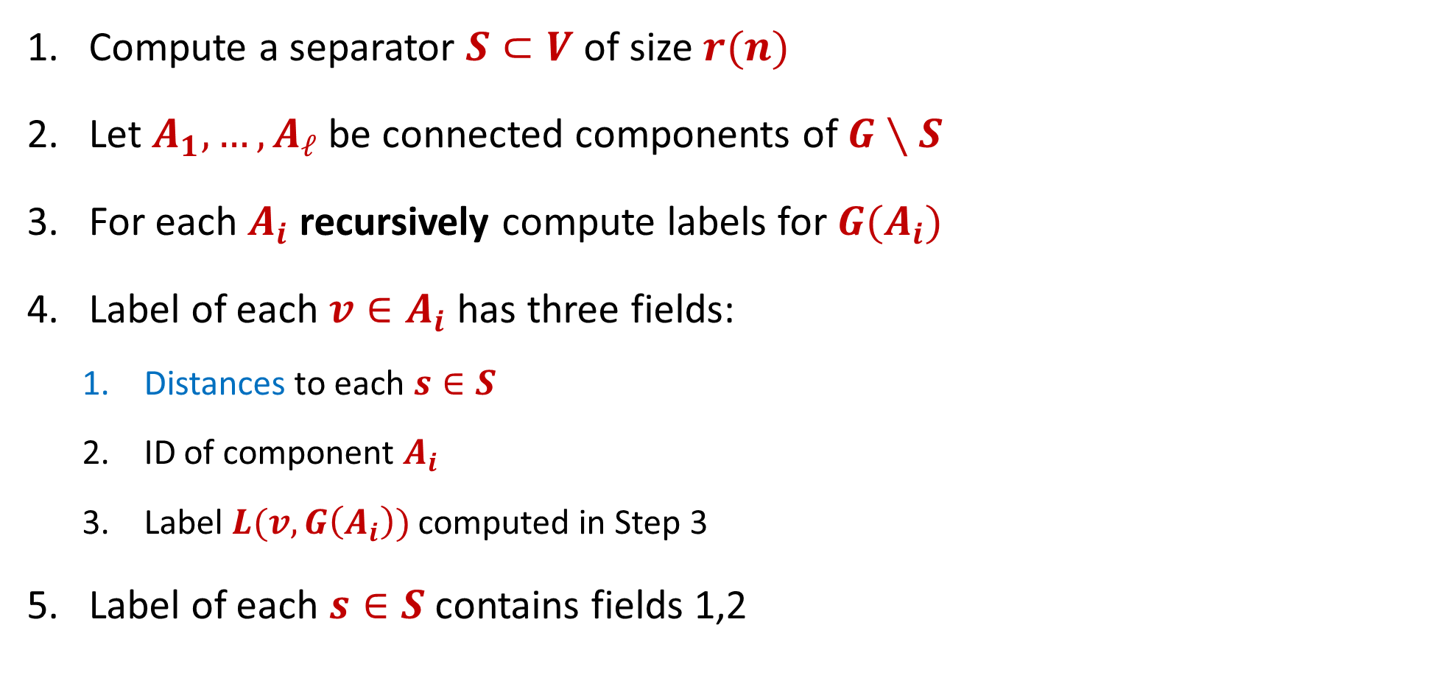

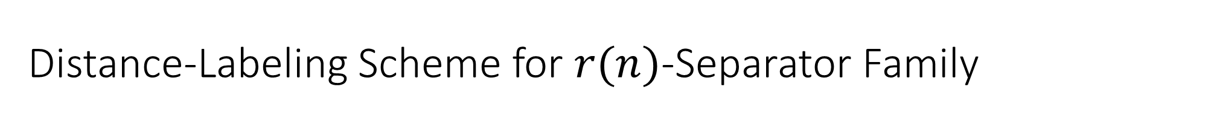




Distance-Labeling Scheme for $r(n)$-Separator Family
Compute a separator $S⊂V$ of size $r(n)$
Let $A_{1},…, A_{ℓ}$ be connected components of $G∖S$
For each $A_{i}$ recursively compute labels for $G(A_{i})$
Label of each $v∈A_{i}$ has three fields:
Distances to each $s∈S$
ID of component $A_{i}$
Label $L(v, G\left(A_{i}\right))$ computed in Step 3
Label of each $s∈S$ contains fields 1,2
$$A_{1}$$
$$A_{2}$$
$$A_{1,1}$$
$$S′$$
$$S$$
$$A_{1,2}$$

Slide 25
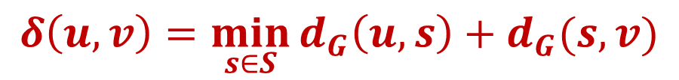

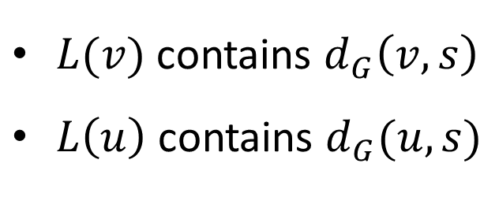



Distance-Labeling Scheme for $r(n)$-Separator Family
Case 1: the $u$-$v$ shortest path goes through $s∈S$
$$A_{1}$$
$$S$$
$$A_{2}$$
$L(v)$ contains $d_{G}\left(v,s\right)$
$L\left(u\right)$ contains $d_{G}(u,s)$
$$δ\left(u,v\right)=\min_{s∈S}{d_{G}\left(u,s\right)+d_{G}(s,v)}$$

Slide 26
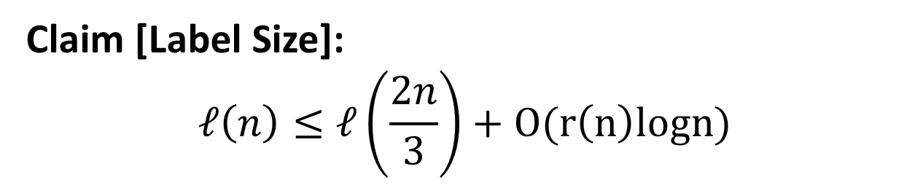
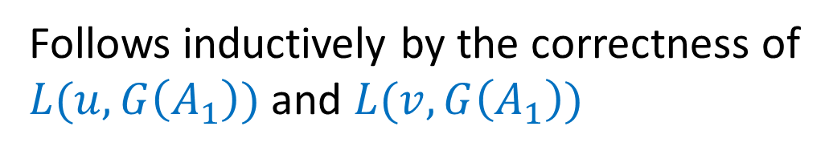



Distance-Labeling Scheme for $r(n)$-Separator Family
Case 2: the $u$-$v$ shortest path does not go through $s∈S$
$$A_{1}$$
$$S$$
$$A_{2}$$
Follows inductively by the correctness of
$L(u,G\left(A_{1}\right))$ and $L(v,G\left(A_{1}\right))$
Claim [Label Size]:
$$ℓ\left(n\right)≤ℓ\left(\frac{2n}{3}\right)+O(r\left(n\right)logn)$$

