Slide 1
Succinct Graph Structures and Their Applications Spring 2020
Class 7: Cut Sparsifiers

Slide 2

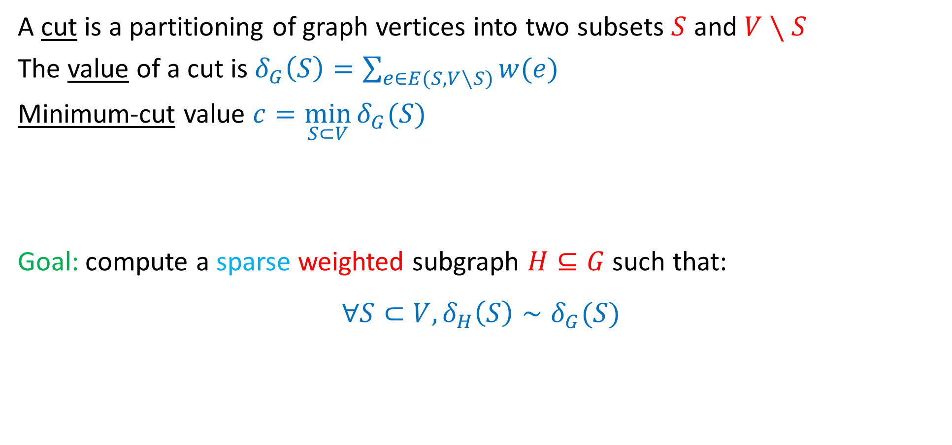

Cut Sparsifiers
A cut is a partitioning of graph vertices into two subsets $S$ and $V∖S$
The value of a cut is $δ_{G}\left(S\right)=\sum_{e∈E(S,V∖S)}{w(e)}$
Minimum-cut value $c=\min_{S⊂V}{δ_{G}(S)}$
Goal: compute a sparse weighted subgraph $H⊆G$ such that:
$$∀S⊂V, δ_{H}\left(S\right)∼δ_{G}(S)$$
$$S$$
$$V\backslash S$$

Slide 3
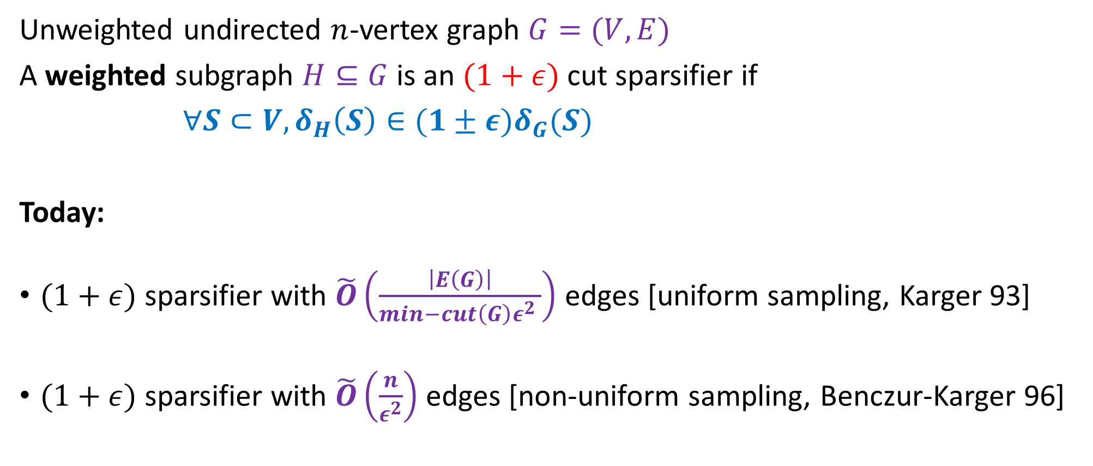
Cut Sparsifiers
Unweighted undirected $n$-vertex graph $G=(V,E)$
A weighted subgraph $H⊆G$ is an $(1+ε)$ cut sparsifier if
$∀S⊂V, δ_{H}\left(S\right)∈(1±ε)δ_{G}(S)$
Today:
$(1+ε)$ sparsifier with $\tilde{O}\left(\frac{\left|E\left(G\right)\right|}{min−cut\left(G\right)ε^{2} }\right)$ edges [uniform sampling, Karger 93]
$(1+ε)$ sparsifier with $\tilde{O}\left(\frac{n}{ε^{2}}\right)$ edges [non-uniform sampling, Benczur-Karger 96]

Slide 4

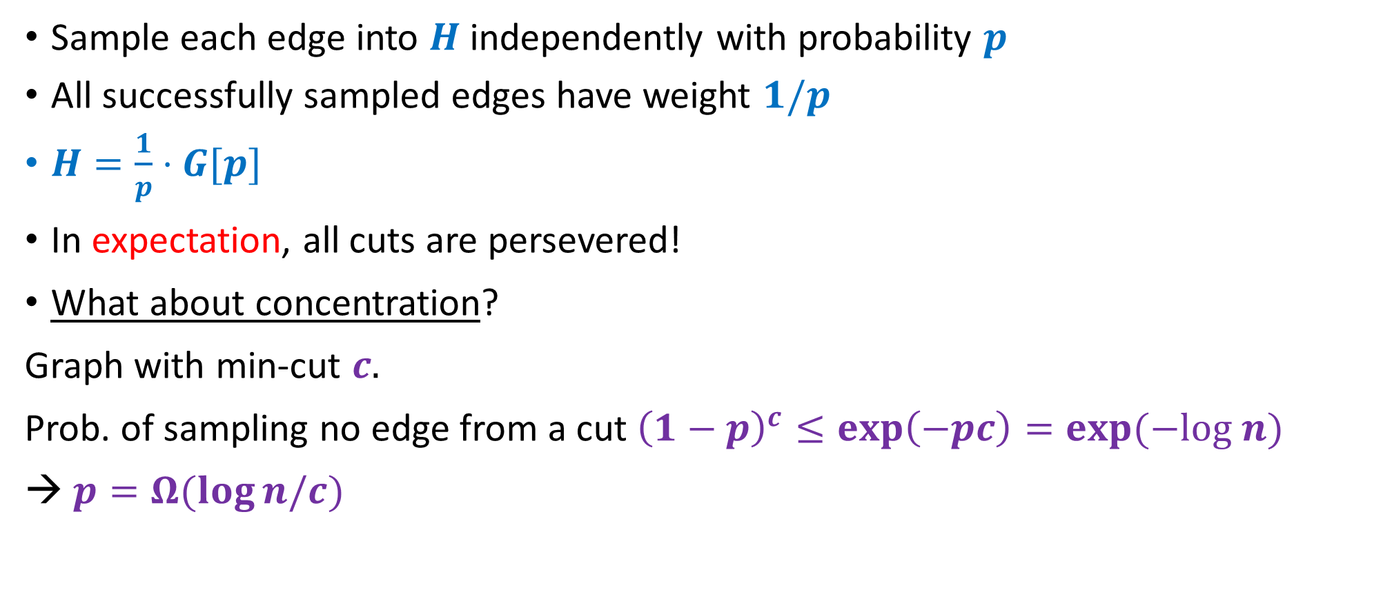

First Attempt
Sample each edge into $H$ independently with probability $p$
All successfully sampled edges have weight $1/p$
$H=\frac{1}{p}⋅G[p]$
In expectation, all cuts are persevered!
What about concentration?
Graph with min-cut $c.$
Prob. of sampling no edge from a cut ${\left(1−p\right)}^{c}≤\exp\left(−pc\right)=\exp{(−log n)}$
→ $p=Ω(\log{n/c)}$
$$S$$
$$V\backslash S$$

Slide 5
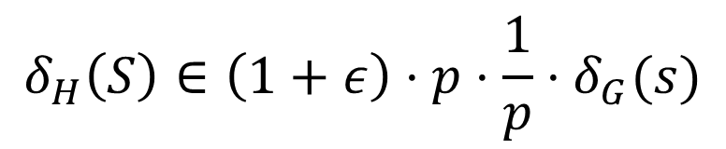
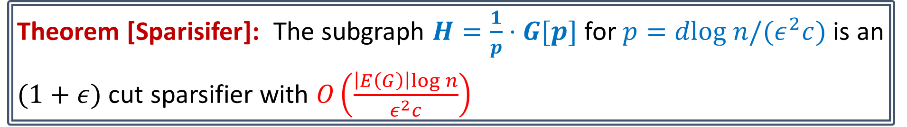

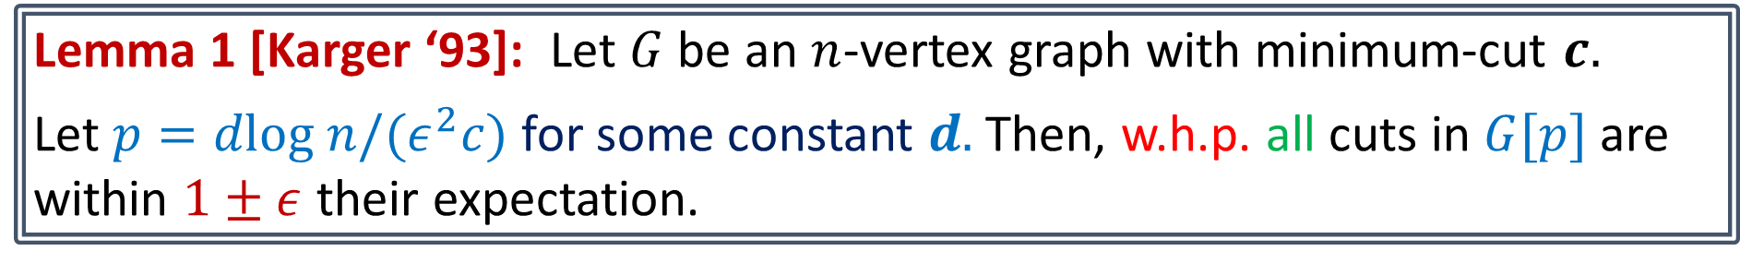


Cut Sparsifiers via Uniform Sampling
Lemma 1 [Karger ‘93]: Let $G$ be an $n$-vertex graph with minimum-cut $c.$
Let $p=dlog n/(ε^{2}c)$ for some constant $d.$Then, w.h.p. all cuts in $G[p]$ are within $1±ε$ their expectation.
Theorem [Sparisifer]: The subgraph $H=\frac{1}{p}⋅G[p]$ for $p=dlog n/(ε^{2}c)$ is an
$(1+ε)$ cut sparsifier with $O\left(\frac{\left|E\left(G\right)\right|log n}{ε^{2}c}\right)$
$$δ_{G\left[p\right]}\left(S\right)∈\left(1+ε\right)⋅p⋅δ_{G}(s)$$
$$S$$
$$V∖S$$
$$δ_{H}\left(S\right)∈\left(1+ε\right)⋅p⋅\frac{1}{p}⋅δ_{G}(s)$$

Slide 6
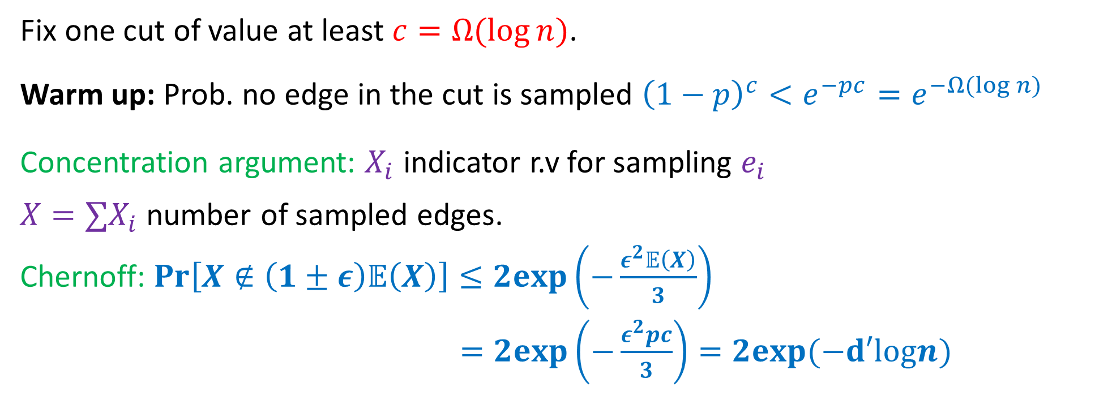
Lemma 1 [Karger ‘93]: Let $G$ be an $n$-vertex graph with minimum-cut $c.$
Let $p=dlog n/(ε^{2}c)$. Then, w.h.p. all cuts in $G[p]$ are within $1±ε$ their expectation.
Fix one cut of value at least $c=Ω(\log{n)}$.
Warm up: Prob. no edge in the cut is sampled ${\left(1−p\right)}^{c}<e^{−pc}=e^{−Ω(log n)}$
Concentration argument: $X_{i}$ indicator r.v for sampling $e_{i}$
$X=∑X_{i}$ number of sampled edges.
Chernoff: $\operatorname{Pr}\left[X∉\left(1±ε\right)𝔼\left(X\right)\right]≤2exp\left(−\frac{ε^{2}𝔼\left(X\right)}{3}\right)$
$=2exp\left(−\frac{ε^{2}pc}{3}\right)=2exp(−d′logn)$
W.h.p concentration holds for one cut, but there are $Ω\left(2^{n}\right)$ many cuts

Slide 7


Key Cut Lemma[Karger ‘93]: $∀α≥1$, there are at most $n^{2α}$ cuts of size $≤α⋅c$
Fix a cut of size $α⋅c$
Chernoff: $\operatorname{Pr}\left[X∉\left(1±ε\right)𝔼\left(X\right)\right]≤2exp\left(−\frac{ε^{2}𝔼\left(x\right)}{3}\right)$
$=2exp\left(−\frac{ε^{2}p⋅α⋅c}{3}\right)=2exp\left(−d′⋅α⋅logn\right)$
$=1/n^{Ω(α)}$
W.h.p. all cuts of size $αc$ are concentrated
$O\left(n\right)$ classes of cuts with values $[αc, \left(α+1\right)c]$ for every $α∈\left[1,\frac{n}{c}\right]$
W.h.p. all cuts are concentrated

Slide 8



Limitations
$\left|E\left(H\right)\right|=O(|\frac{E\left(G\right)logn}{min−cut(G)}|)$
Not useful for dense graphs with small cuts
Approach: sample more aggressively in highly-connected regimes
$$k_{n/2}$$
$$k_{n/2}$$

Slide 9
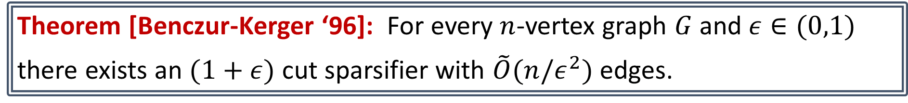
Cut Sparsifiers via Non-Uniform Sampling
Theorem [Benczur-Kerger ‘96]: For every $n$-vertex graph $G$ and $ε∈(0,1)$
there exists an $(1+ε)$ cut sparsifier with $\tilde{O}(n/ε^{2})$ edges.

Slide 10
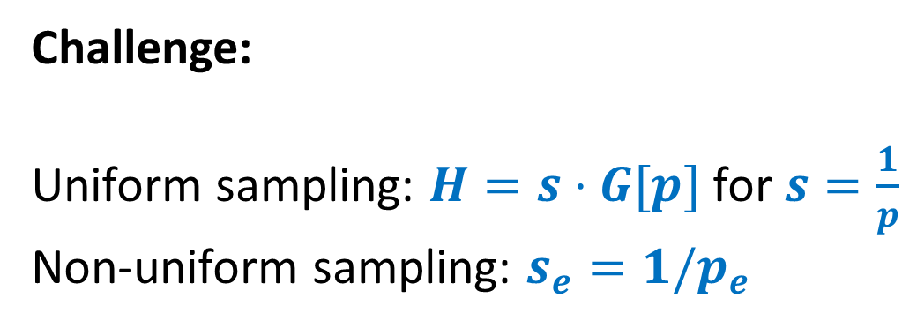
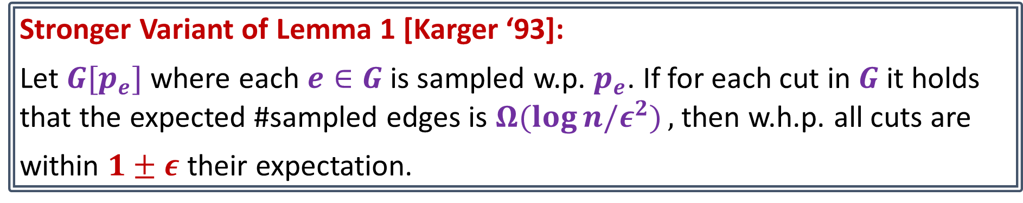
Towards Sparser Sparsifiers with Non-Unifrom Sampling
Stronger Variant of Lemma 1 [Karger ‘93]:
Let $G[p_{e}]$ where each $e∈G$ is sampled w.p. $p_{e}$. If for each cut in $G$ it holds that the expected #sampled edges is $Ω(\log{n/ε^{2})},$ then w.h.p. all cuts are
within $1±ε$ their expectation.
Challenge:
Uniform sampling: $H=s⋅G[p]$ for $s=\frac{1}{p}$
Non-uniform sampling: $s_{e}=1/p_{e}$

Slide 11
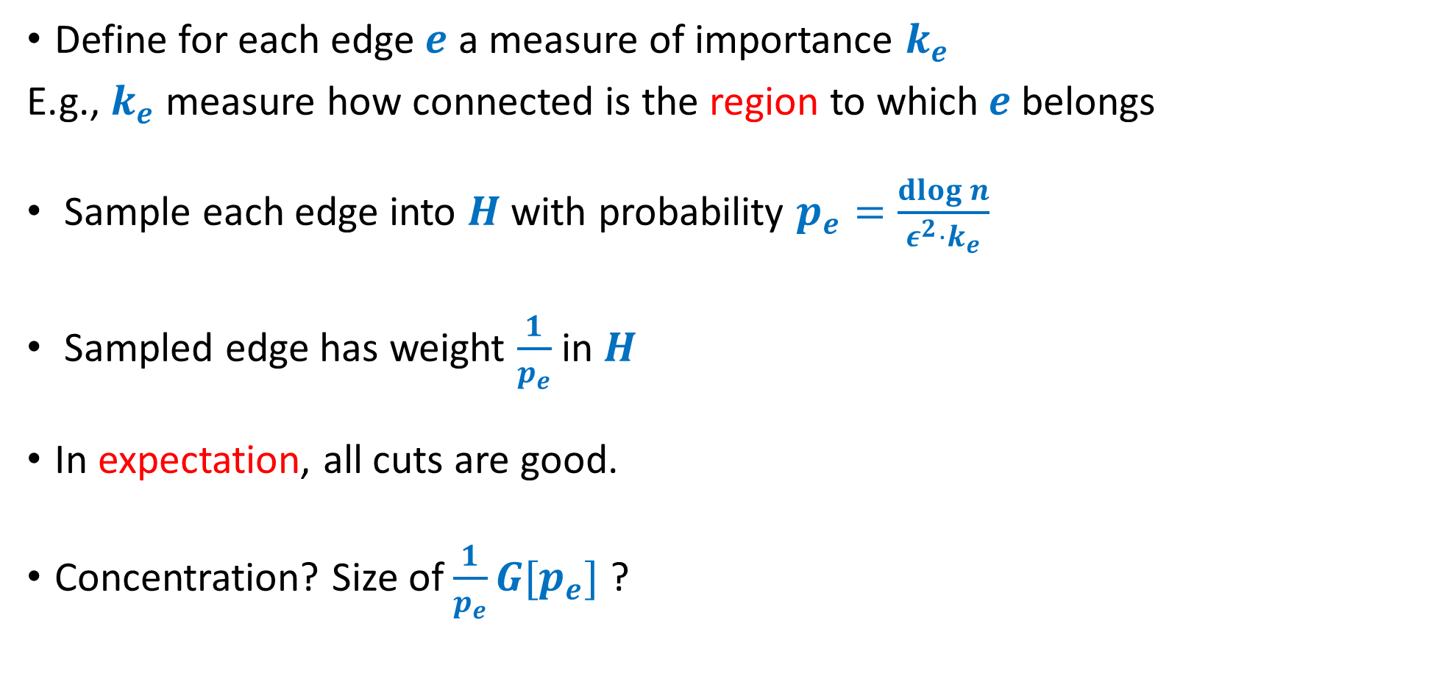
The High-Level Approach
Define for each edge $e$ a measure of importance $k_{e}$
E.g., $k_{e}$ measure how connected is the region to which$e$belongs
Sample each edge into $H$with probability $p_{e}=\frac{\operatorname{dlog}{n}}{ε^{2}⋅k_{e}}$
Sampled edge has weight $\frac{1}{p_{e}}$in $H$
In expectation, all cuts are good.
Concentration? Size of $\frac{1}{p_{e}}G[p_{e}]$ ?

Slide 12
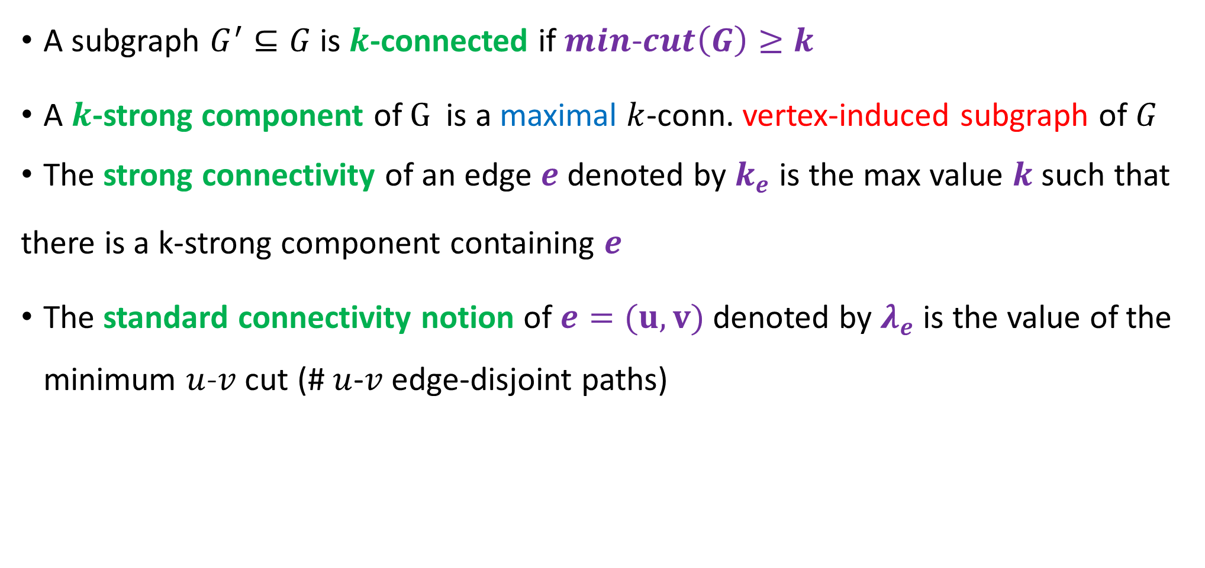


Connectivity Definitions
A subgraph $G^{′}⊆G$ is $k$-connected if $min$-$cut\left(G\right)≥k$
A $k$-strong component of $G$is a maximal $k$-conn. vertex-induced subgraph of $G$
The strong connectivity of an edge $e$ denoted by $k_{e}$ is the max value $k$ such that
there is a k-strong component containing $e$
The standard connectivity notion of $e=(u,v)$ denoted by $λ_{e}$ is the value of the minimum $u$-$v$ cut (#$u$-$v$ edge-disjoint paths)
$$k_{n/2}$$
$$k_{n/2}$$

Slide 13

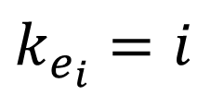





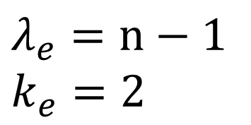
Examples
$$v$$
$$u$$
$$e$$
$$e_{1}$$
$$e_{2}$$
$$λ_{e}=n−1$$
$$k_{e}=2$$
$$e_{3}$$
$$k_{e_{i}}=i$$

Slide 14


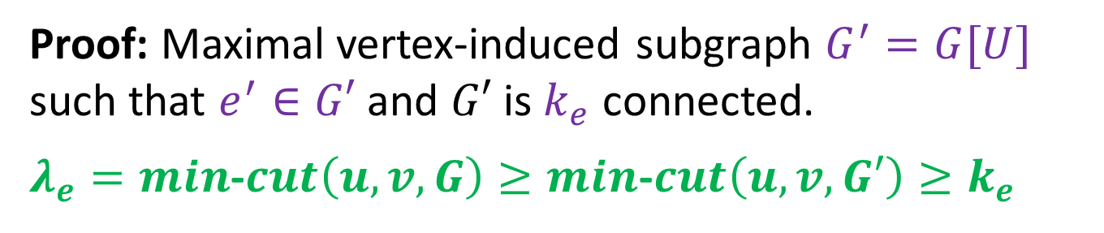



Observations
$$v$$
$$u$$
$$e$$
Obs. 1: $k_{e}≤λ_{e}$
Obs. 2: If $e$ belongs to cut in $G$ of size $k$then $k_{e}≤k$
Obs. 3: If $e$ belongs to the min-cut then $k_{e}=λ_{e}$
Proof: Maximal vertex-induced subgraph $G^{′}=G[U]$
such that $e^{′}∈G′$ and $G′$ is $k_{e}$ connected.
$λ_{e}=min$-$cut\left(u,v,G\right)≥min$-$cut\left(u,v,G′\right)≥k_{e}$
Proof: $k_{e}≤λ_{e}≤k$

Slide 15

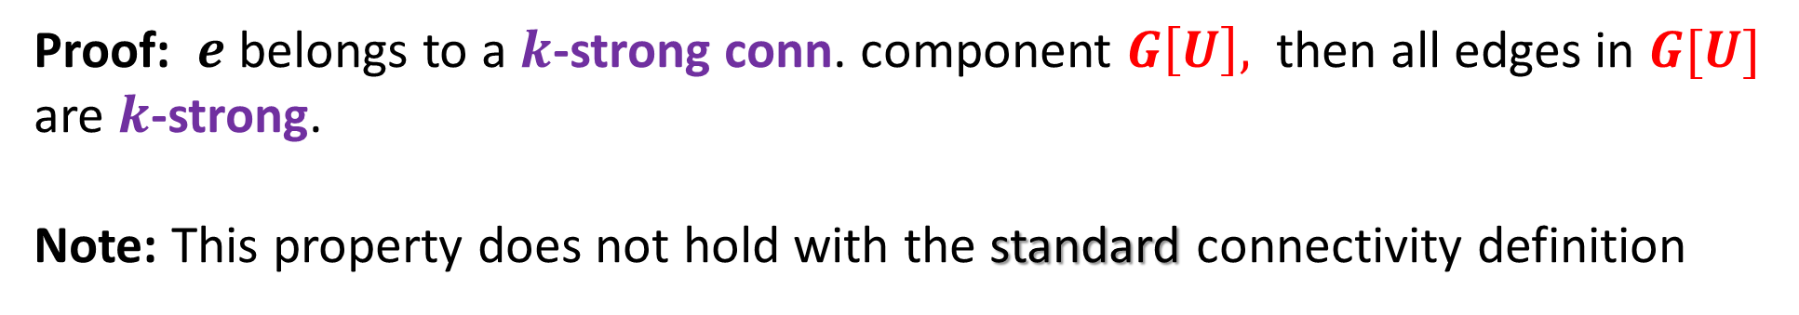
Key Property of Strong Connectivity
Def: An edge $e$ is $k$-strong if $k_{e}≥k,$ otherwise it is $k$-weak
Lemma 2 [Benczur-Karger ‘96]: Deleting $k$-weak edges does not change the strength of any of $k$-strong edges
Proof: $e$ belongs to a $k$-strong conn. component $G\left[U\right],$ then all edges in $G[U]$
are $k$-strong.
Note: This property does not hold with the standard connectivity definition

Slide 16


$$u$$
$$e$$
$$v$$
$$e$$

Slide 17
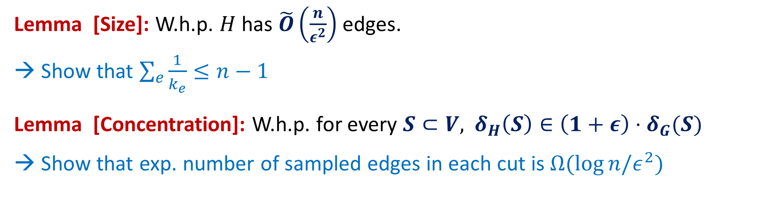
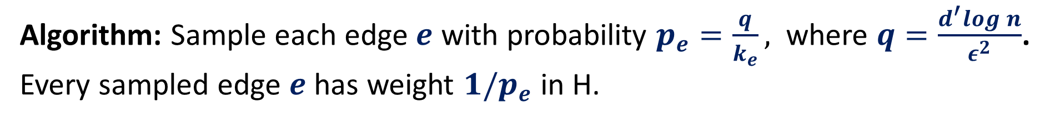
Improved Cut Sparsifier
Algorithm: Sample each edge $e$ with probability $p_{e}=\frac{q}{k_{e}},$ where $q=\frac{d^{′}log{n}}{ε^{2}}$.
Every sampled edge $e$ has weight $1/p_{e}$ in H.
Lemma [Size]: W.h.p. $H$ has $\tilde{O}\left(\frac{n}{ε^{2}}\right)$ edges.
Show that $\sum_{e}{\frac{1}{k_{e}}≤n−1}$
Lemma [Concentration]: W.h.p. for every $S⊂V,$ $δ_{H}\left(S\right)∈\left(1+ε\right)⋅δ_{G}(S)$
→ Show that exp. number of sampled edges in each cut is $Ω(\log{n/ε^{2})}$

Slide 18


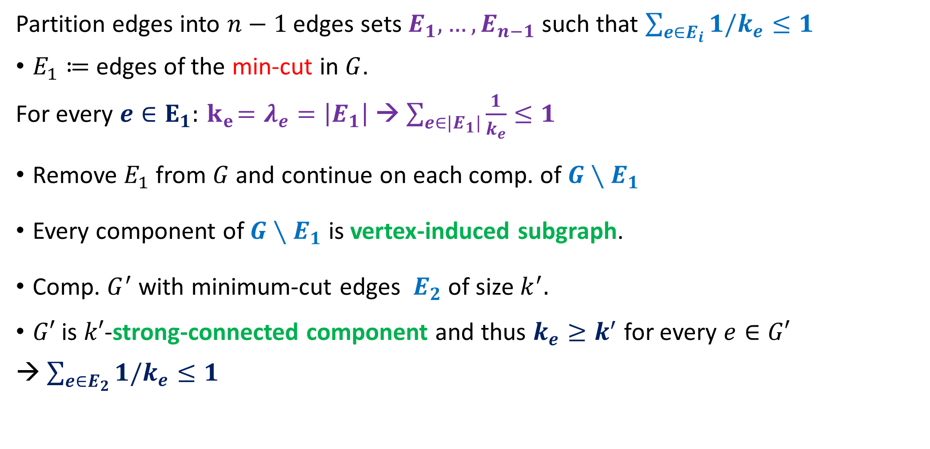
Lemma: $\sum_{e}{\frac{1}{k_{e}}≤n−1}$
Partition edges into $n−1$ edges sets $E_{1},…,E_{n−1}$such that $\sum_{e∈E_{i}}{1/k_{e}≤1}$
$E_{1}≔$edges of the min-cut in $G$.
For every $e∈E_{1}:{ k}_{e}=λ_{e}=\left|E_{1}\right|$→ $\sum_{e∈|E_{1}|}{\frac{1}{k_{e}}≤1}$
Remove $E_{1}$ from $G$ and continue on each comp. of $G∖E_{1}$
Every component of $G∖E_{1}$ is vertex-induced subgraph.
Comp. $G^{′}$with minimum-cut edges $E_{2}$ of size $k^{′}.$
$G′$ is $k′$-strong-connected component and thus $k_{e}≥k^{′}$ for every $e∈G′$
→ $\sum_{e∈E_{2}}{1/k_{e}≤1}$
$$e$$

Slide 19
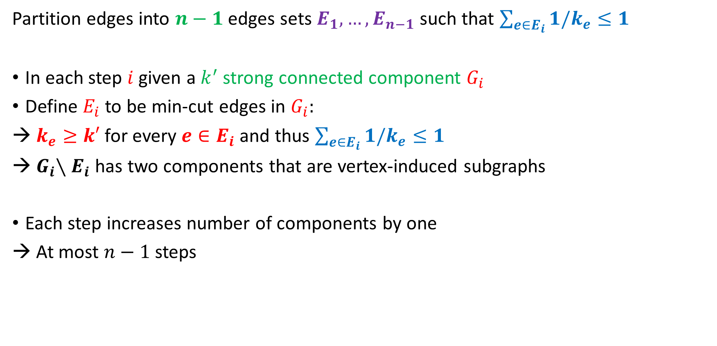

Lemma: $\sum_{e}{\frac{1}{k_{e}}≤n−1}$
Partition edges into $n−1$ edges sets $E_{1},…,E_{n−1}$such that $\sum_{e∈E_{i}}{1/k_{e}≤1}$
In each step $i$ given a $k^{′}$strong connected component $G_{i}$
Define $E_{i}$ to be min-cut edges in $G_{i}$:
$k_{e}≥k′$ for every $e∈E_{i}$ and thus $\sum_{e∈E_{i}}{1/k_{e}≤1}$
${ G}_{i}∖E_{i}$ has two components that are vertex-induced subgraphs
Each step increases number of components by one
→ At most $n−1$ steps

Slide 20
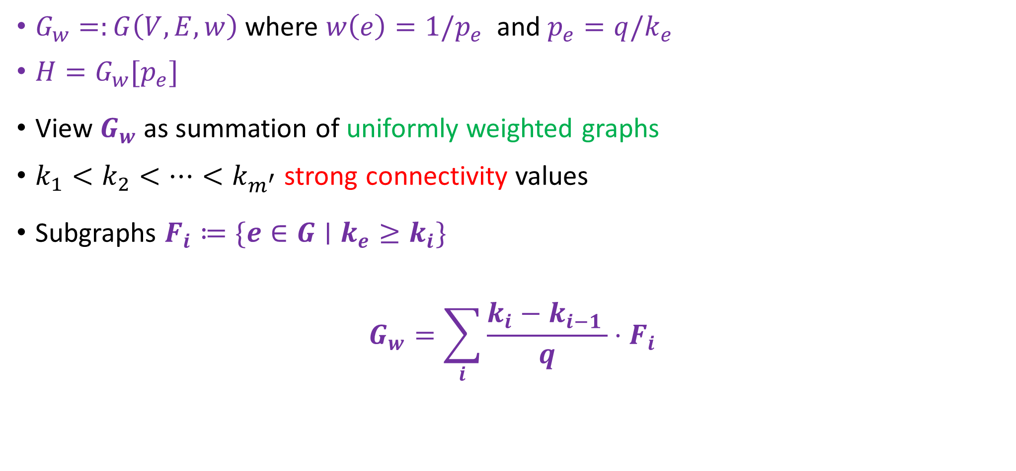
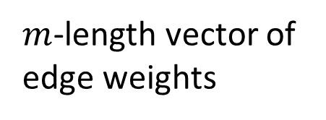
Cut Analysis: Every Sampled Cut is Large in Exp.
$G_{w}=:G\left(V,E,w\right)$where $w\left(e\right)=1/p_{e}$ and $p_{e}=q/k_{e}$
$H=G_{w}[p_{e}]$
View $G_{w}$ as summation of uniformly weighted graphs
$k_{1}<k_{2}<…<k_{m^{′}}$ strong connectivity values
Subgraphs $F_{i}≔\{e∈G∣k_{e}≥k_{i}\}$
$$G_{w}=\sum_{i}{\frac{k_{i}−k_{i−1 }}{q}⋅F_{i}}$$
$m$-length vector of
edge weights

Slide 21
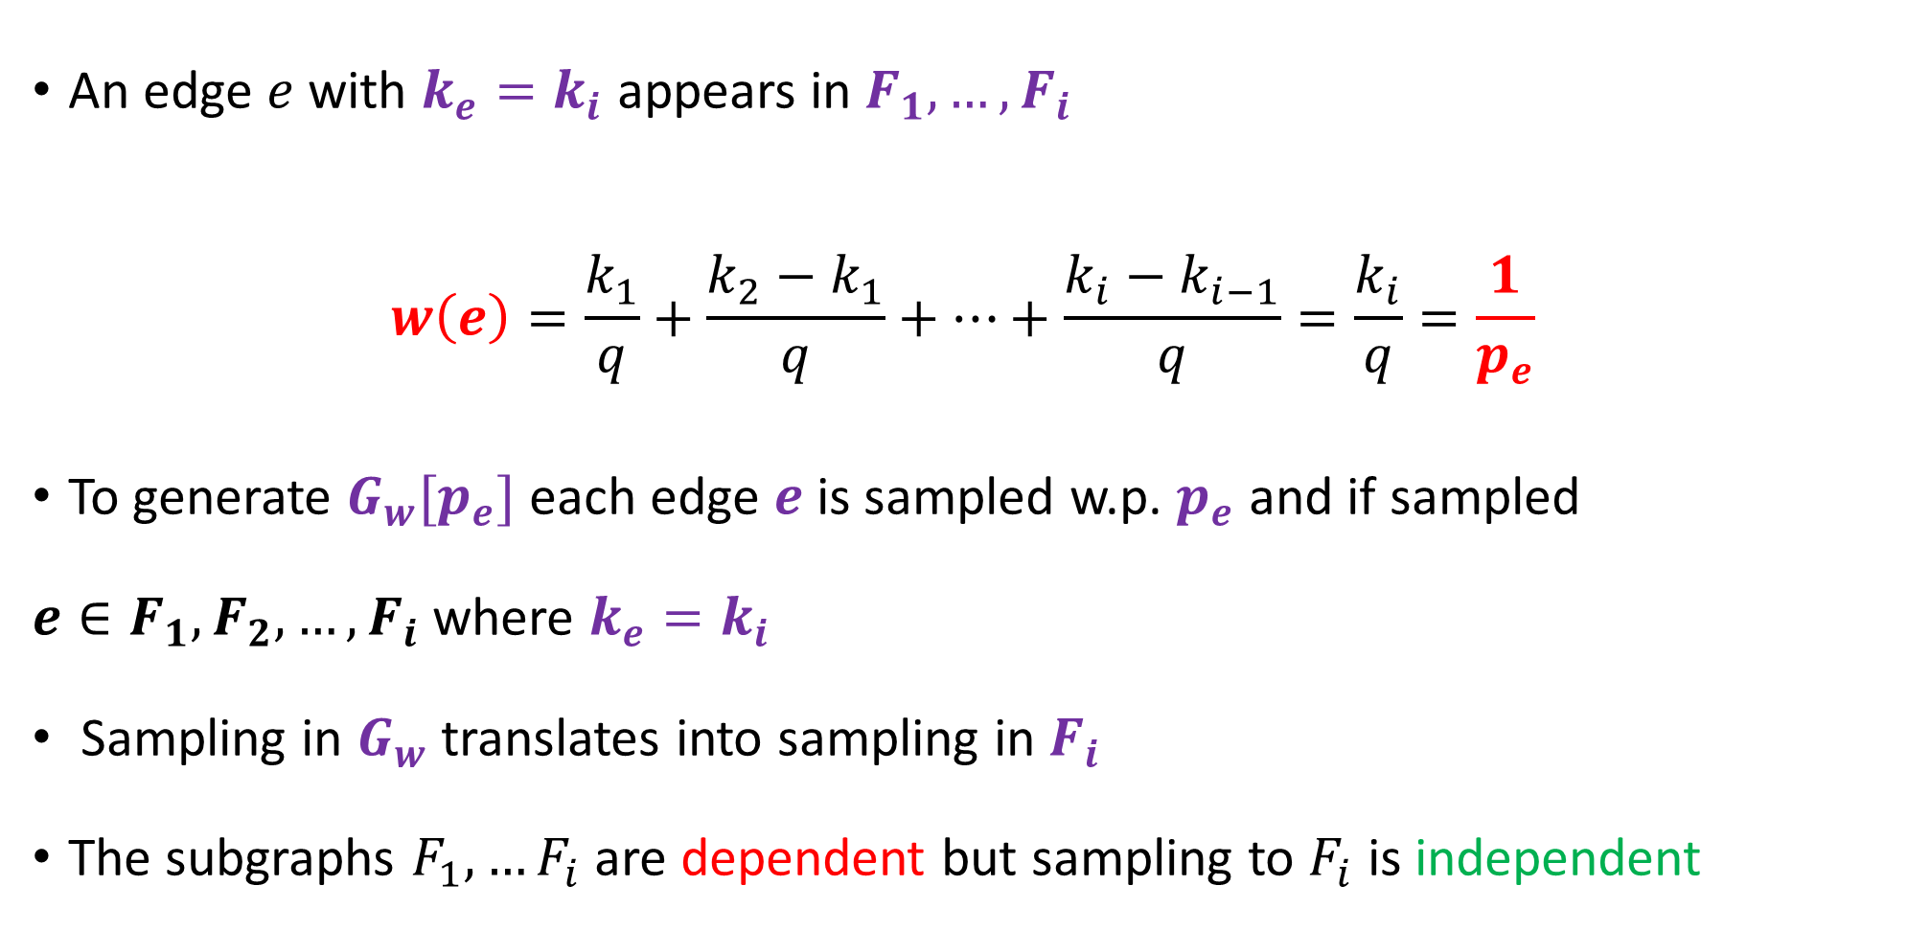
An edge $e$ with $k_{e}=k_{i}$ appears in $F_{1},…, F_{i}$
$$w\left(e\right)=\frac{k_{1}}{q}+\frac{k_{2}−k_{1}}{q}+…+\frac{{k_{i}−k}_{i−1}}{q}=\frac{k_{i}}{q}=\frac{1}{p_{e}}$$
To generate $G_{w}[p_{e}]$ each edge $e$ is sampled w.p. $p_{e}$ and if sampled
$e∈F_{1},F_{2}, …,F_{i}$ where $k_{e}=k_{i}$
Sampling in $G_{w}$ translates into sampling in $F_{i}$
The subgraphs $F_{1},…F_{i}$ are dependent but sampling to $F_{i}$ is independent

Slide 22




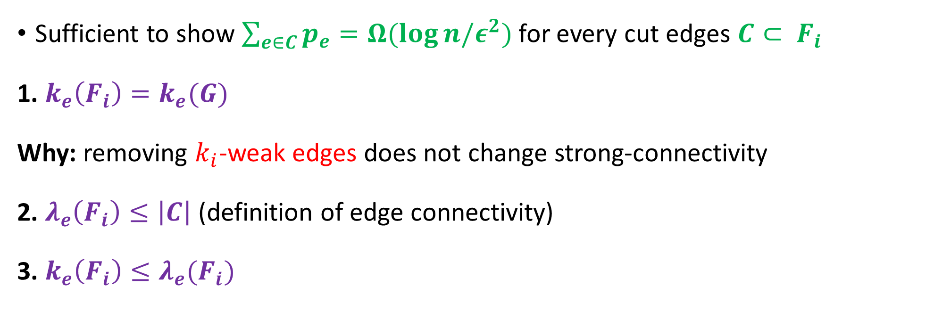
Cut Concentration in $F_{i}$
Sufficient to show $\sum_{e∈C}{p_{e}=Ω(\log{n/ε^{2})} }$for every cut edges $C{⊂ F}_{i}$
1. $k_{e}\left(F_{i}\right)=k_{e}(G)$
Why: removing $k_{i}$-weak edges does not change strong-connectivity
2. $λ_{e}\left(F_{i}\right)≤\left|C\right|$ (definition of edge connectivity)
3. $k_{e}\left(F_{i}\right)≤λ_{e}(F_{i})$
$$e$$
$$k_{e}\left(G\right)=k_{e}\left(F_{i}\right)≤λ_{e}\left(F_{i}\right)≤|C|$$
$$\sum_{e∈C}{p_{e}=\sum_{e∈C}{\frac{q}{k_{e}}≥q=Ω\left(\frac{\log{n}}{ε^{2}}\right)}}$$
$$C$$

Slide 23







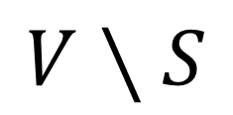


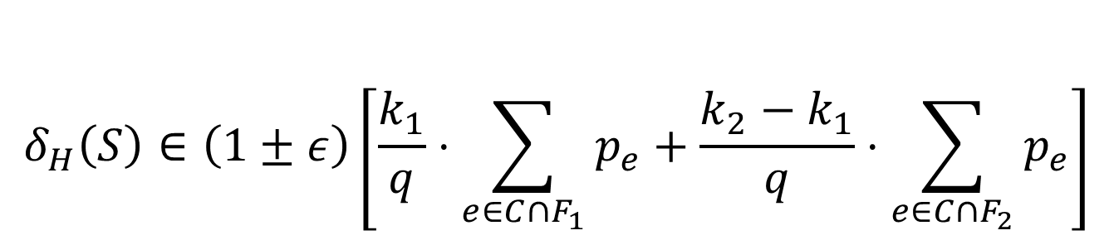
So-far: all cuts of $F_{i}$ are concentrated w.h.p.
Goal: $δ_{H}\left(S\right)∈\left(1±ε\right)δ_{G}(S)$
$$S$$
$$V∖S$$
$$k_{1}$$
$\left|C∩F_{1}\left(p_{e}\right)\right|∈\left(1±ε\right)\sum_{e∈C∩F_{1}}{p_{e}}$
$\left|C∩F_{2}\left(p_{e}\right)\right|∈\left(1±ε\right)\sum_{e∈C∩F_{2}}{p_{e}}$
$H=G_{w}\left[p_{e}\right]=\frac{k_{1}}{q}F_{1}\left[p_{e}\right]+\frac{k_{2}−k_{1}}{q}F_{2}\left[p_{e}\right]$
$$k_{1}$$
$$k_{2}$$
$$k_{2}$$
$$k_{1}$$
$$δ_{H}\left(S\right)∈\left(1±ε\right)\left[\frac{k_{1}}{q}⋅\sum_{e∈C∩F_{1}}{p_{e}}+\frac{k_{2}−k_{1}}{q}⋅\sum_{e∈C∩F_{2}}{p_{e}}\right]$$
$$C=E(S,V∖S)$$

Slide 24

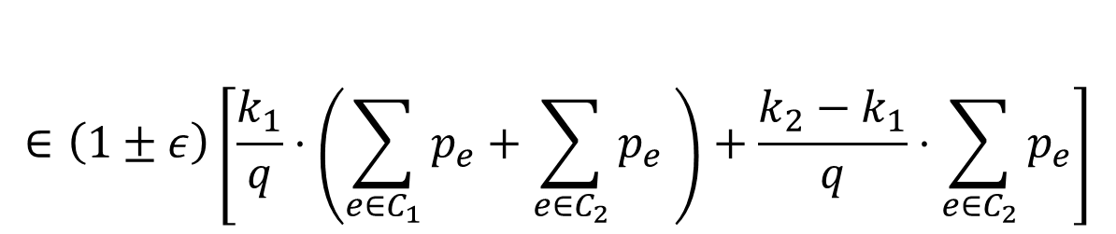

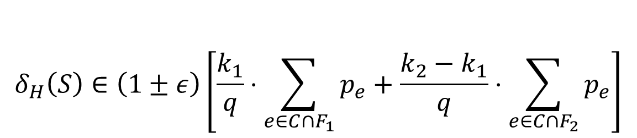

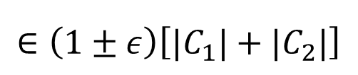
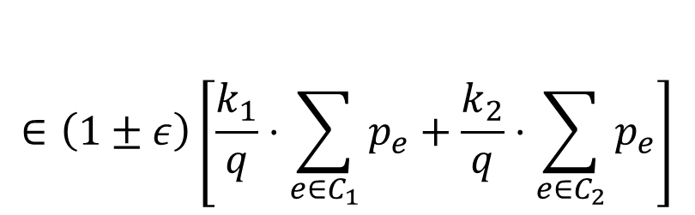
$$δ_{H}\left(S\right)∈\left(1±ε\right)\left[\frac{k_{1}}{q}⋅\sum_{e∈C∩F_{1}}{p_{e}}+\frac{k_{2}−k_{1}}{q}⋅\sum_{e∈C∩F_{2}}{p_{e}}\right]$$
$$S$$
$$V∖S$$
$$k_{1}$$
$$∈\left(1±ε\right)\left[\frac{k_{1}}{q}⋅\left(\sum_{e∈C_{1}}{p_{e}+\sum_{e∈C_{2}}{p_{e} }}\right)+\frac{k_{2}−k_{1}}{q}⋅\sum_{e∈C_{2}}{p_{e}}\right]$$
$$k_{1}$$
$$k_{2}$$
$$∈\left(1±ε\right)\left[\frac{k_{1}}{q}⋅\sum_{e∈C_{1}}{p_{e}}+\frac{k_{2}}{q}⋅\sum_{e∈C_{2}}{p_{e}}\right]$$
$$k_{2}$$
$$k_{1}$$
$$∈\left(1±ε\right)\left[|C_{1}|+|C_{2}|\right]$$
$$C=E(S,V∖S)$$
$$C_{1}=\{e∈C∣k_{e}=k_{1}\}$$
$$C_{2}=\{e∈C∣k_{e}=k_{2}\}$$

