Slide 1
Succinct Graph Structures and Their Applications Spring 2020
Class 8: Efficient Cut Algorithms

Slide 2
Efficient Cut Algorithms
Cut Counting Argument (debt from last week)
Towards linear time algorithm:
Tree Packing
Next Week: Gomory Hu

Slide 3



Cut
A cut is a partitioning of graph vertices into two subsets $S$ and $V∖S$
The value of a cut is $δ_{G}\left(S\right)=\sum_{e∈E(S,V∖S)}{w(e)}$
Minimum-cut value $c=\min_{S⊂V}{δ_{G}(S)}$
$$S$$
$$V\backslash S$$

Slide 4
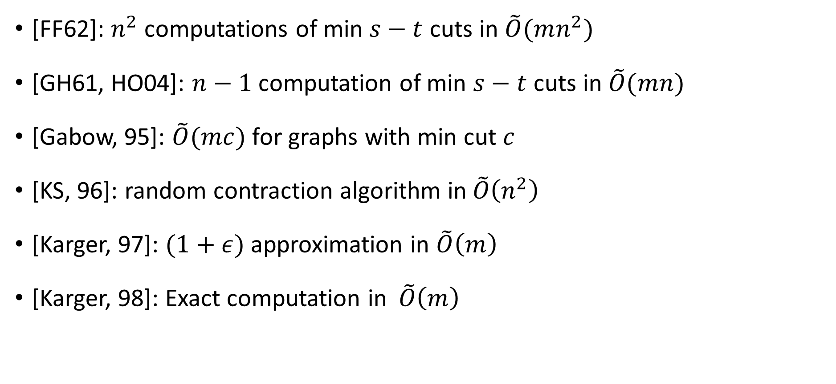
Short History of Min-Cut Algorithms
[FF62]: $n^{2}$ computations of min $s−t$ cuts in $\tilde{O}(mn^{2})$
[GH61, HO04]: $n−1$ computation of min $s−t$ cuts in $\tilde{O}(mn)$
[Gabow, 95]: $\tilde{O}(mc)$ for graphs with min cut $c$
[KS, 96]: random contraction algorithm in$\tilde{O}\left(n^{2}\right)$
[Karger, 97]: $(1+ε)$ approximation in $\tilde{O}\left(m\right)$
[Karger, 98]: Exact computation in$\tilde{O}\left(m\right)$

Slide 5
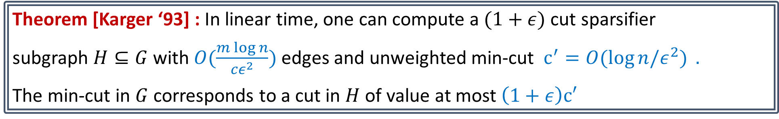
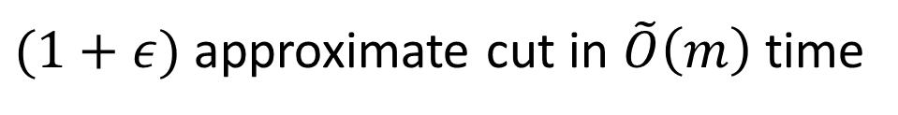
Last Week
Key Cut Lemma[Karger ‘93]: $∀α≥1$, there are at most $n^{2α}$ cuts of size $≤α⋅c$
Tight for cycles
Theorem [Karger ‘93] : In linear time, one can compute a $(1+ε)$ cut sparsifier
subgraph $H⊆G$ with$O(\frac{m\log{n}}{cε^{2}})$ edges and unweighted min-cut $c^{′}=O(\log{n/ε^{2})} .$
The min-cut in $G$ corresponds to a cut in $H$ of value at most $\left(1+ε\right)c′$
$(1+ε)$ approximate cut in $\tilde{O}\left(m\right)$ time

Slide 6




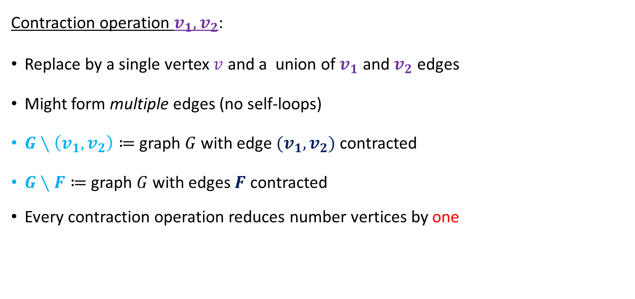




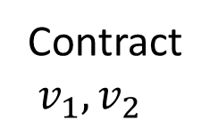

The Contraction Algorithm [Karger and Stein ’96]
$$v_{1}$$
$$v_{2}$$
Contraction operation $v_{1},v_{2}$:
Replace by a single vertex $v$ and a union of $v_{1}$ and $v_{2}$ edges
Might form multiple edges (no self-loops)
$G∖\left(v_{1},v_{2}\right)≔$ graph $G$ with edge $(v_{1},v_{2})$ contracted
$G∖F≔$ graph $G$ with edges $F$ contracted
Every contraction operation reduces number vertices by one
$$a$$
$$b$$
$$c$$
Contract
$v_{1},v_{2}$
$$v$$
$$a$$
$$b$$
$$c$$

Slide 7



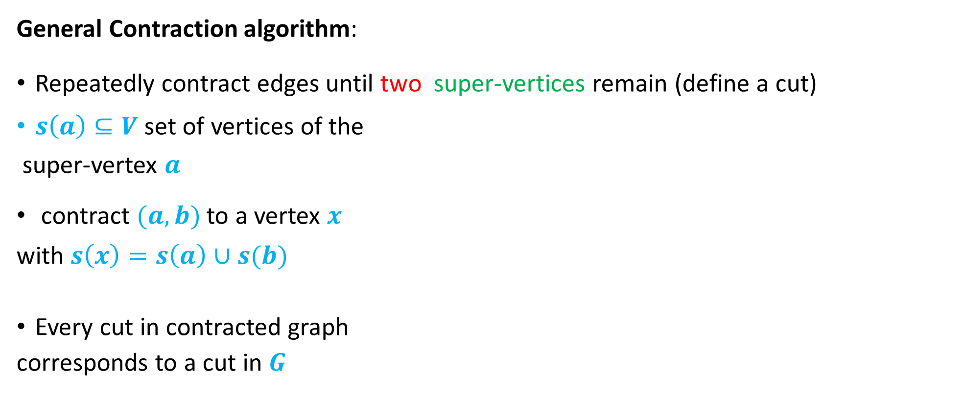





The Contraction Algorithm [Karger and Stein ’96]
General Contraction algorithm:
Repeatedly contract edges until two super-vertices remain (define a cut)
$s\left(a\right)⊆V$ set of vertices of the
super-vertex $a$
contract $(a,b)$ to a vertex $x$
with $s\left(x\right)=s\left(a\right)∪s(b)$
Every cut in contracted graph
corresponds to a cut in $G$
$$a$$
$$a$$
$$b$$
$$c$$
$$v$$
$$a$$
$$b$$
$$c$$

Slide 8
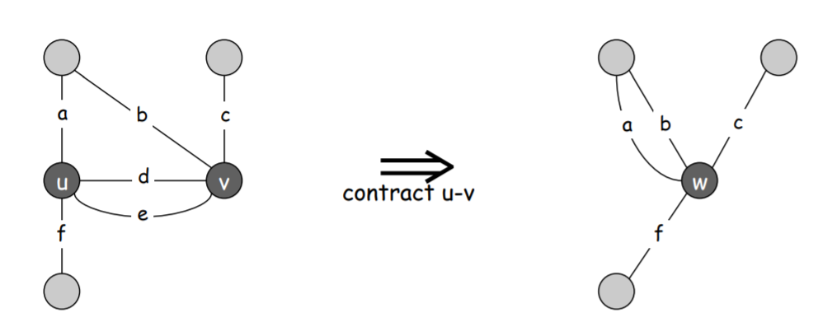

Slide 9
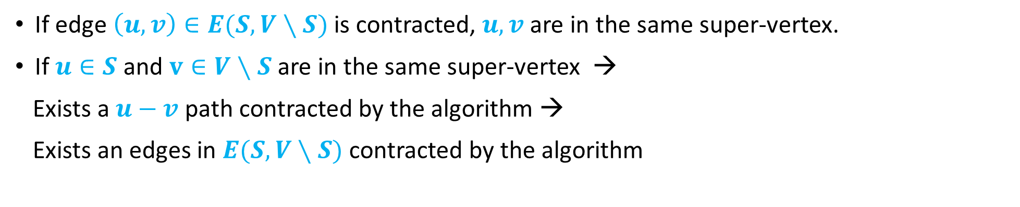
The Contraction Algorithm [Karger and Stein ’96]
General Contraction algorithm:
Repeatedly contract edges until two super-vertices remain (define a cut)
Lemma: A cut $(S, V∖S)$ is output by a contraction algorithm iff no edge crossing $(S,V∖S)$ is contracted by the algorithm.
If edge $\left(u,v\right)∈E(S,V∖S)$ is contracted, $u,v$ are in the same super-vertex.
If $u∈S$ and $v∈V∖S$ are in the same super-vertex →
Exists a $u−v$ path contracted by the algorithm →
Exists an edges in $E(S,V∖S)$ contracted by the algorithm

Slide 10
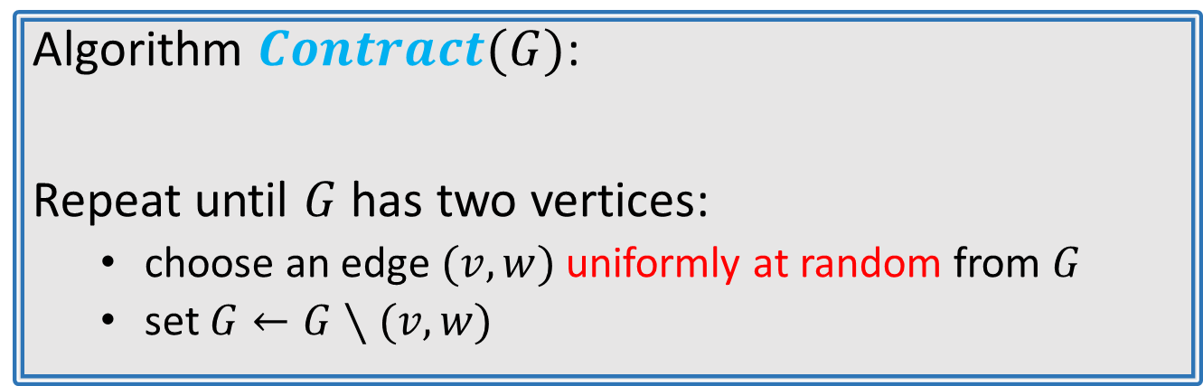
The Contraction Algorithm [Karger and Stein ’96]
Algorithm $Contract(G)$:
Repeat until $G$ has two vertices:
choose an edge $(v,w)$ uniformly at random from $G$
set $G←G∖(v,w)$
Lemma: A particular minimum cut is returned by the algorithm w.p ${\left({n \atop 2}\right)}^{−1}$

Slide 11
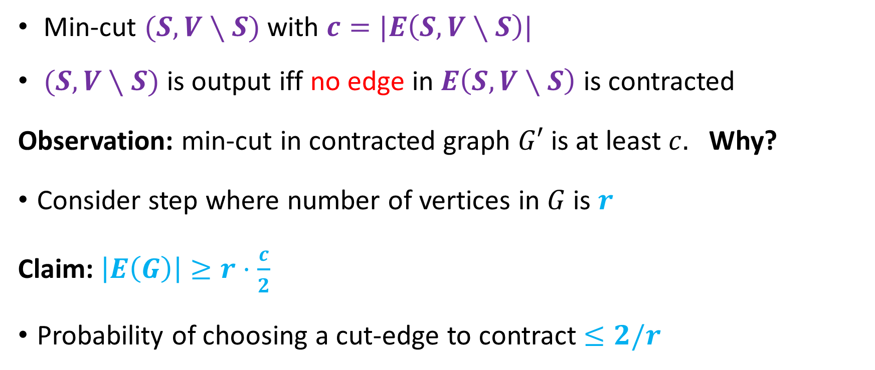
Lemma: A particular minimum cut is returned by the algorithm w.p ${\left({n \atop 2}\right)}^{−1}$
Min-cut $(S, V∖S)$ with $c=|E\left(S,V∖S\right)|$
$(S, V∖S)$ is output iff no edge in $E\left(S,V∖S\right)$ is contracted
Observation: min-cut in contracted graph $G′$ is at least $c.$ Why?
Consider step where number of vertices in $G$ is $r$
Claim: $\left|E\left(G\right)\right|≥r⋅\frac{c}{2}$
Probability of choosing a cut-edge to contract $≤2/r$

Slide 12
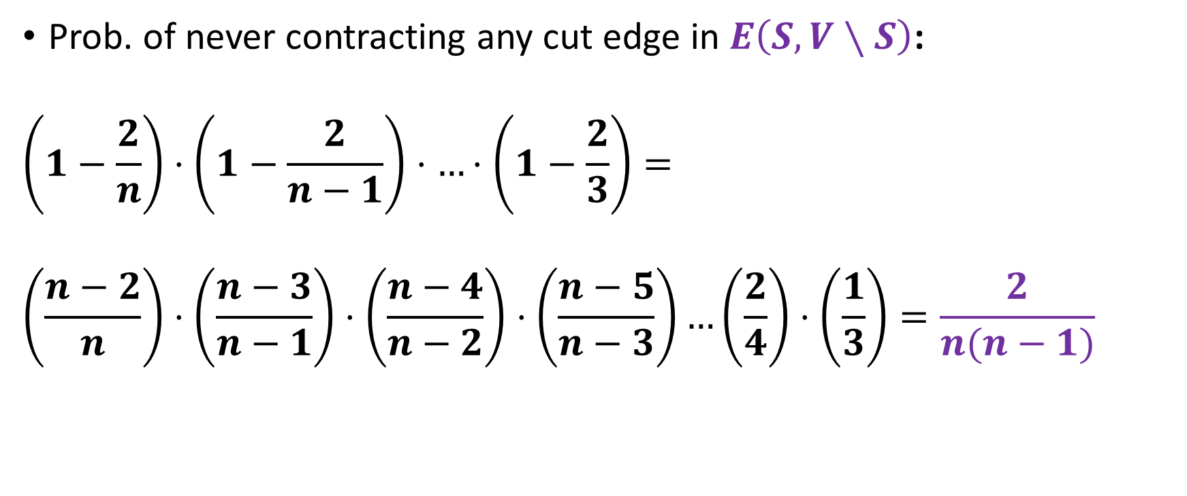
Prob. of never contracting any cut edge in $E\left(S,V∖S\right)$:
$$\left(1−\frac{2}{n}\right)⋅\left(1−\frac{2}{n−1}\right)⋅…⋅\left(1−\frac{2}{3}\right)=$$
$$\left(\frac{n−2}{n}\right)⋅\left(\frac{n−3}{n−1}\right)⋅\left(\frac{n−4}{n−2}\right)⋅\left(\frac{n−5}{n−3}\right)…\left(\frac{2}{4}\right)⋅\left(\frac{1}{3}\right)=\frac{2}{n(n−1)}$$
$O(n^{4}\log{n)}−$time algorithm for computing minimum-cut

Slide 13
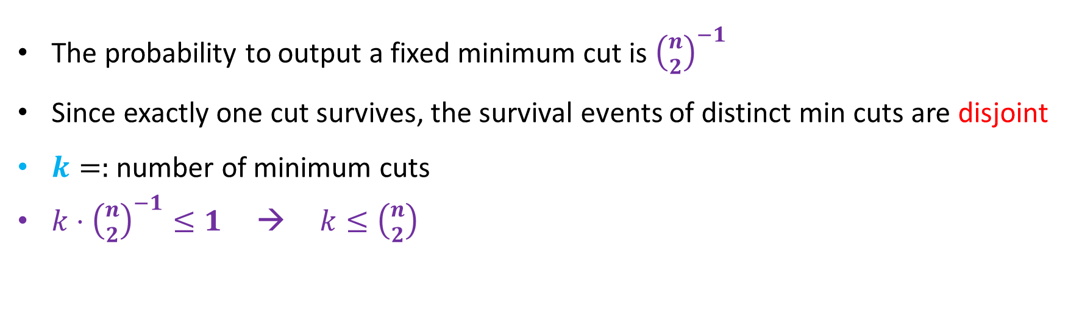
Cut Counting Through Contraction
Corollary: The number of minimum cuts is t most $\left({n \atop 2}\right)$
The probability to output a fixed minimum cut is ${\left({n \atop 2}\right)}^{−1}$
Since exactly one cut survives, the survival events of distinct min cuts are disjoint
$k=:$ number of minimum cuts
$k⋅{\left({n \atop 2}\right)}^{−1}≤1$ → $k≤\left({n \atop 2}\right)$

Slide 14
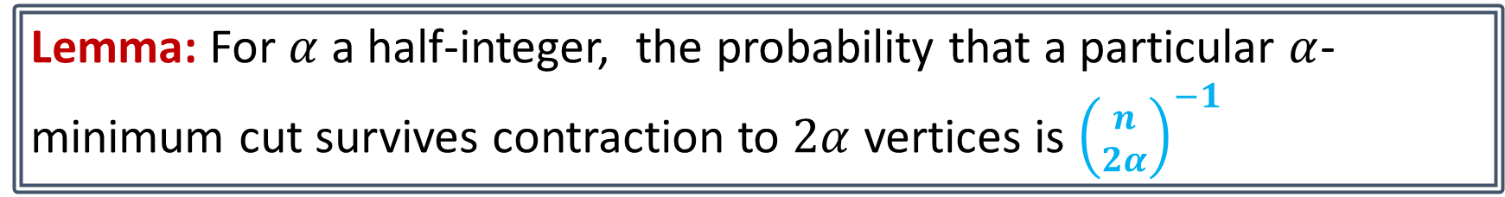
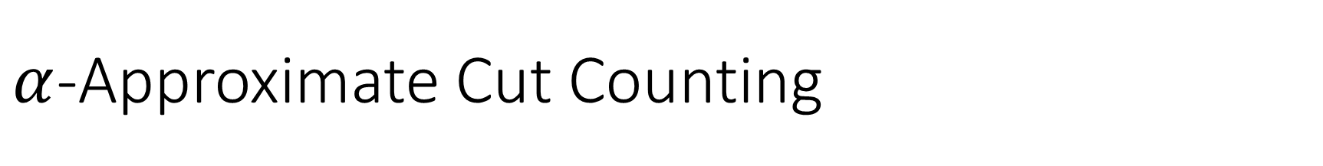
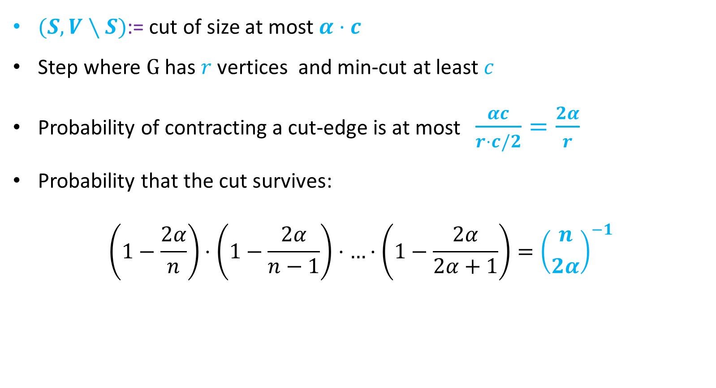
$α$-Approximate Cut Counting
Lemma: For $α$ a half-integer, the probability that a particular $α$-minimum cut survives contraction to $2α$ vertices is ${\left({n \atop 2α}\right)}^{−1}$
$(S, V∖S)$:= cut of size at most $α⋅c$
Step where $G$ has $r$ vertices and min-cut at least $c$
Probability of contracting a cut-edge is at most $\frac{αc}{r⋅c/2}=\frac{2α}{r}$
Probability that the cut survives:
$$\left(1−\frac{2α}{n}\right)⋅\left(1−\frac{2α}{n−1}\right)⋅…⋅\left(1−\frac{2α}{2α+1}\right)={\left({n \atop 2α}\right)}^{−1}$$

Slide 15
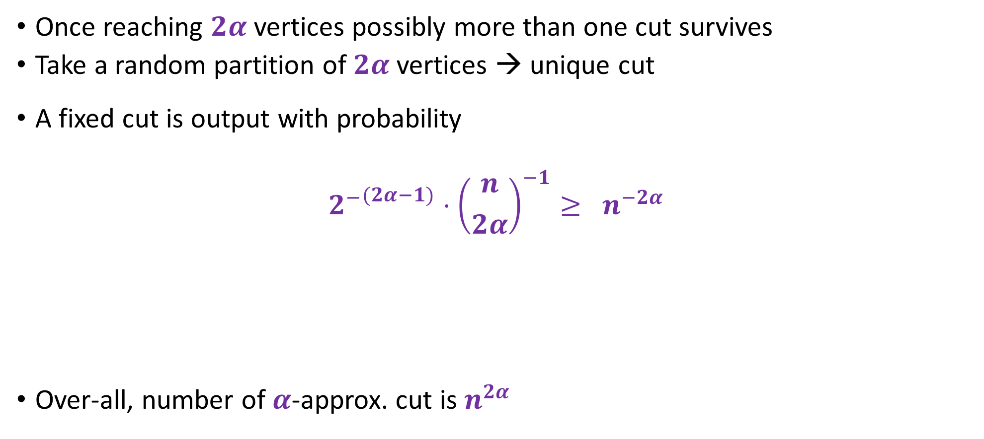

Lemma: For $α$ a half-integer, the number of $α−$minimum cuts is at most $n^{2α}$ .
Once reaching $2α$ vertices possibly more than one cut survives
Take a random partition of $2α$ vertices → unique cut
A fixed cut is output with probability
$${2^{−}}^{(2α−1)}⋅{\left({n \atop 2α}\right)}^{−1}≥ n^{−2α}$$
Over-all, number of $α$-approx. cut is $n^{2α}$
$$2^{2α−1 }≤\left(2α\right)!$$

Slide 16
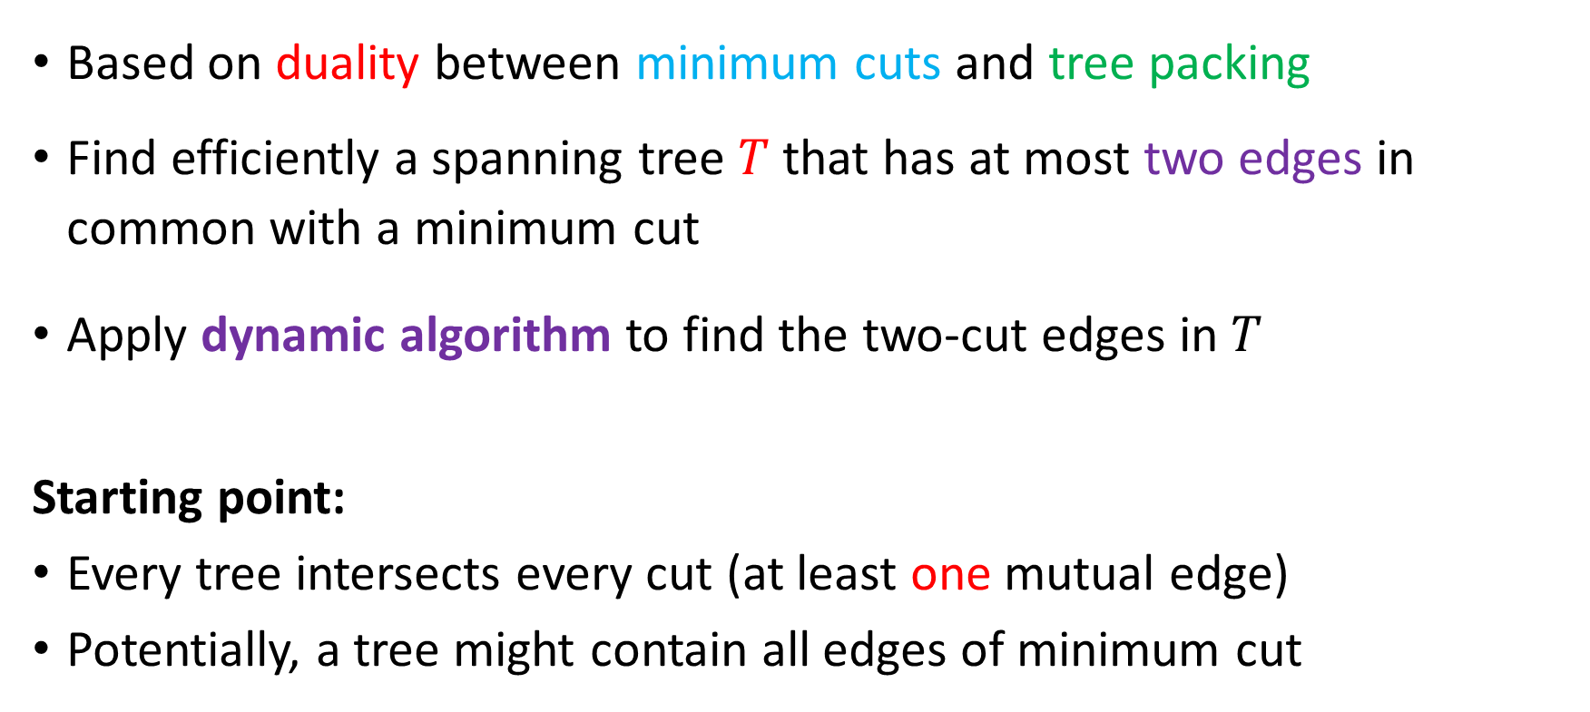
Near Linear Time Algorithm (Karger, ’98)
Based on duality between minimum cuts and tree packing
Find efficiently a spanning tree $T$that has at most two edges in common with a minimum cut
Apply dynamic algorithm to find the two-cut edges in $T$
Starting point:
Every tree intersects every cut (at least one mutual edge)
Potentially, a tree might contain all edges of minimum cut

Slide 17

Cuts and Tree Packing
Definition: Let $T$ be a spanning tree of $G.$ A cut in $G$ $k$-respects $T$ if it cuts at most $k$ edges of $T$.
Theorem: Given a tree $T$ such that the minimum cut 2-respects it, one can compute the minimum cut (in G) in $O(m \log^{2}n)$ time
Goal: Find (efficiently) a tree $T$ such that the minimum-cut 2-respects $T$.
Linear time

Slide 18
Trees and Cuts

Slide 19
Tree Packing
For unweighted graph: A collection of edge disjoint trees
Weighted Packing: A collection of (weighted) trees $T_{1},…, T_{ℓ}$ satisfying that for every $\sum_{T_{i}:e∈T_{i}}{w_{T_{i}}≤w(e_{i})}$for every edge $e.$ The value of the packing is $∑w_{T_{i}}$
Lemma (Nash-Williams, 61): Any undirected graph with min-cut $c$ contains a tree packing of at least $c/2$ trees
Exists a tree $T$ in the packing such that the minimum cut 2-respects it

Slide 20
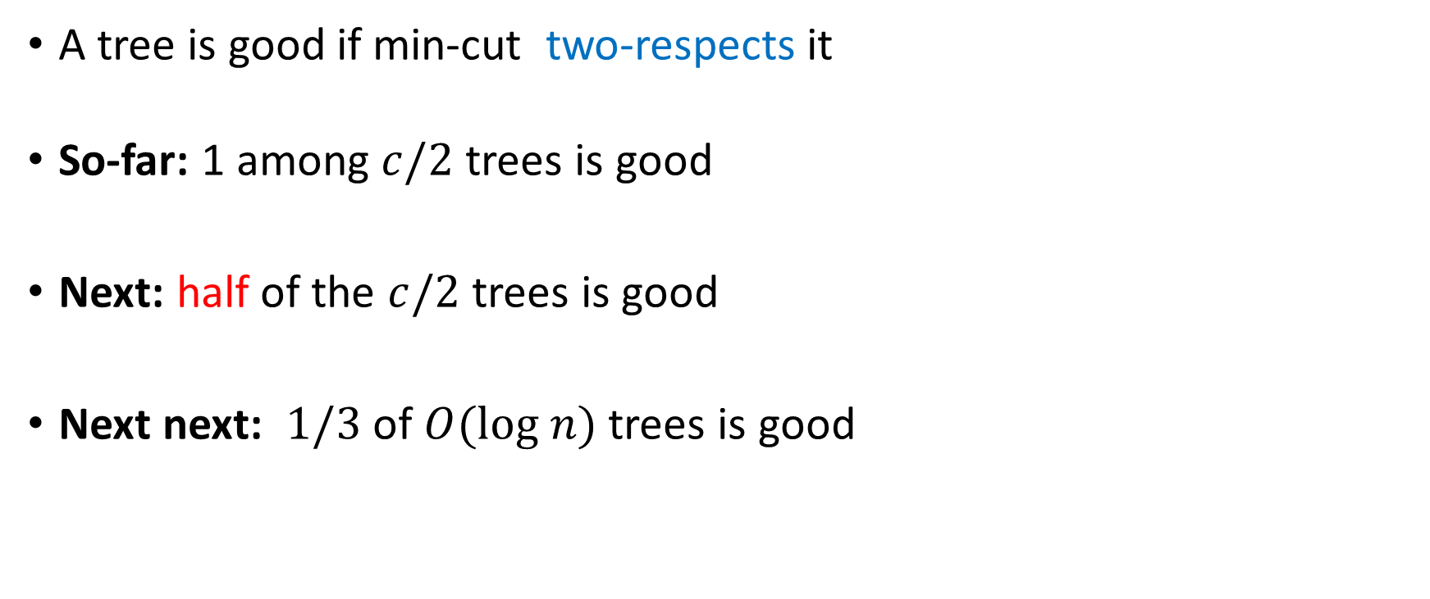
A tree is good if min-cut two-respects it
So-far: 1 among $c/2$ trees is good
Next: half of the $c/2$ trees is good
Next next: $1/3$ of $O(log n)$ trees is good

Slide 21
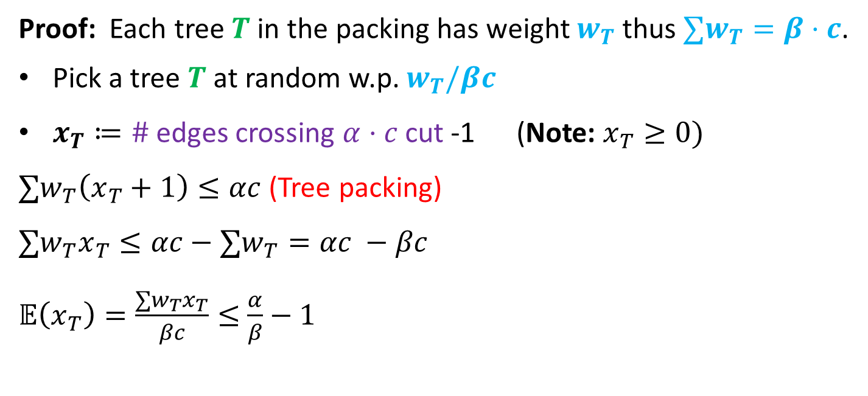

Cuts and Tree Packing
Lemma 1: Given any (weighted) tree packing of value $βc$, and any cut of value $αc,$then at least a $(3−\frac{α}{β})/2$ fraction of the trees (by weight) $2−$respect an cut.
Proof: Each tree $T$ in the packing has weight $w_{T}$ thus $∑w_{T}=β⋅c$.
Pick a tree $T$ at random w.p. $w_{T}/βc$
$x_{T}≔\#$ edges crossing $α⋅c$ cut -1 (Note: $x_{T}≥0)$
$∑w_{T}\left(x_{T}+1\right)≤αc$ (Tree packing)
$$∑w_{T}x_{T}≤αc−∑w_{T}=αc −βc$$
$𝔼\left(x_{T}\right)=\frac{∑w_{T}x_{T}}{βc}≤$ $\frac{α}{β}−1$

Slide 22
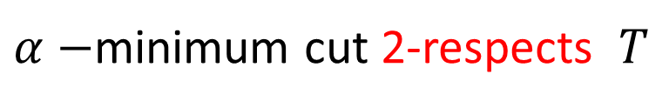

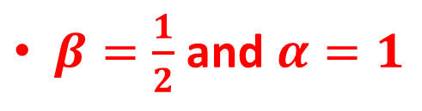
$𝔼\left(x_{T}\right)=\frac{∑w_{T}x_{T}}{βc}≤$ $\frac{α}{β}−1$
By Markov: $\operatorname{Pr}\left(x_{T}<2\right)≥1−\frac{\left(\frac{α}{β}−1\right)}{2}=1/2\left(3−\frac{α}{β}\right)$
As $x_{T}$ is integer, $\operatorname{Pr}\left(x_{T}≤1\right)≥1/2\left(3−\frac{α}{β}\right)$
$α−$minimum cut 2-respects $T$
Corollary: In any maximum packing, the minimum cut 2-respects at least half of the trees
$β=\frac{1}{2}$ and $α=1$

Slide 23

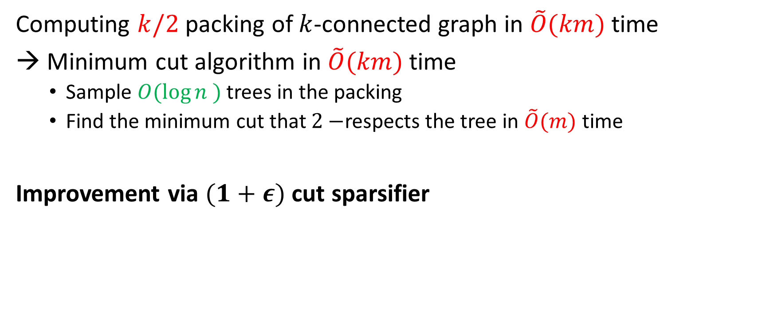
Cuts and Tree Packing
Computing $k/2$ packing of $k$-connected graph in $\tilde{O}(km)$ time
Minimum cut algorithm in $\tilde{O}(km)$ time
Sample $O(\log{n )}$ trees in the packing
Find the minimum cut that $2−$respects the tree in $\tilde{O}(m)$ time
Improvement via $(1+ε)$ cut sparsifier
Theorem [Karger ‘93] : In linear time, one can compute a $(1+ε)$ cut sparsifier
subgraph $H⊆G$ with$O(\frac{m\log{n}}{cε^{2}})$ edges and unweighted min-cut $c^{′}=O(\log{n/ε^{2})} .$
The min-cut in $G$ corresponds to a cut in $H$ of value at most $\left(1+ε\right)c′$

Slide 24

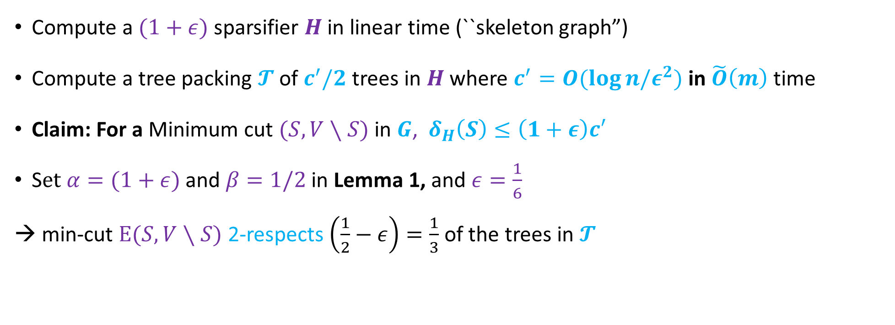
Cuts and Tree Packing via Sampling
Lemma: Given any (possibly weighted) graph $G$ in $\tilde{O}(m)$ time can compute
a set of $O(\log{n)}$ trees s.t the G-minimum-cut 2-respects 1/3 of them w.h.p
Compute a $(1+ε)$ sparsifier $H$ in linear time (``skeleton graph”)
Compute a tree packing $𝓣$ of $c^{′}/2$ trees in $H$ where $c^{′}=O(\log{n/ε^{2})}$ in $\tilde{O}\left(m\right)$ time
Claim: For a Minimum cut $(S, V∖S)$ in $G$, $δ_{H}\left(S\right)≤\left(1+ε\right)c′$
S$et α=(1+ε)$ and $β=1/2$ in Lemma 1, and $ε=\frac{1}{6}$
→ min-cut $E(S, V∖S)$ 2-respects $\left(\frac{1}{2}−ε\right)=\frac{1}{3}$ of the trees in $𝓣$

