Slide 1
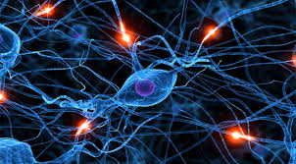

Neuro-RAM Unit in Spiking Neural Networks with Applications
Nancy Lynch, Cameron Musco and Merav Parter

Slide 2
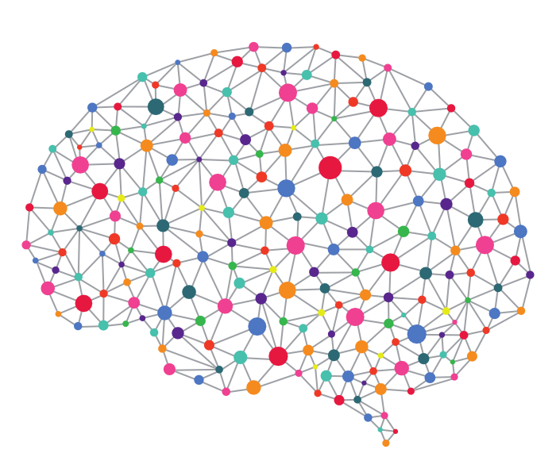

High Level Goal
Study biologically neural networks from a distributed, algorithmic perspective.

Slide 3
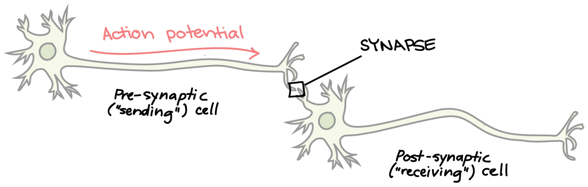


Neural Networks
Nodes (neurons), Edges (synapses).
Directed weighted graph, weight indicates synaptic strength.
Two types of neurons: Excitatory (all positive) and Inhibitory (all negative).
$$u$$
$$v$$

Slide 4


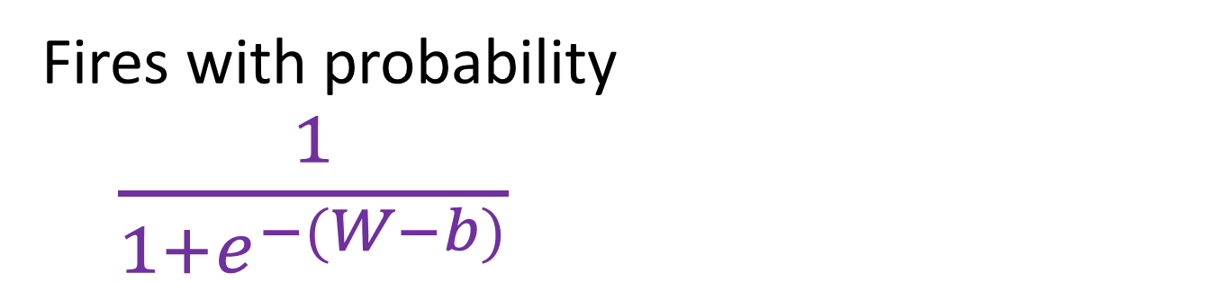


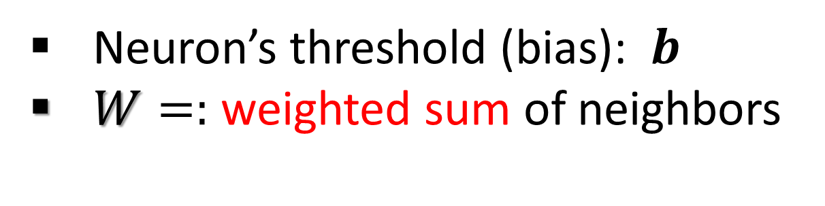





Modeling Spiking Neurons
Node (e.g. neuron) is a probabilistic threshold gate
Neuron’s threshold (bias): $b$
$W=:$ weighted sum of neighbors
$$1$$
$$0$$
$$1$$
$$3$$
$$2$$
$$−1$$
$$u$$
Det. Neuron
Spiking Neuron
Firing
probability
Fires with probability
$\frac{1}{1+e^{−(W−b)}}$
$$W−b≥0$$
1/2
$$b$$
weight

Slide 5














Modeling Spiking Neural Networks
Given:
Weighted directed graph.
Threshold for each neuron
Initial states (0/1 to all nodes).
$$2$$
$$0$$
$$0$$
$$−2$$
$$−5$$
$$−3$$
$$1$$
$$1$$
$$2$$
$$4$$
$$2$$
$$1$$
$$1$$
Dynamics:
Synchronous discrete rounds.
Firing in round $t$ depends on firing in round $t−1.$

Slide 6

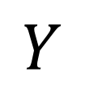


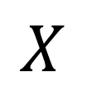




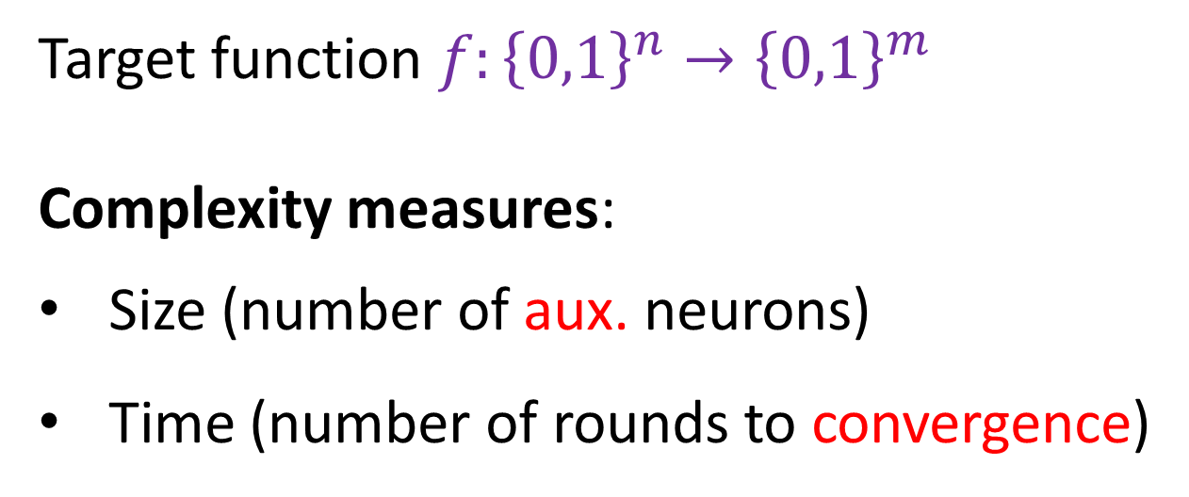

Computational Problems in SNN
Target function $f:{\left\{0,1\right\}}^{n}→{\left\{0,1\right\}}^{m}$
Complexity measures:
Size (number of aux. neurons)
Time (number of rounds to convergence)
$$0$$
$$1$$
$$X$$
$$1$$
$$0$$
$$0$$
Auxiliary
Neurons
$$Y$$
$$0$$
$$0$$
$$1$$

Slide 7
The Main Theme
Computational tradeoffs
Role of randomness
Previous work [Lynch, Musco, P ‘17]:
Neural leader election
Randomness was crucial to break symmetry

Slide 8
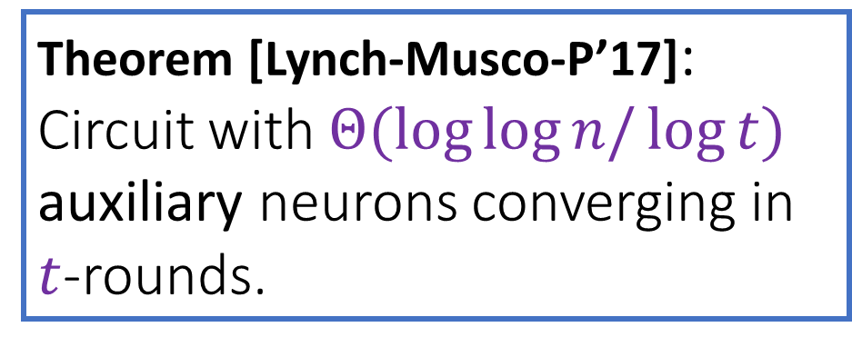
Randomness Helps for Breaking Symmetry
``Neural Leader Election”: Given a subset of firing neurons, design a
circuit that converges fast to one firing neuron
Input
0
1
1
1
0
1
Theorem [Lynch-Musco-P’17]:
Circuit with $Θ(\log{\log{n/\log{t}) }}$ auxiliary neurons converging in $t$-rounds.
Auxiliary
Neurons
Output
0
0
1
0
0
0

Slide 9
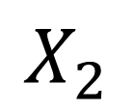
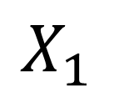
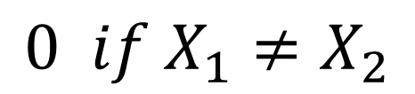

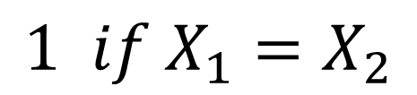

This Work: Similarity Testing
$$X_{1}$$
$$X_{2}$$
$$000010001000100$$
$$001010101000010$$
Auxiliary
Neurons
$$1 if X_{1}=X_{2}$$
$$0 if X_{1}≠X_{2}$$

Slide 10


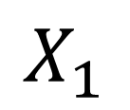









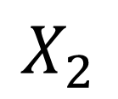


Similarity Testing - Equality
Solution with two auxiliary threshold gates
Not biologically plausible
Not clear how to obtain
sublinear size even with spiking neurons.
$$X_{1}$$
$$X_{2}$$
$$i$$
$$i$$
$$000010001000100$$
$$001010101000010$$
$$2^{i}$$
$$2^{i}$$
$${−2}^{i}$$
$${−2}^{i}$$
$$X_{1}≥X_{2}$$
$$X_{2}≥X_{1}$$
$$1$$
$$1$$
$$X_{1}≥X_{2} AND{ X}_{2}≥X_{1}$$

Slide 11
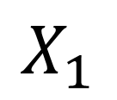

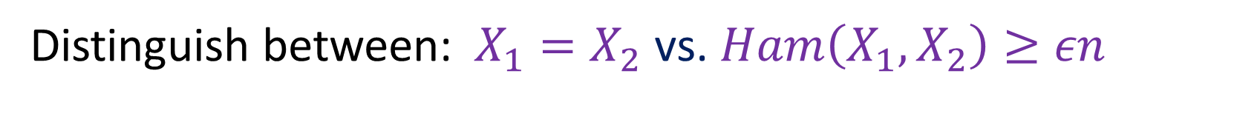
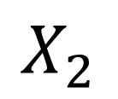

Approximation Similarity Testing
Distinguish between:$X_{1}=X_{2}$ vs. $Ham\left(X_{1},X_{2}\right)≥εn$
$$X_{1}$$
$$X_{2}$$
$$000010001000100$$
$$001010101000010$$
Auxiliary
Neurons
Goal: sublinear size

Slide 12








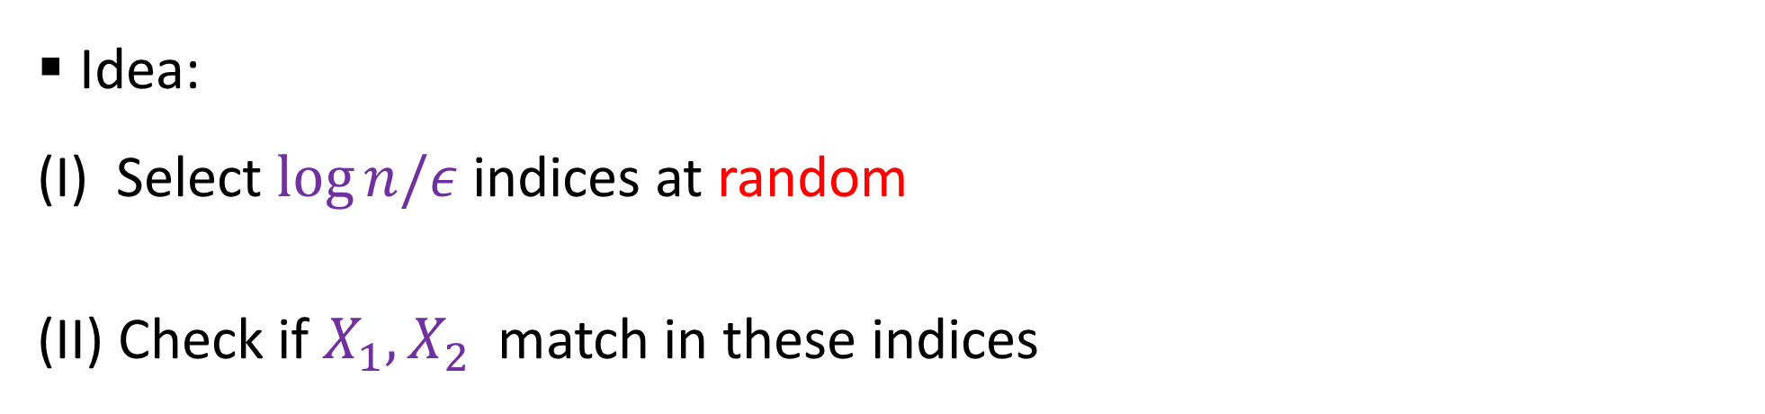
Approximate Equality
Distinguish between:$X_{1}=X_{2}$ vs. $Ham\left(X_{1},X_{2}\right)≥εn$
$$X_{1}$$
$$X_{2}$$
$$i$$
$$i$$
$$000010001000100$$
$$001010101000010$$
Idea:
(I) Select $\log{n/ε}$ indices at random
(II) Check if $X_{1},X_{2}$match in these indices
Implementation:
Encoding random index
$log n$spiking neurons
Random access memory

Slide 13

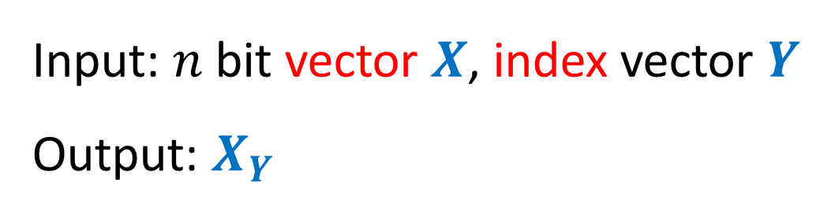



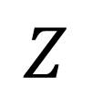






Key Building Block: Neuro-RAM
$$X$$
$$Y$$
$$INDEX: {\left\{0,1\right\}}^{n+\log{n}}→{\left\{0,1\right\}}^{}$$
$$0$$
$$1$$
$$1$$
$$0$$
$$0$$
$$1$$
Input: $n$bit vector $X$, index vector $Y$
Output: $X_{Y}$
Auxiliary
Neurons
$$1$$
$$Z$$
The Neuro-RAM construction is deterministic
But the module is used when Y is random

Slide 14
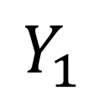
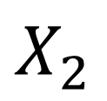





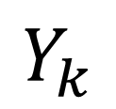















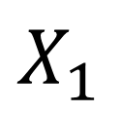


Solving Approximate Testing with Neuro-RAM
$$X_{1}$$
$$X_{2}$$
$$0$$
$$1$$
$$1$$
$$0$$
$$0$$
$$1$$
$$1$$
$$1$$
$\log{n }$random
neurons
$${NR}_{2,1}$$
$${NR}_{1,1}$$
$$=$$
$$0$$
$$Y_{1}$$
$$1$$
$$…$$
$$⋀$$
$$…$$
$$1$$
$${NR}_{1,k}$$
$${NR}_{2,k}$$
$$=$$
$$Y_{k}$$
$$1$$

Slide 15
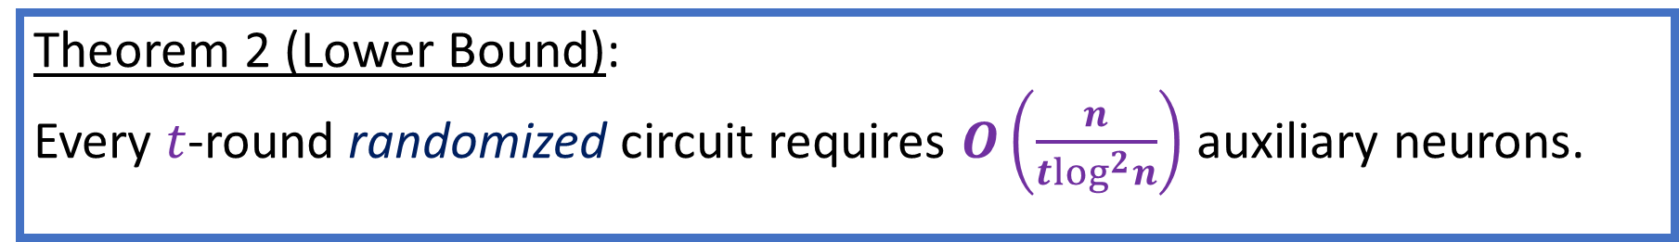
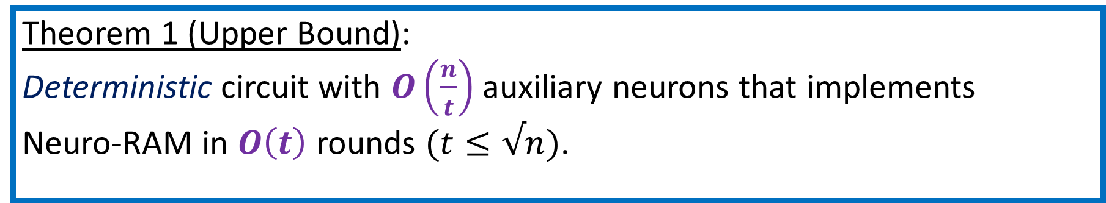
Main Results (Neuro-RAM)
Theorem 1 (Upper Bound):
Deterministic circuit with $O\left(\frac{n}{t}\right)$ auxiliary neurons that implements
Neuro-RAM in $O\left(t\right)$ rounds $(t≤√n)$.
Theorem 2 (Lower Bound):
Every $t$-round randomized circuit requires $O\left(\frac{n}{t\log^{2}n}\right)$ auxiliary neurons.

Slide 16
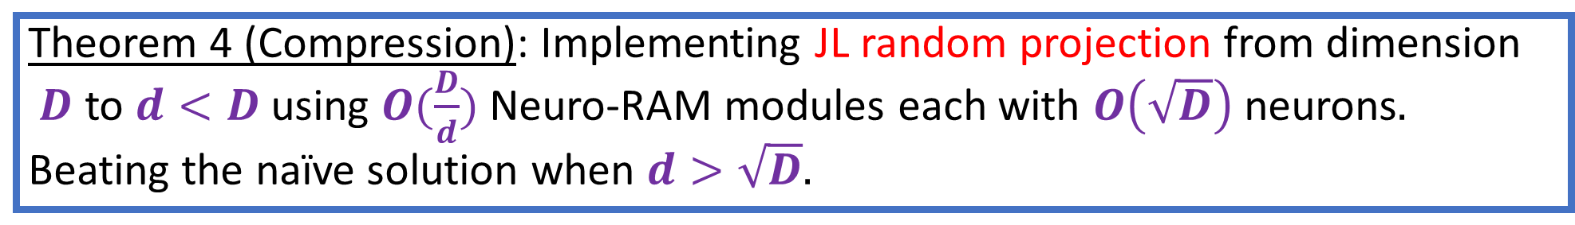
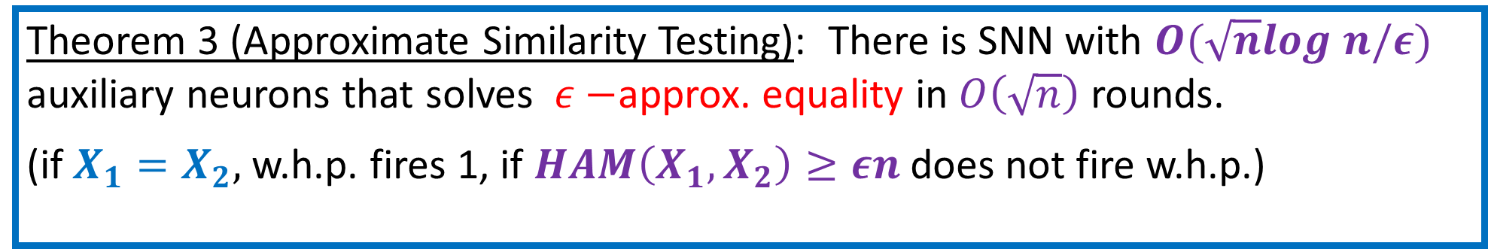
Main Results (Applications)
Theorem 3 (Approximate Similarity Testing): There is SNN with $O(\sqrt{n}log n/ε)$ auxiliary neurons that solves $ε−$approx. equality in $O\left(\sqrt{n}\right)$ rounds.
(if $X_{1}=X_{2},$w.h.p. fires 1, if $HAM\left(X_{1},X_{2}\right)≥εn$does not fire w.h.p.)
Theorem 4 (Compression): Implementing JL random projection from dimension
$D$ to $d<D$using $O(\frac{D}{d})$ Neuro-RAM modules each with $O\left(\sqrt{D}\right)$neurons$.$
Beating the naïve solution when $d>\sqrt{D}.$

Slide 17
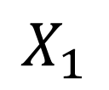


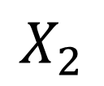
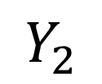



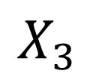
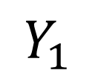



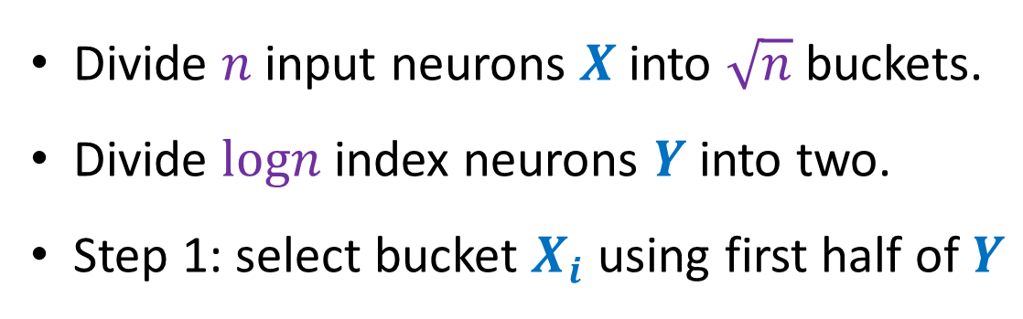

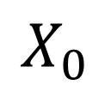

High Level Idea of Neuro-RAM Module
Here: $O\left(\sqrt{n}\right)$ auxiliary neurons that implements Neuro-RAM in $O\left(\sqrt{n}\right)$ rounds.
Divide $n$input neurons $X$into $\sqrt{n}$ buckets.
Divide $logn$ index neurons $Y$into two.
Step 1: select bucket $X_{i}$ using first half of $Y$
$$X_{3}$$
$$X_{2}$$
$$X_{1}$$
$$X_{0}$$
$$Y_{1}$$
$$Y_{2}$$
$$[10 01]$$
$$[11 10]$$
$$[11 10]$$
$$[10 10]$$
$$[00 10]$$
$$e_{3}$$
$$e_{2}$$
$$e_{1}$$
$$e_{0}$$
$$E$$

Slide 18
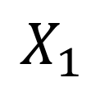


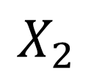












High Level Idea of Neuro-RAM Module
Here: $O\left(\sqrt{n}\right)$ auxiliary neurons that implements Neuro-RAM in $O\left(\sqrt{n}\right)$ rounds.
$$X_{3}$$
$$X_{2}$$
$$X_{1}$$
$$X_{0}$$
$$Y_{1}$$
$$Y_{2}$$
$$[10 01]$$
$$[11 10]$$
$$[11 10]$$
$$[10 10]$$
$$[00 10]$$
$$e_{3}$$
$$e_{2}$$
$$e_{1}$$
$$e_{0}$$
$$E$$
Selecting $e_{i}$ with $i=dec\left(Y_{1}\right)$
The non-selected $e_{j}$are depressed and will not fire.

Slide 19

















High Level Idea of Neuro-RAM Module
Here: $O\left(\sqrt{n}\right)$ auxiliary neurons that implements Neuro-RAM in $O\left(\sqrt{n}\right)$ rounds.
$$X_{3}$$
$$X_{2}$$
$$X_{1}$$
$$X_{0}$$
$$Y_{1}$$
$$Y_{2}$$
$$[10 01]$$
$$[11 10]$$
$$[11 10]$$
$$[10 10]$$
$$[00 10]$$
$$2^{n−j}$$
$$2^{n}$$
$$e_{3}$$
$$e_{2}$$
$$e_{1}$$
$$e_{0}$$
$$E$$
Next: use $O\left(\sqrt{n}\right)$ decoding neurons to decode the value of the bit $dec\left(Y_{i}\right)$

Slide 20




















High Level Idea of Neuro-RAM Module
Here: $O\left(\sqrt{n}\right)$ auxiliary neurons that implements Neuro-RAM in $O\left(\sqrt{n}\right)$ rounds.
$$X_{3}$$
$$X_{2}$$
$$X_{1}$$
$$X_{0}$$
$$Y_{1}$$
$$Y_{2}$$
$$[10 01]$$
$$[11 10]$$
$$[11 10]$$
$$[10 10]$$
$$[00 10]$$
$$2^{n−j}$$
$$2^{n}$$
$$e_{3}$$
$$E$$
$$D$$
Successive decoding:
In the beginning $e_{3}$ fires only if first bit in $X_{3}$ fires.
In step $j,$ $e_{3}$fires only if $j^{th}$ bit in $X_{3}$ fires.
This continues until getting a stopping signal
from selected $d_{j}$
$$d_{0}$$
$$d_{1}$$
$$d_{2}$$
$$d_{3}$$

Slide 21


























$$X_{0}$$
$$X_{1}$$
$$X_{2}$$
$$X_{3}$$
$$Y_{1}$$
$$Y_{2}$$
$$[10 01]$$
$$[11 10]$$
$$[11 10]$$
$$[01 01]$$
$$[11 10]$$
$$e_{0}$$
$$e_{1}$$
$$e_{2}$$
$$e_{3}$$
$$E$$
$$0$$
$$0$$
$$2^{3}$$
$$1$$
$$2$$
$${−2}^{2}$$
$$d_{0}$$
$$d_{1}$$
$$d_{2}$$
$$d_{3}$$
Inhibition (neg. weight)
Excitation (pos. weight)
$$0$$

Slide 22

Lower Bound for Neuro-RAM with Spiking Neurons
Theorem 2 (Lower Bound):
Every randomized SNN that solves the INDEX function in $t$rounds, requires $O\left(\frac{n}{t\log^{2}n}\right)$ auxiliary neurons.
Roadmap:
Step 1:
Reduction from SNN to
Deterministic Circuit
Step 2:
Lower Bound for Det. Circuit via VC dimension

Slide 23




















Step 0: Reduction from SNN to Feed-Forward SNN
$t$-round SNN with $a$ aux. neurons
solving INDEX with high probability
Feedforward SNN with $O(at)$ neurons
$$0$$
$$1$$
$$1$$
$$0$$
$$0$$
$$1$$
$$0$$
$$1$$
$$1$$
$$0$$
$$0$$
$$1$$
$$1$$
$$2$$
$$t−1$$
$$…$$
$$1$$
$$t−1$$

Slide 24







Step 1: Reduction to Distribution of Deterministic Circuits
Probabilistic Circuit $C_{R}$
Distribution $ℋ$over deterministic circuits
$$X$$
$$…$$
$$…$$
$$z$$
Goal: find $ℋ,$s.t. for every input $X$
$$Prob_{C_{R}}\left(z=1 | X\right)=Prob_{ℋ}\left(z=1 | X\right)$$

Slide 25









Step 1: Reduction to Distribution of Deterministic Circuits
Probabilistic Circuit $C_{R}$
Distribution $ℋ$over deterministic circuits
$$X$$
$$…$$
$$…$$
$a⋅t$
aux. neurons
$$z$$
Spiking Neuron u with threshold b(u):
Fires with probability
Det. threshold neuron $u$ whose threshold is sampled from a logistic distribution with
mean $b(u)$
$$\frac{1}{1+e^{−(w−b(u))}}$$

Slide 26





Step 2: Reducing to Deterministic Circuits for Subset of Inputs
$$X$$
$$Y$$
A deterministic circuit that solves INDEX for
most X values
This circuits solves $2^{n−1}$ functions:
$f_{X}:{\left\{0,1\right\}}^{log n}→\left\{0,1\right\}$, $f_{X}(Y)=X_{Y}$
$$→ VC\left(C_{D}\right)≥Θ(\frac{n}{logn})$$
But a FF circuit with $m$ gates has VC
at most $m/log⁡m$
We have $a⋅t=Ω(n/log^{2}{n)}$
$$…$$
Circuit is
correct
$2^{n}$possible X values

Slide 27





Summing Up:
FF deterministic circuits for INDEX
$$…$$
$$…$$
SNN for INDEX
FF SNN for INDEX
Exists det. circuit with
$O\left(a⋅t\right)$ gates that solves
INDEX for half of X-space
$C_{D}$ has large VC as solves many functions.
Hence must have many gates.
$$C_{D}$$

Slide 28


Consequences of Neuro-RAM Lower Bounds
Randomization does not give an advantage for neuro-RAM task.
Separation between feedforward sigmoidal networks and feedforward spiking networks
Spiking Neuron: Fires with probability $\frac{1}{1+e^{−(w−b)/λ}}$
Sigmoidal Neuron: outputs $\frac{1}{1+e^{−(w−b)/λ}}$
Fact [Koiran’96]
There is a feedforward sigmoidal circuit for Neuro-RAM with $\sqrt{n}$neurons.
Here:
Any feedforward spiking circuit for Neuro-RAM has $\frac{n}{logn}$neurons.

Slide 29
Main Results (Neuro-RAM)
Theorem 1 (Upper Bound):
Deterministic circuit with $O\left(\frac{n}{t}\right)$ auxiliary neurons that implements
Neuro-RAM in $O\left(t\right)$ rounds $(t≤√n)$.
Theorem 2 (Lower Bound):
Every $t$-round randomized circuit requires $O\left(\frac{n}{t\log^{2}n}\right)$ auxiliary neurons.

Slide 30
Take Home Message
Biologically inspired model for SNN
Main questions: computational tradeoffs, role of randomness.
Randomness not needed for neuro-RAN
But does help for similarity testing and compression
Remaining problems: exact equality? simpler circuits?
Thank You!
(Toda Raba!)

