Slide 1
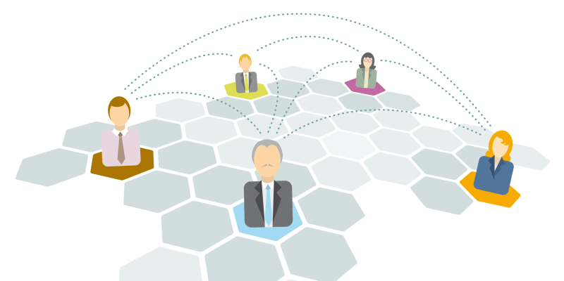


Distributed Computing Made Secure:
A New Cycle Cover Theorem
Merav Parter Eylon Yogev
GTACS, 2018

Slide 2
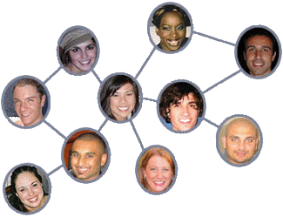
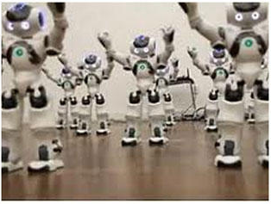
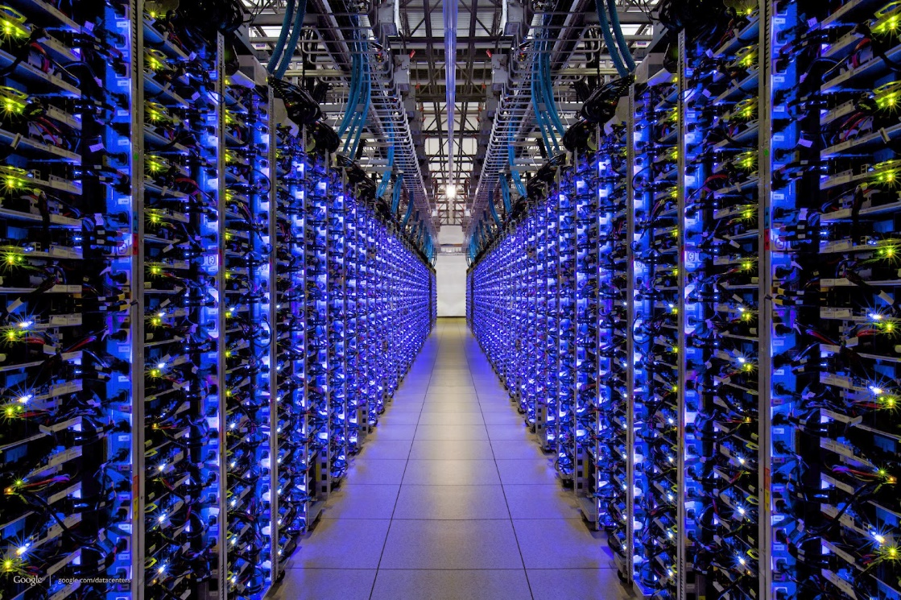

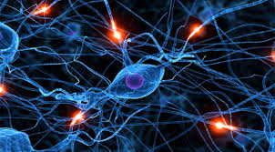
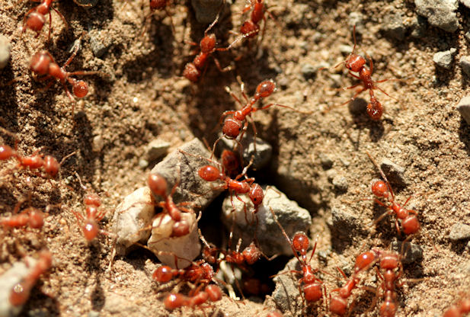
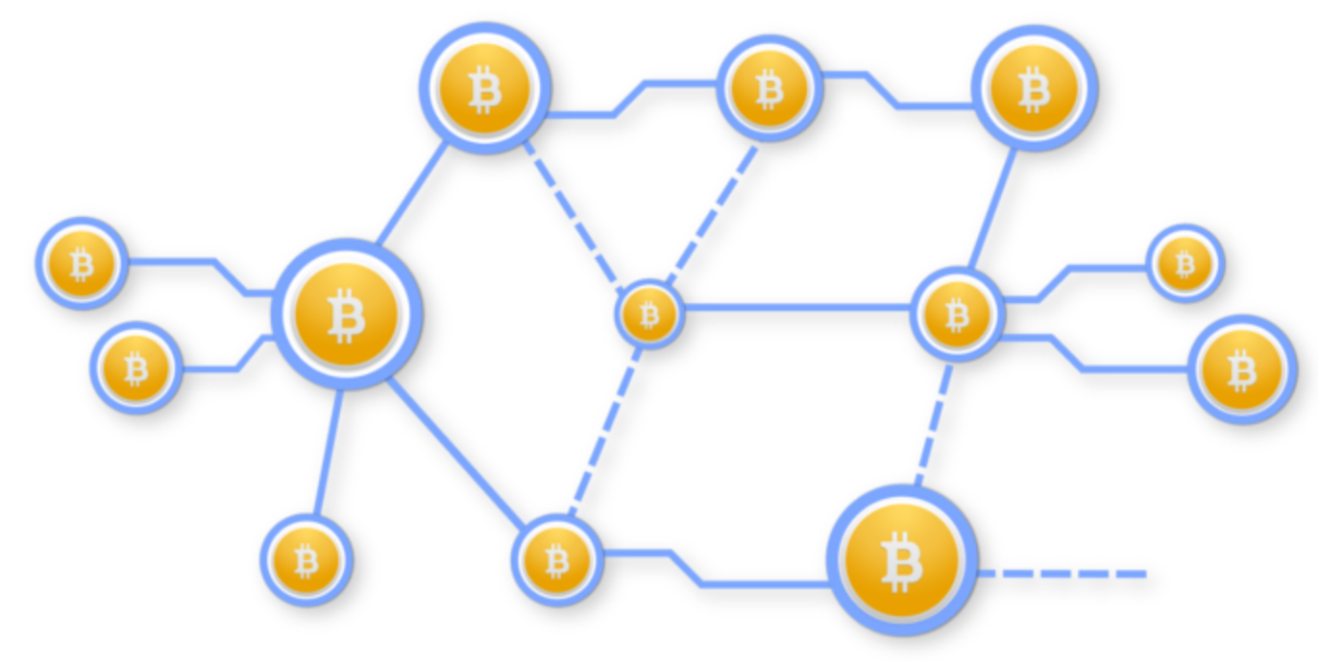
Distributed Computing
Social Networks
Robot Swarms
Data Centers
Neural Network
Ant Colonies
Bitcoin Network

Slide 3
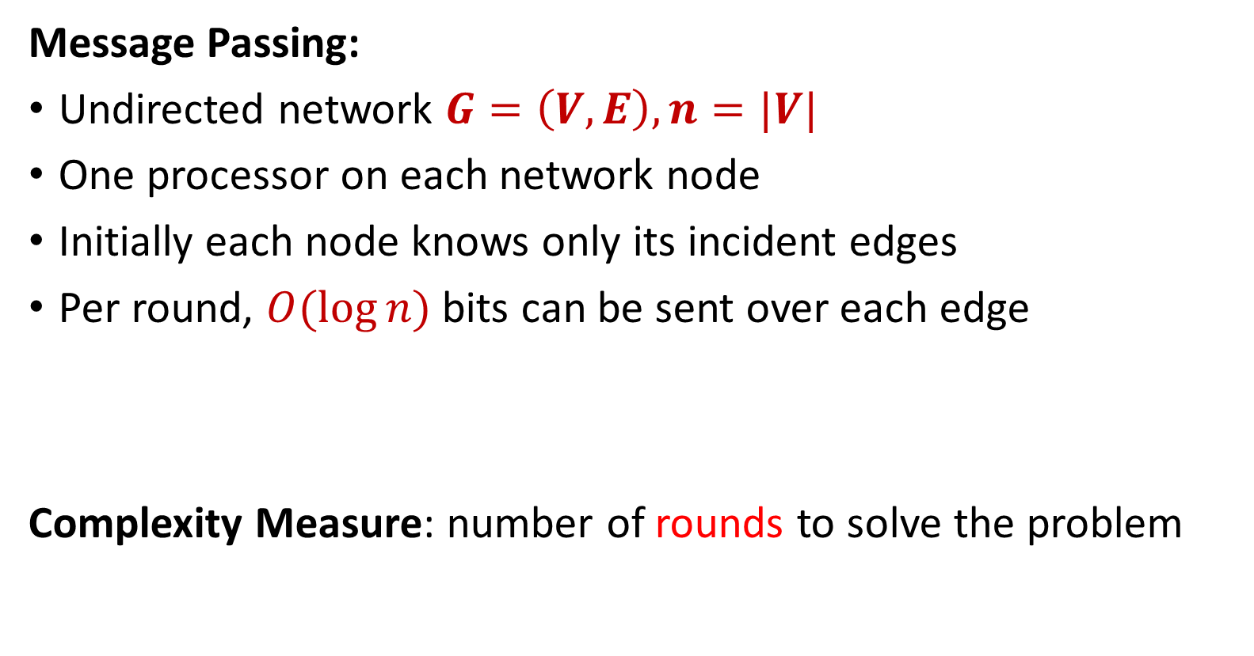
Distributed Computing Model
Message Passing:
Undirected network $G=\left(V, E\right), n=|V|$
One processor on each network node
Initially each node knows only its incident edges
Per round, $O(log⁡n)$ bits can be sent over each edge
Complexity Measure: number of rounds to solve the problem
[ALGP89, Linial92, Peleg90, NS95]
Notes:
Baruch Awerbuch, Andrew V. Goldberg, Michael Luby, and Serge A. Plotkin. Network decomposition and locality in distributed computation

Slide 4
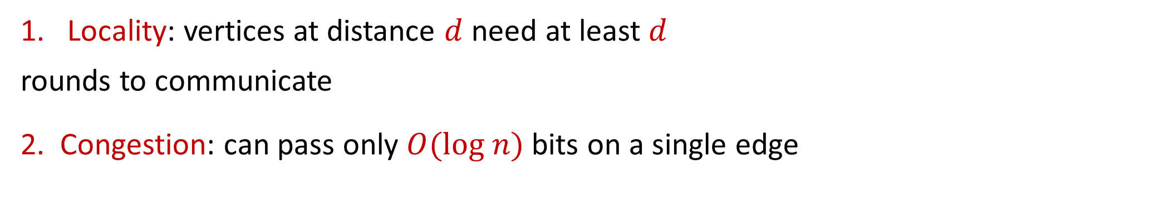
Main Challenges in Distributed Computing
Locality: vertices at distance $d$ need at least $d$
rounds to communicate
2. Congestion: can pass only $O(log n)$ bits on a single edge
Today: What about security?
Notes:
Baruch Awerbuch, Andrew V. Goldberg, Michael Luby, and Serge A. Plotkin. Network decomposition and locality in distributed computation

Slide 5
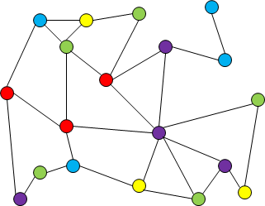
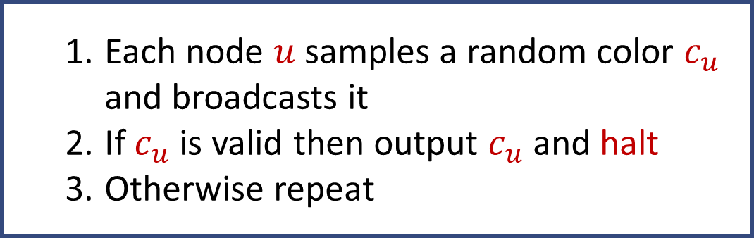

Example – Graph Coloring
$n$ vertex graph of maximum degree $Δ$
Task: color the graph with $2Δ$ colors
# rounds is $O(log n)$
  Each node $u$ samples a random color $c_{u}$ and broadcasts it
  If $c_{u}$ is valid then output $c_{u}$ and halt
  Otherwise repeat
Side effect: nodes learn more than just their own color!

Slide 6
How to design distributed algorithms that are both
efficient and secure?
Efficient: round and bandwidth complexity
Secure: nothing is learned but the desired output

Slide 7
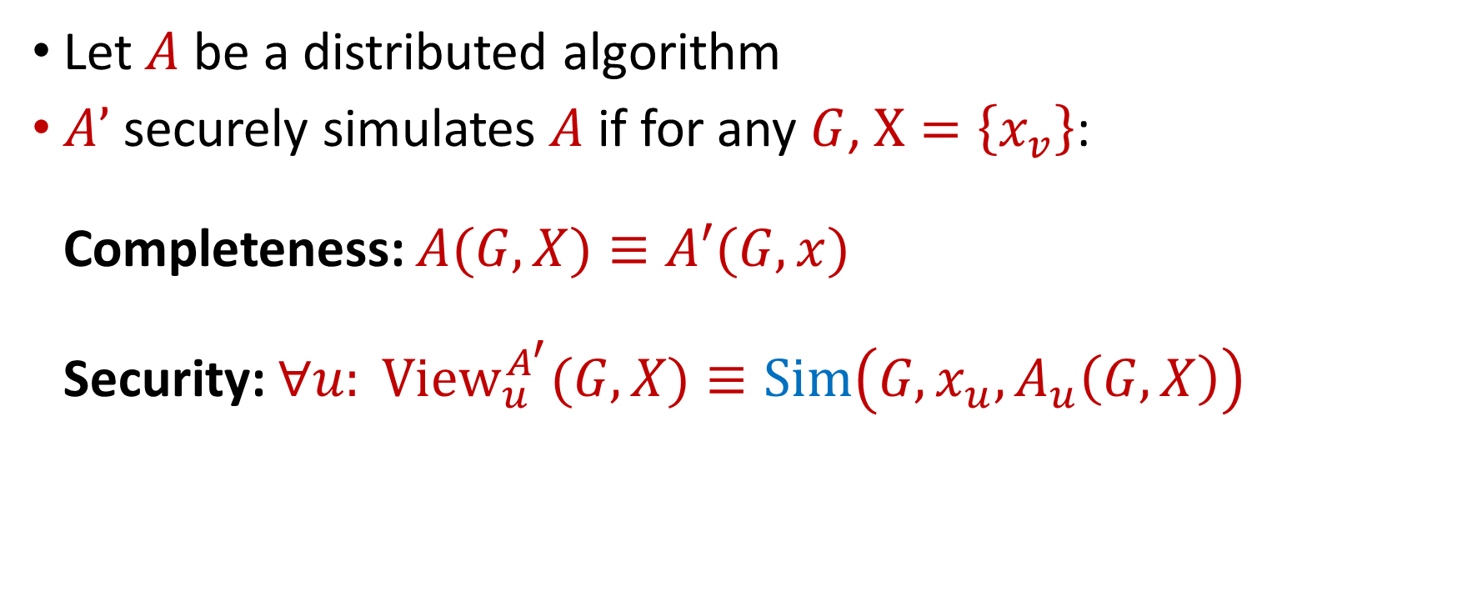
Secure Distributed Algorithm: Setup
Let $A$ be a distributed algorithm
$A’$ securely simulates $A$ if for any $G$, $X=\left\{x_{v}\right\}$:
Completeness: $A(G,X)≡A′(G,x)$
Security: $∀u: {View}_{u}^{A^{′}}(G,X)≡Sim\left(G,x_{u},A_{u}\left(G,X\right)\right)$
Semi honest

Slide 8
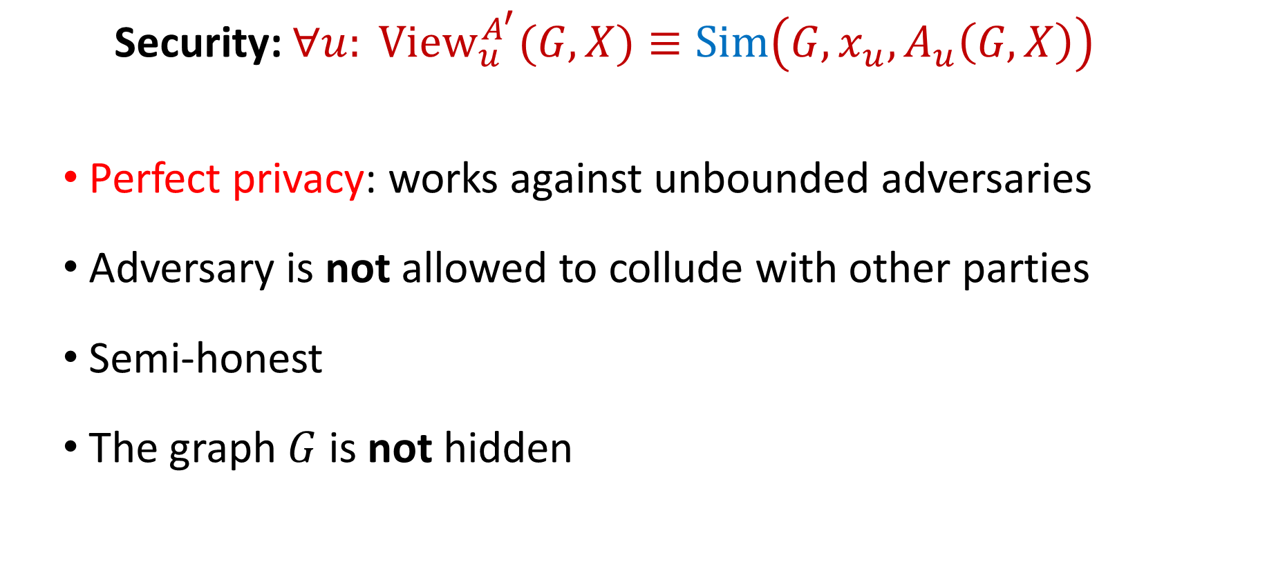
Secure Distributed Algorithm: Setup
Security: $∀u: {View}_{u}^{A^{′}}(G,X)≡Sim\left(G,x_{u},A_{u}\left(G,X\right)\right)$
  Perfect privacy: works against unbounded adversaries
  Adversary is not allowed to collude with other parties
  Semi-honest
  The graph $G$ is not hidden

Slide 9

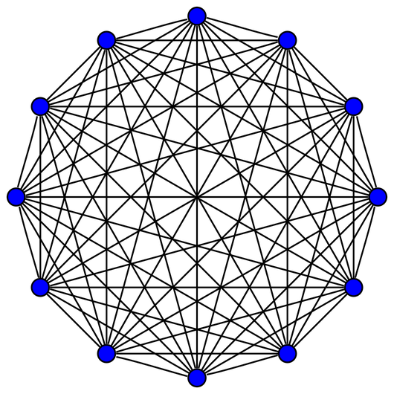
Multiparty Computation (MPC)
Parties with private inputs wish to compute
a joint function of all inputs
Private channels between every two parties
Security: each party learns “nothing” but the output
General Results: [Yao86,GMW87,BGW88,CCD88]
handling a variety of adversaries
Assumes the graph is a clique!

Slide 10
The Challenge
Secure Algorithm
Efficient Algorithm
Secure and Efficient Algorithm

Slide 11
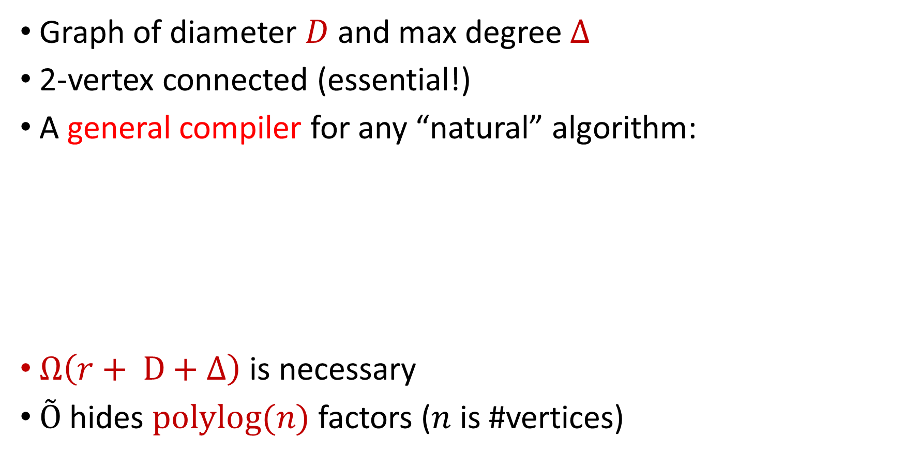
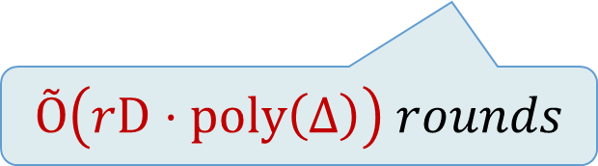
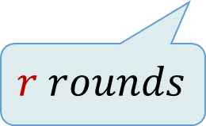
Our Result
Graph of diameter $D$ and max degree $Δ$
2-vertex connected (essential!)
A general compiler for any “natural” algorithm:
$Ω\left(r+ D+Δ\right)$ is necessary
$Õ$ hides $polylog(n)$ factors ($n$ is #vertices)
Distributed Algorithm A
Secure Distributed Algorithm A’
$$r rounds$$
$Õ\left(rD⋅poly\left(Δ\right)\right)$ $rounds$

Slide 12
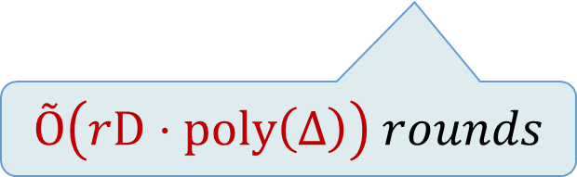
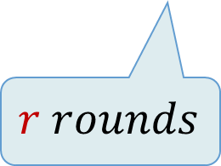
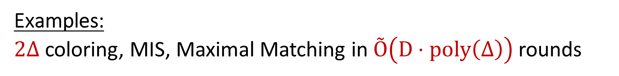
Our Result
Distributed Algorithm A
Secure Distributed Algorithm A’
$$r rounds$$
$Õ\left(rD⋅poly\left(Δ\right)\right)$ $rounds$
Examples:
$2Δ$ coloring, MIS, Maximal Matching in $Õ\left(D⋅poly\left(Δ\right)\right)$ rounds

Slide 13
Previous MPC Work – Beyond Clique
General graph patterns: [HIJKR16, BGIKMP14,HIJKSY17]
MPC with locality: [BGT13, CCGGOZ14, BIPW17]
Do not fit well the distributed graph algorithm model:
  computational assumptions (e.g., obfuscation)
  trusted setup phase
  many rounds and large bandwidth
  specific interaction patterns (e.g., star topology)
Our work:
no setup, no assumptions, round + bandwidth efficient
starting with a good distributed algorithm!
Notes:
[HIJKR16] - Shai Halevi, Yuval Ishai, Abhishek Jain, Eyal Kushilevitz, and Tal Rabin. Secure multiparty computation with general interaction patterns
[BGIKMP14] - Amos Beimel, Ariel Gabizon, Yuval Ishai, Eyal Kushilevitz, Sigurd Meldgaard, and Anat Paskin-Cherniavsky. Non-interactive secure multiparty computation
Function versus algorithm!!!! Starting f , starting for us: algorithm
[BGT13] - Elette Boyle, Shafi Goldwasser, and Stefano Tessaro. Communication locality in secure multi-party computation - how to run sublinear algorithms in a distributed setting
[CCGGOZ14] - Nishanth Chandran, Wutichai Chongchitmate, Juan A. Garay, Shafi Goldwasser, Rafail Ostrovsky, and Vassilis Zikas. Optimally resilient and adaptively secure multi-party computation with low communication locality
[BIPW17] - Elette Boyle, Yuval Ishai, Rafael Pass, and Mary Wootters. Can we access a database both locally and privately?

Slide 14
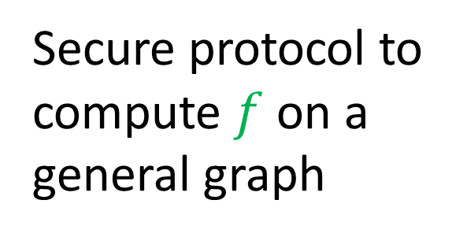
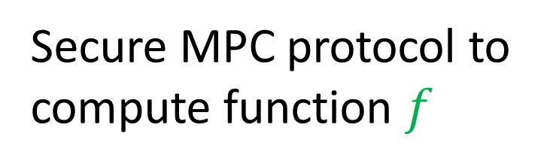
Common Approach to Handle General Graphs
Secure protocol to
compute $f$ on a
general graph
Secure MPC protocol to
compute function $f$

Slide 15
Our Approach to Handle General Graphs
Efficient distributed algorithm for general graphs
Secure MPC protocol
Efficient secure distributed algorithm for general graphs

Slide 16


Example – Graph Coloring
How to verify an edge without revealing the color of the nodes?
Must have a third party! [Kus89]
Alice
Bob

Slide 17



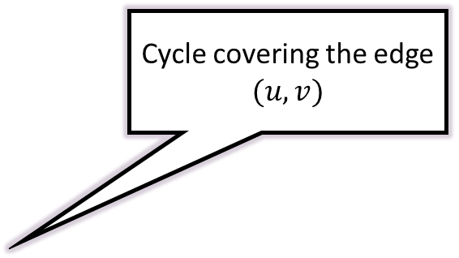
Example – Graph Coloring
How to verify an edge without revealing the color of the nodes?
Must have a third party! [Kus89]
Run an MPC protocol between the 3 parties
How to cover all edges with short cycles and
small overlap?
Cycle covering the edge $(u,v)$
Carol
Alice
$$u$$
$$v$$
Bob

Slide 18


The Remedy: $\left(d,c\right)$-Cycle Cover
Cover the edges of a 2-edge connected graph with cycles
Each cycle is of length at most $d$
Each edge participates in at most $c$ cycles
Not 2 edge connected
Has a (4,2)-cycle cover

Slide 19

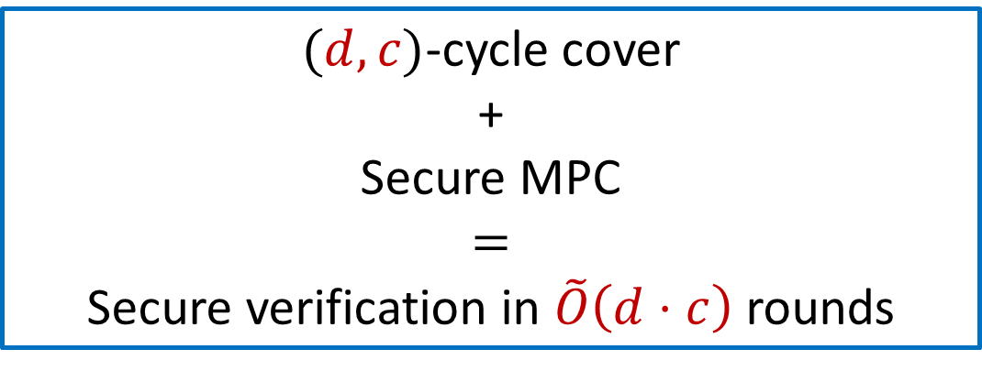

The Remedy: $\left(d,c\right)$-Cycle Cover
Cover the edges of a 2-edge connected graph with cycles
Each cycle is of length at most $d$
Each edge participates in at most $c$ cycles
$(d,c)$-cycle cover
+
Secure MPC
$$=$$
Secure verification in $\tilde{O}\left(d⋅c\right)$ rounds
Notes:
Leighton, Maggs, Rao.
Ghaffari

Slide 20
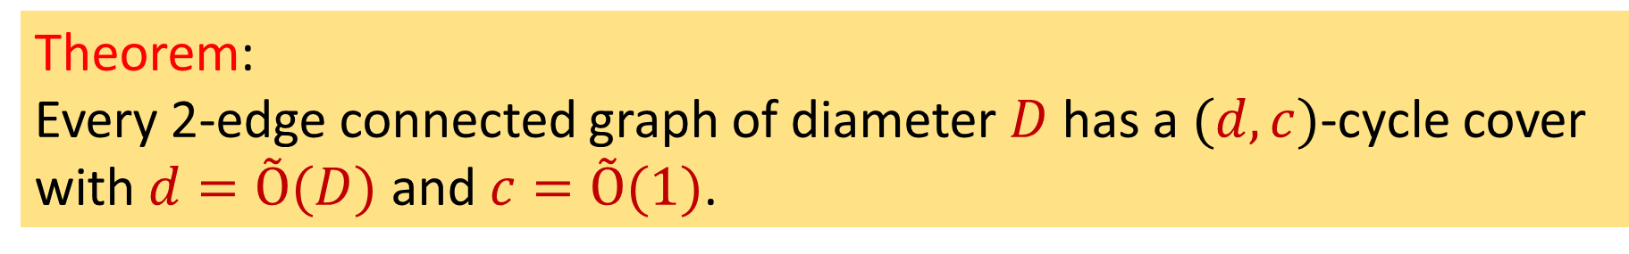

A New Cycle Cover Theorem
Theorem:
Every 2-edge connected graph of diameter $D$ has a $(d,c)$-cycle cover
with $d=Õ(D)$ and $c=Õ(1)$.
$Õ$ hides $polylog(n)$ factors ($n$ is #vertices)
This is (nearly) optimal (cycle graph)

Slide 21
Perfect Secure Compiler
Secure simulation of a single round
New combinatorial graph structure
Secure simulation of many rounds

Slide 22




Secure Simulation of a Single Round
Assume that $A$ works in a single round:
$u$ computes $y=f\left({σ_{u},m}_{1},…,m_{Δ}\right)$
Example: Color Verification
Alice
$$m_{1}$$
$$m_{2}$$
$$m_{Δ}$$
…
How to verify a node without revealing
the color of its neighbors?

Slide 23







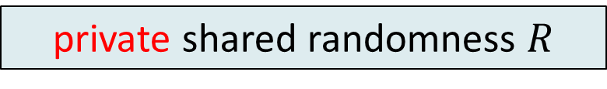



Private Simultaneous Messages (PSM)
$${f(x}_{1},{…,x}_{k})=y$$
A minimal model of MPC [FKN94, IK97]
$k$ clients have private shared randomness
Each sends a single message to a server
Server learns $y$ but “nothing more”
Efficient perfect secure protocols
for “small space functions”
$$m_{1}$$
$$m_{k}$$
. . .
$$x_{1}$$
$$x_{2}$$
$$x_{k}$$
private shared randomness $R$

Slide 24
How to share private randomness?
  Computationally Secure Solution
  Perfect Secure Solution

Slide 25
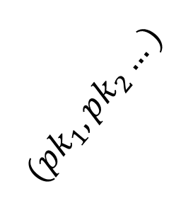


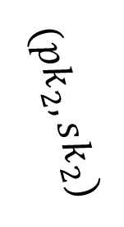
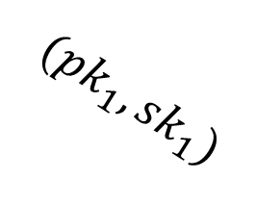
Computationally Secure Solution
Each neighbor picks public key + secret key
$Δ$ public keys are sent to all the neighbors through Alice
Send the encrypted shared randomness through Alice
Alice
$$(pk_{1},pk_{2}…)$$
$$(pk_{1},sk_{1})$$
$$(pk_{2},sk_{2})$$
…
Message size depends on
security parameter
$$R$$
Bob

Slide 26
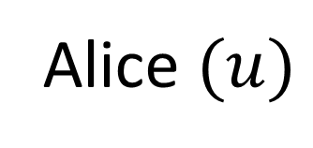

How to Exchange Private Shared Randomness in a Perfect Secure Manner?
Alice $(u)$
Bob
Carol
Key Insight: in perfect secure protocol, nodes must have a secure channel without $u$

Slide 27


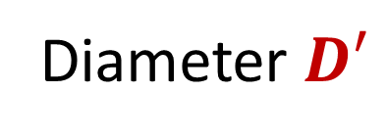
Perfect Secure Solution: First Attempt
Recall: $G$is 2-vertex connected!
→ $∃$ tree in $G−Alice$ that
spans all neighbors without Alice!
Diameter $D′$
Sharing $r$ bits on the tree
takes $O\left(D′+r\right)$ rounds

Slide 28
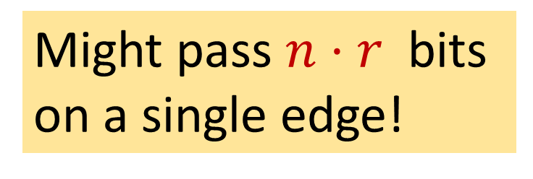
Perfect Secure Solution: First Attempt
Challenge: should be done
for all nodes simultaneously !
Might pass $n⋅r$ bits
on a single edge!

Slide 29
In an Ideal World, ….
Small depth trees
Edge disjoint
Small depth trees
Small overlap!

Slide 30






The Remedy: $\left(d,c\right)$-Private Neighborhood Trees
A collections of $n$trees $T\left(u_{1}\right), …, T(u_{n})$
Tree $T\left(u_{i}\right)$spans all neighbors of $u_{i}$but does not contain $u_{i}$
Each tree is of depth at most $d$
Each edge participates in at most $c$ trees
$$u$$
$$T(u)$$
$$T(v)$$
$$v$$
Notes:
picture

Slide 31

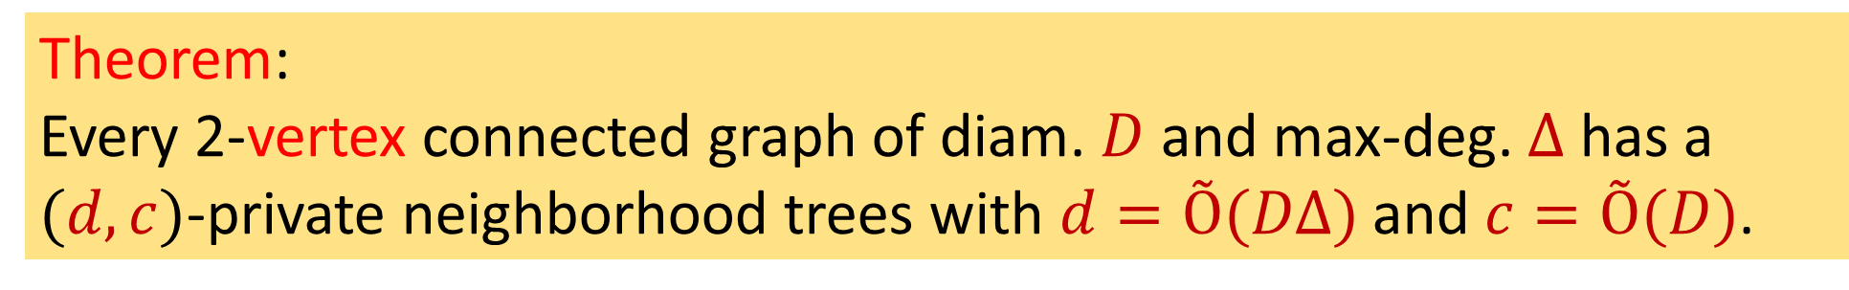
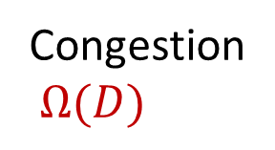
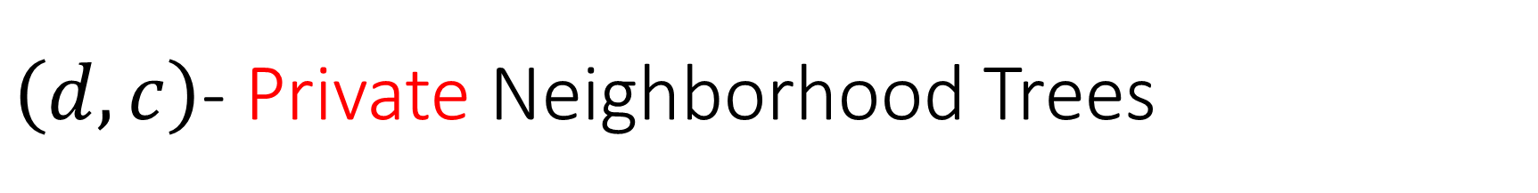



$\left(d,c\right)$- Private Neighborhood Trees
Theorem:
Every 2-vertex connected graph of diam. $D$ and max-deg. $Δ$ has a $(d,c)$-private neighborhood trees with $d=Õ(DΔ)$ and $c=Õ(D)$.
This is (nearly) optimal
$$u$$
Congestion
$Ω(D)$
depth
$Ω(DΔ)$
$$D$$
$$D$$

Slide 32
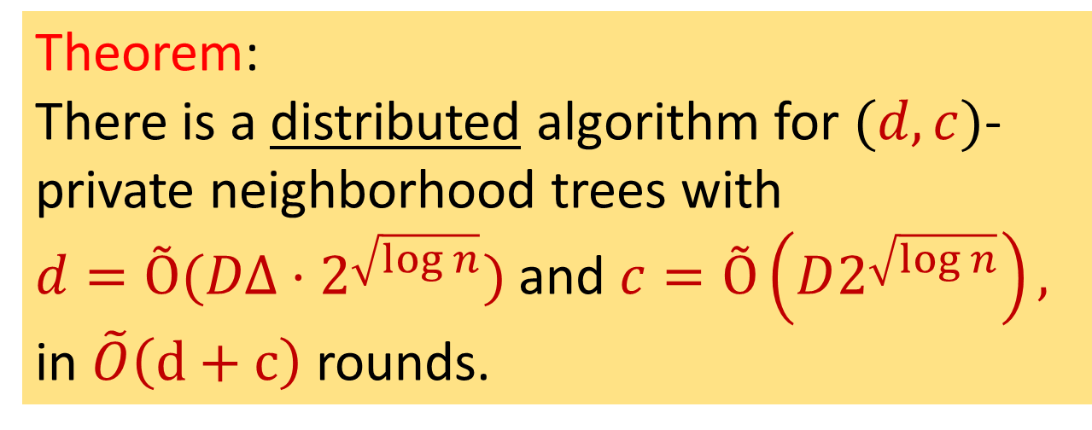
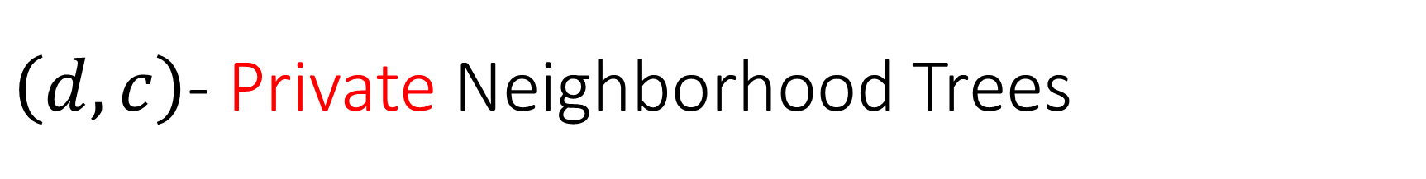
$\left(d,c\right)$- Private Neighborhood Trees
$$u$$
Theorem:
There is a distributed algorithm for $(d,c)$-private neighborhood trees with
$d=Õ(DΔ⋅2^{\sqrt{\log{n}}})$ and $c=Õ\left(D2^{\sqrt{\log{n}}}\right),$
in $\tilde{O}\left(d+c\right)$ rounds.
$$T(u)$$
$$T(v)$$
$$v$$

Slide 33
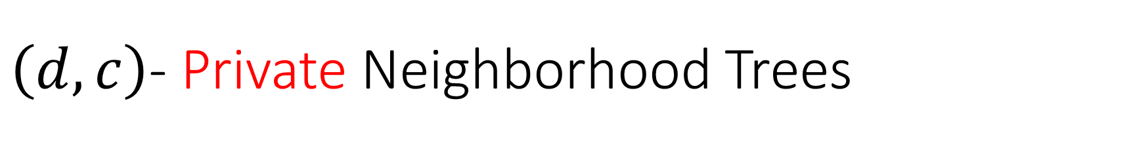
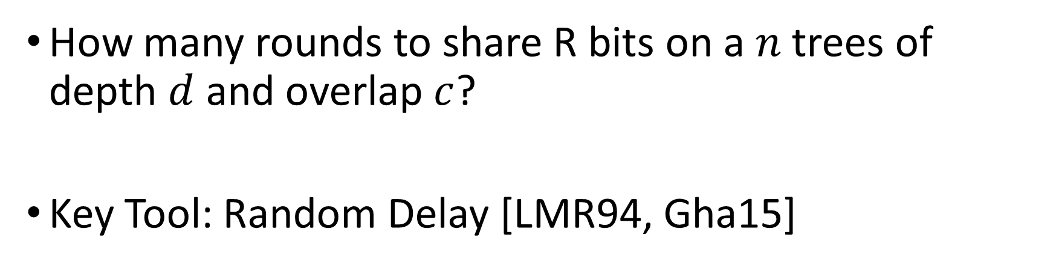
$\left(d,c\right)$- Private Neighborhood Trees
How many rounds to share R bits on a tree of depth $d$?
How many rounds to share R bits on a $n$ trees of depth $d$ and overlap $c$?
Key Tool: Random Delay [LMR94, Gha15]

Slide 34



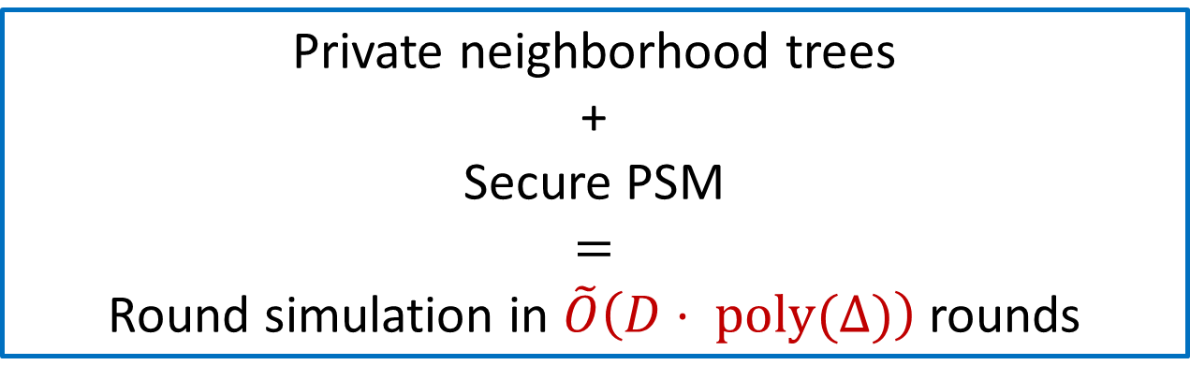
Secure Simulation of a Single Round
$u$ computes $y=f\left(σ_{u},m_{1},…,m_{Δ}\right)$
The secure algorithm for a node $u$:
  Broadcast $R$ using the private neighborhood tree
  Run the PSM protocol to compute $f$ securely
Apply the above for all nodes simultaneously
$$R$$
Private neighborhood trees
+
Secure PSM
$$=$$
Round simulation in $\tilde{O}\left(D⋅ poly(Δ)\right)$ rounds
$$y=f\left(σ_{u},m_{1},…,m_{Δ}\right)$$

Slide 35

Secure Simulation of Many Rounds
For an $r$-round algorithm $A$: $u$ computes $σ_{i}=f\left(σ_{i−1},m_{1},…,m_{Δ}\right)$
Attempt #1: Run the secure algorithm for a single round $r$ times
  Might reveal more than the final output (!)
Solution: states are “encrypted” and we “homomorphically” compute the next state
  Keys chosen by neighbors
  Homomorphic operations simulated by the PSM protocol

Slide 36







Secure Simulation of Many Rounds
Encryption of $m$: $m⊕k$
Chosen by neighbors
Ciphertext
The function $f′$:
Decrypt the input to get $σ_{i−1},m_{1},…,m_{Δ}$
Compute
$\left(σ_{i},{m′}_{1},…,{m′}_{Δ}\right)←f\left(σ_{i−1},m_{1},…,m_{Δ}\right)$
Encrypt the new state $σ_{i}$ and messages
Decryption keys
$$m_{1}$$
$$m_{Δ}$$
…
$$m_{2}$$
New encryption keys
Ciphertext

Slide 37












Secure Simulation of Many Rounds
$$\left[σ_{i−1}\right],R_{v_{1}→u},…,R_{v_{Δ}→u}$$
$$u$$
Run the PSM protocol for $f′$:
  $u$ is the server
  $v_{1},…,v_{Δ}$ are the parties.
  Parties exchange private randomness using
  the private neighborhood cover.
$u$ learns $\left[σ_{i}\right],\left[m_{u→v_{1}}\right],…,[m_{u→v_{Δ}}]$.
Runs simultaneously for all nodes.
Schedule all algorithms using [LMR94,Gha15].
$$v_{1}$$
$$v_{2}$$
$$v_{Δ}$$
$$\left[m_{v_{1}→u}\right]$$
$$R_{u→v_{1}}$$
$$R_{σ_{i−1}},R_{σ_{i}}$$
$$\left[m_{v_{2}→u}\right]$$
$$R_{u→v_{2}}$$
$$\left[m_{v_{Δ}→u}\right]$$
$$R_{u→v_{Δ}}$$
$$\left[σ_{i−1}\right],\left[m_{v_{1}→u}\right],…,[m_{v_{Δ}→u}]$$
Decryption keys
$$f′$$
New encryption keys
$$\left[σ_{i}\right],\left[m_{u→v_{1}}\right],…,[m_{u→v_{Δ}}]$$

Slide 38
Cycle Cover
Private Neighborhood Trees
Secure Compiler

Slide 39


$\left(d,c\right)$-Cycle Cover
2-edge connected graph $G$
Collection of k cycles $C_{1}, …, C_{k}$ such that:
  For each edge $e∈G$ there is a cycle $C_{i}$ that contains it
  Each cycle is of length at most $d$
  Each edge participates in at most $c$ cycles
Has a (4,2)-cycle cover
Not 2 edge connected

Slide 40
A New Cycle Cover Theorem
Theorem:
Every 2-edge connected graph of diameter $D$ has a $(d,c)$-cycle cover
with $d=Õ(D)$ and $c=Õ(1)$.
$Õ$ hides $polylog(n)$ factors ($n$ is #vertices)
This is (nearly) optimal (cycle graph)

Slide 41




Constructing $\left(d,c\right)$-Cycle Cover
Fact [Moore Bound]:
every n-vertex graph with $≥2n$edges, has girth $g≤\log{n}$
Can cover all but $2n$edges of
$G$by edge-disjoint short cycles
As long as #edges $≥$ $2n,$compute shortest cycle
and omit it from the graph

Slide 42


Constructing $\left(d,c\right)$-Cycle Cover
Fact: every n-vertex graph with $≥2n$edges, has girth $g≤\log{n}$
Can cover all but $2n$edges of
$G$by edge-disjoint short cycles
As long as #edges $≥$ $2n,$compute shortest cycle
and omit it from the graph

Slide 43
Constructing $\left(d,c\right)$-Cycle Cover
Fact: every n-vertex graph with $≥2n$edges, has girth $g≤\log{n}$
Can cover all but $2n$edges of
$G$by edge-disjoint short cycles
As long as #edges $≥$ $2n,$compute shortest cycle
and omit it from the graph

Slide 44

Constructing $\left(d,c\right)$-Cycle Cover
Fact: every n-vertex graph with $≥2n$edges, has girth $g≤\log{n}$
Can cover all but $2n$edges of
$G$by edge-disjoint short cycles
As long as #edges $≥$ $2n,$compute shortest cycle
and omit it from the graph
Remaining graph might have a large diameter

Slide 45




Constructing $\left(d,c\right)$-Cycle Cover
Construct a BFS tree $T$ in $G$
Here: covering non-tree edges
Attempt 1:
Cover each edge with its fundamental cycle in $T$
Length: at most $D$
Congestion: might be $Ω\left(n\right)$

Slide 46

Constructing $\left(d,c\right)$-Cycle Cover
Construct a BFS tree $T$ in $G$
Here: covering non-tree edges
Even if the graph G has many disjoint trees,
there is no guarantee on their depth!
We use a single BFS tree, but in a different manner

Slide 47

Our Approach: Block Decomposition
Here: all edges $E’$ to cover are between leafs, $\left|E^{′}\right|=2n$
Partition the leafs into blocks of small density (number of edges in $E’$)
#blocks $≤n/4$.
Density threshold: 8
The idea: use tree paths between vertices in the same block

Slide 48

The Contracted Graph
Contracted graph:
$n/4$ block-vertices
$2n$ edges
small girth!

Slide 49

Compute Short Cycles in Contracted Graph
Since the “graph” has $n/4$ vertices,
all but $n/2$ edges are covered by short cycles

Slide 50
Computing Short Cycles in Contracted Graph

Slide 51



Translating to Real Cycles
$$a$$
$$b$$
$$c$$
Note: using tree paths only
between vertices
in the same block

Slide 52

Cycle Length Analysis:
Cycles in the contracted graph are of length $O(log n)$
Each edge is replaced by a tree path of length at most $D$
Final cycle length: $O(Dlog n)$
Tree path
Non-tree edge

Slide 53




Congestion Analysis
Claim: Each tree edge is used in constant number of cycles.
Definition:
A block uses a tree edge $e$ if
$∃u,v$ in the block whose tree path
passes through$e$
Tree path
Non-tree edge
$$e$$
$$u$$
$$v$$

Slide 54





Key Observation: Blocks are Almost Edge Disjoint
Edge $e=(x,y)$ on tree path between $u,v$
$u∈T\left(y\right)$ and $v∉T(y)$
$$e$$
$$u$$
$$v$$

Slide 55
Key Observation: Blocks are Almost Edge Disjoint
Blocks inside the tree do not effect the edge
Blocks outside the tree do not effect the edge
Each tree edge is effected
by at most 2 blocks!
$$e$$

Slide 56



Cycle Cover Algorithm (Non-tree edges)
For $i=1, …, clog n$do:
Set $E’$ of edges to be covered
Partition into blocks of constant density
Compute short cycles in contracted graph
Translate these cycles to $G$-cycles
Omit covered edges from $E’$
Tree path
Non-tree edge
$$u$$
$$v$$
How to cover the tree edges?
Significantly harder!

Slide 57


$\left(d,c\right)$Private Neighborhood Trees
A collections of $n$trees $T\left(u_{1}\right), …, T(u_{n})$
Tree $T\left(u_{i}\right)$spans all neighbors of $u_{i}$but does not contain $u_{i}$
Each tree is of depth at most $d$
Each edge participates in at most $c$ trees
$$u$$
$$T(u)$$
Constructed by reduction to cycle cover!
$$T(v)$$
$$v$$

Slide 58
Toda!
(Thanks)
Cryptographic Requirements → New Combinatorial Structures
Cycle Cover
Private Neighborhood Trees
Secure Compiler

Slide 59




$\left(d,c\right)$Private Neighborhood Trees
Theorem: Every 2-vertex connected graph has a $(d,c)$ private neighborhood trees with $d=Õ(DΔ) \text{and} c=Õ(D)$.
Idea: grow forest for each $u$in (a la Boruvka):
Start: trivial empty forest
$$u$$

Slide 60



$\left(d,c\right)$Private Neighborhood Trees
Compute cycle cover in $G$ → # components reduces by half!
$$u$$
$$≤D$$

Slide 61



$\left(d,c\right)$Private Neighborhood Trees
Compute cycle cover in auxiliary graph: adding virtual node per component
$$u$$
$$≤D$$

Slide 62



$\left(d,c\right)$Private Neighborhood Trees
$$u$$
After $O\left(log Δ\right)$steps, the forest becomes a tree!

