Slide 1
Succinct Graph Structures and Their Applications Spring 2020
Class 1: Spanners

Slide 2
Course Overview
Real day networks are very dense (e.g., Facebook, internet..)
Sketch the graph while keeping key properties
Fault Tolerance
Distances
Subgraphs
Routing Tables
Cuts
Data-Structure
Labels

Slide 3
Basic Example: Shortest-Path Trees
Preserve distances w.r.t a fixed source node
What if we want to preserve distances between all pairs?
Stretch

Slide 4
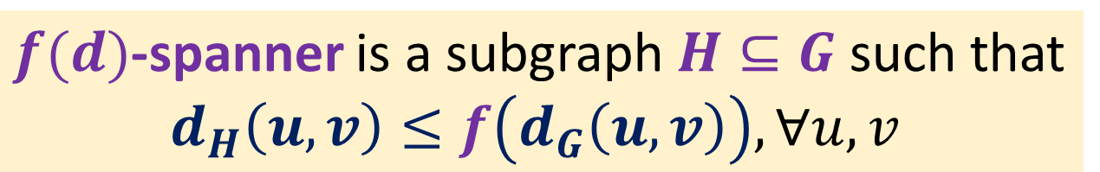
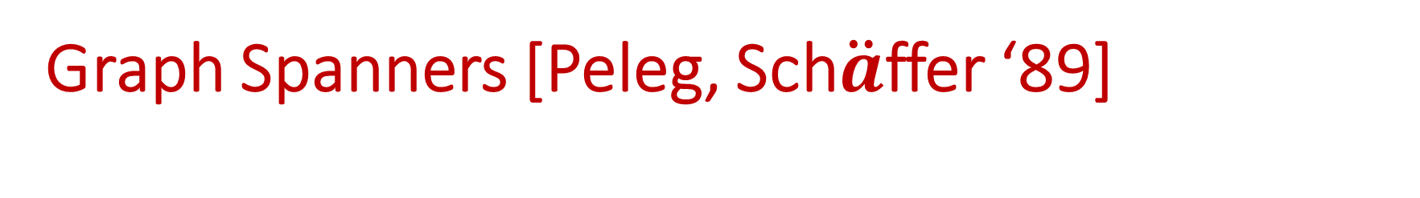


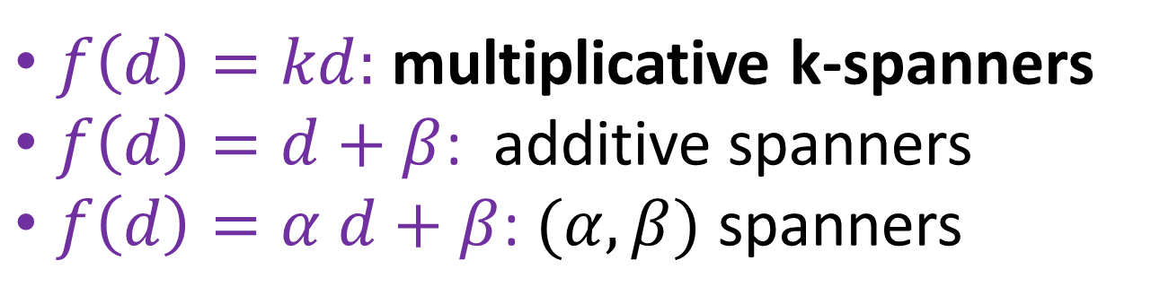
Graph Spanners [Peleg, Sch$\ddot{a}$ffer ‘89]
Sparse subgraphs that preserve distances up to some bounded stretch
$f(d)$-spanner is a subgraph $H⊆G$such that
$d_{H}\left(u,v\right)≤f\left(d_{G}\left(u,v\right)\right), ∀u,v$
$f\left(d\right)=kd:$ multiplicative k-spanners
$f\left(d\right)=d+β$: additive spanners
$f\left(d\right)=α d+β$: $(α, β)$ spanners
$$d_{H}\left(u,v\right)≤k⋅d_{G}\left(u,v\right)$$
$$d_{H}\left(u,v\right)≤d_{G}\left(u,v\right)+β$$
Goal: optimize tradeoff between size and stretch

Slide 5


Examples
2-spanner for $K_{n}?$
2-spanner for general graph?
$d_{H}\left(u,v\right)≤2d_{G}\left(u,v\right), ∀u,v$

Slide 6
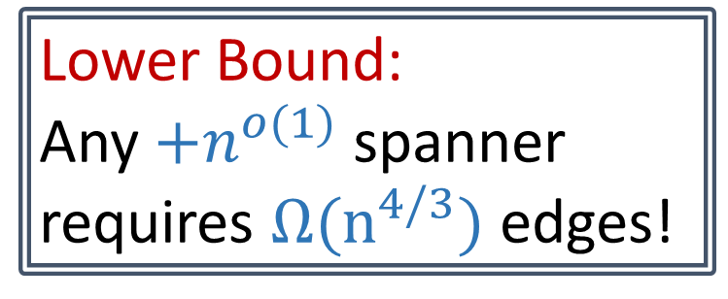
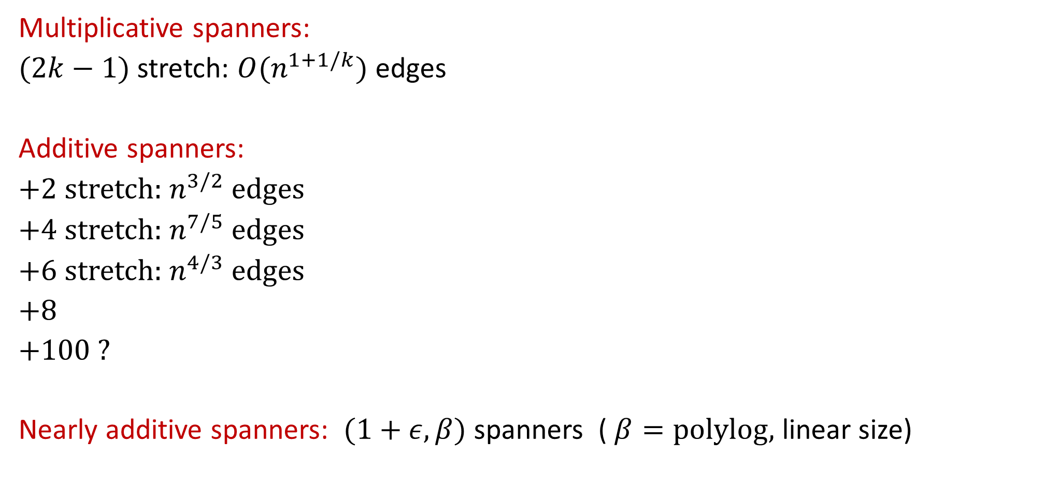
What’s Known?
Multiplicative spanners:
$(2k−1)$ stretch: $O(n^{1+1/k})$ edges
Additive spanners:
+2 stretch: $n^{3/2}$edges
+4 stretch: $n^{7/5}$edges
+6 stretch: $n^{4/3}$edges
+8
+100 ?
Nearly additive spanners: $(1+ε, β)$ spanners ( $β=polylog,$ linear size)
Lower Bound:
Any $+n^{o(1)}$ spanner
requires $Ω(n^{4/3})$ edges!

Slide 7
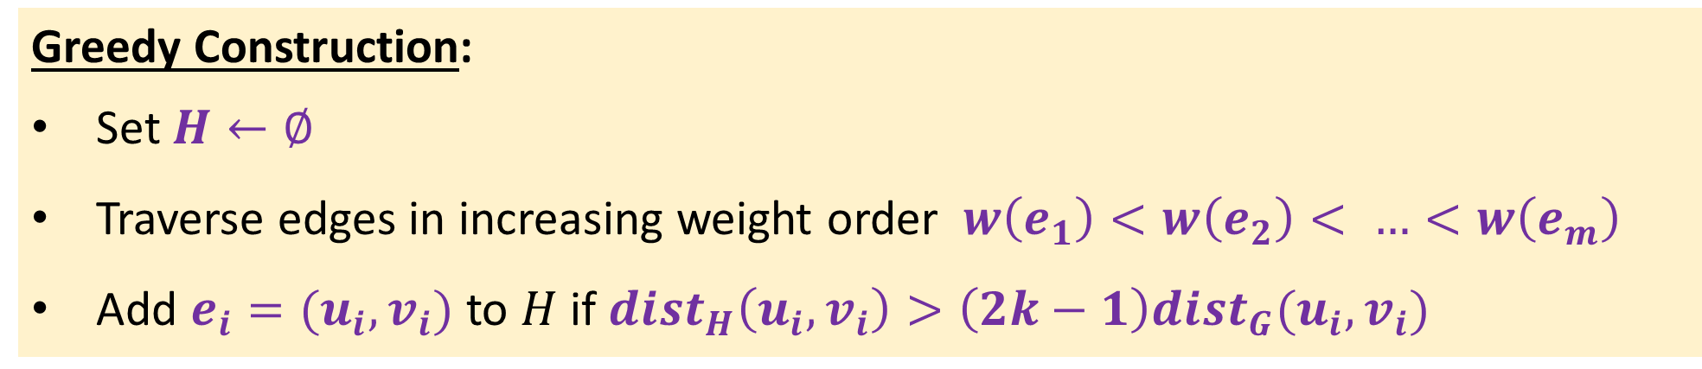
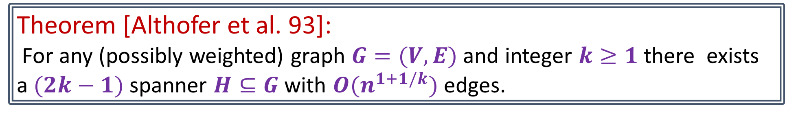
Multiplicative Spanners
Theorem [Althofer et al. 93]:
For any (possibly weighted) graph $G=(V,E)$ and integer $k≥1$ there exists a $(2k−1)$ spanner $H⊆G$ with $O(n^{1+1/k})$ edges.
Greedy Construction:
Set $H←∅$
Traverse edges in increasing weight order $w\left(e_{1}\right)<w\left(e_{2}\right)< …<w\left(e_{m}\right)$
Add $e_{i}=(u_{i},v_{i})$ to $H$ if $dist_{H}\left(u_{i}, v_{i}\right)>\left(2k−1\right)dist_{G}(u_{i},v_{i})$

Slide 8


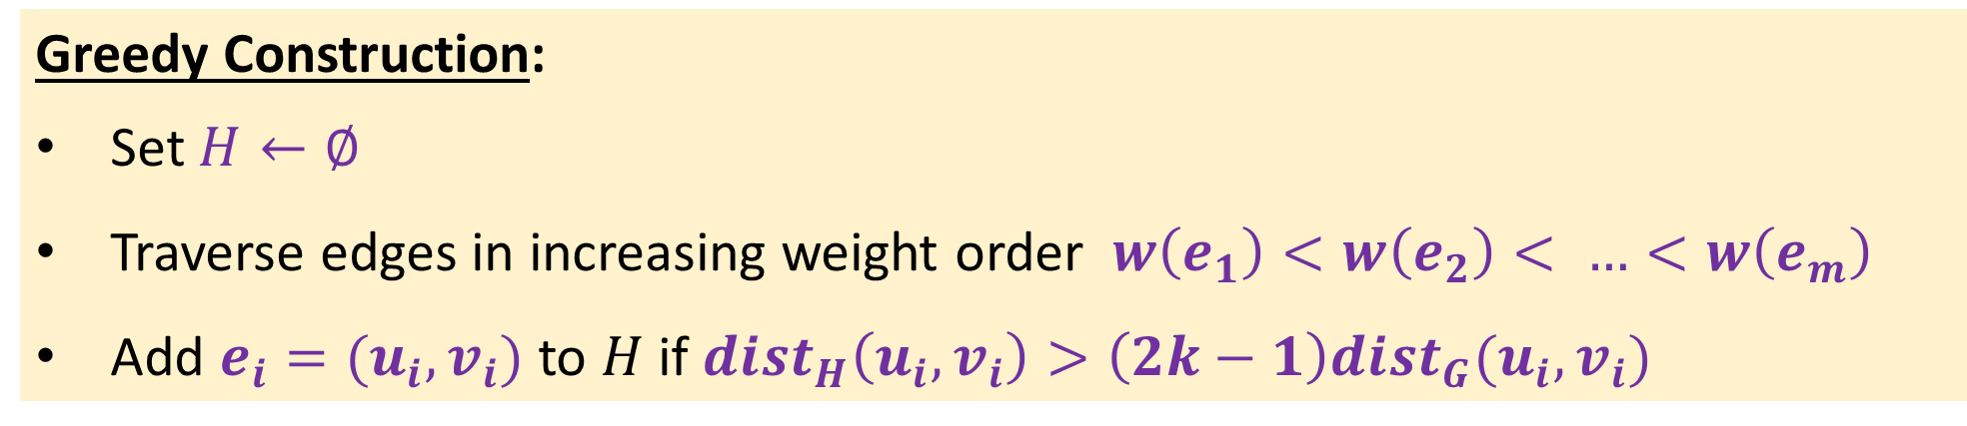




Greedy Construction:
Set $H←∅$
Traverse edges in increasing weight order $w\left(e_{1}\right)<w\left(e_{2}\right)< …<w\left(e_{m}\right)$
Add $e_{i}=(u_{i},v_{i})$ to $H$ if $dist_{H}\left(u_{i}, v_{i}\right)>\left(2k−1\right)dist_{G}(u_{i},v_{i})$
Correctness: Consider a $u−v$ shortest path P in $G$
$$u$$
$$x$$
$$y$$
$$v$$
$$e$$
$$≤\left(2k−1\right)w(e)$$
$dist_{H}\left(u,v\right)≤(2k−1)\sum_{e∈P}{w(e)}$= $\left(2k−1\right)dist_{G}(u,v)$

Slide 9

Greedy Construction:
Set $H←∅$
Traverse edges in increasing weight order $w\left(e_{1}\right)<w\left(e_{2}\right)< …<w\left(e_{m}\right)$
Add $e_{i}=(u_{i},v_{i})$ to $H$ if $dist_{H}\left(u_{i}, v_{i}\right)>\left(2k−1\right)dist_{G}(u_{i},v_{i})$
Size analysis: show that $\left|H\right|=O(n^{1+1/k})$ edges.
Claim 1: the girth of H is at least 2k+1
Girth: length of shortest cycle
Claim 2: Every graph G with g(G)$≥2k+1$ has $O(n^{1+1/k})$ edges.

Slide 10
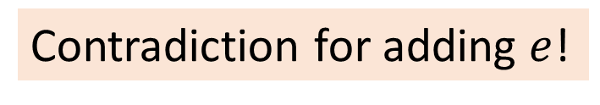
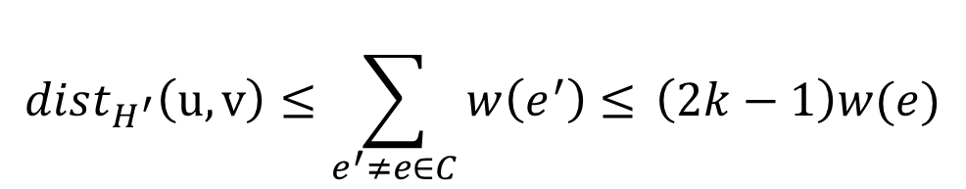



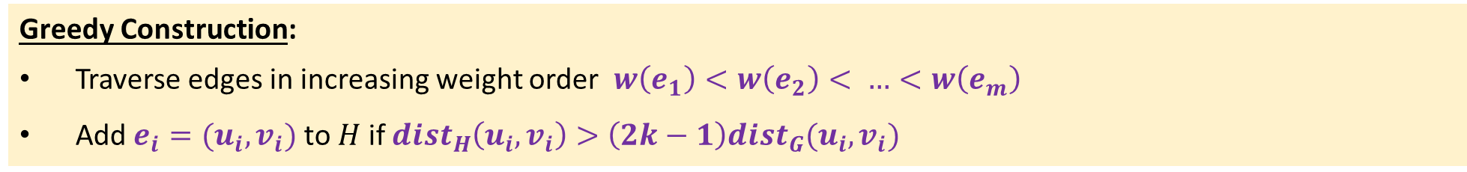
Greedy Construction:
Traverse edges in increasing weight order $w\left(e_{1}\right)<w\left(e_{2}\right)< …<w\left(e_{m}\right)$
Add $e_{i}=(u_{i},v_{i})$ to $H$ if $dist_{H}\left(u_{i}, v_{i}\right)>\left(2k−1\right)dist_{G}(u_{i},v_{i})$
Claim 1: the girth of $H$ is at least 2k+1
Proof: Suppose there is a cycle $C$ of length at most $2k$
Let $e=(u,v)$ be the last added edges on $C$
By the ordering: $e$is the heaviest on $C$
Girth: length of shortest cycle
$$u$$
$$v$$
$$dist_{H^{′}}\left(u,v\right)≤\sum_{e^{′}≠e∈C}{w\left(e^{′}\right)≤} \left(2k−1\right)w(e)$$
The subgraph H just before adding e
Contradiction for adding $e$!

Slide 11

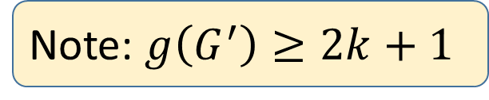
Claim 2: Every graph G with g(G)$≥2k+1$ has $O(n^{1+1/k})$ edges.
Proof: Assume $G$ has $≥$ 4$n^{1+1/k}$ edges and $g(G)≥2k+1$
Compute $G^{′}⊆G$ with min-degree $≥2n^{1/k}$
Note: $g\left(G^{′}\right)≥2k+1$

Slide 12



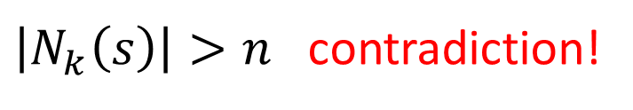





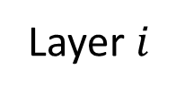
Claim 2: Every graph G with g(G)$≥2k+1$ has $O(n^{1+1/k})$ edges.
Note: $g\left(G^{′}\right)≥2k+1$
Grow BFS of radius k around a fixed node $s$ in $G’$
Claim: vertices in layer $i≤k−1$ have no mutual neighbor in layer $i+1$
$$s$$
$$…$$
$$\left|N_{1}\left(s\right)\right|≥{2n}^{1/k}$$
$$\left|N_{2}\left(s\right)\right|≥{4n}^{2/k}$$
$$\left|N_{i}\left(s\right)\right|≥{2^{i}n}^{i/k}$$
Layer $i$
Cycle length $2i+2≤2k$
$\left|N_{k}\left(s\right)\right|>n$ contradiction!

Slide 14

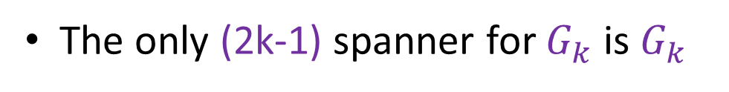
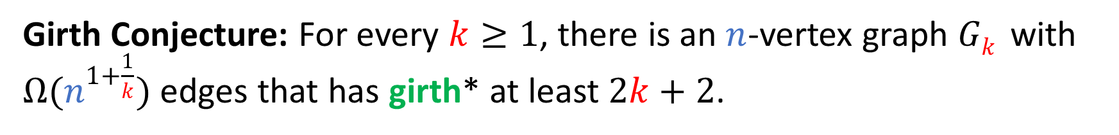
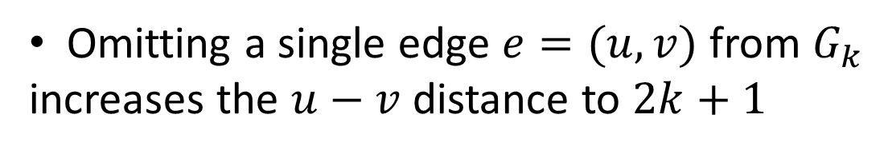


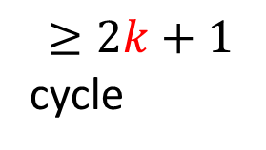
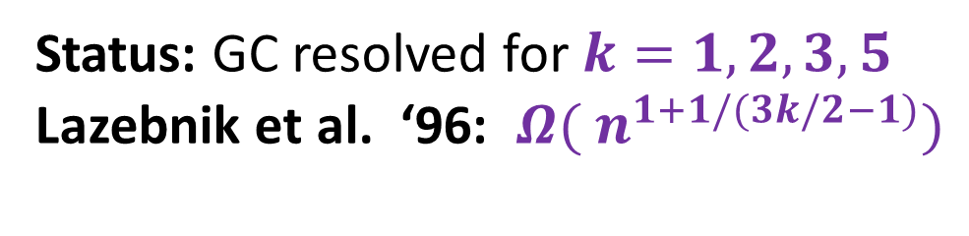
Girth Conjecture: For every $k≥1$, there is an $n$-vertex graph $Gk$ with $Ω(n^{1+\frac{1}{k}})$ edges that has girth* at least $2k+2$.
The Girth Conjecture
$$u$$
$$v$$
Omitting a single edge $e=(u,v)$ from $G_{k}$
increases the $u−v$ distance to $2k+1$
The only (2k-1) spanner for $G_{k}$ is $G_{k}$
$$≥2k+1$$
cycle
Status: GC resolved for $k=1,2,3,5$
Lazebnik et al. ‘96: ${Ω( n}^{1+1/(3k/2−1)})$

Slide 15
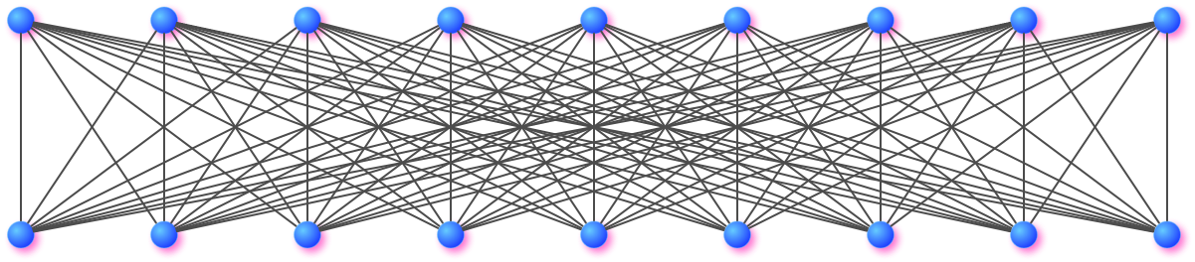

k=2, $Ω(n^{2})$
Girth=4

Slide 16
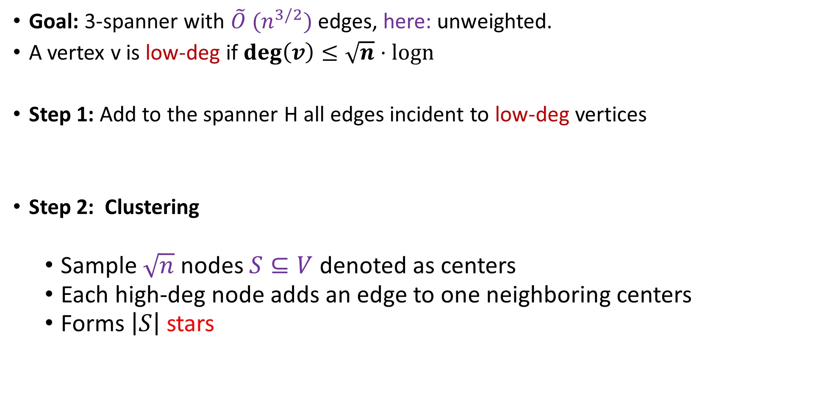
Baswana-Sen Algorithm for 3-Spanners
Goal: 3-spanner with $\tilde{O} (n^{3/2})$ edges, here: unweighted.
A vertex v is low-deg if $\deg\left(v\right)≤\sqrt{n}⋅logn$
Step 1: Add to the spanner H all edges incident to low-deg vertices
Step 2: Clustering
Sample $\sqrt{n}$ nodes $S⊆V$ denoted as centers
Each high-deg node adds an edge to one neighboring centers
Forms $\left|S\right|$stars

Slide 17
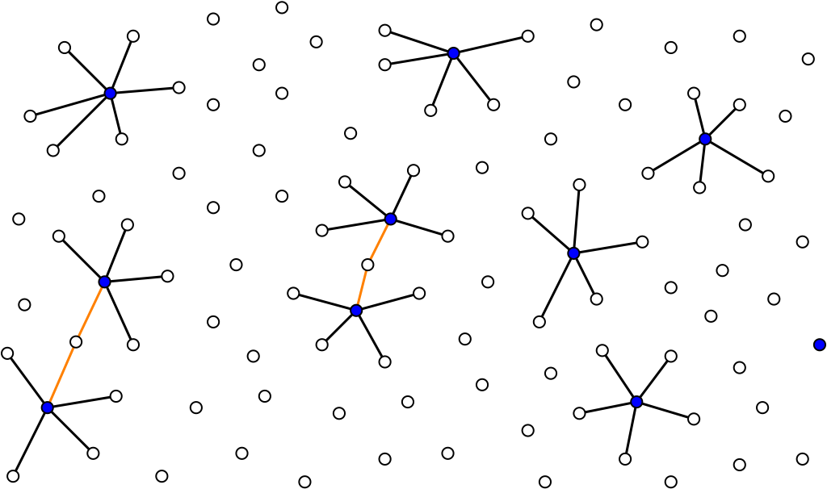

Slide 18
Step 3: each high-deg vertex adds one edge to each neighboring star

Slide 19
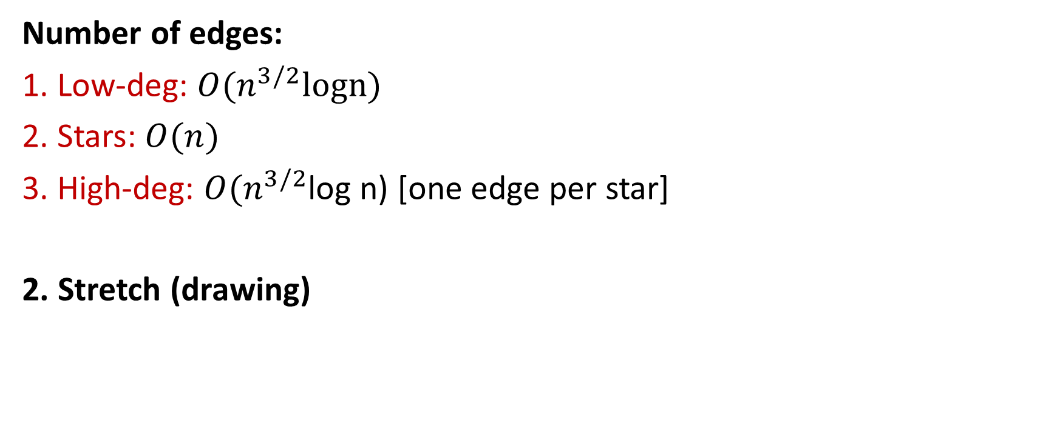
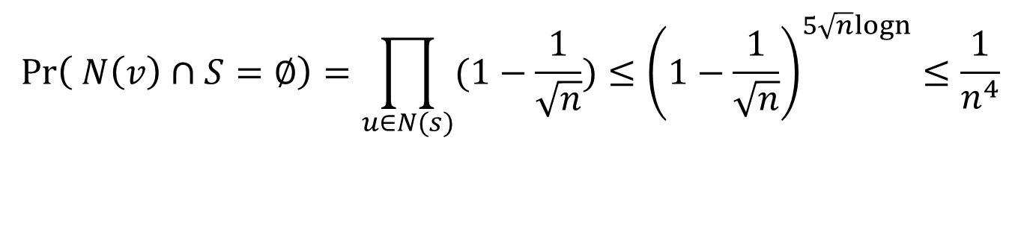
3-Spanner Analysis
Claim: each high-deg vertex has at least one sample neighbor in$S$
$$\operatorname{Pr}\left( N\left(v\right)∩S=∅\right)=\prod_{u∈N(s)}{(1−\frac{1}{\sqrt{n}})}≤{\left(1−\frac{1}{\sqrt{n}}\right)}^{5\sqrt{n}logn}≤\frac{1}{n^{4}}$$
Number of edges:
1. Low-deg: $O(n^{3/2}logn)$
2. Stars: $O(n)$
3. High-deg: $O(n^{3/2}$log n) [one edge per star]
2. Stretch (drawing)

Slide 20



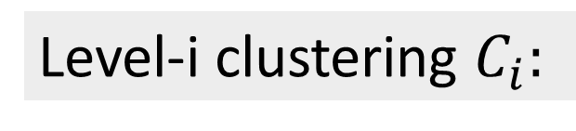
Baswana-Sen Algorithm for (2k-1) Spanners
Output: $(2k−1)$spanner$H$ with $O\left(kn^{1+1/k}\right)$ edges
$k$ levels of clustering $C_{0}=\{ \{v_{1}\}, …, \{v_{n}\}\}$, $C_{1},…, C_{k}=∅$
Level-i clustering $C_{i}:$
$$i$$
$${\left|C_{i}\right|=n}^{1−i/k}$$

Slide 21


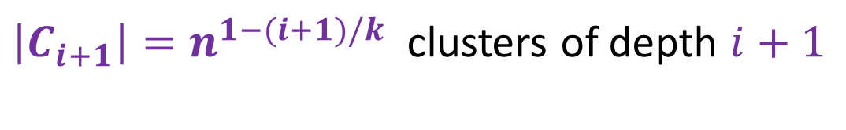


Phase i:
Input: clustering $C_{i}$ , subgraph $H_{i}$
Step 1: Define clustering $C_{i+1}$
Each cluster center gets sampled independently w.p $n^{−1/k}$
Each vertex joins an adjacent sampled cluster (if exists)
Level-i clustering $C_{i}:$
$$i$$
$${\left|C_{i}\right|=n}^{1−i/k}$$
${\left|C_{i+1}\right|=n}^{1−(i+1)/k}$ clusters of depth $i+1$

Slide 22

Phase i:
Input: clustering $C_{i}$ , subgraph $H_{i}$
Step 2: Handle newly-unclustered vertices
Each vertex adds one edge per neighboring cluster in $C_{i}$
Level-i clustering $C_{i}:$
$$i$$
$${\left|C_{i}\right|=n}^{1−i/k}$$

Slide 23


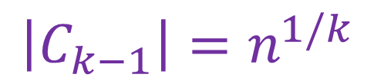
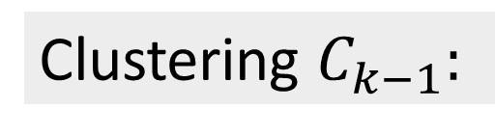
Final Phase k-1:
Input: clustering $C_{k−1}$, subgraph $H_{k−1}$
$C_{k}←∅$
Each vertex in $C_{k−1}$ adds (to $H_{k}$) one edge per neighboring cluster in $C_{k−1}$
$H←H_{k}$
Clustering $C_{k−1}:$
$$k−1$$
$${\left|C_{k−1}\right|=n}^{1/k}$$

Slide 24






Analysis (Stretch)
Consider an edge $\left(u,v\right)∉H$
W.l.o.g. assume $u$stopped being clustered not after $v$, say in step $i$
Show: $dist_{H}\left(u,v\right)≤2i+1$
Level-i clustering $C_{i}:$
$$i$$
$$v$$
$${\left|C_{i}\right|=n}^{1−i/k}$$
$$u$$
Claim follows as all vertices stopped being cluster up to step $k−1$

Slide 25






Analysis (Size)
Show: each step $i$adds $O(n^{1+\frac{1}{k}}log n)$ edges
Level-i clustering $C_{i}:$
$$i$$
$$v$$
$${\left|C_{i}\right|=n}^{1−i/k}$$
$$u$$
w.h.p. a vertex has at most $n^{1/k}log n$ adjacent clusters

