Slide 1


Sparse Fault-Tolerant BFS Trees
Merav Parter and David Peleg
Foundation of Computer Science Seminar
17-11-2013

Slide 2
Breadth First Search (BFS) Trees
Unweighted graph G=(V,E), source vertex sV
Shortest-Path Tree (BFS) rooted at s.
Sparse solution:
n-1 edges.
Problem:
Not robust against edge
and vertex faults.
s
v₁
v₂
v₃
v₄
v₅
Notes:
Insert in click

Slide 3
s
v₁
v₂
v₃
v₄
v₅

Slide 4
Fault-Tolerant BFS Trees
Objective:
Add edges to the BFS tree to make it robust against
single edge (or vertex) fault.
s
v₁
v₂
v₃
v₄
v₅
Notes:
Insert in click

Slide 5


Fault-Tolerant (FT) BFS Trees
Subgraph H that contains a BFS tree in G\{e}
for every edge failure e in G.
s
s
e₁
e₂
e₃
e₄
v₁
v₂
v₁
v₂
v₃
v₄
v₃
v₄
e₅
v₅
v₅
$$G∖\{e1\}$$
$$H∖\{e1\}$$
Notes:
Insert in click

Slide 6
Fault-Tolerant (FT) BFS Trees
Subgraph H that contains a BFS tree in G\{e}
for every edge failure e in G.
s
s
e₁
e₂
e₃
e₄
v₁
v₂
v₁
v₂
v₃
v₄
v₃
v₄
e₅
v₅
v₅
$$G∖\{e1\}$$
$$H∖\{e1\}$$
Notes:
Insert in click

Slide 7
Fault-Tolerant (FT) BFS Trees
Subgraph H that contains a BFS tree in G\{e}
for every edge failure e in G.
s
s
e₁
e₂
e₃
e₄
v₁
v₂
v₁
v₂
v₃
v₄
v₃
v₄
e₅
v₅
v₅
$$G∖\{e1\}$$
$$H∖\{e1\}$$
Notes:
Insert in click

Slide 8


Fault-Tolerant (FT) BFS Trees
Subgraph H that contains a BFS tree in G\{e}
for every edge failure e in G.
s
s
e₁
e₂
e₃
e₄
v₁
v₂
v₁
v₂
v₃
v₄
v₃
v₄
e₅
v₅
v₅
$$G∖\{e5\}$$
$$H∖\{e5\}$$
Notes:
Insert in click

Slide 9
Fault-Tolerant (FT) BFS Trees
Subgraph H that contains a BFS tree in G\{e}
for every edge failure e in G.
s
s
e₁
e₂
e₃
e₄
v₁
v₂
v₁
v₂
v₃
v₄
v₃
v₄
e₅
v₅
v₅
$$G∖\{e1\}$$
$$H∖\{e1\}$$
Notes:
Insert in click

Slide 10
FT-BFS Tree - Formal Definition
Consider an unweighted graph G=(V,E) and a source vetrex s.
A subgraph H is an FT-BFS of G and s if for every v in V and e in E: d(s,v, H \{e}) = d(s,v, G\{e})

Slide 11
FT-BFS for Multiple Sources (FT-MBFS)
Consider an unweighted graph G=(V,E) and a source set S in V.
A subgraph H is an FT-MBFS of G if for every s in S, v in V and e in E: d(s,v, H \{e}) = d(s,v, G\{e})

Slide 12
The Minimum FT-BFS tree Problem
Input: unweighted graph G=(V,E)
source vertex s in V.
Output:
An FT-BFS subgraph H⊆ G with minimum number of edges.
Notes:
Insert in click

Slide 13
Outline
Related work
Lower bound construction
Upper bound
Hardness and approximation algorithm.
Notes:
Insert in click

Slide 14
Related Work
Replacement Path
Fault-Tolerant Spanners
Notes:
Insert in click

Slide 15
A related problem:
replacement paths problem
s
Problem definition: Given a source s, destination t, compute d(u,v, Ge) efficiently for each
e ϵ P(s,t) .
Trivial algorithm:
For every edge e ϵ P(s,t), run Dijkstra’s algorithm from s in G\{e}.
Time complexity: O(mn)
P(s,t)
t

Slide 16
A related problem:
the replacement path problem
P(s,t,e) : s-t shortest path in G\{e}
P(s,t)
Problem definition:
Given a source s, destination t, for every
e ϵ P(s,t) , compute P(s,t,e) the shortest s-t path that avoids e.
Trivial algorithm:
For every edge e ϵ P(s,t), run Dijkstra’s algorithm from s in G\{e}.
Time complexity: O(mn)
s
P(s,t,e)
e
t

Slide 17
The structure of a replacement path
P(s,t,e) : s-t shortest path in G\{e}
s
P(s,t)
e
Detour
t

Slide 18
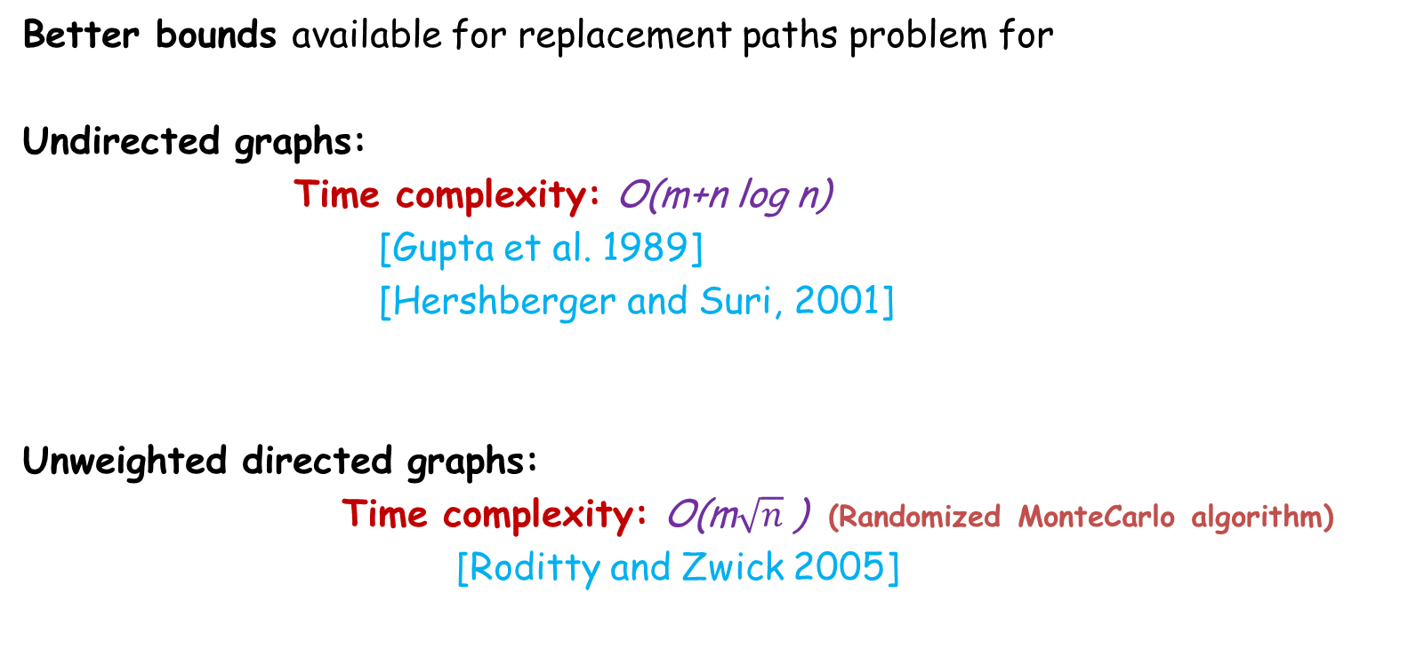
The replacement paths problem
Better bounds available for replacement paths problem for
Undirected graphs:
Time complexity: O(m+n log n)
[Gupta et al. 1989]
[Hershberger and Suri, 2001]
Unweighted directed graphs:
Time complexity: O(m$\sqrt{n}$ ) (Randomized MonteCarlo algorithm)
[Roditty and Zwick 2005]

Slide 19
Single-source replacement paths
Problem definition:
Given a source s, compute P(s,t,e) efficiently for each t in V and every e ϵ P(s,t).
Time complexity: O(n^{ɯ})
[Grandoni and Williams, FOCS’12]
FT-BFS tree revisited:
An FT-BFS tree H contains the collection of all
single source replacement paths.
Complexity measure: size of H (#edges).
New!

Slide 20
Distance sensitivity oracle
Notations:
P(s,t,e): shortest path from s to t in G\{e}
d(s,t,e): distance from s to t in G\{e}
A compact data structure capable of reporting P(s,t,e) and d(s,t,e) efficiently.

Slide 21
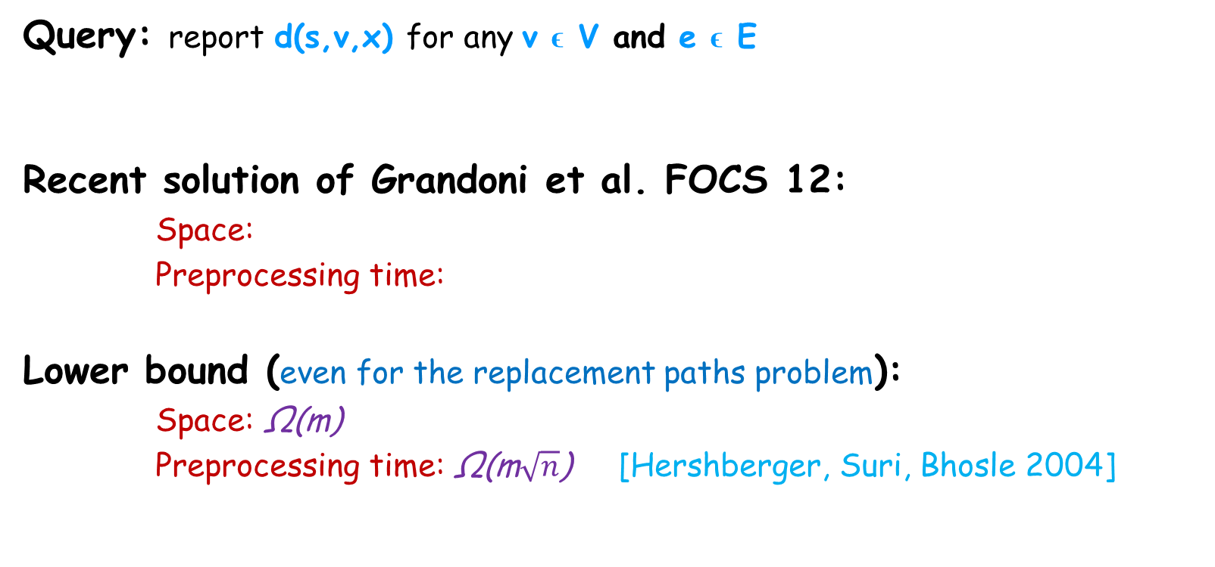
Single Source Distance sensitivity oracle
Query: report d(s,v,x) for any v ϵ V and e ϵ E
Recent solution of Grandoni et al. FOCS 12:
Space:
Preprocessing time:
Lower bound (even for the replacement paths problem):
Space: Ω(m)
Preprocessing time: Ω(m$\sqrt{n}$) [Hershberger, Suri, Bhosle 2004]

Slide 22
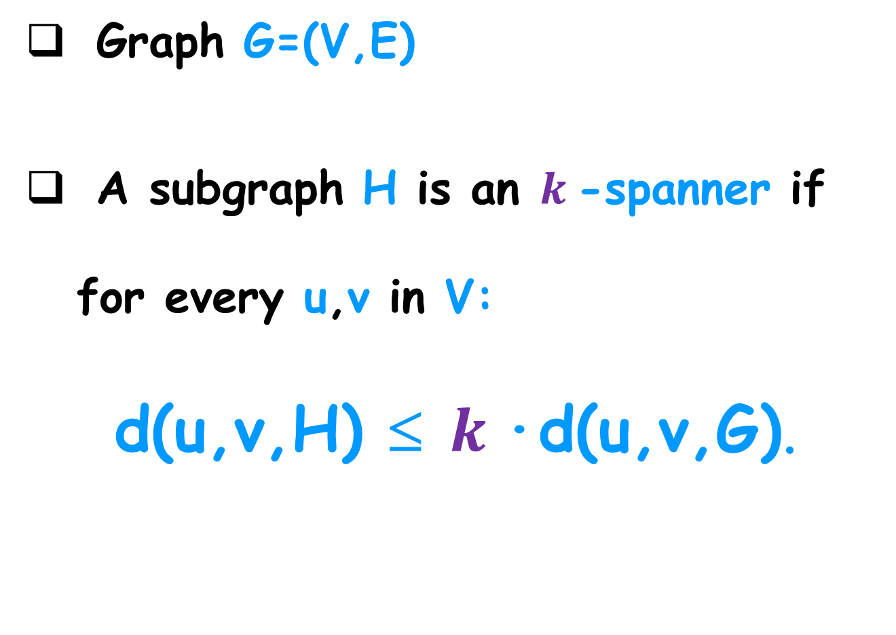
Spanners
Graph G=(V,E)
A subgraph H is an $k$-spanner if for every u,v in V:
d(u,v,H) ≤ $k$·d(u,v,G).

Slide 23
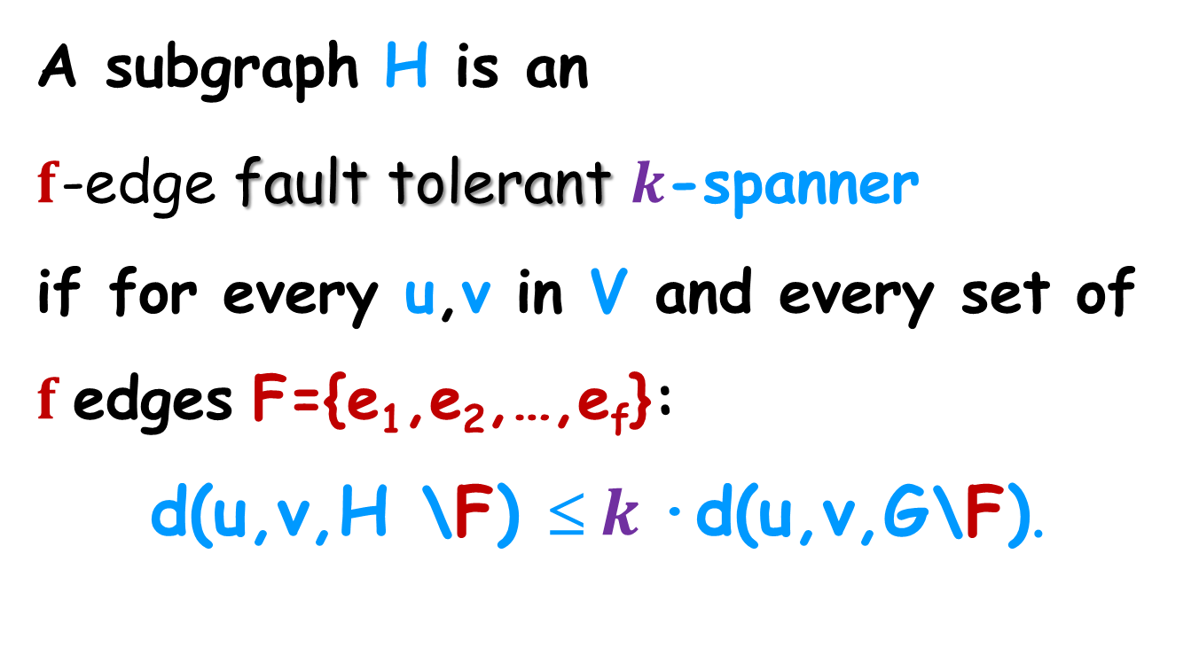
Fault-Tolerant Spanners
A subgraph H is an
$f$-edge fault tolerant $k\text{−}$spanner
if for every u,v in V and every set of $f$edges F={e₁,e₂,…,e_{f}}:
d(u,v,H \F) ≤ $k$·d(u,v,G\F).

Slide 24
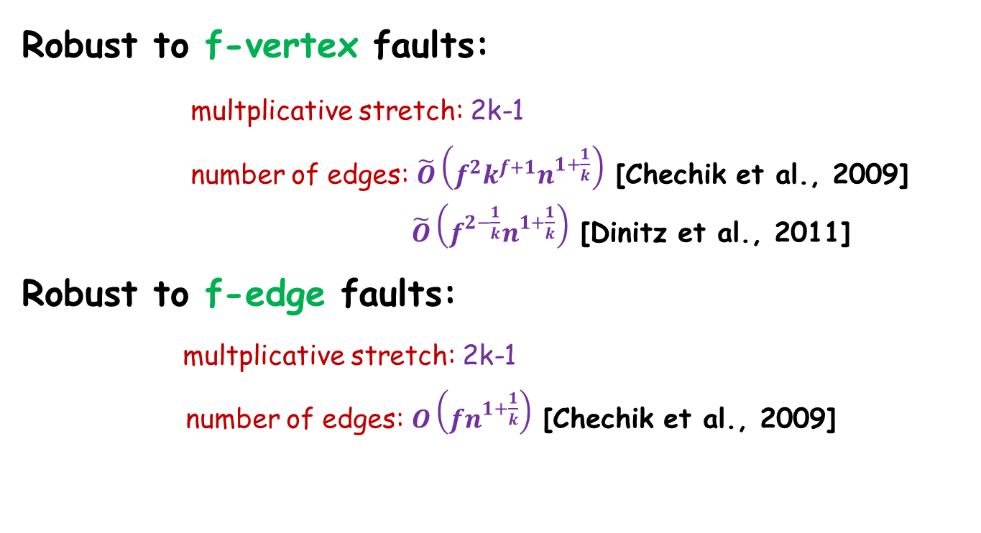
Fault-Tolerant Spanners
d(u,v,H \F) ≤ $α$·d(u,v,G\F) + $β$ for all u,v in V
Robust to f-vertex faults:
multplicative stretch: 2k-1
number of edges: $\tilde{O}\left(f^{2}k^{f+1}n^{1+\frac{1}{k}}\right)$ [Chechik et al., 2009]
$\tilde{O}\left(f^{2−\frac{1}{k}}n^{1+\frac{1}{k}}\right)$ [Dinitz et al., 2011]
Robust to f-edge faults:
multplicative stretch: 2k-1
number of edges: $O\left(fn^{1+\frac{1}{k}}\right)$ [Chechik et al., 2009]

Slide 25
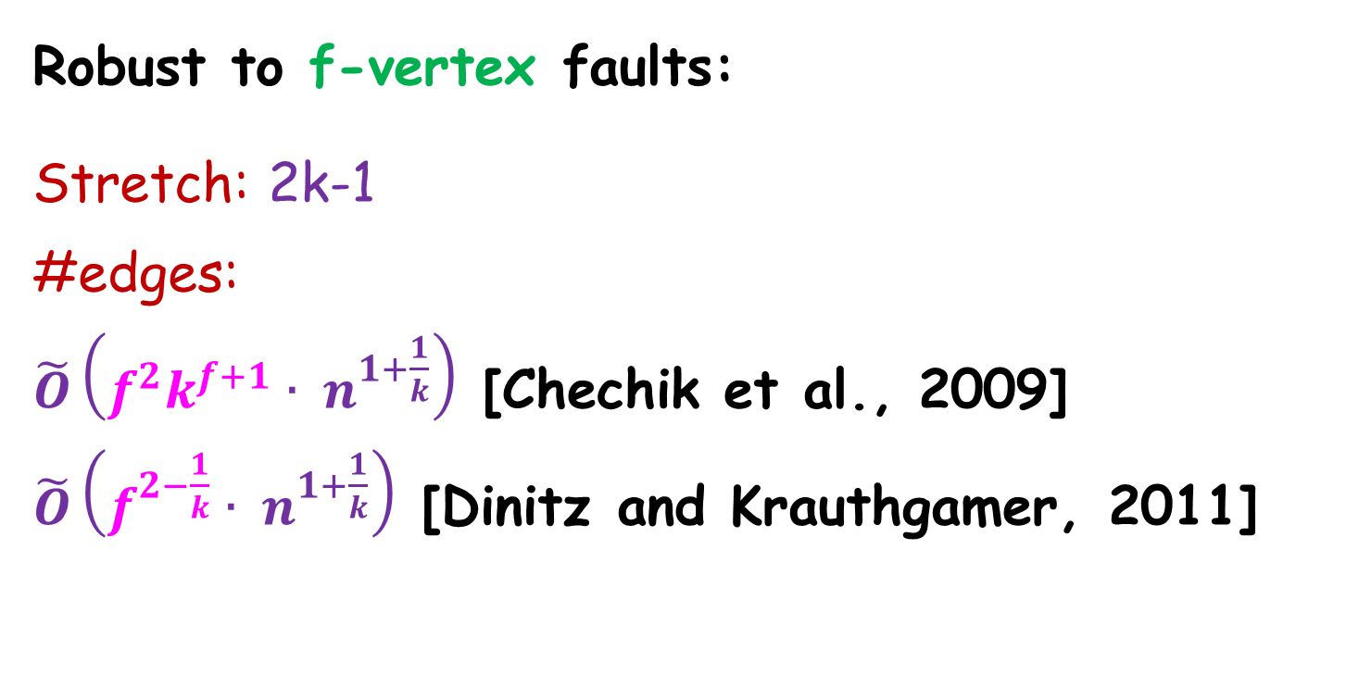
Fault-Tolerant Spanners
d(u,v,H \F) ≤ $(2k−1)$·d(u,v,G\F) for all u,v in V
Robust to f-vertex faults:
Stretch: 2k-1
#edges:
$\tilde{O}\left(f^{2}k^{f+1}{ ∙ n}^{1+\frac{1}{k}}\right)$ [Chechik et al., 2009]
$\tilde{O}\left(f^{2−\frac{1}{k}}{ ∙ n}^{1+\frac{1}{k}}\right)$ [Dinitz and Krauthgamer, 2011]

Slide 26
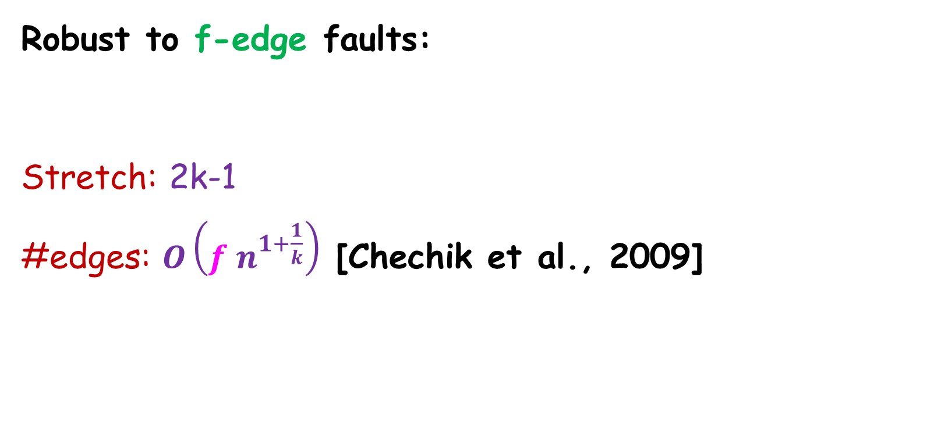
Fault-Tolerant Spanners
d(u,v,H \F) ≤ $(2k−1)$·d(u,v,G\F) for all u,v in V
Robust to f-edge faults:
Stretch: 2k-1
#edges: $O\left(f{ n}^{1+\frac{1}{k}}\right)$ [Chechik et al., 2009]

Slide 27

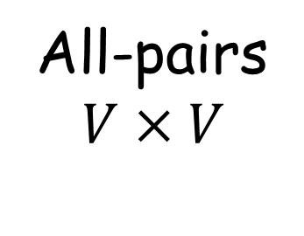
FT-Spanners vs. FT-BFS trees
FT-Spanners
FT-BFS tree
All-pairs
$$V×V$$
Single source
s $×V$
FT-BFS’s
easier
approximate
exact
FT-BFS’s
harder

Slide 28
Outline
Related work
Lower bound construction
Upper bound
Hardness and approximation algorithm.
Notes:
Insert in click

Slide 29
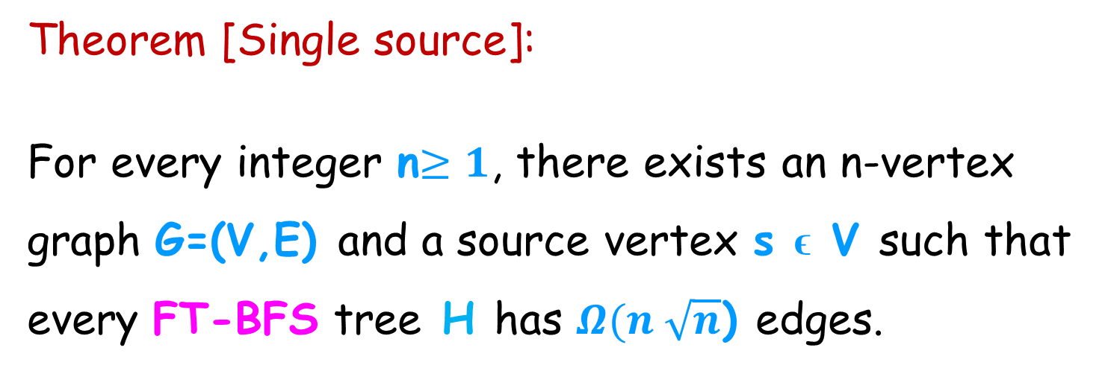
Lower Bound
Theorem [Single source]:
For every integer n$≥1$, there exists an n-vertex
graph G=(V,E) and a source vertex s ϵ V such that
every FT-BFS tree H has $Ω(n \sqrt{n}$) edges.

Slide 30
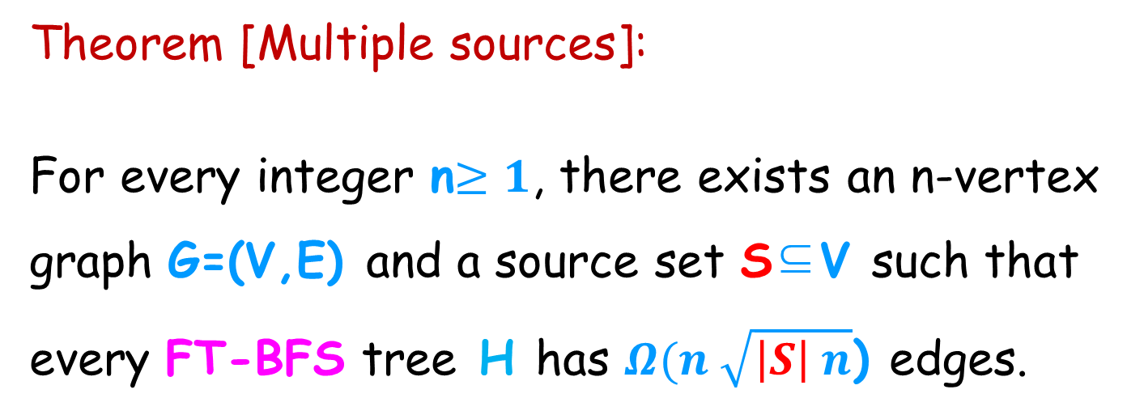
Generalization to multiple sources (FT-MBFS)
Theorem [Multiple sources]:
For every integer n$≥1$, there exists an n-vertex
graph G=(V,E) and a source set S⊆V such that
every FT-BFS tree H has $Ω(n \sqrt{\left|S\right| n}$) edges.

Slide 31
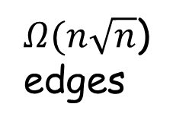

The Construction
s
Complete Bipartite Graph (X,Z):
|X|=$Ω(n$) , |Z|=$Ω(\sqrt{n}$)
Path of
length $Ω(\sqrt{n}$)
Collection of$Ω(\sqrt{n}$)
Paths which are:
Monotone increasing
Vertex disjoint
|Z|
X
Z
$Ω(n\sqrt{n}$)
edges

Slide 32
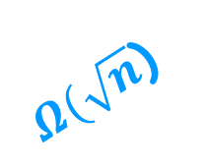

The Lower Bound Construction
s
Complete bipartite graph B(X,Z):
|X|=$Ω(n$), |Z|=$Ω(\sqrt{n}$)
Path of length $|Z|$
Collection of$|Z|$
paths which are
Vertex disjoint
of monotone
increasing lengths.
$Ω(\sqrt{n}$)
|Z|
8
6
X
Z

Slide 33

The Construction
s
Total number of vertices: n
$Ω(\sqrt{n}$) vertex disjoint paths
of increasing length
contain$Ω(n$) vertices.
Total number of
edges: $Ω(n\sqrt{n}$)
$Ω(\sqrt{n}$)
|Z|
8
6
X
Z
$Ω(n\sqrt{n}$)
edges

Slide 34
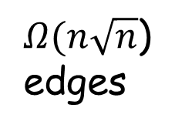
The Construction
Cl. : Every FT-BFS tree H must contain ALL the edges of the bipartite graph.
By contradiction:
Assume there exists an
edge e_{i,j} that is not in H.
Consider the case
where f_{i} fails.
s
f_{i}
X
e_{i,j}
x_{j}
z_{i}
Z
$Ω(n\sqrt{n}$)
edges

Slide 35
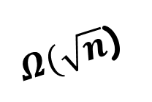
The Construction
Cl. In G\{f_{i}} there is a unique
s-x_{j} shortest-path
that goes through z_{j}
s
$Ω(\sqrt{n}$)
5
f_{i}
3
X
x_{j}
Z
z_{i}
$Ω(n\sqrt{n}$)
edges
$Ω(n\sqrt{n}$)
edges

Slide 36
The Construction
s
d(s,x_{j}, H \{f_{i}}) >d(s,x_{j}, G\{f_{i}})
Contradiction
since H is an
FT-BFS tree.
$Ω(\sqrt{n}$)
v_{i}
8
f_{i}
6
v_{i+1}
X
x_{j}
Z
z_{i}
$Ω(n\sqrt{n}$)
edges
$Ω(n\sqrt{n}$)
edges

Slide 37
Outline
Related work
Lower bound construction
Upper bound
Hardness and approximation algorithm.
Notes:
Insert in click

Slide 38
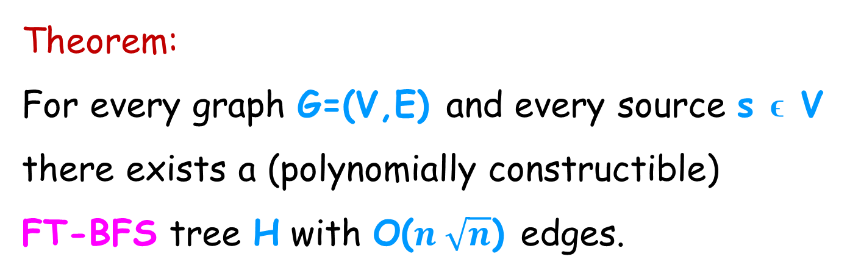
Matching Upper Bound
Theorem:
For every graph G=(V,E) and every source s ϵ V
there exists a (polynomially constructible)
FT-BFS tree H with O($n \sqrt{n}$) edges.

Slide 39
Algorithm for constructing FT-BFS
Input: unweighted graph G=(V,E), source vertex s.
Output: FT-BFS tree H ⊆ G.
*Assume that all shortest paths in G are unique.
e₁
s
e₂
T₀ := BFS(s, G)
T_{e} := BFS(s, G \{e})
e₃
e₄
v₁
v₂
v₃
v₄
e₅
v₅

Slide 40
Algorithm for constructing FT-BFS
T₀ := BFS(s, G)
T_{e} := BFS(s, G \{e})
s
e₁
e₂
e₃
e₄
T₀
v₁
v₂
v₃
v₄
e₅
v₅

Slide 41
Algorithm for constructing FT-BFS
T₀ := BFS(s, G)
T_{e} := BFS(s, G \{e})
s
e₁
e₂
e₃
e₄
v₁
v₂
v₃
v₄
e₅
v₅

Slide 42
Algorithm for constructing FT-BFS
T₀ := BFS(s, G)
T_{e} := BFS(s, G \{e})
s
e₁
e₂
e₃
e₄
v₁
v₂
v₃
v₄
e₅
v₅

Slide 43
Algorithm for constructing FT-BFS
T₀ := BFS(s, G)
T_{e} := BFS(s, G \{e})
s
H
v₁
v₂
v₃
v₄
v₅

Slide 44
Correctness
Recall: P(s,t,e) is the s-t shortest path in G\{e}.
H contains the collection of all
single source replacement paths.
s
e₁
e₂
e₃
e₄
The replacement path P(s,v₅,e₁) is the s-t path in T_{e1}=BFS(s, G\{e₁}).
v₁
v₂
v₃
v₄
e₅
v₅

Slide 45

Size Analysis – Basic Intuition
An edge e in H is new if it is not in T₀.
s
Lemma:
Every vertex t has at most
$O(\sqrt{n}$) new edges in H.
v₁
v₂
v₃
v₄
v₅

Slide 46

Size Analysis – Basic Intuition
$π$(s,t,T): s-t path in tree T
New(t) ={ Last edge of $π$(s,t,T_{e}) , e  T₀} \T₀
s
v₁
v₂
v₃
v₄
v₅

Slide 47

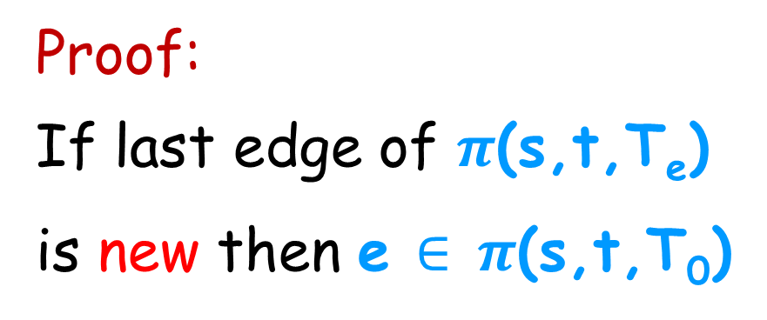

Size Analysis – First Bound
$π$(s,t,T): s-t path in tree T
New(t) ={ Last edge of $π$(s,t,Te) , e $∈$ T₀} \T₀
Cl. 1: | New(t)| $≤$ dist(s,t,G)
s
Proof:
If last edge of $π$(s,t,T_{e})
is new then e $∈$ $π$(s,t,T₀)
v₁
v₂
v₃
v₄
v₅

Slide 48

Size Analysis – Second Bound
$π$(s,t,T): s-t path in tree T
New(t) ={ Last edge of $π$(s,t,T_{e}) , e $≤$ T₀} \T₀
Cl. 2: | New(t)| $≤$ $\sqrt{2n}$
s
v₁
v₂
v₃
v₄
v₅

Slide 49
Size Analysis – Second Bound
$π$(s,t,T): s-t path in tree T
New(t) ={ Last edge of $π$(s,t,Te) , e $∈$ T₀} \T₀
s
A replacement path
P(s,t,e) whose
last edge is new
v₁
v₂
v₃
v₄
v₅

Slide 50
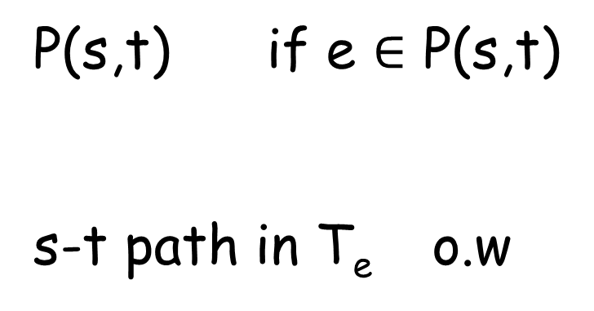
Analysis – Second Bound
P(s,t) if e $∈$ P(s,t)
s-t path in T_{e} o.w
P(s,t,e)=
s
e₁
e₂
e₃
e₄
v₁
v₂
v₃
v₄
e₅
v₅

Slide 51
Analysis – First Bound
P(s,t) if e $∈$ P(s,t)
s-t path in T_{e} o.w
P(s,t,e)=
s
e₁
e₂
e₃
e₄
Vertex t has at most dist(s,t,G) new-ending paths.
v₁
v₂
v₃
v₄
e₅
v₅

Slide 52
Size Analysis – Second Bound
$π$(s,t,T): s-t path in tree T
New(t) ={ Last edge of $π$(s,t,T_{e}) , e $∈$ T₀} \T₀
s
A replacement path
P(s,t,e) whose
last edge is new
v₁
v₂
v₃
v₄
v₅
Count the number of new ending paths.

Slide 53


New Ending Replacement Paths
P(s,t,e) is the s-t path in T_{e}=BFS(s, G\{e}).
s
s
$$\text{P}\text{(}\text{s}\text{,}\text{t}\text{)}$$
$$\text{P}\text{(}\text{s}\text{,}\text{t}\text{)}$$
e
e
P(s,t,e)
t
P(s,t,e)
t
Non-New Ending Path
New Ending Path

Slide 54

Analysis – Second Bound
Strategy: Count the number of new ending paths.
Consider the set of L new ending replacement paths
P₁=P(s,t,e₁), P₂=P(s,t,e₂) , …., P_{L}=P(s,t,e_{L})
where each P_{i} ends with a distinct new edge of t.
Show that L$≤\sqrt{2n}$

Slide 55
The structure of new ending replacement path
D_{i}:=detour segment of P(s,t,e_{i}).
d_{i}:= unique divergence point of P(s,t,e_{i}) and P(s,t).
s
P(s,t)
P(s,t,e_{i})
e_{i}
Detour
t

Slide 56
The structure of a new ending replacement path
s
P(s,t)
P(s,t,e)
Divergence point
e
Detour
T₀=BFS(s,G)
t
Lemma:
The detour segment is edge disjoint from P(s,t)

Slide 57
Analysis – Basic Intuition
Cl. 1: The detour segment is edge disjoint from P(s,t)
s
P(s,t)
By Contradiction:
e
P(s,t,e)
There are two
v-t shortest
paths in G\{e}.
v
t
Contradiction!

Slide 58
Analysis – Basic Intuition
s
P(s,t)
e₁
Claim 2:
The detour segments
are vertex disjoint!
P(s,t,e₁)
e₂
P(s,t,e₂)
t

Slide 59

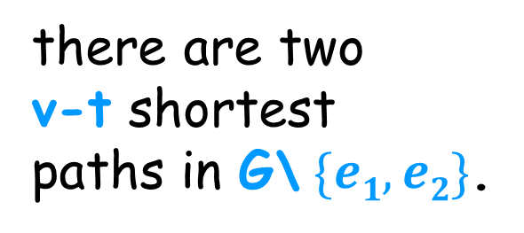
Analysis – Basic Intuition
Claim 2: the detours are vertex disjoint!
P(s,t,e₁)
s
P(s,t)
P(s,t,e₂)
e₁
b₂
there are two
v-t shortest
paths in G\ $\{e1,e2\}$.
e₂
v
t

Slide 60

New Ending Replacement Path
Notation:
b_{i}:= unique divergence point
of P(s,t,e_{i}) and P(s,t).
D_{i}:=detour segment of P(s,t,e_{i}).
s
$$\text{P}\text{(}\text{s}\text{,}\text{t}\text{)}$$
d_{i}
b_{i}
D_{i}
e_{i}
P(s,t,e_{i})
t

Slide 61
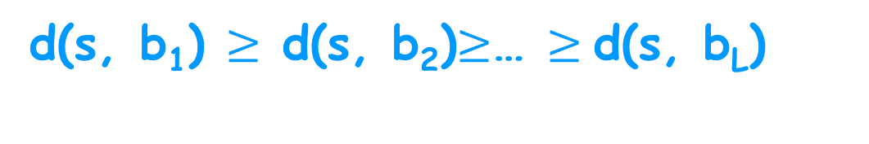
New Ending Replacement Path
Set of L new ending replacement paths
P₁=P(s,t,e₁), P₂=P(s,t,e₂) , ….,P_{L}
s
d_{i}
D_{L}
b_{L}
Assume,
D_{i}
b_{i}
d(s, b₁) $≥$ d(s, b₂)$≥$… $≥$d(s, b_{L})
b₃, b₄
b₁, b₂
t

Slide 62
New Ending Replacement Path
Set of L new ending replacement paths
P₁=P(s,t,e₁), P₂=P(s,t,e₂) , ….,P_{L}
s
d_{i}
D_{L}
b_{L}
Assume,
D_{i}
b_{i}
d(s, b₁) $≥$ d(s, b₂)$≥$… $≥$d(s, b_{L})
Cl. 1: The divergence points b_{i} are distinct.
b₃, b₄
b₁, b₂
d(s, b₁)>d (s, b₂)> … >d(s, b_{L})
t

Slide 63
Analysis – Basic Intuition
s
P(s,t)
b_{i}
e_{i}
Observation:
The detour segments
are vertex disjoint!
D_{i}
b_{j}
P_{i}=
P(s,t,e_{i})
e_{j}
D_{j}
P_{j}=P(s,t,e_{j})
t

Slide 64


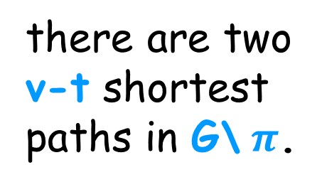

Analysis – Basic Intuition
Observation: the detours are vertex disjoint!
s
$π$=P(s,t)
D_{i} ⊆ G\ $π$
b_{i}
e_{i}
D_{j}⊆ G\ $π$
D_{i}
b_{j}
By the optimality:
D_{j}
e_{j}
there are two
v-t shortest
paths in G\ $π$.
P_{j}=P(s,t,e_{j})
v
t

Slide 65

Analysis – Basic Intuition
Observation: the detours are vertex disjoint!
s
$π$=P(s,t)
b_{i}
e_{i}
b_{j}
Di
Dj
e_{j}
there are two
v-t shortest
paths in G\ $π$.
P_{j}=P(s,t,e_{j})
v
t

Slide 66

Analysis – Basic Intuition
Set of new ending replacement paths P₁, P₂ , …., P_{L}.
d(s, b₁) $≥$ d(s, b₂) $≥$… d(s, b_{L})
s
b_{L}
The divergence points b_{i} are distinct!
b_{i}
d(s, b₁)>d (s, b₂)> … >d(s, b_{L})
b₃
b₂
b₁
t

Slide 67
Analysis – Basic Intuition
Set of new ending replacement paths P₁, P₂ , …., P_{L}.
d(s, b₁) $≥$ d(s, b₂) $≥$… d(s, b_{L})
s
b_{L}
The divergence points b_{i} are distinct!
b_{i}
d(s, b₁)>d (s, b₂)> … >d(s, b_{L})
b₃
b₂
b₁
t

Slide 68
Analysis – Basic Intuition
Observation: the detours are vertex disjoint!
s
$π$=P(s,t)
D_{i} ⊆ G\ $π$
b_{i}
e_{i}
D_{j}⊆ G\ $π$
D_{i}
b_{j}
By the optimality:
D_{j}
e_{j}
there are two
v-t shortest
paths in G\ $π$.
P_{j}=P(s,t,e_{j})
v
t

Slide 69
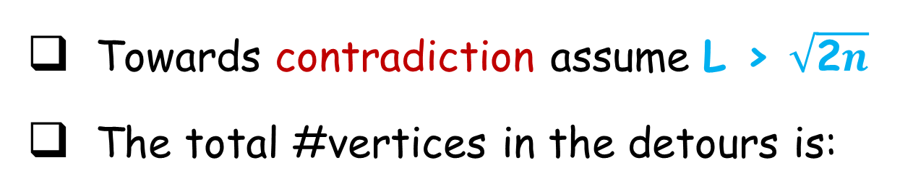


Analysis – Basic Intuition
Set of new ending replacement paths P₁, P₂ , …., P_{L}.
Towards contradiction assume L > $\sqrt{\text{2}n}$
The total #vertices in the detours is:
|$\bigcup_{i=1}^{L}{Di}|=\sum_{i=1}^{L}{\left|Di\right| ≥ \sum_{i=1}^{L}{i>L2> n} }$
s
D_{i}
b_{i}
Detours are
vertex disjoint
Divergence
points are
are distinct
$$≥i$$
Contradiction!
t

Slide 70
FT-MBFS tree - Formal Definition
Consider an unweighted graph G=(V,E) and source set S in V.
A subgraph H is an FT-MBFS of G if for every v in V, s in S and e in E: d(s,v, H \{e}) = d(s,v, G\{e})

Slide 71
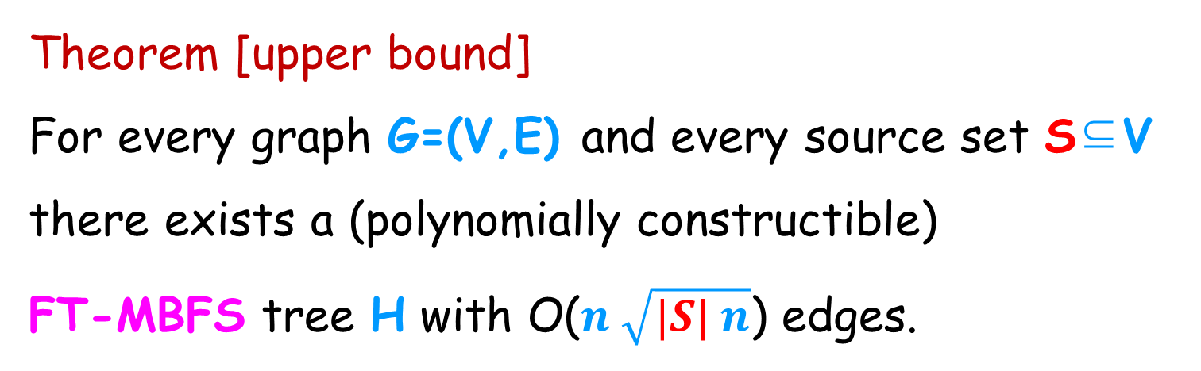
Generalization to multiple sources (FT-MBFS)
Theorem [upper bound]
For every graph G=(V,E) and every source set S⊆V
there exists a (polynomially constructible)
FT-MBFS tree H with O($n \sqrt{|S| n}$) edges.

Slide 72
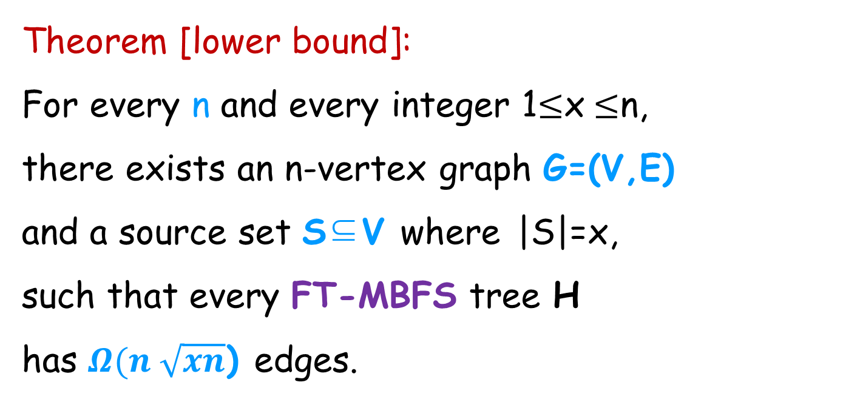
Generalization to multiple sources (FT-MBFS)
Theorem [lower bound]:
For every n and every integer 1$≤$x $≤$n,
there exists an n-vertex graph G=(V,E)
and a source set S⊆V where |S|=x,
such that every FT-MBFS tree H
has $Ω(n \sqrt{xn}$) edges.

Slide 73
The Minimum FT-BFS tree Problem
Input: unweighted graph G=(V,E)
source vertex s in V.
Output:
An FT-BFS subgraph H⊆ G with minimum number of edges.
Notes:
Insert in click

Slide 74
Outline
Related work
Lower bound construction
Upper bound
Hardness and approximation algorithm.
Notes:
Insert in click

Slide 75
The Minimum FT-BFS tree Problem
Theorem [Hardness]
The Minimum FT-BFS problem is NP-hard and cannot
be approximated to within a factor of (log n) unless
NP⊆TIME(n^{ploylog(n)}).
(By a gap preserving reduction from Set-Cover)

Slide 76
The Minimum FT-BFS tree Problem
Theorem [Approximation]
The Minimum FT-BFS problem can be approximated
within a factor of O(log n) .

Slide 77
O(log n) Approximation algorithm for
the Min-FT BFS problem
Solve n-1 instances of Set-Cover.
A Set-Cover instance of vertex t:
Universe of vertex t: U_{t}= E(P(s,t))
Every neighbor v of t is a set S_{vt}:
e  P(s,t) is in the set S_{vt} if
dist(s, t, G\{e})=dist(s,v, G\{e})+1
P(s,t)
s
e₁
e₂
e₅
t

Slide 78
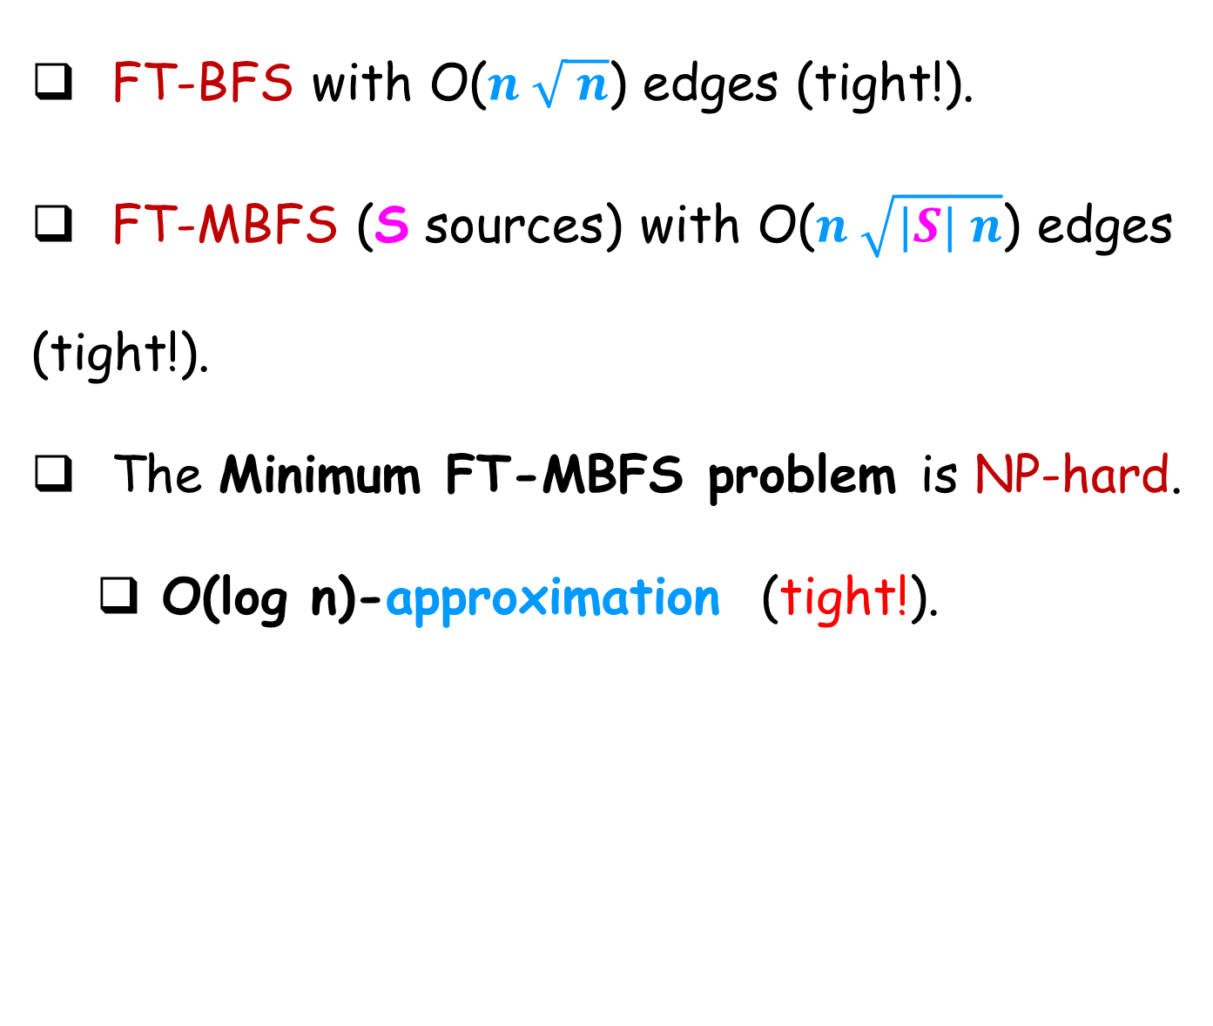
Summary
FT-BFS with O($n \sqrt{ n}$) edges (tight!).
FT-MBFS (S sources) with O($n \sqrt{|S| n}$) edges
(tight!).
The Minimum FT-MBFS problem is NP-hard.
O(log n)-approximation (tight!).

Slide 79
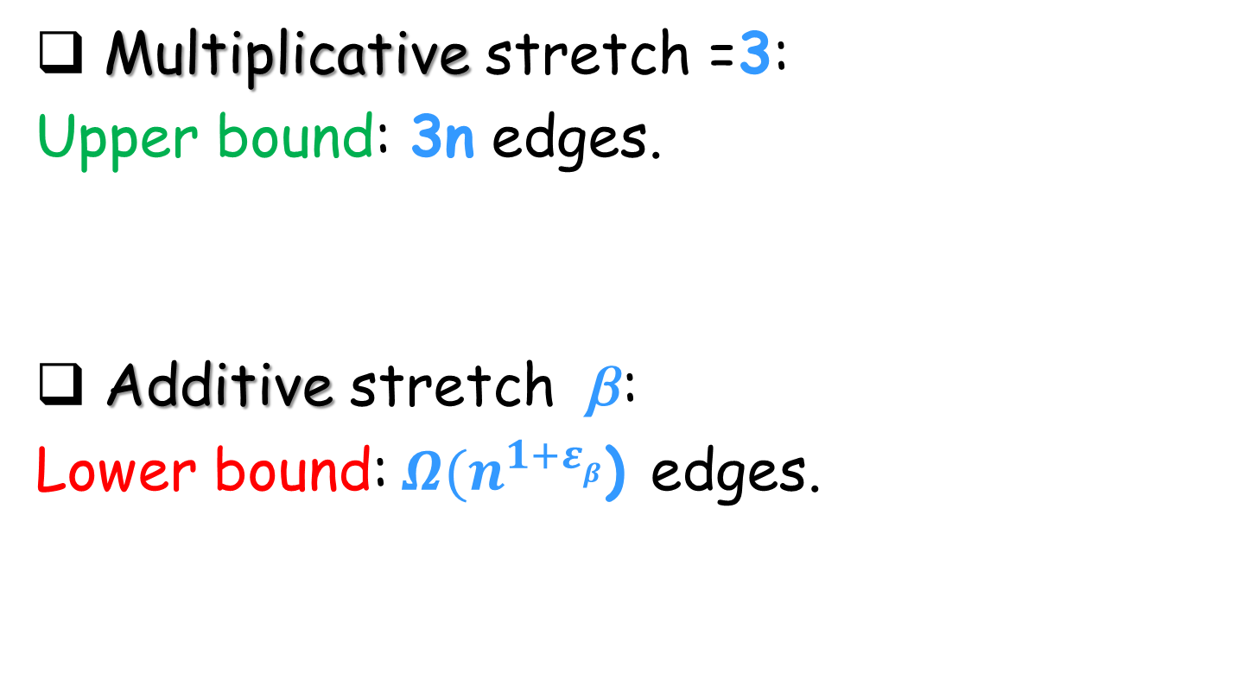
What about approximate FT-BFS structure?
Multiplicative stretch =3:
Upper bound: 3n edges.
Additive stretch :
Lower bound: ${Ω(n}^{1+εβ}$) edges.
P, Peleg, SODA’14

Slide 80

Thanks !
Have a Happy Week!

