Slide 1


Fault Tolerant
Approximate BFS Structure
Merav Parter and David Peleg
Weizmann Institute of Science, Israel
SODA 2014

Slide 2
Breadth First Search (BFS) Trees
Unweighted graph G=(V,E), source vertex s $∈$V.
Shortest-Path Tree (BFS) rooted at s.
Sparse solution:
n-1 edges.
Problem:
Not robust against edge
and vertex faults.
s
v₁
v₂
v₃
v₄
v₅
Notes:
Purchase in advance a large enough set of edges BFS+ structure that maintains.
the question is how many edge the system desi need to purchase, of course n-1 are necc. But the question is how many edges are required

Slide 3
Fault Tolerant BFS Trees
Objective:
Add a few edges to the BFS tree to make it robust against single edge (or vertex) fault.
s
v₁
v₂
v₃
v₄
v₅
Notes:
Insert in click

Slide 4
Fault Tolerant BFS Trees
s
Objective:
Purchase a
collection of edges (BFS + backup edges) that is robust against edge faults.
v₁
v₂
v₃
v₄
v₅
Notes:
Insert in click

Slide 5


(Exact) Fault-Tolerant BFS Trees
Subgraph H that contains a BFS tree in G\{e}
for every edge failure e in G.
s
s
e₁
e₂
e₃
e₄
v₁
v₂
v₁
v₂
v₃
v₄
v₃
v₄
e₅
v₅
v₅
$$G∖\{e1\}$$
$$H∖\{e1\}$$
Notes:
Insert in click

Slide 6
Fault-Tolerant (FT) BFS Trees
Subgraph H that contains a BFS tree in G\{e}
for every edge failure e in G.
s
s
e₁
e₂
e₃
e₄
v₁
v₂
v₁
v₂
v₃
v₄
v₃
v₄
e₅
v₅
v₅
$$G∖\{e1\}$$
$$H∖\{e1\}$$
Notes:
Insert in click

Slide 7
Fault Tolerant (FT) BFS Trees
Subgraph H that contains a BFS tree in G\{e}
for every edge failure e in G.
s
s
e₁
e₂
e₃
e₄
v₁
v₂
v₁
v₂
v₃
v₄
v₃
v₄
e₅
v₅
v₅
$$G∖\{e1\}$$
$$H∖\{e1\}$$
Notes:
Edge→ wide edge
Say in the left we have….

Slide 8


Fault Tolerant (FT) BFS Trees
Subgraph H that contains a BFS tree in G\{e}
for every edge failure e in G.
s
s
e₁
e₂
e₃
e₄
v₁
v₂
v₁
v₂
v₃
v₄
v₃
v₄
e₅
v₅
v₅
$$G∖\{e5\}$$
$$H∖\{e5\}$$
Notes:
Insert in click

Slide 9
FT-BFS Tree - Formal Definition
Consider an unweighted graph G=(V,E) and a source vetrex s.
A subgraph H is an FT-BFS of G and s if for every v in V and e in E:
d(s,v, H\{e}) = d(s,v, G\{e})

Slide 10
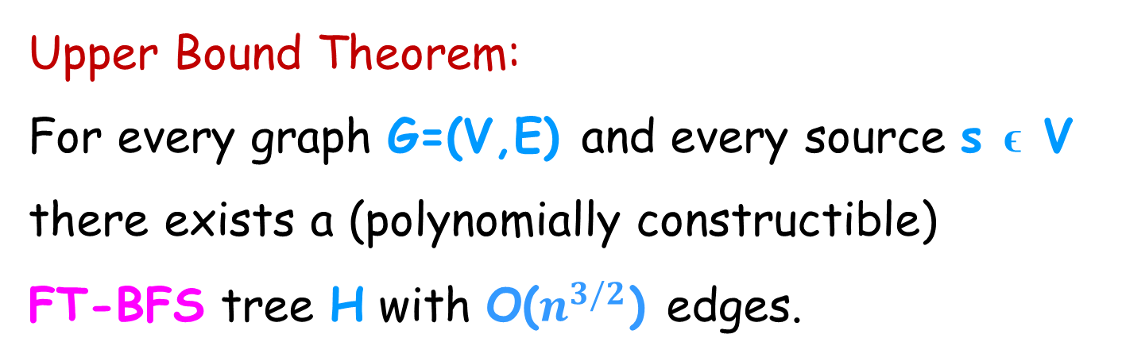
Exact FT-BFS Trees [P, Peleg, ESA’13]
Upper Bound Theorem:
For every graph G=(V,E) and every source s ϵ V
there exists a (polynomially constructible)
FT-BFS tree H with O($n^{3/2}$) edges.
Notes:
N^{3/2}

Slide 11
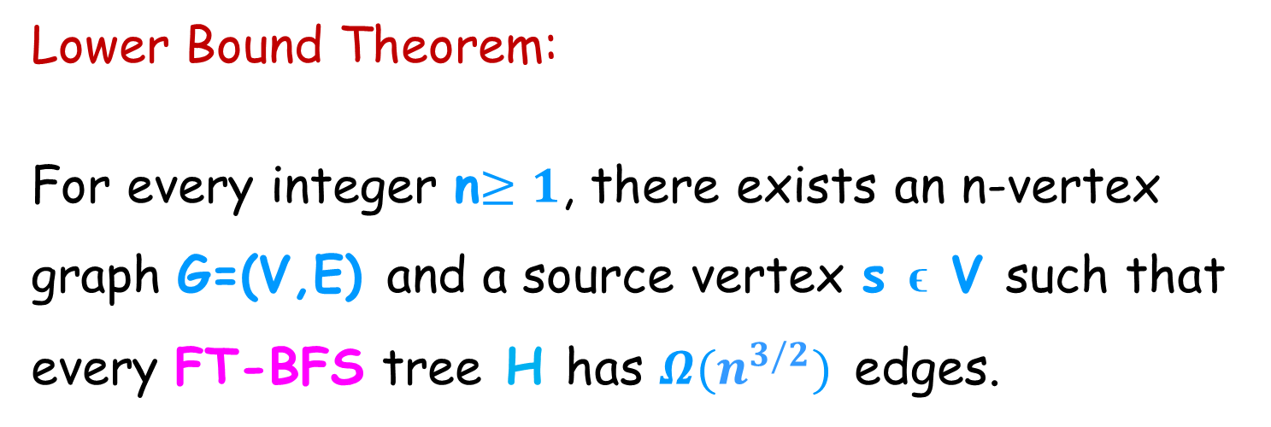
Exact FT-BFS Trees Are Dense
Lower Bound Theorem:
For every integer n$≥1$, there exists an n-vertex
graph G=(V,E) and a source vertex s ϵ V such that
every FT-BFS tree H has $Ω(n^{3/2})$ edges.
Resorting to approximate distances!

Slide 12
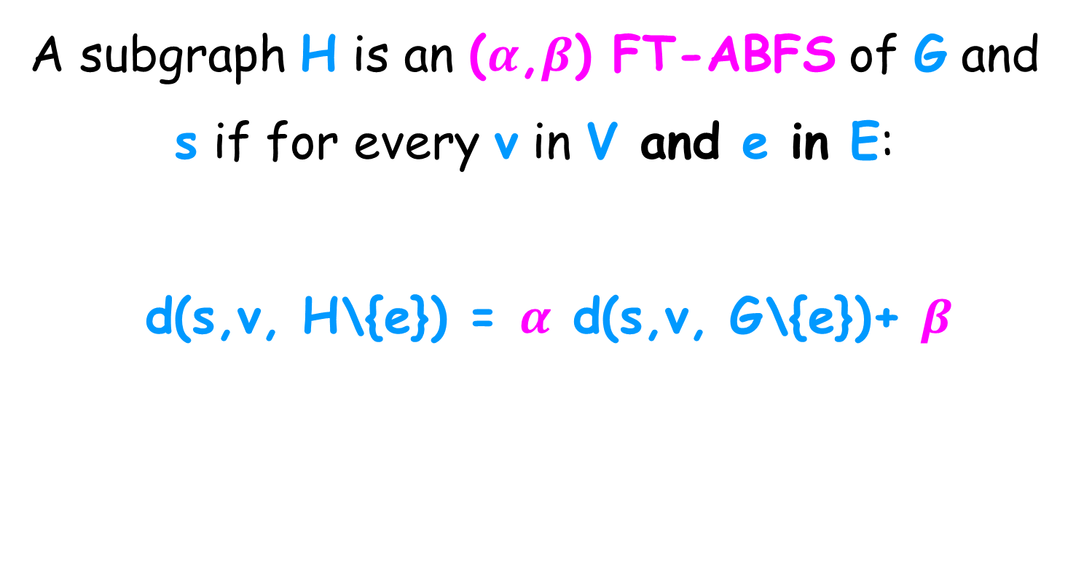
FT-ABFS Tree - Formal Definition
A subgraph H is an ($α$,$β$) FT-ABFS of G and s if for every v in V and e in E:
d(s,v, H\{e}) = $α$ d(s,v, G\{e})+ $β$

Slide 13
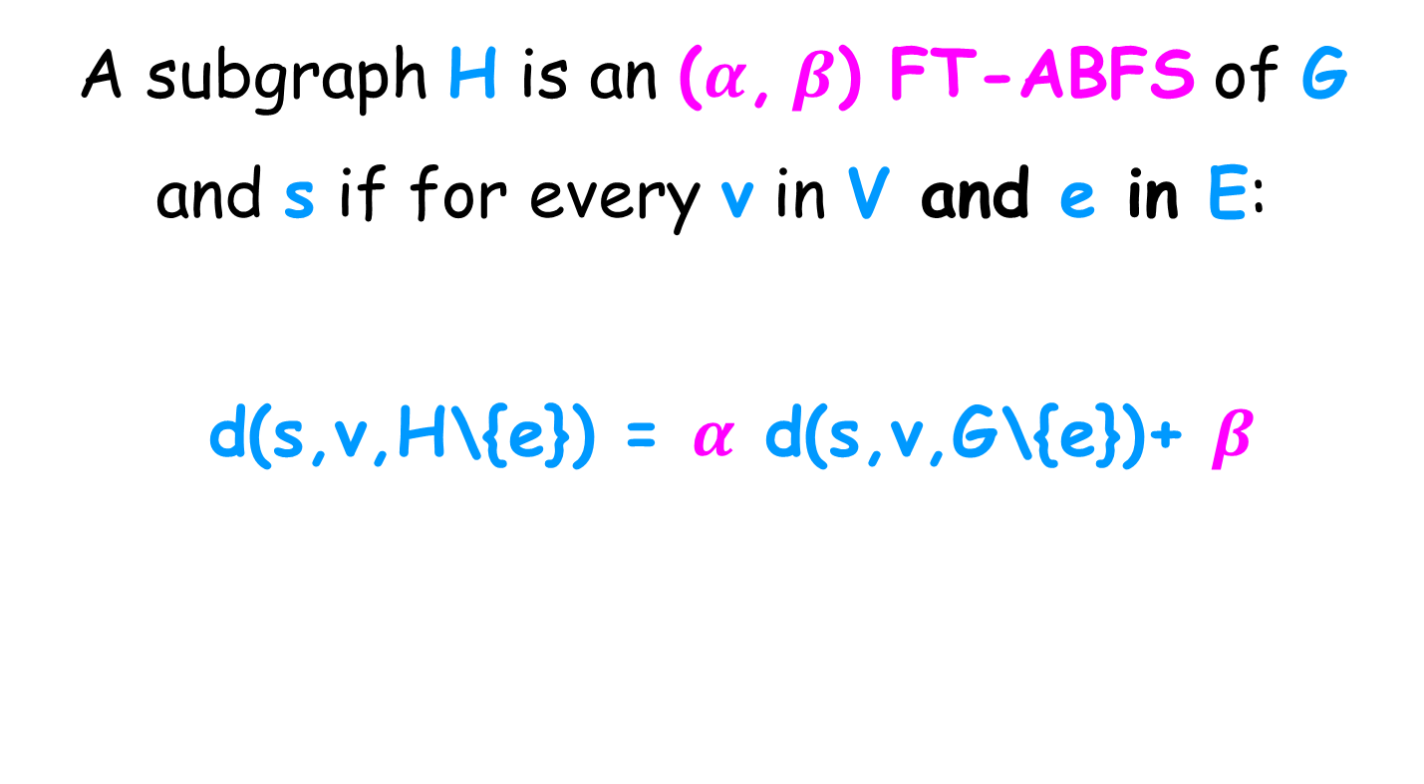
FT-ABFS Tree - Formal Definition
A subgraph H is an ($α$, $β$) FT-ABFS of G and s if for every v in V and e in E:
d(s,v,H\{e}) = $α$ d(s,v,G\{e})+ $β$
Can be viewed as FT single source spanners

Slide 14
Related Work
Replacement paths.
[Gupta et al. 1989; Hershberger and Suri, 2001;
Roditty and Zwick, 2005; Weimann and Yuster 2010]
Single source distance oracle.
[Kahanna and Baswana, 2010; Gradoni, Williams, 2012]
Fault tolerant spanners .
[Chechik et al., 2009; Dinitz and Krauthgamer, 2011;
Braunschvig et al., 2012]

Slide 15
A related problem:
the replacement path problem
P_{s,t,e}: s-t shortest path in G\{e}
π(s,t)
Problem definition:
Given a source s, destination t, for every
e ϵ π(s,t) , compute P_{s,t,e}
the shortest s-t path
that avoids e.
s
P_{s,t,e}
e
t

Slide 16
The structure of a replacement path
P(s,t,e) : s-t shortest path in G\{e}
s
P(s,t)
e
Detour
t

Slide 17
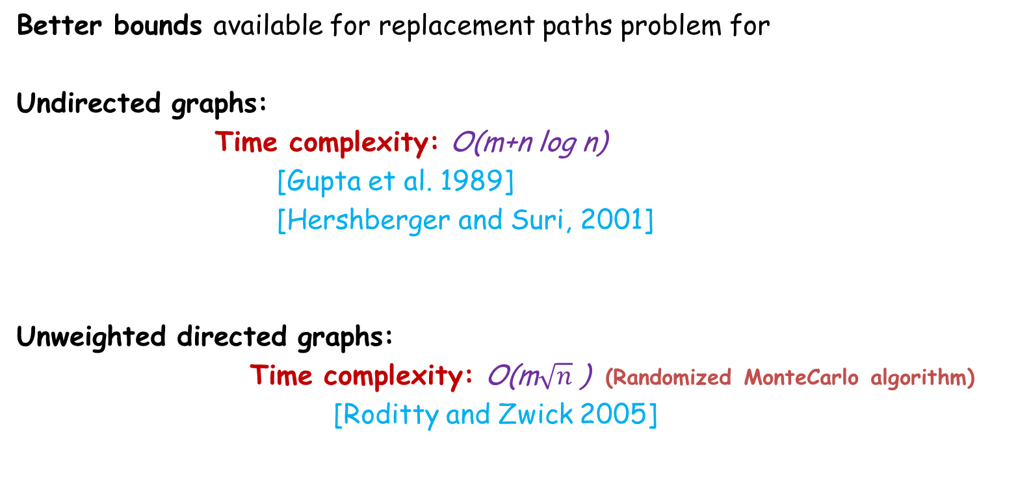
The replacement paths problem
Better bounds available for replacement paths problem for
Undirected graphs:
Time complexity: O(m+n log n)
[Gupta et al. 1989]
[Hershberger and Suri, 2001]
Unweighted directed graphs:
Time complexity: O(m$\sqrt{n}$ ) (Randomized MonteCarlo algorithm)
[Roditty and Zwick 2005]

Slide 18
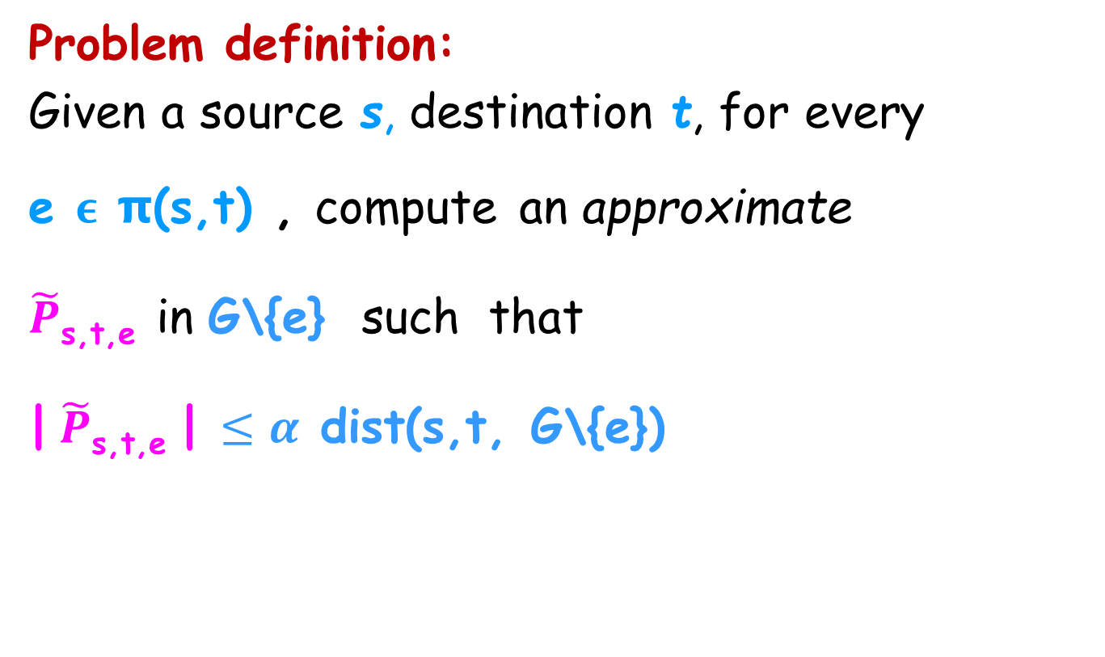
A related problem:
Approximate replacement path problem
Problem definition:
Given a source s, destination t, for every
e ϵ π(s,t) , compute an approximate
$\tilde{P}$_{s,t,e} in G\{e} such that
| $\tilde{P}$_{s,t,e} | $≤α$ dist(s,t, G\{e})

Slide 19
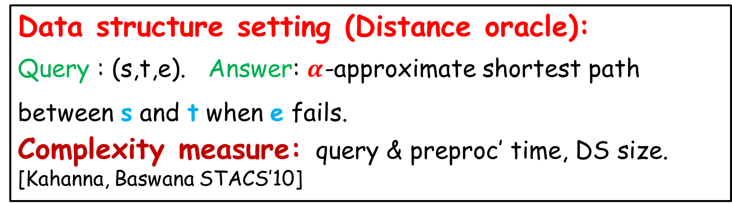
Single source approximate replacement path
Data structure setting (Distance oracle):
Query : (s,t,e). Answer: $α$-approximate shortest path between s and t when e fails.
Complexity measure: query & preproc’ time, DS size.
[Kahanna, Baswana STACS’10]
FT-ABFS tree revisited:
An FT-ABFS tree H contains the collection of all
single source approximate replacement paths.
Complexity measure: size of H (#edges).
New!

Slide 20
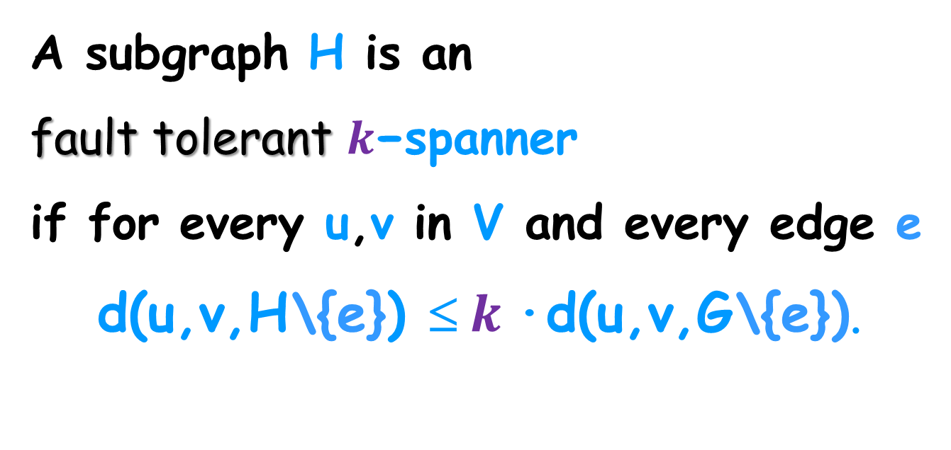
Fault-Tolerant Spanners
A subgraph H is an
fault tolerant $k\text{−}$spanner
if for every u,v in V and every edge e
d(u,v,H\{e}) ≤ $k$·d(u,v,G\{e}).

Slide 21

Fault-Tolerant Spanners
d(u,v,H \F) ≤ $(2k−1)$·d(u,v,G\F) for all u,v in V
Robust to f-edge faults:
Stretch: 2k-1
#edges: $O\left(f{ n}^{1+\frac{1}{k}}\right)$ [Chechik et al., 2009]
FT-ABFS tree revisited:
An FT-ABFS tree H is a single source FT-spanner.

Slide 22
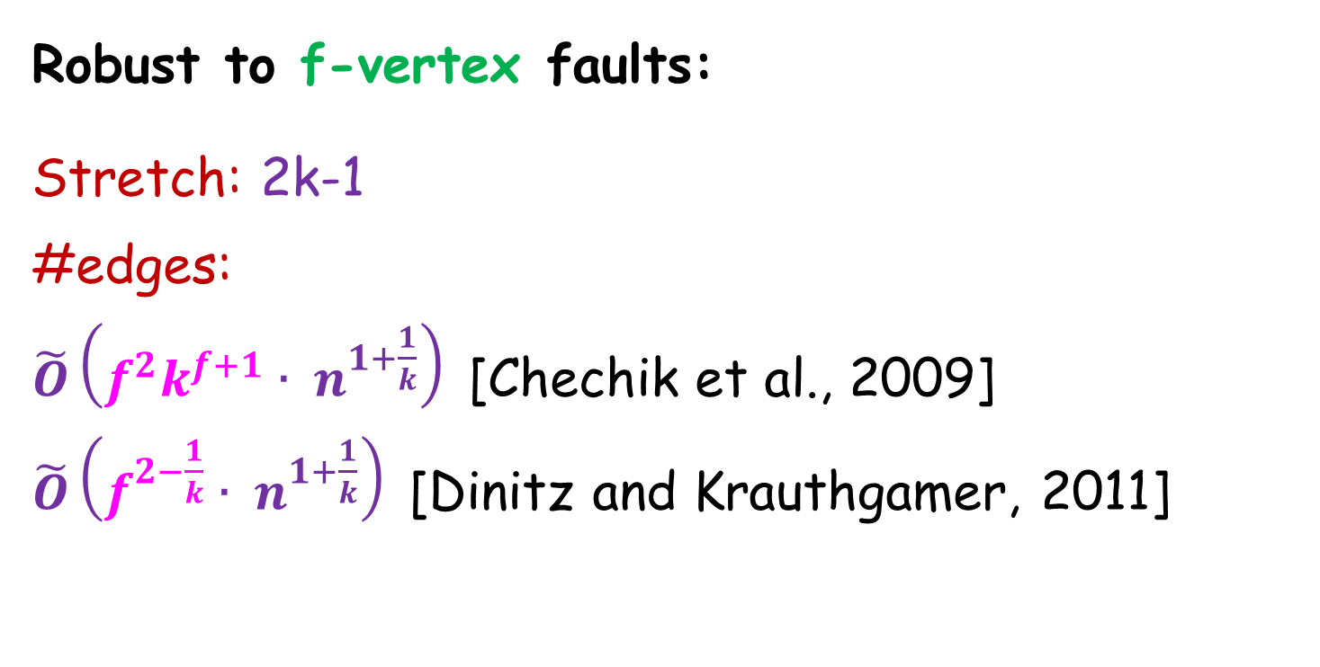
Fault-Tolerant Spanners
d(u,v,H \F) ≤ $(2k−1)$·d(u,v,G\F) for all u,v in V
Robust to f-vertex faults:
Stretch: 2k-1
#edges:
$\tilde{O}\left(f^{2}k^{f+1}{ ∙ n}^{1+\frac{1}{k}}\right)$ [Chechik et al., 2009]
$\tilde{O}\left(f^{2−\frac{1}{k}}{ ∙ n}^{1+\frac{1}{k}}\right)$ [Dinitz and Krauthgamer, 2011]

Slide 23
Our Results
Multiplicative stretch: linear upper bound.
Additive stretch: superlinear lower bound.

Slide 24
Multiplicative stretch:
(,0) FT-ABFS structures
Upper Bound:
For every graph G=(V,E) and every source s ϵ V
there exists a (polynomially constructible)
(3,0) FT-BFS structure H with at most 4n edges.
FT multiplicative single source spanners are linear!
* O(log n) improvement from [Kahanna, Baswana STACS’10]

Slide 25

Algorithm for constructing (3,0) FT-ABFS
Input: unweighted graph G=(V,E), source vertex s.
Output: (3,0) FT-ABFS structure H ⊆ G.
Add BFS(s, G) to H
s
u
$$π(u,v)$$
v
Notes:
(u,v) as in tree

Slide 26
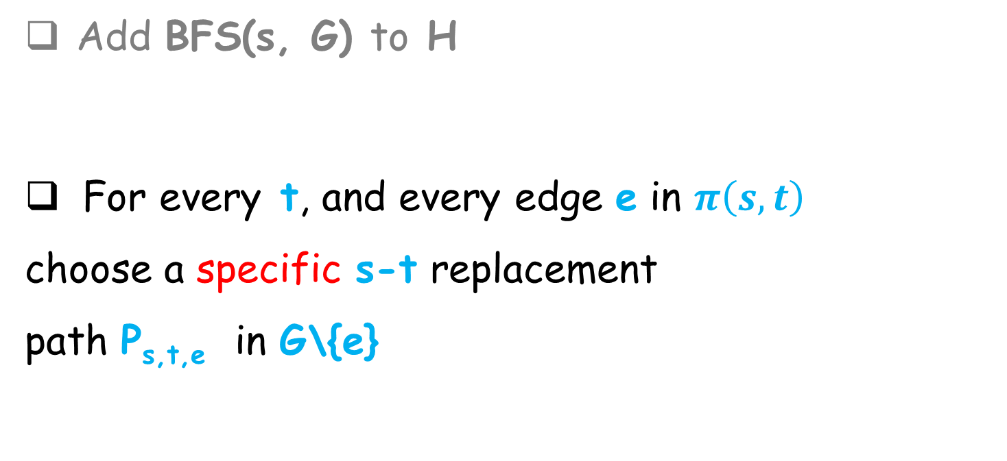
Algorithm for constructing (3,0) FT-ABFS
Add BFS(s, G) to H
For every t, and every edge e in $π\left(s,t\right)$
choose a specific s-t replacement
path P_{s,t,e} in G\{e}
π(s,t)
s
e
P_{s,t,e}
New edge
not in T₀
t

Slide 27
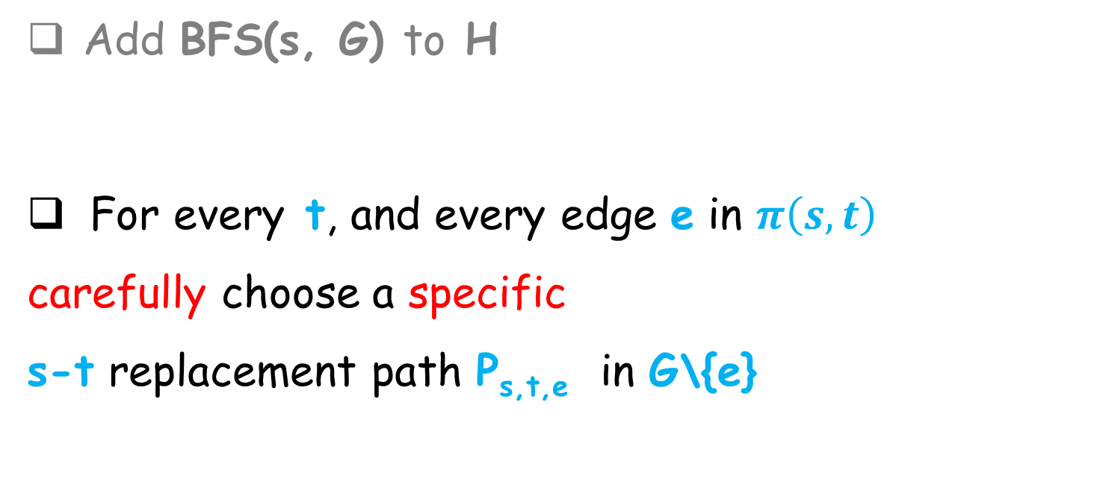
Algorithm for constructing (3,0) FT-ABFS
Add BFS(s, G) to H
For every t, and every edge e in $π\left(s,t\right)$
carefully choose a specific
s-t replacement path P_{s,t,e} in G\{e}
π(s,t)
s
P_{s,t,e}
e
New edge
not in
BFS(s,G)
t

Slide 28
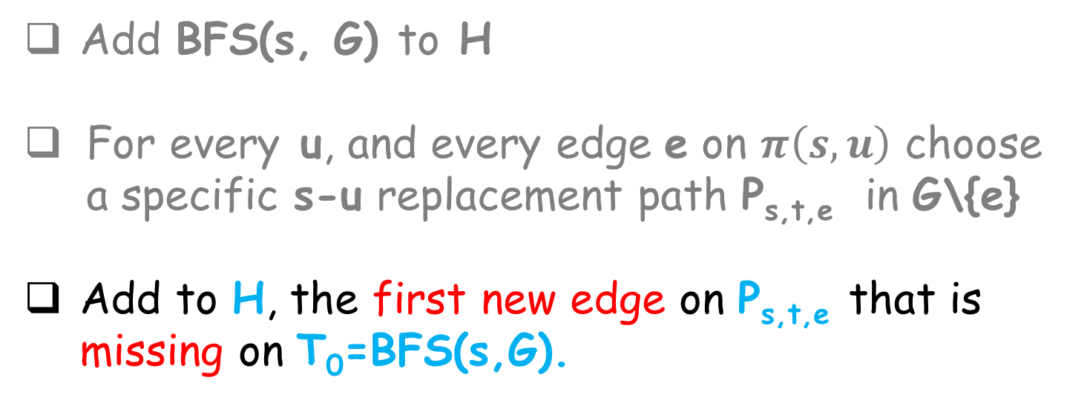
Algorithm for constructing (3,0) FT-ABFS
Input: unweighted graph G=(V,E), source vertex s.
Output: (3,0) FT-BFS tree H ⊆ G.
Add BFS(s, G) to H
For every u, and every edge e on $π\left(s,u\right)$ choose a specific s-u replacement path P_{s,t,e} in G\{e}
Add to H, the first new edge on P_{s,t,e} that is missing on T₀=BFS(s,G).

Slide 29
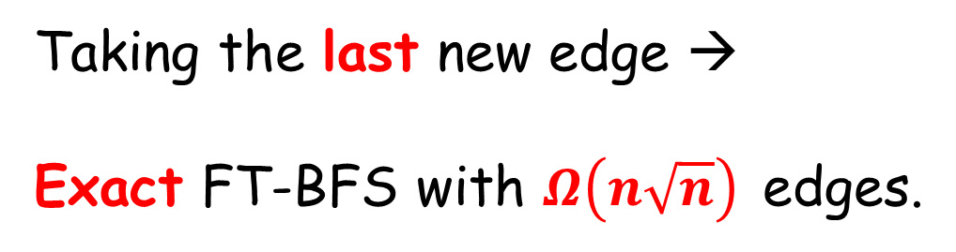
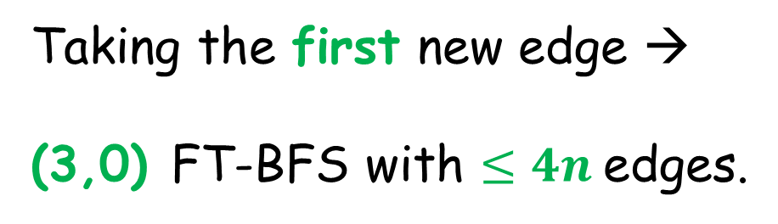
Picking the first edge is critical
Taking the last new edge →
Exact FT-BFS with $Ω\left(n\sqrt{n}\right)$ edges.
π(s,t)
ESA’13
s
P_{s,t,e}
e
Taking the first new edge →
(3,0) FT-BFS with $≤4n$edges.
SODA’14
t
Notes:
Increase fonts.
Naïve approach—add all of them. Try add only one.
If we add all of them-ok. Choose one edge—sufficient. Then, important which edge to choose

Slide 30

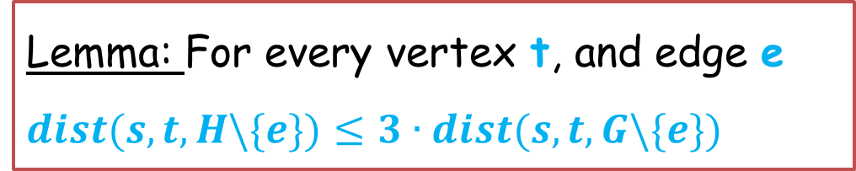

Correctness
Lemma: $\text{F}\text{or} \text{every} \text{vertex} \text{t}\text{, }\text{and} \text{edge} \text{e}$
$$dist(s,t,H\backslash \{e\})≤3∙dist(s,t,G\backslash \{e\})$$
P_{s,t,e}
s
$π\text{(}\text{s}\text{,}\text{t}\text{)}$
Here:
Show that s and t are connected
in (BFS $∪\{e^{′}\}$) \ {e}
e'
e
u
t

Slide 31
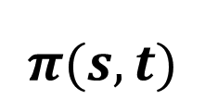
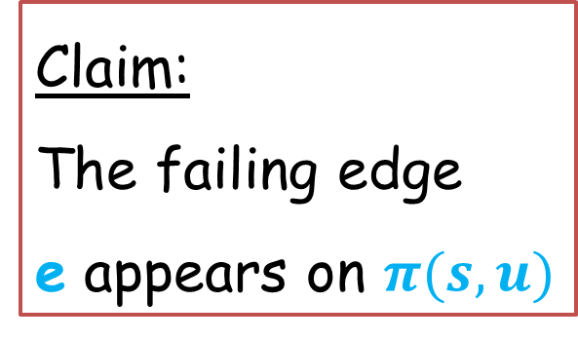
Correctness
Claim:
The failing edge
e appears on $π(s,u)$
s
$$π(s,t)$$
e
P_{s,t,e}
f
e'
First edge not
in BFS
u
t

Slide 32
Correctness
Claim:
The failing edge
e appears on $π(s,u)$
s
$$π(s,t)$$
e
e'
P_{s,t,e}
f
u
First edge not
in BFS(s,G)
t

Slide 33

Correctness
Claim:
The failing edge
e appears on $π(s,u)$
s
$$π(s,t)$$
e
P_{s,t,e}
f
e'
Hence u and t
are in BFS\{e}
First edge not
in BFS(s,G)
u
$$π(u,t)$$
t

Slide 34
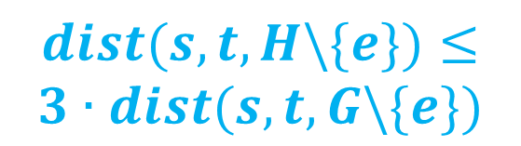
Correctness
Claim:
The failing edge
e appears on $π(s,u)$
s
$$π(s,t)$$
e
P_{s,t,e}
f
e'
$$dist(s,t,H\backslash \{e\})≤$$
$$3∙dist(s,t,G\backslash \{e\})$$
First edge not
in T₀
u
$$π(u,t)$$
t

Slide 35
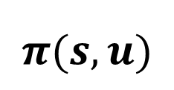
Size Analysis
Claim:
Every vertex u is
adjacent to at most
3 first new edges.
s
$$π(s,u)$$
e₁
P_{s,t,e1}
P_{s,t,e2}
e₂
P_{s,t,e3}
e₃
P_{s,t,e4}
By contradiction.
e₄
c
d
b
a
Prove that
dist(s,a)>dist(s,b)>dist(s,c)>dist(s,d)
u

Slide 36
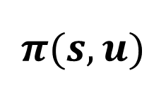
Size Analysis
Claim:
Every vertex u is
adjacent to at most
3 first new edges.
s
$$π(s,u)$$
e₁
e₂
e₃
Prove that
dist(s,a)>
dist(s,b)>
dist(s,c)>
dist(s,d)
P_{s,t,e1}
e₄
d
c
b
a
u

Slide 37
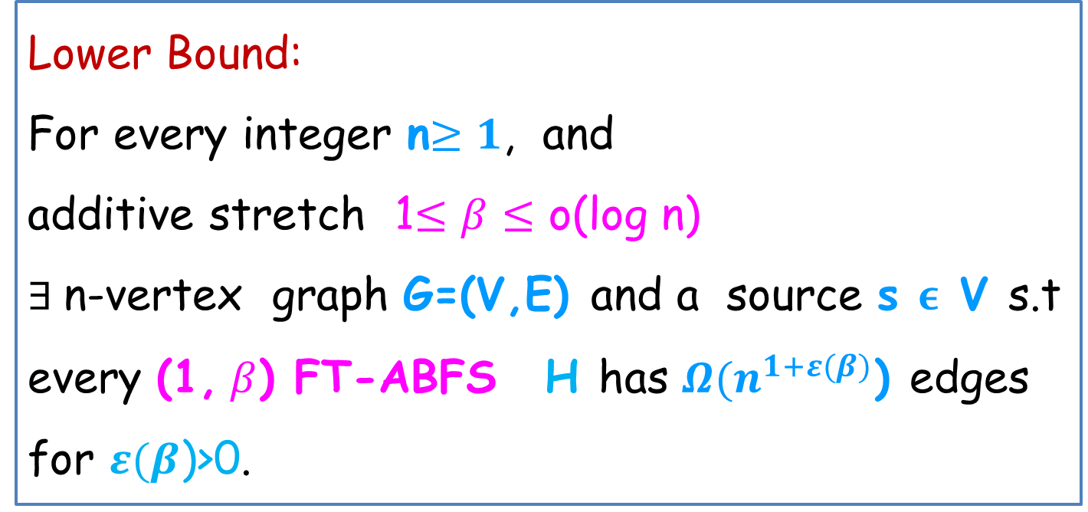
Additive stretch:
(1,) FT-ABFS structures
Lower Bound:
For every integer n$≥1$, and
additive stretch 1$≤β≤$ o(log n)
$∃$n-vertex graph G=(V,E) and a source s ϵ V s.t
every (1, $β$) FT-ABFS H has $Ω(n^{1+ε(β)}$) edges
for $ε(β$)>0.
FT additive single source spanners are superlinear!

Slide 38

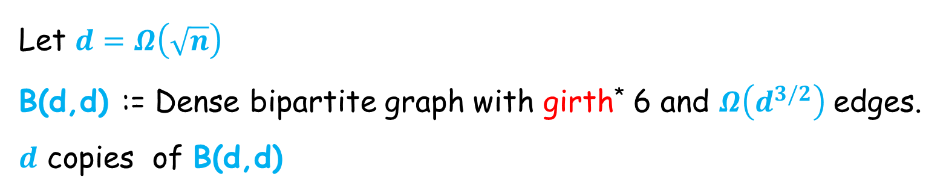
The Lower Bound Construction ($β=3$)
Let $d=Ω\left(\sqrt{n}\right)$
B(d,d) := Dense bipartite graph with girth* 6 and $Ω\left(d^{3/2}\right) \text{e}$dges.
$d$ copies of B(d,d)
B₁(d,d)
B₂(d,d)
B_{d}(d,d)
* Girth is the minimal cycle length in the graph.
Notes:
For simplicity I will show for beta=3

Slide 39
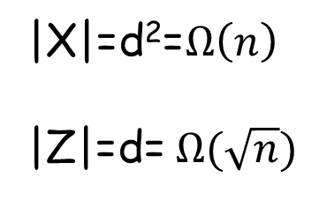
The Lower Bound Construction ($β=3$)
v
+1
X
B₁(d,d)
B₂(d,d)
B_{d}(d,d)
Z
|X|=d²=$Ω\left(n\right)$
|Z|=d= $Ω(\sqrt{n})$

Slide 40
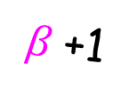
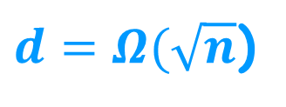
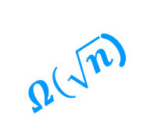

The Lower Bound Construction ($β=3$)
s
$Ω(\sqrt{n}$)
$d=Ω(\sqrt{n}$)
21+
20
v
$β$+1
X
B₁(d,d)
B₂(d,d)
B_{d}(d,d)
Girth=6
Z
Collection of$|Z|$
paths which are
Vertex disjoint
Monotone increasing.
Notes:
Momote increasing length

Slide 41

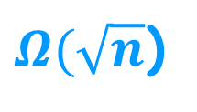
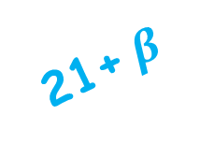
The Lower Bound Construction ($β=3$)
s
$Ω(\sqrt{n}$)
$Ω(\sqrt{n}$)
21+ $β$
20
v
+1
X
B₁(d,d)
B₂(d,d)
B_{d}(d,d)
Girth=6
Z
Collection of$|Z|$
paths which are
Vertex disjoint
Monotone increasing.

Slide 42
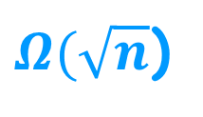

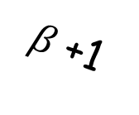
The Construction
Total number of vertices: n
$O(\sqrt{n}$) copies of $\sqrt{n}×\sqrt{n}$ graphs.
$O(\sqrt{n}$) vertex disjoint
paths
of increasing length
contain$O(n$) vertices.
s
$Ω(\sqrt{n}$)
$β$+1
B₁
B₂
B_{d}
Z

Slide 43

The Construction
s
Total number of edges:
In each B_{i} $Ω$($n^{3/4}$) edges.
Overall,
$Ω$($\sqrt{n}{×n}^{3/4}$)= $Ω$($n^{5/4}$)
edges.
$Ω(\sqrt{n}$)
B₁
B₂
B_{d}
Z

Slide 44
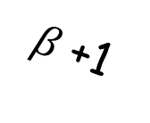

The Construction
Cl. : Every (1,3) FT-ABFS tree H must
contain ALL the edges of the B_{i} graphs
s
By contradiction:
Assume there exists an
edge e_{i,j} that is not in H.
Consider the case
where f_{i} fails.
$Ω(\sqrt{n}$)
f_{i}
$β$+1
B₁
e_{i,j}
B_{d}
Z

Slide 45
The Construction
s
d(s,x_{j}, H \{f_{i}}) >d(s,x_{j}, G\{f_{i}})+3
Contradiction
since H is an
(1,3) FT-ABFS tree.
f_{i}
x_{j}
$β$+1
B₁
e_{i,j}
B_{d}
Z

Slide 46
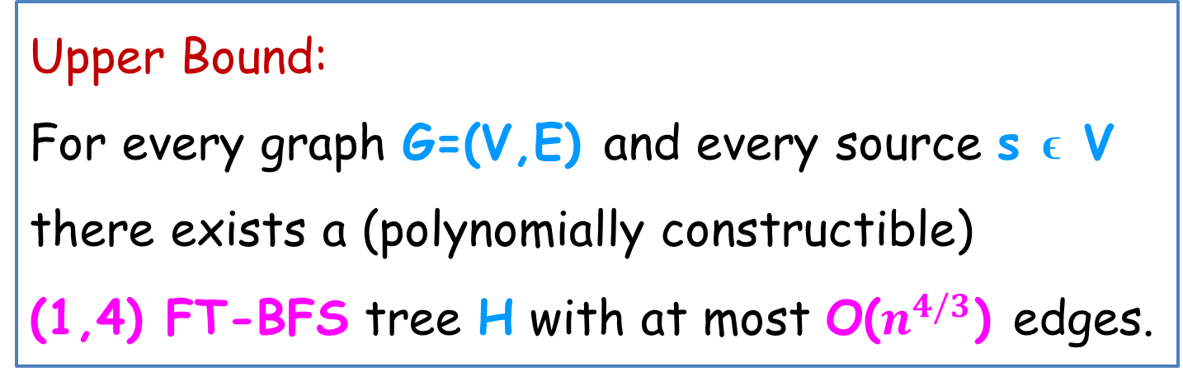
Additive stretch:
(1,) FT-ABFS structures
Upper Bound:
For every graph G=(V,E) and every source s ϵ V
there exists a (polynomially constructible)
(1,4) FT-BFS tree H with at most O($n^{4/3}$) edges.
Main technical contribution:
Adapting the Path-Buying scheme to the FT-setting.

Slide 47



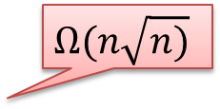



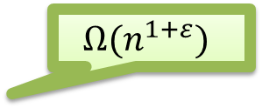
Dichotomy between
additive and multiplicative stretch
$$Ω(n^{1+ε})$$
Size of
($\backslash alpha$,$β$) FT-ABFS
structure
O(log n)
$$β$$
$O(n^{4/3})$, $Ω(n^{7/6})$
4
$$Ω(n^{5/4})$$
3
Additive stretch
O(nlogn)
$$Ω(n\sqrt{n)}$$
4n
1
$$O(n\sqrt{n)},Ω(n\sqrt{n)}$$
1
2
3
$$α$$
Multiplicative stretch
Notes:
Add 2 to both axis

Slide 48
Thanks!

