Slide 1

The Impostor Syndrome
Maya Schuldiner
Dept. Of Molecular Genetics

Slide 2

The Impostor Syndrome
A syndrome where sufferers are unable to internalize their accomplishments.
Regardless of what level of success they may have achieved or what external proof they get, they remain convinced internally that they do not deserve the success and are really frauds.
Proofs of success are dismissed as luck, timing, or ability to deceive others.
This syndrome is typically associated with academics (70%).
Wikipedia

Slide 3
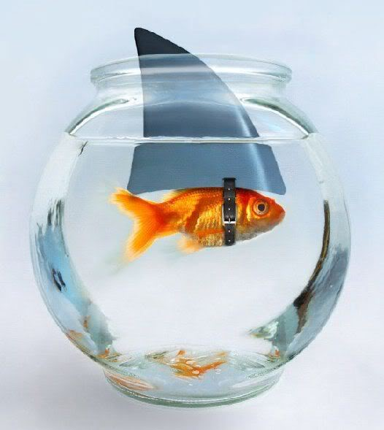
Are you an imposter-ist?
Do you tend to chalk your accomplishments up to being a "fluke," “no big deal” or the fact that people just "like" you?
Do you hate making a mistake, being less than fully prepared or not doing things perfectly?
Do you worry that others will find out that you're not as capable as they think you are?
When you DO succeed, do you think, "Phew, I fooled 'em this time but I may not be so lucky next time.”?
Taken from: Dr. Valerie Young
http://impostorsyndrome.com/

Slide 4
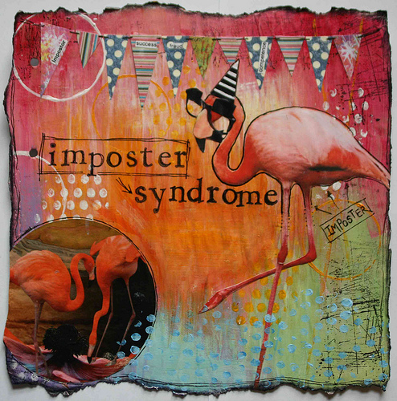
Are you an imposter-ist?
Do you tend to feel crushed by even constructive criticism, seeing it as evidence of your "ineptness?”
Do you believe that other people are smarter and more capable than you?
Do you sometimes shy away from challenges because of self-doubt?
Do you live in fear of being discovered or unmasked?
Taken from: Dr. Valerie Young
http://impostorsyndrome.com/

Slide 5

If you answered yes to any of these questions join the club!

Slide 6

How did this happen?
Parenting modes:
A family label of a “smart” child and a “sensitive” child are branded at an early stage and remains fixed in the family no matter what. The so called “sensitive” child will keep on doubting its success and intelligence even when contrasting evidence arises.
A child is given messages of being perfect and highly capable of success even without any effort. This view is contrasted later in life by the fact that in order to succeed the person actually needs to invest much effort. There is thus a sense of inadequacy and of being only average.

Slide 7

How did this happen?
Society's take on psychology…..
our entire approach to psychology is focused is on disease and failure. There are some 40,000 studies on depression on record with the American Psychology Association, and just 14 on joy. That bias translates to the workplace as an obsession with correcting weaknesses, filling gaps, and focusing on the laggards.
In science this translates to people rarely getting/giving positive feedback….

Slide 8
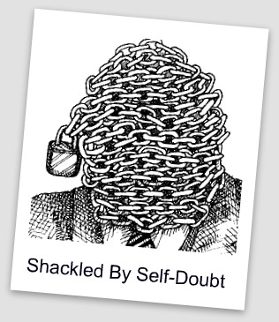
How did this happen?
Human psychology
Self-doubt and negative feedback weigh heavily on the mind, but praise barely registers. People tend to attribute their failures to a stable, inner core of ineptness. While discounting successes as accidental.

Slide 9
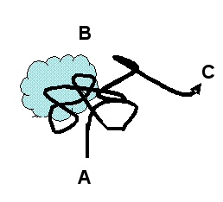
How did this happen?
Our distorted take on science
We are often taught that Science deals with objective things and absolute truths and think that doing science is the same.
When we find that our own discoveries have a big element of randomness we feel that we were just lucky.
It can seem like people around us discovered things in a logical way since that is the way papers and seminars are presented.
Notes:
Image refer to Uri Alon’s cloud model of how scientific progress usually works.

Slide 10
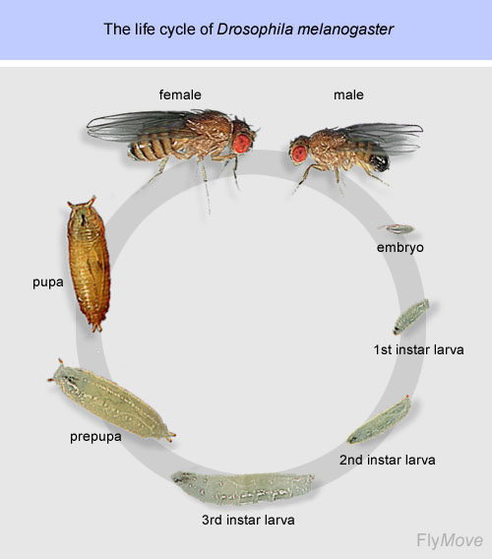
How did this happen?
PI
PostDoc (After....)
Start undergraduate school
B.A
PostDoc (before you publish)
M.SC
Ph.D

Slide 11

How did this happen?
The pyramid effect…

Slide 12

Why it sucks to have the impostor syndrome….
It can make you less inclined to compete for advanced positions (such as postdocs or faculty positions).
It can instill a fear to pursue new ideas and to take scientific risks.
It can make you reticent about offering potentially valuable insights, ideas, opinions and solutions to problems for fear of being wrong or exposing your “ignorance.”

Slide 13

Why it sucks to have the impostor syndrome….
It can make you prone to procrastination. This often causes delays in graduation of students.
It can cause stress-related problems leading to disease. M.Sc and PhD students are under VERY high risk for psychological stress
It makes you more likely to see constructive criticism as proof of your ineptitude, rather than using it to improve skills and knowledge.
Notes:
I shortened text (original is in next slide)

Slide 14

How can you deal with your syndrome?
1. Break the silence. Knowing there’s a name for these feelings and that you are not alone can be tremendously freeing.
Taken from: Dr. Valerie Young
http://impostorsyndrome.com/

Slide 15
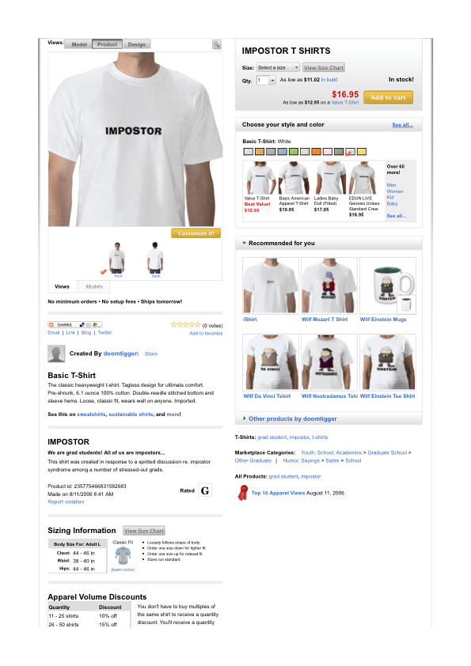

IMPOSTOR T-SHIRTS from Zazzle website

Slide 16
How can you deal with your syndrome?
1. Break the silence. Knowing there’s a name for these feelings and that you are not alone can be tremendously freeing.
2. Separate feelings from fact. Realize that just because you may feel stupid, doesn’t mean you are.
3. Instead of taking your self-doubt as a sign of your ineptness, recognize that it might be a normal response to being a beginner – which you will often be in an academic environment..
4. Accentuate the positive. Forgive yourself when the inevitable mistake happens.
5. Develop a new response to failure and mistake making. Henry Ford once said, “Failure is only the opportunity to begin again more intelligently.” (PI’s – remember this when talking to your students….)
Taken from: Dr. Valerie Young
http://impostorsyndrome.com/

Slide 17

How can you deal with your syndrome?
6. Right the rules. Recognize that you have just as much right as the next person to be wrong, have an off-day (or day off….), or ask for assistance.
7. Develop a new script in your head. When you start a new job don’t think: “Wait till they find out I have no idea what I’m doing,” try thinking, “Everyone who starts something new feels off-base in the beginning. I may not know all the answers but I’m smart enough to find them out.”
8. Visualize success. Spend time beforehand picturing yourself making a successful presentation or calmly posing your question in class.
9. Fake it ‘til you make it. Instead of considering “winging it” as proof of your ineptness learn to view it as a skill.
10. Reward yourself. Break the cycle of continually seeking and then dismissing validation outside of yourself by learning to pat YOURSELF on the back.
Taken from: Dr. Valerie Young
http://impostorsyndrome.com/

Slide 18

Rewarding ourselves in science
We often feel like we get very few moments of happiness in science (people often say it’s a “thankless” job) but it is only because of the way WE choose to view it.
For example – when you get a good PCR to work – you will never stop to celebrate (it seems SO trivial to have a PCR work – anyone can do it – right?) but when you have run it for 10 times without success you will SURE beat yourself up about it…
SO – learn how to give equal weight to your failures and successes.
Notes:
awesome

Slide 19

Rewarding ourselves in science
We never celebrate when we send a paper/grant/PhD proposal out because we fear it still might get rejected or criticized
By the time news of the submission comes back you can only feel relief.
If you learn to measure yourself and celebrate your OWN finish lines you will increase your own self assessment skills.

Slide 20
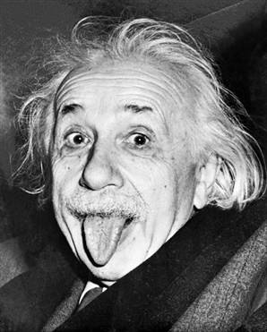
What famous impostor-ists have to say about it…
Perfectionism is a refusal to let yourself move ahead. ~ Jennifer White
I use not only all the brains I have but all that I can borrow. ~ Woodrow Wilson
The secret of creativity is knowing how to hide your sources. ~ Albert Einstein
Everybody is ignorant, only on different subjects. ~ Woodrow Wilson
I was gratified to be able to answer promptly. I said, I don't know. ~ Mark Twain
Taken from: Dr. Valerie Young
http://impostorsyndrome.com/

Slide 21
Some of the materials in this presentation were also taken from:
John Gradem
webpbage: http://www.johngraden.com/impsyn.html

