Slide 1
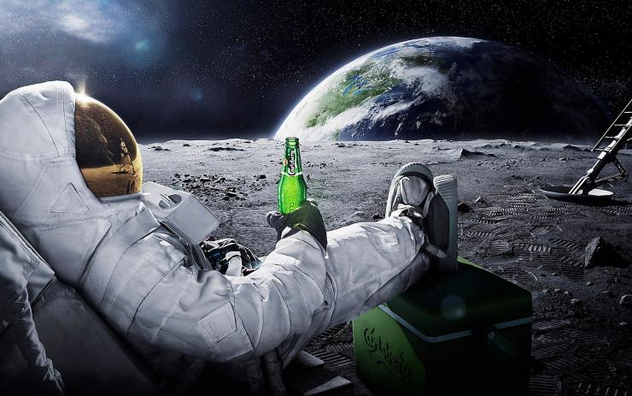
Living in space: energy balance of a lunar research station
Presentation in 2015 FGS (Weizmann Inst.) Guided Reading Course
Energy and Sustainability
LIOR RUBANENKO

Slide 2
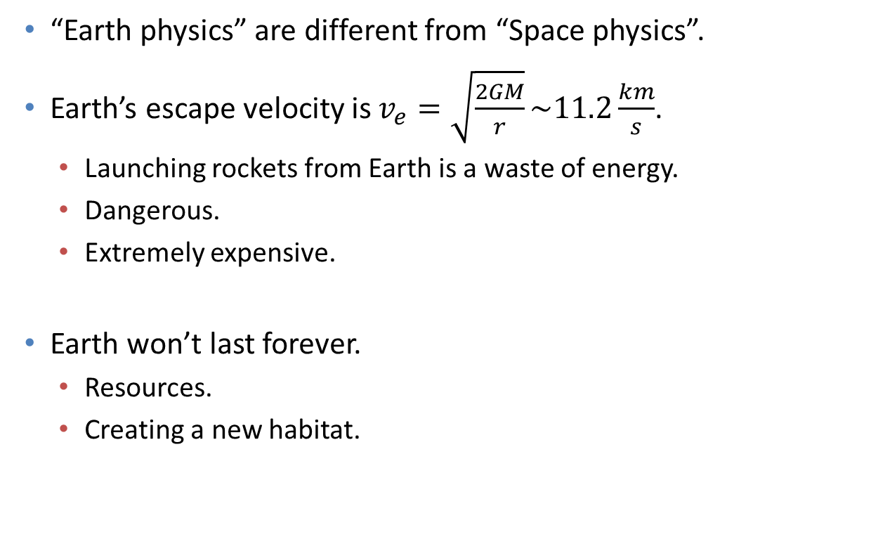
Motivation #1 (why?)
“Earth physics” are different from “Space physics”.
Earth’s escape velocity is $v_{e}=\sqrt{\frac{2GM}{r}}\sim 11.2\frac{km}{s}$.
Launching rockets from Earth is a waste of energy.
Dangerous.
Extremely expensive.
Earth won’t last forever.
Resources.
Creating a new habitat.

Slide 3
Motivation #2 (where?)
Space station / space city:
Very expensive and technologically advanced (“futuristic”).
World wide effort (which we are quite far from).
Living without natural gravity is difficult.
A different planet:
Mercury and Venus: too warm.
Mars is a good (yet far away) candidate.
Exoplanets are beyond our reach.
Earth’s satellite:
Relatively close.
Physically similar to space (vacuum environment, low gravity).
Earthlike temperatures in temperate latitudes.

Slide 4
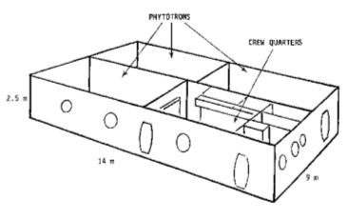
Past experiment: BIOS 3 (Salisbury, et al., 1997)
Preceded by BIOS-1 and 2.
Set up in 1972.
Located in Siberia.
Goal: test the possibility of living in an outer-space colony.

Slide 5
Past experiment: BIOS 3 (Salisbury, et al., 1997)
Notes:
Size: 14x9x2.5
Four compartments.
3 vegetation growing chambers.
1 living quarter that includes a kitchen, a lavatory, a control room a work area and three sleeping rooms.
Air pressure within BIOS was maintained using pumps. mean air leak was 60-80 liters per day.

Slide 6
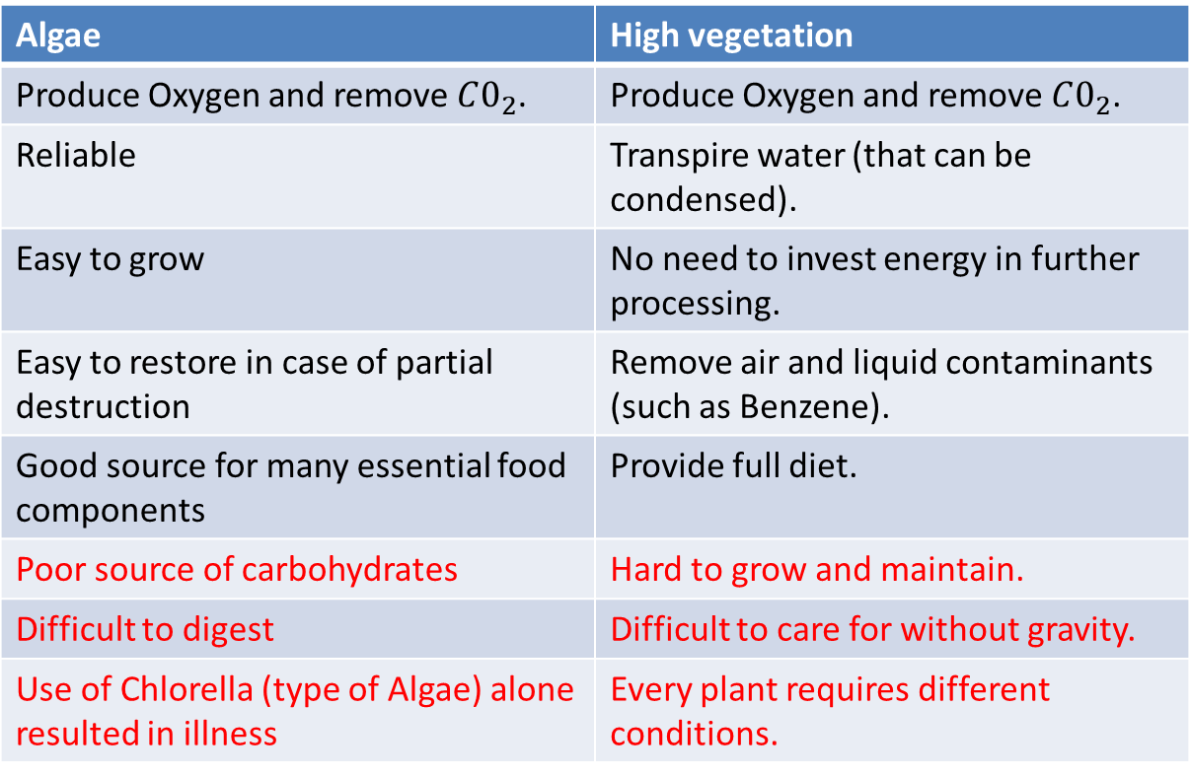
BIOS 3: algae or high vegetation? (Salisbury, et al., 1997)
Algae | High vegetation
Produce Oxygen and remove . | Produce Oxygen and remove .
Reliable | Transpire water (that can be condensed).
Easy to grow | No need to invest energy in further processing.
Easy to restore in case of partial destruction | Remove air and liquid contaminants (such as Benzene).
Good source for many essential food components | Provide full diet.
Poor source of carbohydrates | Hard to grow and maintain.
Difficult to digest | Difficult to care for without gravity.
Use of Chlorella (type of Algae) alone resulted in illness | Every plant requires different conditions.
Notes:
Lamps power = 400 kW.
Source – a power planet.
Each lamp provided 1000 PPF (photosynthetic photon flux).
Planets took care of half the air purification and the rest was by a thermocatalytic filter (which warms the air to 600C, oxidizing organic molecules to $CO_{2}$ and water).

Slide 7
Project Outline
Main objective:
To keep the station inhabitants alive.
Secondary objectives:
To provide ample food and balanced diet that could sustain the crew for long enough time.
To perform scientific research.

Slide 8


The Lunar Environment: Problems and Solutions
Vacuum (${10}^{−11} Torr$). Air must be produced and filtered.
28 days diurnal cycle. Some energy must be produced during the night.
Steep temperature gradient (more than 200 K).
No protection from impacts or radiation. Underground facility ($∆T\left(Z=\frac{1}{2}m\right)<10$).
Little surface water ice. Much more buried ice.
Vacuum (${10}^{−11} Torr$). Air must be produced or filtered.
28 days diurnal cycle. Some energy must be produced during the night.
Steep temperature gradient (more than 200 K).
No protection from impacts or radiation. Underground facility ($∆T\left(Z=\frac{1}{2}m\right)<10$).
Little surface water ice. Much more buried ice.

Slide 9
Energy analysis
Input energy:
Solar panels.
Energy recycling:
Kinetic energy to electric energy (gym).
Gravitational energy (floor tiles).
Night time solution.
Output energy (by importance).
Life support.
Food production.
Operate instruments.
Operate scientific equipment.

Slide 10
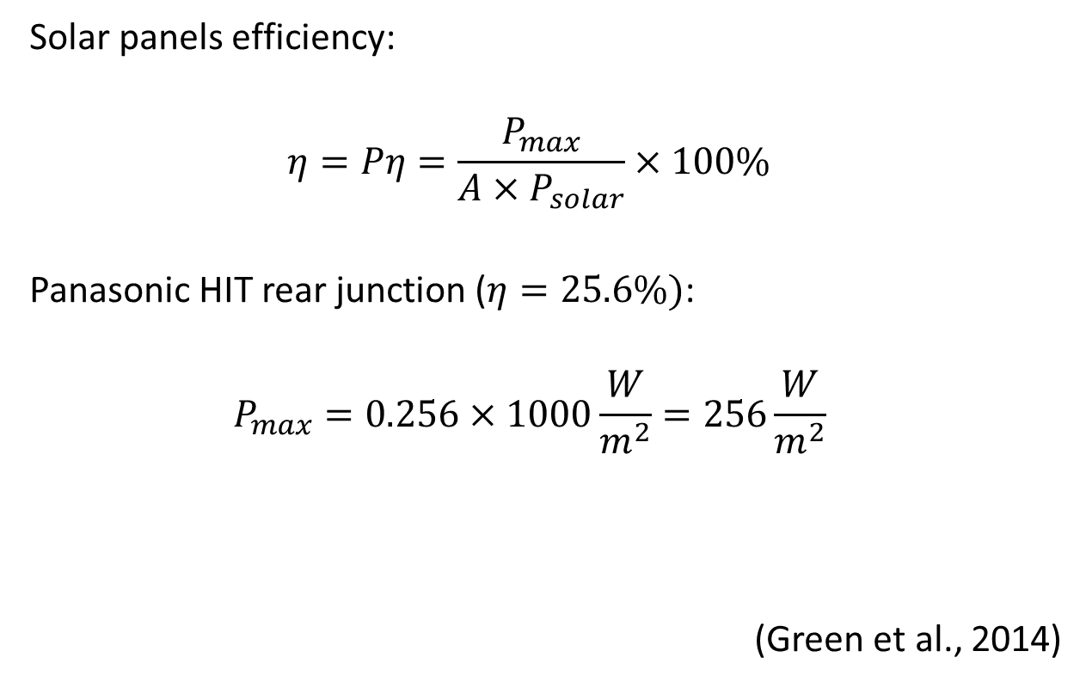
Energy analysis - input
Solar panels efficiency:
Panasonic HIT rear junction (:
(Green et al., 2014)

Slide 11
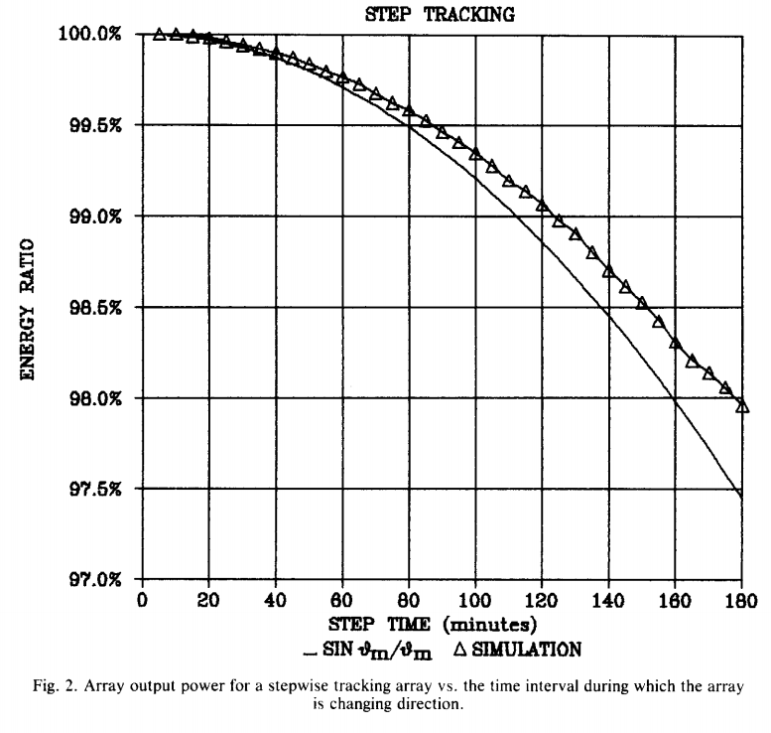
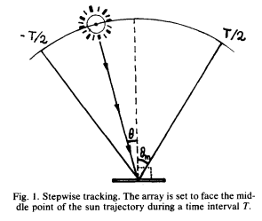
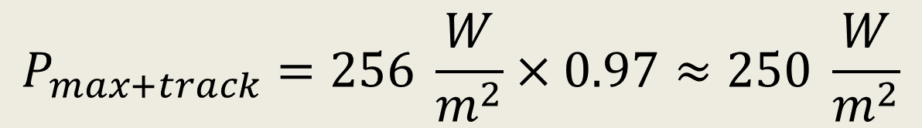
Energy analysis - input
Solar panels tracking system: Stepwise tracking
$$P_{max+track}=256 \frac{W}{m^{2}}×0.97≈250 \frac{W}{m^{2}}$$
(Baltas et al., 1986)

Slide 12
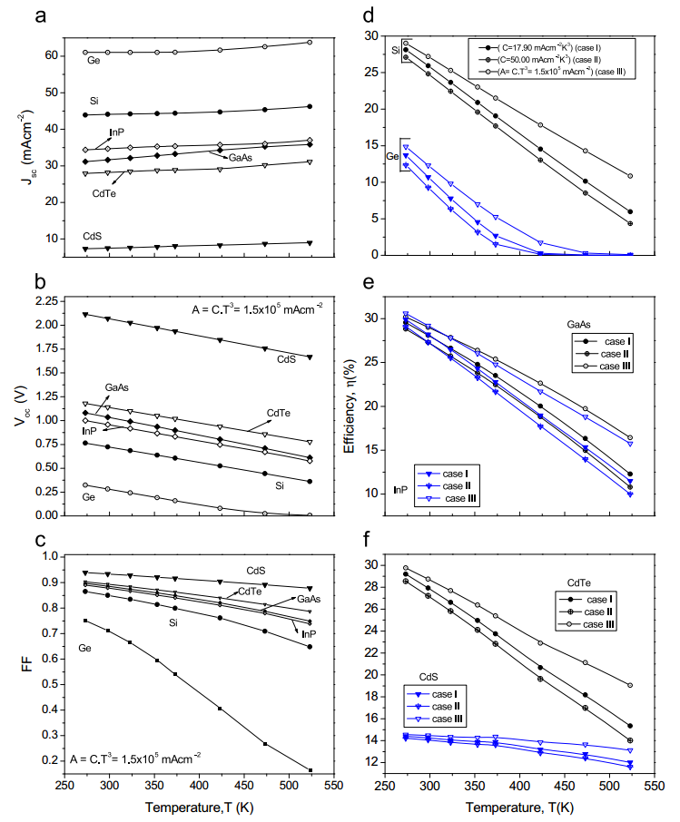


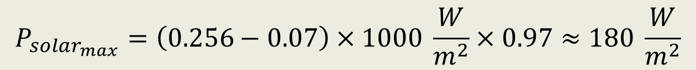
Energy analysis - input
Solar panels tracking system: Temperature dependence of Si
$$T_{eq}={\left(\frac{1000}{σ}\right)}^{0.25}=364 °K≈87 °C$$
Saturation current density:
$$J_{0}=CT^{3}\exp\left(−\frac{E}{kT}\right)$$
$$P_{solar_{max}}=\left(0.256−0.07\right)×1000 \frac{W}{m^{2}}×0.97≈180 \frac{W}{m^{2}}$$
$$η (\%)$$
(Singh and Ravindra, 2012)

Slide 13
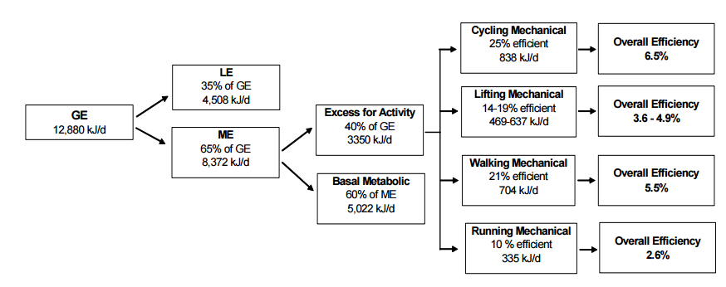
Energy analysis - input
Kinetic energy – physical activity (Gym)
$$P_{kinetic}=12880×0.65×0.4×0.25≈10 W$$
(Gilmore, 2008)

Slide 14
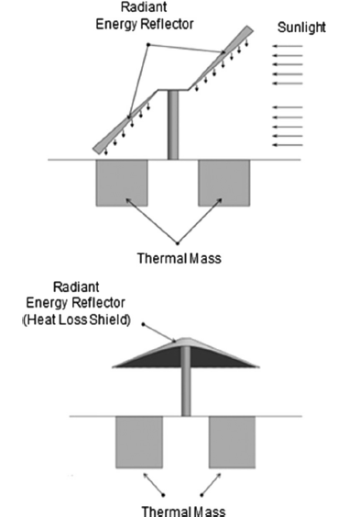
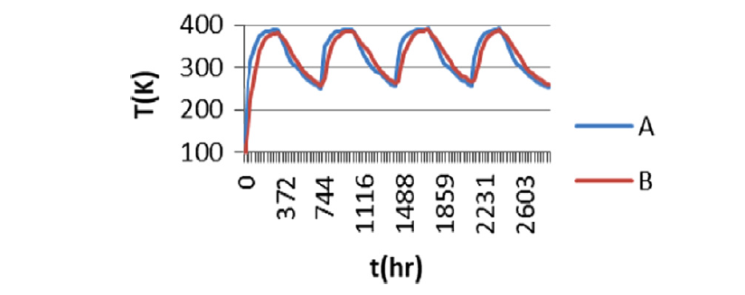
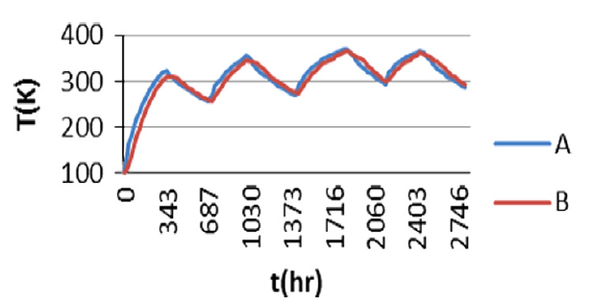
Energy analysis - input
Night time solution: Wadis
A – with dust layer, B – exposed regolith.
Climent et al., 2014

Slide 15
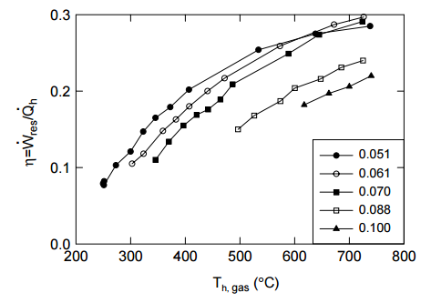
Energy analysis - input
Night time solution: heat engine (Stirling)
Climent et al., 2014
Notes:
efficiency of the Backhaus Stirling engine. The efficiency increases with the hot reservoir temperature, and reaches 30% at 700 K. The different curves show $\frac{p1}{pm}$, the ratio between the pressure wave amplitude (p1) and the mean pressure (pm). Higher values mean higher pressure amplitude normalized by the mean amplitude. (Backhaus et al., 1999)

Slide 16
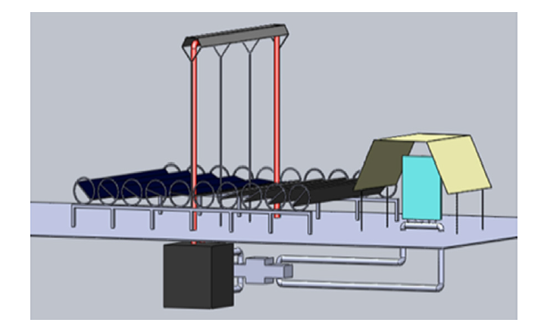
Energy analysis - input
Night time solution: TES (thermal energy storage)
Climent et al., 2014
Notes:
The Fresnel reflectors used to power the HTTER. The navy blued rectangles are the mirrors. They focus light onto the linear receiver that transfers warm liquid to the dark gray HTTER on the bottom. Heat is then transferred to the Striling engine (bottom, grey). On the right, the LTTER (light blue) is cooled using a radiator (yellow). Figure is taken from Climent et al., 2014.

Slide 17
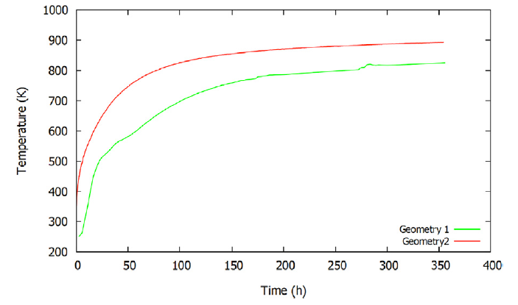
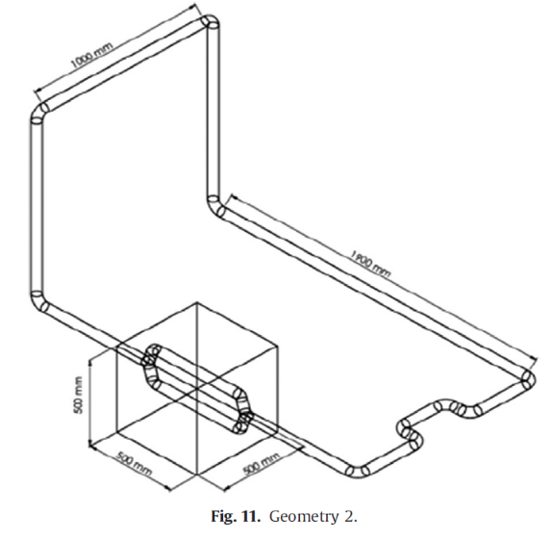
Energy analysis - input
Night time solution: TES (thermal energy storage)
Climent et al., 2014
Notes:
The preferred geometry of the RCC system (right) and the modeled temperatures of the heat engine for that geometry. The fluid is diverted into two different pipes as it enters the HTTER. This configuration allows reaching 700 K after approximately 25 hours, meaning enough power can be supplied to the thermal engine

Slide 18
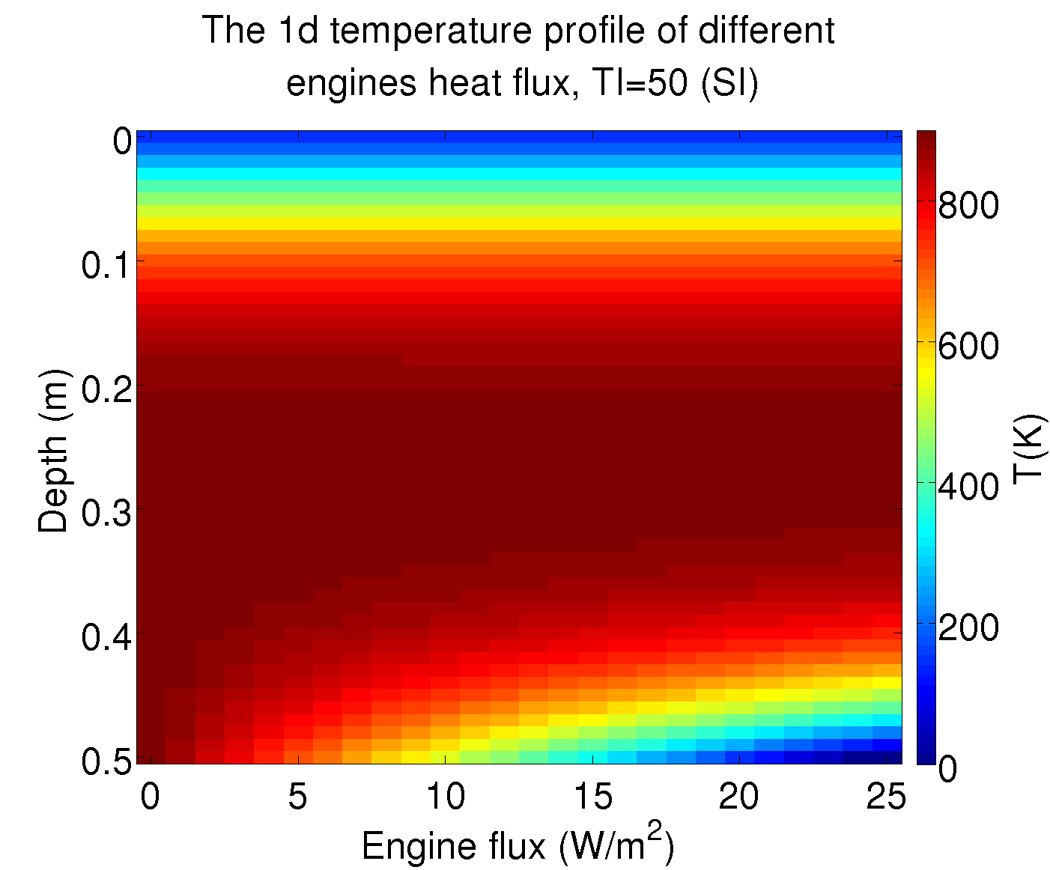
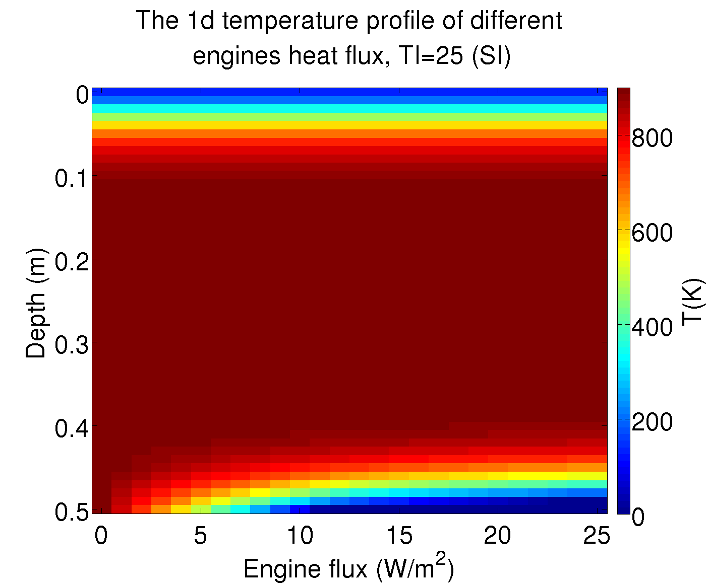
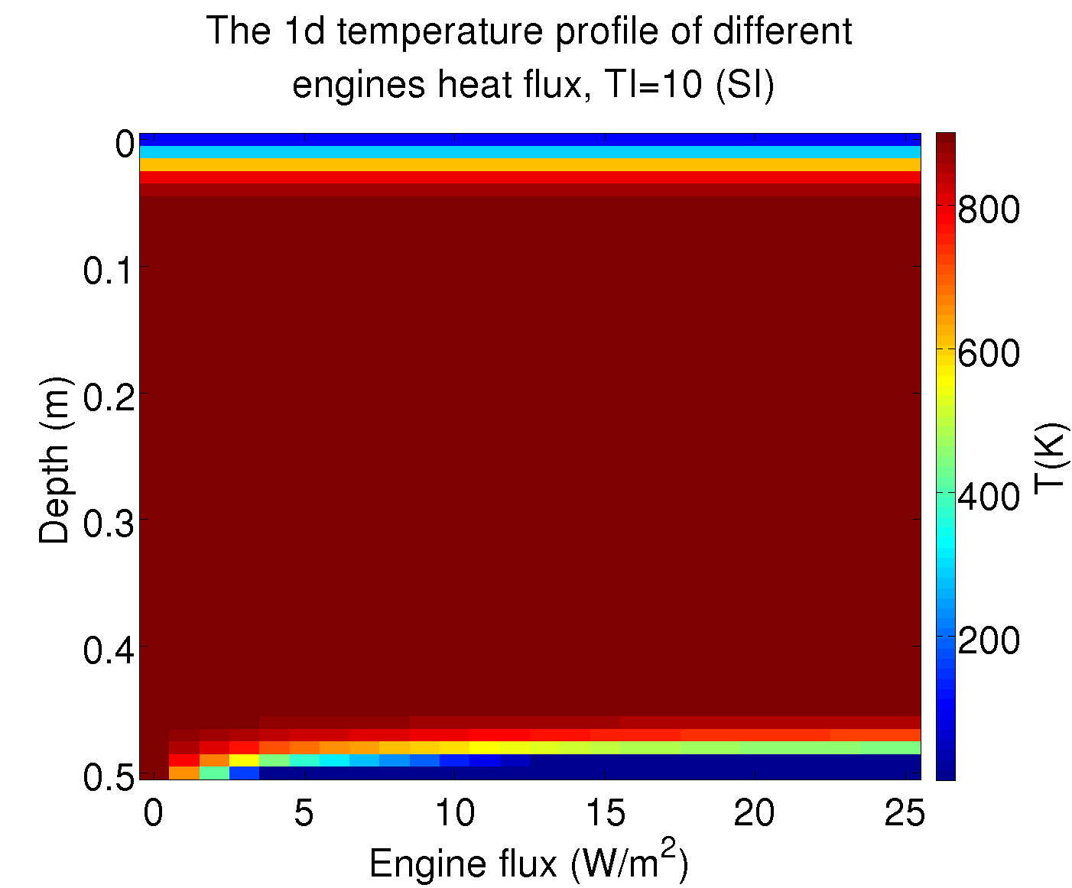
Energy analysis - input
TES: night time cooling
Notes:
1d model results for different thermal inertias. The simulation ran during 1 lunar night, assuming that during the day the entire thermal mass reached a temperature of 900 K. Higher thermal inertias cause more heat to flow from the inside of the thermal mass to its faces, thus heating its bottom. Areas with a higher thermal inertia are preferable when selecting the material and location of the buried thermal mass, as those remain warm even throughout the night.
k~0.01

Slide 19

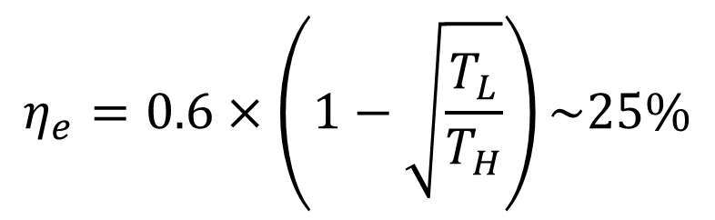
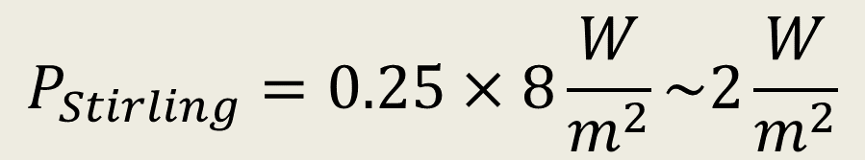
Energy analysis - input
TES: efficiency
$$η=0.6×\left(1−\frac{T_{L}}{T_{H}}\right)=0.6×\left(1−\frac{250}{700}\right)\sim 45\%$$
Climent et al., 2014
$$P_{Stirling}=0.25×8\frac{W}{m^{2}}\sim 2\frac{W}{m^{2}}$$
$$η_{e}=0.6×\left(1−\sqrt{\frac{T_{L}}{T_{H}}}\right)\sim 25\%$$
(Novikov efficiency)

Slide 20
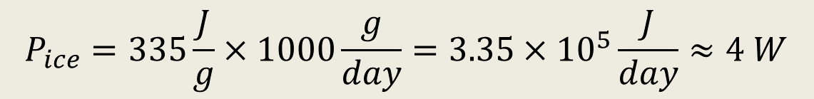
Energy analysis - output
Producing water: ice and recycling
In order to make a kg of ice:
$$P_{ice}=335\frac{J}{g}×1000\frac{g}{day}=3.35×{10}^{5}\frac{J}{day}≈4 W$$
 | Inflow rate, kg per day | produced on average, kg per person per day | Power (W) per person
SRV-K2M | 24 | 1.2 | 0.1
SRV-UM | 60 | 1 | 12
Bobe et al. (2007)
Notes:
The enthalpy of fusion for water ice is roughly $L_{ice}=335\frac{J}{g}$

Slide 21
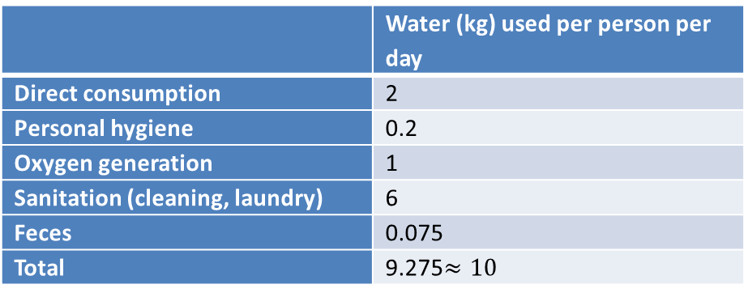
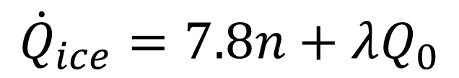
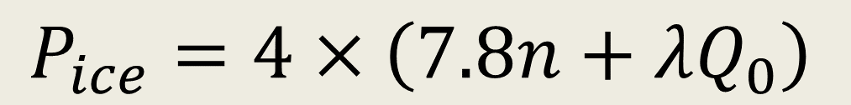
Energy analysis - output
Producing water: ice and recycling
 | Water (kg) used per person per day
Direct consumption | 2
Personal hygiene | 0.2
Oxygen generation | 1
Sanitation (cleaning, laundry) | 6
Feces | 0.075
Total | 9.275
$$P_{ice}=4×\left(7.8n+λQ_{0}\right)$$
Bobe et al. (2007)
$${\dot{Q}}_{tot}=2.2n+{\dot{Q}}_{ice}−10n−λQ_{tot}$$
$${\dot{Q}}_{ice}=7.8n+λQ_{0}$$

Slide 22
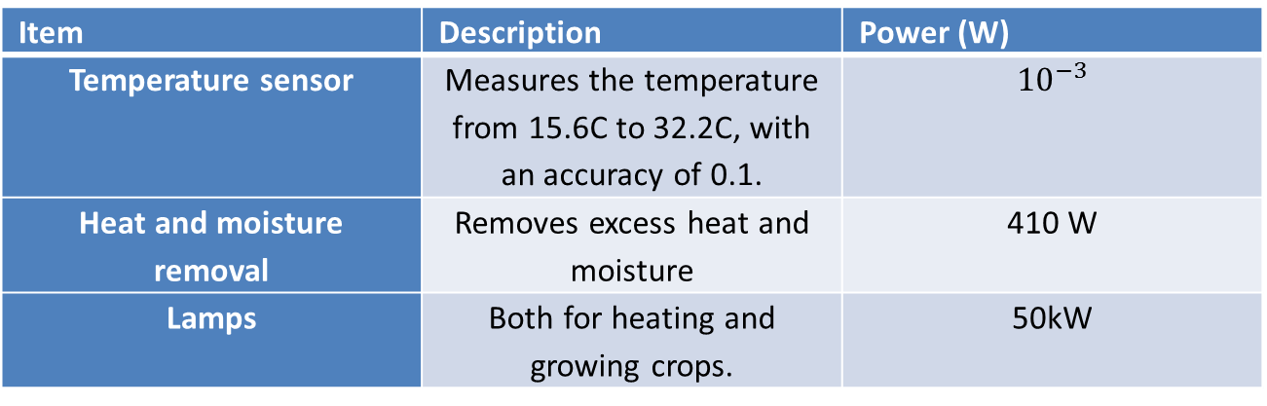
Energy analysis - output
Growing food
Item | Description | Power (W)
Temperature sensor | Measures the temperature from 15.6C to 32.2C, with an accuracy of 0.1.
Heat and moisture removal | Removes excess heat and moisture | 410 W
Lamps | Both for heating and growing crops. | 50kW
(Wieland, 1998, Salisbury, et al., 1997).

Slide 23
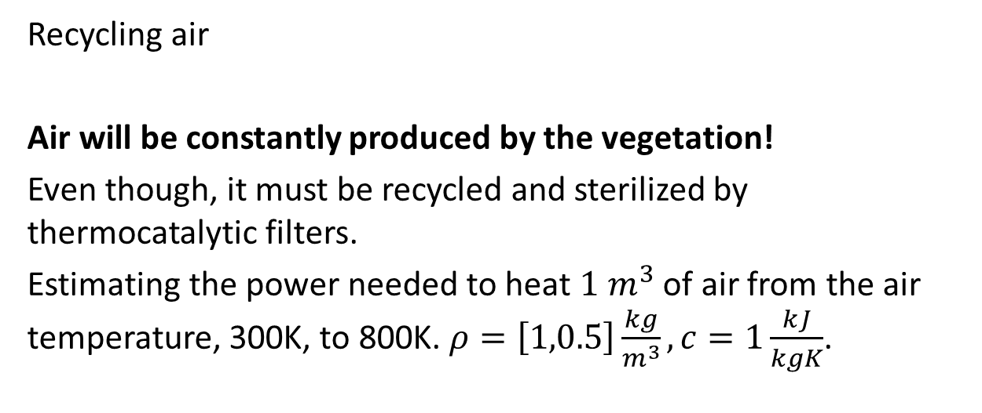
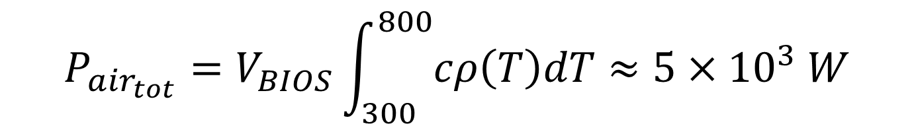
Energy analysis - output
Recycling air
Air will be constantly produced by the vegetation!
Even though, it must be recycled and sterilized by thermocatalytic filters.
Estimating the power needed to heat $1 m^{3}$ of air from the air temperature, 300K, to 800K. $ρ=\left[1,0.5\right]\frac{kg}{m^{3}}, c=1\frac{kJ}{kgK}$.
$$P_{air_{tot}}=V_{BIOS}\int_{300}^{800}{cρ\left(T\right)dT}≈5×{10}^{3} W$$
Notes:
While most of the air can and will be filtered by the plants themselves, some air must be recycled using thermocatalytic filters. This is a wasteful but necessary process that heats the air to ~800 K, which oxidized organic molecules to $CO_{2}$ and water.

Slide 24
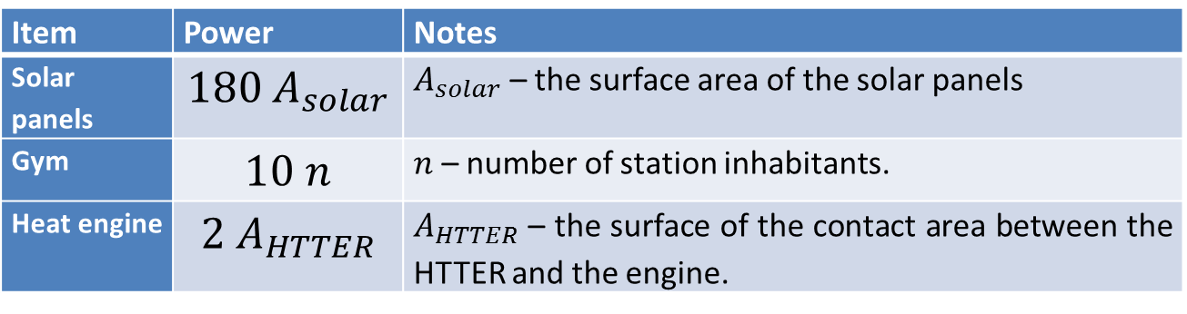
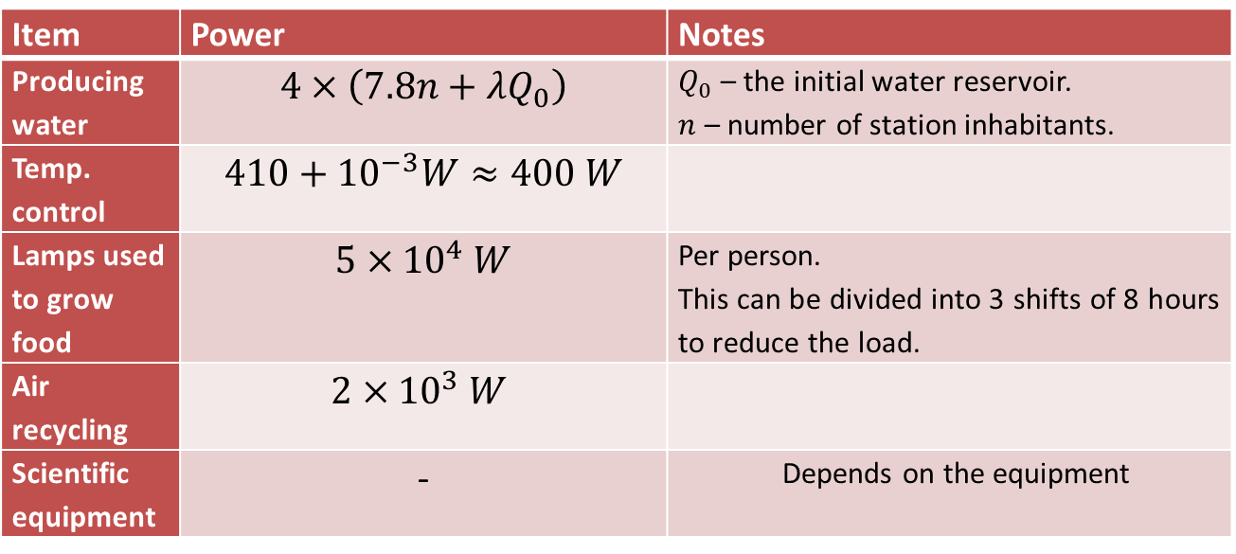
Energy analysis - summary
Item | Power | Notes
Solar panels |  | – the surface area of the solar panels
Gym |  | – number of station inhabitants.
Heat engine |  | – the surface of the contact area between the HTTER and the engine.
Item | Power | Notes
Producing water |  | – the initial water reservoir. – number of station inhabitants.
Temp. control
Lamps used to grow food |  | Per person. This can be divided into 3 shifts of 8 hours to reduce the load.
Air recycling
Scientific equipment | - | Depends on the equipment

Slide 25
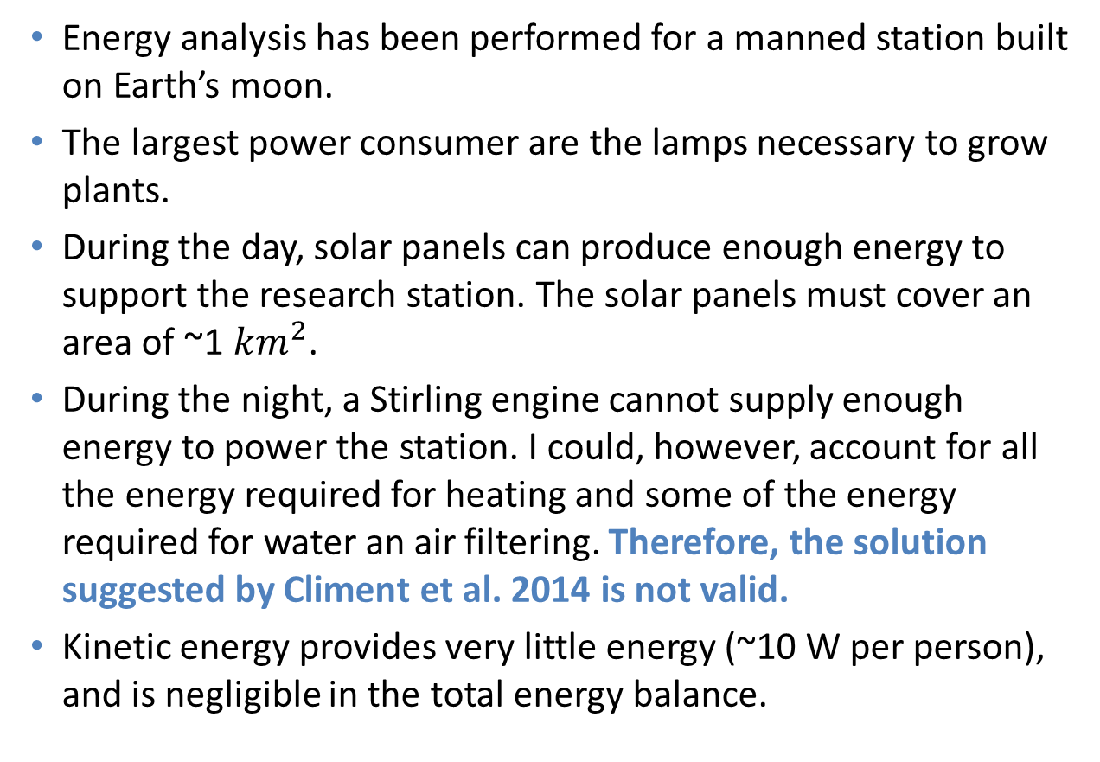
Conclusions
Energy analysis has been performed for a manned station built on Earth’s moon.
The largest power consumer are the lamps necessary to grow plants.
During the day, solar panels can produce enough energy to support the research station. The solar panels must cover an area of ~1 $km^{2}$.
During the night, a Stirling engine cannot supply enough energy to power the station. I could, however, account for all the energy required for heating and some of the energy required for water an air filtering. Therefore, the solution suggested by Climent et al. 2014 is not valid.
Kinetic energy provides very little energy (~10 W per person), and is negligible in the total energy balance.

Slide 26
References
Backhaus, S. & Swift, G. W., 1999. A thermoacoustic Stirling heat engine. Nature, pp. 335-338.
Baltas, P., Tortoreli, M. & Russel, P., 1986. Evaluation of power output for fixed and step tracking photovoltaic arrays. Solar Energy, pp. 147-163.
Bobe, L. et al., 2007. Regenerative water supply for an interplanetary space station: experience gained on the SS "Salut", "Mir" and ISS. Acta Astronautica, pp. 8-15.
Climent, B. et al., 2014. Heat storage and electricity generation in the Moon during the lunar night. Acta Astronautica, Volume 93, pp. 352-358.
Duffie, J. A. &. B. W. A., 2006. Solar Engineering of Thermal Processes. 3rd ed. s.l.:Wiley.
Emery, K. & Osterwald, R., 1986. Solar cell efficiency measurements. Solar Cells, pp. 253-274.
Gilmore, A., 2008. Human Power: Energy Recovery from Recreational Activity. Guelph Engineering Journal, Volume 1, pp. 8-16.
Green, M. et al., 2014. Solar cell efficiency tables (version 44). Progress in photovoltaics, Volume 22, pp. 701-710.
Heinke, G., 1991. The Lunar Sourcebook. s.l.:Cambridge press.
Hendrickx, L. et al., 2006. Microbial ecology of the closed artificial ecosystem MELiSSA (Micro-Ecological Life Support System Alternative): Reinventing and compartmentalizing the Earth’s food and oxygen regeneration system for long-haul space exploration missions. Research in Microbiology, Volume 157, pp. 77-86.
Ivanov, B., 2006. Earth/Moon impact rate comparison: Searching constraints for lunar. Icarus, Volume 183, pp. 504-507.
Purkey, S. & Johnson, G., 2010. Warming of Global Abyssal and Deep Southern Ocean Waters between the. Journal of climate, Volume 23, pp. 6336-6338.
Salisbury,, F., Gitelson, J. & Lisovsky, G., 1997. Bios-3: Siberian Experiments in Bioregenerative Life Support. BioScience, 47(9), pp. 575-585.
Singh, P. & Ravindra, N., 2012. Temperature dependence of solar cell performance—an analysis. Solar energy materials and solar cells, pp. 36-45.
Wheeler, R. et al., 1996. NASA's Biomass Production Chamber: a Testbed for Bioregenerative Life Support Studies. Peramon, 18(4), pp. 215-224.
Wieland, P. O., 1998. Living together in space: the design and operation of the life support systems on the International Space Station.. Huntsville, AL: National Aeronautics and Space Administration, Marshall Space Flight Center.

