Slide 1
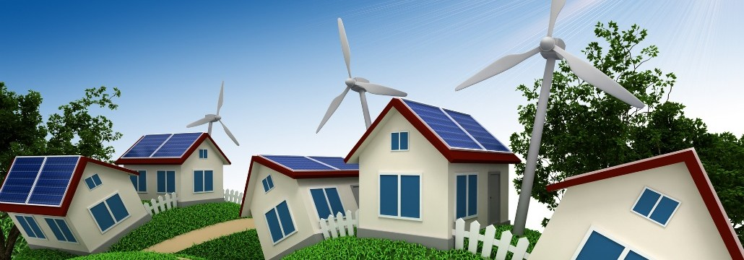
Small scale wind turbines
Are they worth it, energy-wise?
Presentation in 2015 FGS (Weizmann Inst.)
Guided Reading Course
Energy and Sustainability
Ayelet Klein
Notes:
Wind power was very popular in the search for renewable energy sources, it is quite developed.
What was interesting to me was to see what will happen if we use small scale wind turbines in our homes. What will be the influence.
No cover for financial information

Slide 2
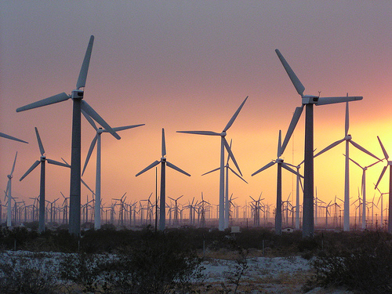
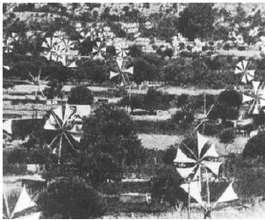
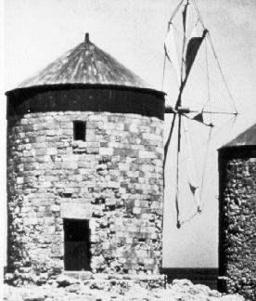
History
Persian drag machine design, used for water pumping and grain grinding
Water pumping machines on the Island of Crete
An early mill on the Mediterranean coast
Notes:
The first wind-mills were developed in Persia and probably in Chaina between 500-900 B.C to automate the tasks of water-pumping and grain grinding .
From there the use of wind-mills spread from Persia to the surrounding areas in the middle east , where it was used in food production.
Around 1,000 A.D., wind power technology spread north to European countries such as The Netherlands, which adapted windmills to help drain lakes and also to grind grain, with a new design for the wind mill – a tower mill.
The technology developed
Between 1850 and 1970, over six million mostly small (1 horsepower or less) mechanical output wind machines were installed in the U.S. alone.

Slide 3
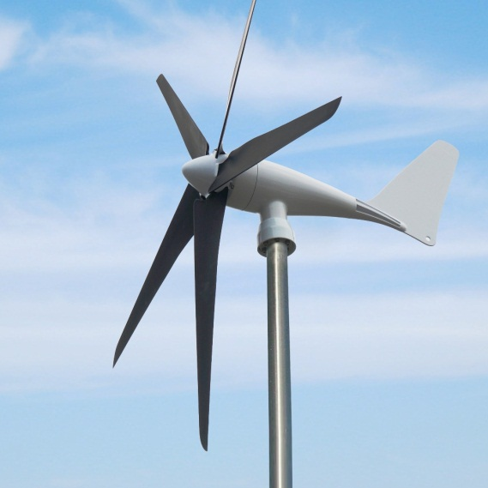
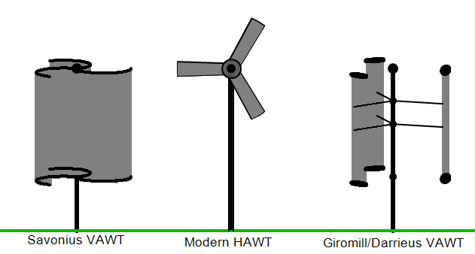
Types
Horizontal axis wind turbine (HAWT)
Vertical axis wind turbine (VAWT)
HAWT
VAWT
HAWT
VAWT
Notes:
The most common type in the UK is the HAWT [Bahaj et al., (1)]

Slide 4
HAWT VAWT
Main rotor shaft and electrical generator at the top of the tower
Must be pointed into the wind
Main rotor shaft arranged vertically
The generator and gearbox can be placed near the ground
Does not need to be pointed into the wind
Relatively low rotational speed
Notes:
Most of the small scale (and in general) wind turbines are horizontal axis – more efficient, usually
Most early ones – vertical
In Europe - horizontal

Slide 5

Gross power
$$P_{G}=\frac{1}{2}ρAu^{3}e$$
$A=\frac{π}{4}D^{2}$
$D$ – rotor diameter
$ρ$ – air density
$u$ – wind velocity
[Sahin et al. 2006]
Notes:
Wind turbine - a device that converts kinetic energy from the wind into electrical power.
U (cubic) and D (square) are the dominant factor
Has cubic dependence on wind velocity

Slide 6
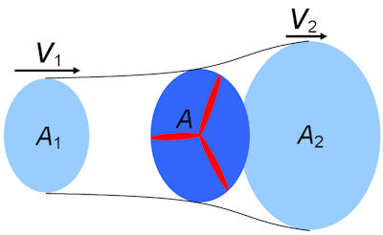
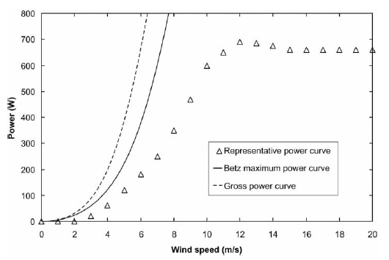

Betz limit - Max power of $59\%$
[Betz 1946]
Notes:
16/27 or 59% of the Gross power. Betz's law calculates the maximum power that can be extracted from the wind.
Real turbine extract less than Betz limit due to aerodynamics and power conversion losses.
Figure: representative micro-wind turbine power curve, compared with the Gross power and the Betz limit.

Slide 7
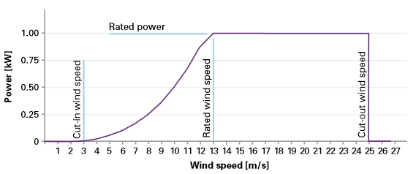
Power curve
[Entec]
Notes:
Entec – a company that de sign environmental solutions and products
http://www.entec-international.com/
Cut-in speed: At very low wind speeds, there is insufficient torque exerted by the wind on the turbine blades to make them rotate
Rated power: the power output reaches the limit that the electrical generator is capable of – keep the power at const level
Cut-out speed: There is a risk of damage to the rotor

Slide 8
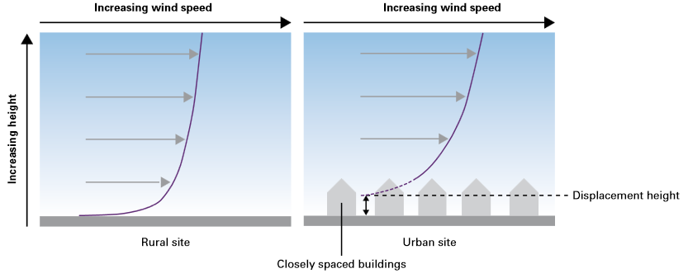
Wind resource
[Entec]
Notes:
Globally, winds are caused by pressure gradients generated by the differential heating of the Earth’s surface by the Sun
Within the atmospheric boundary layer the shear stresses caused by the Earth’s surface extract momentum from the wind,
and cause a variation of velocity with height. Topography,surface roughness etc.
Urban environments typically have the greatest surface roughness, and climatological processes in such environments are accordingly complex.

Slide 9
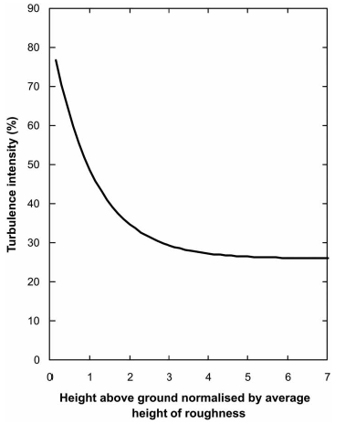
Turbulence
[Roth, 2000]
Notes:
Turbulence intensity as a function of height in urban environments

Slide 10
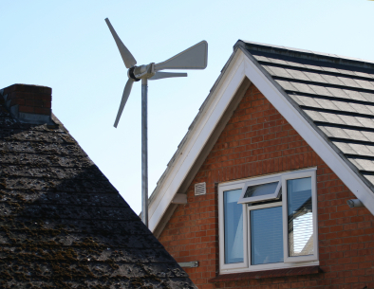
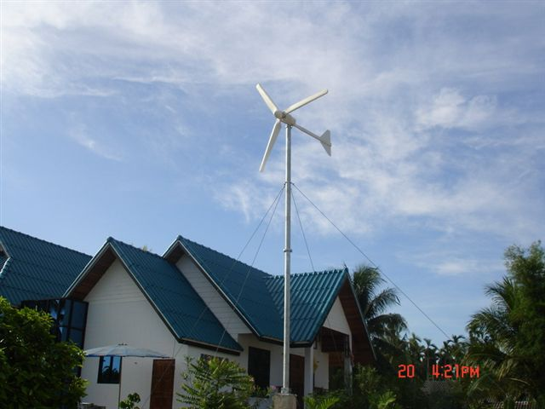
Small scale
Rated power of less than 50kW

Slide 11
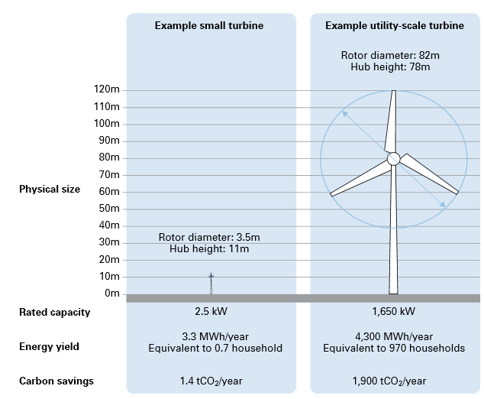
[Carbon trust]
Notes:
1650/2.5 = 660
4300/3.3 = 1303
1900/1.4 = 1360

Slide 12
Turbine comparison
 | micro HAWT | Swift rooftop wind turbine
Power rating (kW) | 0.6 | 1.5
Mean annual output (kWh) | 870 / 164 * | 2000-3000
Rotor diameter (m) | 1.7 | 2
Lifetime (y) | 15 | 20
Rated velocity (m/s) | 12 | 12
[Allen et al., 2008 & Rankine et al. ,2006 ]
Notes:
870 – rural, 164 - urban

Slide 13
Output energy

Slide 14
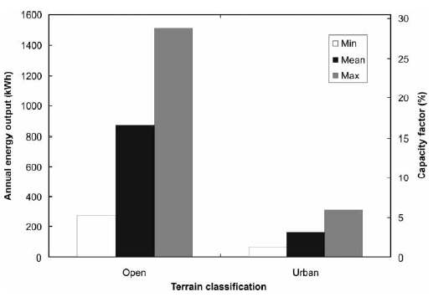
Annual energy output
[Allen et al., 2008]
Notes:
The mean annual wind speed in rural environments ranges between 2.8-7.8 m/s, in urban environments – 2.3 – 5.2 m/s (more affected by turbulence – power robbing effect of 50%, compared with 15% in rural environments).
Capacity factor = actual energy production/output in rated power continually %
Estimations:
1. Wind speed data was taken between 1990-2006 in 26 sites, 18 rural and 8 urban.
2. Position : a. rural – mounted upon a 10m mast away from rural household
b. urban – mounted upon a building
3. The estimations were corrected for turbulence intensity
4. The wind turbine works 90% of the time (breakdown, maintenance).
5. All the energy is consumed by the household or exported to the grid (no transmission losses)

Slide 15
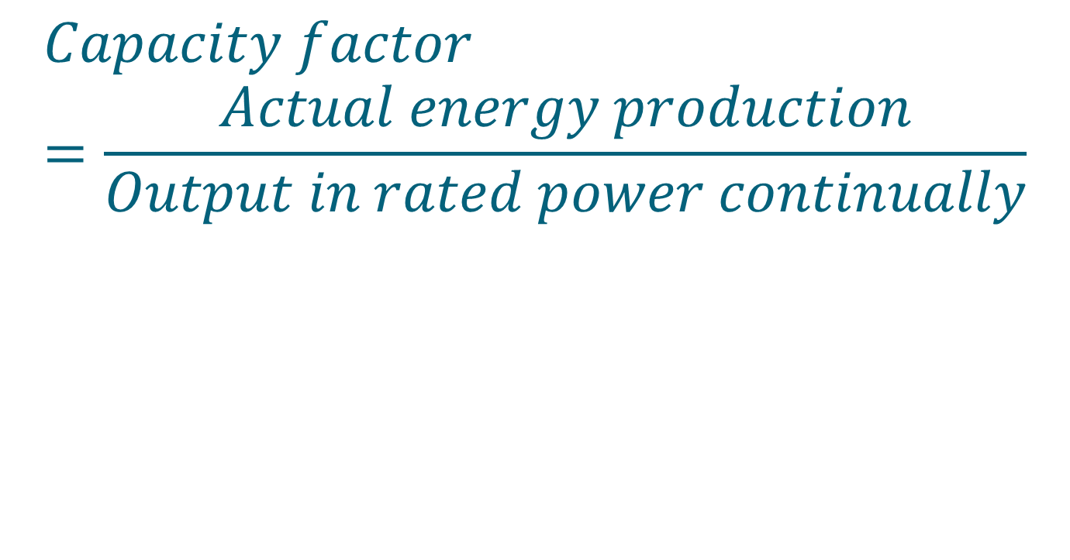
Annual energy output

Slide 16
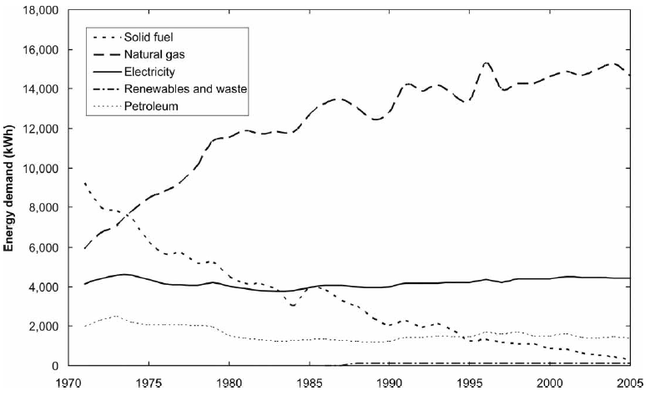
Annual household electricity consumption
[DBERR, DCLG ]
Notes:
The electricity consumption is broadly const.
~4450 kwh per year (in the us it’s 11700 kWh/year) and ~2000kWh per person http://shrinkthatfootprint.com/average-household-electricity-consumption
https://www.gov.uk/government/uploads/system/uploads/attachment_data/file/338662/ecuk_chapter_3_domestic_factsheet.pdf

Slide 17



Annual energy output
870 kwh
$$\frac{1}{5}$$
$$1/5$$
164 kwh
$$1/{25}$$
[Allen et al., 2008(6)]
Notes:
870 ~ 1/5 of the household consumption
164 ~1/25 of the household consumption
Now its financially unattractive, but need also to consider environmental impacts

Slide 18
Input energy
Component manufacture
Transportation
Installation and maintenance

Slide 19
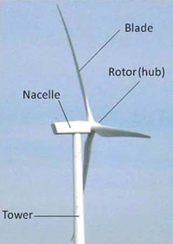
Turbine components

Slide 20
Small scale turbine components
Component | Item | Material | Percentage of total mass
Tower |  | Aluminium | 40%
Nacelle | Frame & cover | Aluminium | 25%
 | Generator | Steel | 15%
 |  | Copper | 2%
Rotors | Blades | carbon fibre-reinforced epoxy (CFRP) | 4%
 | Hub and bolts | Aluminium | 1%
 |  | Steel | 1%
[Allen et al., 2008 & Rankine et al. ,2006 ]
Notes:
Very different from large scale wind-turbines – no concrete, less steel

Slide 21
Small scale turbine components
[Rankine et al. ,2006]

Slide 22
Component manufacture
Material | Energy consumption (MJ/kg)
concrete | 4
Stainless Steel | 60
Steel | 42
Aluminium | 206
Recycled aluminium (100%) | 19
Copper | 67
Epoxy | 46
Glass fiber | 115
Carbon fiber | 200
[Allen et al., Rankine et al., Crawford, Schleisner , Lenzen et al., Fleck et al.]
Notes:
The number were taken as an average over different values presented in the following articles

Slide 23
Component manufacture
Material | Energy consumption per kg without recycled aluminium (MJ) | Energy consumption per kg with recycled aluminium (MJ)
Steel | 7 | 7
Aluminium | 145 | 72
Recycled aluminium (100%) | - | 7
Copper | 1 | 1
Epoxy | 2 | 2
Carbon fibre | 8 | 8
Total | 163 | 97
Total for 95 kg | 15430 | 9190
[Allen et al., 2008 & Rankine et al. ,2006 ]
Notes:
The difference is probably a result of a varying proportion of aluminum that is recycled for use within the turbines.
The Ecoinvent database used in the present study estimates that to produce 1 kg of virgin aluminum takes 201 MJ, but to produce 1 kg of recycled aluminum takes only 23 MJ.
By using virgin Aluminium in all relevant parts of the generator, the energy used in production changes to 8220 MJ. This compares with 5320 MJ when using the
recycled content adopted for this study (just over 50 per cent recycled, not including alloys or powder coatings). Using virgin aluminium for turbine production
means that the amount of energy used to produce the turbine per kg increases to 224 MJ.

Slide 24
Transportation
Vehicle | Fuel consumption (l/km) | Average distance* (km) | Fuel consumption (l) | Energy consumption (MJ/l)** | Total energy consumption (MJ)
Curtain-sided truck | 0.34 | 470 | 160 | 39 | 6230
Light commercial vehicle | 0.08 | 470 | 37 | 39 | 1440
Medium-sized car | 0.07 | 470 | 31 | 35 | 1090
[Allen et al., 2008 & Rankine et al. ,2006 ]
Notes:
* Delivery distance of 533 km was calculated on the basis of the average distance between Edinburgh and all major cities (Rankine). In Allen they took 400 km – I took an average
** Used diesel for trucks and regular petrol for the car

Slide 25
Installation and maintenance
Vehicle | Fuel consumption (l/km) | Average distance*** (km) | Fuel consumption (l) | Energy consumption (MJ/l)** | Total energy consumption (MJ)
Light commercial vehicle | 0.08 | 66 | 5 | 40 | 205
[Rankine et al. ,2006]
Notes:
*** km in 40 min
The energy from this activity was taken to be equivalent to those of a light commercial vehicle operating for 40 min.

Slide 26
Total input energy
 | Energy consumption (MJ)* | Energy consumption with 50% recycled aluminium(MJ)*
Component manufacure | 15430 | 9190
Transportation | 6230 | 6230
Installation and maintenance | 205 | 205
Total | 21870 | 15625
[Allen et al., 2008 & Rankine et al. ,2006 ]
Notes:
comparing with Allen's article: (5320-1645)/37=~99, similar to 97.6 in slide 19
* for a 95 kg turbine

Slide 27
Energy intensity
 | Annual output (kWh) | Output energy over lifetime (MJ) | Input energy (MJ) | Energy intensity
Hydro |  |  |  | 93
Wind (800 kW onshore) |  |  |  | 19
Wind (2MW offshore) |  |  |  | 16
Mean open micro wind turbine | 870 | 46,980 | 5,320 | 9
Mean urban micro wind turbine | 164 | 8,860 | 5,320 | 1.7
SWIFT rooftop wind turbine | 2,500 | 180,000 | 22,630 | 8
Comparative micro-wind turbine (600W) |  |  |  | 4
Solar |  |  |  | 3
Natural gas |  |  |  | 0.4
Current UK grid |  |  |  | 0.3
Coal |  |  |  | 0.3
Nuclear |  |  |  | 0.3
Oil |  |  |  | 0.2
[Allen et al., Rankine et al. , Swiss centre for life cycle inventories, Ancona et al., DTI ]
Notes:
Energy intensity is defined as Output energy over the turbine life time divided by the input energy invested in the turbine production

Slide 28
Payback time
 | Annual output energy (MJ) | Input energy (MJ) | Payback time (y)
Mean urban micro wind turbine | 590 | 5320 | 9
Mean open micro wind turbine | 3130 | 5320 | 1.7
SWIFT rooftop wind turbine | 9000 | 22630 | 2.5
[Allen et al., 2008 & Rankine et al. ,2006 ]
Notes:
Annual energy output 164 kWh=590MJ
Annual energy input 5320/15=354MJ
Primary: wind, solar, hydro
Secondary: fossil fuel
Payback time – Energy invested in turbine divided by the annual output energy

Slide 29
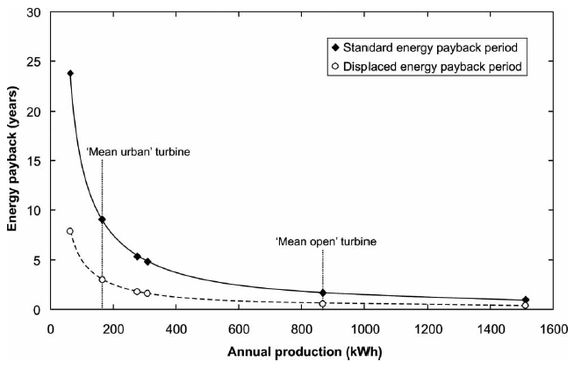
Payback time
[Allen et al., 2008]

Slide 30
References
Bahaj, A. S.,Myers, L., and James, P. A. B. Urban energy generation: influence of micro-wind turbine output on electricity consumption in buildings.EnergyBuild., 2007, 39(2), 154–165.
Sahin,A.D.,Dincer, I.,andRosen,M. A.Thermodynamic analysis of wind energy. Int. J. Energy Res., 2006, 30(8), 553–566.
Betz, A. Windenergie und ihre Ausnutzung durch Windmühlen, 1946 (Vandenhoek and Ruprecht, Göttingen).
Entec - http://www.entec-international.com/
Roth, M. Review of atmospheric turbulence over cities. Q. J. R.Meteorol. Soc., 2000, 126, 941–990.
S. R. Allen, G. P. Hammond, and M. C. McManus, Energy analysis and environmental life cycle assessment of a micro-wind turbine, J. Power and Energy, 2008, 669-683.
DBERR. Energy consumption tables: domestic energy consumption tables. 2007, available from:http://www.dti.gov.uk/energy/statistics/publications/ecuk/domestic/page18071.html, accessed 13 August 2007.
DCLG. Live tables on stock. 2007, available from: http://www.communities.gov.uk/index.asp?id=1156006,accessed 13 August 2007.
Department of trade and industry, UK energy in brief, 2005 (DTI, London).

Slide 31
References
Dutton, A. G., Halliday, J. A. , and Blanch, A. J., The feasibility of building-mounted/integrated wind turbines. (BUWTs): Achieving their potential for carbon emission reductions. Final report, 4 May 2005, p. 109.
Ancona, D. and McVeigh, J. Wind turbine – materials and manufacturing fact sheet, Prepared by Princeton Energy Resources International, LLC for the Office of Industrial Technologies, US Department of Energy,2001.
Rankine, R. K., Chick, J. P. and Harrison, G. P. Energy and carbon audit of a rooftop wind turbine. Proc. InstnMech. Engrs, Part A: J. Power and Energy, 2006, 220(7),643–654
R.H. Crawford, Life cycle energy and greenhouse emissions analysis of wind turbines and the effect of size on energy yield, Renewable and Sustainable Energy Reviews 13 (2009) 2653–2660
Carbon trust - http://www.carbontrust.com/media/77248/ctc738_small-scale_wind_energy.pdf
http://energy.gov/eere/wind/history-wind-energy
Illustrated history of wind power development - http://energy.gov/eere/wind/history-wind-energy
Swiss Centre for Life Cycle Inventories. Ecoinvent database [v1.3], 2007 (EPMA, Switzerland).
DTI.Digest ofUnitedKingdomenergy statistics 2005, 2006 (Department of Trade and Industry, London).
Manfred Lenzen, *, Jesper Munksgaardb, Energy and CO2 life-cycle analyses of wind turbines—review and applications. Renewable energy, 26 (2002) 339–362

Slide 32


