Slide 1
Striclty for educational purposes
Final project in M.Sc. Course for teachers, in the framework of the Caesarea –Rothschild program of the Feinberg Grad School of the Weizmann inst. of Science.
Note that ppt may contain copy-righted material and as such any use that can violate such rights will require permission from the © holders.

Slide 2
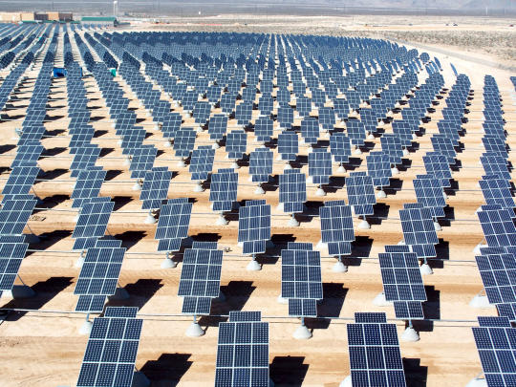
Solar Energy in Israel
Using Photovoltaic Cells – Based
Electricity Generation Systems
by:
Duaa Nassar Hammam Bshara

Slide 3
Goals
- To generate electricity from non-biodegradable and green source.
- To reduce Israel’s dependence on energy resources that are not locally available.
- To meet the growing electricity consumption of Israel.
Notes:
Why is the non-biodegradable important
I think you mean stable, durable With green I think you may mean : sustainable

Slide 4
PV Cell
Input
* Array of photovoltaic panels.
* Electronic interface equipment to convert DC to AC voltage and current and to assure connection to the user/grid
* Solar radiation.
Technical challenges
* Solar to electrical energy conversion.
* Increase the efficiency of the cell.
* Make the technology affordable and worthwhile (economically and energetically) several times more than today.

Slide 5
Common Photovoltaic Systems
Mono-crystalline (mono-Si, c-Si).
Multi-crystalline (multi-Si, mc-Si).
Amorphous silicon (a-Si).
CdTe polycrystalline thin film (CdTe).
CIS polycrystalline thin film (CIS).
* Mono-Si PV yields the highest conversion efficiency among these solar cells, but also requires most energy during its life cycle.

Slide 6
Data
* Israel receives 4 kWh/m²-day radiative energy.
Solar power intensity of 1 kW/m² at noon in the most sunny of locations.
1/6 load factor over 24 hr
PV cell: mono-Si.
Assume 18.5% module efficiency, η, (3.5% less in summer, because η decreases @ with  temp.
Life time of PV cell: about 30 years.
* DC-AC conversion losses: 10%.
* Panels are installed at optimum angle for Israel: 30◦
Notes:
3.5 % of 18.5 %?
Or4 15 instead of 18.5 %?

Slide 7
Calculations
* Maximum output from such module:
~1 kW/m² *18.5% *0.9 *24 h/day *365 day/yr * 1/6 =
~ 240 kWh/m²/yr
* Electricity consumption of Israel in 2013: 61.6 10⁹ kWh
What is the area needed to generate all the electricity for the country:
(61.6*10⁹ kWh/year) / (240 kWh/m²yr) =
~250 km²
* This area is ~2% of the Negev.

Slide 8
PV systems can be located on top of commercial or industrial buildings to which power can be supplied:
→ minimal transmission loss, since electricity is generated close to the consumer.
* Eliminates need to use extra land area.
* Provides relatively free available area.
Placing panels on a building’s rooftops can decrease the solar heating of the building.

Slide 9
The question is if enough roof area exists for producing a significant amount of electricity.
Rooftops generally contain all sorts of structures and equipment, such as heating exhausts and cooling units;
→ available unshaded rooftop area required for PV installations is limited.
We can estimate that ~30% of the rooftops will be available for PV installations (~75 km² out of ~ 251 km²

Slide 10
Total electricity generation potential of PV cells installed on rooftops in Israel can reach up to 32% of total consumption.
The potential was obtained by multiplying the calculated output per unit area by the available rooftop area.

Slide 11
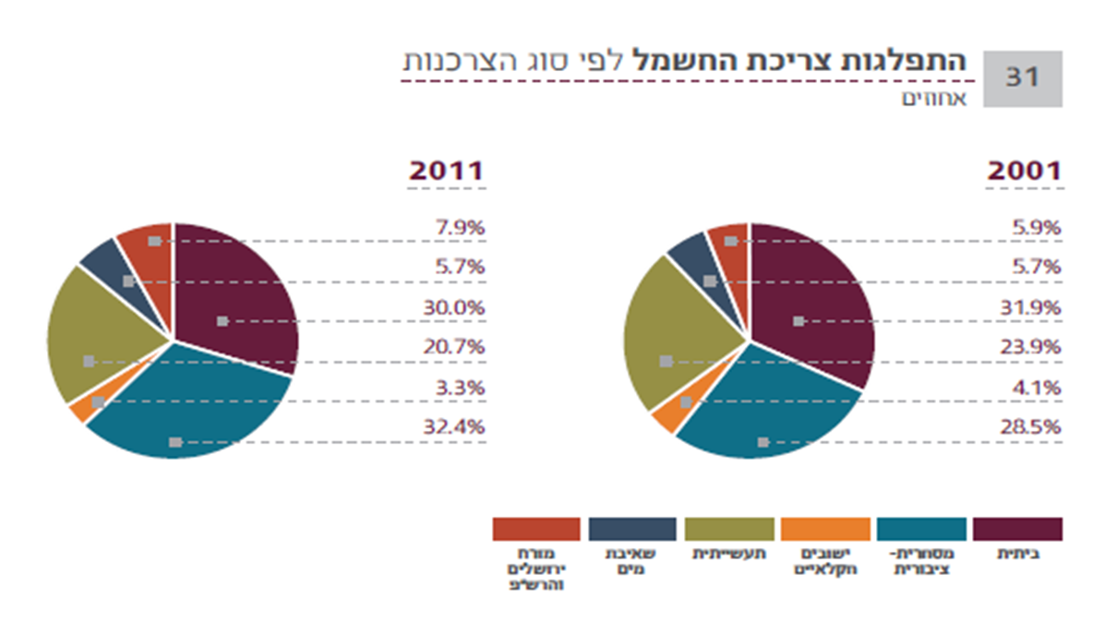
The Electricity Consumption Distribution In Israel

Slide 12
The Energy Cost Of PV Cell
Total life cycle energy losses of the mono-Si PV ranging from ~ 800 – 1500 kWh/m²
* Output calculated: ~ 240 kWh/m² year
* it takes ~ 3 to 6 years to generate the energy to cover the energy costs of the cell during its lifetime.
Serving of panels is simple and doesn’t require much
effort. But, it is important to clean the panels from
dust and dirt that reduce the efficiency of the solar system.

Slide 13
It is noteworthy that..
* The energy output calculated is not accurate and may deviate from the real power output.
During the real operating process of PV modules, there will be different kinds of energy losses caused by:
Self degradation of solar cell
Influence of cell temperature
Impact of orientation and tilt angle of modules
Shadowing by dust, clouds,
Spectral changes,
Mismatch between PV modules and inverter
………….

Slide 14
Points to Think About..
* Calculated output is not accurate.
Difficult to calculate the energy losses of the lifecycle of the PV cell.
Viability of the system depends on steady and undisturbed operation.

Slide 15
This technology is growing rapidly and continually improving.
* Efficiency of the cells increases with time.
Production methods are developing, with lower energetic cost of manufacturing.
Recycling and reuse of materials made from silicon.

Slide 16
Conclusions
This technology is very important to:
* Utilizing of sustainable energy sourse.
Encouraging lack of dependence on external energy sources that are not environmentally friendly.

Slide 17
Solar energy is now an integral part of the life and the economy of every country in the world.
This is a developing industry which helps to protect the environment and reduce greenhouse gas emissions into the atmosphere.

Slide 18
References
Vardimon, R. Assessment of the potential for distributed photovoltaic electricity production in Israel. Renewable Energy 2011;36.
Peng, J, Lu, L, Yang, H. Review on life cycle assessment of energy payback and greenhouse gas emission of solar photovoltaic systems. Renewable and Sustainable Energy Reviews 2013;19;255-274.
Zhai, P and Williamse, D. Dynamic Hybrid Life Cycle Assessment of Energy and Carbon of Multicrystalline Silicon Photovoltaic Systems. Environ.Sci Technol.2010;44;7950-7955.

Slide 19
www.withouthotair.com
משרד התשתיות הלאומית, האנרגיה והמים: www.energy.gov.il
www.electric.org.il
הלשכה המרכזיתלסטטיסטיקה: http://www.cbs.gov.il/reader
חברת החשמל לישראל: http://www.iec.co.il/Pages/default.aspx

