Slide 1
Mechanisms of stimulus feature selectivity in sensory systems
Orientation and direction selectivity in the visual cortex
Selectivity to sound frequency in the auditory cortex
Feature selectivity in the somatosensory system.

Slide 2
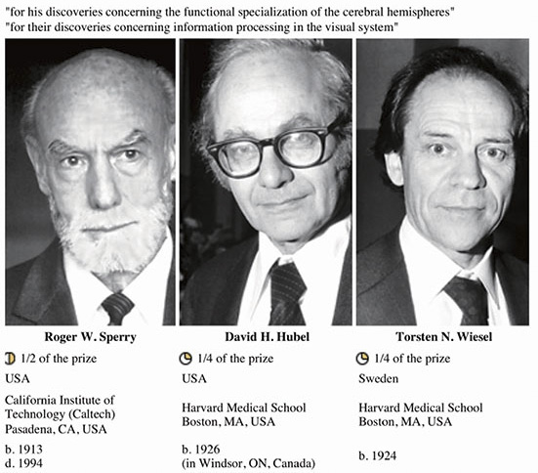
Orientation selectivity in the primary visual cortex
The Nobel Prize in Physiology or Medicine 1981

Slide 3
Orientation selectivity in the primary visual cortex
Hubel and Wiesel experiments
The H&W model – a simple feedforward model
Predictions of the H&W model
Mismatches between H&W model and experimental data
Recurrent models for orientation selectivity
Experiments that support the H&W – intracellular recording data
Advanced imaging experiments and the H&W model
Optogenetic manipulations of specific types of neurons
Recent studies on orientation selectivity in mouse visual cortex

Slide 4
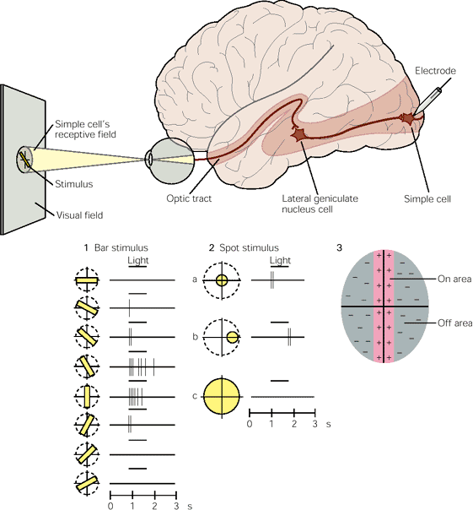
Orientation selectivity

Slide 5
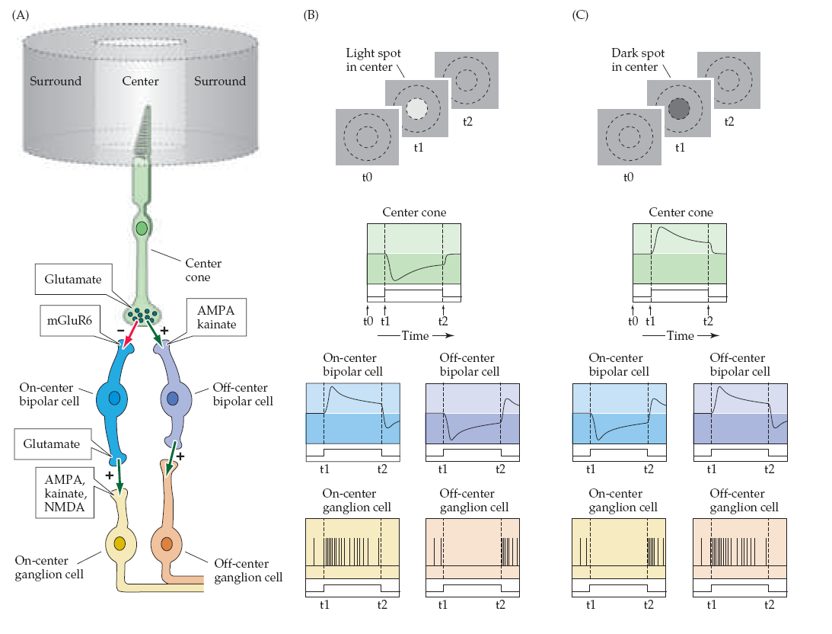
Receptive fields in the retina
On and Off centers are important to generate reliable output signal (firing) in ganglion cells
The transmission between cones and bipolar cells depends on the type (on vs off) target type
Note:
mGluR6 is metabotropic and leads to hyperpolarization of the bipolar cell
AMPA and Kinate are ionotropic and have excitatory effect on bipolar cells
Bipolar cells are:
On = Sign Inverting
Off = Sign conserving

Slide 6
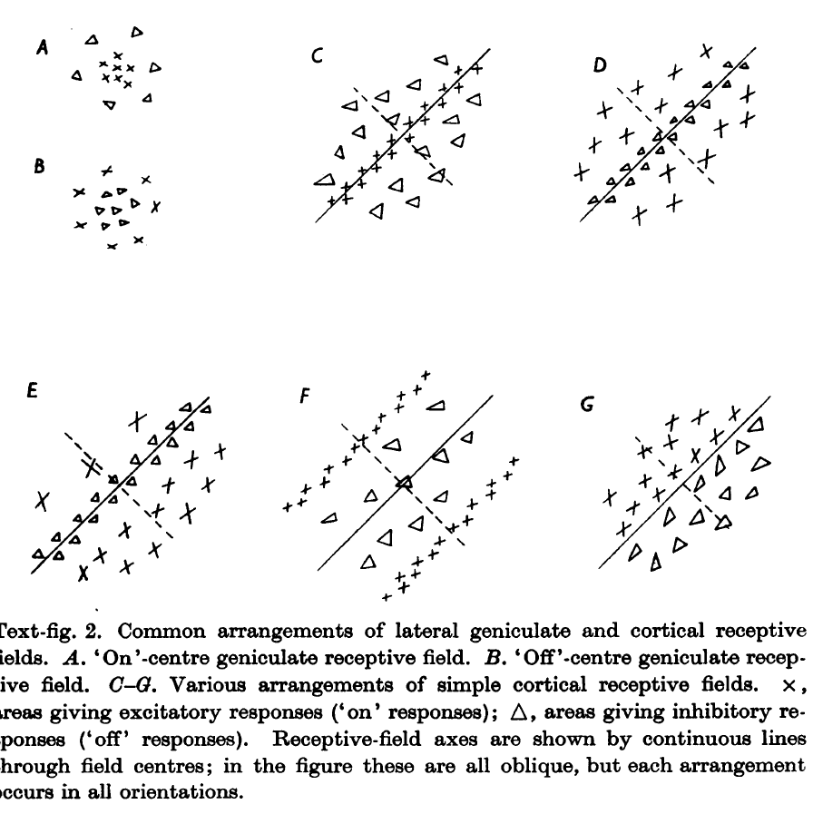
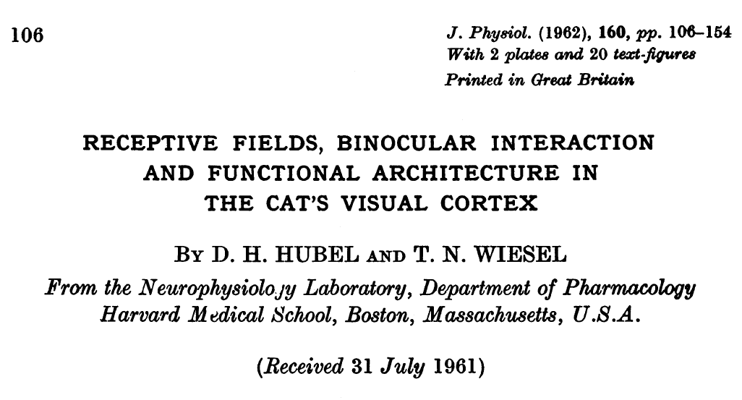
Receptive fields in V1, H&W experiments
‘Simple cells’
Thalamic cells
Cortical cells
Cortical cells

Slide 7
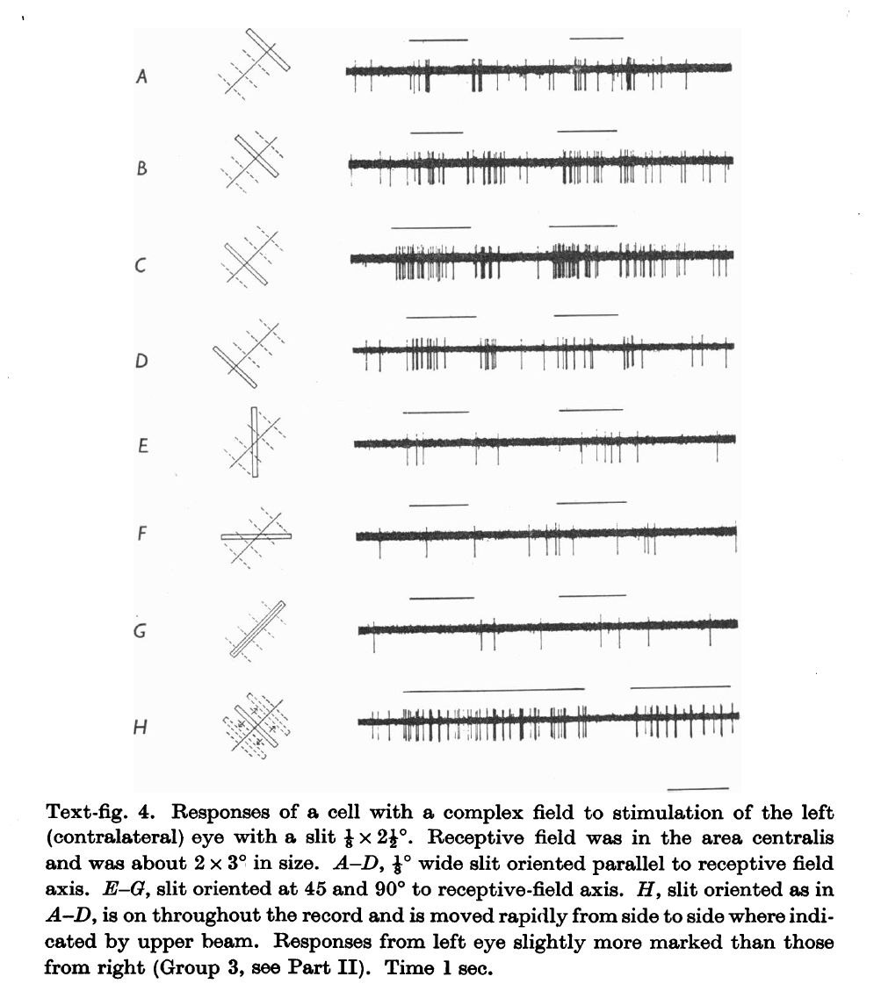
Data from H&W experiments: flashing bars : “complex cell”

Slide 8
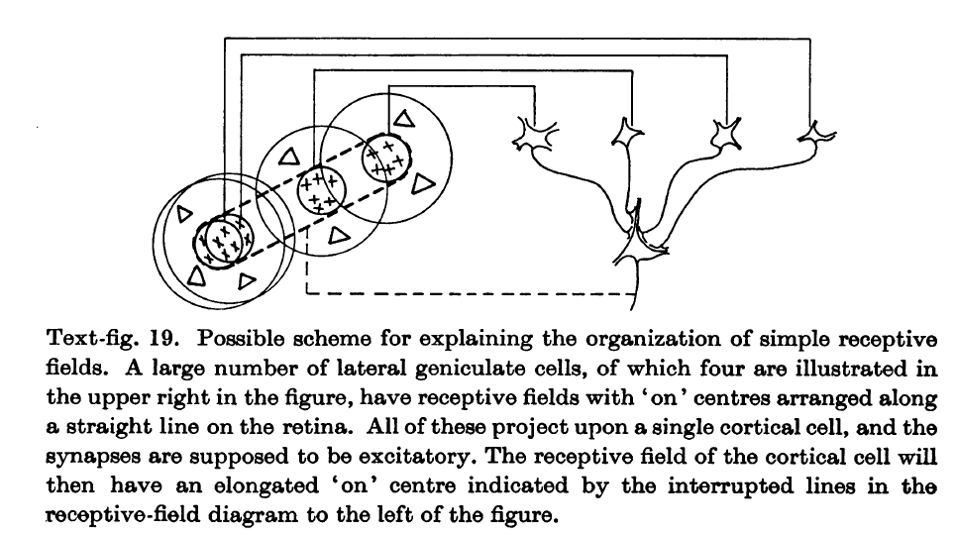
H&W model for simple cells

Slide 9
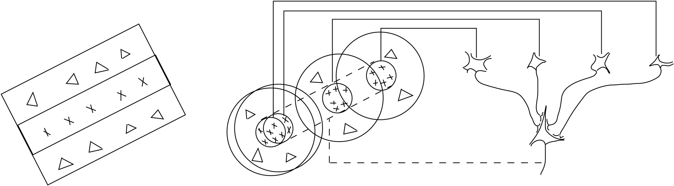
H&W model:
The Feedforward Model
LGN
Cortical Simple cell
Hubel and Wiesel, 1962

Slide 10
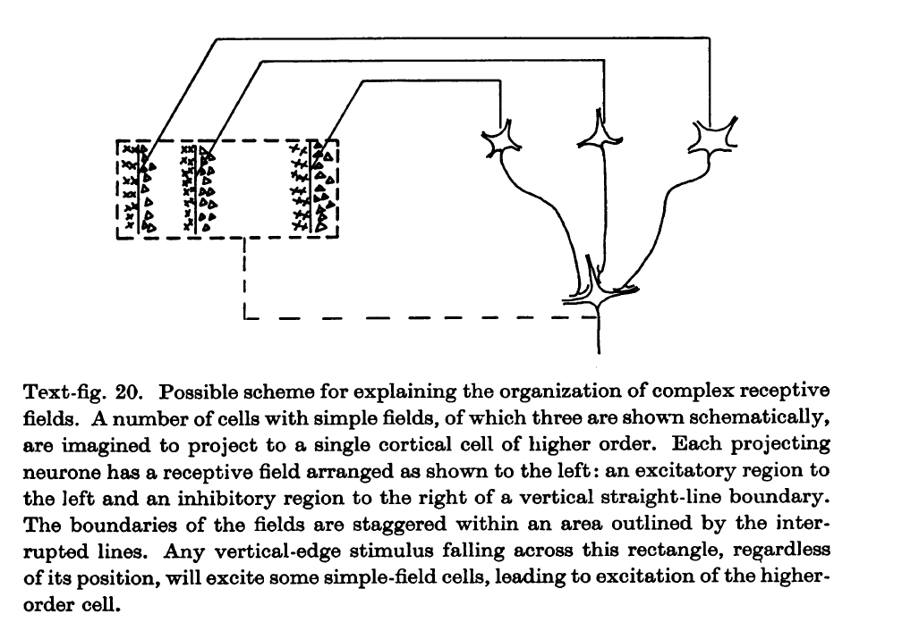
H&W model for complex cells

Slide 11
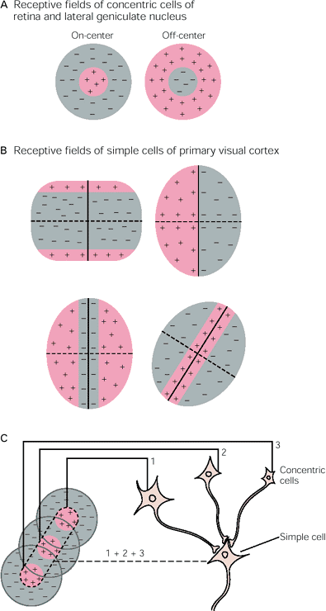
H&W model for simple cells

Slide 12
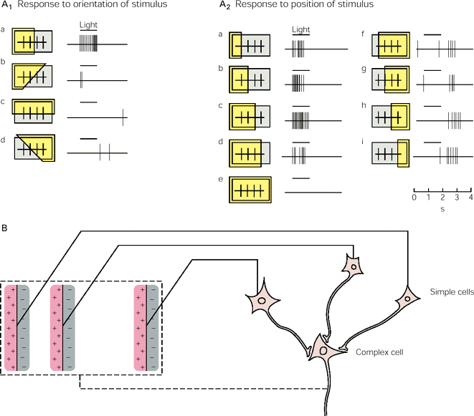
H&W model for complex cells

Slide 13
Visual cortex cell

Slide 14

Binocularity

Slide 15
The Feedforward Model
Hubel and Wiesel model
LGN
Cortical Simple cell
Hubel and Wiesel, 1962

Slide 16
Predictions of the H&W model for simple cells do not match the data
Major Failures of the FF model of H&W:
Contrast invariance
Cross-orientation suppression
Mismatch of receptive field maps and orientation tuning
Missing response at the null orientation
Pharmacology: blocking GABA(a) causes widening of TC.

Slide 17
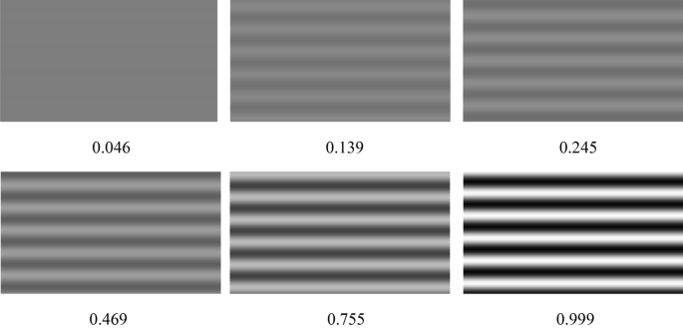
Contrast response to drifting grating at different contrasts

Slide 18
The Feedforward Model
Hubel and Wiesel model
LGN
Cortical Simple cell
Hubel and Wiesel, 1962

Slide 19
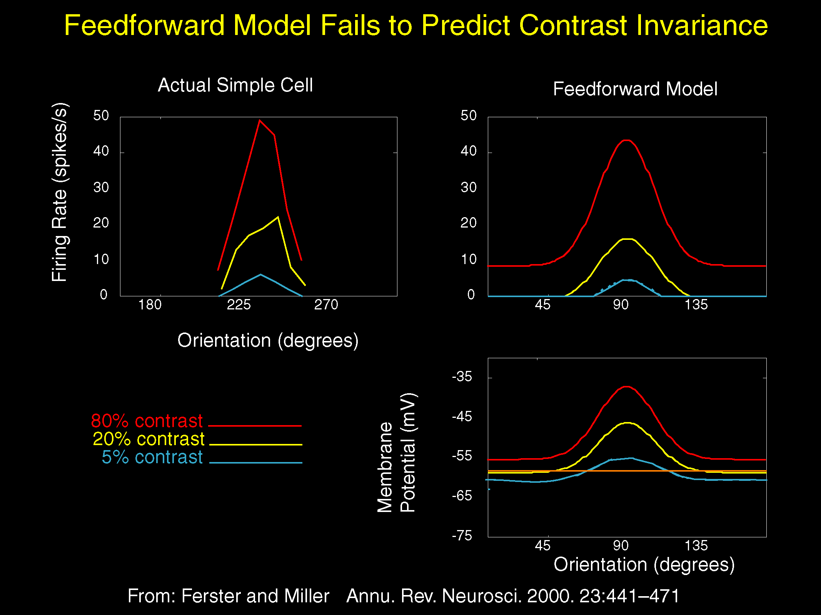

Slide 20
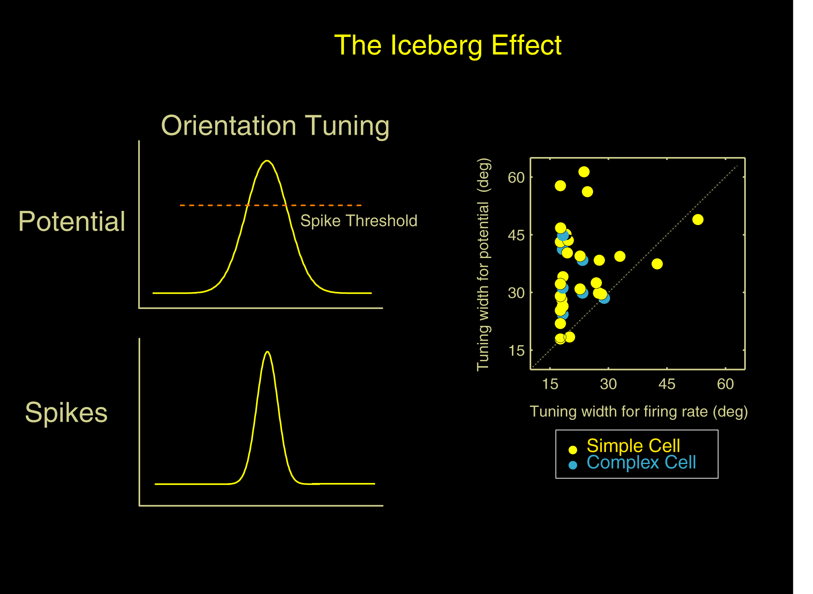

Slide 21
Predictions of the H&W model for simple cells do not match the data
The model predicts narrowing of the TC as contrast increases !
Actual data: the tuning curves show contrast invariance

Slide 22
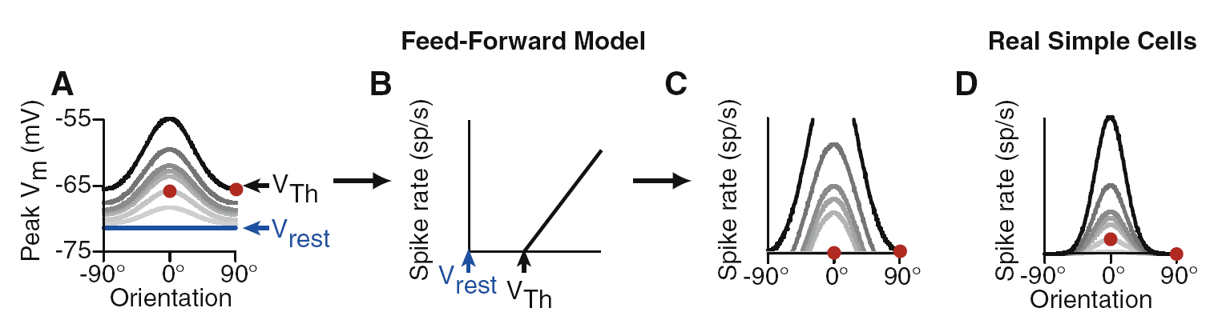
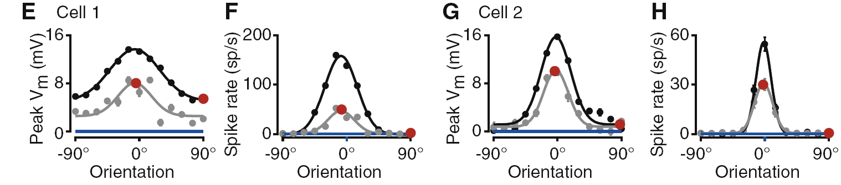
Predictions of the H&W model for simple cells: actual data

Slide 23
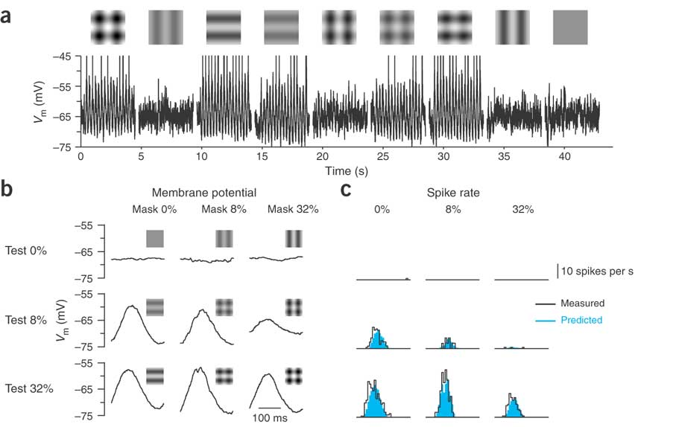
Predictions of the H&W model:
Failure 2: cross-orientation suppression

Slide 24
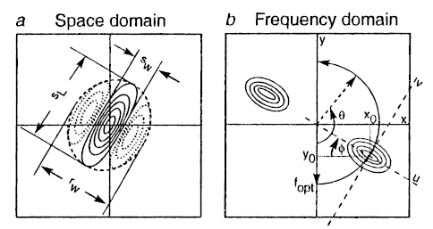
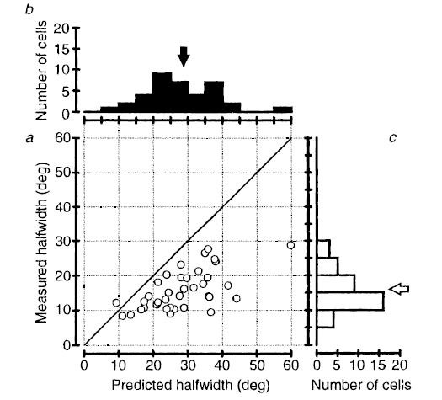
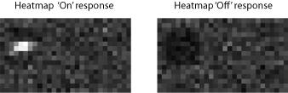
Predictions of the H&W model:
Failure 3:
Mismatch of receptive field maps and orientation tuning
Gardner et al. 1999
Extracellular data
From drifting grating
Mapping RF
From sparse noise maps

Slide 25
The relation between the structure of the receptive field and orientation selectivity
The predicted curve
Measured curve from Spikes

Slide 26
Predictions of the H&W model:
Failure 4: Missing response at the null orientation
The Feedforward Model
That the V1 cells barely respond to null orientation is puzzling given the fact that the AVERAGE activation of thalamic cells is the same, regardless the orientation of the stimulus
LGN
Cortical Simple cell
Hubel and Wiesel, 1962

Slide 27
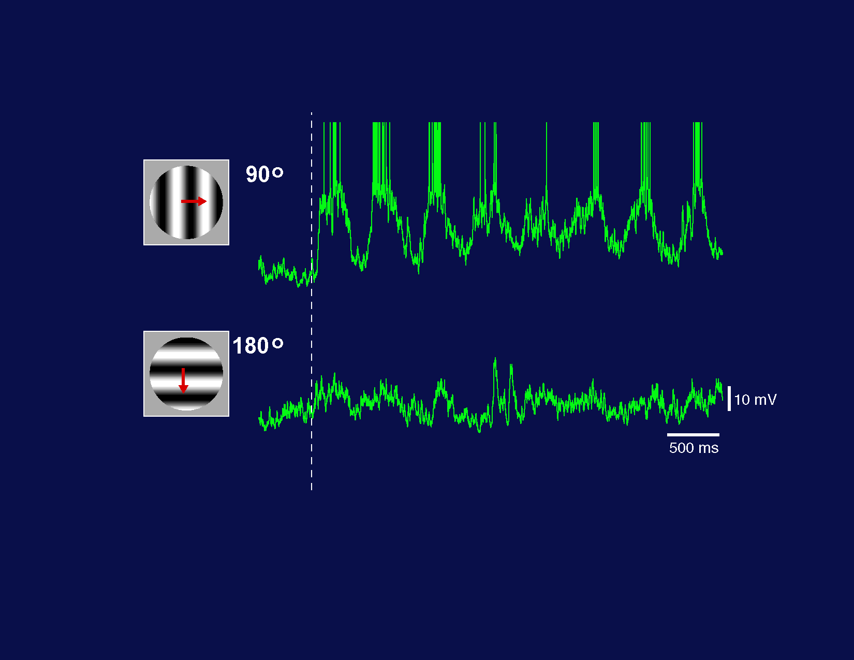
The response at the null direction is low (i.e., lack of DC response even when looking at membrane potential level.
Predictions of the H&W model:
Failure 4: Missing response at the null orientation
The Feedforward Model
LGN
Cortical Simple cell
Hubel and Wiesel, 1962

Slide 28
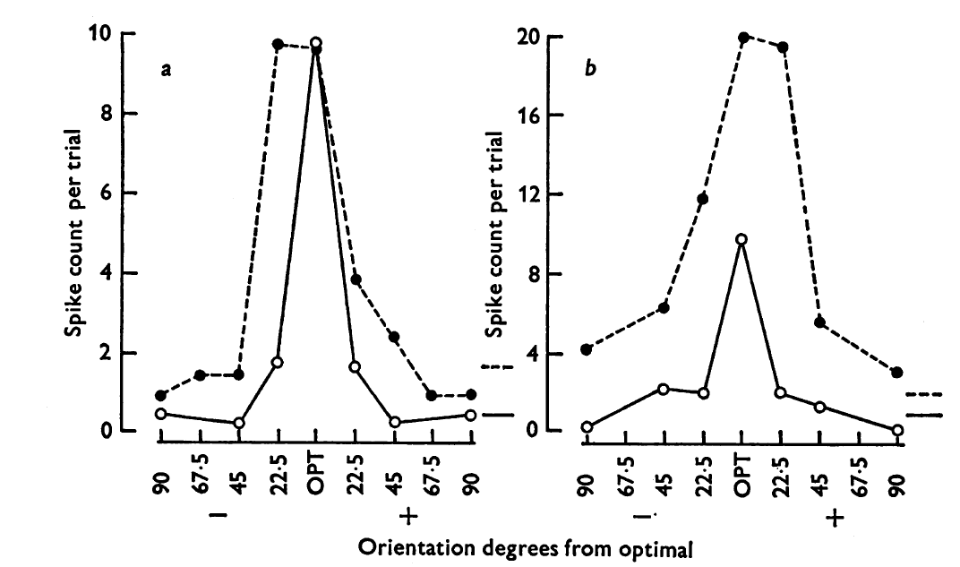
Predictions of the H&W model:
Failure 5: Pharmacolgy
The effect of bicuculline , antagonist of GABA(A), on the TC of V1 cells
Sillito 1975

Slide 29
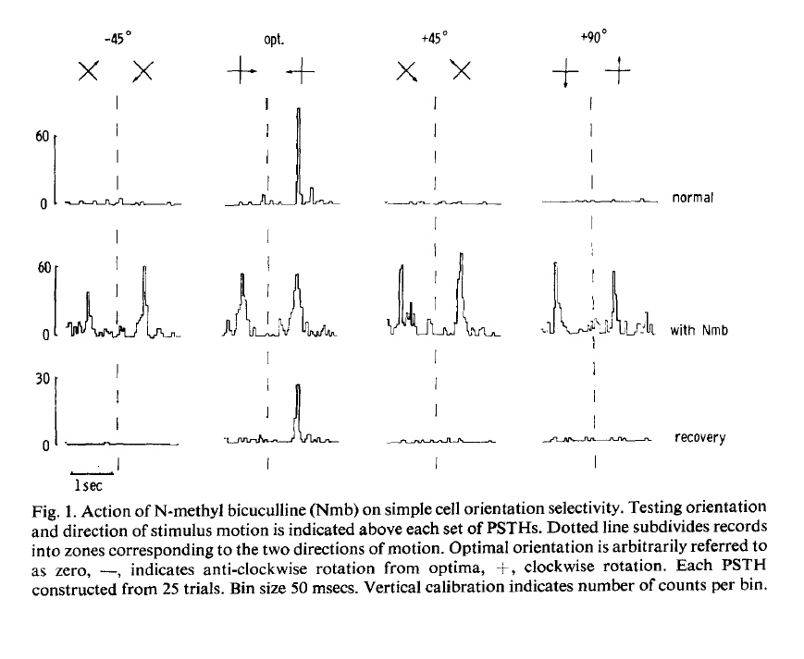
Predictions of the H&W model:
Failure 5: Pharmacolgy
Bicucullin caused widening of the tuning curves, suggesting that inhibition shapes the TC of the cells
Sillito et al. 1980

Slide 30
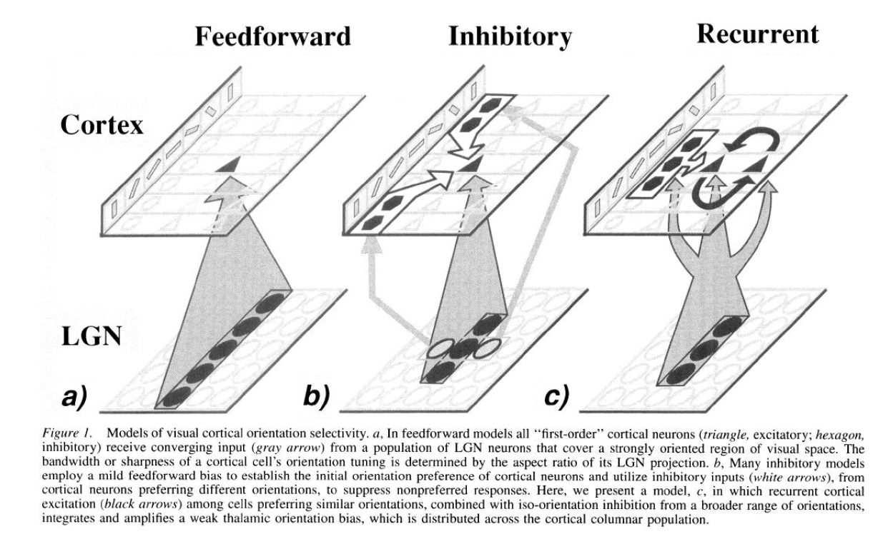
Excitatory and inhibitory recurrent models for orientation selectivity
Somers et al. 1995

Slide 31
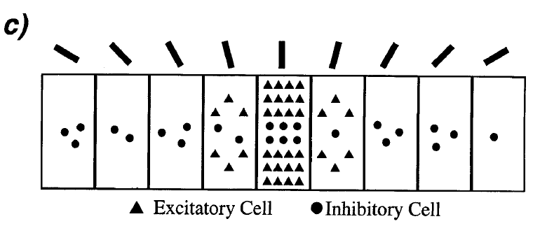
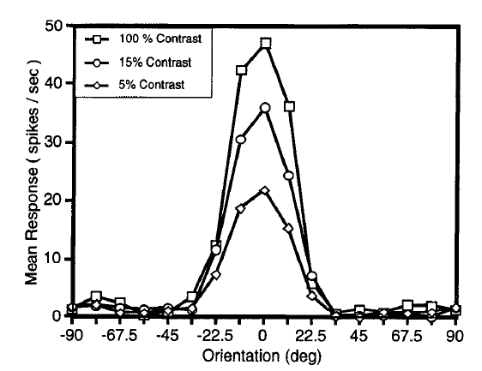
Role of inhibition in orientation selectivity:
Lateral inhibition: inhibition suppresses the response more in non-preferred orientations and thus narrowing the TC at high contrasts
Somers et al. 1995

Slide 32
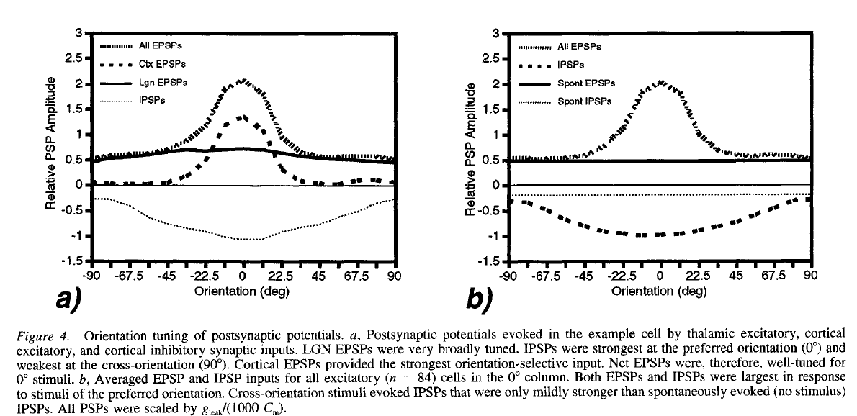
Recurrent models for orientation selectivity
There are two processes that sharpen thalamic inputs and allow contrast invariance:
Lateral inhibition at non-preferred orientations
Amplification of thalamic inputs by recurrent excitatory connections
Somers et al. 1995
Prediction: the width of TC inhibition should be wider than for excitation TC
We will see if this is true later…

Slide 34
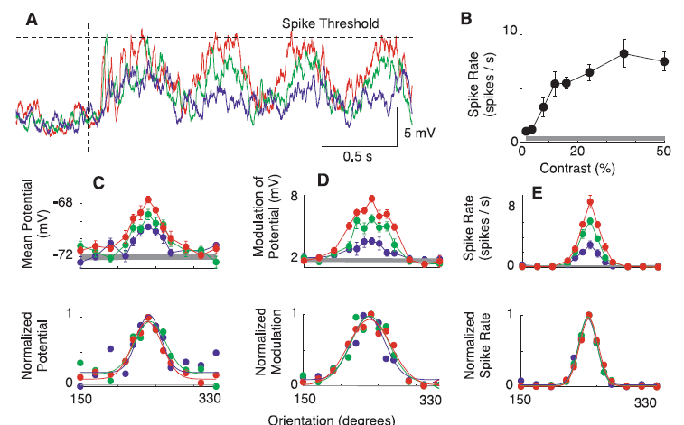
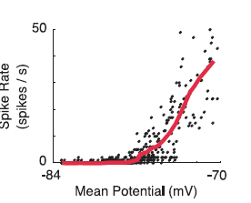
Experiments that support the H&W – intracellular recording data. The role of noise in contrast invariance
Contrast invariance
Anderson et al. 2000

Slide 35
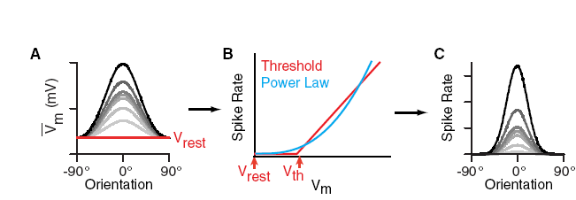
Experiments that support the H&W – intracellular recording data. The role of noise in contrast invariance
Contrast invariance
Priebe and Ferster 2012

Slide 36
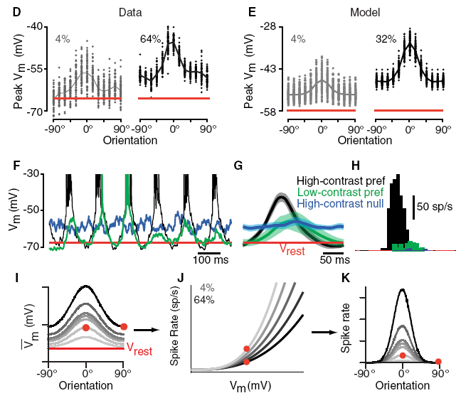
Experiments that support the H&W :
The role of noise in contrast invariance
Contrast invariance
Priebe and Ferster 2012

Slide 37
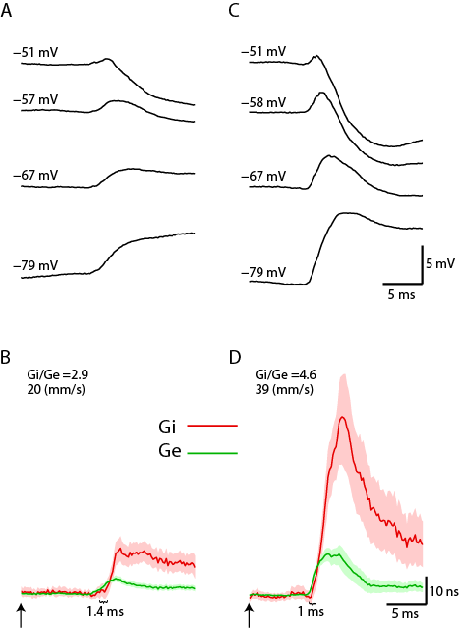
Experiments that support the H&W – measurements of sensory evoked conductance in-vivo
2. TC of excitatory and inhibitory inputs
Synaptic current
Ei ~= -80 mV
Ee~ = 0 mV
Heiss et al. 2008

Slide 38
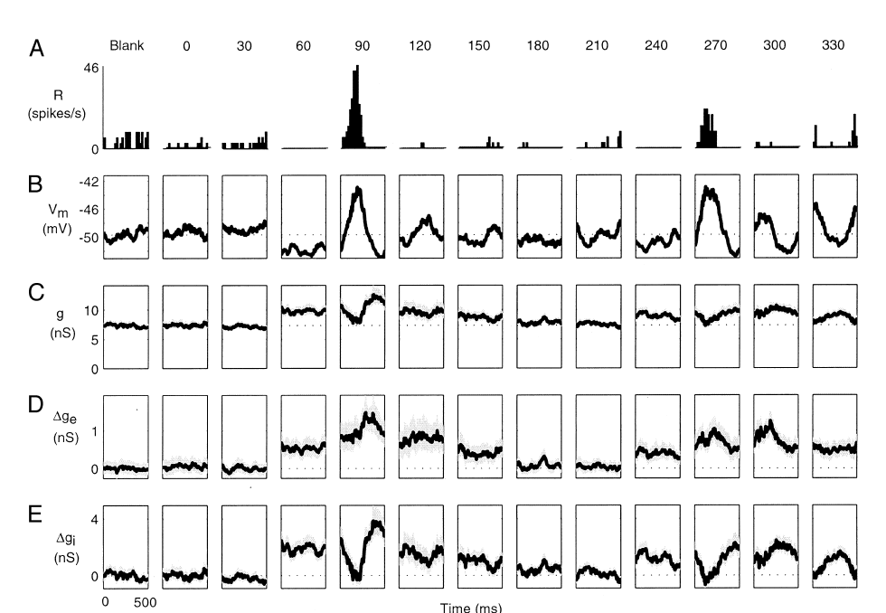
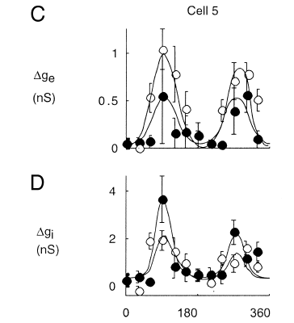
Experiments that support the H&W – Excitatory and inhibitory inputs have similar TC
Hence: inhibition is unlikely to sharpen thalamic inputs
Inhibition
Excitation
2. TC of excitatory and inhibitory inputs
Prediction from models with inhibition :
orientation
*The width of inhibition TC is not wider than for excitation
Anderson et al. 2000

Slide 39
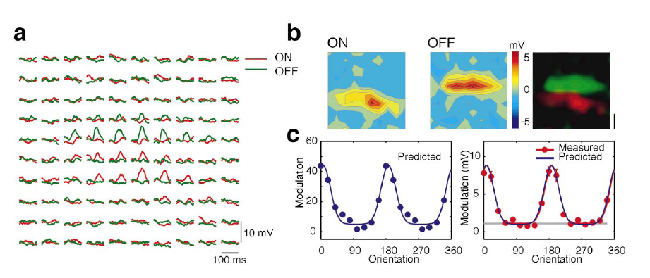
Experiments that support the H&W – Mismatch of receptive field maps and orientation tuning.
Intracellular data show why TC and RF do not match at spikes level - this is because of the iceberg effect. At Vm level they nicely match
Spikes data
Vm data
Lampl et al. 2001

Slide 40
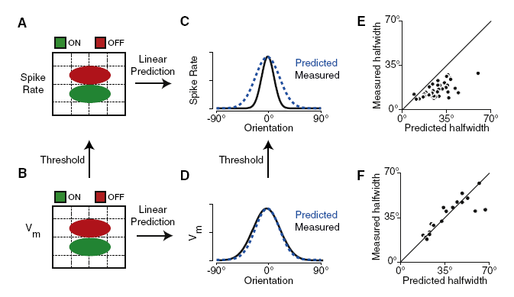
Experiments that support the H&W – Mismatch of receptive field maps and orientation tuning.
Intracellular data show why TC and RF do not match at spikes level - this is because of the iceberg effect. At Vm level they nicely match
Priebe and Ferster 2012

Slide 41
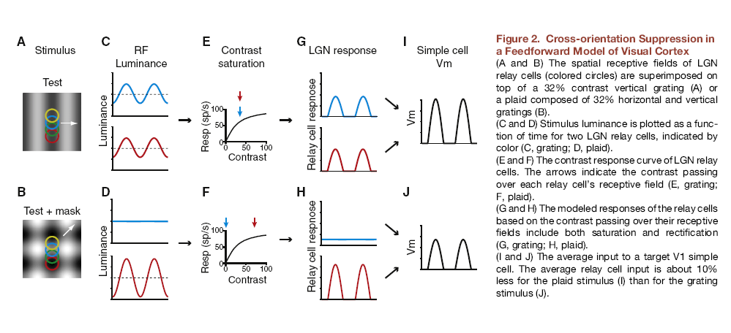
Experiments that support the H&W – Cross-orientation suppression
Priebe and Ferster 2012

Slide 42
Experiments that support the H&W – Cross-orientation suppression
Priebe and Ferster 2012

Slide 43
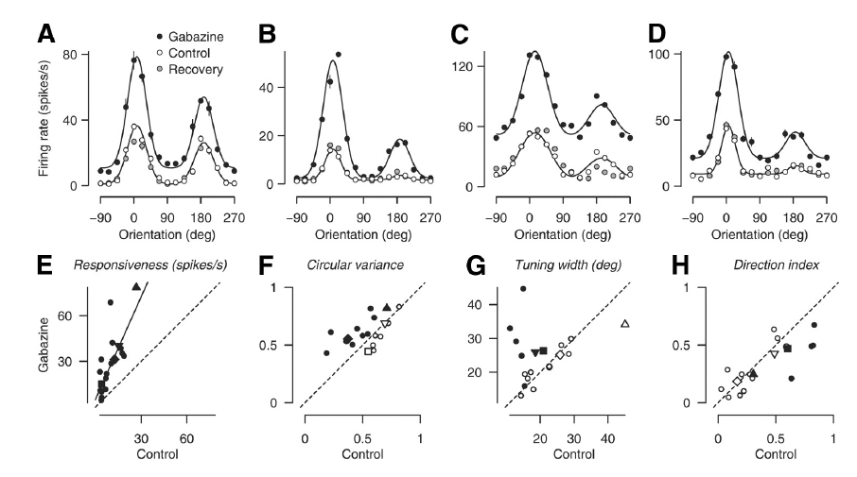
Experiments that support the H&W:
New insights on the pharmacological effects on TC
Katzner et al. 2011

Slide 44
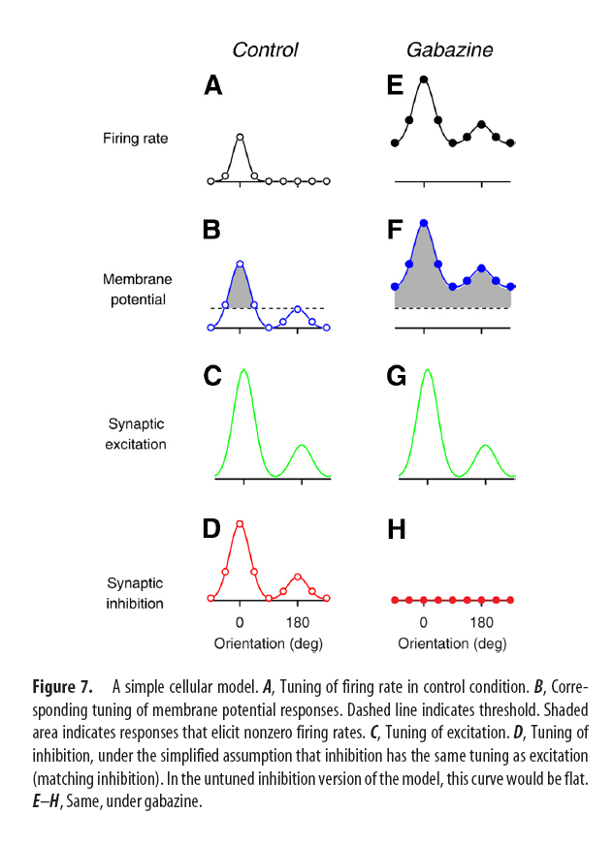
Experiments that support the H&W:
New insights on the pharmacological effects on TC – the iceberg effect
Katzner et al. 2011

Slide 45
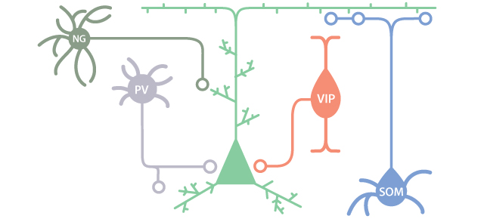
Different types of cortical inhibitory cells in cortex
PV – parvalbumin
NG - Neurogliaform
VIP – Vasoactive intestinal peptide
SOM- somatostatin

Slide 46
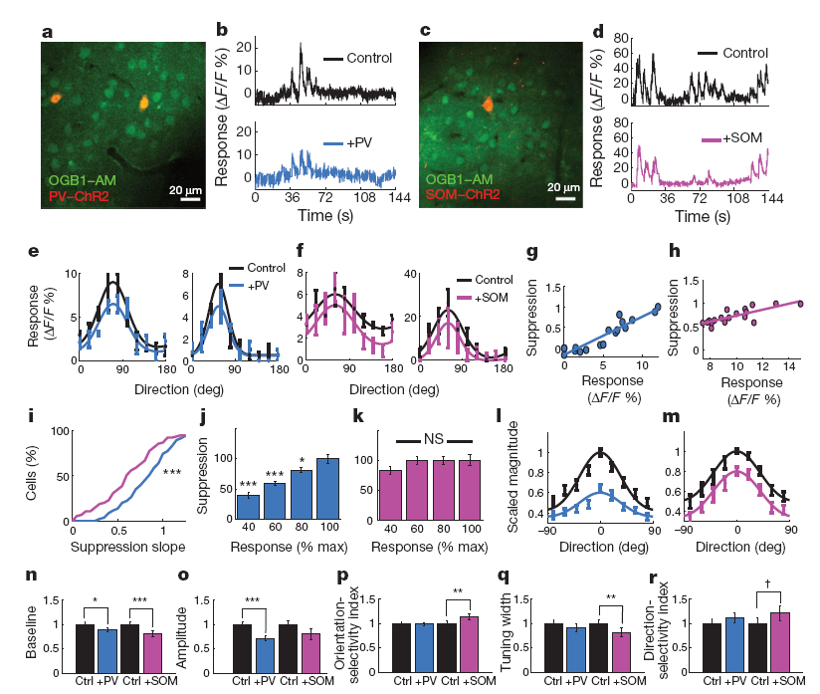
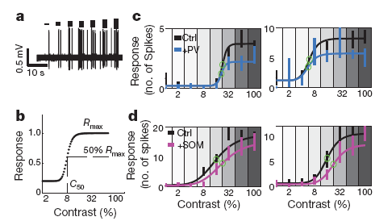
Two Photon (2P) Imaging and optogenetic studies of the visual cortex
Contrast invariance
Divisive
Subtraction
Wilson et al. 2012

Slide 47
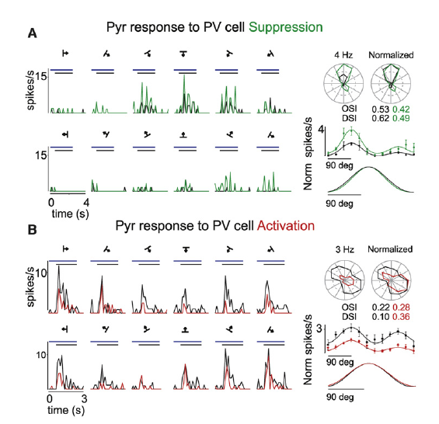
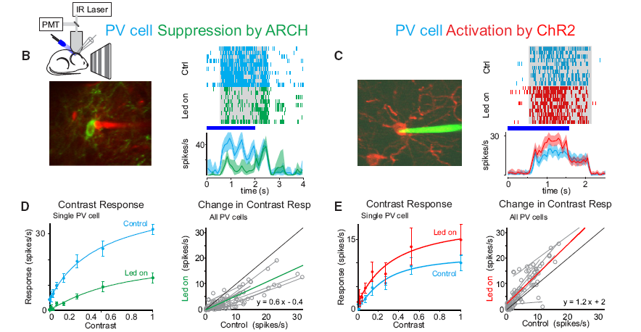
Optogenetic studies of the visual cortex
Contrast invariance
Attalah et al. 2012

Slide 48
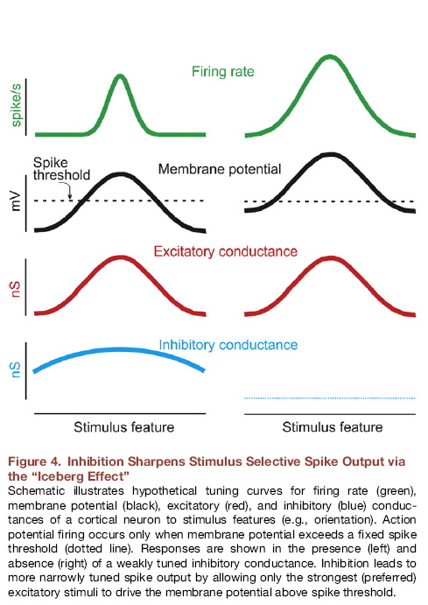
Recurrent models for orientation selectivity
Issacoson and Scanziani 2011

Slide 49
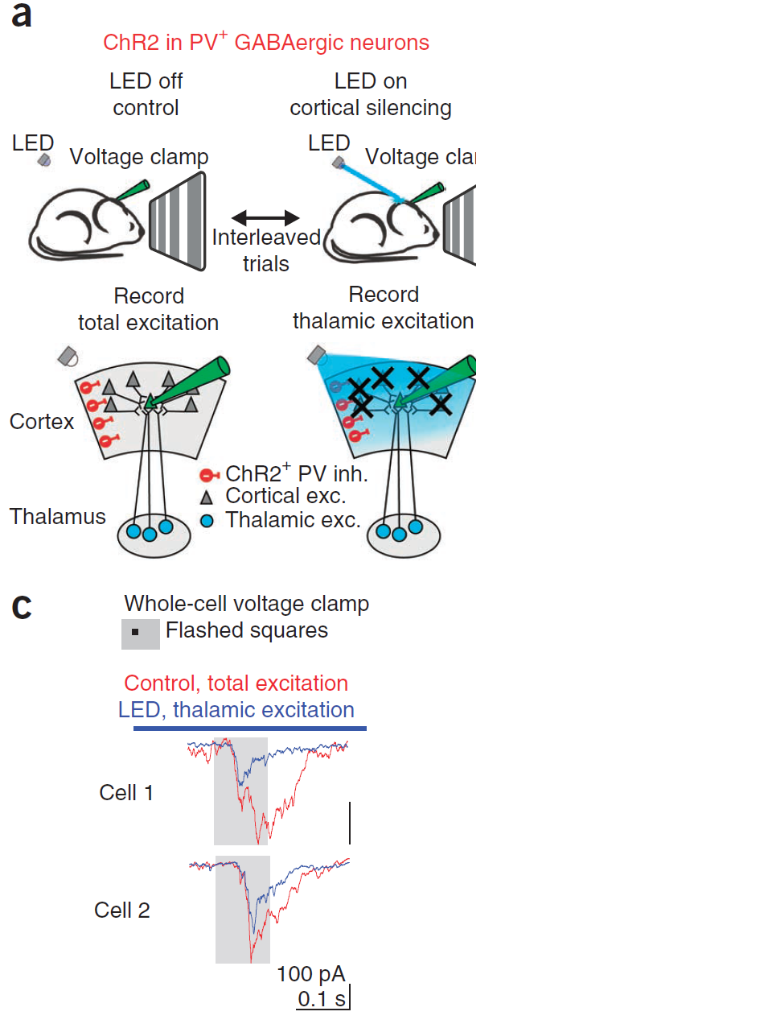
Optogenetic studies of the visual cortex
Lien and Scanziani, 2013
To find the tuning of thalamic inputs they silenced cortical firing while patching layer 4 cells of V1
Conclusion: about 1/3 of E in cortex comes from thalamic input, the other 2/3 is due to recurrent amplification of these input by cortical cells.

Slide 50
Cortical circuits amplify tuned thalamic inputs without altering orientation selectivity

Slide 51
Cortical circuits amplify tuned thalamic inputs without altering orientation selectivity
The TCs of cortical inputs are similar to the TCs of thalamic inputs

Slide 52
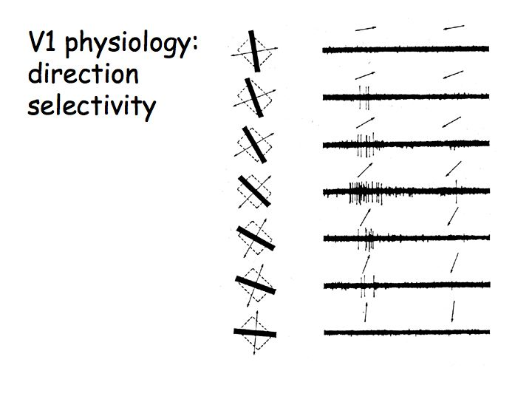
Direction selectivity in V1
From H&H

Slide 53
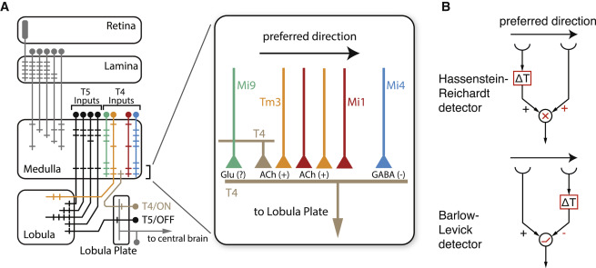
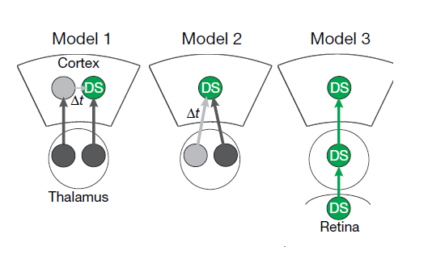
Direction selectivity in V1
Intracortical
TC Convergence
Retina
Lien and Scanziani 2018

Slide 54
Direction selectivity in V1
Isolation of thalamic inputs of L4 cells in PV-ChR2 cells (cortical silencing)
Thalamic input is also direction selective!
Lien and Scanziani 2018

Slide 55
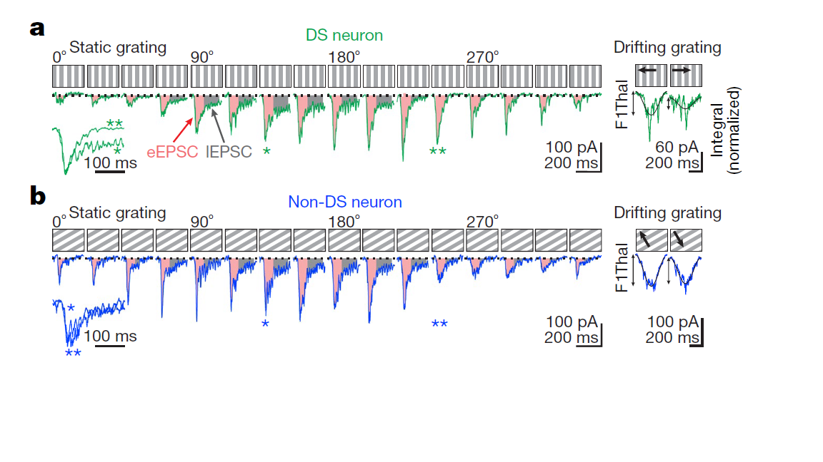
Direction selectivity in V1
Static stimulation at different spatial phases shows that TC component of DS cells exhibits two components:
fast decaying response (eEPSP) and late (slow) response (lEPSP) and in non-DS there is only one type of response.
Thalamic input is also direction selective!

Slide 56
Direction selectivity in V1
Simulation of summation (different phases)

Slide 57
Direction selectivity in V1
Recordings in thalamus with cortical recordings.
Two types of TC cells: 1) transient firing at certain phases (blue unit). 2) sustain firing at other phases (red unit).

Slide 58
Direction selectivity in V1
Model of thalamo-cortical convergence for DS of cortical cells.

Slide 59


Auditory cortex – Excitation and inhibition are co-tuned to sound intensity and frequency
Inhibition?
Voltage clamp experiments of A1 neurons
Inhibition
Excitation
Wehr and Zador 2003

Slide 60
Auditory cortex – Excitation and inhibition are co-tuned to sound intensity and frequency
AWAKE MICE
Li et al, 2014

Slide 61

Adaptation of excitation and inhibition in barrel cortex
Inhibition adapts faster and to greater degree than excitation
rest
Heiss et al. 2008

Slide 62

Selectivity to direction of whisker deflection
Wilent and Contreras 2005

Slide 63

Selectivity to direction of whisker deflection:
Excitation but not inhibition is selective
Wilent and Contreras 2005

Slide 64


Selectivity to direction of whisker deflection:
Response to preferred direction is NMDA dependent
Lavzin et al. 2012

Slide 65


Slide 66


Auditory cortex – lateral suppression
Inhibition?
Sutter et al. 1999

Slide 67
Auditory cortex – Excitation and inhibition are co-tuned to sound intensity and frequency
Inhibition?
Wehr and Zador 2003

