Slide 1
One Photon Phase Control in Open Quantum Systems
Paul Brumer
Chemical Physics Theory Group
Department of Chemistry
University of Toronto
Safed 2012

Slide 2
Issue: In the weak field regime (“one photon”)
Can one control the dynamics (products) of a laser induced
molecular processes by varying the relative phases (but not
amplitudes) of the frequency components of the laser?
Surprisingly interesting question!
Depends on Continuum (no) vs. Bound State (yes) Process
Depends on Isolated Molecule (sometimes possible) or
Open System (generally possible)
Basics discussed in…

Slide 3
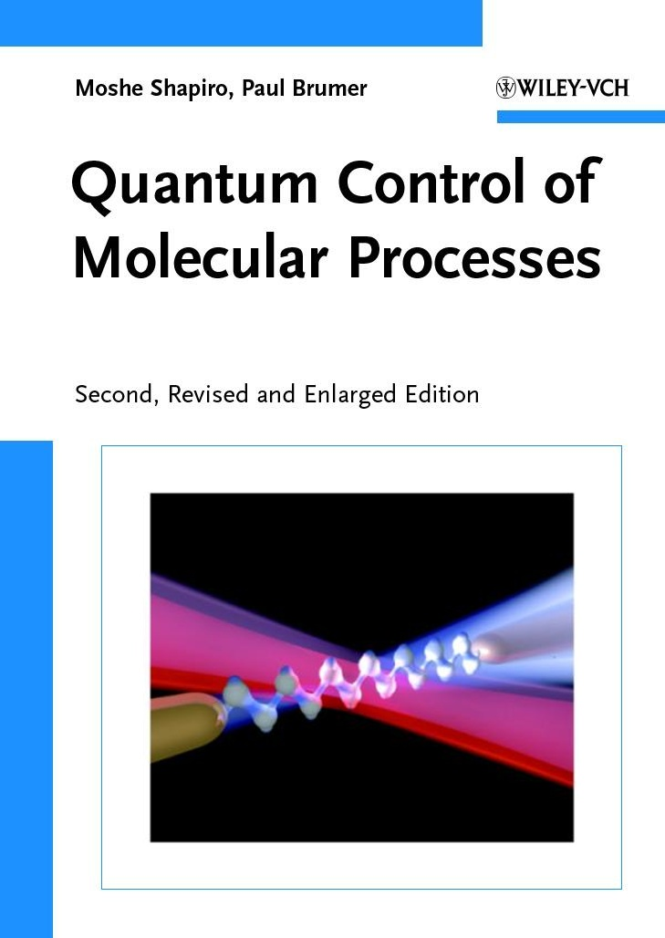
Call to your attention
Focused summary
As of mid-2011

Slide 4
Talk Outline:
1. Some History of the Phase Control Problem (starts with Retinal)
2. Basic Theorem on Weak Field Phase Control
a. Isolated Molecule
b. Molecule in an open environment
3. Focus on open environment (bath assisted phase control)
a. Insight via Redfield, theory
➔ b. Insight via Functional Integrals, and numbers
4. Phase control results for Retinal.

Slide 5
Major interesting observation
(Or “It’s all Dwayne’s Fault”)

Slide 6
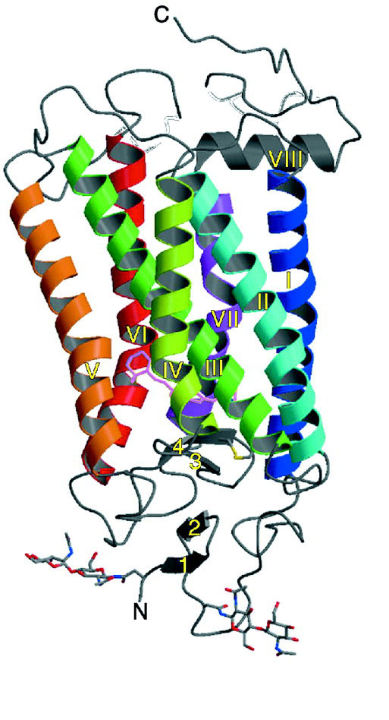
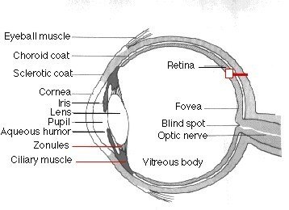
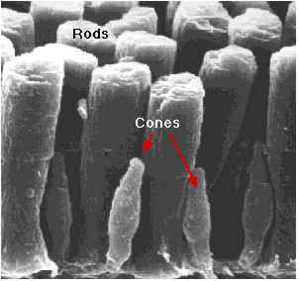
The Dream – To Control Isomerization in Rhodopsin (Courtesy Dwayne Miller)
rods
cones
http://users.rcn.com/jkimball.ma.ultranet/BiologyPages/V/Vision.html
Palczewski et al. SCIENCE 289:739
retinal
chromophore
Ideal System: Biologically Relevant Photoinduced Function THAT is fast enough to compete with Quantum Decoherence
Must Demonstrate under Weak Field Control

Slide 7
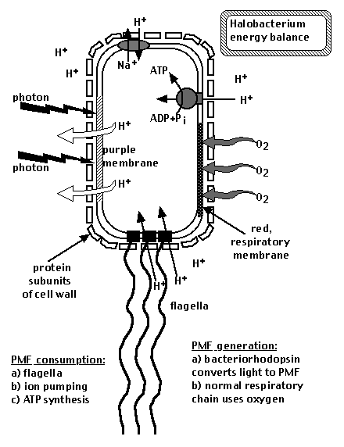
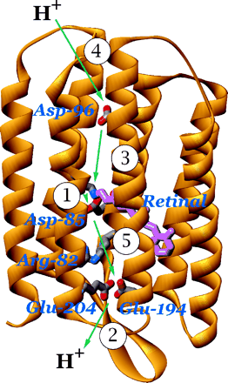
Bacteriorhodopsin-a Precursor to Rhodopsin
(Courtesy Dwayne Miller)
bacteriorhodopsins
are sitting in purple
membrane
cytoplasmic region
retinal
http://www.science.siu.edu/microbiolog/micr425/Halobacteria96
extracellular region

Slide 8
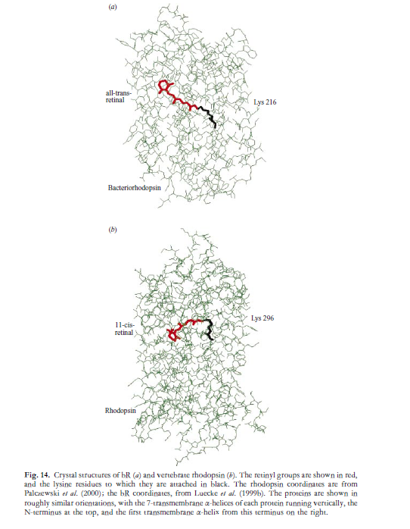
Bacteriohodopsin:
trans→cis isomerization
Rhodopshin:
Relevant for verterbrate visual
transduction: light induced
cis → trans isomerization

Slide 9
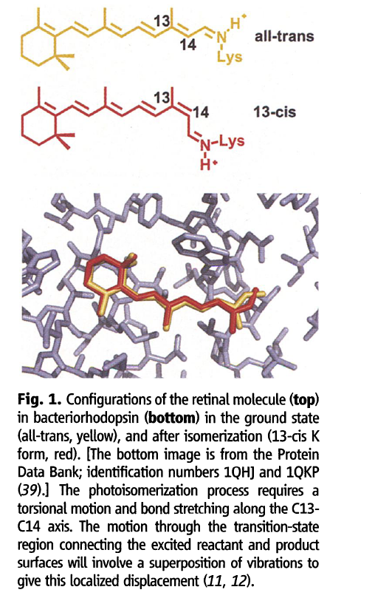
Control over cis-trans isomerization
i.e. control over initial step

Slide 10
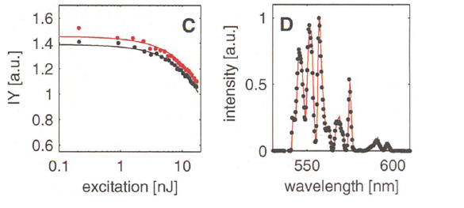
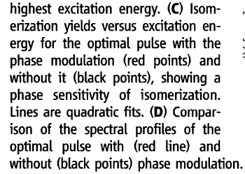
Main Result of Interest Here: Weak Field Phase Control

Slide 11
Excitement/confusion due to a fundamental prior proof:
One Photon Mode Selective Control of Reactions by Rapid Or
Shaped Laser Pulses: An Emperor Without Clothes,
Brumer and Shapiro, Chem. Phys. 130, 221 (1989).
One Photon Phase Control (control over relative populations
of product states) is not possible for isolated molecule with
products in the continuum (scattering, photodissociation..)
But Retinal Case: Bound system dynamics in an open system
(Open system = a system in contact with an environment)
So – what is the condition for control in such cases?

Slide 12
Theorem on Conditions for One Photon Phase Control in Isolated and
Open Systems (Spanner, Arango and Brumer , JCP 133, 151101, 2010)
Consider a system with Hamiltonian H_0 and eigenfunctions phi_{n} and eigenvalues E_{n} irradiated with a pulse with frequency spectrum
In first order (where initial state is an eigenstate of system + bath)
are dipole transition matrix elements .
An arbitrary Operator
evolves as
MEASUREMENT

Slide 13
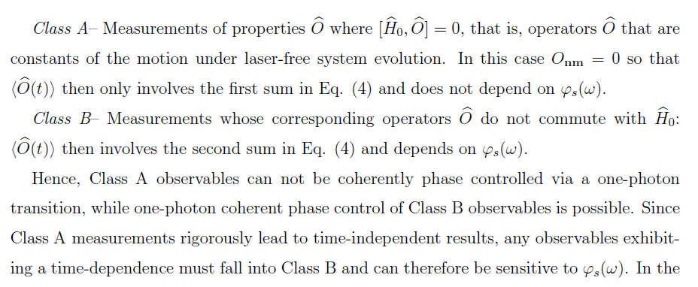
Or, exposing the laser phase:
Immediately identify two classes of operators (time ← → phase):

Slide 15
Isolated system:
Sample, Class A -- no phase control
\hat{O } commutes with H₀:
simplest measuring eigenstates of H₀ (like
photodissociation products)
b. Any time averaged property
Sample, Class B -- phase control
\hat{O } does not commute with H₀, e.g. prob of cis or trans in
trans-cis isomerization (does not require open system case for phase
control).

Slide 16
Even more interesting --- system in contact with environment (open system)
Previously
Define system “s” of interest as space upon which \hat{O} operates
When Class B, phase controllable, i.e. when
Possibilities:
a.
Same as isolated system case above
b.
but
Can show that as long as
generically

Slide 17
NOTA BENE latter
b.
but
➔
Implies that the phase control is environmentally assisted,
i.e. no control without the environment, yes with environment
And here is a sample demonstration

Slide 18
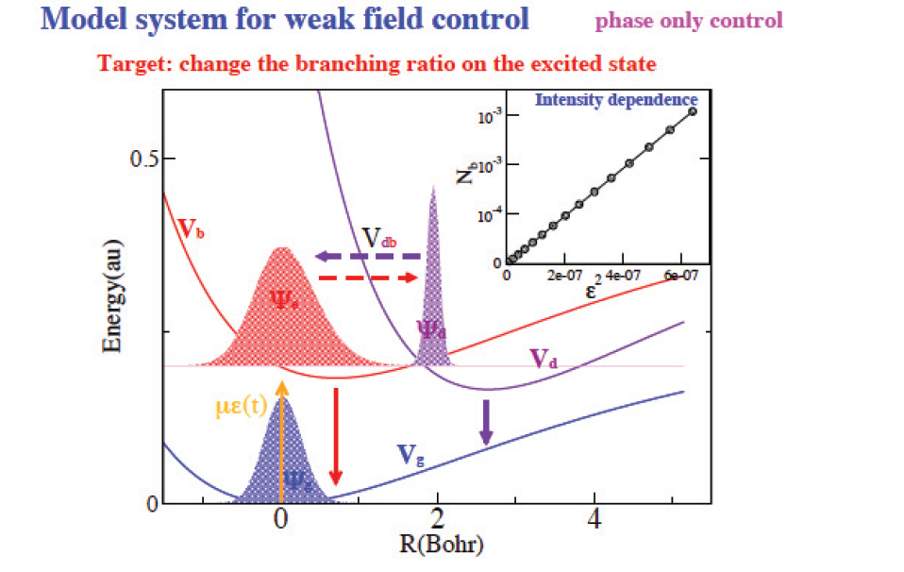
Sample Open System Computation (Kosloff, Ratner, Katz, Khasin,
Proc. Chem,3, 322, 2011)

Slide 19
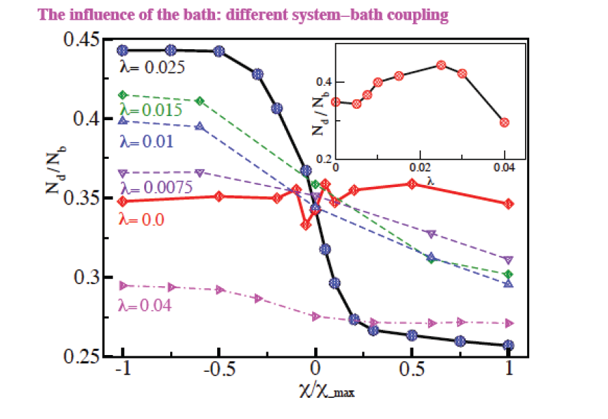

Slide 20
OK so done --- all’s well that ends well.
Implies that the phase control is environmentally assisted,
i.e. no control without the environment, yes with environment
But controversy and confusion continues to reign. E.g.
Usage of open system argument when not necessary to understand the control
Kosloff calc showing control depends on state of initial system-bath entanglement,
But why?
Markovian computations give smaller control than non-Markovian
Vigorous arguments at last year’s Faraday meeting--- summary

Slide 21
Summary --- Faraday Discussions 153:
One Photon Phase Control?
YES TOO SMALL
NO
MAYBE
IMPOSSIBLE
POSSIBLE
IMPROBABLE
LIKELY
OF COURSE

Slide 22
The issue is clear --- we need to understand the mechanism
of environmentally assisted phase control, and the features
that control its magnitude.
and – this is the focus of this talk (plus retinal)

Slide 23
Two approaches to expose these conditions :
a. Qualitatively interesting (Redfield) theory --- weak field (Li Yu)
b. Exact Influence functional approach (Leonardo Pachon)
But first the qualitative answer --- and then the details

Slide 24
Preliminary Information:
System Coherence means non-zero elements of the system density matrix
In the energy representation of the system.
How to examine this?
Construct the density matrix of the entire system+environment.
Trace over the environment to get rho, the system density matrix.
Examine this in the system energy eigenstate basis.
Diagonal elements are rho_{ii}, populations of system energy levels,
Off diagonal elements rho_{ij} are coherences.
[Normally we see the coherences associated with time evolution via
exp(-i{E_{j}-E_{k})t/hbar type terms.]

Slide 25
BUT NOT NECESSARILY , I.E.
STATIONARY COHERENCES FROM “SYSTEM-BATH ENTANGLEMENT”
Look at system + bath in typical thermal equilibrium
In a canonical ensemble
tot
These in terms of the eigenstates of the FULL Hamiltonian. Now
Trace over bath to get system density matrix, gives off-diagonal elements rhoi_{j}
These are stationary coherences--.and they can then be used by an
incident laser to give phase control. --- as below.

Slide 26
STATIONARY COHERENCES “SYSTEM-BATH ENTANGLEMENT”
Emphasize --- these are deviations from what we teach --- i.e. deviations
From diagonal Boltzmann distribution of the system in the energy rep’n
in the presence of a bath.
But not “unknown” --- existence discussed by several (e.g. Meier/Tannor
In Chemistry)
------------------------------------------------------------------------------
To gain insight into the required conditions consider..

Slide 27
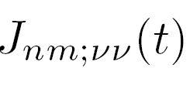
System-bath Propagation --- Influence Functional Equation for System:
In system energy eigenbasis. Extremely enlightening LINEAR map.
Propagating Initial populations with
Propagating Initial coherences with
Hence initial stationary coherences will propagate via second term
Remarkably--- completely general for propagation of the system density matrix
Dynamics is exact (need J’s, of course!)--- non-Markovian

Slide 28
Time dependence of operator satisfying:
➔ Any phase control is environmentally assisted.
Note two possible sources of laser phase dependence:
Propagation directly of initial coherences (e.g. of stationary coherences in equilibrated system)
Propagation via diagonal term --- which turns out to be much smaller
Here then is a valid environmentally induced mechanism from control

Slide 29
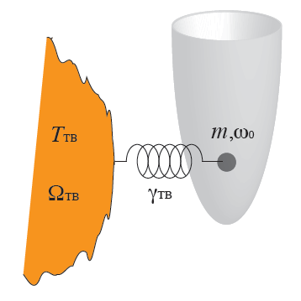
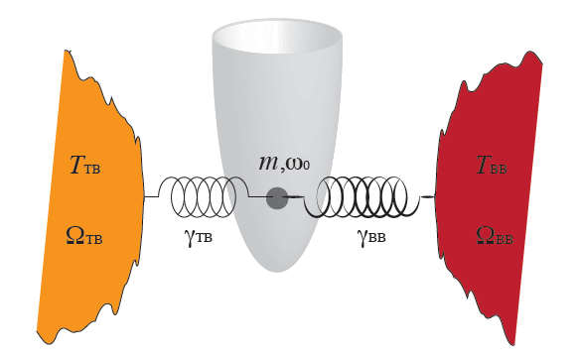
Model Computation with Influence Functional Approach:
General Algortihm: Pachon and Brumer, quant-ph ArXiv 1207.3104 , (PRA submitted);
Two applications: (open system + incoherent light, and one photon control, in prep)
Provides Analytic result for parametrically driven harmonic oscillator in contact
With different heat baths---- Here simpler choice of a model system to examine
And couple to environment = thermal bath

Slide 30
First picture ---Pulse used
NB: The frequency spectrum is independent of the sign of the chirp rate c_{L}
Pulse conditions: 20 time units, centered at 100
frequency 500 nm, chirp c_{L} very small and somewhat bigger.
Weak field
Thermal Bath described by ohmic spectral density with finite frequency cutoff

Slide 31
Diagonal contribution, two different chirp pairs, Markovian vs Non-Markovian
Here, no chirp effect. Also, Markovian v. Non-Markovian propagation essentially
similar. But--

Slide 32
Off-diagonal contribution, two different chirp pairs, Markovian vs Non-Markovian
Big dependence on chirp sign (black vs red) or (green vs. orange)
Also, non-Markovian term an order of magnitude larger than Markovian!
Hence, any initial phase dependence in off-diagonals is propagated nicely to
<O(t)> --- giving weak field phase control

Slide 33
Hence, there is a mechanism to propagate initial coherences which is phase
dependent
The initial system coherences can be those arising from system-bath coupling--- I,e,
No system-bath coupling, no such term --- i.e.no weak field phase control
---hence the origin of “environmentally assisted control”
Ronnie’s concern – J’s for transitions between different electronic states…

Slide 34
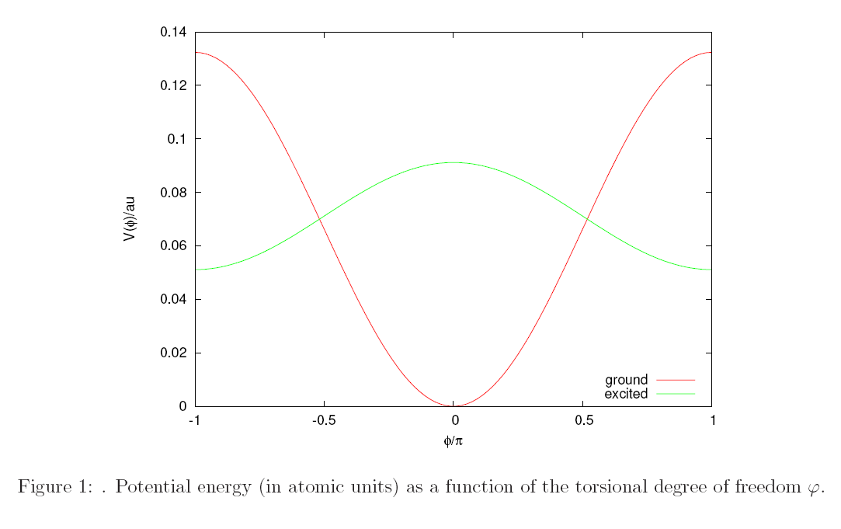
And the original case? : retinal isomerization (here in rhodopsin):
Arango and Brumer (manuscript in preparation)
Consider the diabatic potential energy surfaces |g> and |e> that look like:
Note def’n of cis and trans

Slide 35
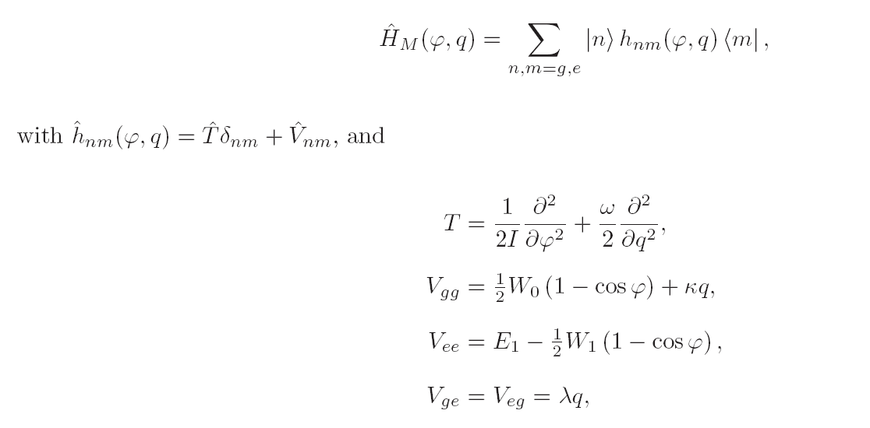
Hamiltonian of Stock and Hahn (conical intersection)
Torsion angle phi defines cis-trans rotation and a vibrational mode q coupled to
ground and excited states as:

Slide 36
But we include (Stock-Hahn) coupling to the vibrational background as
Interesting form (fits spectroscopy) ground electronic state – uncoupled
excited electronic state --- coupled
Bath is above 23 modes plus q mode (to which phi is initially entangled
Carry out dynamics with MCDTH including the laser excitation.
(Non-Markovian)
Note that this is a “bath” because it is of no interest to the measurement of product
Definition of decoherence!

Slide 37
Pulse used
NB: The frequency spectrum is independent of the sign of the chirp rate c_{L}
Pulse conditions: 200 fs wide ; field amplitude, 10^{{-5}} to 10 ^{{-6}} au, carrier
frequency 500 nm, chirp c_{L} 10^{{-7}} au --- range of experiment

Slide 38
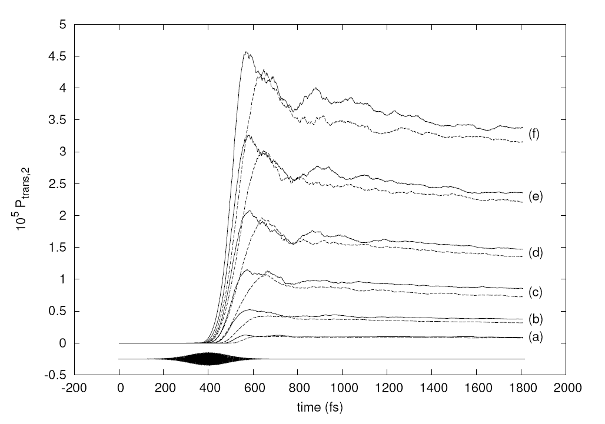
Trans product as function of time for positive (solid) and negative (dashed)
chirp for different laser powers.
Note consistent
difference of positive
and negative chirp.
Note relatively constant
(well) after pulse is over.

Slide 39
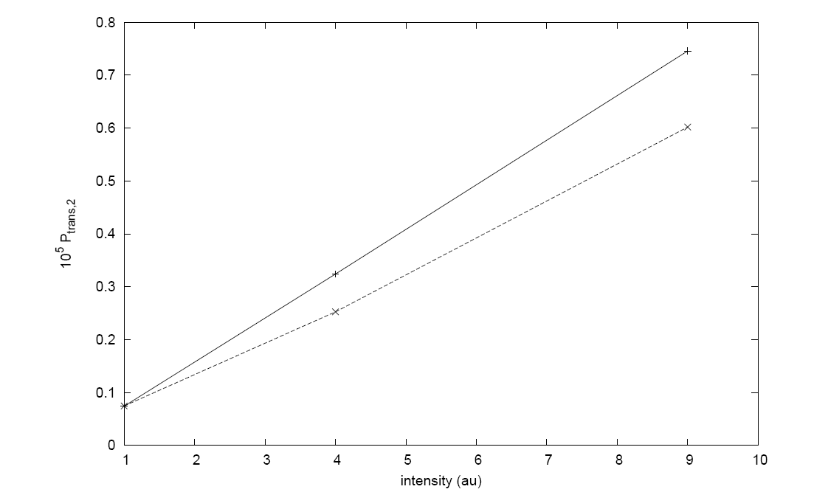
Extracted from a fit to the previous figure
Clear dependence of product formation on laser phase, nice linear
dependence, in low field intensity domain
Note that coupling should be strong since the bath is BOUND to the system).

Slide 40
Start with retinal--- end with retinal
Evident phase control
Note that coupling should be strong since the bath is BOUND to the system).

Slide 41
Summary:
Environmentally assisted one-photon phase control is possible
Environmental assistance arises, at least partially, from the
fact that the initial (thermal) state is an entangled state of the
system and the environment .
The Markovian approximation shows far smaller effect than
the (correct) non-Markovian dynamics; also evidence of
role of the environment
Conjecture that the stationary rho_{ij} are larger in systems bound
to the environment (e.g. where bath is part of the molecule) –
hence possibly larger phase control effect.

Slide 42
Acknowledge --- amazing/strange group interest
Li Yu (Redfield) – undergrad off to Harvard
Leonardo Pachon (Influence Functions) – postdoc, Toronto
Carlos Arango (retinal) – chairman, Cali, Columbia
$$ FROM NSERC CANADA $$

