Slide 1
Open Questions in Quantum Control of Chemical Reactions:
A Guide to the Perplexed
Is weak field control possible? Dwayne Miller, Shapiro, Brumer, Kosloff
What are the limits on control of bimolecular reactions? Dantus, Shapiro, Brumer, de Vivie Riedle, Motzkus, Ohmori, Amitay, Koch, Kosloff
Can attosecond pulses generate coherent control of electrons? Can electron correlation be controlled? Bucksbaum, Dudovich, Ivanov, Smirnova, Baumert
Laser control of photodissociation products – where do we stand? Gerber, Levis, Dantus
Can quantum control landscapes have traps? Rabitz, Pechen, Tannor
What is responsible for the differences between theoretical vs. practical limits on controllability? Rabitz, Brixner, Khasin, Kosloff
How does one elucidate mechanism? How can we learn from learning algorithms?
Can one distinguish unambiguously between quantum coherent control and classical control? Gerber, Bucksbaum, Brumer, Weinacht, Rabitz, Brixner, Tannor, Meier, Kallush
This is just a beginning --- what other open questions can you add?

Slide 2
Open Questions in Quantum Control of Chemical Reactions:
A Guide to the Perplexed
Is weak field control possible? Dwayne Miller, Shapiro, Brumer, Kosloff…

Slide 3

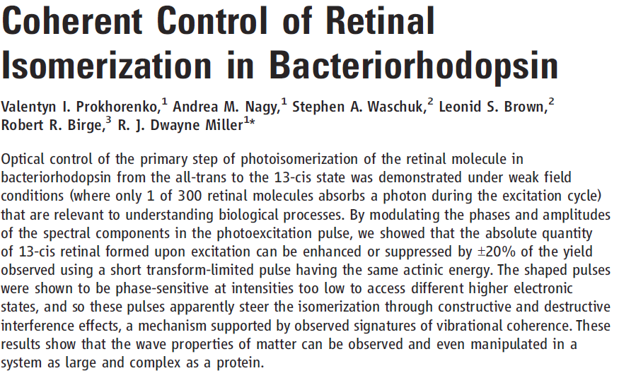
1. Is Weak Field Control Possible?

Slide 4
1. Is Weak Field Control Possible?

Slide 5
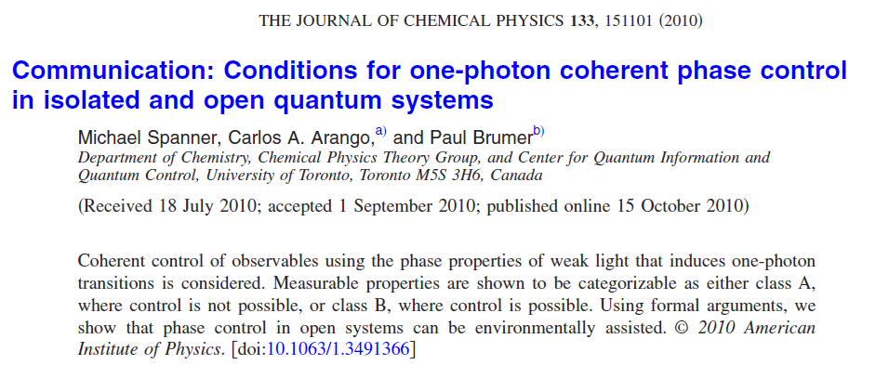
1. Is Weak Field Control Possible?

Slide 6
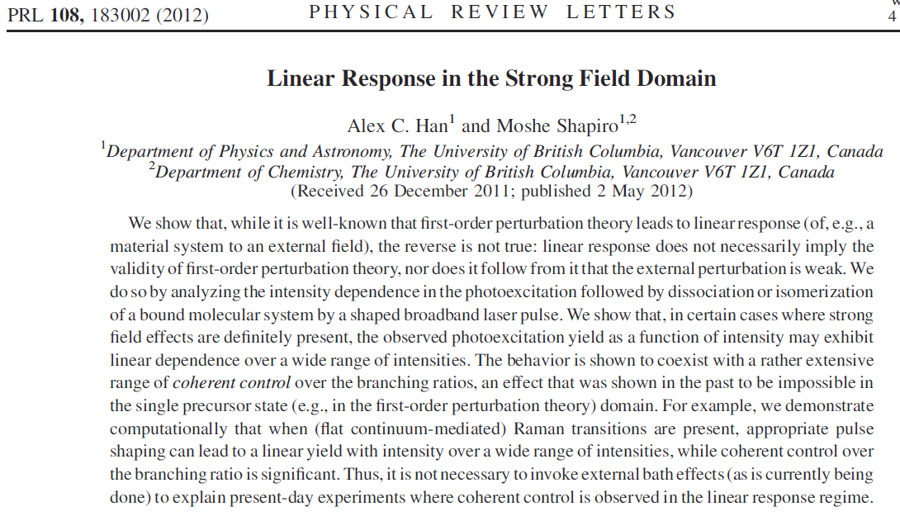
1. Is Weak Field Control Possible?

Slide 7
Open Questions in Quantum Control of Chemical Reactions:
A Guide to the Perplexed
What are the limits on control of bimolecular reactions? Dantus, Shapiro, Brumer, de Vivie Riedle, Motzkus, Ohmori, Amitay, Koch, Kosloff,…

Slide 8
What are the limits on control of bimolecular reactions?

Slide 9
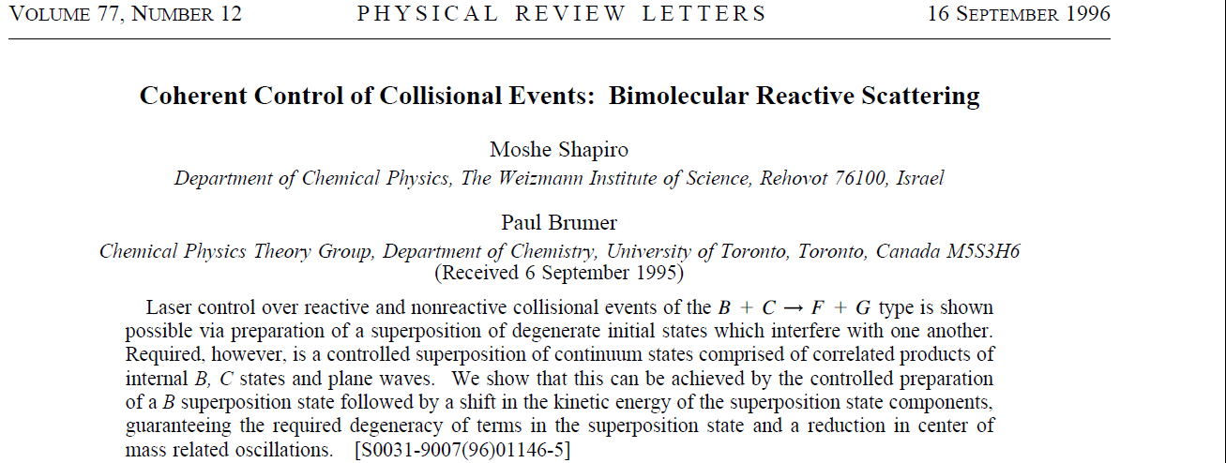
What are the limits on control of bimolecular reactions?

Slide 10
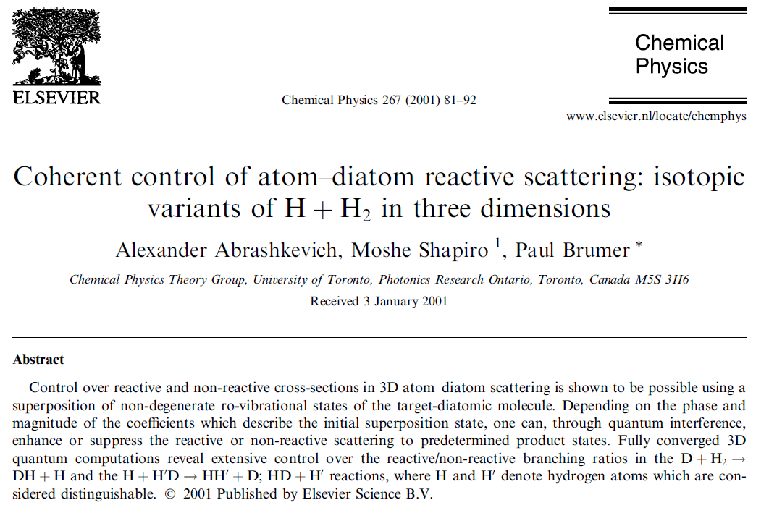
What are the limits on control of bimolecular reactions?

Slide 11
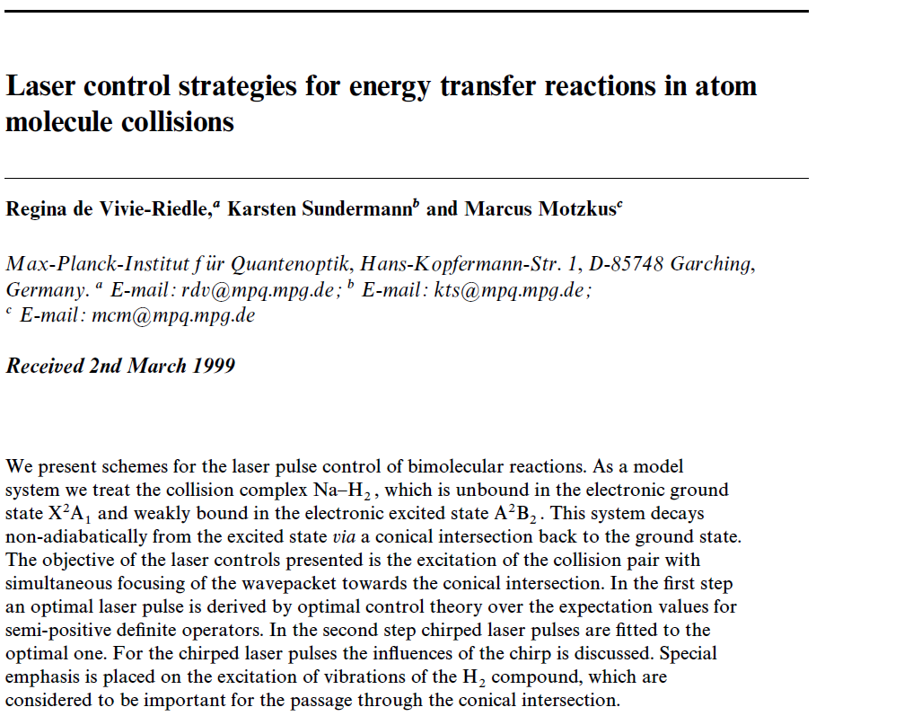
What are the limits on control of bimolecular reactions?

Slide 12
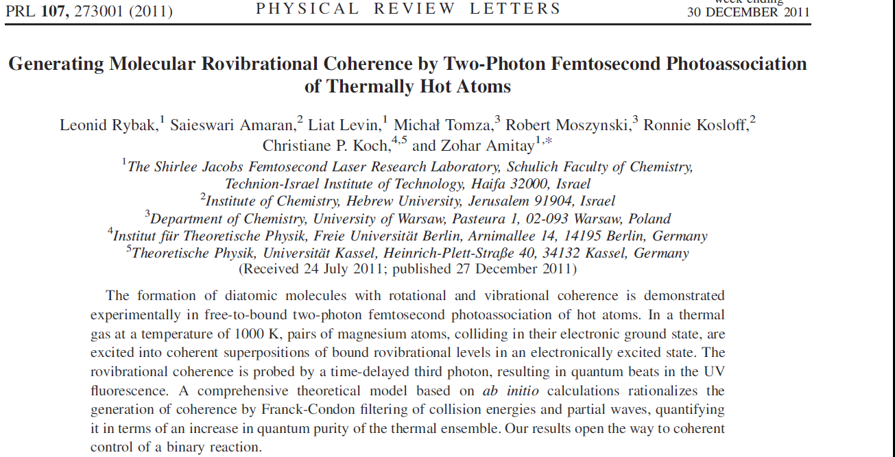
What are the limits on control of bimolecular reactions?

Slide 13
Open Questions in Quantum Control of Chemical Reactions:
A Guide to the Perplexed
Can attosecond pulses generate coherent control of electrons? Can electron correlation be controlled? Bucksbaum, Dudovich, Ivanov, Smirnova, Baumert,…

Slide 14
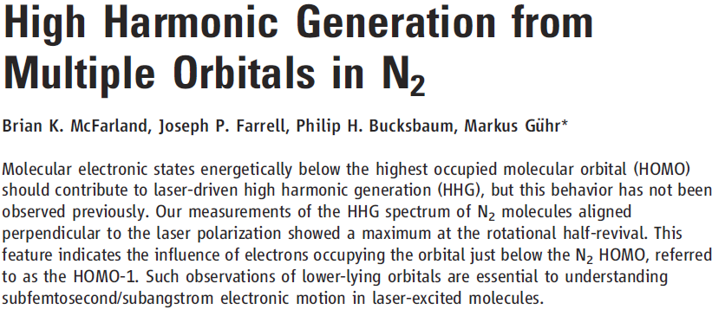
Can attosecond pulses generate coherent control of electrons?
Can electron correlation be controlled?

Slide 15
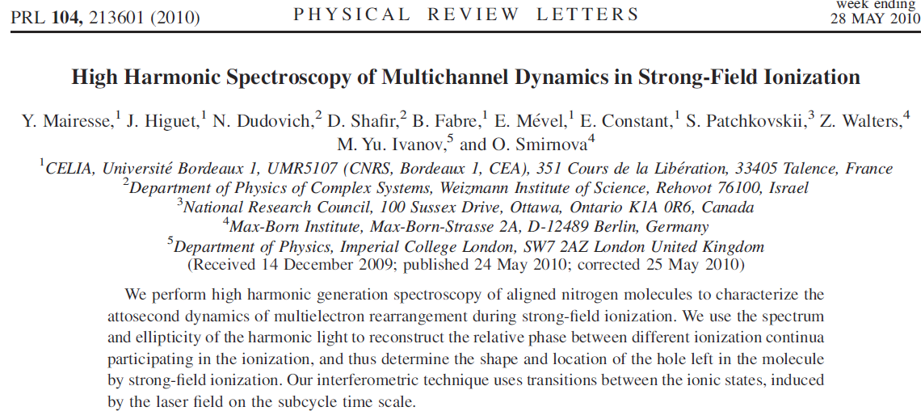
Can attosecond pulses generate coherent control of electrons?
Can electron correlation be controlled?

Slide 16
Open Questions in Quantum Control of Chemical Reactions:
A Guide to the Perplexed
Laser control of photodissociation products – where do we stand? Gerber, Levis, Dantus,…

Slide 17

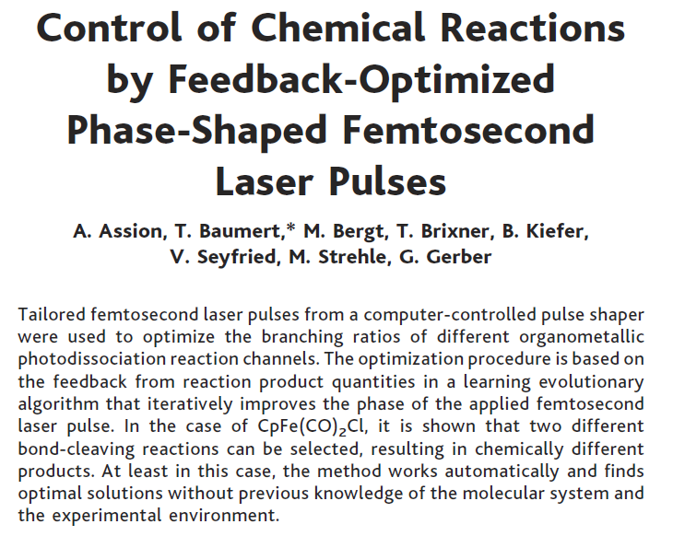
Laser control of photodissociation products – Where do we stand?

Slide 18

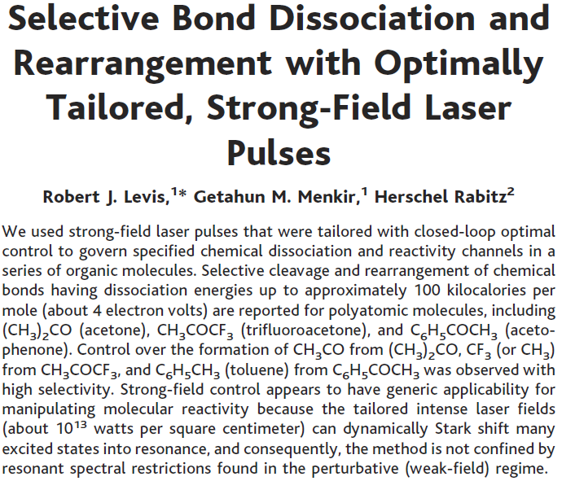
Laser control of photodissociation products – Where do we stand?

Slide 19
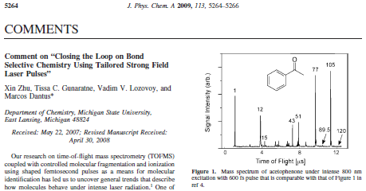
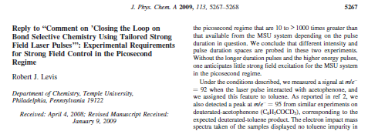
Laser control of photodissociation products – Where do we stand?

Slide 20
Open Questions in Quantum Control of Chemical Reactions:
A Guide to the Perplexed
Can quantum control landscapes have traps? Rabitz, Schirmer, Pechen, Tannor,…

Slide 21

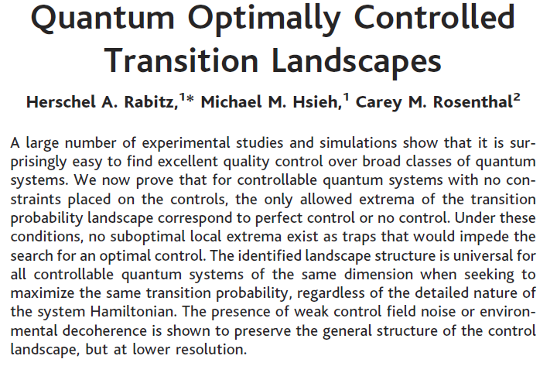
Can quantum control landscapes have traps?

Slide 22
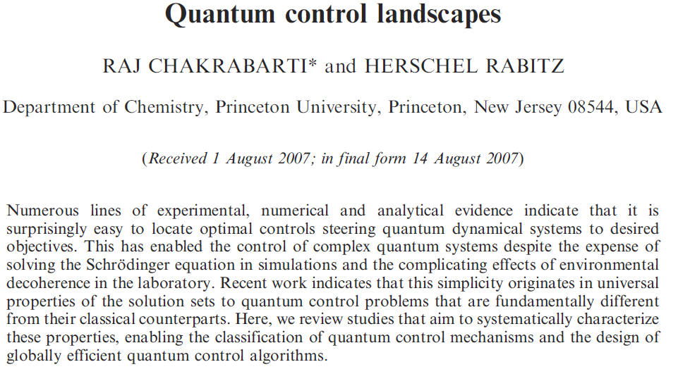
Can quantum control landscapes have traps?

Slide 23
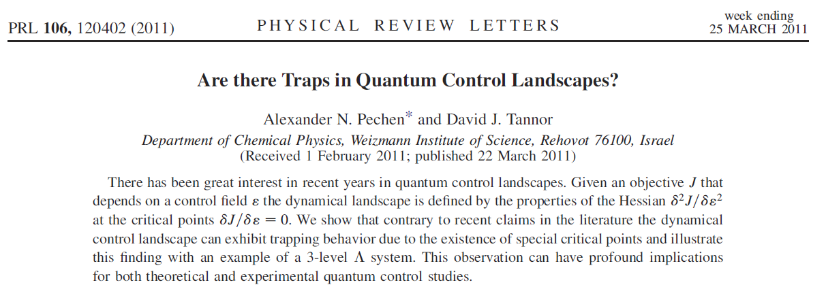
Can quantum control landscapes have traps?

Slide 24
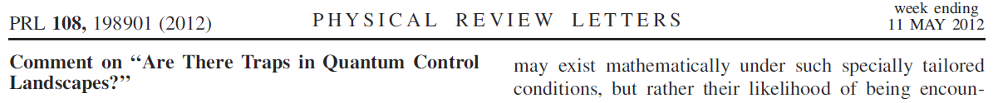

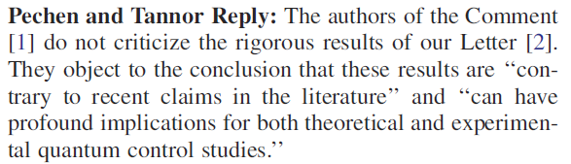
Can quantum control landscapes have traps?

Slide 25
Open Questions in Quantum Control of Chemical Reactions:
A Guide to the Perplexed
What is responsible for the differences between theoretical vs. practical limits on controllability? Rabitz, Brixner, Khasin, Kosloff,…

Slide 26
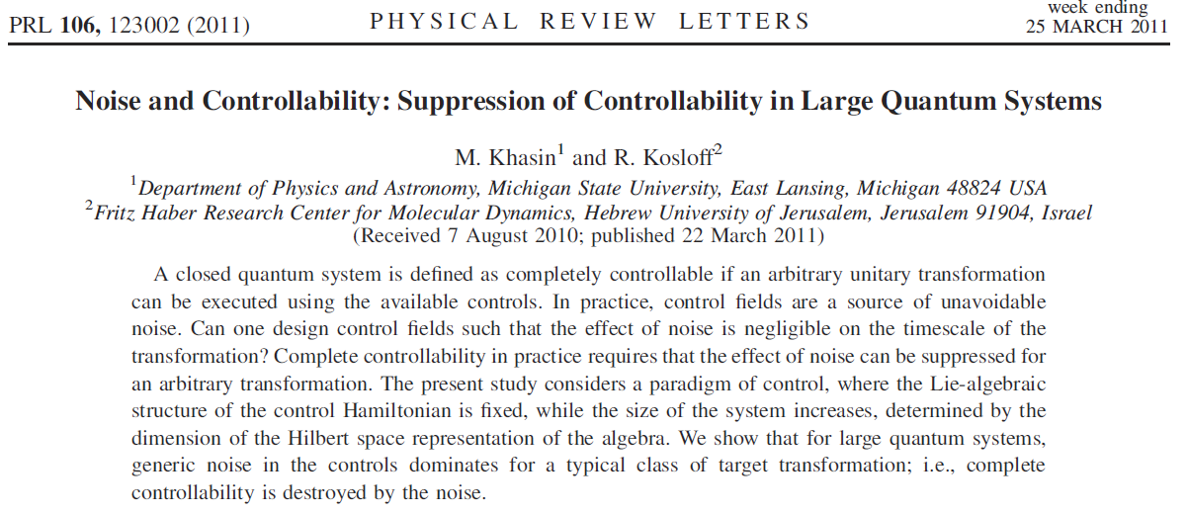
What is responsible for the differences between
theoretical vs. practical limits on controllability?

Slide 27
Open Questions in Quantum Control of Chemical Reactions:
A Guide to the Perplexed
How does one elucidate mechanism?
How can we learn from learning algorithms?
Can one distinguish unambiguously between quantum coherent control and classical control?
Weinacht, Sension, Bucksbaum, Rabitz, Brixner, Kallush,…

Slide 28
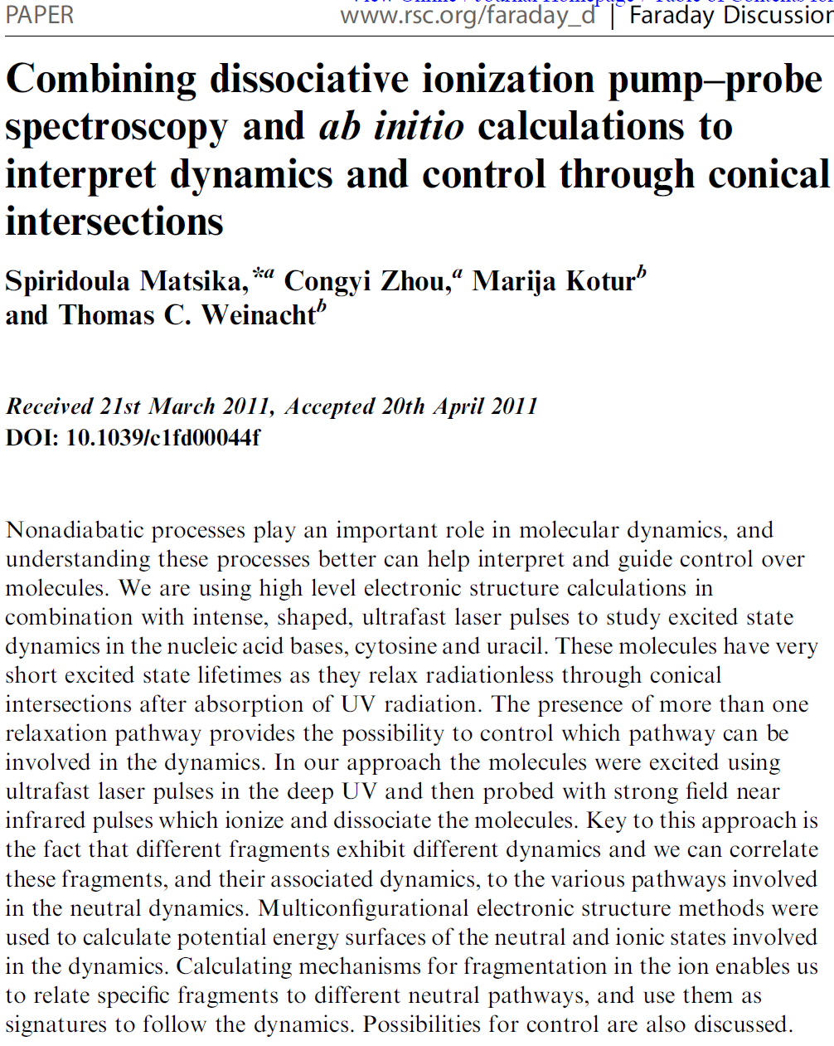
How does one elucidate mechanism?
How can we learn from learning algorithms?
Can one distinguish unambiguously between quantum coherent control and classical control?

Slide 29
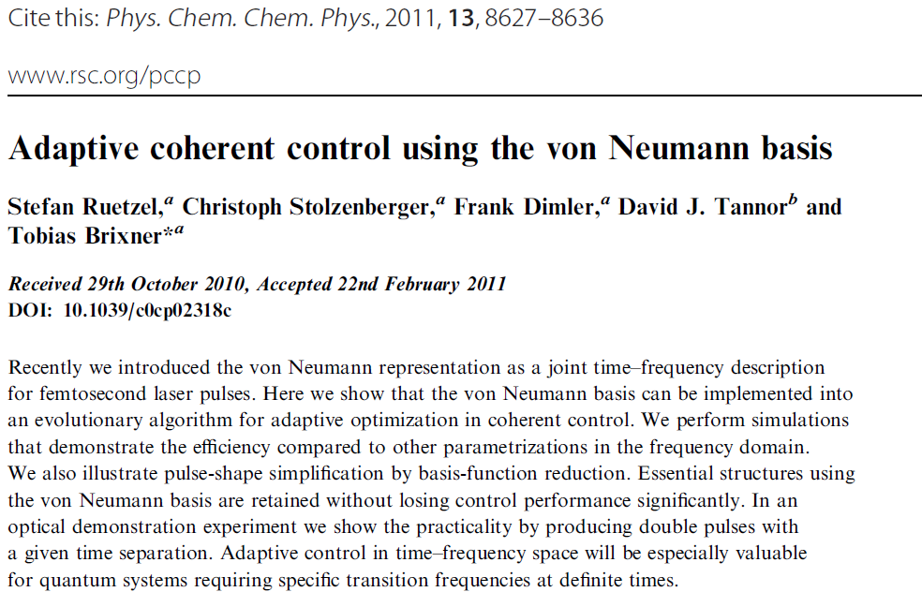
How does one elucidate mechanism?
How can we learn from learning algorithms?
Can one distinguish unambiguously between quantum coherent control and classical control?

Slide 30
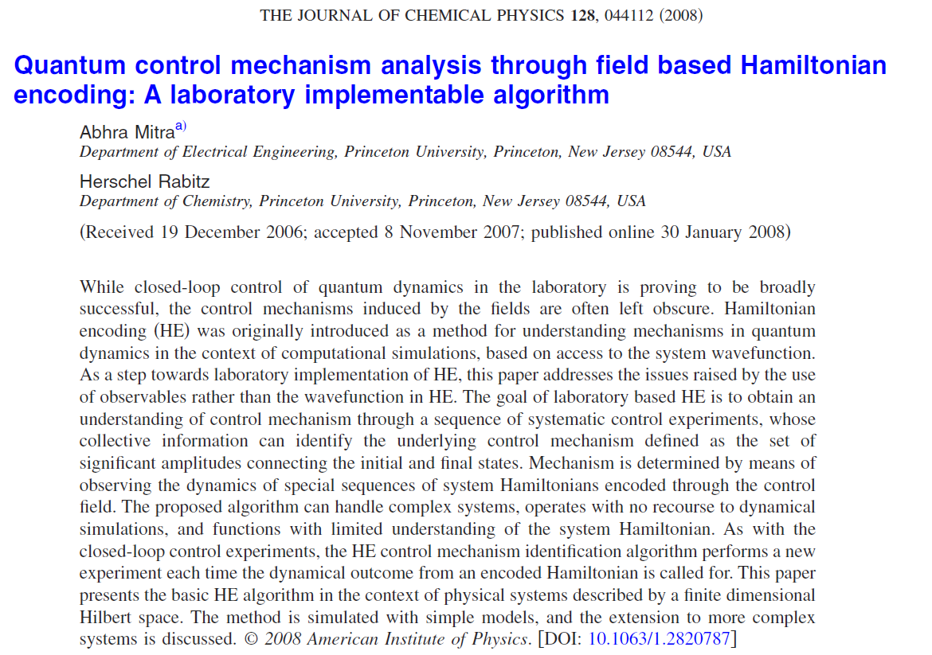
How does one elucidate mechanism?
How can we learn from learning algorithms?
Can one distinguish unambiguously between quantum coherent control and classical control?

Slide 31
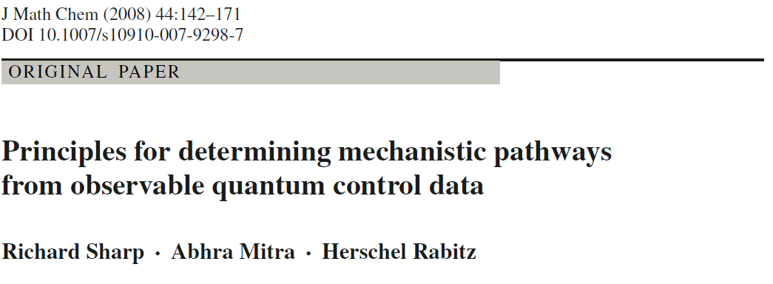
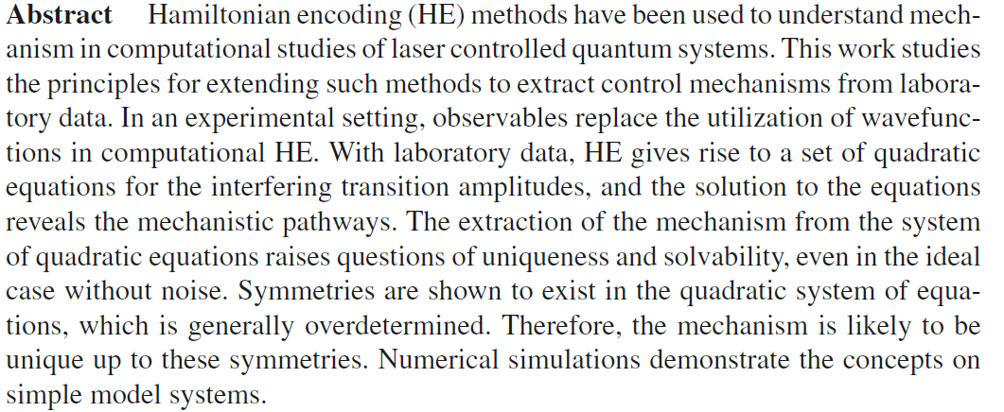
How does one elucidate mechanism?
How can we learn from learning algorithms?
Can one distinguish unambiguously between quantum coherent control and classical control?

Slide 32
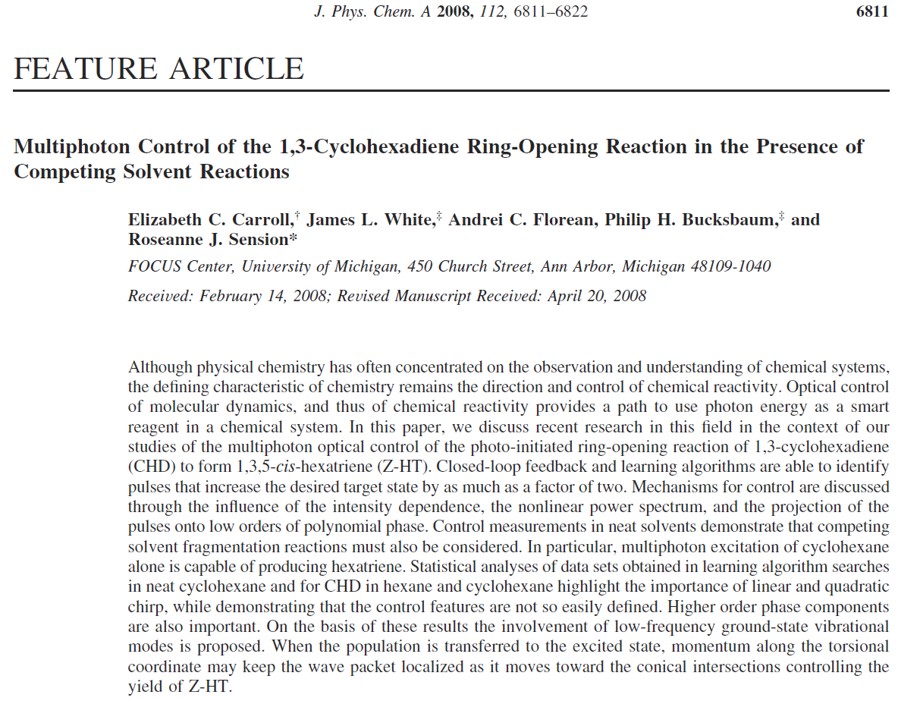
How does one elucidate mechanism?
How can we learn from learning algorithms?
Can one distinguish unambiguously between quantum coherent control and classical control?

Slide 33
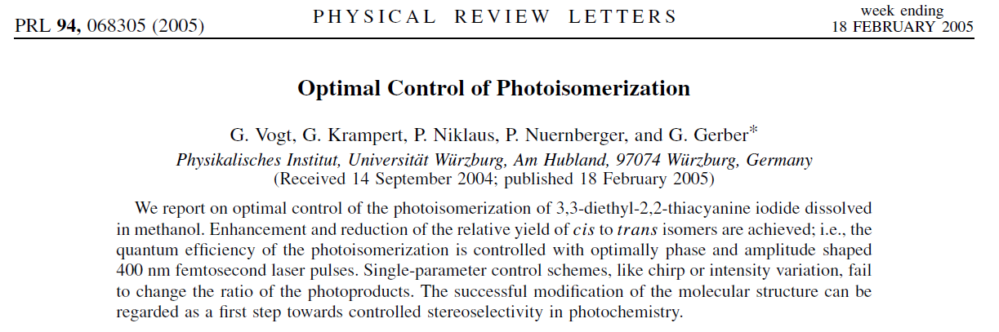
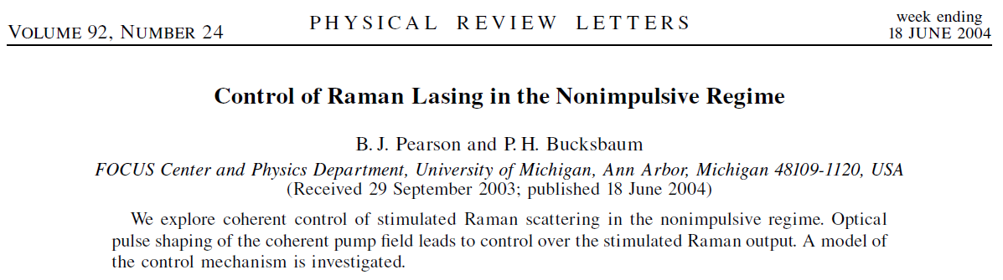
How does one elucidate mechanism?
How can we learn from learning algorithms?
Can one distinguish unambiguously between quantum coherent control and classical control?

Slide 34
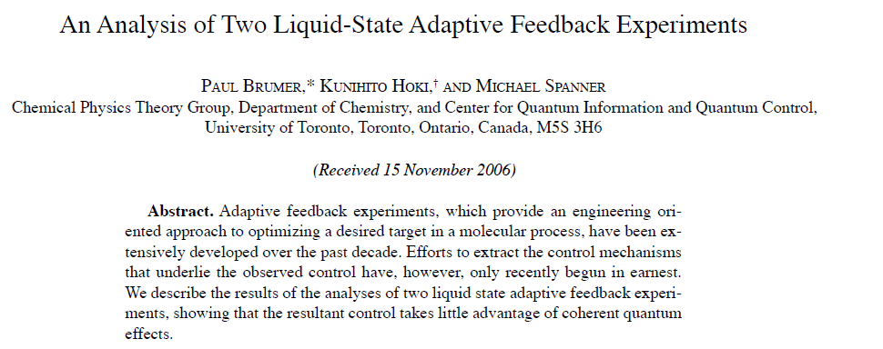
How does one elucidate mechanism?
How can we learn from learning algorithms?
Can one distinguish unambiguously between quantum coherent control and classical control?

Slide 35
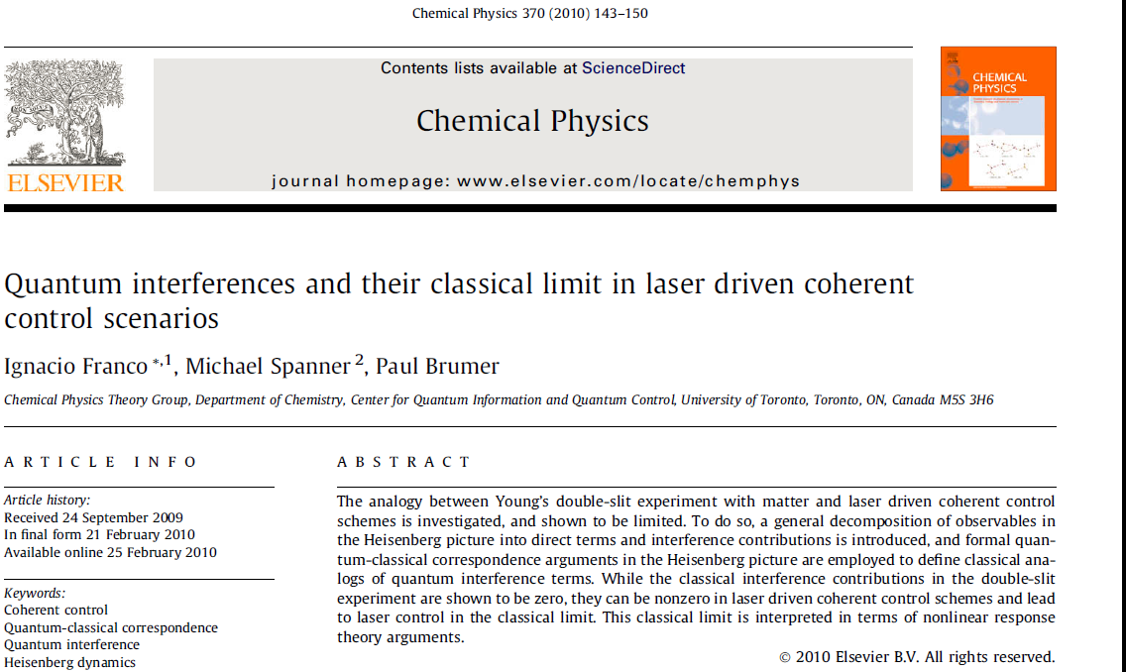
How does one elucidate mechanism?
How can we learn from learning algorithms?
Can one distinguish unambiguously between quantum coherent control and classical control?

Slide 36
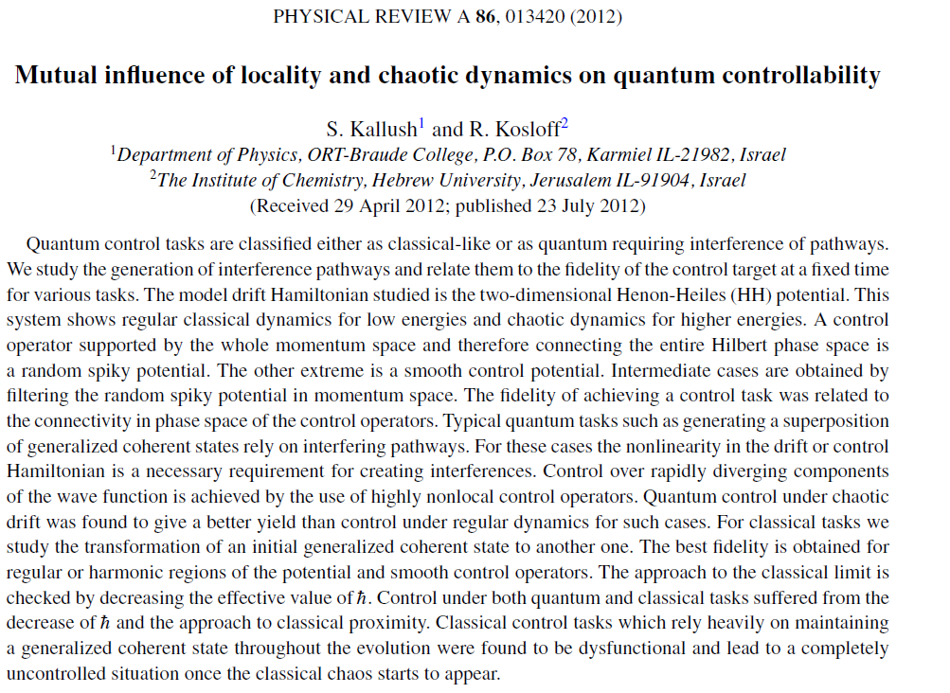
How does one elucidate mechanism?
How can we learn from learning algorithms?
Can one distinguish unambiguously between quantum coherent control and classical control?

