Slide 1
Resolving molecular dynamics via high harmonic generation with mid-IR lasers
B.D. Bruner¹, H. Soifer¹, C. Vozzi², M. Negro³, M. Devetta³, S. Stagira³, and N. Dudovich¹
¹ Department of Physics of Complex Systems, Weizmann Institute of Science, Rehovot 76100 Israel
² Istituto di Fotonica e Nanotecnologie—CNR, Milan 20133, Italy
³ Dipartimento di Fisica, Politecnico di Milano, Milan 20133, Italy

Slide 2
Various assumptions and other things we sometimes like to think about
Can we perform two-colour gating measurements with multielectron systems? How general is this? Are we limited to measuring only specific molecules?
What happens in molecules with multiple orbitals and multiple ionization channels?
What happens if the tunneling conditions (= Keldysh parameter) are changed?

Slide 3
High harmonic spectroscopy with mid-IR lasers
HHG cutoff energy
Intensity scaling leads to saturation
But we can explore the tunneling regime more fully using wavelength scaling:
For tunneling, the Keldysh parameter
γ = 0.6 - 0.9 (800 nm)
γ = 0.3 - 0.6 (1300 nm)

Slide 4
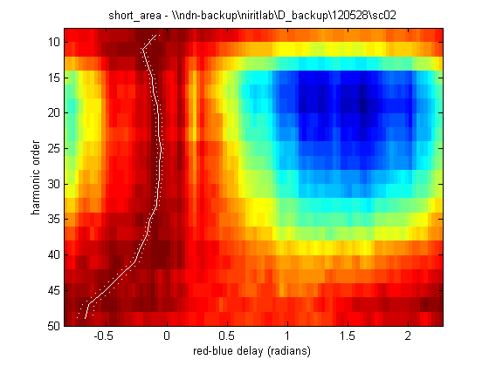
Some examples
Kr
= 1450 nm
I ~ 1 × 10¹⁴ W/cm²
pulse duration = 20 fs
CO₂
= 1300 nm
I ~ 1 × 10¹⁴ W/cm²
pulse duration = 40 fs
20
30
Photon energy (eV)
Photon energy (eV)
40
50
Two colour phase ϕ [rad]
Two colour phase ϕ [rad]

