Slide 1

Understandable Optimal Control and Cooling Optomechanical Systems
Shai Machnes
Ulm University
Safed, 9/2012

Slide 2
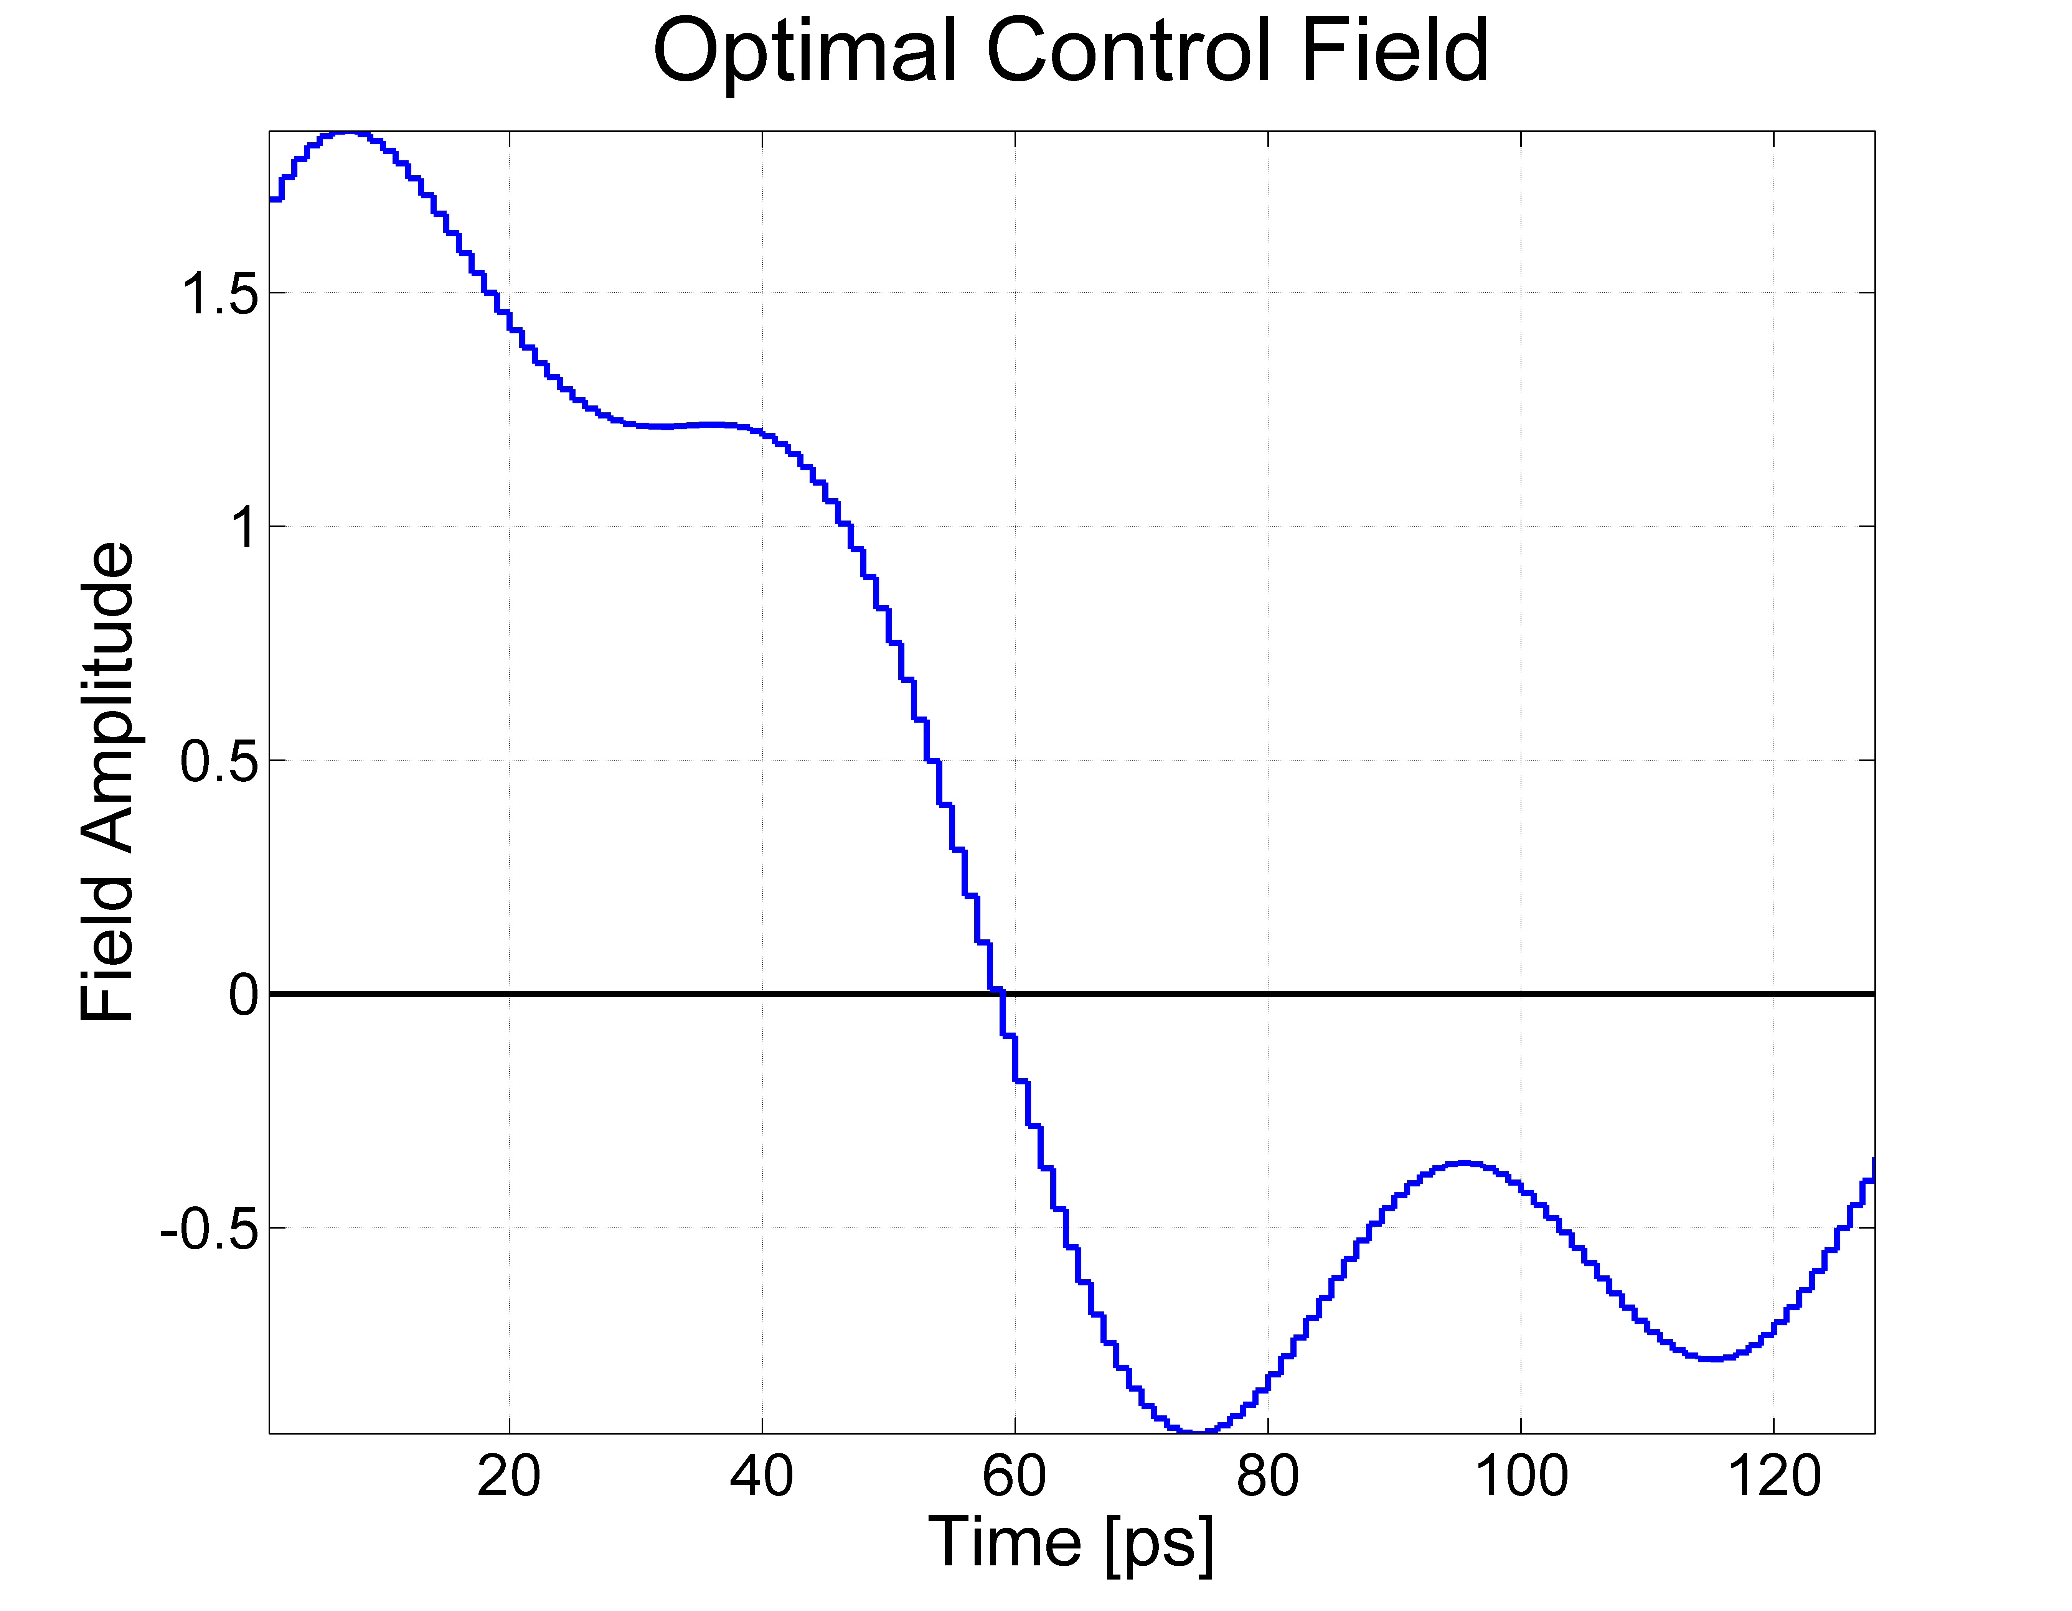
Why does this work?
(or sometimes doesn’t)

Slide 3
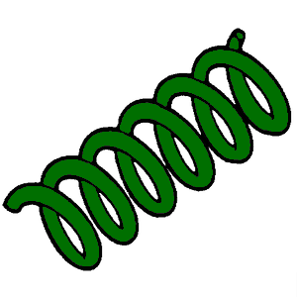

The Model System
Cavity is inherently dissipative
(to allow driving).
“a” - optical cavity modes
substrate
Laser driving
“b” - mech. modes

Slide 4
The 3 steps
Analytical sub-optimal sequence at simplifying limit
(e.g. coherent & impulsive)
Generalize with mechanized algebra
(teach the computer to do operator algebra and BCH)
Numeric search for optimal sequence
  Use analytical result as starting point
  Gradually go beyond limitations of analytics
    Incoherent system
    Experimental constraints (via Jacobians “stack”)

Slide 5
Thank you
Phys. Rev. Lett. 108, 153601 (2012),
Pulsed Laser Cooling for Cavity-Optomechanical Resonators,
S. Machnes, J. Cerrillo, M. Aspelmeyer, W. Wieczorek, M. B. Plenio and A. Retzker
Phys. Rev. A 84, 022305 (2011),
Comparing, optimizing, and benchmarking quantum-control algorithms in a unifying programming framework
S. Machnes, U. Sander, S. J. Glaser, P. de Fouquières, A. Gruslys, S. Schirmer, and
T. Schulte-Herbrüggen,
Phys. Rev. Lett. 104, 183001 (2010),
Superfast Laser Cooling,
S. Machnes, M. B. Plenio, B. Reznik, A. M. Steane, and A. Retzker,

