Slide 1

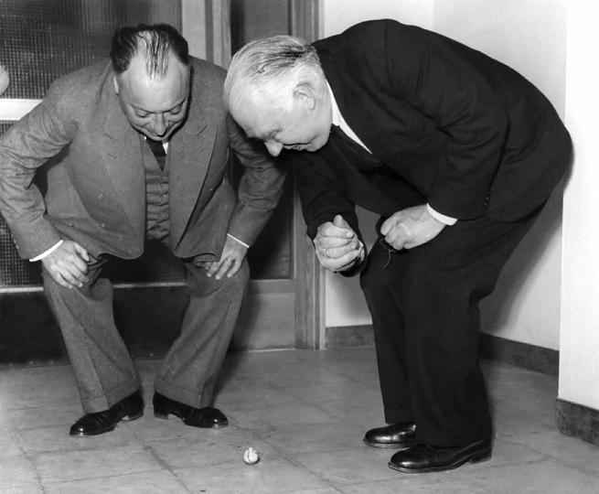
Laser-Induced Vortices in Gases
Uri Steinitz, Yehiam Prior and Ilya Sh. Averbukh
What happens when many rotating tops collide?
Do they retain a memory of their rotation?
Bohr and Pauli observing a (simple) ensemble of spinning tops

Slide 2
Laser-Induced Vortices in Gases
Uri Steinitz, Yehiam Prior and Ilya Sh. Averbukh
Short laser pulses can create an ensemble of unidirectionally rotating molecules
even in dense gas
Upon collisions, the rotation direction is randomized
Conservation of angular momentum leads to a circular flow
A vortex is created

Slide 3
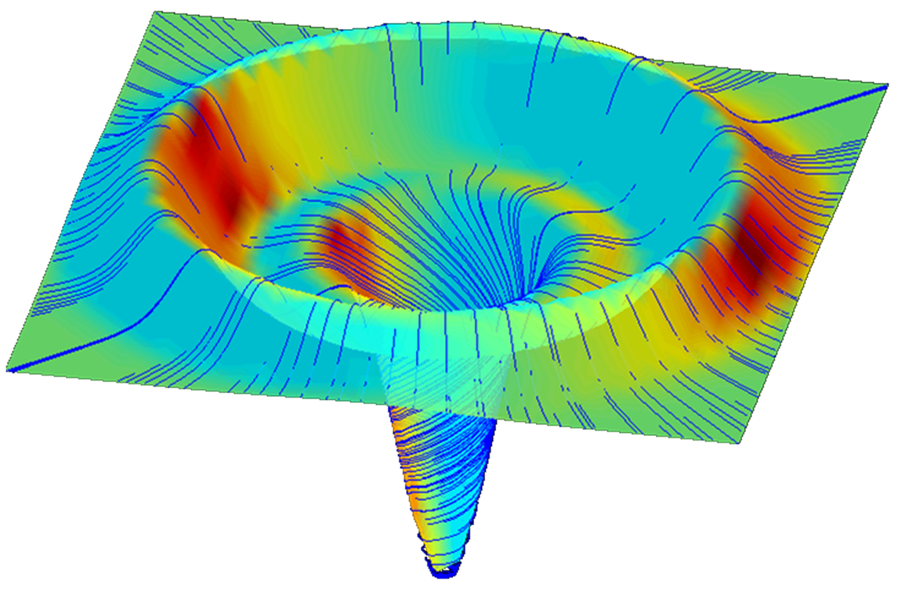
Results of molecular dynamic simulations
Laser-Induced Vortices in Gases
Uri Steinitz, Yehiam Prior and Ilya Sh. Averbukh
Vortex size- laser beam waist (macroscopic)
Typical time- viscous ~μs (compare to coherence time?)
Mechanical rotation frequency ~ 100 kHz
Relates to the creation of
atmospheric cyclones
PRL 2012

