Slide 1
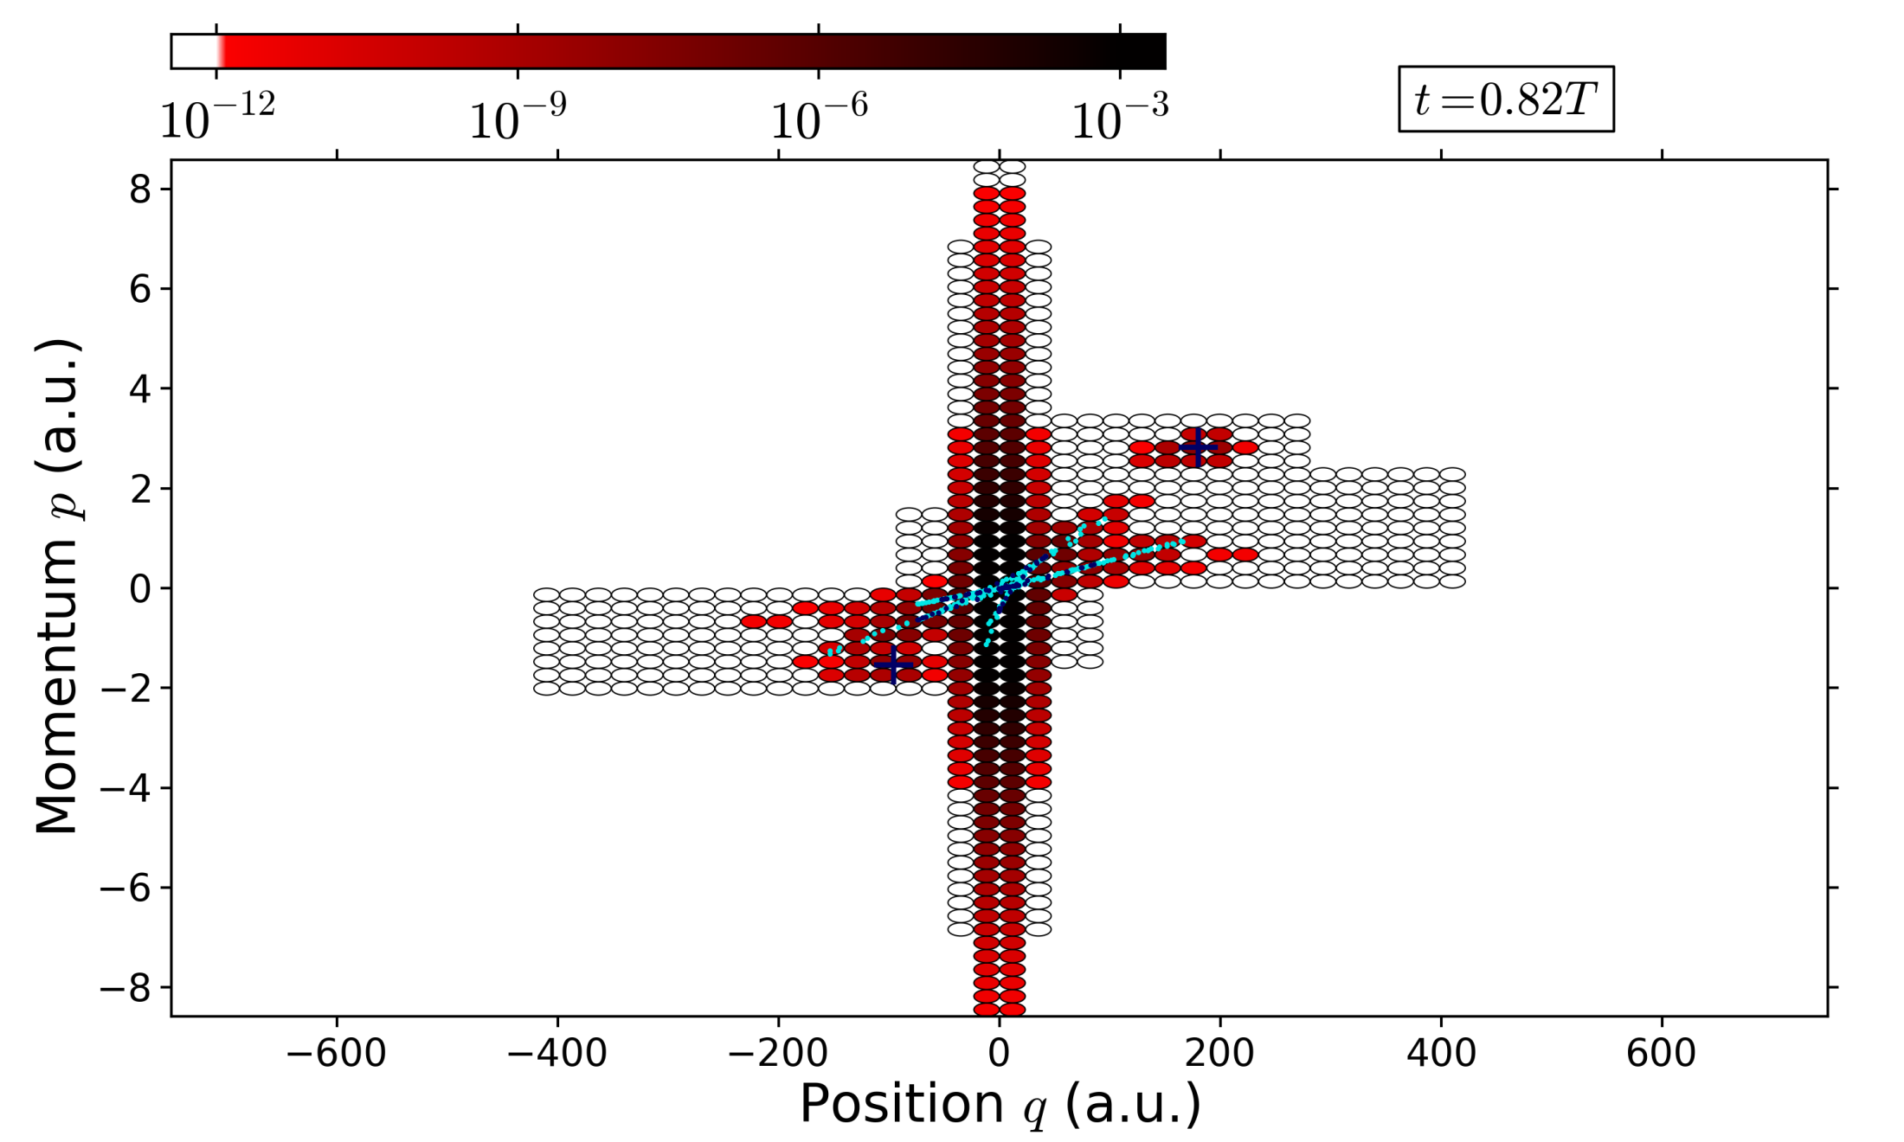
Phase space approach to propagating a laser-driven electronic wavepacket

Slide 2
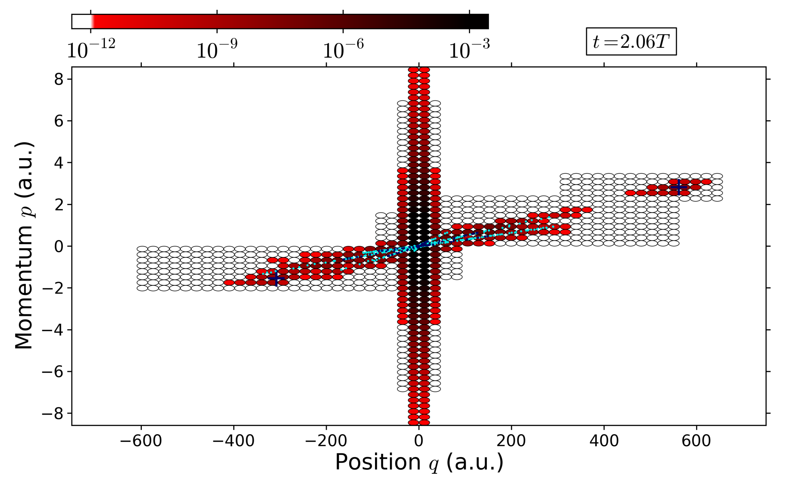
Phase space approach to propagating a laser-driven electronic wavepacket

