Slide 1



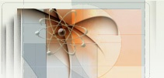

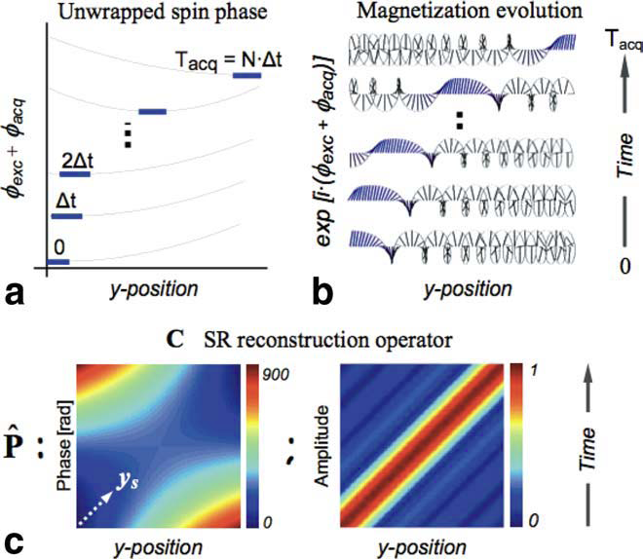
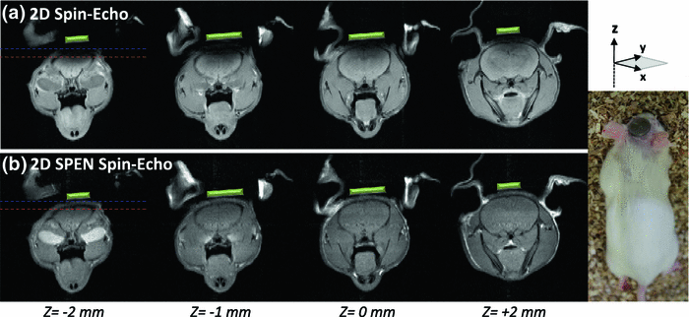
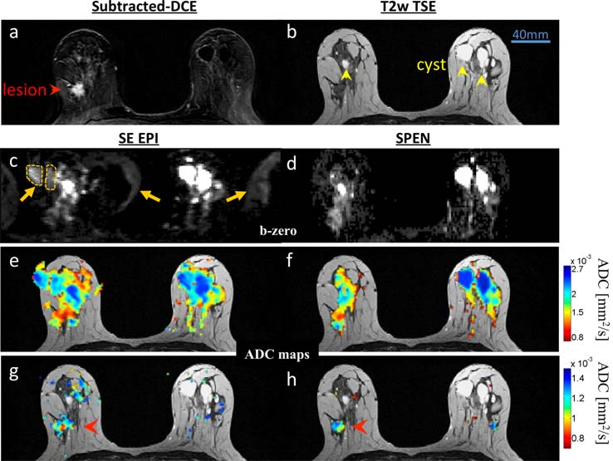
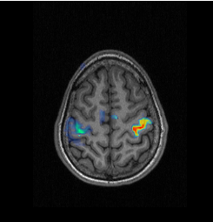
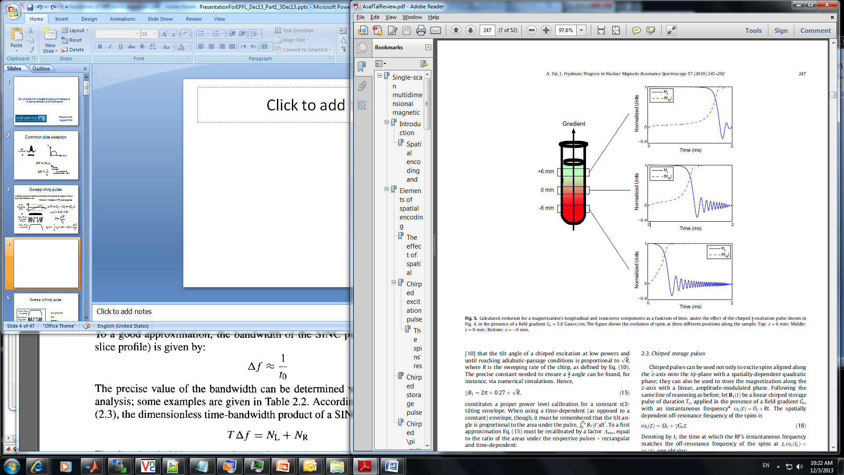
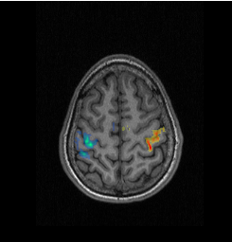
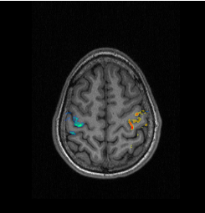
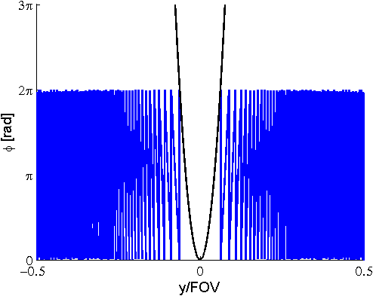
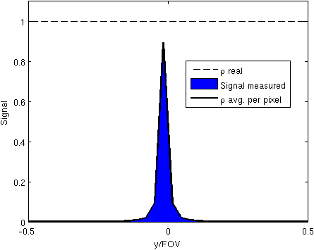
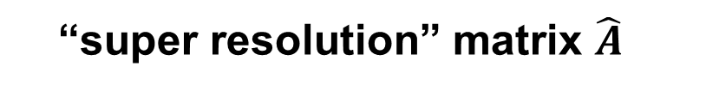

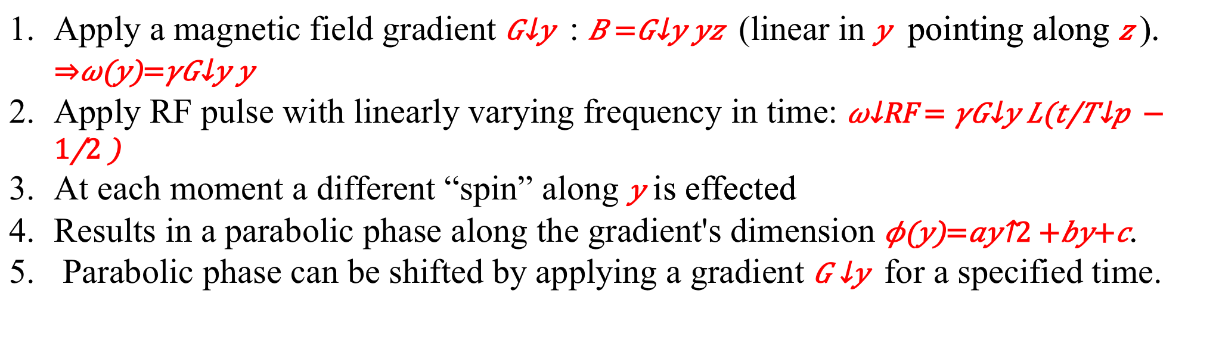
Spatiotempral Encoding (SPEN) for Fast and Robust Magnetic Resonance Imaging (MRI) and spectroscopy (NMR): Principles and Applications
Frydman Group, Chemical Physics Department
Israel Science Foundation
Kimmel Prize for
Innovative Research
1. Introduction
3. Image Reconstruction
Magnetic resonance spectroscopy (NMR) and imaging (MRI) are safe and highly versatile modalities, based on fundamental concepts in quantum spin physics. Although highly informative and useful, NMR and MRI are intrinsically slow, usually requiring several minutes per scan (i.e., to deliver a 3D set of images). Faster imaging is possible, but typically suffers from image artifacts and is less robust. Our group is developing a new approach to collecting magnetic resonance data from nuclear spins, which is both faster and more robust than existing alternatives. This poster highlights some of the new opportunities that our method has opened in the field of MRI. Our new method is based on a special spatiaotemporal encoding (SPEN), where radiofrequency (RF) pulses are applied in conjunction with suitably timed magnetic field gradient waveforms. A specialized signal processing is needed to process these data. The application of the new sequences to different important problems such as diffusion measurements to diagnose cancer, and functional MRI (fMRI) to monitor brain activities, are described below.
Signal acquired is typically low resolution with internal inconsistencies. Post processing is required for a final high-resolution image.
“super resolution” matrix $\hat{A}$
Amplitude
Phase
$$\vec{S}\left(t\right)=\hat{A}(y,t)ρ(y)$$
Signal
(“pre super-resolution)
Object
Single shot Hybrid-SPEN scan of a phantom (SPEN along columns)
2. SPEN: swept chirp pulses and gradients
Pre Super-Resolution
Post Super-Resolution
no correction
Super-Resolution
with corrections
4. Some of our Ongoing Applications
MRI: Spin precession frequency is linear with local magnetic field: )
Imaging Near Metallic Impalants (7T microimaging):
Apply a magnetic field gradient : (linear in pointing along ).
Apply RF pulse with linearly varying frequency in time:
At each moment a different “spin” along is effected
Results in a parabolic phase along the gradient's dimension .
Parabolic phase can be shifted by applying a gradient for a specified time.
Sinc pulse
Sweep chirp pulse vs sinc
Swept chirp pulse
2T₀
T_{p}
RF
amplitude
Functional SPEN MRI – Motor Activation Monitored in the Human Brain (3T) :
Breast Cancer Patient – Detection of malignancies by SPEN-based Diffusion Imaging (3T) :
RF
phase
G_{z}
Amplitude shape defines the frequency selectivity.
Constant phase.
Pulse duration defines the bandwidth
Constant amplitude.
Phase modulation defines the linear frequency dependence and the frequency selectivity.
Pulse duration does not define the bandwidth
a) GE-EPI
2.7x2.7mm²
d) Percent of signal change
4
GE-EPI 2.7x2.7mm²
SPEN 1.7x1.7mm²
SPEN 1.7x0.8mm²
Spatial and time dependence of the spin magnetization
3
ΔS/S [%]
2
1
0
-1
0
10
20
30
40
50
60
b) 4 shots SPEN
1.7x1.7mm²
time [sec]
c) 4 shots SPEN
1.7x0.8mm²
fMRI based on motor stimuli including all fingers tapping for 30 seconds, interleaving right and left hands for a 5 minutes total study duration (5 pairs of stimuli blocks).
Comparison between images derived from SE-EPI and single-slice SPEN scans of a patient with IDC. Red arrowheads indicate the cancer; yellow arrowheads indicate the cysts; dashed orange regions highlight the folding of cysts and fat
Results presented above from the following references:
Ben-Eliezer N., Irani M., Frydman L. Super-Resolved Spatially-Encoded Single-Scan 2D MRI. MRM; 63:1594–1600, 2010.
Ben-Eliezer N., Solomon E., et al. Fully refocused multi-shot spatiotemporally encoded MRI: robust imaging in the presence of metallic implants. MAGMA; 25(6): 433-442, 2012.
Schmidt R., Seginer A., Frydman L. An interleaved multi-shot scheme involving self-refocused single-scan SPEN that is immune to in-plane movement and phase shifts. Proc. Intl. Soc. Mag. Reson. Med. 22 (2014).
Seginer A., Schmidt R., et al. Referenceless reconstruction of spatiotemporally encoded imaging data: Principles and applications to real-time MRI. MRM; 72:1687–1695, 2014.
Solomon E., Nissan N., et al. Overcoming Limitations in Diffusion-Weighted MRI of Breast by Spatio-Temporal Encoding. MRM; 2014; doi: 10.1002/mrm.25344.
Tal A., Frydman L. Single-scan multidimensional magnetic resonance. Prog. Nucl. Magn. Reson. Spectrosc.; 57: 241–292, 2010.
Signal due to parabolic phase Signal=Image
Parabolic phase along sample (after chirp)
Signal per voxel due to phase
Acknowledgments
We are grateful to Dr. Sagit Shushan (Wolfson Medical Center), Dr. Edna Haran and the Weizmann MRI technician team, for assistance in the human imaging scans and Dr, Nava Nevo for animal scans assistance.
Conclusions: Ultrafast and fast SPEN acquisitions can offer a new alternative with an improved robustness to B₀ inhomogeneity. In-vivo animal and human imaging studies promise valuable gains in functional and diffusion MRI as well as other applications.

