Slide 1
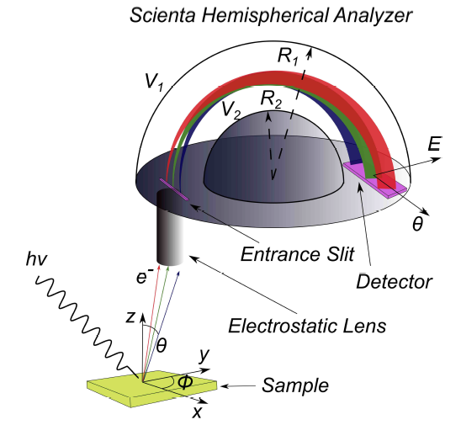
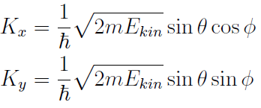
ARPES
Electronic band dispersion (E vs k)
Challenges
Ultra High Vacuum (Surface + Analyzer)
EM Noise (Surface + Analyzer)
Temperature – 15K (Analyzer)
Light Source

Slide 2
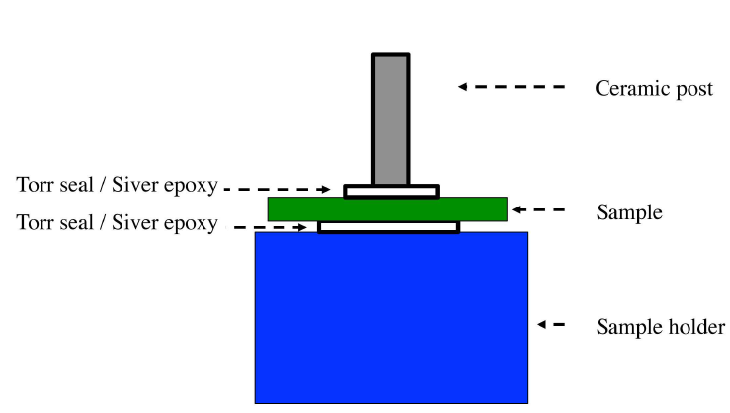
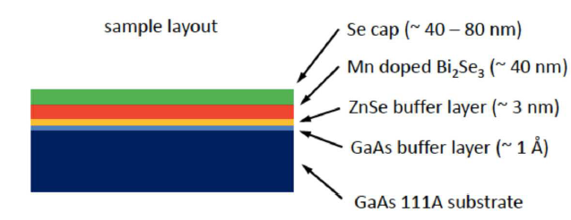
ARPES
Electronic band dispersion (E vs k)

Slide 3
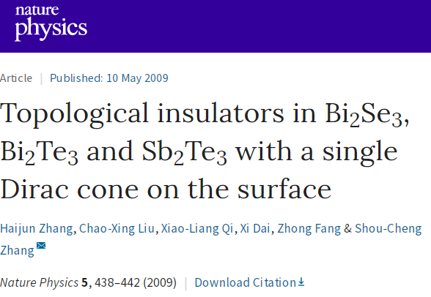
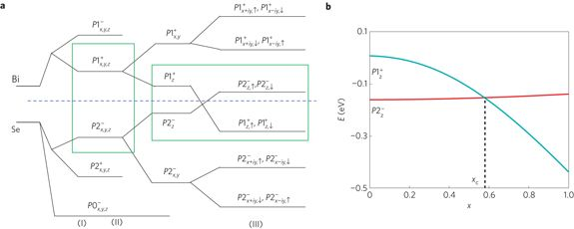
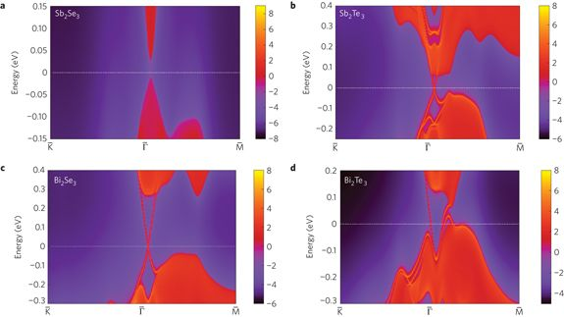

Slide 5
Electronic structure
Resolution:
ΔE < 16 meV
Δk < 0.012 (1/A)
PRB 87, 075113 (2013)

Slide 6
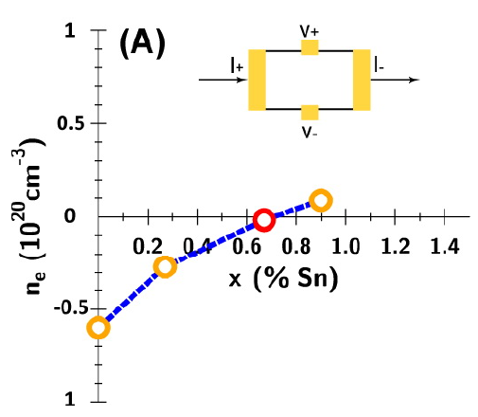
Doping

Slide 7
Aging of undoped Bi2Te3

Slide 8
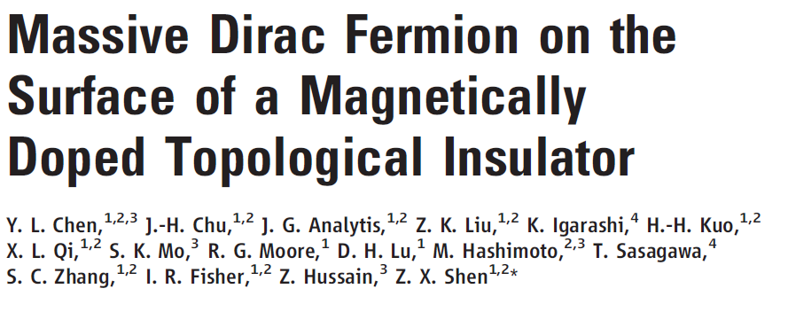
SCIENCE 329 659-662 (2010)

Slide 9
Band structure Bi₂Se₃
In gap Dirac point

Slide 10
Magnetic Doping (Fe)

Slide 11
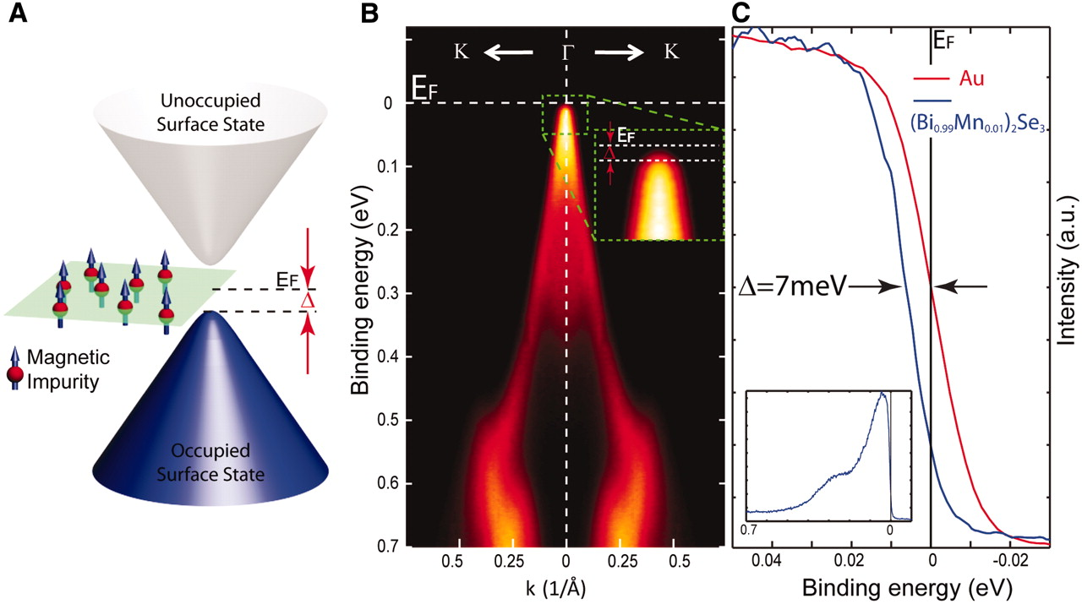
Magnetic Doping (Mn)

