Slide 1
Novel concepts in blood development and leukemia
Jung/Shlush
Department
of Immunology

Slide 2
Objectives of the seminar
Learn about the newest research the
hematopoetic system and leukemia
Identify emerging topics and techniques
Learn to use literature-research tools
Learn to read papers critically
Identify gaps in the literature
Improve presentation skills in English
Have intellectually stimulating fun

Slide 4
Structure of the presentations
Intro
Paper discussion
Outlook

Slide 5
Questions that can be addressd in your presentation
What was already known in the field when the research was done?
What was generally done in the research? You can show Flowchart of Exp. A critical Figure or two.
How conceptually novel was the paper and why?
Was the paper technically innovative and how?
Was the study controversial?
What questions remained open?
What were the new questions raised?
What is the link to your co-presenter?
Why was the paper important?

Slide 6
How to prepare and present your papers
General background
Send the 2 papers via E-mail to everybody a week ahead of the presentation.
Send a reminder one day ahead of the presentation
Read 4-5 related papers
Prepare a PowerPoint presentation
Send the presentation to everybody after your seminar

Slide 7
Important research tools
Pubmed - http://www.ncbi.nlm.nih.gov/sites/entrez/
Scholar - http://scholar.google.com
ISI - http://apps.isiknowledge.com
Faculty of 1000 - http://www.f1000biology.com/browse/
Citation maps - http://highwire.stanford.edu/
News and views. Highlights.

Slide 8
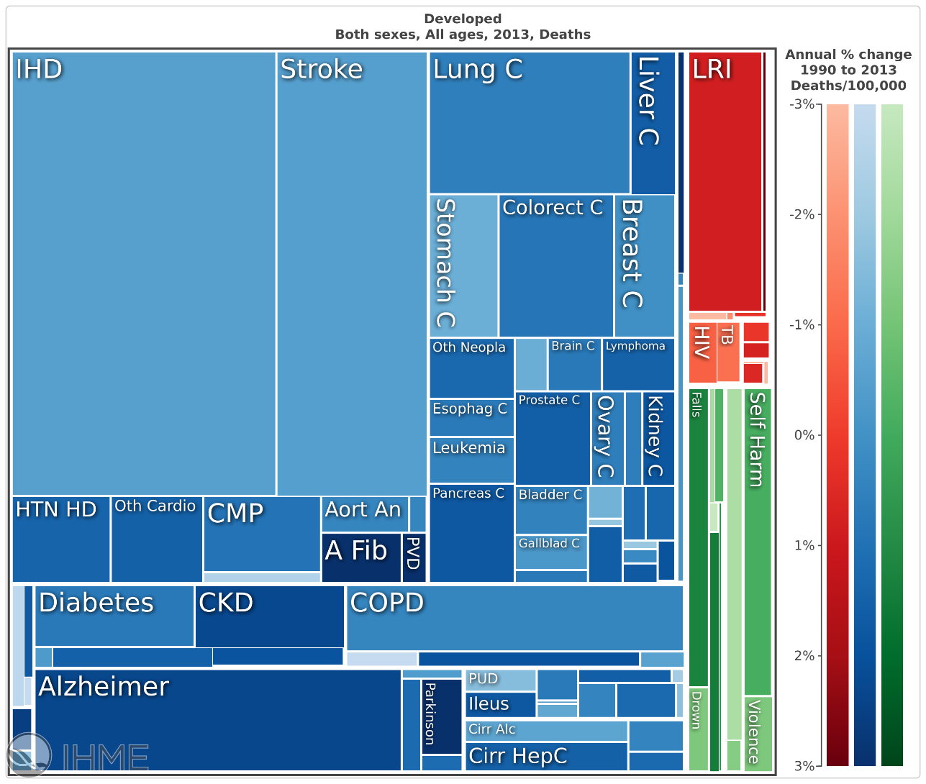
Cancer #1 Cause of death
Leukemia 0.5% of all death
http://vizhub.healthdata.org/gbd-compare/

Slide 9
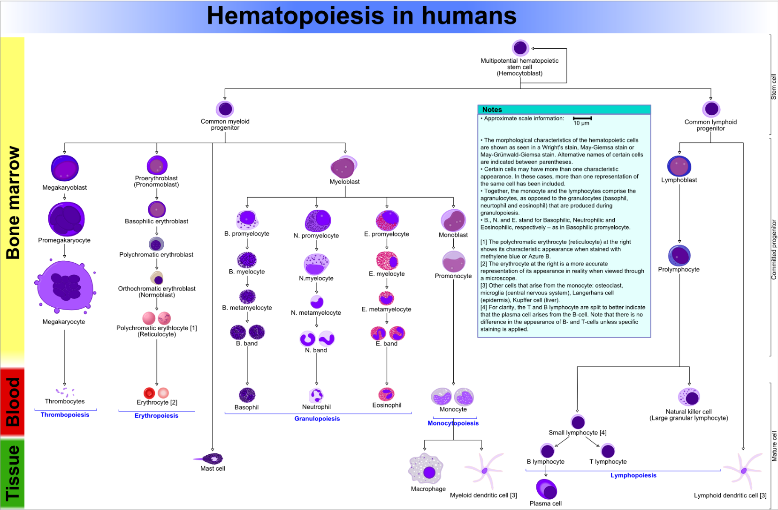
Leukemia is clinically relevant aberrant differentiation

Slide 10

pathophysiology
physiology

Slide 11
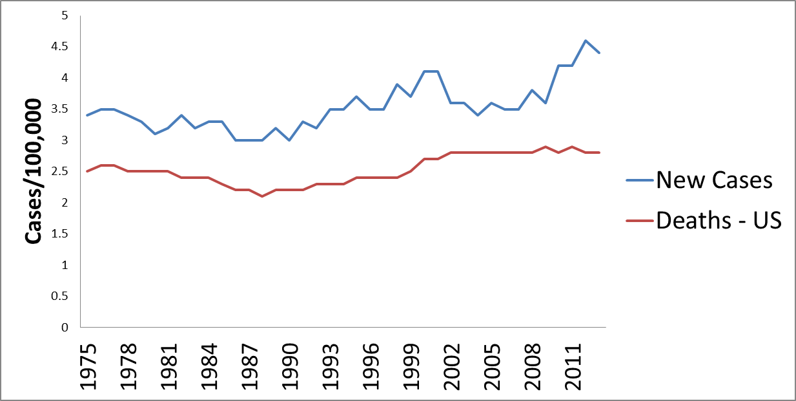
Acute Myeloid Leukemia death rate last 40 years
NIH National Cancer Institute

Slide 12
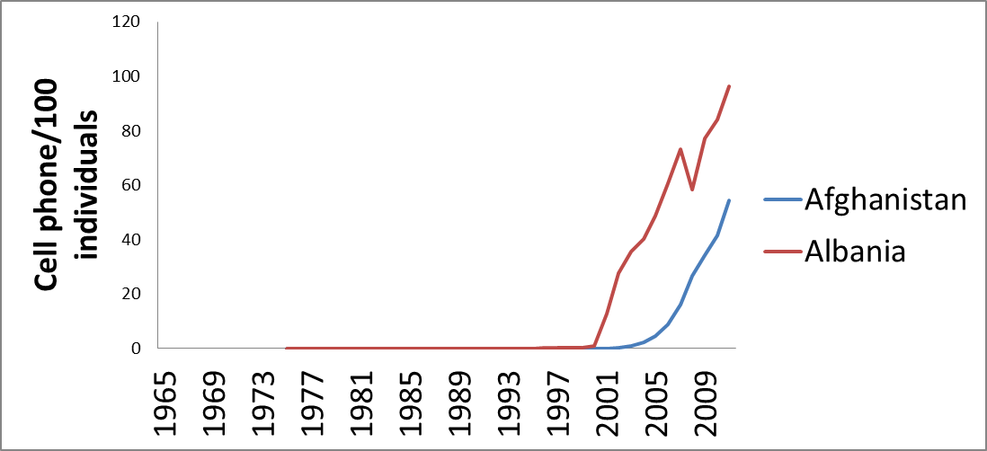
Cell phones per 100 people in and Afganistan and Albania (GAP-Minder data)
http://data.worldbank.org/indicator/IT.CEL.SETS.P2
Notes:
Abkhazia

Slide 13
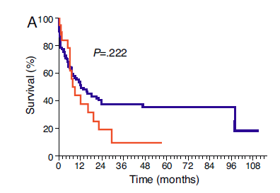

AML kills you fast

Slide 14
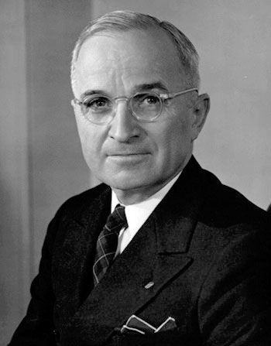
AML is Not acute
CML
ALL
AML
Annals of Internal Medicine 1967
Notes:
Epidemiological studies after the Hiroshima and Nagasaki bombing demonstrated that AML incidence picked 10 years after the bomb –
so if we were to consider the entire leukomogenesis process as a whole it seems that it takes years to develop AML.

Slide 15
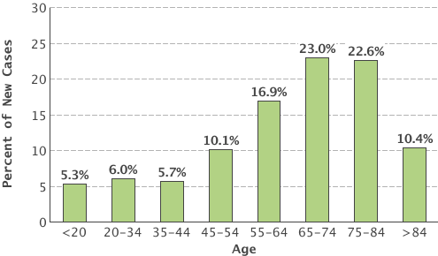
AML incidence increases with age

Slide 16

















Clonal Hematopoiesis of Indeterminate Potential (CHIP)
Clonal Hematopoiesis
Progenitor- Preleukemia
Stem cells
×
×
×
Wild type
×
×
×
×
Mutant
×
×
×
×
×
Progenitors
Mature cells
×
×
×
×
×
×
Recurrent
Mutations VAF%
4%
2%
Healthy and Normal CBC
Adapted from Steensma Blood 2015.

Slide 17
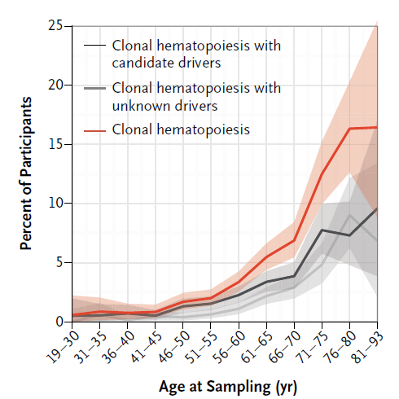
Preleukemic mutations and aging
Genovese G et.al NEJM 2014

Slide 18
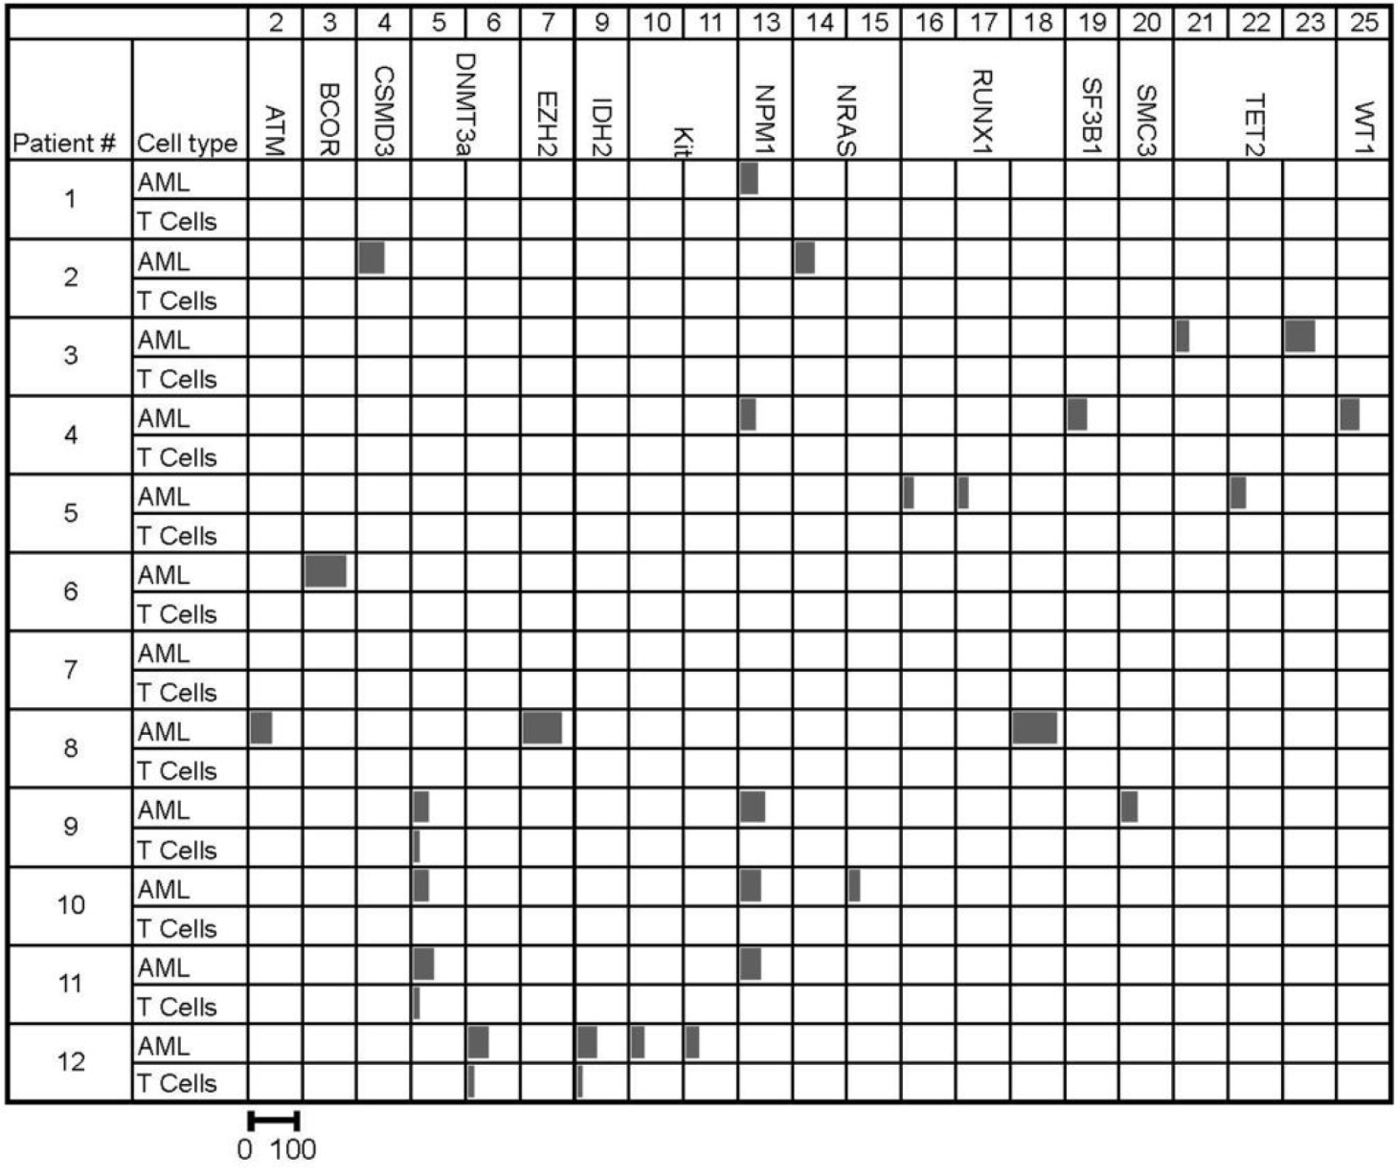


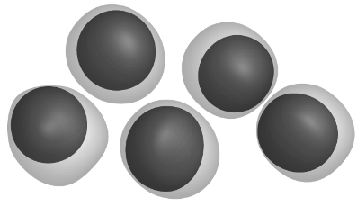
Recurrent somatic DNA Methyltransferase 3a (DNMT3a) mutations in T cells from AML patients
DNMT3a^{mut}
X
PreL-HSC
X
X
T cells
X
X
XY
X
X
Leukemic blasts
Mutant allele frequency:
Shlush et.al Nature 2014

Slide 19
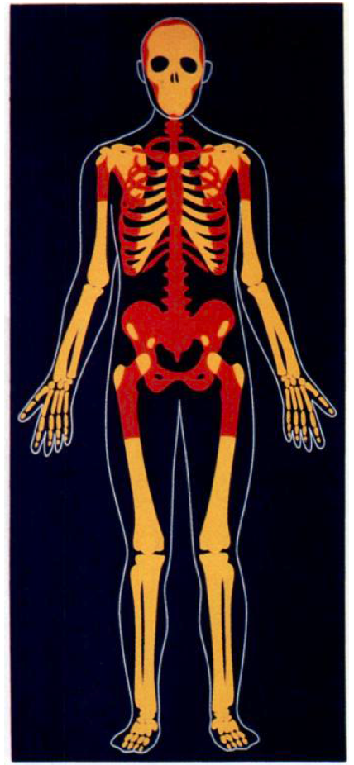
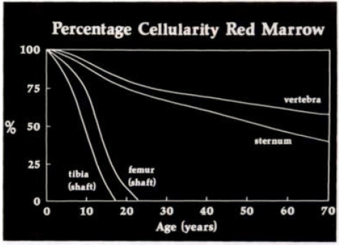
Human marrow as we Age
MRI studies
Volger, JB. Murphy, WA. 1988 Radiology

Slide 20










Preleukemia is common in other hematological malignancies
Hairy Cell Leukemia
Preleukemia Mutations x:n\x:m
X:L
X:L
X:L
X:M
X:M
X:M
X:L
T(9;22)
CLL
X:M
X:M
X:M
X:M
NPM1
CML
Del5q
JAK2
MPN
AML
MDS
X:L
X:M
X:M
X:M
X:M
X:M
Shlush & Minden Cur Opin Hem 2015

Slide 21














Leukemia evolution
YX
XYZ
XYZ
X
XY
XYZ
XY
XYZ
XYZ
X
Preleukemia
Leukemia Diagnosis
Remission
Relapse
Normal/preleukemic
HSPC
Normal/preleukemic
HSPC
Normal/preleukemic
HSPC
Normal/preleukemic
HSPC
Leukemic stem cell
Leukemic stem cell
Leukemic stem cell
Blast
Blast

Slide 22
Can leukemia be diagnosed earlier?
Clonal Hematopoiesis
Pre-Leukemia
Leukemia
(AML MPN MDS etc)
No preleukemic mutation
Aging
Preleukemic Mutation
Aging

Slide 23
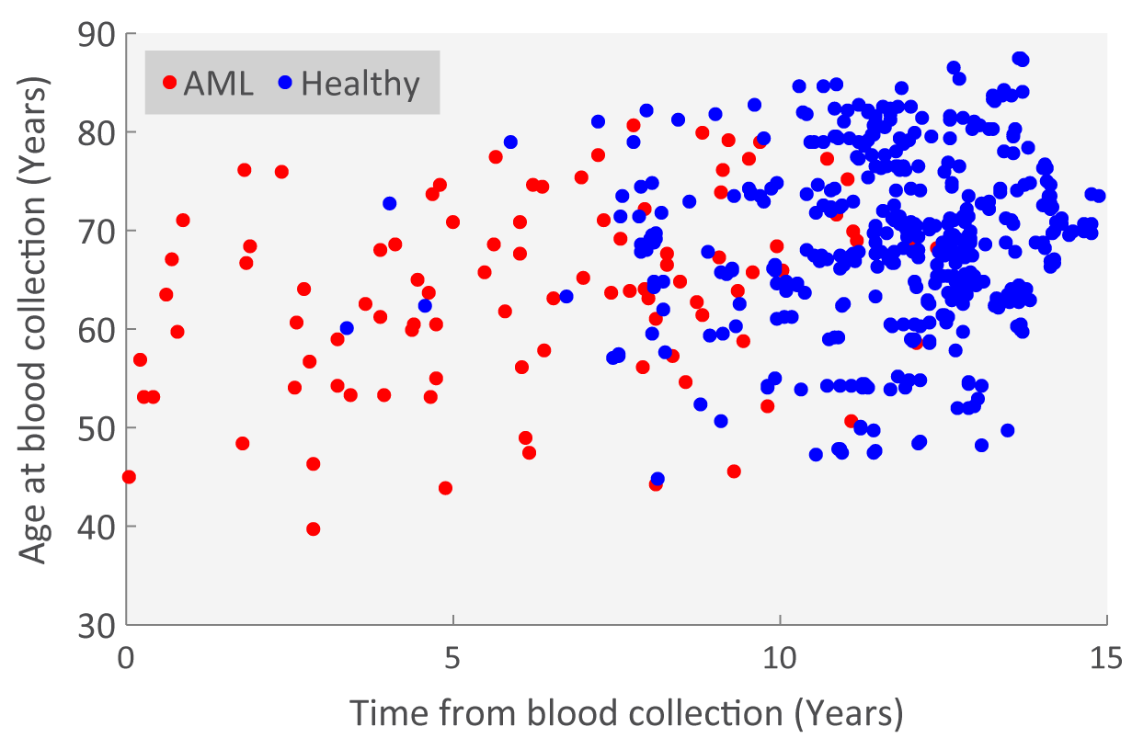
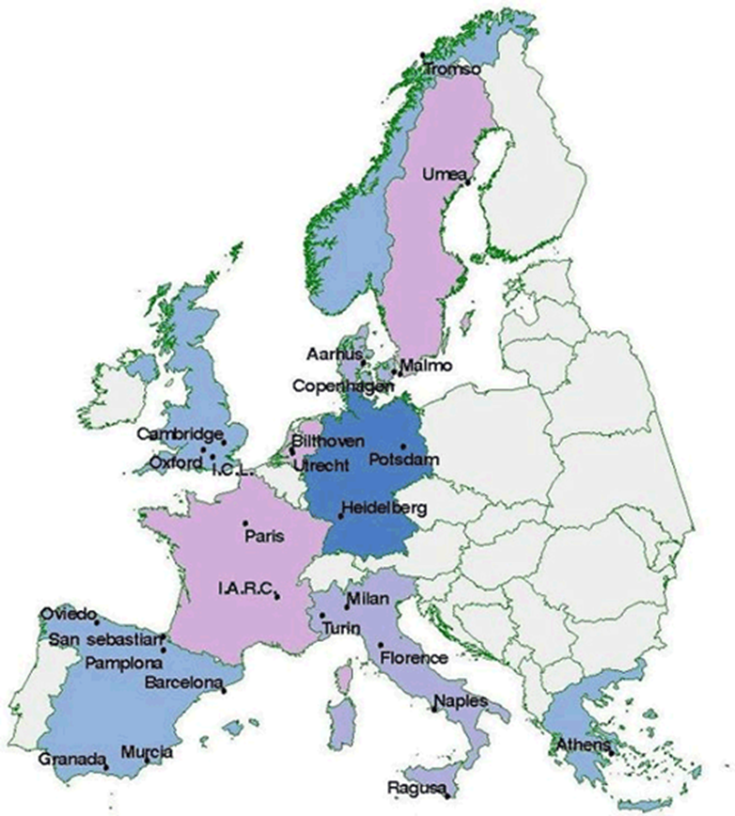
Preleukemia versus CHIP using EPIC data
European Prospective Investigation into Cancer and Nutrition (EPIC)
Samples in Shlush Lab
Targeted barcoded Seq of AML related genes
520,000 People
100 AML Cases
400 Matched Controls

Slide 24
Increased number of mutations with VAF 10-20% in Pre-AML
Control
Pre-AML

Slide 25
Different mutation spectrum between Pre-AML and Controls
Germline
Somatic

Slide 26
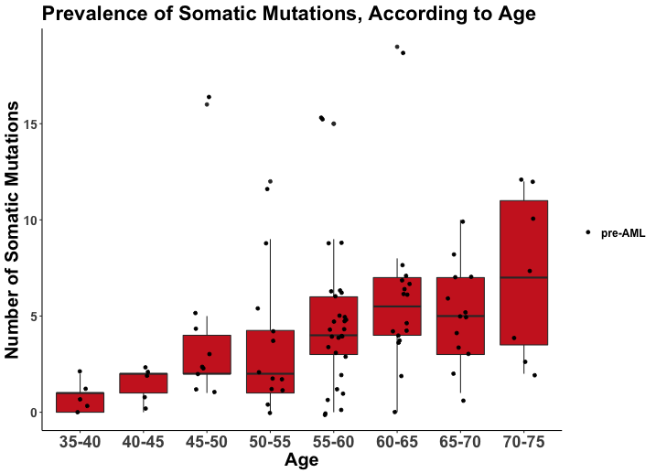
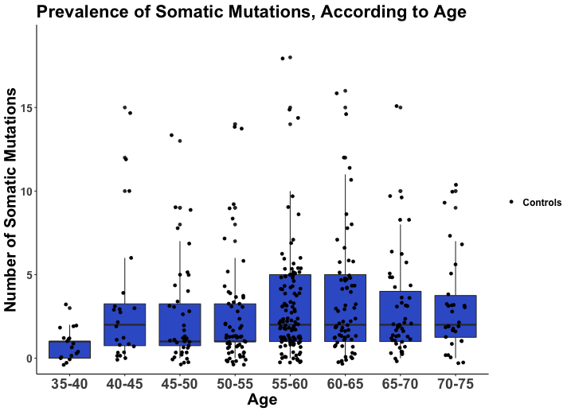
The number of somatic mutations increases linearly in the Pre-AML group
Adjusted R-squared: 0.6286
p-value: < 2.2e-16
Adjusted R-squared: 0.1149
p-value: < 5.66e-13

Slide 27
http://cancer.sanger.ac.uk/cosmic

Slide 28
Recurrent leukemic mutations are more prevalent and at higher VAF in pre-AMLs
Pre-AML
Controls

Slide 29
Prevalence of Discriminative Mutations According to Age

Slide 30
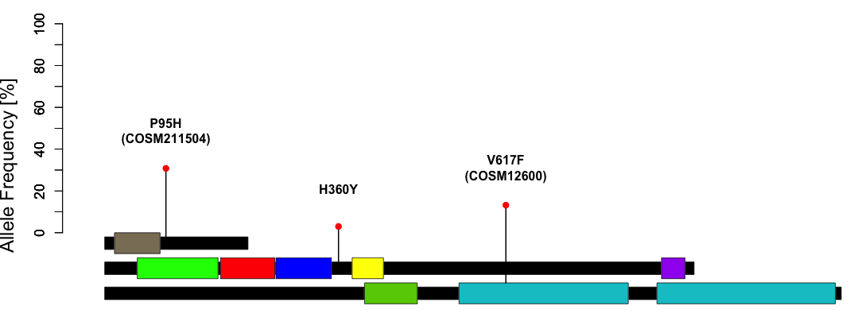
Patient_0397 - 9.7 Years Before AML Diagnosis
SRSF2
30%
JAK2
CBL
13%
3%
RRM
Cbl_N
Cbl_N
Cbl_N
Ring
ubl
SH2
Pkinase_Tyr
Pkinase_Tyr

Slide 31
The future
Identify healthy individuals doomed to develop AML but also other malignancies
Treat earlier based on better understanding the mechanisms of pre-L-HSPCs clonal advantage, and their vulnerabilities.

Slide 32
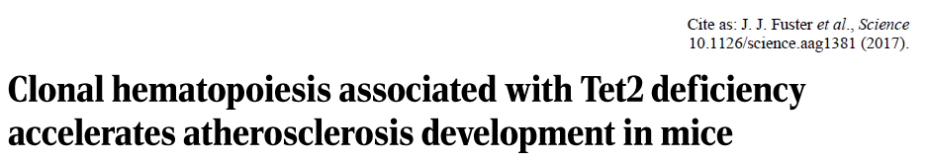
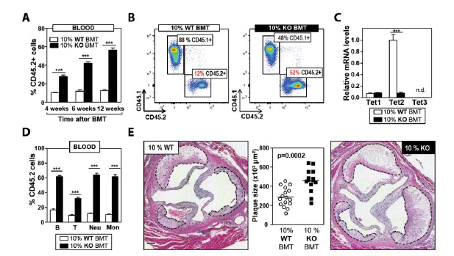

Slide 33
Advances in science and hematology
Big leaps in science
Technology
Breaking paradigms
Theory
Genomics
Single cell
Mass spectrometry
HSCs hierarchy
HSCs
Kinetics
Aging
System biology
Computational biology big data
Leukemia
Evolution

Slide 34
Subjects and papers
Stem cell Differentiation
1) Prospective identification of hematopoietic lineage choice by deep learning.
2) Platelet-biased stem cells reside at the apex of the hematopoietic stem-cell hierarchy.
3) The Branching Point in Erythro-Myeloid differentiation.
4) Transcriptional Heterogeneity and Lineage Commitment in Myeloid Progenitors.
5) Distinct routes of lineage development reshape the human blood hierarchy across ontogeny.

Slide 35
Subjects and papers
Stem cell kinetics and dynamics
Hematopoietic Stem Cells Count and Remember Self-Renewal Divisions.
2) Decoupling the Functional Pleiotropy of Stem
Cell Factor by Tuning c-Kit Signaling.
3) Exit from dormancy provokes DNA-damage-
induced attrition in hematopoietic stem cells.
4) Fundamental properties of unperturbed
hematopoiesis from stem cells in vivo.
5) Clonal dynamics of native hematopoiesis.

Slide 36
Subjects and papers
HSCs and Aging
1) Clonal reversal of ageing-associated stem cell lineage bias via a pluripotent intermediate.
2) Clonal hematopoiesis associated with TET2 deficiency accelerates atherosclerosis development in mice.
3) Detectable clonal mosaicism from birth to old age and its relationship to cancer.
4) Clonal hematopoiesis and blood-cancer risk inferred from blood DNA sequence.
5) The unfolded protein response governs integrity of the hematopoietic stem-cell pool during stress.

Slide 37
Subjects and papers
Leukomognesis
1) CpG Island Hypermethylation mediated by DNMT3A Is a Consequence of AML Progression.
2) Genomic and Epigenomic Landscapes of Adult De Novo Acute Myeloid Leukemia.

Slide 38
Subjects and papers
Stem cell and leukemia evolution
1) Hematopoietic differentiation is required for Initiation of acute myeloid leukemia.
2) Lineage-specific and single-cell chromatin accessibility charts human hematopoiesis and leukemia evolution.
3) Identification of pre-leukaemic haematopoietic stem cells in acute leukaemia.
4) Role of TP53 mutations in the origin and evolution of therapy-related acute myeloid leukaemia.
5) Somatic Mutations and Clonal Hematopoiesis in Aplastic Anemia.

Slide 39
Subjects and papers
HSCs and leukemia metabolism
1) Self-renewal of a purified Tie2+ hematopoietic stem cell population relies on mitochondrial clearance.
2) Metabolic gatekeeper function of B-lymphoid transcription factors.
3) Hematopoietic stem cells require a highly regulated protein synthesis rate.
4) Fasting selectively blocks development of acute lymphoblastic leukemia via leptin-receptor upregulation

Slide 40
Subjects and papers
Microenviroment stem cells and leukemia
1) Distinct bone marrow blood vessels differentially regulate haematopoiesis.
2) Age-dependent modulation of vascular niches for haematopoietic stem cells.
3) Mesenchymal Inflammation Drives Genotoxic Stress in Hematopoietic Stem Cells and Predicts Disease Evolution in Human Pre-leukemia.
4) Leukaemogenic effects of Ptpn11 activating mutations in the stem cell microenvironment.

Slide 41
Dates

Slide 42
What’s next
Download this presentation from:
http://www.weizmann.ac.il/immunology/Shlush/novel-concepts-blood-development-and-leukemia
Send us a list of 4 papers that are interesting to you (two from a group).
Links to paper PDFs can be found in the Shlushlab web.

