Slide 1

c-Si/PEDOT:PSS Interface Modification a Model for Studying Hybrid Organic-Inorganic Systems
Int’l. Mini-Symposium on Organic Semiconductors:
Their Electronic Structures and Device Physics
Chiba , Jan. 28, 2015
Ann Ericksson, Arava Zohar, Nir Kedem
Thanks also to
Ayelet Vilan; Rotem Har-Lavan; Igor Lubomirsky & David Ehre (C-V);
Rafi Kalish - Technion (H-plasma); Lars Korte – HBZ
$ €: Helmsley trust
Minerva foundation

Slide 2

Motivation
Explore use of “inversion layer” PV* device
by controlling interface properties of Si in MIS** cell,
using monomolecular layers on Si
* PhotoVoltaic **Metal-Insulator-Semiconductor

Slide 3
Metal-Semiconductor (MS) junction
Accumulation
Depletion
Inversion
E_{F}
E_{F}
E_{G}
E_{G}
E_{F}
Semi-
conductor
Semi-
conductor
Metal
3
E_{G}
Metal
1
Metal
2
Semi-
conductor
MAJORITY carrier
MINORITY carrier

Slide 4
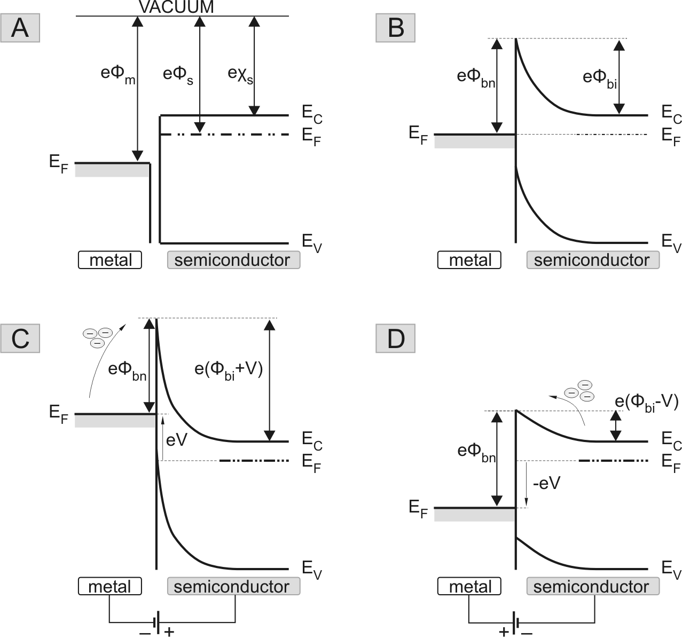
Inversion layer device Metal-Semiconductor (MS) junction
based on Schottky-Mott model
BH
BH

Slide 5
Inversion layer device From MS to MIS junction
P
t ype
n- type
By adding insulating layer to MS junction we can passivate the Si surface and tune Si Electron Affinity (χ_{s})

Slide 6
Questions
(How) can a molecular monolayer control the electronic properties of an (MIS) junction
Is surface dipole retained if interface forms?
To what extent can this affect PV device performance?
Can mc-Si surface be passivated and modified by ultra-thin (< 2 nm) molecular monolayer?

Slide 7
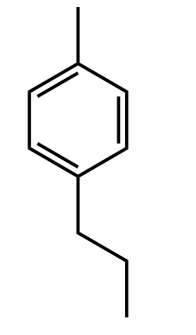
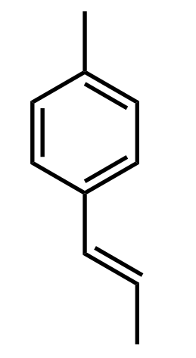
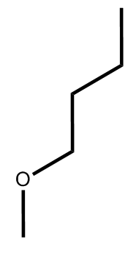


Experimental system
Modified surface
Me- styrene
Br- styrene
Ethynyl Toluene
Butoxy
Methoxy
CH₃
Br
CH₃
Single crystalline (sc) Si
Flat surface (< nm roughness)
<111> or <100> orientation.
Multi-crystalline (mc) Si
Rough surface (few μm)
<111>, <110>, <311>, <331> mixed orientation
M
I
PEDOT:PSS
Organic monolayer
S
sc n-Si
mc n-Si
Eutectic InGa
A.-E. Haj-Yahia, et al. Adv. Mater., 2013, 25,702–706
R. Har-Lavan, et al. J. Appl. Phys., 2013, 113, 084909

Slide 8
Work function (WF) modification
Single Crystal (sc) and multi-crystalline (mc) n-Si WF modification measured by CPD
~ 1000mV
~ 800mV
~ 600mV
~ 850mV
Si WF modification > 0.7 V… → inversion?

Slide 9
Inversion requires well-passivated interface → Silicon passivation
Minority Carrier Lifetime

Surface Photo-Voltage, SPV
Sample | Minority carrier lifetime sc-Si[μsec] | SPV sc-Si [mV] | SPV mc-Si [mV]
H-terminated <111> | 42 | 80 | 90
Br-styrene <111> | - | 105 | 65
Me-styrene <111> | 20 | 165 | 85
ET <111> | 18 | 235 | 105
Methoxy +HQ <100> | 28 | 292 | 162
SiO₂ <111> | 8 | 210 | 150
Molecules can passivate mc-Si

Slide 10


Passivation:
Surface Interface
? ?
M
contact
I
Organic monolayer
S
sc n-Si
mc n-Si
Eutectic InGa

Slide 11
Molecular effect at sc-Si MIS with M=Hg
sc-Si / MML/ Hg (MML= mol. monolayer)
Molecules can tune junction behavior!!! (with M=Hg)
A.-E. Haj-Yahya et al., Adv,. Mater. 2013

Slide 12
mc n-Si passivation
n-Si / Me-styrene/ Hg
Molecules can passivate mc-Si

Slide 13
Molecular effect at mc-Si MIS with M=Hg
mc-Si / MML/ Hg
Molecules can passivate mc-Si,
but …
we cannot (YET) tune the interface

Slide 14
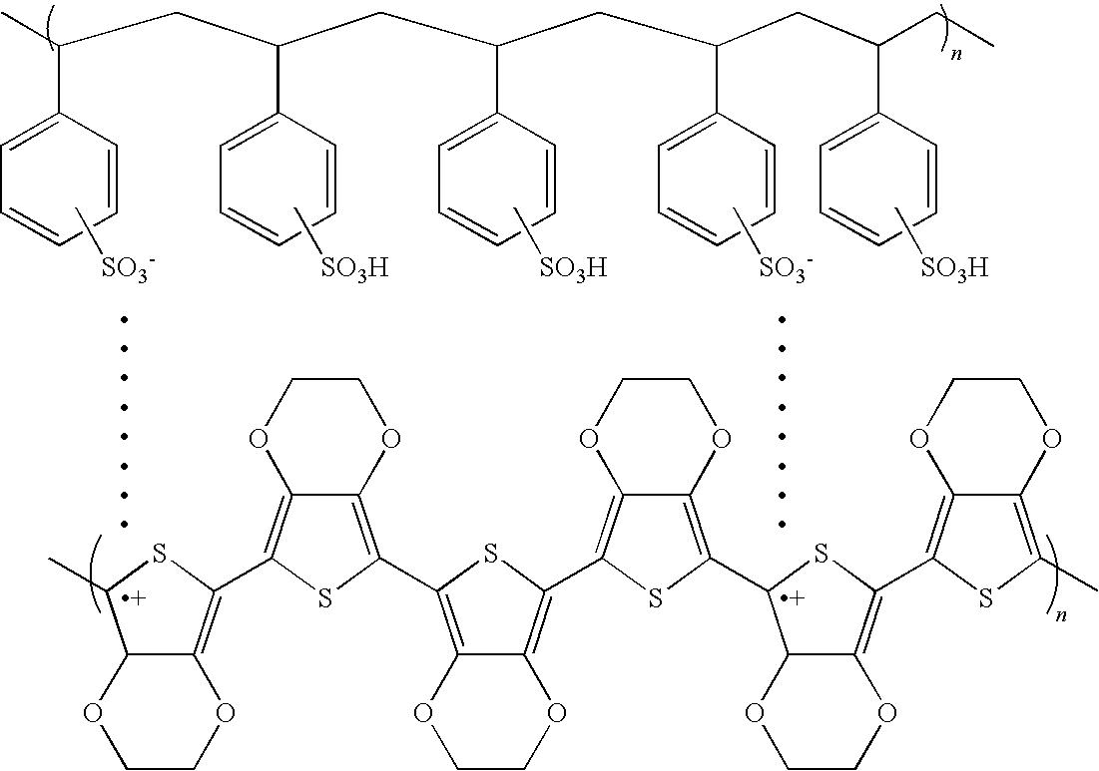
CONTACTING Molecularly passivated surface → soft contact
poly(3,4-ethylenedioxythiophene)
and poly(styrenesulfonate) (PEDOT:PSS)
Transparent in the visible and IR range (T > 90%)
High (5 eV) WF → invert n-Si?
Highly conductive (300-850 S/cm)
Deposit by soft methods such as spin coating or….
PEDOT:PSS
Organic monolayer
sc n-Si
mc n-Si

Slide 15
Lift-Off Float-On
PEDOT:PSS deposition by LOFO
PEDOT:PSS layer deposited and annealed on sacrificial substrate, then floated onto device
Avoids heating of device or exposing it to acidic solution
Deposit and anneal
PEDOT:PSS solution.
Partially dissolve substrate.
Float PEDOT onto H₂O.
Lift substrate onto film, pump under vacuum.

Slide 16
Energy band diagrams for inverted (a) and defect (b) interfaces
Notes:
Energy band diagram for (a) an inversion layer formed between PEDOT:PSS and n-Si,
and (b) the energy band alignment that results with a significant number of defects
at the Si – contact interface.

Slide 17
Barrier Height at MIS
J-V data – Thermionic Emission
E_{C}
Capacitance – Voltage
E_{f}
E_{g}=1.12eV
E_{V}
 | BH [±0.03V] From J-V | SBH [±0.01V] n –Si/ PEDOT:PSS THEORETICAL SBH= V_{bi} + ζ *
sc-Si <111> / Me styrene | 0.89 | 0.98
sc-Si <111> / ET | 0.83 | 0.98
sc-Si <100> /Methoxy |  | 0.98
sc-Si <111> /H | 0.84 | 0.98 | 0.88 NSLewis et al

Slide 18
Barrier Height at MIS
J-V data – Thermionic Emission
C-V data –capacitance of inversion layer
E_{C}
E_{C}
E_{f}
E_{f}
E_{g}=1.12eV
E_{g}=1.12eV
E_{V}
E_{V}
 | BH [±0.03V] From J-V | SBH [±0.01V] n –Si/ PEDOT:PSS theoretical value SBH= V_{bi} + ζ * | BH [±0.01V] From C-V
sc-Si <111> / Me styrene | 0.89 | 0.98 | 0.96
sc-Si <111> / ET | 0.83 | 0.98 | 0.98
sc-Si <100> /Methoxy | 0.86 | 0.98 | 0.90
sc-Si <111> /H | 0.84 | 0.98 | 0.91

Slide 19
Advantages of C-V measurement
Built-in voltage, depletion region width
Semiconductor carrier density
Density of interface defects
W
E_{c}-E_{f}
E
V_{bi}
E_{C}
E_{f}
X
E_{V}
Metal
Insulator
Si

Slide 20
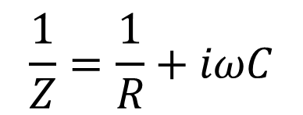
Equivalent circuits
n-Si/MML/PEDOT:PSS
C
R
$$\frac{1}{Z}=\frac{1}{R}+iωC$$

Slide 21
Equivalent circuits
n-Si/MML/PEDOT:PSS
E_{vac}
φ_{m} = 5.0 eV
C_{IL}
R_{IL}
φ_{b}
V_{bi}
E_{F}
PEDOT: PSS
IL
n-Si
$$\frac{1}{Z}=\frac{1}{R}+iωC$$

Slide 22
Built-in voltage (V_{bi}) from C-V @high ω
Notes:
Results of C(V) measurements for samples with different N_{D}, shown as A²/C² vs V.
The inset shows data for the highest doping sample, which are displayed on a different scale.
Each curve represents an average of 3 devices.

Slide 23
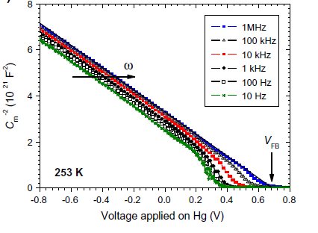
Built-in voltage (V_{bi}) from C-V @high ω
Slope N_{D}
Intercept with X-axis V_{FB}
B.Fabre C-V for n-Si –C18- Hg

Slide 24
Built-in voltage, V_{bi}, vs. N_{D}
A. Erickson et al. Adv. En. Mater. 2014

Slide 25
Barrier Height, φ_{B}, vs. N_{D}
Dark I-V curves for devices that were also measured by C(V).
Each curve is average of 2 (N_{D} = 8.9x10¹⁶ cm⁻³) or 3(all other) devices.
A. Erickson et al. Adv. En. Mater. 2014

Slide 26
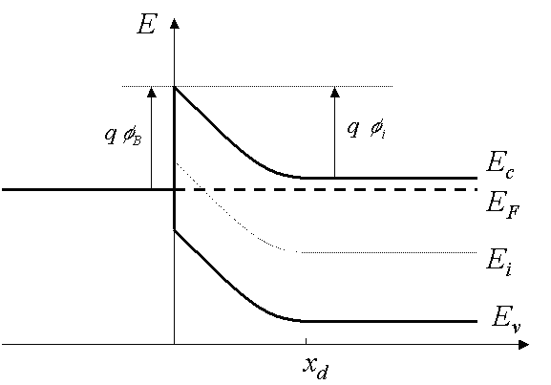
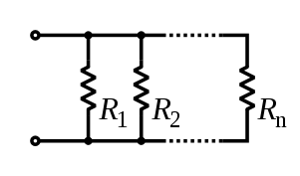

J-V vs. C-V data
Different bias regime (depletion vs. inversion)
Forward bias
Reverse bias
Different model system- coverage effect

Slide 27
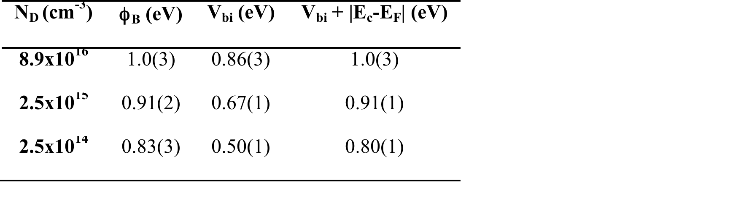
Effect of n-Si Doping Density
ϕ_{B} from fits to the linear ln(J) - V region; V_{bi} extracted from C(V); Theory: ϕ_{B} = V_{bi} + |E_{c} - E_{F}|.
Errors are standard deviations of fits to each individual sample.
A. Erickson et al. Adv. En. Mater. 2014

Slide 28
MIS junction modification with M=PEDOT:PSS
PEDOT:PSS
H
p-type IL
n-type Si <111>
MIS junction can reach theoretical limit
PEDOT:PSS
H
H
p-type IL
n-type Si <100>

Slide 29
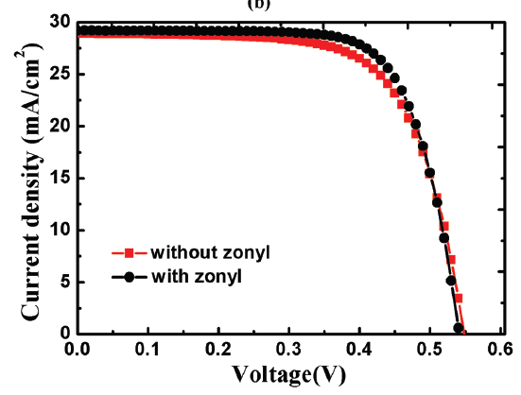
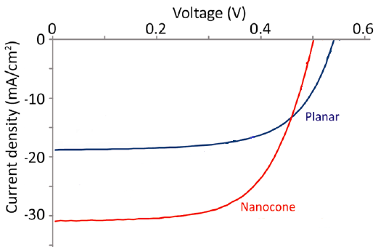
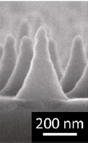
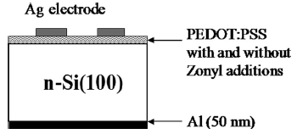
Si-Organic Schottky solar cells (cf. R. Har-Lavan, D. Cahen, “40 yr of inversion PV”, IEEE J. PV (2013)
Use high work function transparent organic as top contact to n-Si → strong inversion
PEDOT:PSS, PANI, or P3HT
Can be applied to variety of Si surface morphologies
Influence of PEDOT:PSS composition
Influence of Si morphology: nanocones
With 0.1% zonyl
h = 11.3%
h = 11.1%
Q. Liu, et al. APL . 100, 183901 (2012).
~12 % @ IEEE PVSC 6-2013 Nagamatsu ….. Sturm
S. Jeong, et al. Nano Lett. 12, 2971 (2012).

Slide 30
Si-Organic INVERSION solar cells
PEDOT:PSS contacts to Al₂O₃ inversion layer devices
Strong inversion layer by oxide interface charges, contact via PEDOT:PSS
Soft PEDOT:PSS deposition compatible with inversion-inducing molecular dipole layer
H or Me-styrene passivation
PEDOT:PSS
Oxide charge
-
-
-
-
-
-
-
-
-
-
-
-
-
-
Interface dipole effect
+
+
+
+
+
+
+
+
+
+
+
+
+
+
Inversion layer
n-type Si
h = 8.4%
10¹⁴ cm⁻³
Erickson et al.,APL 101, 233901 (2012);

Slide 31
Si-Organic INVERSION solar cells
PEDOT:PSS – n-Si solar cell under 1 sun illumination
V_{oc} = 0.56(1) V J_{sc} = 26.1(5) mA cm⁻² η = 10.4(3)%

Slide 32
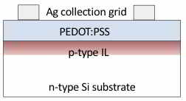
Si-Organic INVERSION solar cells
sc-Si /MML / PEDOT:PSS
Si-H/ PEDOT:PSS PV devices as good as best
Si-MML/ PEDOT:PSS ones (but less stable…)
Br styrene
double diode
Me styrene and Si- H
Voc = 0.58 V
Isc = 32 mA/cm²
FF = 65 %
η ≥ 12%

Slide 33
Conclusions
Characterization of energy band alignment @MIS interface is essential for electronic properties analysis.
BH measured by C-V can highlight molecular effect.
Si <111> /MML / PEDOT:PSS interface presents maximum inversion(E_{V}=E_{F}).
For Si <100> interface only strong inversion reached .
Surface reactivity can play important role for MIS junction
Inversion Si PV device reaches 12.5% solar to electrical conversion
mc-Si WF can be modified by molecular monolayer.
but as yet no WF tuning @MIS interface; → challenge for future
mixed orientation and rough surface of mc-Si can result in low coverage.

Slide 34
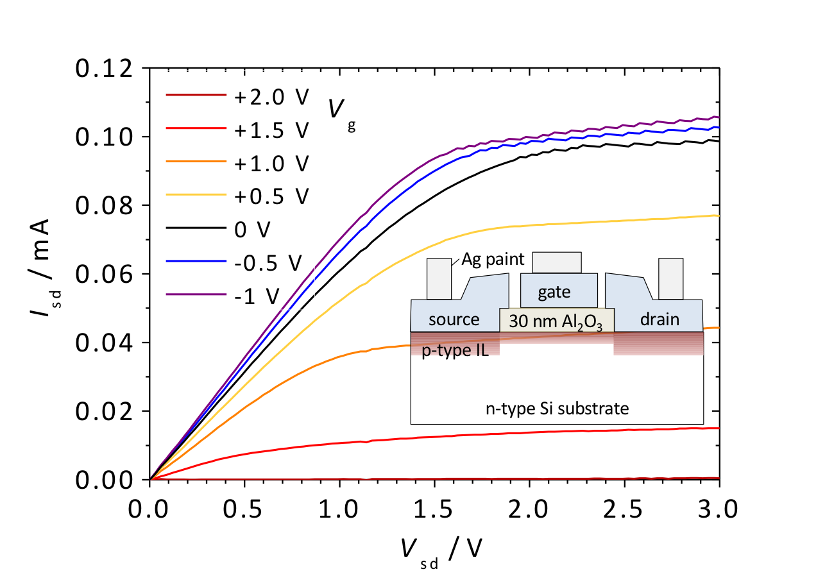
Results of measurements on transistor test devices, used to determine mobility in the
channel under the Al₂O₃ gate dielectric. I_{sd} is shown as a function of V_{sd}, for different values
of V_{g}. Leakage current has been subtracted uniformly.
The inset shows a schematic of the device, where source, gate, and drain electrodes,
shown in blue, are all PEDOT:PSS.

