Slide 1
Distributed Graph Algorithms
Spring 2021
Class 1: Introduction + Tree Coloring

Slide 2
Administrative details
Hybrid teaching (after Passover)
~ 4-5 exercises
Home exam \ final assignment
TA: Avi Cohen (avi.cohen@Weizmann.ac.il)
Course webpage: https://www.weizmann.ac.il/math/parter/courses/distributed-graph-algorithms-s2021

Slide 3


Distributed Graph Algorithms
Network is modeled as a graph
$n$ nodes with unique identifiers
Initially each node knows:
Its ID and IDs of its neighbors
Synchronous rounds:
Each node/computer does some internal computation
Send a message to each neighbor
Receive message from each neighbor
8
5
7
3
2

Slide 4

Distributed Graph Algorithms
Network is modeled as a graph
$n$ nodes with unique identifiers
Complexity measures:
Number of rounds
Number of messages \ bits
8
5
7
3
2
time complexity $=$ number of rounds

Slide 5

Slide by Fabian Kuhn
Objective: solve some graph problem on the network graph
12
9
21
15
20
1
8
4
11
3
16
2
17
5
At the start: Each node knows its own ID+ neighbors IDs, and nothing else about the topology
At the end: Each node knows its part of the output (e.g., its color)
time complexity $=$ number of rounds

Slide 6




Distributed vs. Centralized Algorithms
Centralized Setting
Distributed Setting
Shortest
path
$$G$$
Min. cut
Computation time
Communication rounds

Slide 7



Distributed vs. Centralized Algorithms
Centralized Setting
Distributed Setting
Shortest
path
$$G$$
Min. cut
$$s$$
$$t$$
Computation time
Communication rounds

Slide 8


Two Types of Orthogonal Challenges
Locality (symmetry breaking)
$$u$$
$$v$$
Using IDs
Randomization

Slide 9
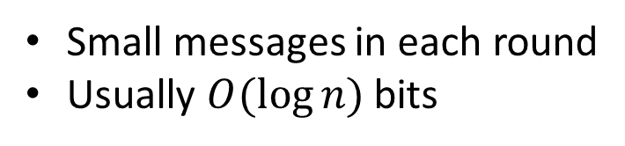
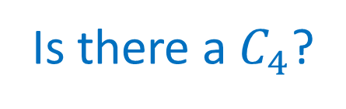
Two Types of Orthogonal Challenges
Congestion (Bandwidth Limitation)
8
5
Small messages in each round
Usually $O(\log{n)}$bits
7
3
2
Is there a $C_{4}$?

Slide 10
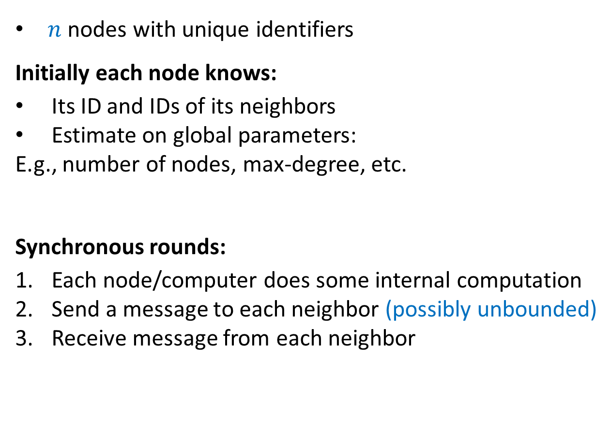
Unbounded internal computation & message size
The LOCAL Model (Linial, FOCS ‘87)
$n$ nodes with unique identifiers
Initially each node knows:
Its ID and IDs of its neighbors
Estimate on global parameters:
E.g., number of nodes, max-degree, etc.
Synchronous rounds:
Each node/computer does some internal computation
Send a message to each neighbor (possibly unbounded)
Receive message from each neighbor
8
5
7
3
2

Slide 11

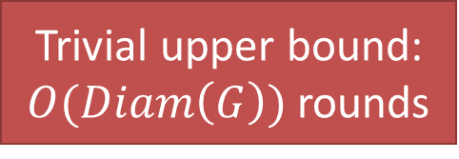
The LOCAL Model
Slide by Fabian Kuhn
$$v$$
Trivial upper bound:
$O(Diam\left(G\right))$ rounds
$r$-Round Algorithm:
Each node computes its output as a function of the initial state of its $r$-neighborhood

Slide 12
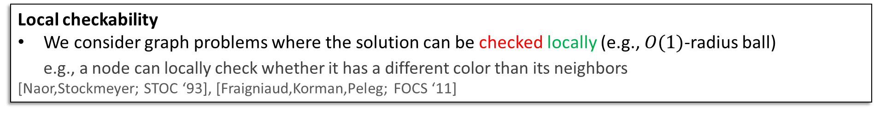
Local Graph Algorithms
Slides by Fabian Kuhn
Objective: solve some graph problem on the network graph
12
9
21
15
20
1
8
4
11
3
16
2
17
5
At the start: Each node knows its own ID and nothing else about the topology
At the end: Each node knows its part of the output (e.g., its color)
Local checkability
We consider graph problems where the solution can be checked locally (e.g., $O(1)$-radius ball)
e.g., a node can locally check whether it has a different color than its neighbors
[Naor,Stockmeyer; STOC ‘93], [Fraigniaud,Korman,Peleg; FOCS ‘11]

Slide 13
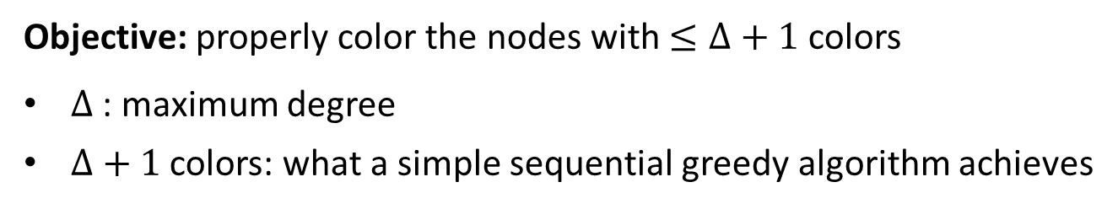

LOCAL Problems (Examples)
Slide by Fabian Kuhn
$\left(Δ+1\right)$-Vertex Coloring
Objective: properly color the nodes with $≤Δ+1$ colors
$Δ$ : maximum degree
$Δ+1$ colors: what a simple sequential greedy algorithm achieves

Slide 14
LOCAL Problems (Examples)
Slide by Fabian Kuhn
Maximal Independent Set (MIS)
Objective: compute a maximal independent set (MIS)
Non-extendible set of pairwise non-adjacent nodes
Trivial to compute sequentially

Slide 15
Slide by Fabian Kuhn
LOCAL Problems (Examples)
Maximal Matching
Objective: compute a maximal matching
Non-extendible set of pairwise non-adjacent edges
A maximal matching is an MIS of the line graph

Slide 16


Challenges in the LOCAL Model
Slide by Fabian Kuhn
Symmetry Breaking / Local Coordination
Neighboring / nearby nodes need to output different values
  e.g., different colors, at most one can be in an MIS, etc.
Nodes need to decide in parallel
$$u$$
$$v$$
Key Challenge: locally coordinate among nearby nodes
randomization naturally helps (e.g., choose color at random)

Slide 17
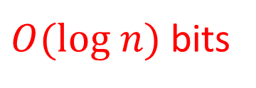
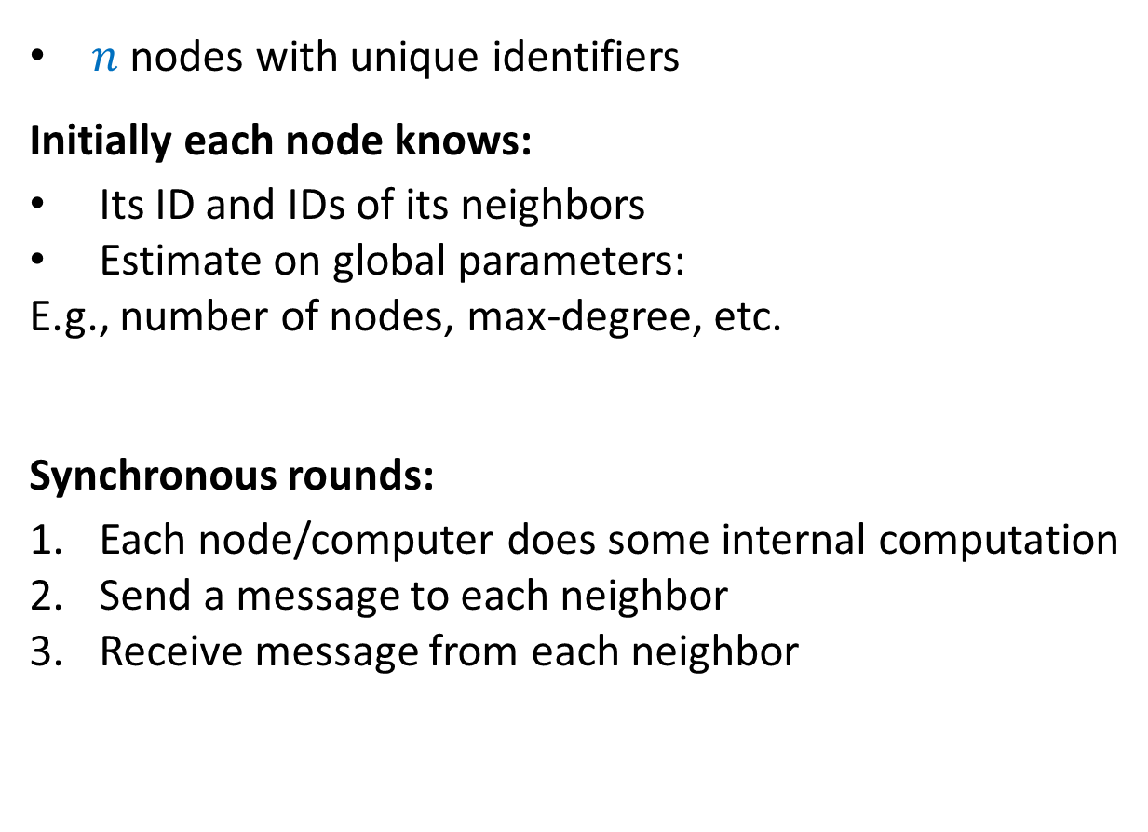
Unbounded internal computation & message size $O(log n)$
The CONGEST Model (Peleg ‘90)
$n$ nodes with unique identifiers
Initially each node knows:
Its ID and IDs of its neighbors
Estimate on global parameters:
E.g., number of nodes, max-degree, etc.
Synchronous rounds:
Each node/computer does some internal computation
Send a message to each neighbor
Receive message from each neighbor
8
5
7
3
2
$O(log n)$ bits

Slide 18
Distributed Graph Problems
LOCAL Model
CONGEST Model
1. Local Problems
Vertex Coloring
Maximal Independent Set
Maximal Matching
Ruling Sets
…
2. Global Problems
Minimum Spanning Tree
Shortest Path
Minimum Cut
Maximum Flow
…
Notes:
2 minute

Slide 19
Next: Coloring Trees with 3 Colors!

