Slide 1
Succinct Graph Structures and Their Applications
Spring 2020
Class 2: Additive Spanners

Slide 2

Outline
Additive Spanners: state-of-the-art
Hitting Sets
+2 Additive Spanners
+4 Additive Spanners
$(1+ε,β)$ Spanners

Slide 3
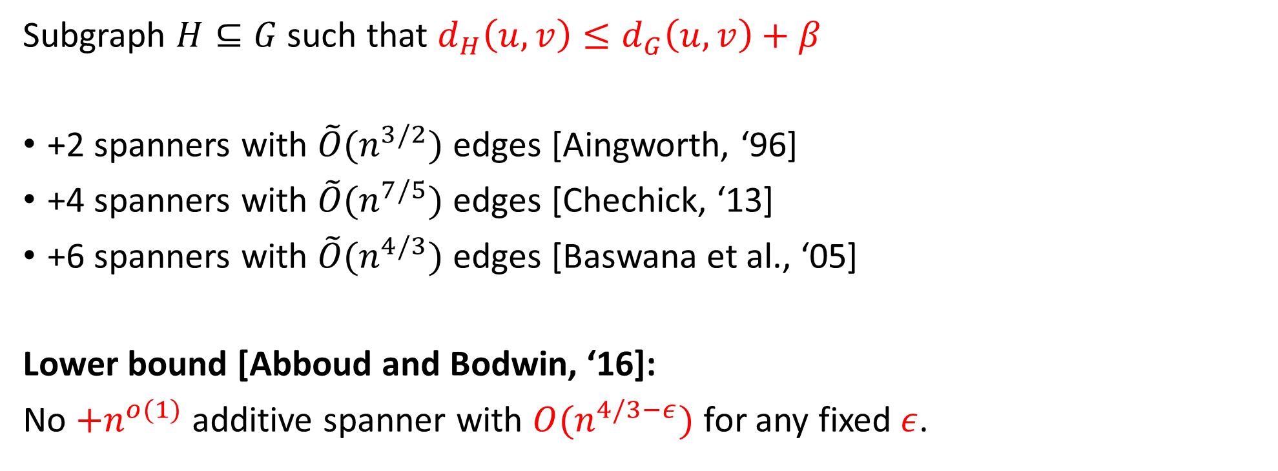
Additive Spanners
Subgraph $H⊆G$such that $d_{H}\left(u,v\right)≤d_{G}\left(u,v\right)+β$
+2 spanners with $\tilde{O}(n^{3/2})$ edges [Aingworth, ‘96]
+4 spanners with $\tilde{O}(n^{7/5})$ edges [Chechick, ‘13]
+6 spanners with $\tilde{O}(n^{4/3})$ edges [Baswana et al., ‘05]
Lower bound [Abboud and Bodwin, ‘16]:
No $+n^{o(1)}$ additive spanner with $O(n^{4/3−ε})$ for any fixed $ε$.

Slide 4
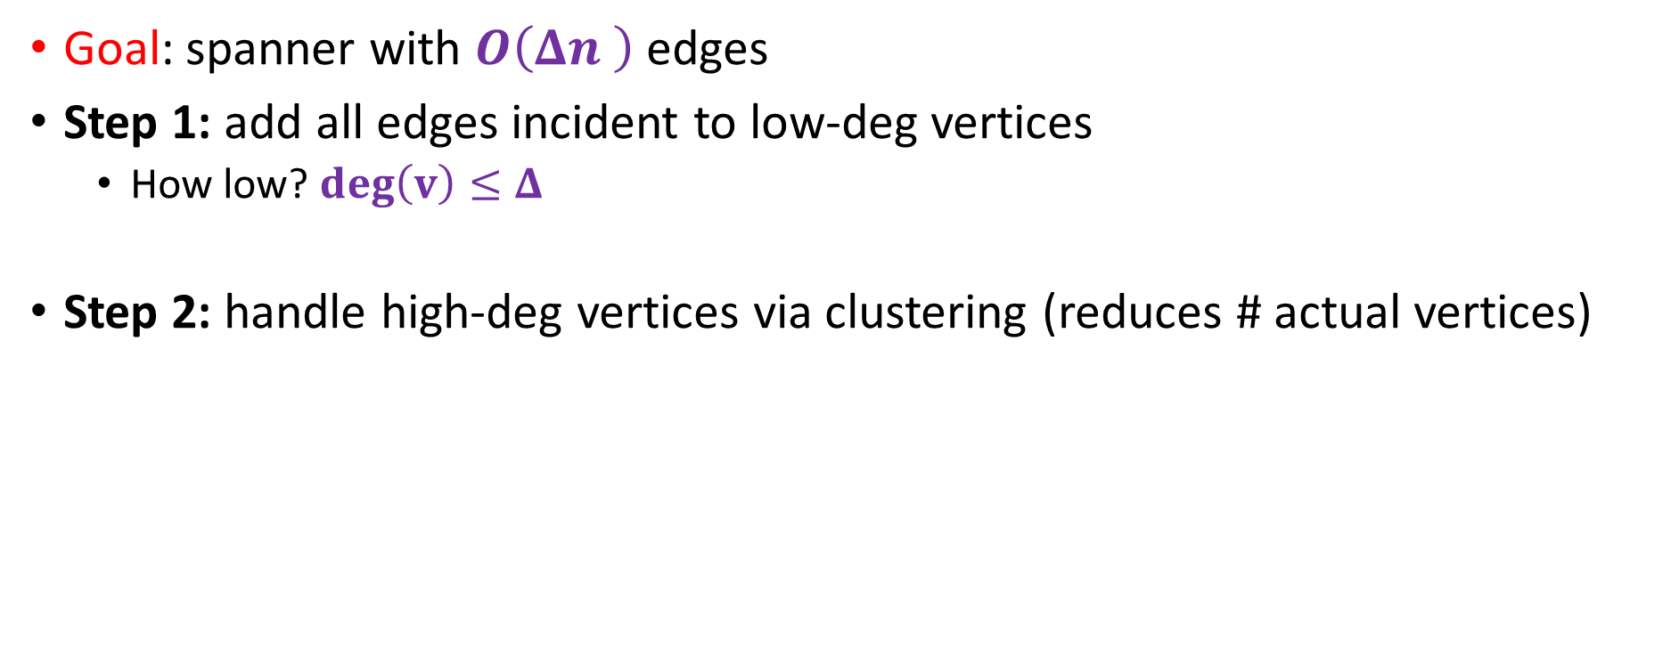
Recurrent Pattern in Spanner Algorithm
Goal: spanner with $O\left(Δn \right)$ edges
Step 1: add all edges incident to low-deg vertices
  How low? $\deg\left(v\right)≤Δ$
Step 2: handle high-deg vertices via clustering (reduces # actual vertices)

Slide 5
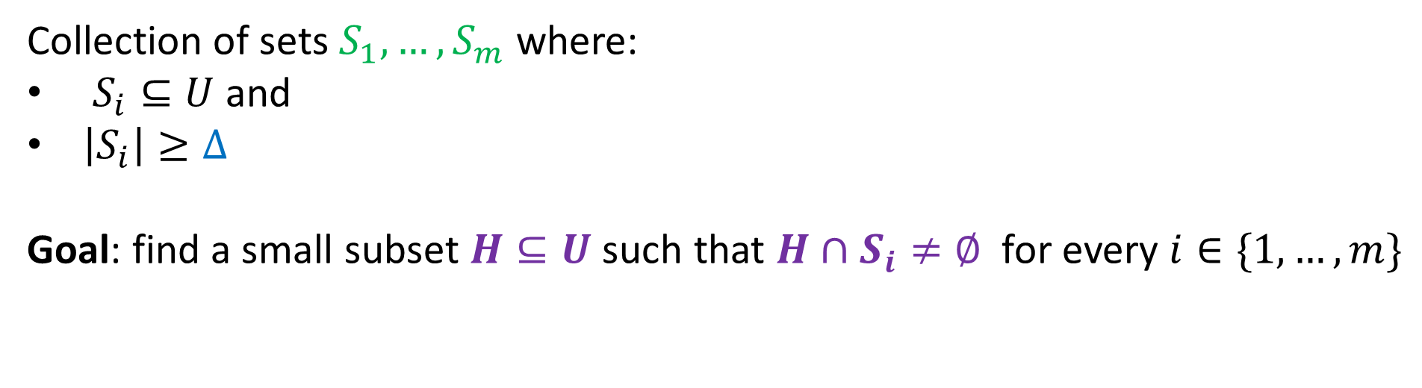




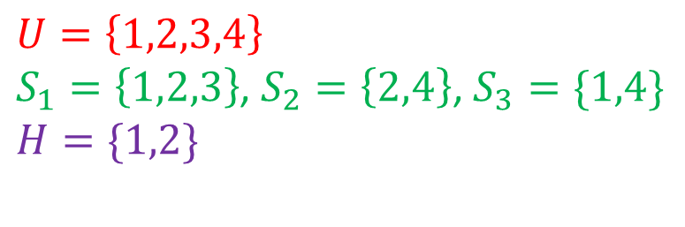
Hitting Sets
Universe: $U=\{u_{1},u_{2},…, u_{n}\}$
Collection of sets $S_{1},…, S_{m}$ where:
$S_{i}⊆U$ and
$\left|S_{i}\right|≥Δ$
Goal: find a small subset $H⊆U$such that $H∩S_{i}≠∅$ for every $i∈\{1,…, m\}$
$$S_{1}$$
$$S_{2}$$
$$S_{3}$$
$$U=\left\{1,2,3,4\right\}$$
$S_{1}=\left\{1,2,3\right\}$, $S_{2}=\left\{2,4\right\}$, $S_{3}=\{1,4\}$
$$H=\{1,2\}$$
1
2
3
4

Slide 6
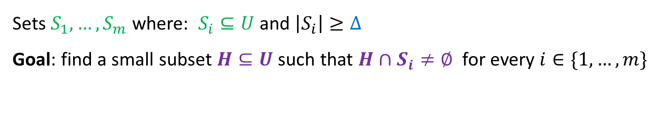

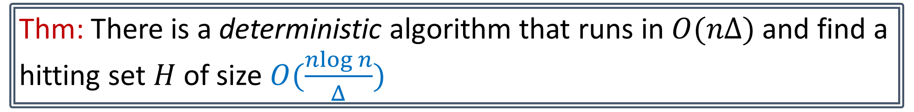
Hitting Sets
Universe: $U=\{u_{1},u_{2},…, u_{n}\}$
Sets $S_{1},…, S_{m}$ where: $S_{i}⊆U$ and $\left|S_{i}\right|≥Δ$
Goal: find a small subset $H⊆U$such that $H∩S_{i}≠∅$ for every $i∈\{1,…, m\}$
Hitting set
Thm: There is a deterministic algorithm that runs in $O(nΔ)$ and find a hitting set $H$ of size $O(\frac{nlog n}{Δ})$

Slide 7
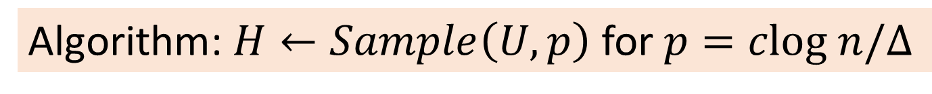
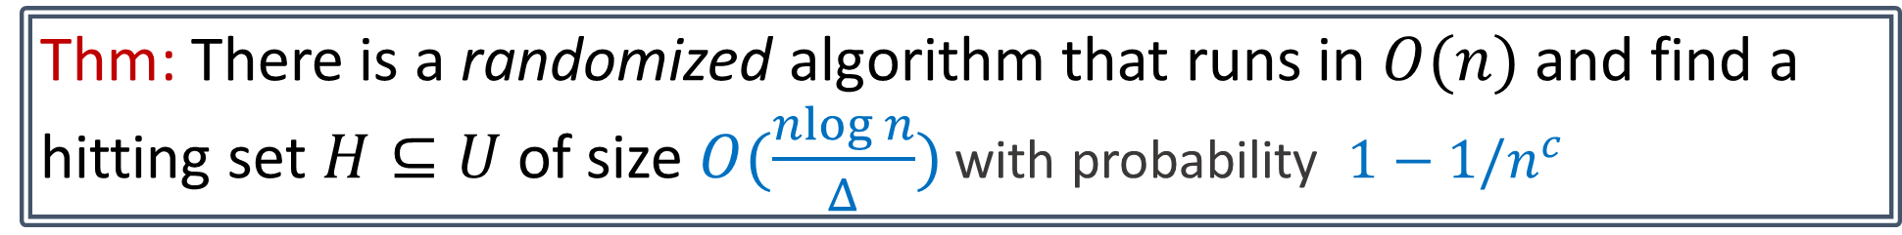
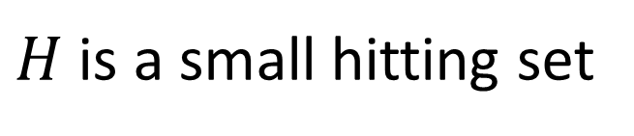
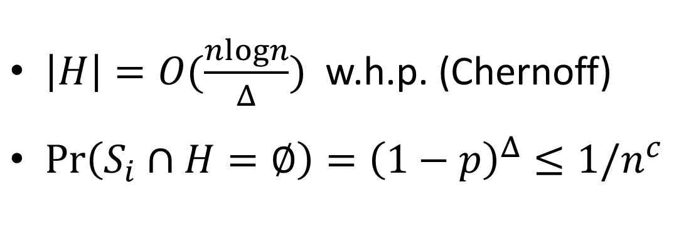
Hitting Sets
Thm: There is a randomized algorithm that runs in $O(n)$ and find a hitting set $H⊆U$ of size $O(\frac{nlog n}{Δ})$ with probability $1−1/n^{c}$
Algorithm: $H←Sample\left(U, p\right)$ for $p=clog n/Δ$
$\left|H\right|=O(\frac{nlogn}{Δ})$ w.h.p. (Chernoff)
$\operatorname{Pr}\left(S_{i}∩H=∅\right)={\left(1−p\right)}^{Δ}≤1/n^{c}$
$H$ is a small hitting set

Slide 8
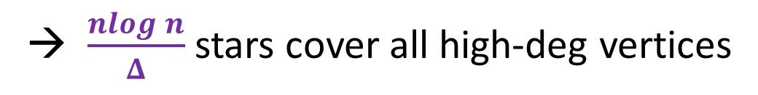

Hitting Set Instance:
  Universe: $V$
  Sets: $N\left(u_{1}\right),…, N(u_{n})$
Goal: hit all vertices of degree $≥Δ$
Solution: sample $nlog n/Δ$ vertices
high-deg vertices
→ $\frac{nlog n}{Δ}$ stars cover all high-deg vertices

Slide 9
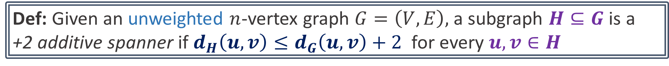
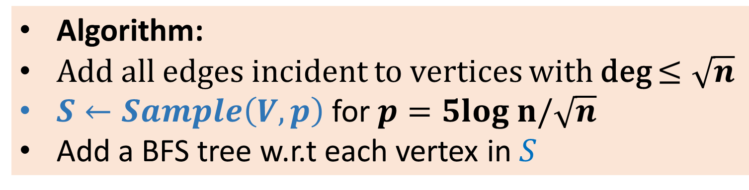
+2 Additive Spanners
Def: Given an unweighted $n$-vertex graph $G=\left(V,E\right),$a subgraph $H⊆G$ is a
+2 additive spanner if $d_{H}\left(u,v\right)≤d_{G}\left(u,v\right)+2$ for every $u,v∈H$
Thm: Every $n$-vertex graph $G$has a +2 additive spanner $H$ with $\tilde{O}(n^{3/2})$ edges.
Algorithm:
Add all edges incident to vertices with deg $≤\sqrt{n}$
$S←Sample\left(V, p\right)$ for $p=5log n/\sqrt{n}$
Add a BFS tree w.r.t each vertex in $S$

Slide 10
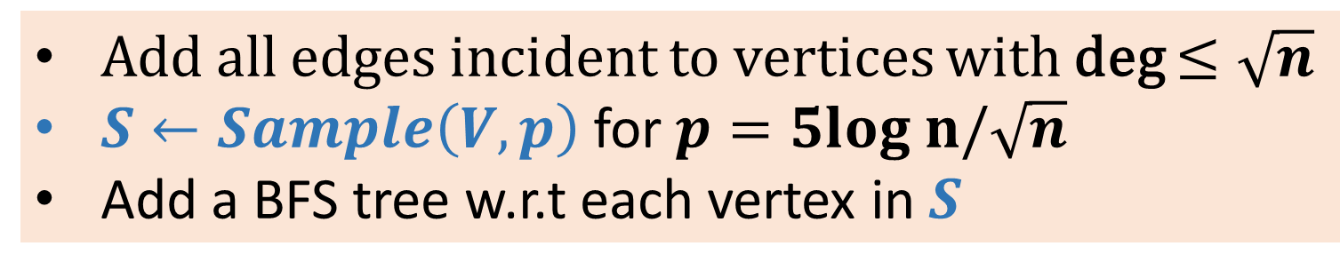
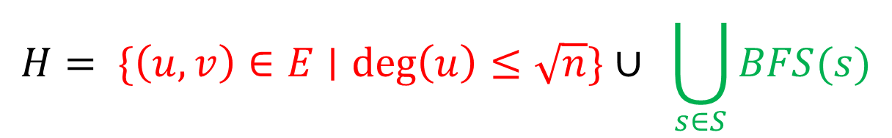
Add all edges incident to vertices with deg $≤\sqrt{n}$
$S←Sample\left(V, p\right)$ for $p=5log n/\sqrt{n}$
Add a BFS tree w.r.t each vertex in $S$
$$H= \{\left(u,v\right)∈E∣\deg\left(u\right)≤\sqrt{n}\}∪ \bigcup_{s∈S}{BFS(s)}$$
Low-deg edges
Hitting-set trees
Claim [Size]: $\left|E\left(H\right)\right|=O(n^{3/2}\log{n})$ edges w.h.p.

Slide 11



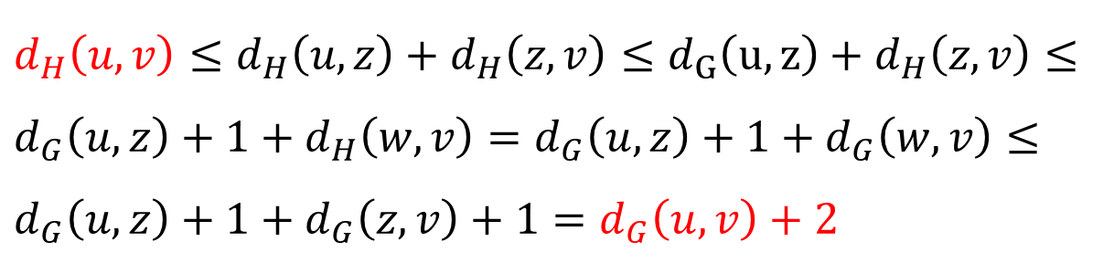




Add all edges incident to vertices with deg $≤\sqrt{n}$
$S←Sample\left(V, p\right)$ for $p=5log n/\sqrt{n}$
Add a BFS tree w.r.t each vertex in $S$
Claim [Stretch]: $dist_{H}\left(u,v\right)≤dist_{G}\left(u,v\right)+2$
$$d_{H}\left(u,v\right)≤d_{H}\left(u,z\right)+d_{H}\left(z,v\right)≤d_{G}\left(u,z\right)+d_{H}\left(z,v\right)≤$$
$$d_{G}\left(u,z\right)+1+d_{H}\left(w,v\right)=d_{G}\left(u,z\right)+1+d_{G}\left(w,v\right)≤$$
$$d_{G}\left(u,z\right)+1+d_{G}\left(z,v\right)+1=d_{G}\left(u,v\right)+2$$
$$z$$
$$ℓ$$
$$u$$
$$v$$
$$1$$
$$w$$
$$≤ℓ+1$$

Slide 12
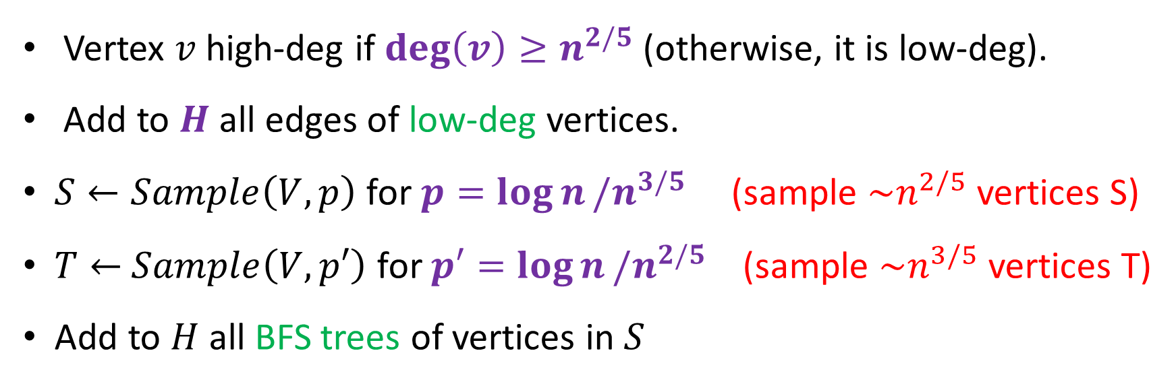
+4 Additive Spanners
Theorem: Every $n$-vertex graph $G$has a +4 spanner $H$ with $\tilde{O}(n^{7/5})$ edges.
Vertex $v$ high-deg if $\deg\left(v\right)≥n^{2/5}$ (otherwise, it is low-deg).
Add to $H$ all edges of low-deg vertices.
$S←Sample\left(V, p\right)$for $p=\log{n}/n^{3/5}$ (sample $\sim n^{2/5}$vertices S)
$T←$ $Sample\left(V, p′\right)$ for $p′=\log{n}/n^{2/5}$ (sample $\sim n^{3/5}$vertices T)
Add to $H$ all BFS trees of vertices in $S$
Hitting set of
high-deg

Slide 13
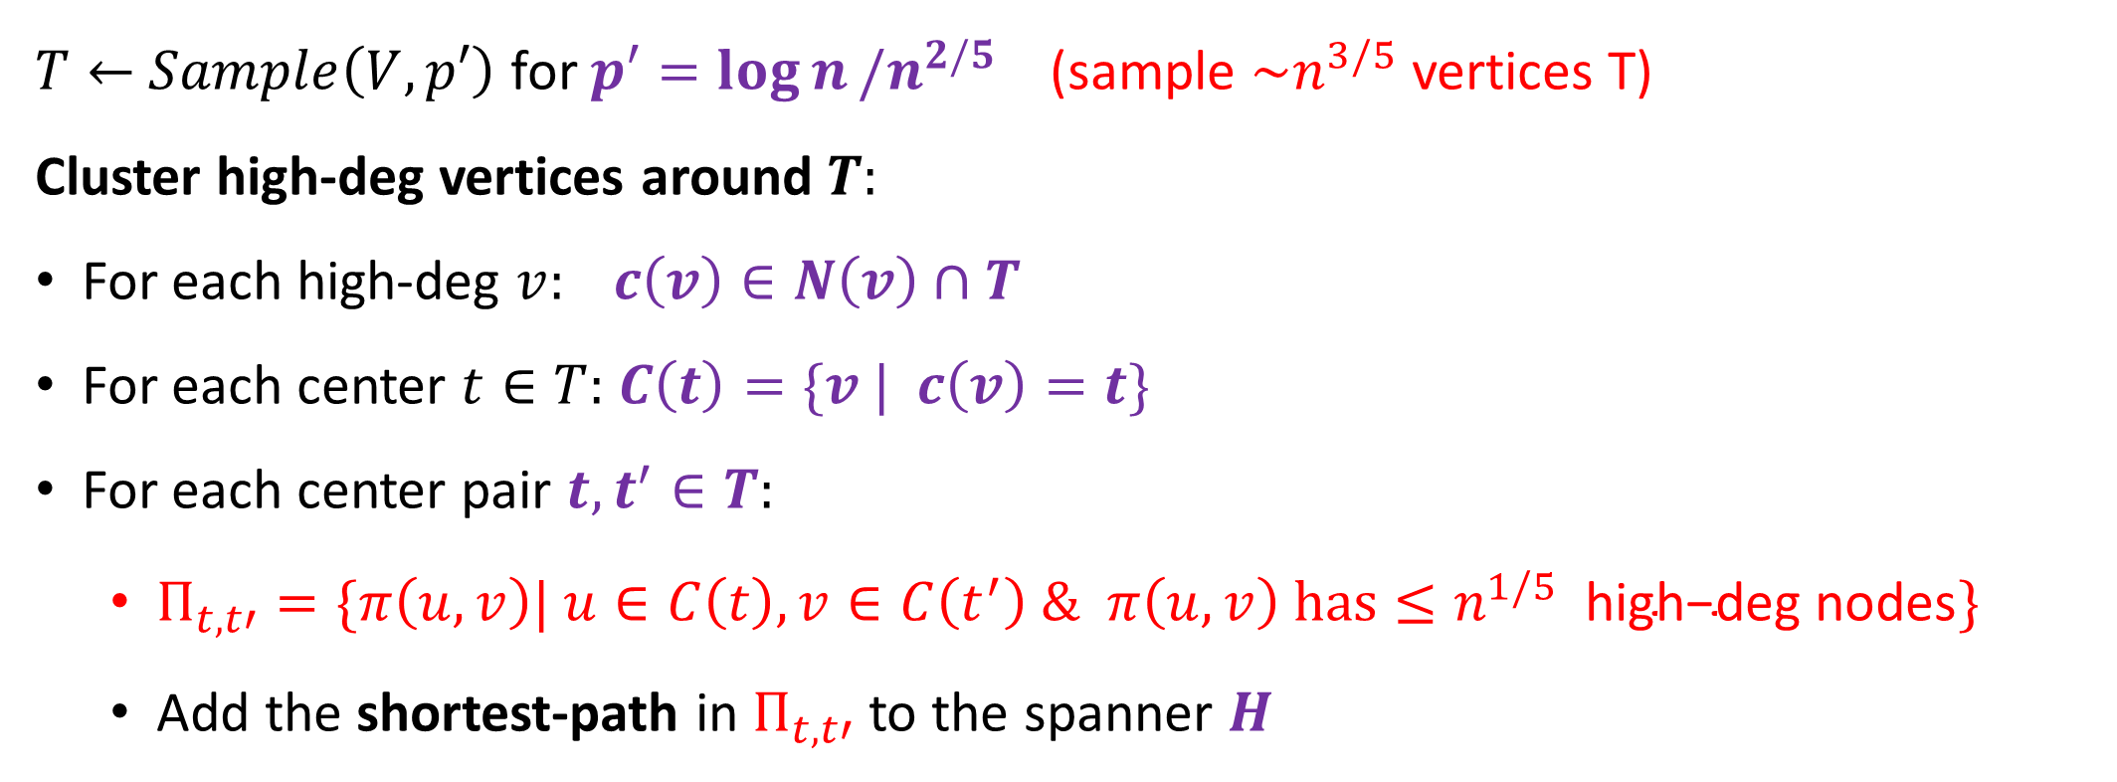
+4 Additive Spanners
$T←$ $Sample\left(V, p′\right)$ for $p′=\log{n}/n^{2/5}$ (sample $\sim n^{3/5}$vertices T)
Cluster high-deg vertices around $T:$
For each high-deg $v: c\left(v\right)∈N\left(v\right)∩T$
For each center $t∈T:$ $C\left(t\right)=\{v | c\left(v\right)=t\}$
For each center pair $t,t^{′}∈T:$
  $Π_{t,t′}=\{π\left(u,v\right)| u∈C\left(t\right), v∈C\left(t^{′}\right) \& π\left(u,v\right) has≤n^{1/5} \text{high}\text{−}\text{deg} \text{nodes}\}$
  Add the shortest-path in $Π_{t,t′}$ to the spanner $H$
Hitting set of
high-deg

Slide 14
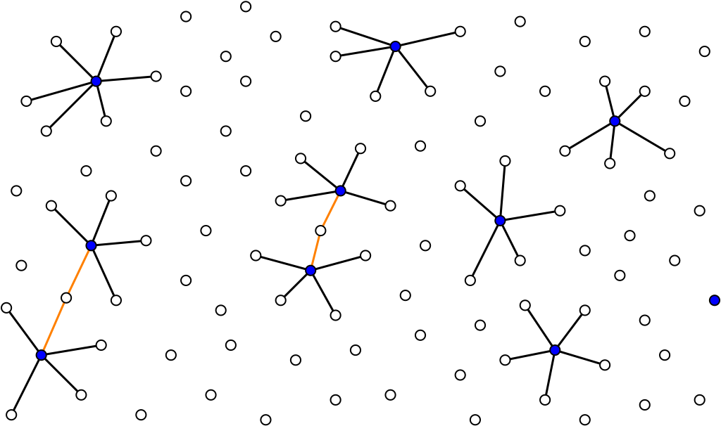


$$t′$$
$$t$$

Slide 15

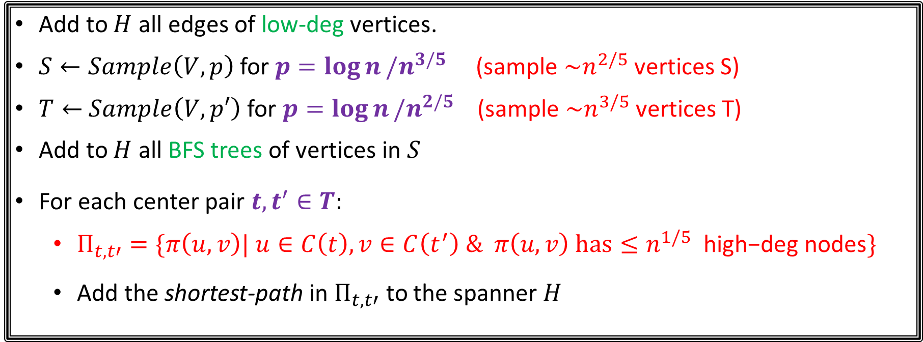
+4 Additive Spanner
Add to $H$ all edges of low-deg vertices.
$S←Sample\left(V, p\right)$for $p=\log{n}/n^{3/5}$ (sample $\sim n^{2/5}$vertices S)
$T←$ $Sample\left(V, p′\right)$ for $p=\log{n}/n^{2/5}$ (sample $\sim n^{3/5}$vertices T)
Add to $H$ all BFS trees of vertices in $S$
For each center pair $t,t^{′}∈T:$
  $Π_{t,t′}=\{π\left(u,v\right)| u∈C\left(t\right), v∈C\left(t^{′}\right) \& π\left(u,v\right) has≤n^{1/5} \text{high}\text{−}\text{deg} \text{nodes}\}$
  Add the shortest-path in $Π_{t,t′}$ to the spanner $H$
Lemma [Size]: $\left|E\left(H\right)\right|=\tilde{O} (n^{7/5})$ edges

Slide 16
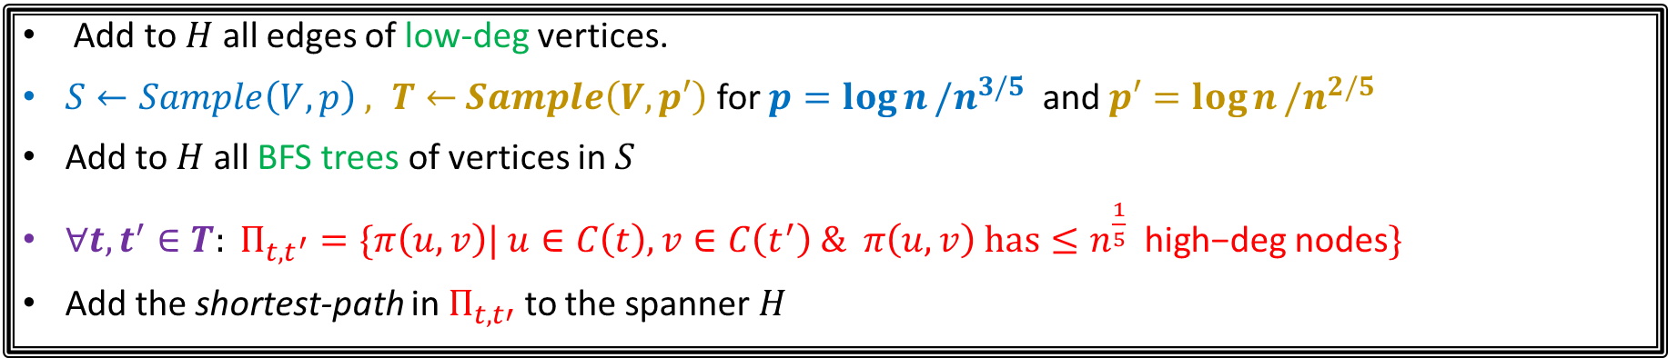
+4 Additive Spanner (Stretch)
Add to $H$ all edges of low-deg vertices.
$S←Sample\left(V, p\right) , T←$ $Sample\left(V, p′\right)$ for $p=\log{n}/n^{3/5}$ and $p′=\log{n}/n^{2/5}$
Add to $H$ all BFS trees of vertices in $S$
$∀t,t^{′}∈T: Π_{t,t^{′}}=\{π\left(u,v\right)| u∈C\left(t\right), v∈C\left(t^{′}\right) \& π\left(u,v\right) has≤n^{\frac{1}{5}} \text{high}\text{−}\text{deg} \text{nodes}\}$
Add the shortest-path in $Π_{t,t′}$ to the spanner $H$
Case 1: $π(u,v)$ has more than $n^{1/5}$high-deg vertices
Case 2: $π(u,v)$ has less than $n^{1/5}$high-deg vertices

Slide 17




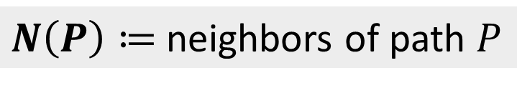

Case 1: $P=π(u,v)$ has more than $n^{1/5}$high-deg vertices
Deg > $n^{2/5}$
$$u$$
$$v$$
$N\left(P\right)≔$neighbors of path $P$
Claim: $\left|N\left(P\right)\right|=Ω\left(n^{3/5}\right)$
Proof: vertices at distance at least 3 on P
do not have a mutual neighbor
$$S∩N\left(P\right)≠∅$$

Slide 18
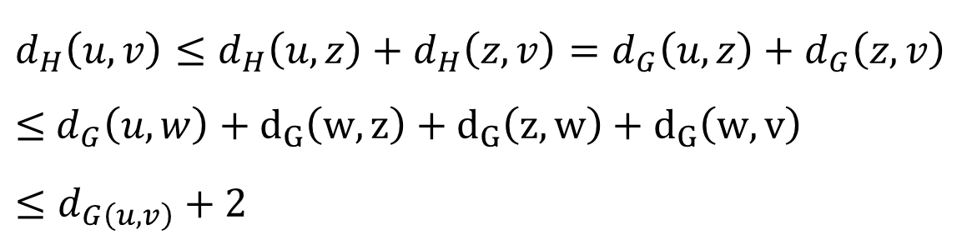





Case 1: $P=π(u,v)$ has more than $n^{1/5}$high-deg vertices
Deg > $n^{2/5}$
$$w$$
$$u$$
$$v$$
$$z∈S$$
$d_{H}\left(u,v\right)≤d_{H}\left(u,z\right)+d_{H}\left(z,v\right)=d_{G}\left(u,z\right)+d_{G}\left(z,v\right)$
$≤$ $d_{G}\left(u,w\right)+d_{G}\left(w,z\right)+d_{G}\left(z,w\right)+d_{G}\left(w,v\right)$
$$≤d_{G\left(u,v\right)}+2$$
(BFS tree of z in H)

Slide 19
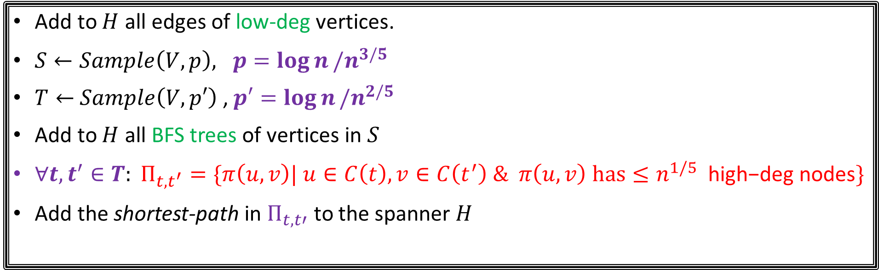
+4 Additive Spanner (Stretch)
Add to $H$ all edges of low-deg vertices.
$S←Sample\left(V, p\right), p=\log{n}/n^{3/5}$
$T←$ $Sample\left(V, p′\right)$ ,$p′=\log{n}/n^{2/5}$
Add to $H$ all BFS trees of vertices in $S$
$∀t,t^{′}∈T: Π_{t,t^{′}}=\{π\left(u,v\right)| u∈C\left(t\right), v∈C\left(t^{′}\right) \& π\left(u,v\right) has≤n^{1/5} \text{high}\text{−}\text{deg} \text{nodes}\}$
Add the shortest-path in $Π_{t,t′}$ to the spanner $H$
Hitting set for paths with many high-deg vertices
Hitting set for high-deg vertices
Case 1: $π(u,v)$ has more than $n^{1/5}$high-deg vertices
Case 2: $π(u,v)$ has less than $n^{1/5}$high-deg vertices

Slide 20
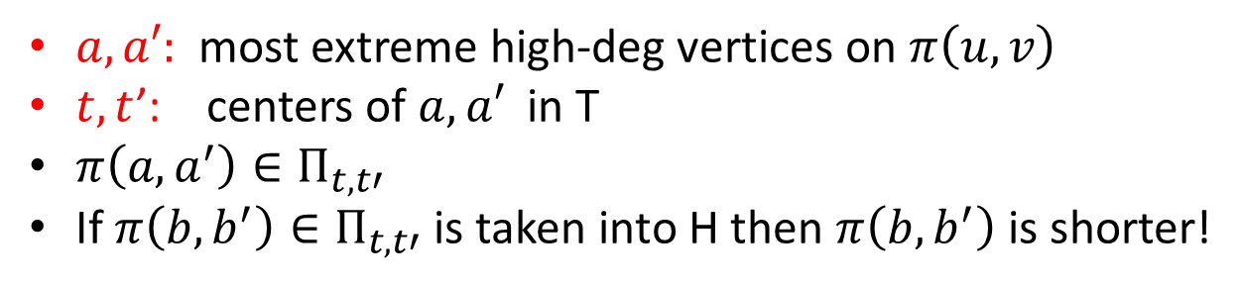










Case 2: $π(u,v)$ has less than $n^{1/5}$high-deg vertices
Deg > $n^{2/5}$
$$a$$
$$a′$$
$$u$$
$$v$$
$$t$$
$$t′$$
$$b$$
$$π(b,b^{′})$$
$$b′$$
$a, a′:$ most extreme high-deg vertices on $π\left(u,v\right)$
$t,t$’: centers of $a,a′$in T
$π\left(a,a^{′}\right)∈Π_{t,t′}$
If $π\left(b,b^{′}\right)∈Π_{t,t′}$ is taken into H then $π\left(b,b^{′}\right)$ is shorter!

Slide 21
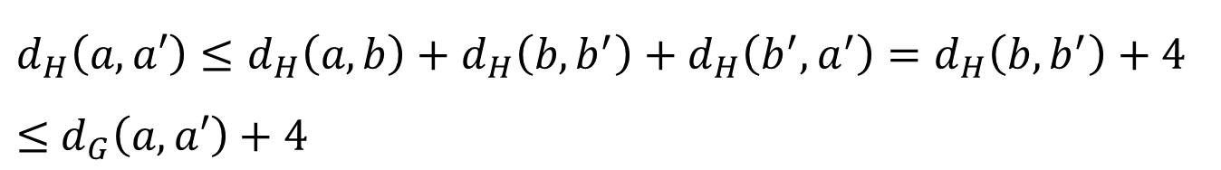
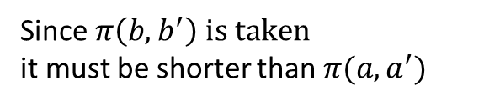
Case 2: $P=π(u,v)$ has less than $n^{1/5}$high-deg vertices
Deg > $n^{2/5}$
$$a$$
$$a′$$
$$u$$
$$v$$
$$t$$
$$t′$$
$$b$$
$$π(b,b^{′})$$
$$b′$$
$$d_{H}\left(a,a′\right)≤d_{H}\left(a,b\right)+d_{H}\left(b,b^{′}\right)+d_{H}\left(b^{′},a^{′}\right)=d_{H}\left(b,b^{′}\right)+4$$
$≤$ $d_{G}\left(a,a′\right)+4$
Since $π\left(b,b^{′}\right) is taken$
it must be shorter than $π(a,a^{′})$

Slide 22
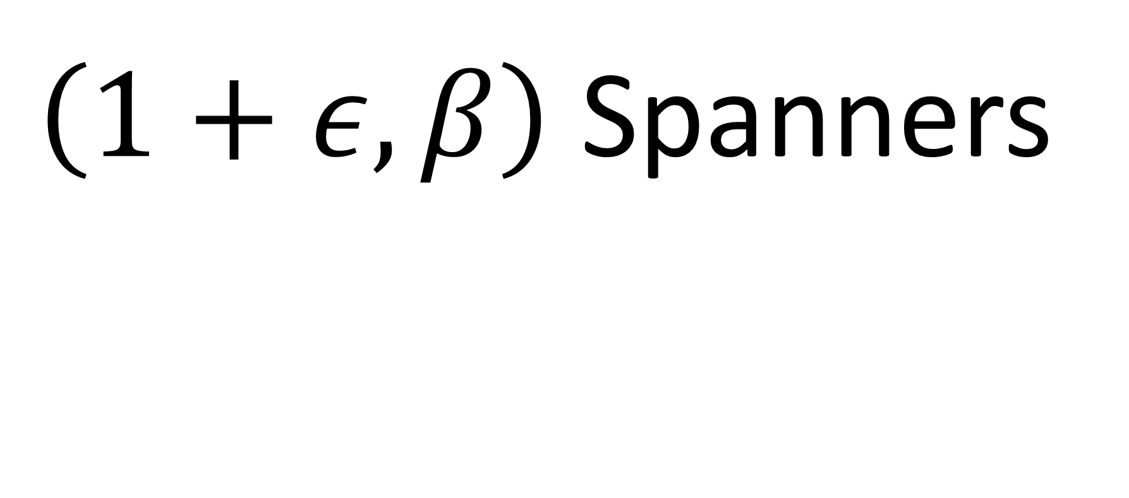
$\left(1+ε,β\right)$ Spanners

Slide 23
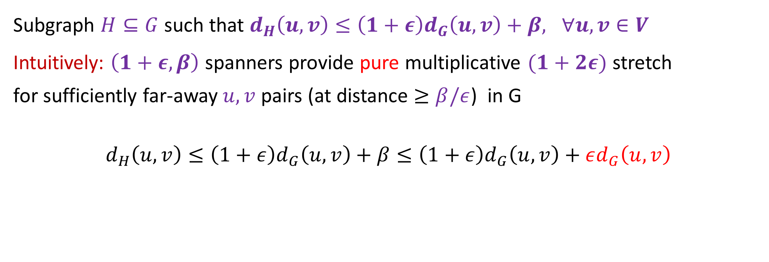
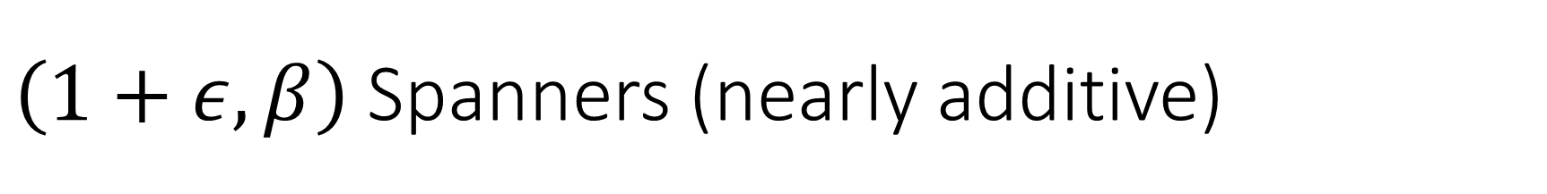

$\left(1+ε,β\right)$Spanners (nearly additive)
Subgraph $H⊆G$ such that $d_{H}\left(u,v\right)≤{\left(1+ε\right)d}_{G}\left(u,v\right)+β, ∀u,v∈V$
Intuitively: $\left(1+ε,β\right)$ spanners provide pure multiplicative $(1+2ε)$ stretch
for sufficiently far-away$u,v$ pairs (at distance $≥β/ε$) in G
$$d_{H}\left(u,v\right)≤\left(1+ε\right)d_{G}\left(u,v\right)+β≤\left(1+ε\right)d_{G}\left(u,v\right)+εd_{G}\left(u,v\right)$$
$$d_{G}\left(u,v\right)≥β/ε$$
Near-exact for far pairs!

Slide 24
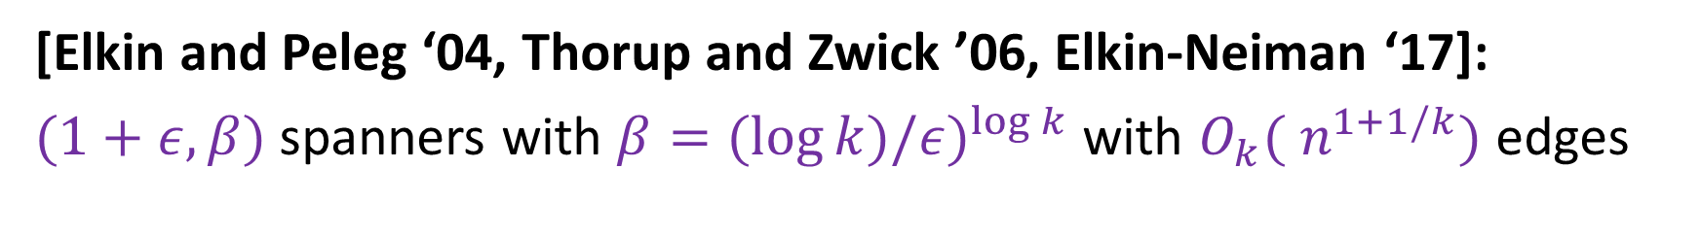
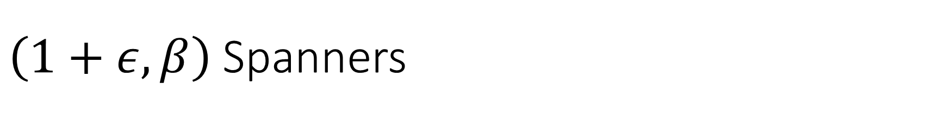
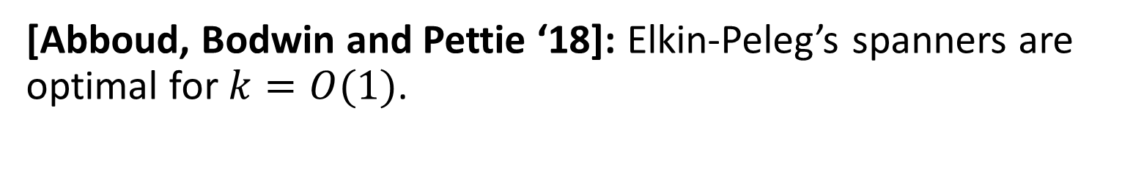
$\left(1+ε,β\right)$Spanners
[Elkin and Peleg ‘04, Thorup and Zwick ’06, Elkin-Neiman ‘17]:
$(1+ε, β)$ spanners with $β=(\log{k)/{ε)}^{\log{k}} }$with $O_{k}({ n}^{1+1/k})$ edges
[Abboud, Bodwin and Pettie ‘18]: Elkin-Peleg’s spanners are optimal for $k=O(1)$.

Slide 25


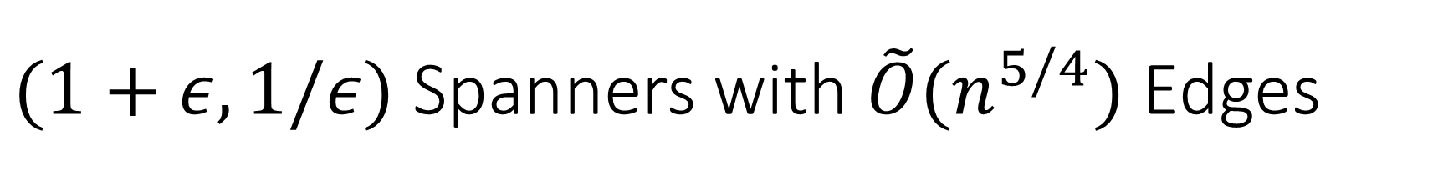


$(1+ε,1/ε)$ Spanners with $\tilde{O}(n^{5/4})$ Edges
$S_{1}←Sample(V,n^{−1/4})$ ($\left|S_{1}\right|=O(n^{3/4})$ vertices)
$S_{2}←Sample(S_{1},n^{−1/2})$ ($\left|S_{2}\right|=O(n^{1/4})$ vertices)
A vertex $s∈S_{1}$ is clustered if $\left|B\left(u,\frac{1}{ε}+2\right)∩S_{1}\right|≥\sqrt{n}⋅log n$
$$\frac{1}{ε}+2$$
Claim: For every clustered vertex $s∈S_{1}$, w.h.p:
$\left|B\left(u,\frac{1}{ε}+2\right)∩S_{2}\right|≠∅$
$$s$$
Pf: Each vertex in $S_{1}$ is sampled into $S_{2}$ with probability $1/\sqrt{n}$
$S_{2}$ is a hitting set for the $B\left(u,\frac{1}{ε}+2\right)$ balls of clustered $S_{1}$ vertices

Slide 26

$S_{1}←Sample(V,n^{−1/4})$

Slide 27

$S_{1}←Sample(V,n^{−1/4})$
$S_{2}←Sample(V,n^{−1/2})$

Slide 28
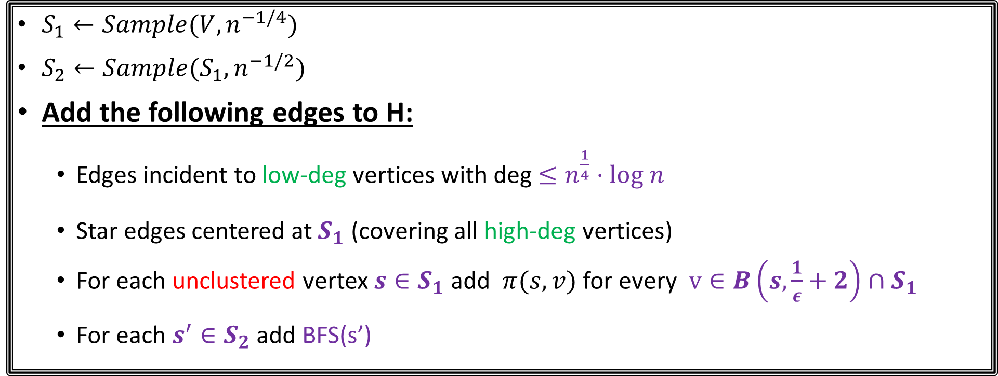
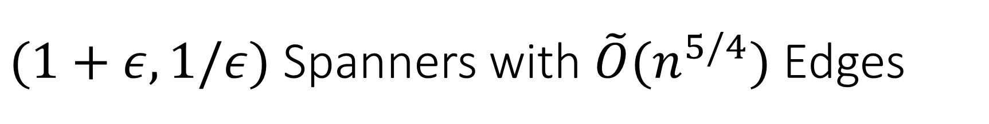


$(1+ε,1/ε)$ Spanners with $\tilde{O}(n^{5/4})$ Edges
$S_{1}←Sample(V,n^{−1/4})$
$S_{2}←Sample(S_{1},n^{−1/2})$
Add the following edges to H:
  Edges incident to low-deg vertices with deg $≤n^{\frac{1}{4}}⋅log n$
  Star edges centered at $S_{1}$ (covering all high-deg vertices)
  For each unclustered vertex $s∈S_{1}$ add $π(s,v)$ for every $v∈B\left(s,\frac{1}{ε}+2\right)∩S_{1}$
  For each $s^{′}∈S_{2}$ add BFS(s’)
$$\frac{1}{ε}+2$$
$$s$$

Slide 29








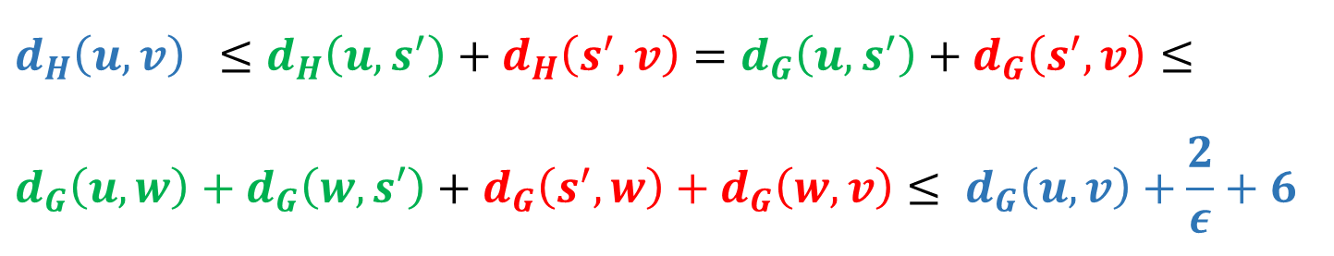
Case 1: $π(u,v)$ has at least one clustered neighbor in $S_{1}$
$$w$$
$$u$$
$$v$$
$$s∈S_{1}$$
$$π(s^{′},u)$$
$$≤\frac{1}{ε}+2$$
$$π(s^{′},v)$$
$$s′∈S_{2}$$
$$d_{H}\left(u,v\right) ≤d_{H}\left(u,s^{′}\right)+d_{H}\left(s^{′},v\right)=d_{G}\left(u,s^{′}\right)+d_{G}\left(s^{′},v\right)≤$$
$$d_{G}\left(u,w\right)+d_{G}\left(w,s′\right)+d_{G}\left(s^{′},w\right)+d_{G}\left(w,v\right)≤ d_{G}\left(u,v\right)+\frac{2}{ε}+6$$

Slide 30



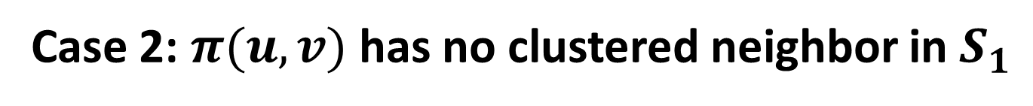

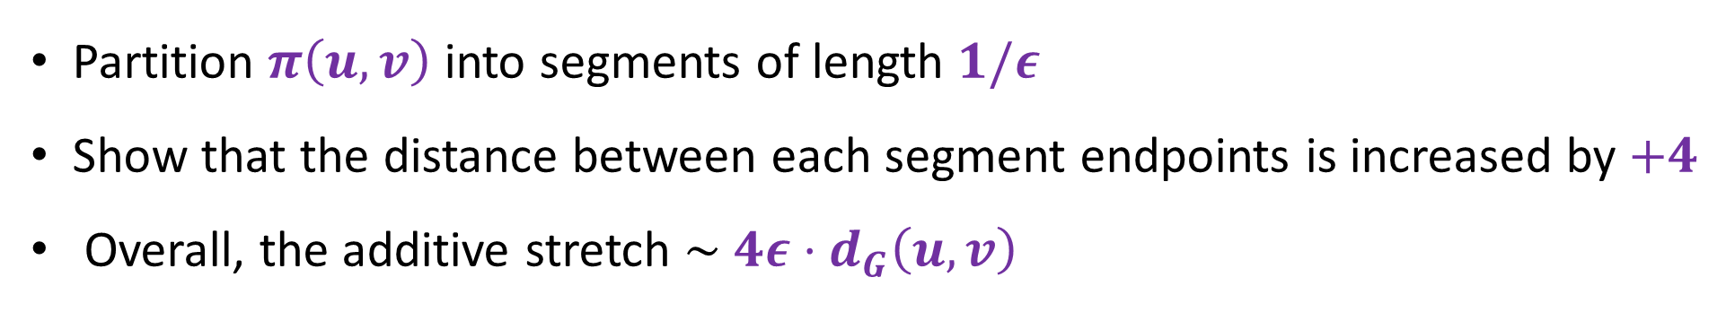


Case 2: $π(u,v)$ has no clustered neighbor in $S_{1}$
$$1/ε$$
$$u$$
$$v$$
$$+4$$
$$+4$$
$$+4$$
Partition $π\left(u,v\right)$ into segments of length $1/ε$
Show that the distance between each segment endpoints is increased by $+4$
Overall, the additive stretch $\sim$ ${4ε⋅d}_{G}\left(u,v\right)$

Slide 31






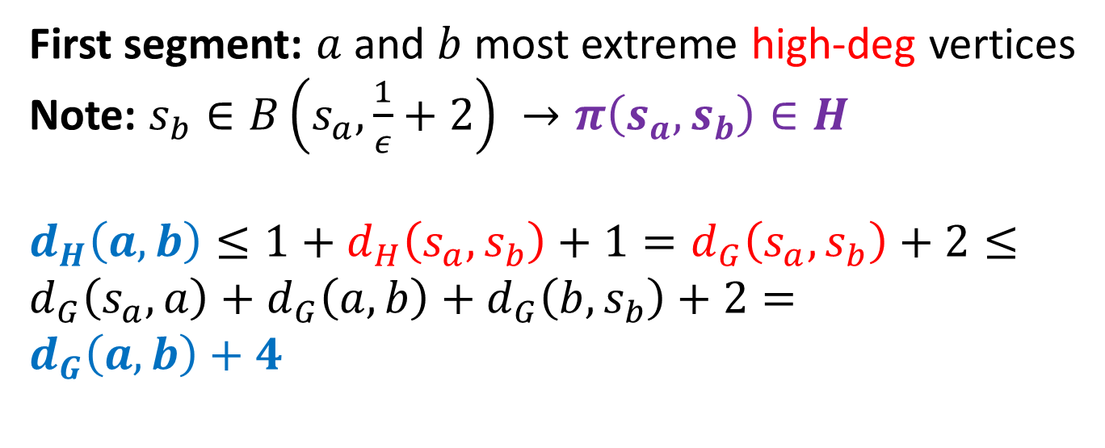



Case 2: $π(u,v)$ has no clustered neighbor in $S_{1}$
$$a$$
$$b$$
$$u$$
$$v$$
$$s_{a}∈S_{1}$$
$$s_{b}∈S_{1}$$
$$\frac{1}{ε}+2$$
First segment: $a$ and $b$ most extreme high-deg vertices
Note: $s_{b}∈B\left(s_{a},\frac{1}{ε}+2\right) →π\left(s_{a},s_{b}\right)∈H$
$$d_{H}\left(a,b\right)≤1+d_{H}\left(s_{a},s_{b}\right)+1=d_{G}\left(s_{a},s_{b}\right)+2≤$$
$$d_{G}\left(s_{a},a\right)+d_{G}\left(a,b\right)+d_{G}\left(b,s_{b}\right)+2=$$
$$d_{G}\left(a,b\right)+4$$
$$s_{a}$$
$$s_{b}$$

