Slide 1
Succinct Graph Structures and Their Applications Spring 2020
Class 3: Distance Oracles

Slide 2
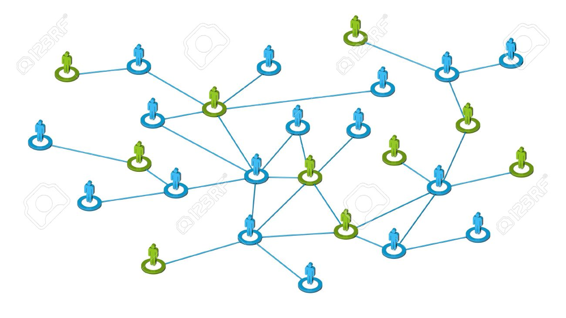
Distance Oracles
Compact data structure that can quickly estimate distances in a given graph
Input graph
Distance query: $u,v$
Preprocessing
$$δ\left(u,v\right)≈d_G(u,v)$$
DO
Goal:
Compute fast a succinct DO that answers distance queries fast and small stretch

Slide 3
Distance Oracles
Key complexity measures: space, query time and stretch
$$n×n$$
Distance Matrix
$(2k−1)$ spanner
$$H⊆G$$
Thorup-Zwick
Oracles
Space: $n^{2}$
Query time: $O\left(1\right)$
Stretch: $1$
Space: $n^{1+1/k}$
Query time: $O\left(n^{1+1/k}\right)$
Stretch:$2k−1$
Space: $O({kn}^{1+1/k})$
Query time: $O\left(k\right)$
Stretch:$2k−1$
Stretch $α$of oracle $O:$ $∀u,v$ $d_{G}\left(u,v\right)≤δ_{O}\left(u,v\right)≤α{⋅d}_{G}\left(u,v\right)$

Slide 4
History of DO
 | Stretch | Query Time | Space
Awerbuch, Berger, Cowen and Peleg, ‘93 | $64k$ | $k n^{1/k}$ | $$k n^{1+1/k}$$
Cohen, ‘93 | $$2k+ε$$ | $$k n^{1/k}$$ | $$k n^{1+1/k}$$
Thorup-Zwick ‘01 | $$2k−1$$ | $$k$$ | $$k n^{1+1/k}$$
Mendel-Naor ‘06 | $$128k$$ | $$O(1)$$ | $$k n^{1+1/k}$$
Wulff-Nilsen ‘12 | $$2k−1$$ | $$O(\log{k})$$ | $$k n^{1+1/k}$$
Chechik ‘15 | $$2k−1$$ | $O(1)$ | $$k n^{1+1/k}$$

Slide 5
Space Lower Bound
Thm: Every $(2k−1)$ approximate DO for $n$-vertex graph requires* $Ω(n^{1+1/k})$ space.
* Under the girth conjecture
Girth Conj.: $∃G^{∗}$ with $Ω(n^{1+1/k})$ edges and girth $≥2k+2$.
Claim: Every subgraphs $G_{1}, G_{2}⊂G^{∗}$ must have distinct DOs
There are $2^{|E\left(G^{∗}\right)|}$distinct oracles, thus requiring $Ω(|E\left(G^{∗}\right)|)$

Slide 6
Claim: Every subgraphs $G_{1}, G_{2}⊂G^{∗}$ must have distinct DOs
By contradiction: ${∃ G}_{1}≠G_{2}⊂G^{∗}$ such that ${ O}_{1}=O_{2}$
$O_{i}:\left(2k−1\right)$ oracle for $G_{i}$
$\left(u,v\right)∈G_{1}∖G_{2}:$
$O_{1}$ is a $(2k−1)$ DO for $G_{1}$
$$1{≤δ}_{O_{1}}\left(u,v\right)≤2k−1$$
$O_{2}$ is a $(2k−1)$ DO for $G_{2}$
$$2k{≤d}_{G_{2}}(u,v){≤δ}_{O_{2}}\left(u,v\right)$$

Slide 7
3-Approx. Distance Oracles
Space: $\tilde{O}\left(n^{3/2}\right)$Query time: $O\left(1\right)$
Preprocessing algorithm:
$S←Sample(V, p)$ , $p=1/\sqrt{n}$
For each vertex $v:$
$p\left(v\right)≔$ closest vertex to $v$is $S$
$B_{0}\left(v\right)=\{w∈V∖S∣d_{G}\left(v,w\right)<d_{G}(v,p\left(v\right))\}$
Store in hash-table distances between $v$
and every vertex in $B_{0}\left(v\right)∪S$
$$v$$

Slide 8
3-Approx. Distance Oracles
Space: $\tilde{O}\left(n^{3/2}\right)$
Query time: $O\left(1\right)$
Query algorithm $〈u,v〉$
If $u∈B\left(v\right)∪S:$ output $d_{G}(u,v)$
Else: $δ\left(u,v\right)=d_{G}\left(u,p\left(v\right)\right)+d(p\left(v\right), v)$
$$v$$
$$p(v)$$
$$p(v)$$
$$≤2Δ$$
$$≤Δ$$
$$u$$
$$u$$
$$Δ$$
$$v$$

Slide 9
Space:
Preprocessing algorithm:
$S←Sample(V, p)$ , $p=clog n/\sqrt{n}$
For each vertex $v:$
$p\left(v\right)≔$ closest vertex to $v$is $S$
$B_{0}\left(v\right)=\{w∈V∖S∣d_{G}\left(w,v\right)<d_{G}(w,p(v)\}$
Store in hash-table distances between $v$
and every vertex in $B_{0}\left(v\right)∪S$
Claim: $\left|B_{0}\left(v\right)\right|=O\left(n^{1/2} log n\right)$ w.h.p
$N\left(v\right)≔{cn}^{1/2} log n$ closest vertices to $v$
$N\left(v\right)∩S≠∅$ w.h.p.
$B\left(v\right)⊆N(v)$
QED
$$v$$

Slide 10
$(2k−1)$ Approximate Oracle
Space: $\tilde{O}\left(n^{1+1/k}\right)$ Query time: $O\left(k\right)$
Preprocessing algorithm:
$V=A_{0} ⊇A_{1}⊇…⊇A_{k−1 }$where $A_{i}←Sample\left(A_{i−1 },n^{−1/k}\right)$
Pivot$p_{i}\left(v\right)≔$ closest vertex to $v$in $A_{i},$ $∀v∈V, i∈\{0,…,k−1\}$
Bunch $B_{i}\left(v\right)≔\{ w∈A_{i}−A_{i+1}∣d\left(v,w\right)<d(v,p_{i+1}\left(v\right))\} , i∈\{0,…,k−2\}$
$B_{k−1}\left(v\right)=A_{k−1}$
Store in hash-table distances between $v$and every vertex in $B\left(v\right)=\bigcup_{i}{B_{i}(v)}$

Slide 11
Bunches
A₀= A₁= A₂=
p₂(v)
v
p₁(v)
$$B_{i}\left(v\right)≔\{ w∈A_{i}−A_{i+1}∣d\left(v,w\right)<{d(v,p}_{i+1}\left(v\right))\}$$
*Slide taken from
Uri Zwick presentation

Slide 12
Space Argument:
Claim: $\left|B_{i}\left(v\right)\right|=O(n^{1/k}\log{n})$ w.h.p.
Recall:
$B_{i}\left(v\right)≔\{ w∈A_{i}−A_{i+1}∣d_{G}\left(v,w\right)<p_{i+1}\left(v\right)\}$ and $A_{i+1}←Sample\left(A_{i },n^{−1/k}\right)$
$N_{i}\left(v\right)≔n^{1/k}\log{n}$ closest neighbors of $v$ in $A_{i}$
$A_{i+1}∩N_{i}\left(v\right)≠∅$ w.h.p
${ B}_{i}\left(v\right)⊆N_{i}(v)$
$$v$$
$$A_{i}$$
Total space: $O(kn^{1+1/k})$
$$A_{i+1}$$

Slide 13
Intuition for Query Alg
$B_{i}\left(v\right)≔\{ w∈A_{i}−A_{i+1}∣d_{G}\left(v,w\right)<p_{i+1}\left(v\right)\}$ , $B\left(v\right)=\bigcup_{i}{B_{i}(v)}$
Obs. 1: $p_{i}\left(v\right)∈B\left(v\right)$ for every $i∈\{0,1,…,k−1\}$
Obs. 2: $p_{k−1}\left(u\right)∈B(v)$ for every $u,v$
Goal: Find min $i$ such that either $p_{i}\left(v\right)∈B(u)$ or $p_{i}\left(u\right)∈B(v)$
$$p_{2}\left(v\right)$$
$$p_{1}\left(u\right)$$
$$3Δ≥$$
$$2Δ≥$$
$$Δ≥$$
$$2Δ≥$$
$$u$$
$$Δ$$
$$v$$

Slide 14
$(2k−1)$ Approximate Oracle
Query Algorithm $〈u,v〉$
$$w←p_{0}\left(v\right)$$
For $i=1$to $k$do:
If $w∈B(u)$: // $w=p_{i−1}\left(v\right)$
return $δ\left(u,v\right)=d_{G}\left(u,w\right)+d_{G}(w,v)$
Else: $w←p_{i}\left(u\right)$
swap $u,v$
$$p_{2}\left(v\right)$$
$$p_{1}\left(u\right)$$
$$3Δ≥$$
$$2Δ≥$$
$$Δ≥$$
$$2Δ≥$$
$$u$$
$$Δ$$
$$v$$
Since $p_{k−1}\left(v\right)∈B\left(u\right),$alg. always outputs a value

Slide 15
Stretch Argument
Query Algorithm $〈u,v〉$
$$w←p_{0}\left(v\right)$$
For $i=1$to $k$do:
If $w∈B(u)$: // $w=p_{i−1}\left(v\right)$
return $δ\left(u,v\right)=d_{G}\left(u,w\right)+d_{G}(w,v)$
Else: $w←p_{i}\left(u\right)$
swap $u,v$
Iteration $i:$ $u_{i}, v_{i}, w_{i}=p_{i−1}(v_{i})$
Claim: $d_{G}\left(v_{i},w_{i}\right)≤\left(i−1\right)d_{G}\left(u_{i}, v_{i}\right)$
for every $i≤i^{∗}$ (when alg. terminates)
By induction:
Base: $i=1, w_{1}=p_{0}(v)$
Assume up to $i−1$ and
consider iteration $i$.
$$w_{i}=p_{i−1}(v_{i})$$
$$w_{i−1}=p_{i−2}(v_{i−1})$$
$$\left(i−1\right)Δ$$
$$\left(i−2\right)Δ$$
$$v_{i}=u_{i−1}$$
$$Δ$$
$${u_{i}=v}_{i−1}$$

Slide 16
Stretch Argument
Query Algorithm $〈u,v〉$
$$w←p_{0}\left(v\right)$$
For $i=1$to $k$do:
If $w∈B(u)$: // $w=p_{i−1}\left(v\right)$
return $δ\left(u,v\right)=d_{G}\left(u,w\right)+d_{G}(w,v)$
Else: $w←p_{i}\left(u\right)$
swap $u,v$
Iteration $i:$ $u_{i}, v_{i}, w_{i}=p_{i−1}(v_{i})$
Claim: $d_{G}\left(v_{i},w_{i}\right)≤\left(i−1\right)d_{G}\left(u_{i}, v_{i}\right)$
for every $i≤i^{∗}$ (when alg. terminates)
$$w_{i^{∗}}$$
$$d_{G}\left(v_{i^{∗}},w_{i^{∗}} \right)≤\left(i^{∗}−1\right)d_{G}\left(u_{i^{∗}}, v_{i^{∗}}\right)$$
$$d_{G}\left(u_{i^{∗}},w_{i^{∗}} \right)≤i^{∗}⋅d_{G}\left(u_{i^{∗}}, v_{i^{∗}}\right)$$
$$i^{∗}Δ$$
$$\left(i^{∗}−1\right)Δ$$
$δ\left(u,v\right)=d_{G}\left(v_{i^{∗}},w_{i^{∗}} \right)$+$d_{G}\left(w_{i^{∗}},u_{i^{∗}}\right)$
$$≤\left(2i^{∗}−1\right)d_{G}(u,v)$$
$$u_{i^{∗}}$$
$$Δ$$
$$v_{i^{∗}}$$

Slide 17
(4k-3) Approx w.o Swap
Let $i^{∗}$be min value such that $p_{i^{∗}}\left(u\right)∈B(v)$.
Claim: $d_{G}\left(u,p_{i^{∗}}\left(u\right)\right)+d_{G}\left(p_{i^{∗}}\left(u\right),v\right)≤\left(4k−3\right)d_{G}(u,v)$.
Show by induction that $d_{G}\left(u,p_{i}\left(u\right)\right)≤2i⋅d_{G}(u,v)$ for every $i≤i^{∗}$
Suppose true for $i,$then:
$$d\left(u, p_{i+1}\left(u\right)\right)≤d(u,p_{i+1}\left(v\right))$$
$≤d\left(u,v\right)+d\left(v, p_{i+1}\left(v\right)\right)$
$≤d\left(u,v\right)+d\left(v, p_{i}\left(u\right)\right)$ // $p_{i}\left(u\right)∈A_{i}(u)$ not in $B_{i}(v)$
$≤d\left(u,v\right)+d\left(v, u\right)+d\left(p_{i}\left(u\right),u\right)$
$≤2(i+1)$ $d\left(u,v\right)$

Slide 18
(4k-3) Approx w.o Swap
Let $i^{∗}$be min value such that $p_{i^{∗}}\left(u\right)∈B(v)$.
Claim: $d_{G}\left(u,p_{i^{∗}}\left(u\right)\right)+d_{G}\left(p_{i^{∗}}\left(u\right),v\right)≤\left(4k−3\right)d_{G}(u,v)$.
Show by induction that $d_{G}\left(u,p_{i}\left(u\right)\right)≤2i⋅d_{G}(u,v)$ for every $i≤i^{∗}$
$$d\left(u,p_{i^{∗}}\left(u\right)\right)+d\left(p_{i^{∗}}\left(u\right),v\right)≤2i^{∗}⋅d\left(u,v\right)+d\left(p_{i^{∗}}\left(u\right),v\right)$$
$≤2i^{∗}⋅d\left(u,v\right)+d\left(p_{i^{∗}}\left(u\right),u\right)+d\left(u,v\right)$
$≤\left(4i^{∗}+1\right)⋅d\left(u,v\right)≤\left(4k−3\right)d(u,v)$

Slide 19
Beyond Thorup-Zwick
Sparse graphs?
Additive approximation?

Slide 20
Conditional Space Lower Bound for (2-eps)-Approx.
Set-Intersection Data Structure:
$S_{1}, . . . , S_{n} ⊆ [X],$ for $X=poly(\log{n) }$
Query: “does $S_{i}$ intersect $S_{j}$?
Conjecture:
If query time is $O(1)$, the space must be $Ω(n^{2})$

Slide 21
Conditional Space Lower Bound for (2-eps)-Approx.
Set-Intersection Data Structure:
$S_{1}, . . . , S_{n} ⊆ [X],$ for $X=poly(\log{n) }$
Query: does $S_{i}$ intersect $S_{j}$?
Conjecture:
If query time is $O(1)$, the space must be $Ω\left(n^{2}\right)$
Corollary: Any DO for unweighted graphs with $\tilde{O}(n)$ edges which distinguish between distances of 2 and 4 in constant time requires $Ω\left(n^{2}\right)$ space, assuming the conjecture

Slide 22
The Reduction
Set system → $n$-vertex graph $G$with $\tilde{O}(n)$ edges.
$$S_{1}$$
$$S_{n}$$
Sets
Universe
$$1$$
$$2$$
$$…$$
$$X$$
$d_{G}\left(S_{i},S_{j}\right)= 2$ If $S_{i}∩S_{j}=∅$
4 Otherwise
$\left(2−ε\right)$ approx. oracle
requires $Ω\left(n^{2}\right)$space

Slide 23
Unconditional Lower Bounds for Sparse Graphs (Sommer, Verbin, Yu ‘09)
Three-way tradeoff between space, stretch and query time
Thm: Every DO with stretch $α$ and query time $t$ requires space
$$S≥n^{1+\frac{1}{t⋅α}}/\log{n}$$

