Slide 1
Succinct Graph Structures and Their Applications Spring 2020
Class 6: Low Stretch Spanning Trees

Slide 2


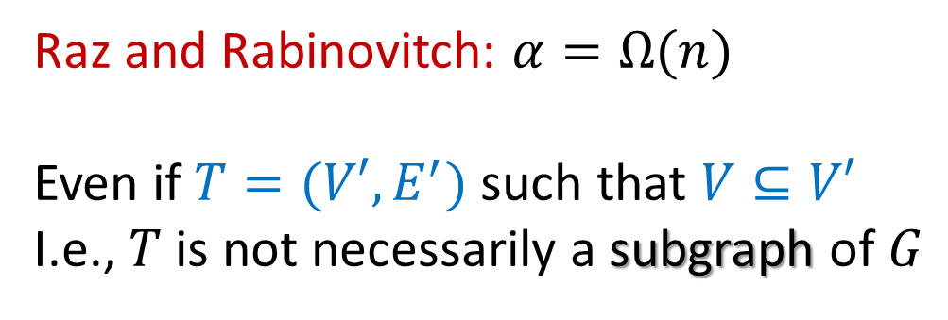
Low Stretch Spanning Trees
Goal: given graph $G=(V,E)$ compute tree $T⊆G$ such that
$${d_{G}\left(u,v\right)≤d}_{T}\left(u,v\right)≤α⋅d_{G}(u,v)$$
Q: What is the best $α$ one can hope for?
Raz and Rabinovitch: $α=Ω(n)$
Even if $T=(V′,E^{′})$ such that $V⊆V′$
I.e., $T$ is not necessarily a subgraph of $G$

Slide 3
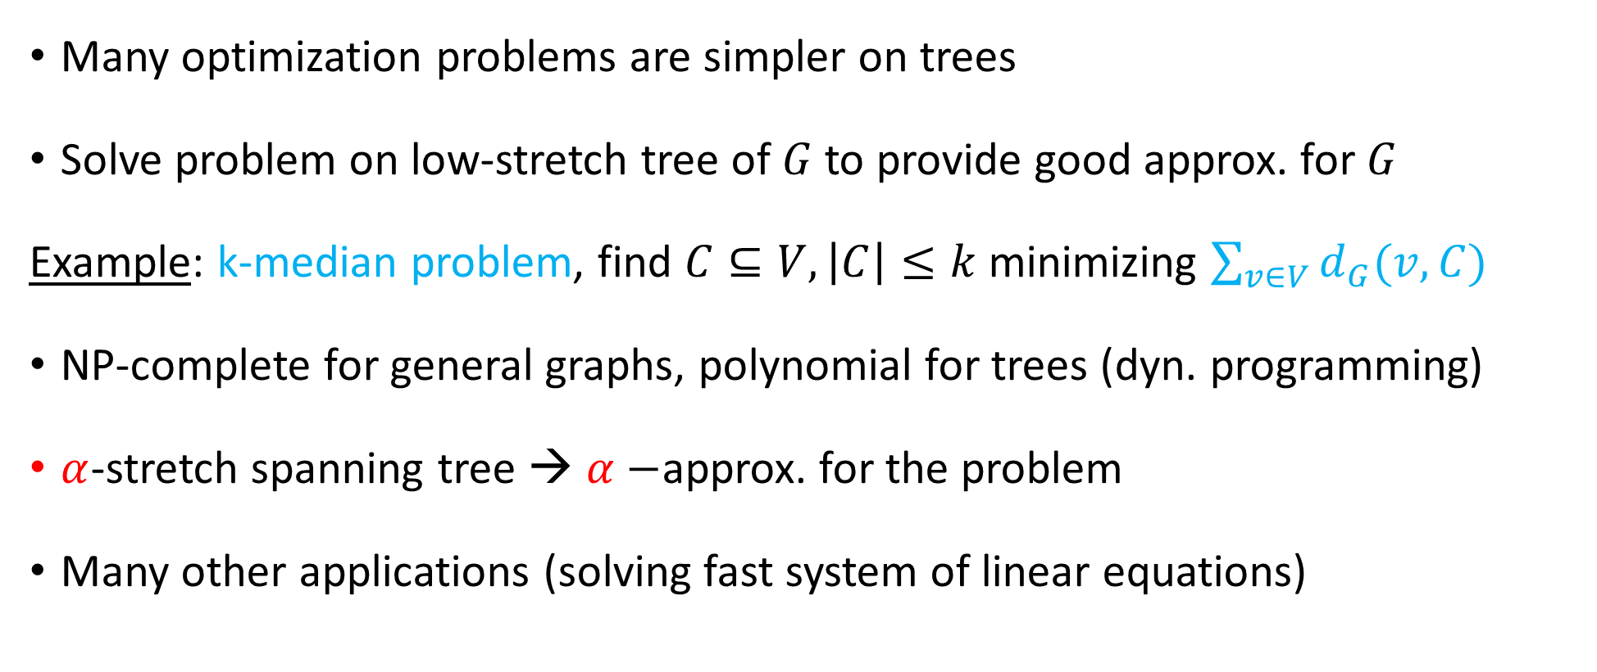
Motivation
Many optimization problems are simpler on trees
Solve problem on low-stretch tree of $G$ to provide good approx. for $G$
Example: k-median problem, find $C⊆V, \left|C\right|≤k$minimizing $\sum_{v∈V}{d_{G}(v,C)}$
NP-complete for general graphs, polynomial for trees (dyn. programming)
$α$-stretch spanning tree → $α−$approx. for the problem
Many other applications (solving fast system of linear equations)

Slide 4
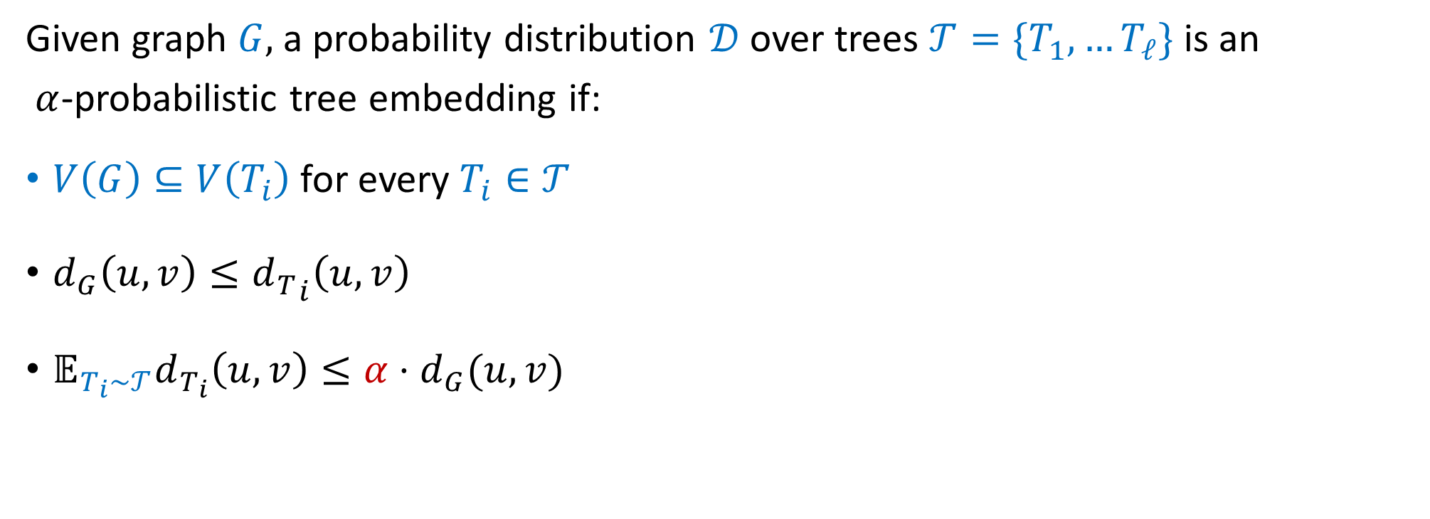
Probabilistic Tree Embedding
Given graph $G,$ a probability distribution $𝒟$ over trees ${𝒯=\{T}_{1},…T_{ℓ}\}$ is an
$α$-probabilistic tree embedding if:
$V\left(G\right)⊆V\left(T_{i}\right)$for every $T_{i}∈𝒯$
$d_{G}\left(u,v\right)≤{d_{T}}_{i}\left(u,v\right)$
$𝔼_{T_{i}∼𝒯}d_{T_{i}}\left(u,v\right)≤α⋅d_{G}(u,v)$
Cycle graph?

Slide 5

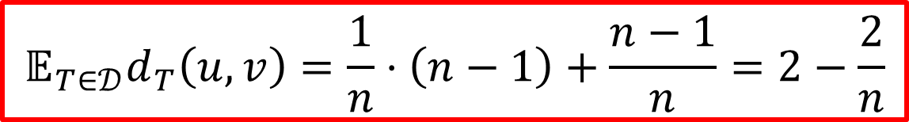



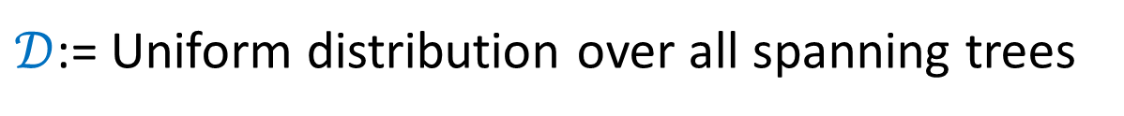



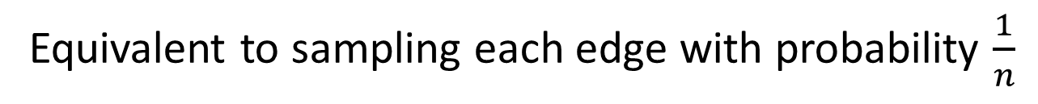




Example: Cycle Graph
$𝒟$:= Uniform distribution over all spanning trees
$$1/n$$
$$1/n$$
Equivalent to sampling each edge with probability $\frac{1}{n}$
$$1/n$$
$$1/n$$
$$1/n$$
$$1/n$$
$$𝔼_{T∈𝒟}d_{T}\left(u,v\right)=\frac{1}{n}⋅\left(n−1\right)+\frac{n−1}{n}=2−\frac{2}{n}$$
$$1/n$$
$$1/n$$
$$1/n$$
$$1/n$$
$$1/n$$
For general graphs $α=Ω(\log{n)}$[Alon, Karp, Peleg, West]

Slide 6
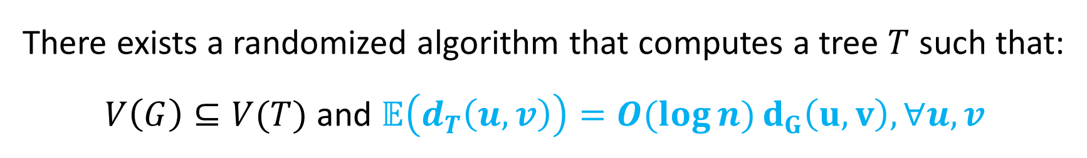
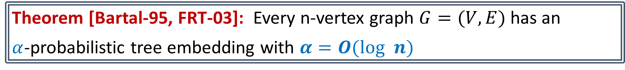
Probabilistic Tree Embedding
Theorem [Bartal-95, FRT-03]: Every n-vertex graph $G=(V,E)$ has an
$α$-probabilistic tree embedding with $α=O(log n)$
There exists a randomized algorithm that computes a tree $T$ such that:
$V\left(G\right)⊆V(T)$ and $𝔼\left(d_{T}\left(u,v\right)\right)=O(\log{n)}d_{G}\left(u,v\right), ∀u,v$
Cor.: By sampling $O(\log{n)}$trees, w.h.p. $d_{T}(u,v)=O(\log{n)}d_{G}\left(u,v\right), ∀u,v$

Slide 7
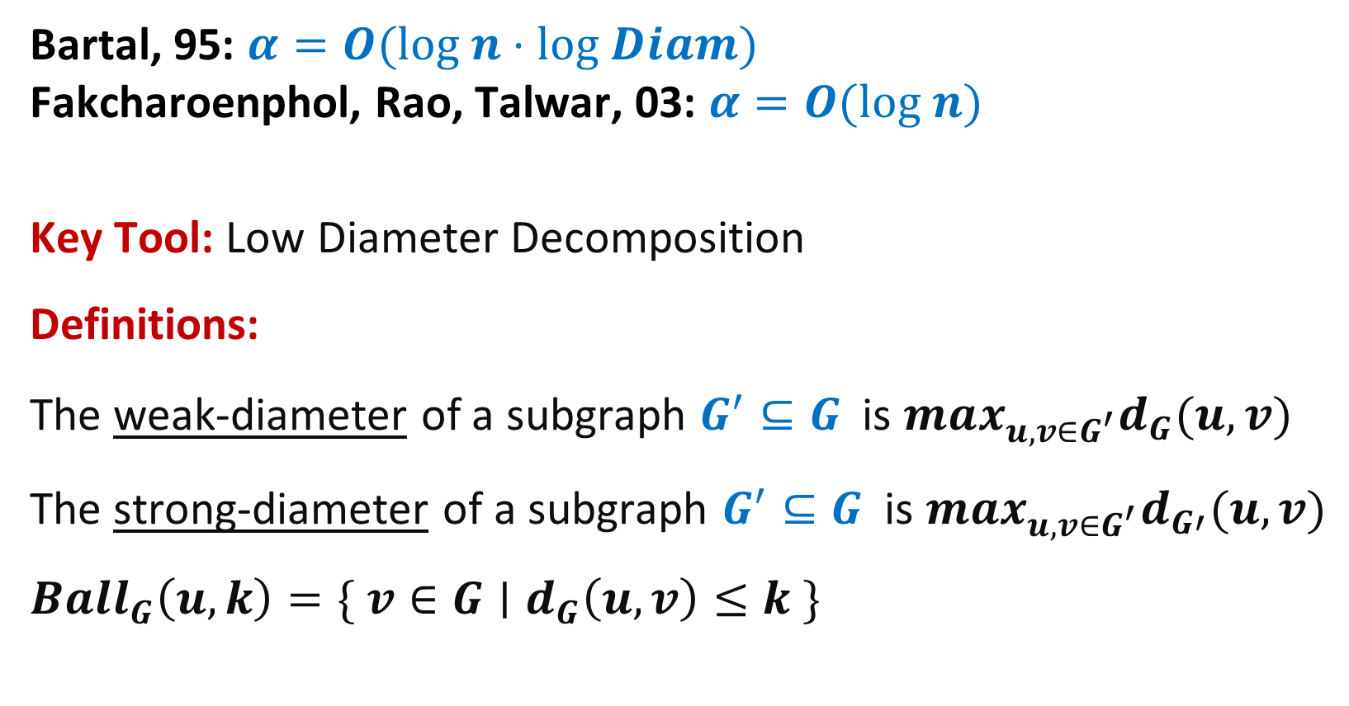
Probabilistic Tree Embedding
Bartal, 95: $α=O(log n⋅log Diam)$
Fakcharoenphol, Rao, Talwar, 03: $α=O(log n)$
Key Tool: Low Diameter Decomposition
Definitions:
The weak-diameter of a subgraph $G^{′}⊆G$ is $max_{u,v∈G^{′}}d_{G}(u,v)$
The strong-diameter of a subgraph $G^{′}⊆G$ is $max_{u,v∈G^{′}}d_{G′}(u,v)$
$$Ball_{G}\left(u,k\right)=\{ v∈G∣d_{G}\left(u,v\right)≤k \}$$

Slide 8







Low Diameter Decomposition (Ball Carving)
Given a graph $G=(V,E)$ and parameter $D$, a low-diameter-decomposition
is a randomized partitioning $V=V_{1} ∪V_{2}∪…V_{ℓ}$ such that:
weak diameter of $G\left[V_{i}\right]$ at most $D$
$Pr⁡[u∈V_{i}$ and $v∈V_{j≠i}]≤O(log n/D){⋅d}_{G}(u,v)$
$$D$$
$$v$$
$$u$$
$$D$$
Low-diam clusters with
few inter-cluster edges
$$D$$
$$D$$

Slide 9



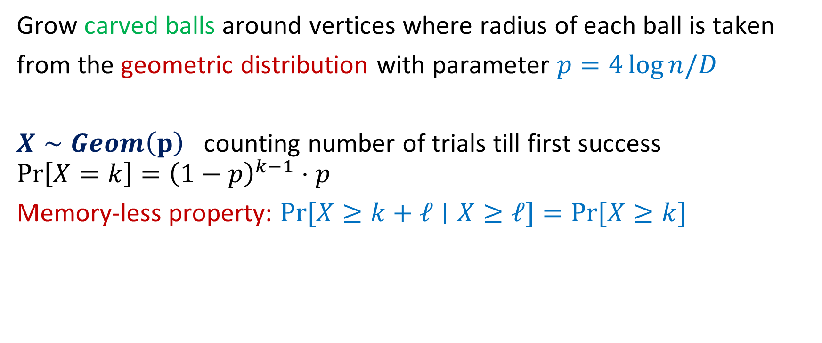



High Level Idea
Grow carved balls around vertices where radius of each ball is taken
from the geometric distribution with parameter $p=4\log{n/D}$
$X∼Geom\left(p\right)$ counting number of trials till first success
$$\operatorname{Pr}\left[X=k\right]={\left(1−p\right)}^{k−1}⋅p$$
Memory-less property: $\operatorname{Pr}{[X}≥k+ℓ∣X≥ℓ]=Pr⁡[X≥k]$
$$w$$
$$R_{w}$$
$$u$$
$$v$$
$$R_{u}$$
$$R_{v}$$

Slide 10



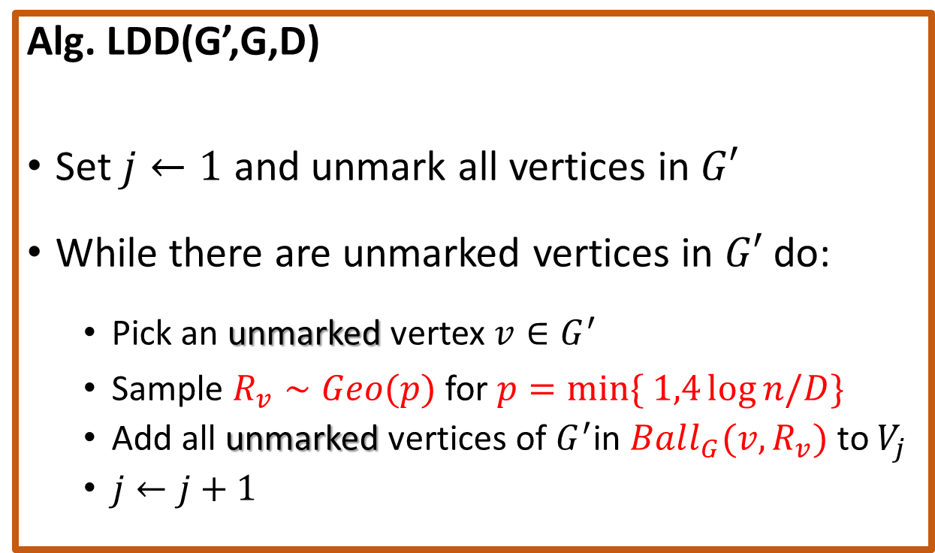



Low Diameter Decomposition
Alg. LDD(G’,G,D)
Set $j←1$ and unmark all vertices in $G′$
While there are unmarked vertices in $G′$ do:
Pick an unmarked vertex $v∈G^{′}$
Sample $R_{v}∼Geo(p)$ for $p=min\{ 1,4\log{n/D}\}$
Add all unmarked vertices of $G^{′}$in $Ball_{G}(v,R_{v})$ to $V_{j}$
$j←j+1$
$$w$$
$$R_{w}$$
$$u$$
$$v$$
$$R_{u}$$
$$R_{v}$$

Slide 11
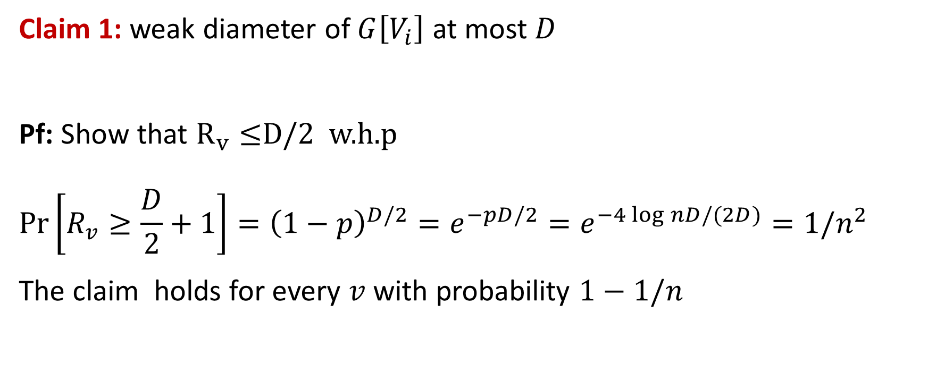
Low Diameter Decomposition
Claim 1: weak diameter of $G\left[V_{i}\right]$ at most $D$
Pf: Show that $R_{v}≤$D/2 w.h.p
$$\operatorname{Pr}\left[R_{v}≥\frac{D}{2}+1\right]={\left(1−p\right)}^{D/2}=e^{−pD/2}=e^{−4\log{nD/(2D)}}=1/n^{2}$$
The claim holds for every $v$ with probability $1−1/n$

Slide 12

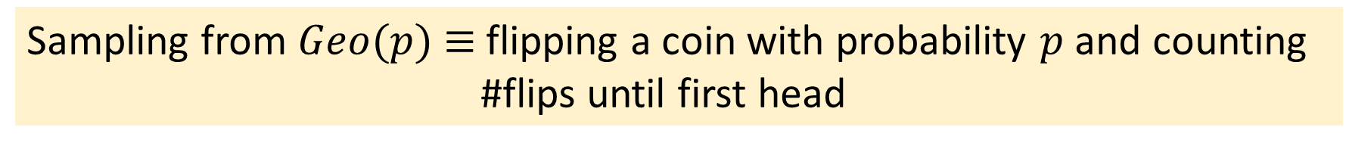



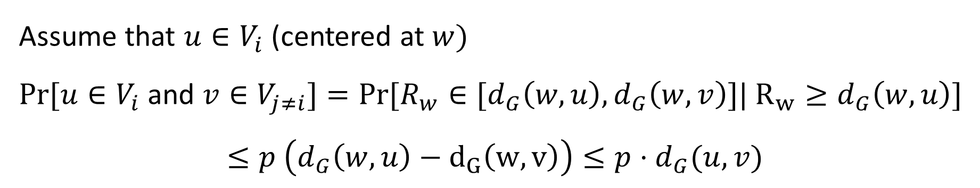

Low Diameter Decomposition
Claim 2: $Pr⁡[u∈V_{i}$ and $v∈V_{j≠i}]≤p{⋅d}_{G}(u,v)$
Sampling from $Geo(p)$ $≡$ flipping a coin with probability $p$ and counting
#flips until first head
Assume that $u∈V_{i}$ (centered at $w)$
$Pr⁡[u∈V_{i}$ and $v∈V_{j≠i}]=Pr⁡[R_{w}∈[d_{G}\left(w,u\right), d_{G}\left(w,v\right)]| R_{w}≥d_{G}\left(w,u\right)]$
$$≤p \left(d_{G}\left(w,u\right)−d_{G}\left(w,v\right)\right)≤p⋅d_{G}(u,v)$$
$$w$$
$$u$$
$$d_{G}(u,v)$$
$$v$$

Slide 13
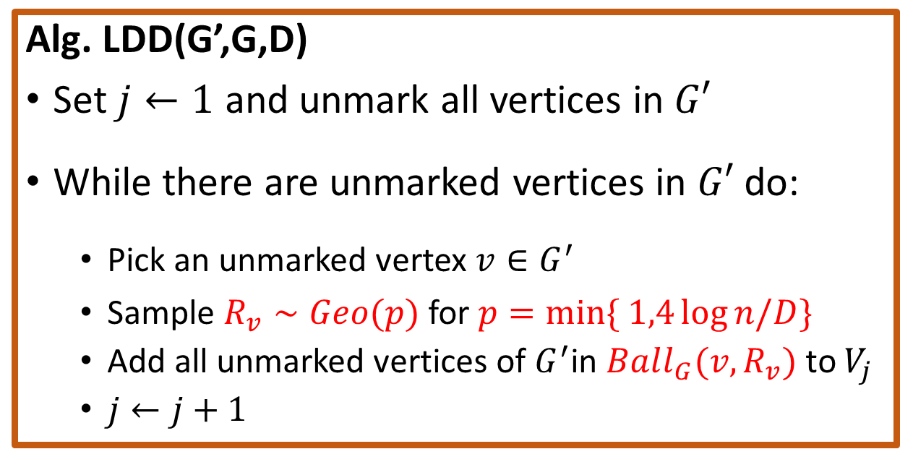
Low Diameter Decomposition
Alg. LDD(G’,G,D)
Set $j←1$ and unmark all vertices in $G′$
While there are unmarked vertices in $G′$ do:
Pick an unmarked vertex $v∈G^{′}$
Sample $R_{v}∼Geo(p)$ for $p=min\{ 1,4\log{n/D}\}$
Add all unmarked vertices of $G^{′}$in $Ball_{G}(v,R_{v})$ to $V_{j}$
$j←j+1$
$$w$$
$$R_{w}$$
$$u$$
$$v$$
$$R_{u}$$
$$R_{v}$$
Diam of each ${G[V}_{i}]$ $∼1/p$, separation probability $p⋅d_{G}(u,v)$

Slide 14





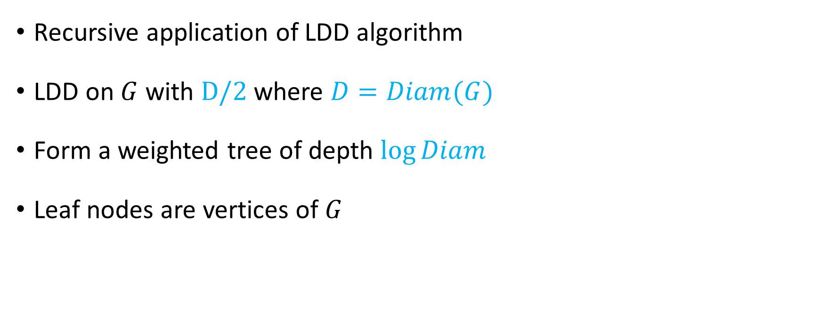







Tree Embedding given LDD
Recursive application of LDD algorithm
LDD on $G$ with $D/2$ where $D=Diam(G)$
Form a weighted tree of depth $\log{Diam}$
Leaf nodes are vertices of $G$
$$r_{0}$$
$$D$$
$$D$$
$$D$$
$$D/2$$
$$G[V_{1}]$$
$$G[V_{2}]$$
$$G[V_{3}]$$
$$D/2$$
$$D/2$$
$$G[V_{1,1}]$$
$$G[V_{1,2}]$$

Slide 15








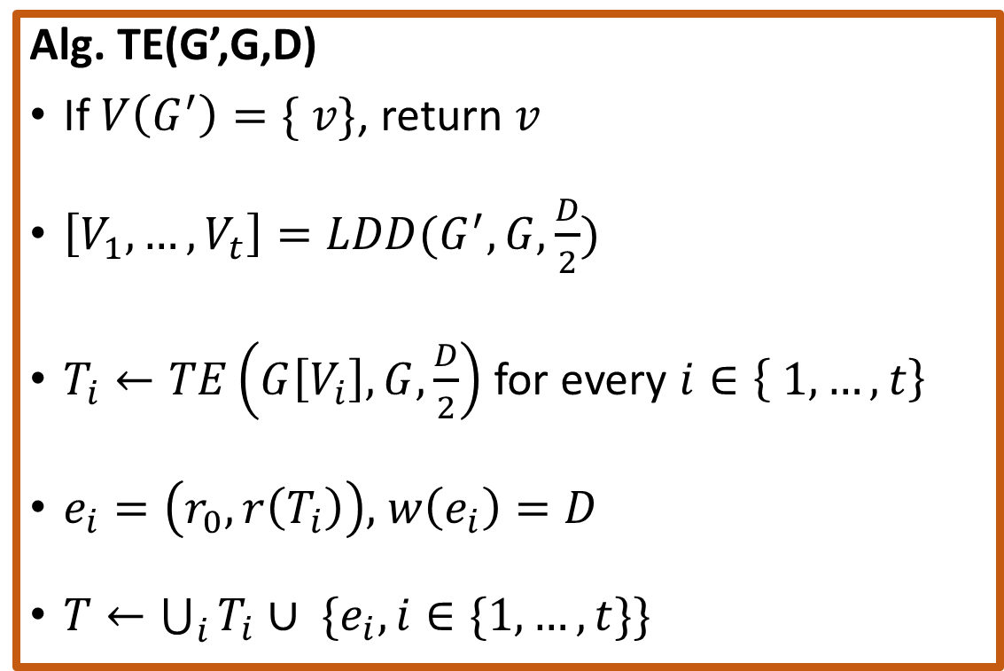













Probabilistic Tree Embedding
$$r_{0}$$
Alg. TE(G’,G,D)
If $V\left(G^{′}\right)=\{ v\}$, return $v$
$\left[V_{1},…,V_{t}\right]=LDD(G^{′},G,\frac{D}{2})$
$T_{i}←TE\left(G\left[V_{i}\right], G,\frac{D}{2}\right)$ for every $i∈\left\{ 1, …, t\right\}$
$e_{i}=\left(r_{0},r\left(T_{i}\right)\right),$ $w\left(e_{i}\right)=D$
$T←\bigcup_{i}{T_{i}}∪ \{e_{i}, i∈\{1,…,t\}\}$
$$D$$
$$D$$
$$D$$
$$G[V_{1}]$$
$$G[V_{2}]$$
$$G[V_{3}]$$
$$r_{0}$$
$$D$$
$$D$$
$$D$$
$$r_{1}$$
$$r_{2}$$
$$r_{3}$$
$$\frac{D}{2}$$
$$\frac{D}{2}$$
$$\frac{D}{2}$$
$$\frac{D}{2}$$
$$…$$
$$…$$
$$…$$

Slide 16















Probabilistic Tree Embedding
$$r_{0}$$
$$D$$
$$D$$
$$D$$
$$D/2$$
$$D/2$$
$$…$$
$$…$$
$$…$$
$$\log{D}$$
$$…$$
$$D/2^{i−1}$$
$$i$$
$$D/2^{i−1}$$
$$…$$

Slide 17
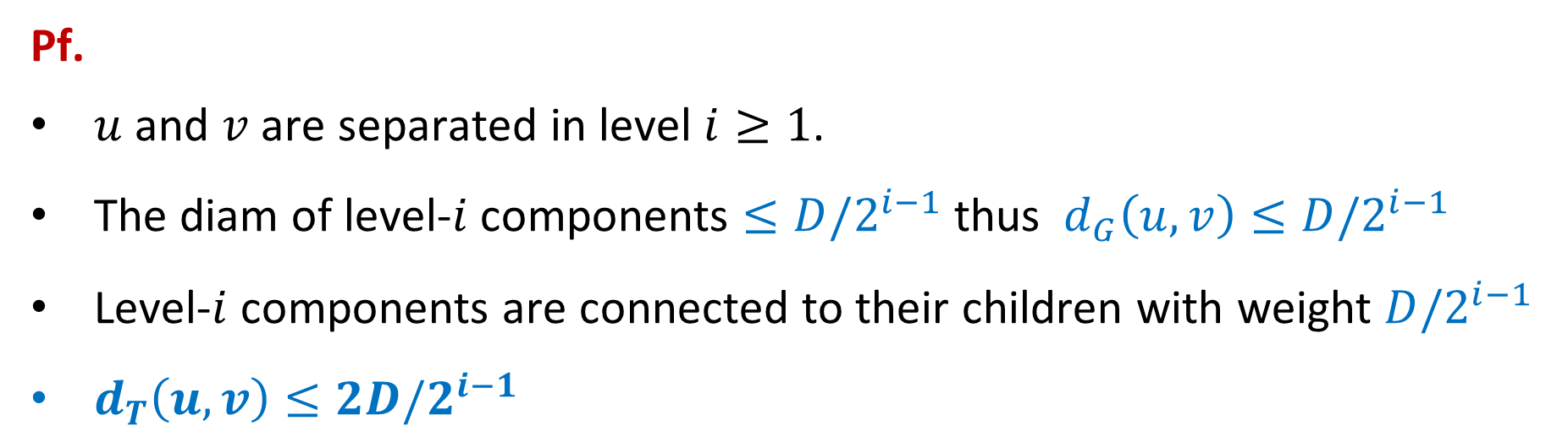

Probabilistic Tree Embedding
Claim 1: $d_{T}\left(u,v\right)≥d_{G}(u,v)$ w.h.p.
Pf.
$u$ and $v$ are separated in level $i≥1$.
The diam of level-$i$ components $≤D/2^{i−1}$ thus $d_{G}\left(u,v\right)≤D/2^{i−1}$
Level-$i$ components are connected to their children with weight $D/2^{i−1}$
$d_{T}\left(u,v\right)≤2D/2^{i−1}$

Slide 18



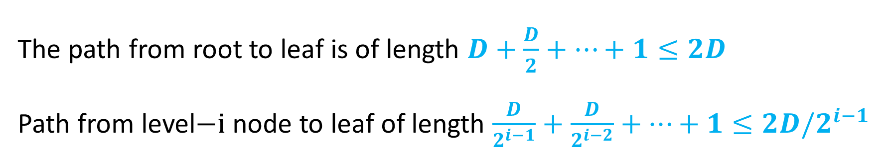







Probabilistic Tree Embedding
Claim 2: If $u$ and $v$ are separated in level $i≥1,$then $d_{T}\left(u,v\right)≤4D/2^{i−1}$
The path from root to leaf is of length $D+\frac{D}{2}+…+1≤2D$
Path from level$−i$ node to leaf of length $\frac{D}{2^{i−1}}+\frac{D}{2^{i−2}}+…+1≤2D/2^{i−1}$
$$r_{0}$$
$$D$$
$$D$$
$$D$$
$$D/2$$
$$D/2$$
$$…$$
$$…$$
$$…$$

Slide 19
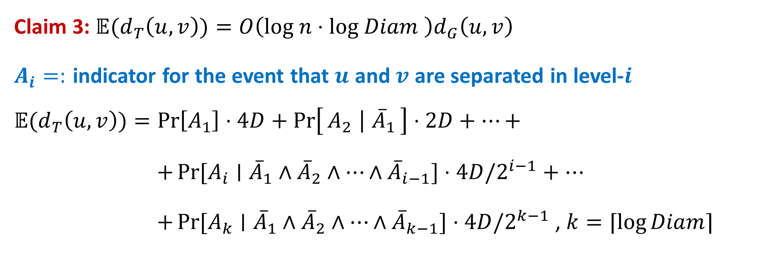
Probabilistic Tree Embedding
Claim 3: ${𝔼(d}_{T}\left(u,v\right))=O\left(log n⋅log Diam \right)d_{G}\left(u,v\right)$
$A_{i}=:$ indicator for the event that $u$ and $v$ are separated in level-$i$
$${𝔼(d}_{T}\left(u,v\right))=\operatorname{Pr}\left[A_{1}\right]⋅4D+\operatorname{Pr}\left[A_{2} ∣ {\overline{A}}_{1}\right]⋅2D+…+$$
$+\operatorname{Pr}{[A_{i}∣{\overline{A}}_{1}∧{\overline{A}}_{2}∧…∧{\overline{A}}_{i−1}]}⋅4D/2^{i−1}+…$
$+\operatorname{Pr}{[A_{k}∣{\overline{A}}_{1}∧{\overline{A}}_{2}∧…∧{\overline{A}}_{k−1}]}⋅4D/2^{k−1}$ , $k=⌈\log{Diam⌉}$

Slide 20
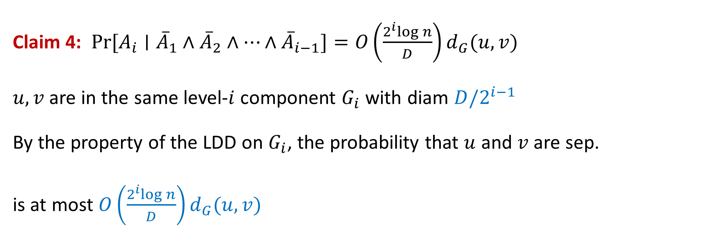
Probabilistic Tree Embedding
Claim 4: $\operatorname{Pr}{[A_{i}∣{\overline{A}}_{1}∧{\overline{A}}_{2}∧…∧{\overline{A}}_{i−1}]}=O\left(\frac{2^{i}log n}{D}\right)d_{G}(u,v)$
$u,v$ are in the same level-$i$ component $G_{i}$ with diam $D/2^{i−1}$
By the property of the LDD on $G_{i}$, the probability that $u$ and $v$are sep.
is at most $O\left(\frac{2^{i}log n}{D}\right)d_{G}(u,v)$

Slide 21
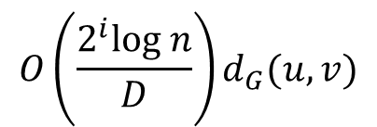
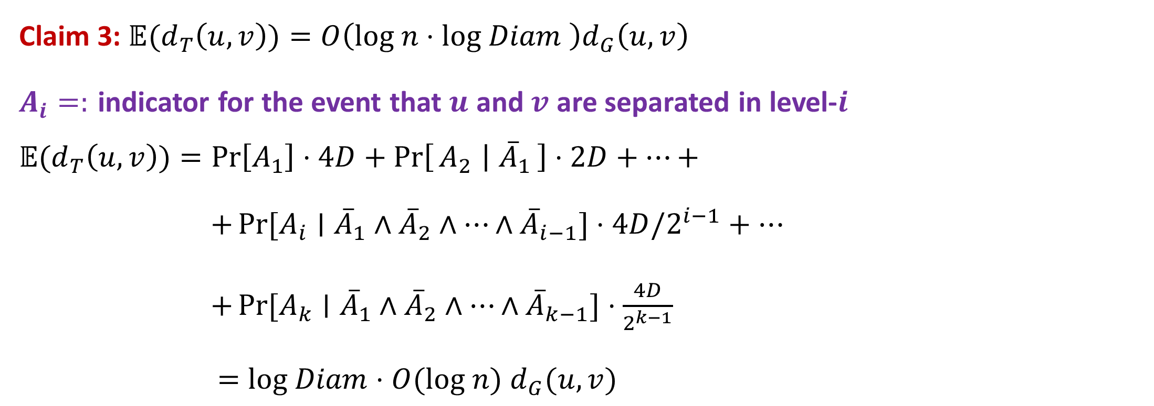
Probabilistic Tree Embedding
Claim 3: ${𝔼(d}_{T}\left(u,v\right))=O\left(log n⋅log Diam \right)d_{G}\left(u,v\right)$
$A_{i}=:$ indicator for the event that $u$ and $v$ are separated in level-$i$
$${𝔼(d}_{T}\left(u,v\right))=\operatorname{Pr}\left[A_{1}\right]⋅4D+\operatorname{Pr}\left[A_{2} ∣ {\overline{A}}_{1}\right]⋅2D+…+$$
$+\operatorname{Pr}{[A_{i}∣{\overline{A}}_{1}∧{\overline{A}}_{2}∧…∧{\overline{A}}_{i−1}]}⋅4D/2^{i−1}+…$
$+\operatorname{Pr}{[A_{k}∣{\overline{A}}_{1}∧{\overline{A}}_{2}∧…∧{\overline{A}}_{k−1}]}⋅\frac{4D}{2^{k−1}}$
$=log Diam$ $⋅O(log n)$ $d_{G}(u,v)$
$$O\left(\frac{2^{i}log n}{D}\right)d_{G}(u,v)$$

Slide 22
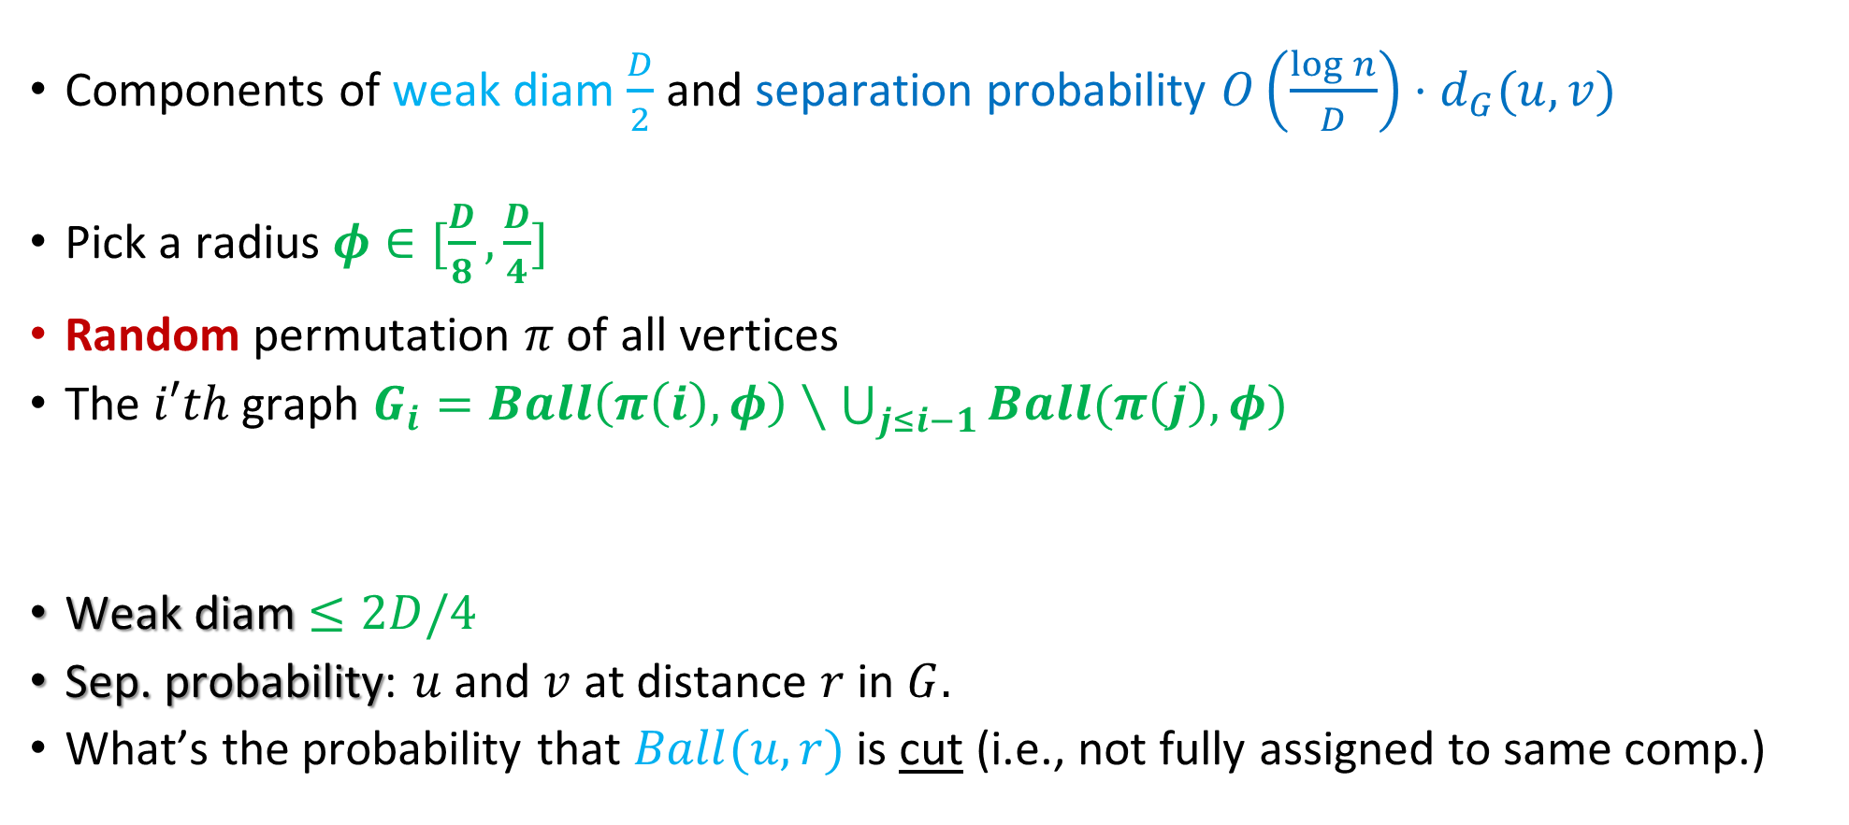
Alternative LDD [CKR01]
Components of weak diam $\frac{D}{2}$ and separation probability $O\left(\frac{\log{n}}{D}\right)⋅d_{G}(u,v)$
Pick a radius $φ∈[\frac{D}{8},\frac{D}{4}]$
Random permutation $π$ of all vertices
The $i′th$ graph $G_{i}=Ball\left(π\left(i\right),φ\right)∖\bigcup_{j≤i−1}{Ball(π\left(j\right),φ)}$
Weak diam $≤2D/4$
Sep. probability: $u$ and $v$ at distance $r$ in $G.$
What’s the probability that $Ball(u,r)$ is cut (i.e., not fully assigned to same comp.)

Slide 23

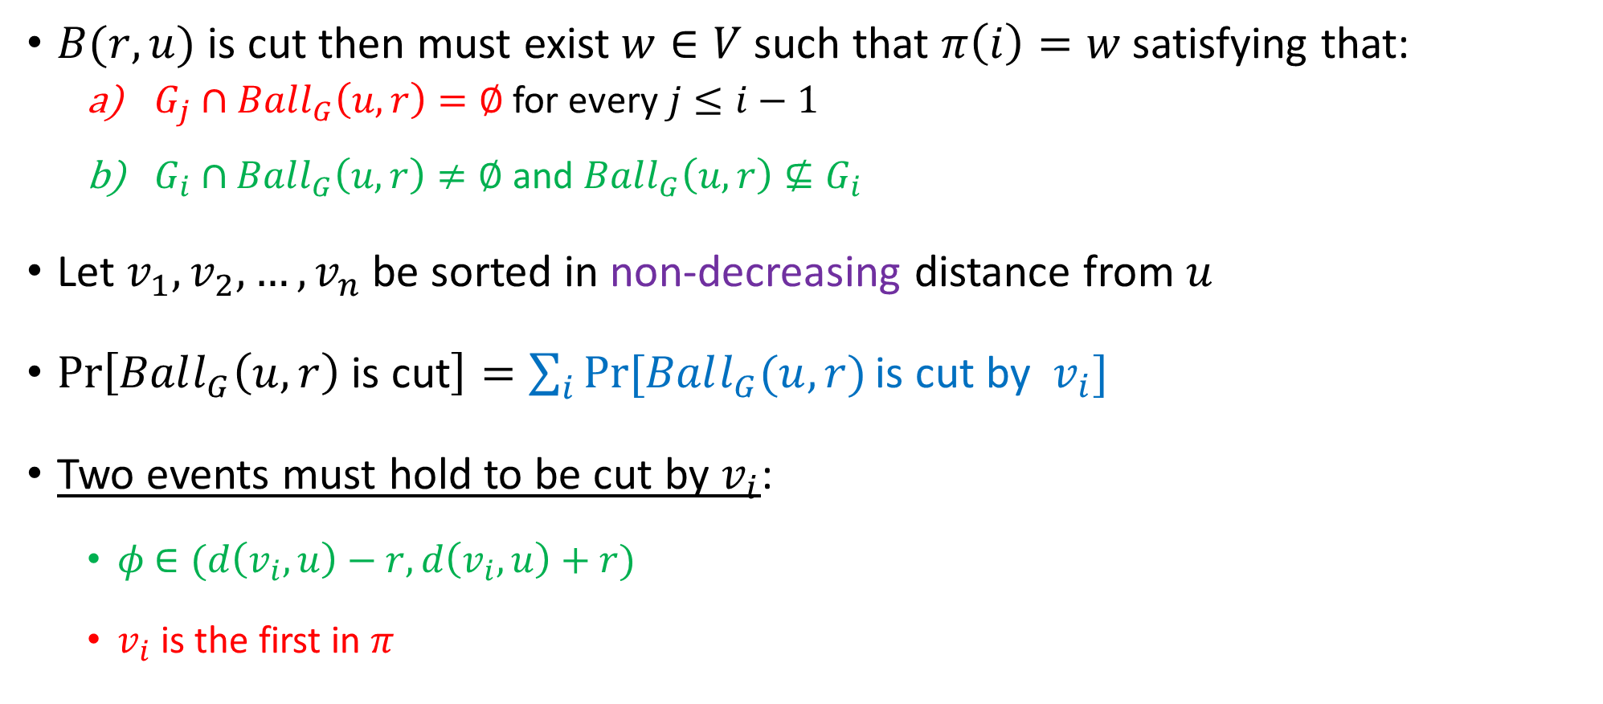


Alternative LDD [CKR01]: Cutting Probability
$B(r,u)$ is cut then must exist $w∈V$such that $π\left(i\right)=w$ satisfying that:
$G_{j}∩Ball_{G}\left(u,r\right)=∅$ for every $j≤i−1$
$G_{i}∩$ $Ball_{G}\left(u,r\right)≠∅$ and $Ball_{G}\left(u,r\right)⊈G_{i}$
Let $v_{1},v_{2},…, v_{n}$ be sorted in non-decreasing distance from $u$
$\operatorname{Pr}\left[Ball_{G}\left(u,r\right) \text{is} \text{cut}\right]=\sum_{i}{Pr⁡[Ball_{G}(u,r)}\text{is} \text{cut} \text{by} v_{i}]$
Two events must hold to be cut by $v_{i}$:
$φ$ $∈(d\left(v_{i},u\right)−r, d\left(v_{i},u\right)+r)$
$v_{i}$ is the first in $π$
$$Ball_{G}(u,r)$$
$$φ$$
$$v_{i}$$

Slide 24




Alternative LDD [CKR01]: Cutting Probability
$$\operatorname{Pr}\left[Ball_{G}\left(u,r\right) \text{is} \text{cut}\right]=\sum_{i}{Pr⁡[Ball_{G}(u,r)}\text{is} \text{cut} \text{by} v_{i}]$$
$≤\sum_{i}{\frac{2r}{D/8}⋅\frac{1}{i}}=O(\ln{n/D))r}$
Two events must hold to be cut by $v_{i}$:
$φ$ $∈(d\left(v_{i},u\right)−r, d\left(v_{i},u\right)+r)$
$v_{i}$ is the first in $π$
$$Ball_{G}(u,r)$$
$$φ$$
$$v_{i}$$

Slide 25
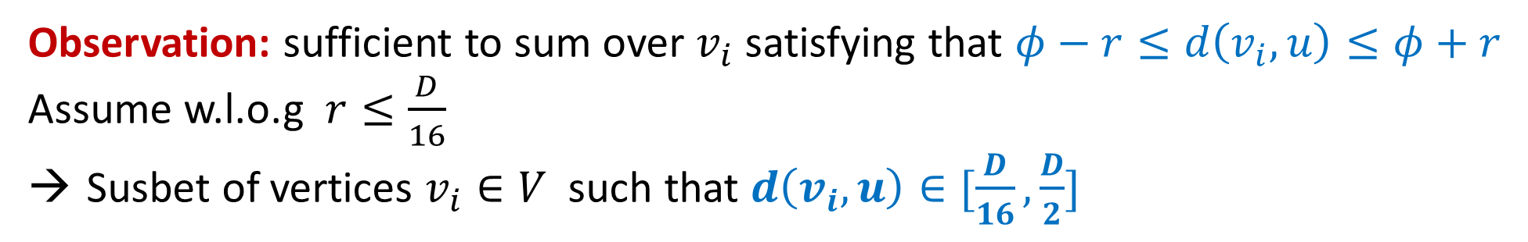

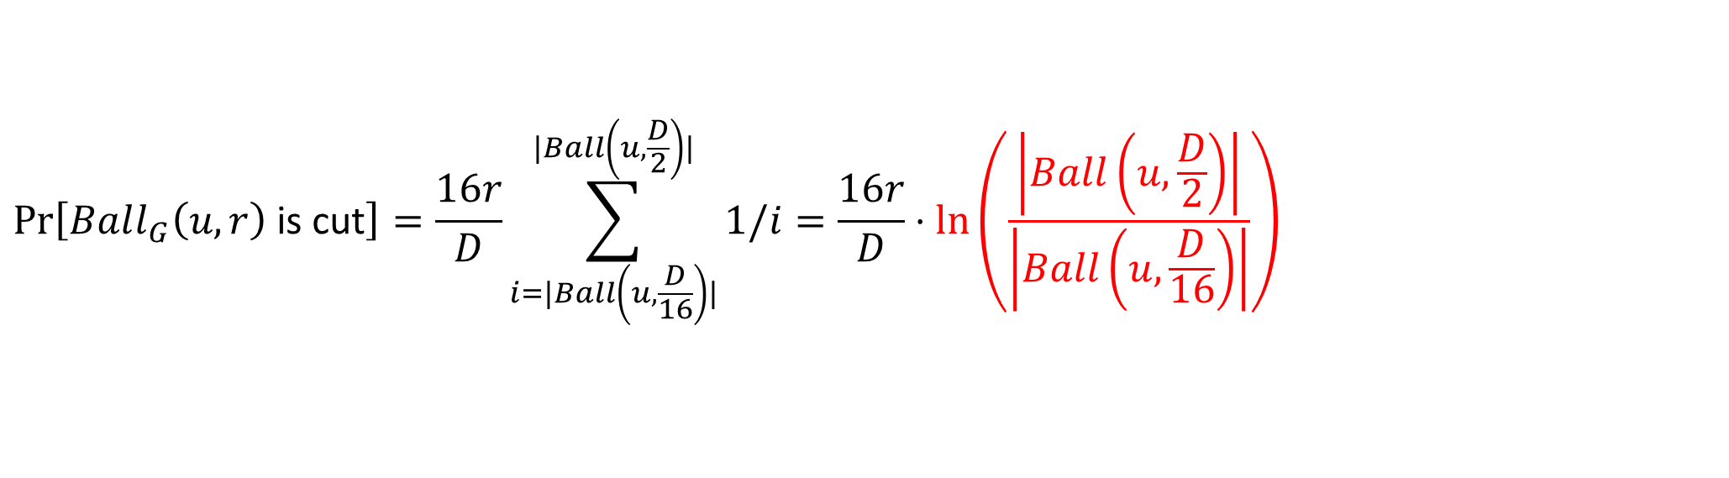
Improved Analysis
$\operatorname{Pr}\left[Ball_{G}\left(u,r\right) \text{is} \text{cut}\right]=\sum_{i}{Pr⁡[Ball_{G}(u,r)}\text{is} \text{cut} \text{by} v_{i}]≤\sum_{i}{\frac{2r}{D/8}⋅\frac{1}{i}}=O(\ln{n/D))r}$
Observation: sufficient to sum over $v_{i}$ satisfying that $φ−r≤d\left(v_{i}, u\right)≤φ+r$
Assume w.l.o.g $r≤\frac{D}{16}$
Susbet of vertices $v_{i}∈V$ such that $d\left(v_{i}, u\right)∈[\frac{D}{16},\frac{D}{2}]$
$$\operatorname{Pr}\left[Ball_{G}\left(u,r\right) \text{is} \text{cut}\right]=\frac{16r}{D}\sum_{i=|Ball\left(u,\frac{D}{16}\right)|}^{|Ball\left(u,\frac{D}{2}\right)|}{1/i}=\frac{16r}{D}⋅\ln\left(\frac{\left|Ball\left(u,\frac{D}{2}\right)\right|}{\left|Ball\left(u,\frac{D}{16}\right)\right|}\right)$$
$$α_{D}$$

Slide 26
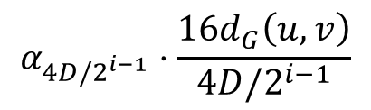
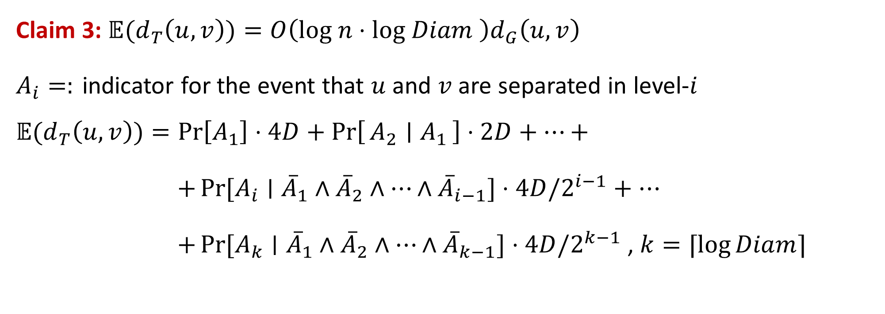
Improved Stretch of Probabilistic Tree Embedding
Claim 3: ${𝔼(d}_{T}\left(u,v\right))=O\left(log n⋅log Diam \right)d_{G}\left(u,v\right)$
$A_{i}=:$ indicator for the event that $u$ and $v$ are separated in level-$i$
$${𝔼(d}_{T}\left(u,v\right))=\operatorname{Pr}\left[A_{1}\right]⋅4D+\operatorname{Pr}\left[A_{2} ∣ A_{1}\right]⋅2D+…+$$
$+\operatorname{Pr}{[A_{i}∣{\overline{A}}_{1}∧{\overline{A}}_{2}∧…∧{\overline{A}}_{i−1}]}⋅4D/2^{i−1}+…$
$+\operatorname{Pr}{[A_{k}∣{\overline{A}}_{1}∧{\overline{A}}_{2}∧…∧{\overline{A}}_{k−1}]}⋅4D/2^{k−1}$ , $k=⌈\log{Diam⌉}$
$$α_{4D/2^{i−1}}⋅\frac{16d_{G}\left(u,v\right)}{4D/2^{i−1}}$$

Slide 27

Probabilistic Tree Embedding
Improved Claim 3: ${𝔼(d}_{T}\left(u,v\right))=O\left(log n\right)d_{G}\left(u,v\right)$
$${𝔼(d}_{T}\left(u,v\right))=4⋅d_{G}\left(u,v\right)\left(α_{D}+α_{\frac{D}{2}}+…+α_{1}\right)≤12 ln n{⋅d}_{G}(u,v)$$

