Slide 1
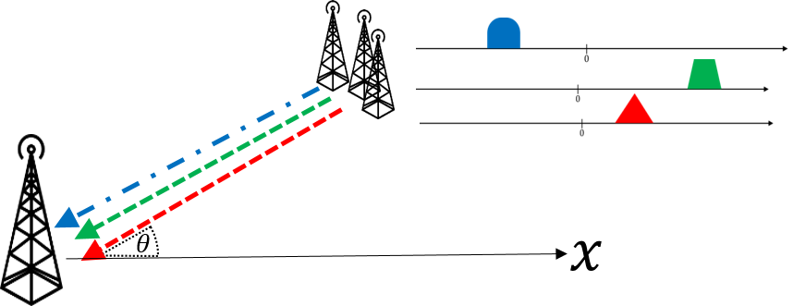


Uniform Linear Array based Spectrum Sensing from sub-Nyquist Samples
Or Yair, Shahar Stein
Supervised by Deborah Cohen and Prof. Yonina C. Eldar
December 7, 2015

Slide 2
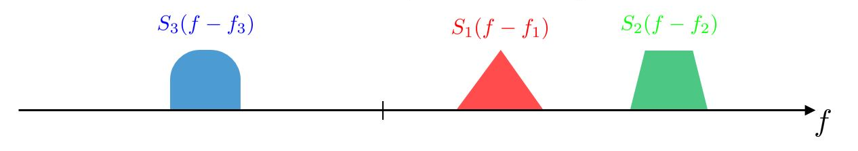
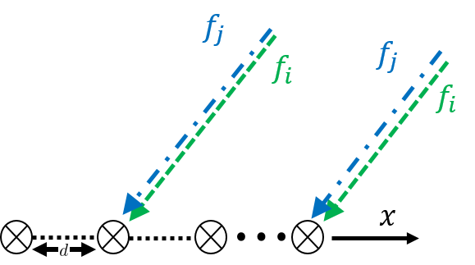

Signal Model
Multiband sparse signal
Each transmission $s_{i}$ corresponds to a carrier frequency, $f_{i}$
Each transmission $s_{i}$ is narrow band of maximum bandwidth $B$
All transmissions are assumed to have identical and known angle of arrival $θ≠{90}^{o}$
Goal: Perfect blind signal reconstruction from sub-Nyquist samples

Slide 3
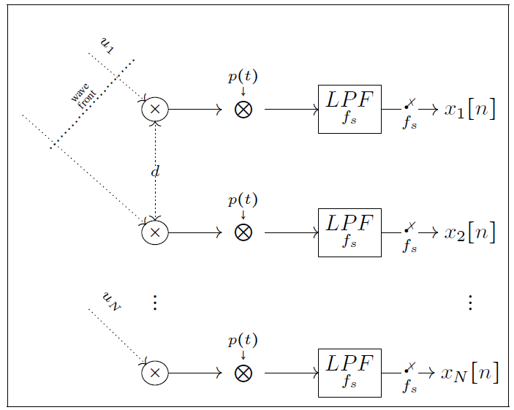
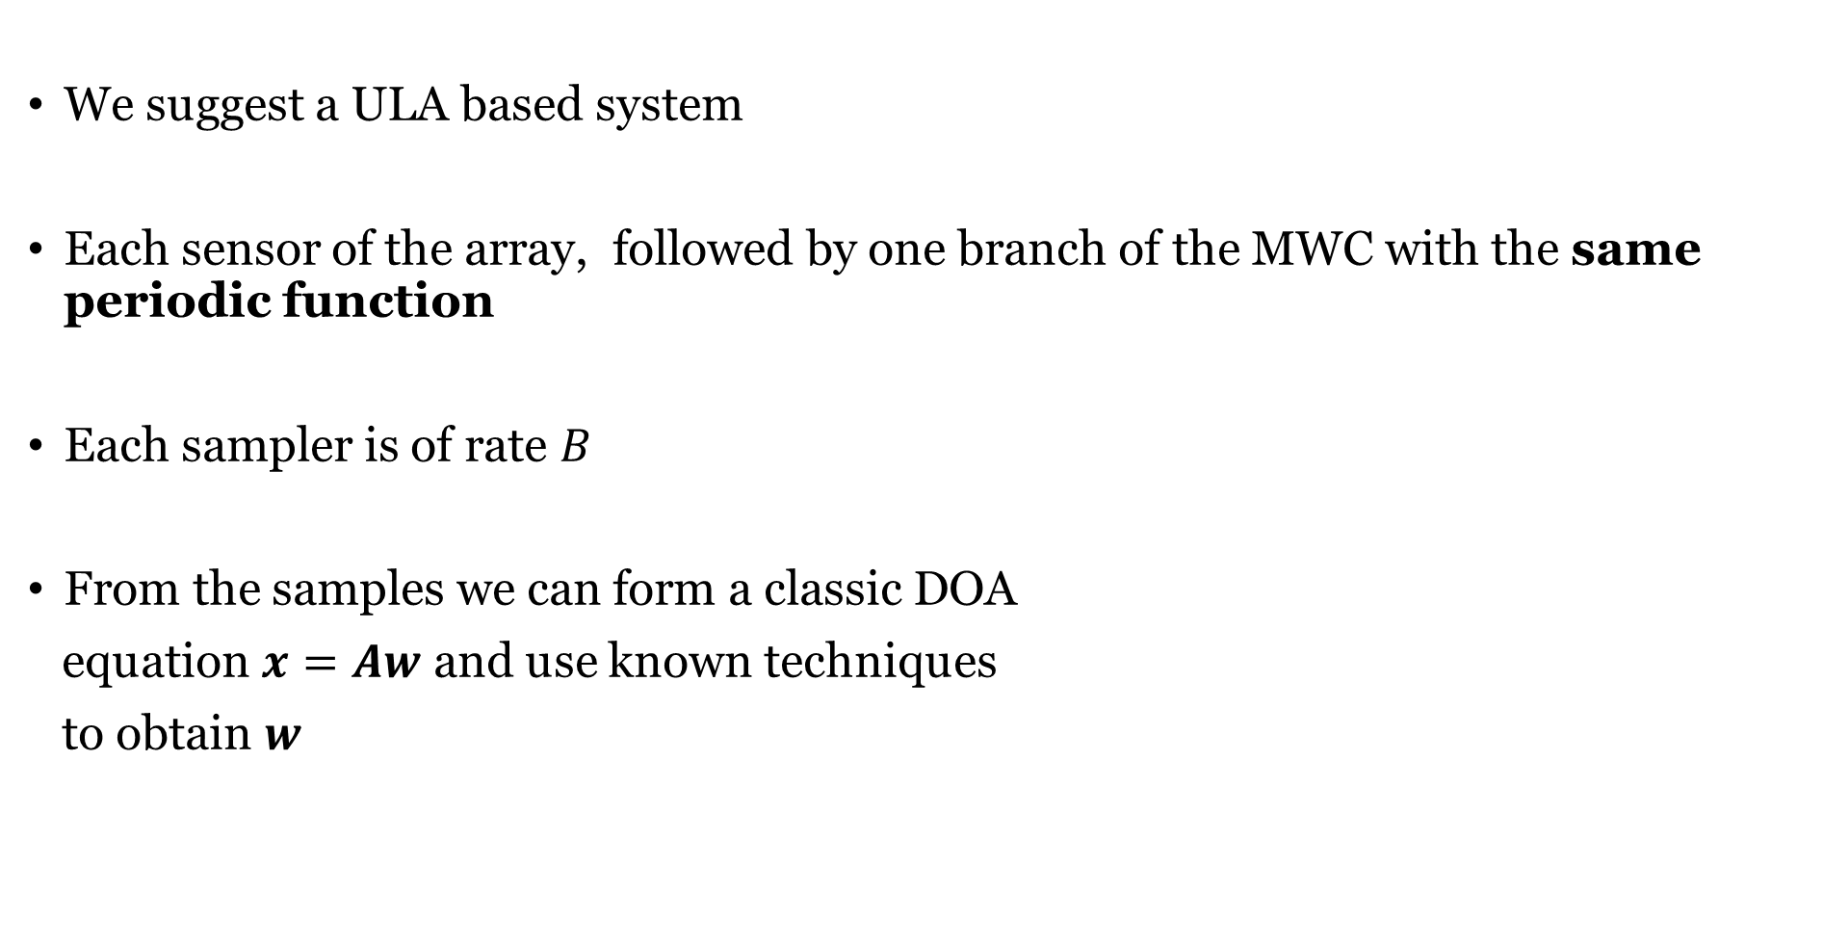

Proposed Algorithm
We suggest a ULA based system
Each sensor of the array, followed by one branch of the MWC with the same periodic function
Each sampler is of rate $B$
From the samples we can form a classic DOA
equation $x=Aw$ and use known techniques
to obtain $w$
We show that the a sufficient condition is $M+1$ samplers

Slide 4







System Description
The received signal at the $n$’th sensor:
$u_{n}\left(t\right)≈\sum_{i=1}^{M}{s_{i}\left(t\right)e^{j2πf_{i}(t+τ_{n})}}$
The mixed signal after multiplying with periodic function:
${\tilde{Y}}_{n}\left(f\right)$=$\sum_{l=−∞}^{∞}{c_{l}}\sum_{i=1}^{M}{S_{i}\left(f−f_{i}−lf_{p}\right)e^{j2πf_{i}τ_{n}}}$
$$S_{3}(f−f_{3})$$
$$S_{1}(f−f_{1})$$
$$S_{2}(f−f_{2})$$
$$0$$
$$B$$
$$0$$

Slide 5


System Description
The filtered signal at the baseband:
${\tilde{Y}}_{n}\left(f\right)$=$\sum_{i=1}^{M}{{\tilde{S}}_{i}\left(f\right)e^{j2πf_{i}τ_{n}}} ,$
$${\tilde{S}}_{i}\left(f\right)=\sum_{l=−L_{0}}^{L_{0}}{c_{l}}S_{i}\left(f−f_{i}−lf_{p}\right)$$
The sampled signal:
$$X_{n}\left(e^{j2πfT_{s}}\right)=\sum_{i=1}^{M}{W_{i}\left(e^{j2πfT_{s}}\right)e^{j2πf_{i}τ_{n}}}$$
$$w_{i}\left[k\right]={\tilde{s}}_{i}(kT_{s})$$
$$0$$
The unknown frequencies are held at the relative accumulated phase

Slide 6
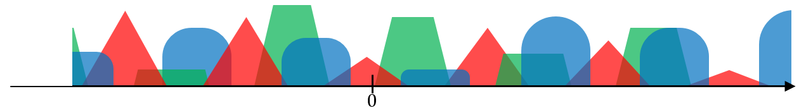
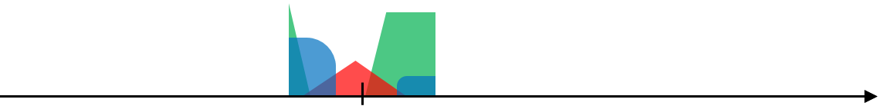

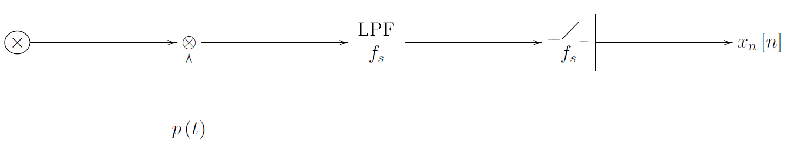


Sampling Scheme
Modified MWC sampling chain.
All sensors use the same periodic function with period $f_{p}$
Single sensor output:
Sufficient condition on $f_{s}{,f}_{p}$:
$$f_{s}≥f_{p}≥B$$

Slide 7
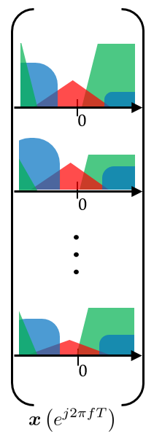

Sampling Scheme
Our measurements
The sampling scheme is simpler than the MWC, since the same sequence can be used in all cannels

Slide 8





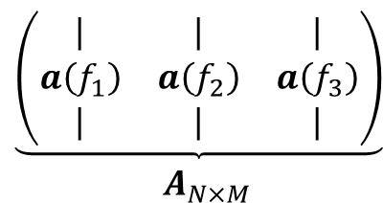






Basic Equation
Similar to classic DOA equation
Source Signal vector is scaled and cyclic-shifted
$$0$$
$$\begin{matrix}\underbrace{\left(\begin{matrix}| & | & | \\ a\left(f_{1}\right) & a\left(f_{2}\right) & a\left(f_{3}\right) \\ | & | & |\end{matrix}\right)} \\ A_{N×M}\end{matrix}$$
$$0$$
$$0$$
$$0$$
$$0$$
$$0$$
$$0$$
$$W\left(e^{j2πfT_{s}}\right)$$
$$X\left(e^{j2πfT_{s}}\right)$$
Goal: estimate $f$ and $w$

Slide 9
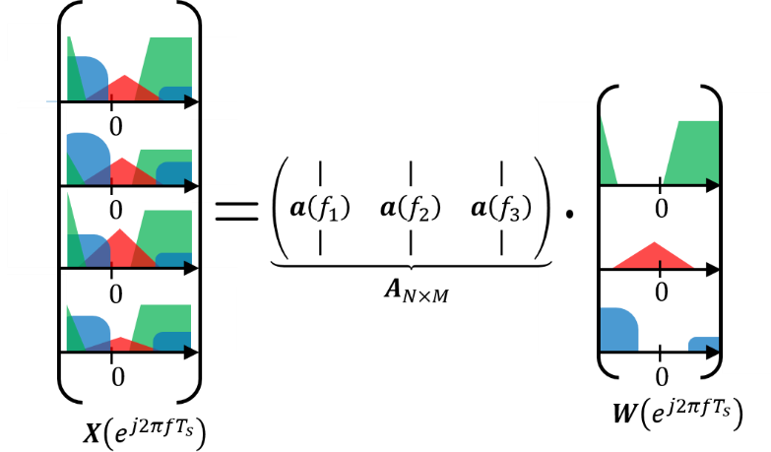
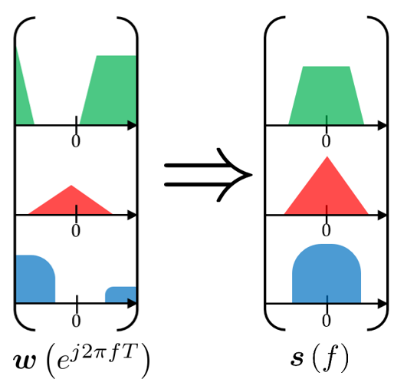

Reconstruction Steps
Estimate all frequencies $\left\{f_{i}\right\}$.
Reconstruct the steering matrix $A\left(f\right)$.
Calculate $w=A^{†}x$
Uniquely recover $s$ from $w$.

Slide 10

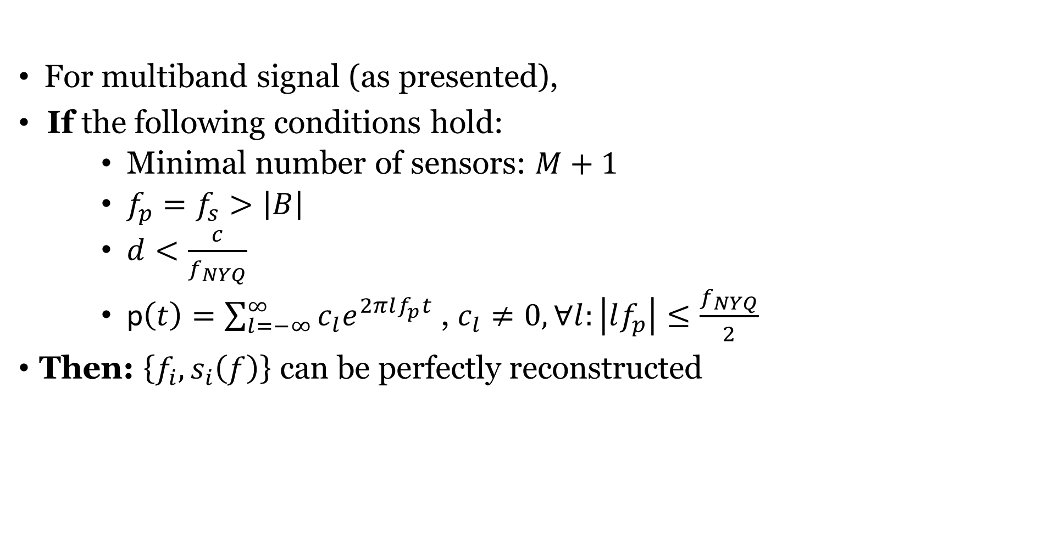
Theorem
For multiband signal (as presented),
If the following conditions hold:
    Minimal number of sensors: $M+1$
    ${f_{p}=f}_{s}>\left|B\right|$
    $d<\frac{c}{f_{NYQ}}$
    p$\left(t\right)=\sum_{l=−∞}^{∞}{c_{l}e^{2πlf_{p}t}}$, $c_{l}≠0,∀l:\left|lf_{p}\right|≤\frac{f_{NYQ}}{2}$
Then: $\left\{f_{i},s_{i}\left(f\right)\right\}$ can be perfectly reconstructed
Achievable sampling rate: $\left(M+1\right)B$

Slide 11
Simulations
For the ULA based system 2 reconstruction methods were tested:
  ESPRIT – analytic method based on SVD
  MMV – CS method based on OMP algorithm
The performance were compared against the MWC
Both systems used the same amount of samplers
  At the ULA based system – the number of sensors
  At the MWC – the number of branches

Slide 12
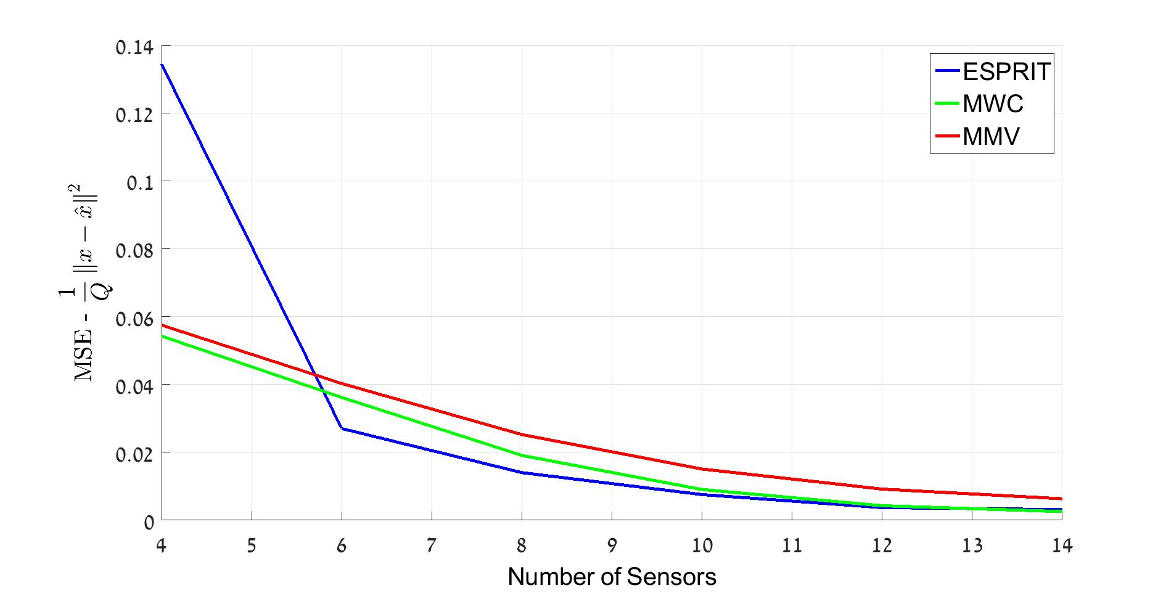
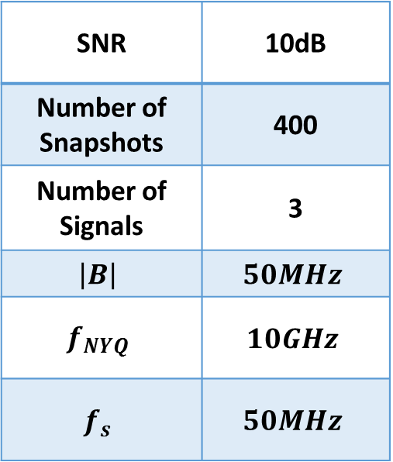
Simulations
Performance against different number of sensors
  For the MWC system: the amount of branches
10dB | SNR
400 | Number of Snapshots
3 | Number of Signals
$$50MHz$$ | $$\left|B\right|$$
$$10GHz$$ | $$f_{NYQ}$$
$$50MHz$$ | $$f_{s}$$

Slide 13
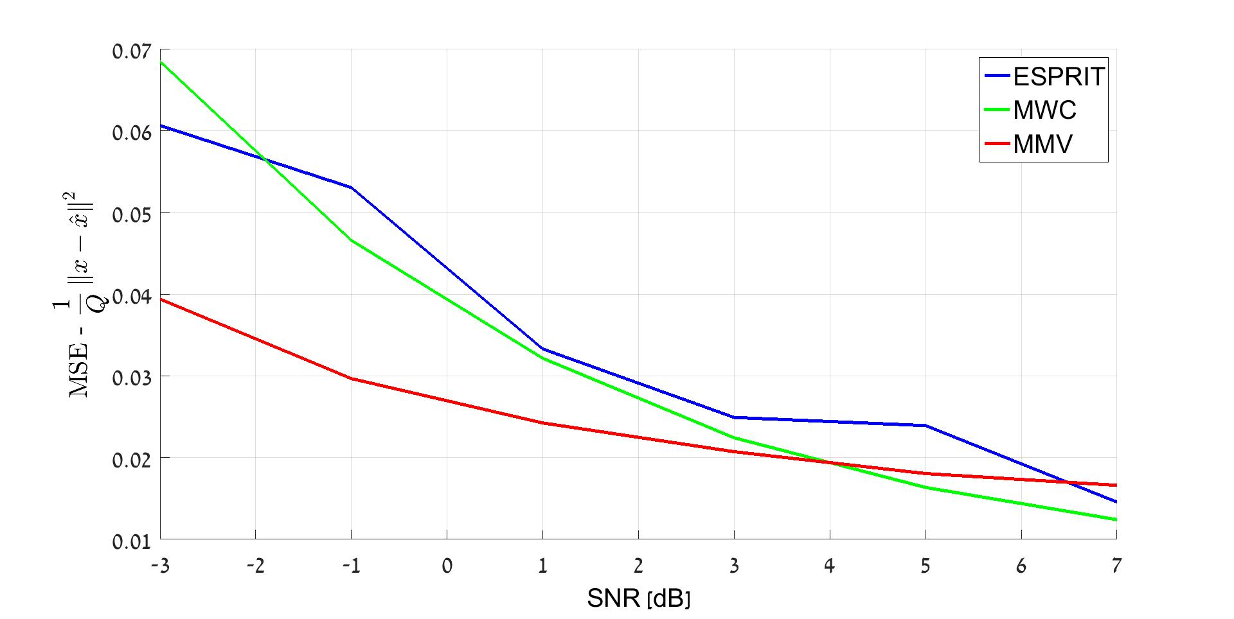
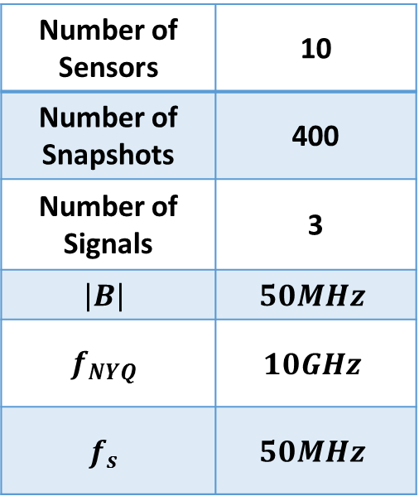


Simulations
Performance against different SNR
10 | Number of Sensors
400 | Number of Snapshots
3 | Number of Signals
$$50MHz$$ | $$\left|B\right|$$
$$10GHz$$ | $$f_{NYQ}$$
$$50MHz$$ | $$f_{s}$$
$$⇓$$
Sampling Rate: $500MHz$

Slide 14
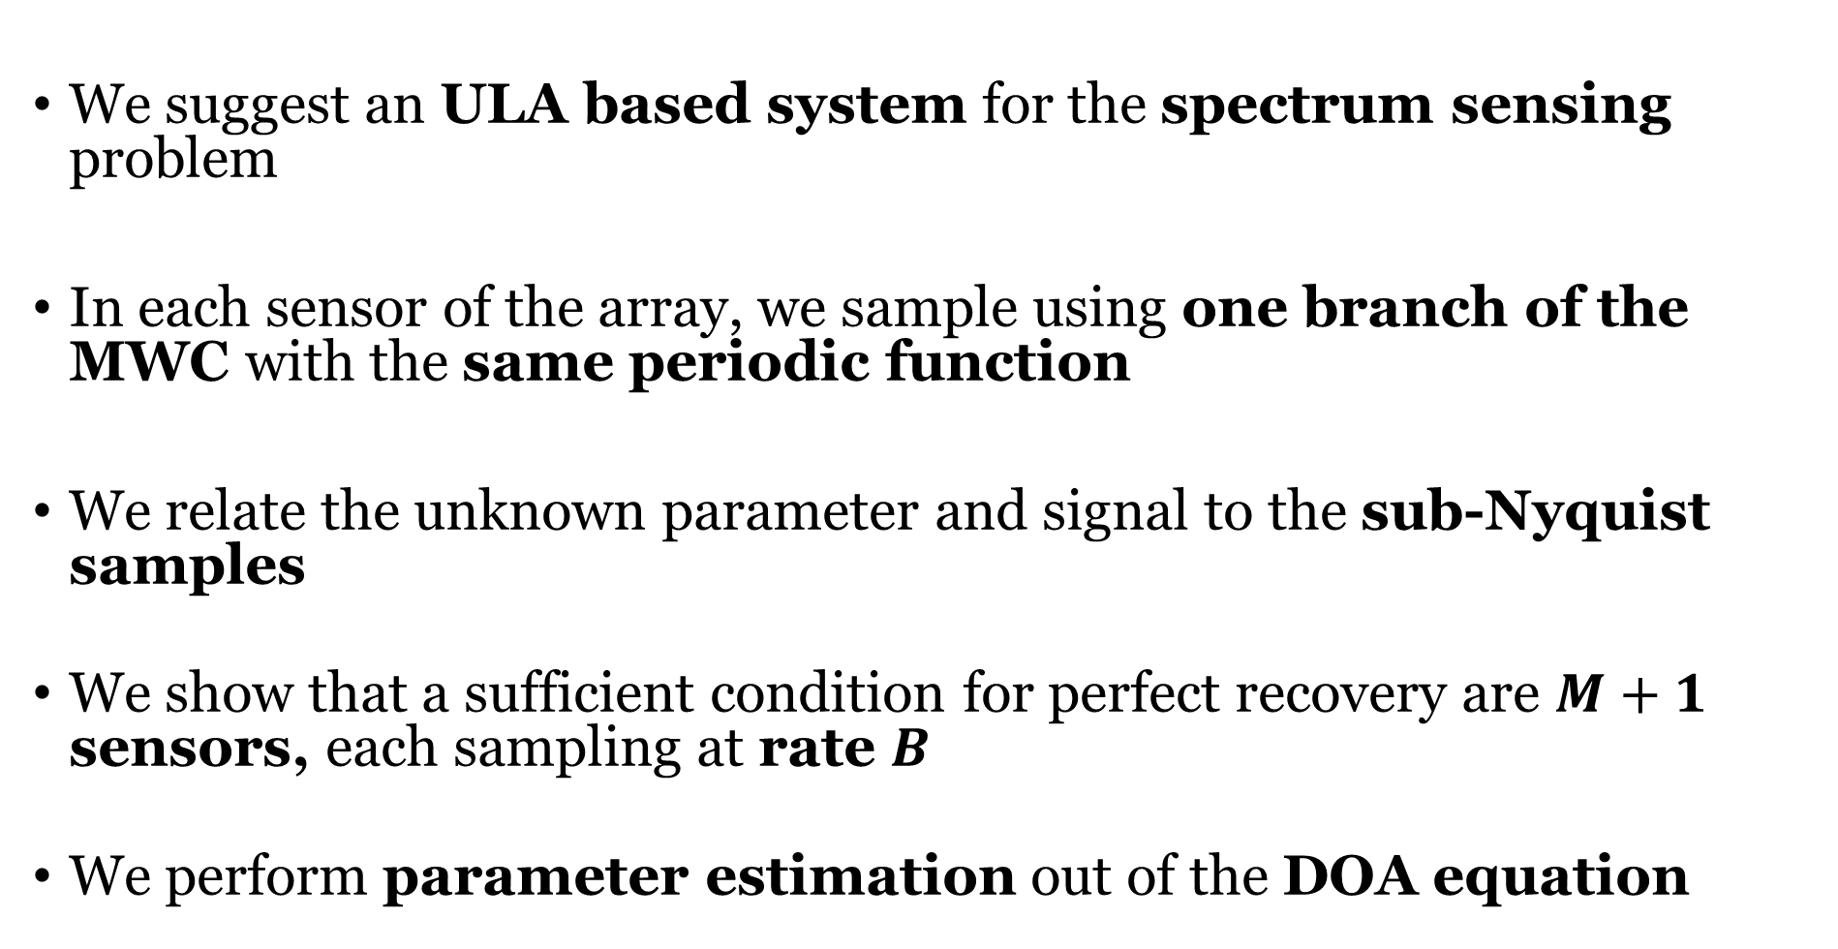
Summary
We suggest an ULA based system for the spectrum sensing problem
In each sensor of the array, we sample using one branch of the MWC with the same periodic function
We relate the unknown parameter and signal to the sub-Nyquist samples
We show that a sufficient condition for perfect recovery are $M+1$ sensors, each sampling at rate $B$
We perform parameter estimation out of the DOA equation

Slide 15

Questions?
Thank you for listening

