Slide 1

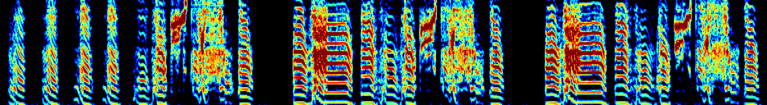
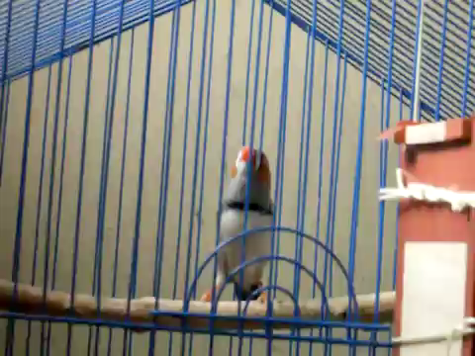
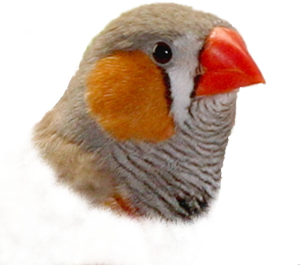
Songbirds sing! Adult song is highly stereotyped
motif
Zebra finch
bout
syllables
Frequency
time
~1sec
There are two modes of singing:
Directed singing
Undirected singing
Ofer Tchernichovski’s Lab (CUNY)

Slide 2
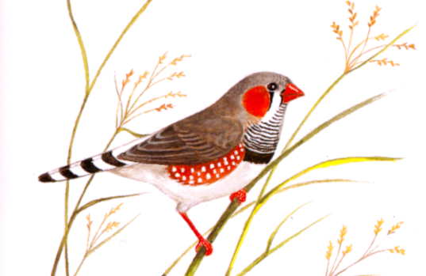


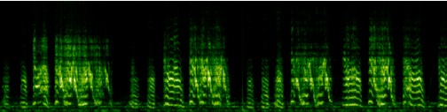
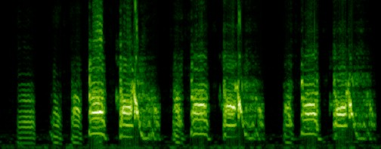
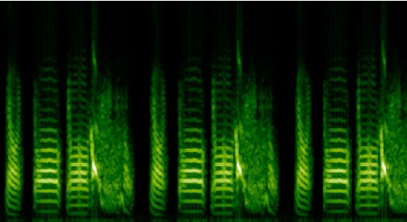
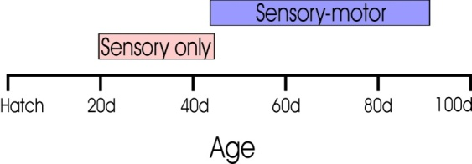
Songbirds learn to sing by imitating their tutor
Press on the sonograms to hear the sound waves
Subsong
40d
60d
Plastic Song
Song Variability
Similarity to Tutor
90d
Crystallized
subsong
crystallized song
plastic song
Tutor Song
Age (days)

Slide 3
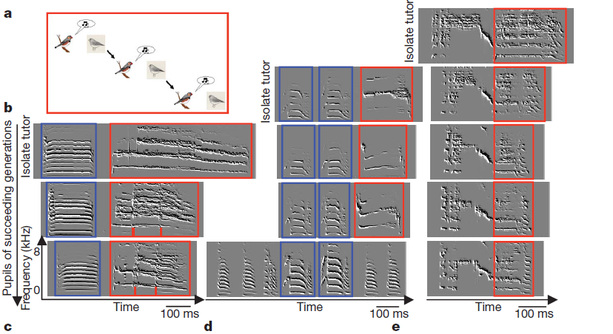
"recursive equation"
Song evolved towards the wild-type in three to four generations. Thus, species-typical song culture can appear de novo.
Fehe´r et al. Nature 2009
The lab of Ofer Tchernichovski

