Slide 1
Noble (liquid) Dreams
Amos Breskin
Weizmann Institute of Science

Slide 2

Noble (liquid) Dreams
Amos Breskin
Weizmann Institute of Science
Detection solutions for LARGE-VOLUME noble-liquid detectors

Slide 3
The reality

Slide 4
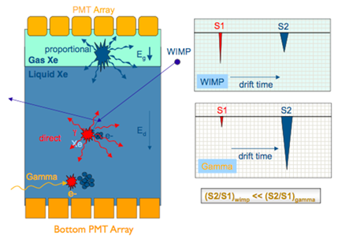
CLASSICAL DUAL-PHASE NOBLE-LIQUID TPC
Present:
XENON100, ZEPLIN, LUX….
Under design:
XENON1ton
Future:
MULTI-TON (e.g. Darwin):
COST
STABILITY
THRESHOLD
A two-phase TPC. WIMPs interact with noble liquid; primary scintillation (S1) is detected by bottom PMTs immersed in liquid. Ionization-electrons from the liquid are extracted under electric fields (E_{d}, and E_{g}) into the saturated-vapor above liquid; they induce electroluminescence in the gas phase – detected with the top PMTs (S2). The ratio S2/S1 provides means for discriminating gamma background from WIMPs recoils, due to the different scintillation-to-ionization ratio of nuclear and electronic recoils.

Slide 5
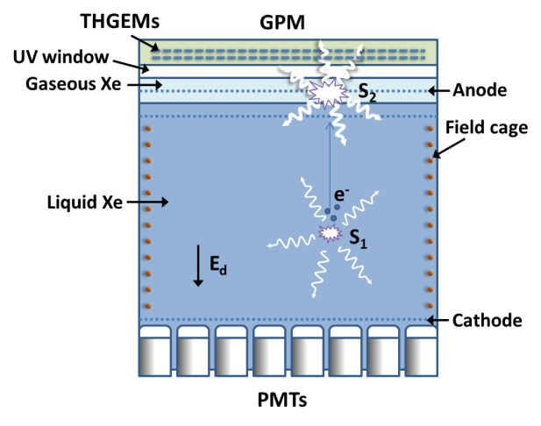
Dual-phase TPC with GPM* S2 sensor
GPM
*GPM: Gaseous Photomultiplier
A proposed concept of a dual-phase DM detector. A large-area Gaseous Photo-Multiplier (GPM) (operated with a counting gas) is located in the saturated gas-phase of the TPC; it records, through a UV-window, and localizes the copious electroluminescence S2 photons induced by the drifting ionization electrons extracted from liquid. In this concept, the feeble primary scintillation S1 signals are preferably measured with vacuum-PMTs immersed in LXe. Under advanced R&D at WIS.

Slide 6
Why Gaseous Photomultipliers?
Present day PMTs for DM searches
Cryogenic GPMs for future large-scale DM searches
QE >30% @ 175 nm
(QE_{eff} < 20% ; low fill factor)
Low radioactivity
Off-the-shelf
Years of proven operation
… But:
~M$/m²
Limited filling factor
Pixel size = PMT diameter
Cost effective coverage of large areas
QE_{eff} ~20% @ 175 nm with high filling factor
Can be of low radioactivity
Flat, thin geometry
Pixelated readout
May allow 4π coverage
Basic technology well understood and mastered

Slide 7
Example: a triple-THGEM GPM
UV window (quartz)
mesh
most negative HV
V1_{top}
CsI photocathode
V1_{bot}
Gas: Ne/CF₄ or Ne/CH₄
V2_{top}
V2_{bot}
~10 mm
V3_{top}
V3_{bot}
Pixilated readout
ground

Slide 8
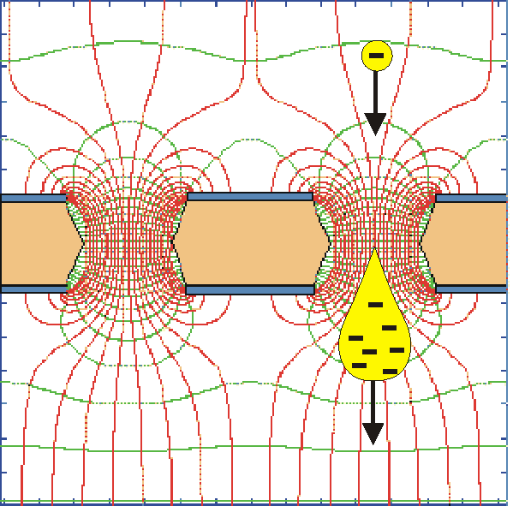
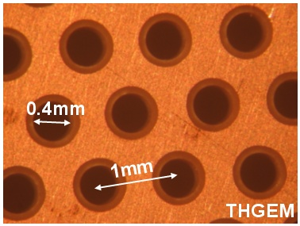
The Thick Gas Electron Multiplier (THGEM)
Chechik 2004
drilled
THGEM
1e⁻ in
etched
ΔV_{THGEM}
0.5 mm
E
10⁴- 10⁵ e⁻s out
Thickness 0.5-1mm
Double-THGEM: 10-100 higher gains
SIMPLE, ROBUST, LARGE-AREA
Printed-circuit technology
(Also of radio-clean materials)
Robust, if discharge no damage
Effective single-electron detection
Few-ns RMS time resolution
Sub-mm position resolution
>MHz/mm² rate capability
Cryogenic operation: OK
Broad pressure range: 1mbar - few bar

Slide 9
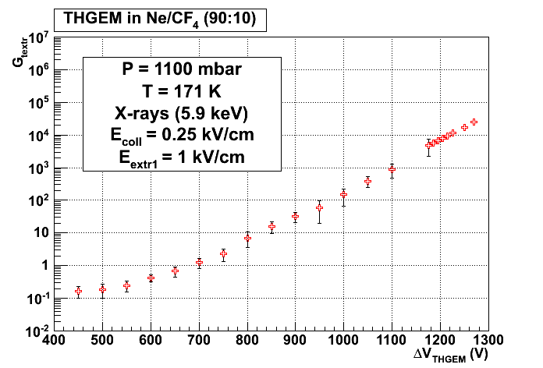
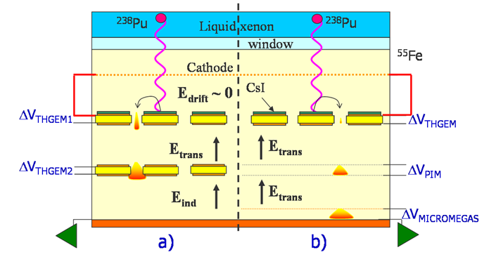
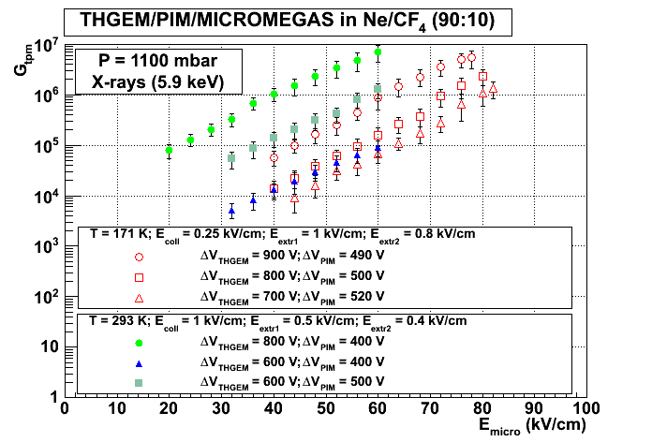
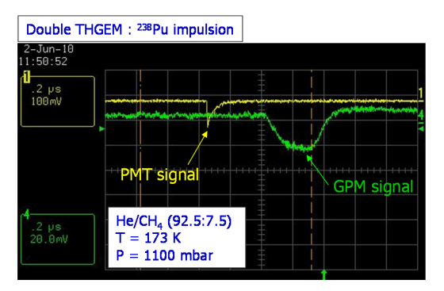
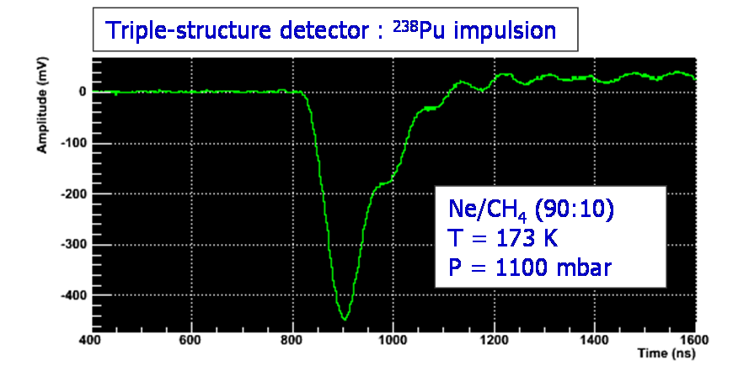
LXe-TPC/GPM
Nantes/Weizmann
1-THGEM
10⁴
171K
RT
10⁷
171K
173K, 1100mbar
Duval 2011 JINST 6 P04007

Slide 10
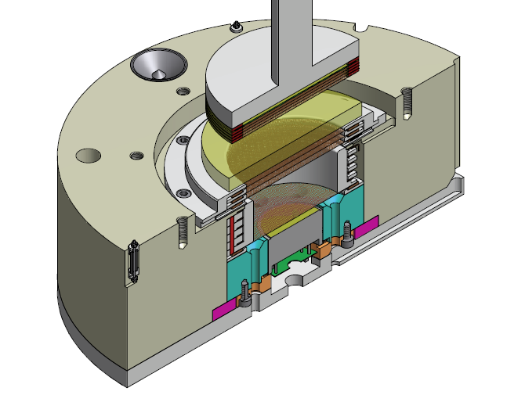
GPM test setup
GPM (cascaded-THGEM) with pixelated readout
UV window
LXe
anode
gate
PMT
cathode
Operational Feb 2013

Slide 11
Towards single-phase TPCs?
Simpler techniques?
Sufficient signals?
Lower thresholds?
Cheaper?
How to record best scintillation & ionization S1, S2?

Slide 12
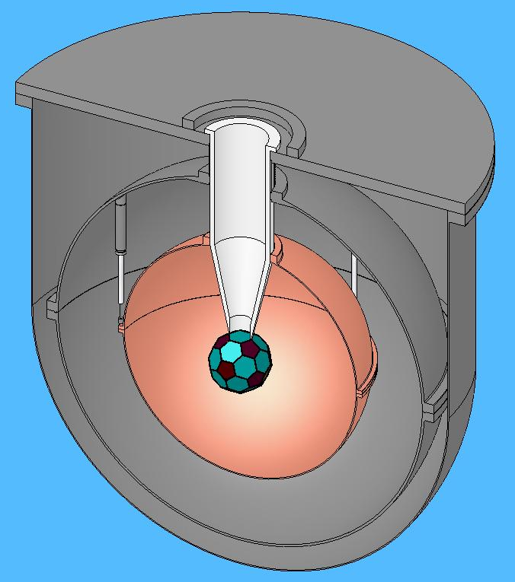
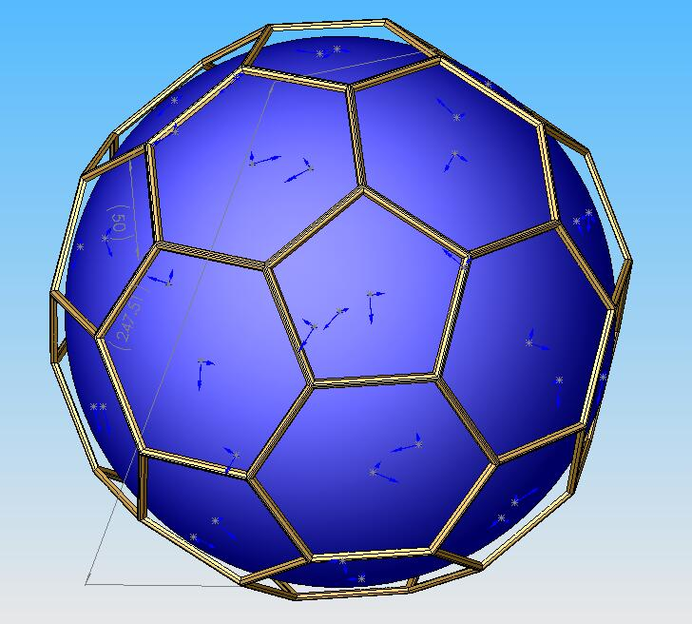
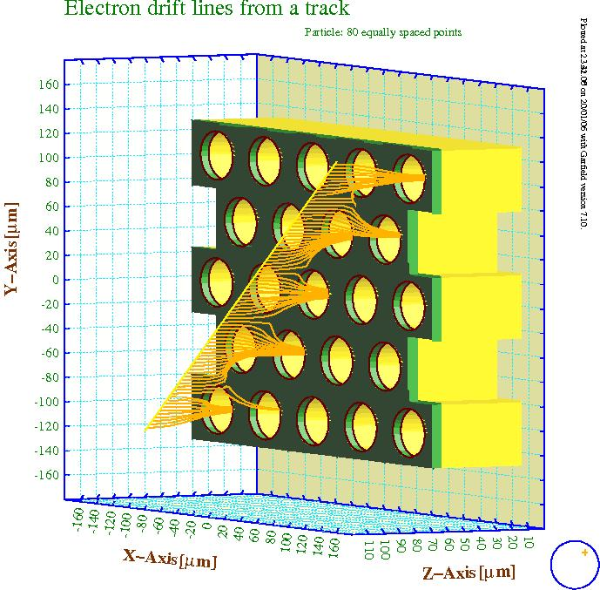
Single-phase spherical L-TPC
Central ball 4π covered with charge collecting and amplifying micro-structure (e.g. GEM)
in liquid phase
P. Majewski, LNGS 2006
S1: photoelectrons from CsI
S2: ionization electrons
S1, S2 electrons multiplied at the central ball
Feedback occurs as well
LXe
LXe
CsI Photocathode
GEM
Requirements:
Sensitivity to single electron
High readout segmentation for
position information
Unknown status
Idea: amplification in liquid phase

Slide 13
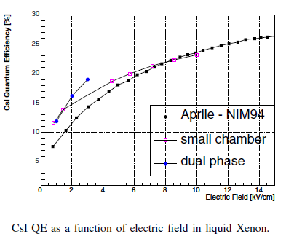

Two-phase LXe/CsI: QE of CsI in LXe
LXe-immersed CsI
Performance of Dual Phase XeTPC with CsI Photocathode and PMTs readout for the Scintillation Light
E. Aprile, K.L. Giboni, S. Kamat, P. Majewski, K. Ni, B.K. Singh and M. Yamashita. IEEE ICDL 2005, p345
QE~25%
PMTs
E
CsI
S2
S3
S4 photon-feedback
can be suppressed
by field gating
E
e⁻
S1
e⁻
e⁻
CsI
Idea not yet materialized

Slide 14
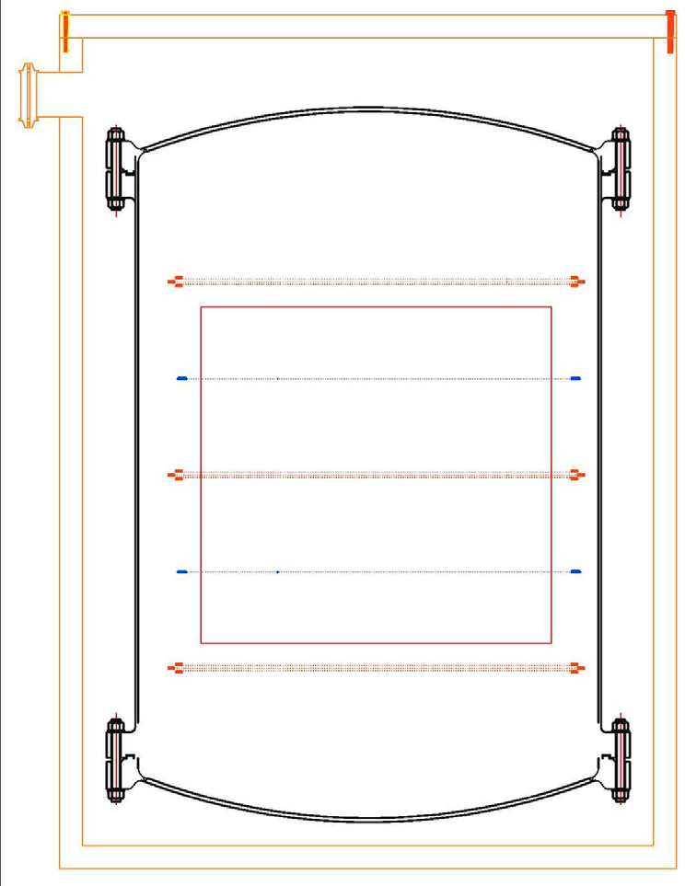
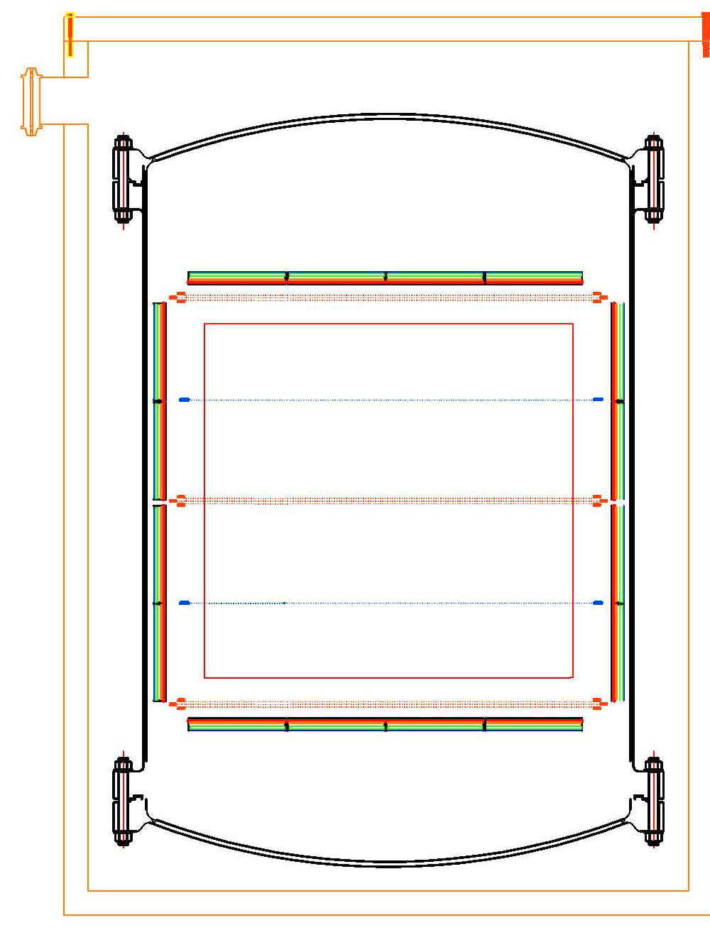
Single-phase option for PANDA
Karl Giboni
KEK Seminar Nov 2011
4π geometry with
immersed GPMs
Anode-wire planes: S1 & S2
GPM
LXe level
photosensors
A
A
C
C
A
A
C
C
A
A
photosensors
Demo facility in course

Slide 15
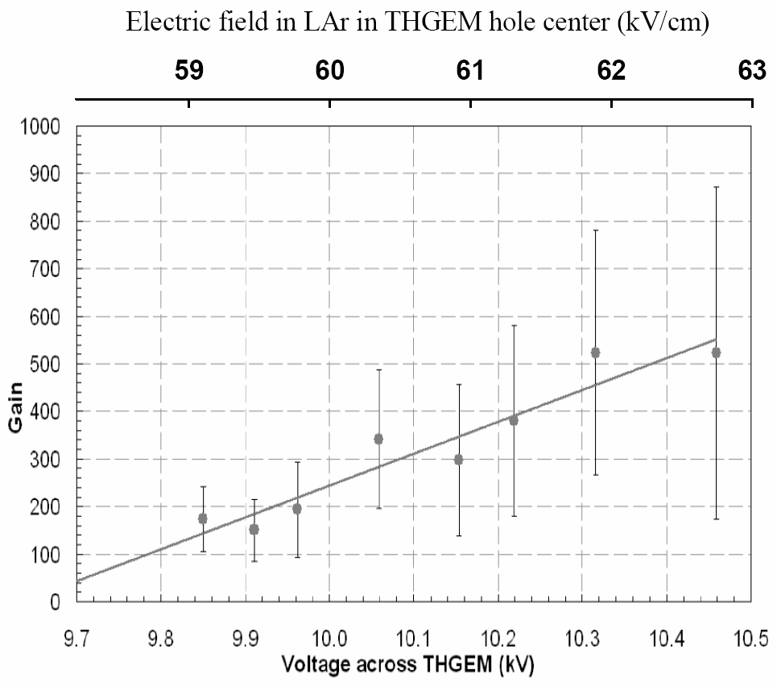
LXe: some relevant numbers
Saturation of e⁻ drift velocity: ~2.6 mm/ms @ 3 kV/cm
Threshold field for proportional scintillation: ~400 kV/cm
Threshold field for avalanche multiplication: ~1 MV/cm
Doke NIM 1982
Maximum charge gain measured 200-400 on:
wires, strips, spikes…
& LAr:
~500 UV photons/e⁻ over 4π
measured with gAPD/WLS in
THGEM holes in LAr
Lightfoot, JINST 2009
THGEM holes in LAr

Slide 16
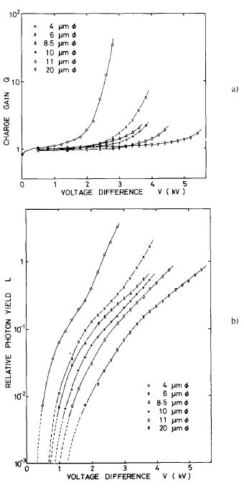
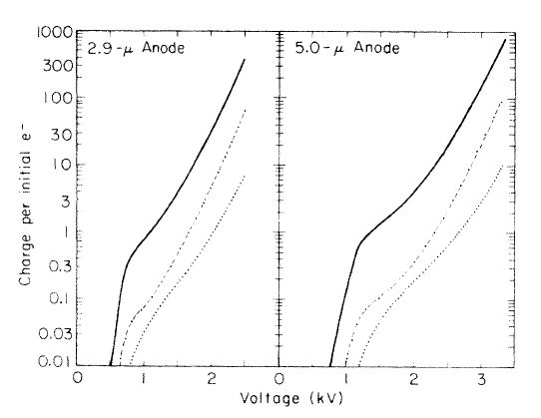
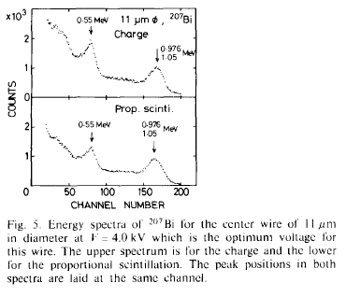
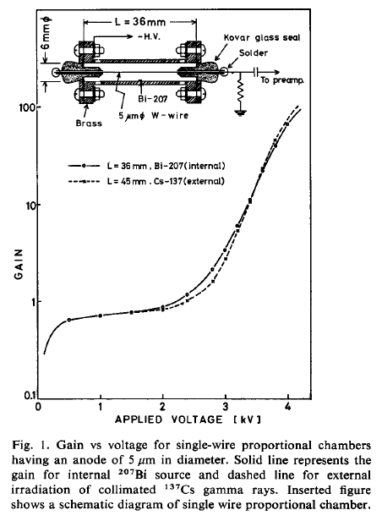
The 70ties: Charge gain & Light yield in wires/LXe
Derenzo PR A 1974
Max gain ~400
Masuda NIM 1979
LXe
LXe: Charge gain & proportional scintillation on a single wire
LXe
LXe
Miyajima NIM 1976
Max gain ~100

Slide 17
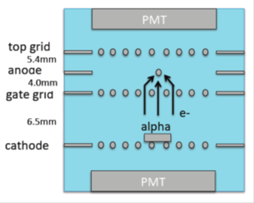
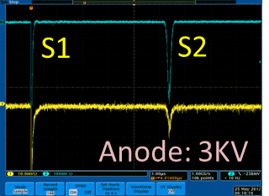
Electroluminescence on thin wires
E. Aprile 2012, private communication
Recent alpha-induced scintillation S1 and S2 electroluminescence signals recorded from a 10 micron diameter wire in LXe. Setup shown on left.
R&D in course

Slide 18
Wires are delicate & gains are limited:
Let’s play with electroluminescence in holes & photocathodes

Slide 19
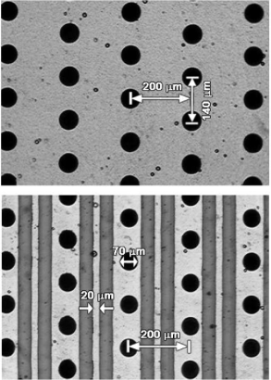
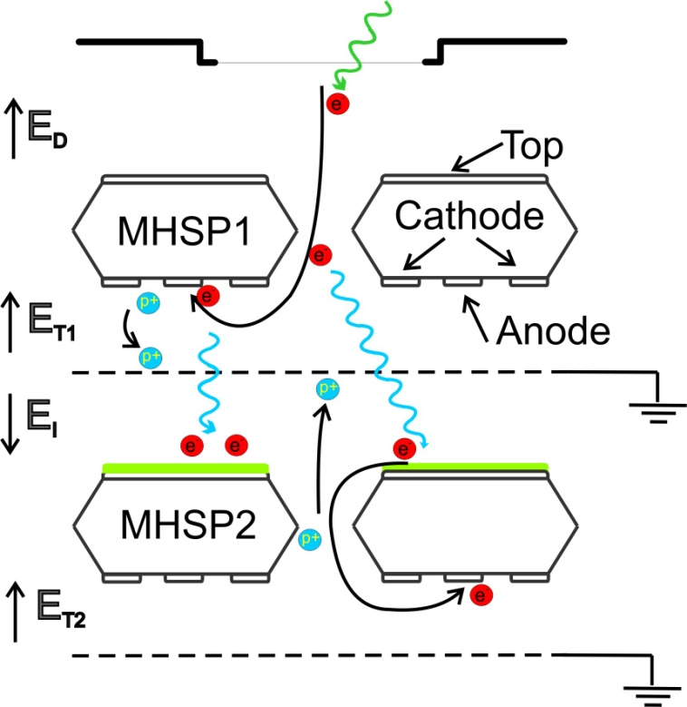
An Optical ion Gate
Aveiro/Coimbra/Weizmann
TPC Workshop LBL 2006
Radiation-induced electrons are multiplied in a first element
Avalanche-induced photons create photoelectrons on a CsI-coated multiplier
The photoelectrons continue the amplification process in the second element
No transfer of electrons or ions between elements: NO ION BACKFLOW
Avalanche-ions from first elements: blocked with a patterned electrode
For higher gains, the second element can be followed by additional ones
radiation
MHSP
1st multiplier: constant gain
2ed multiplier: variable V_{hole}
V_{a-c} = 220V
V_{hole}
V_{a-c} = 0 V
Grounded mesh blocks the ions
Xe 1 bar
Scintillation light converted to photoelectrons on a CsI photocathode
V_{hole} [V]
A. Breskin TPC2012 Paris Dec 2012

Slide 20
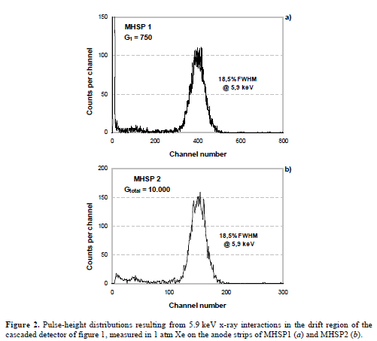
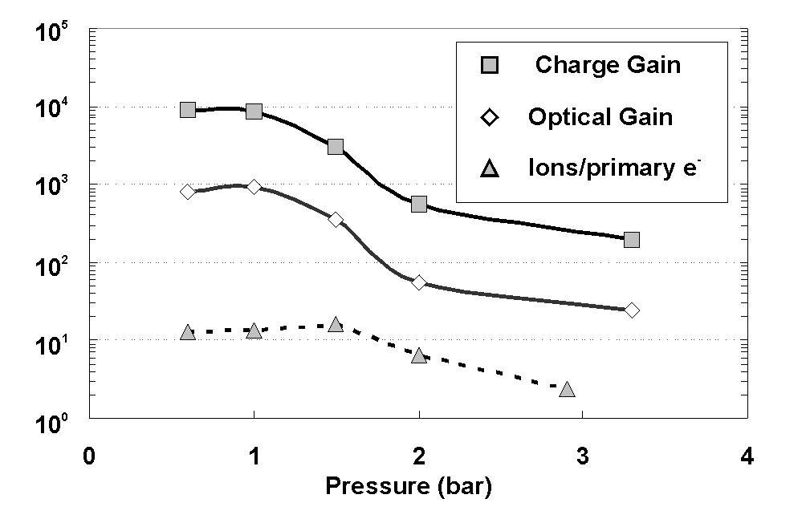
An Optical ion Gate in Xe
Charge gain
Xenon: optical gain vs. pressure
Photon-induced
Charge gain
RESOLUTION MAINTAINED
IEEE TRANSACTIONS ON NUCLEAR SCIENCE, VOL. 56, NO. 3, JUNE 2009
Veloso, Amaro, dos Santos, Breskin, Lyashenko & Chechik. The Photon-Assisted Cascaded Electron Multiplier: a concept for potential avalanche-ion blocking 2006 JINST 1 P08003

Slide 21
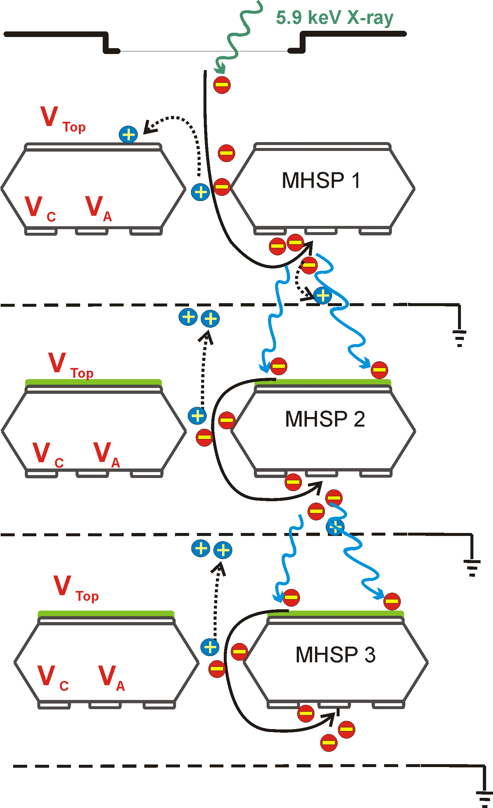
A cascaded Optical Gate
Amaro 2008
Higher optical gain

Slide 22
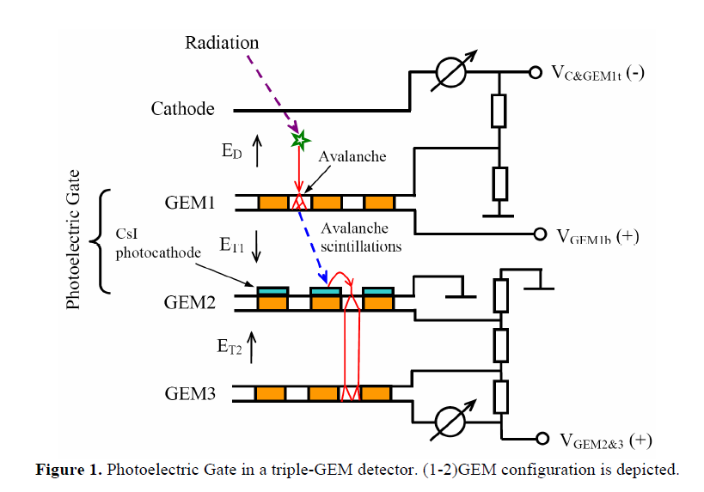
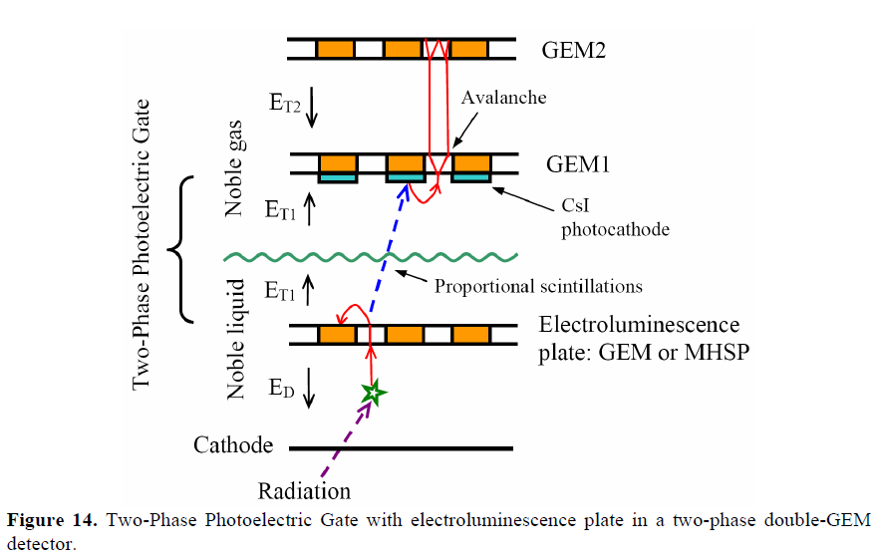
Another optical gate… Budker
Optical gate in gas phase
Optical gate in 2-phase mode
Immersed electroluminescent GEM
Buzulutskov & Bondar, Electric and Photoelectric Gates for ion backflow suppression in multi-GEM structures. 2006 JINST 1 P08006

Slide 23
The dream

Slide 24
S1 & S2 recording with Liquid Hole-Multipliers LHM
Modest charge multiplication + Light-amplification in sensors immersed in the noble liquid, applied to the detection of both scintillation UV-photons (S1) and ionization electrons (S2).
UV-photons impinge on CsI-coated THGEM electrode;
extracted photoelectrons are trapped into the holes, where high fields induce electroluminescence (+possibly small charge gain);
resulting photons are further amplified by a cascade of CsI-coated THGEMs.
Similarly, drifting S2 electrons are focused into the hole and follow the same amplification path.
S1 and S2 signals are recorded optically by an immersed GPM or by charge collected on pads.
Light or charge readout (GPM or pads)
E
CsI
E
E
TPC Anode
S₁ photon
Ionization electrons
Liquid xenon
Holes:
Small- or no charge-gain
Electroluminescence (optical gain)

Slide 25
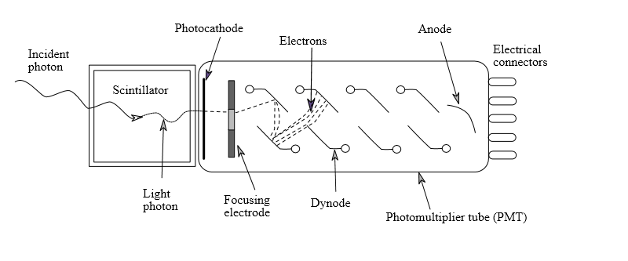
Staggered holes: blocking photon-feedback
High light gain:
GPM readout
GPM
L
PADS
Noble liquid
sufficient charge:
PAD readout
CsI
S2 Ionization electrons
S1 photon
Feedback-photons from
final avalanche
or/and electroluminescence
BLOCKED by the cascade

Slide 26
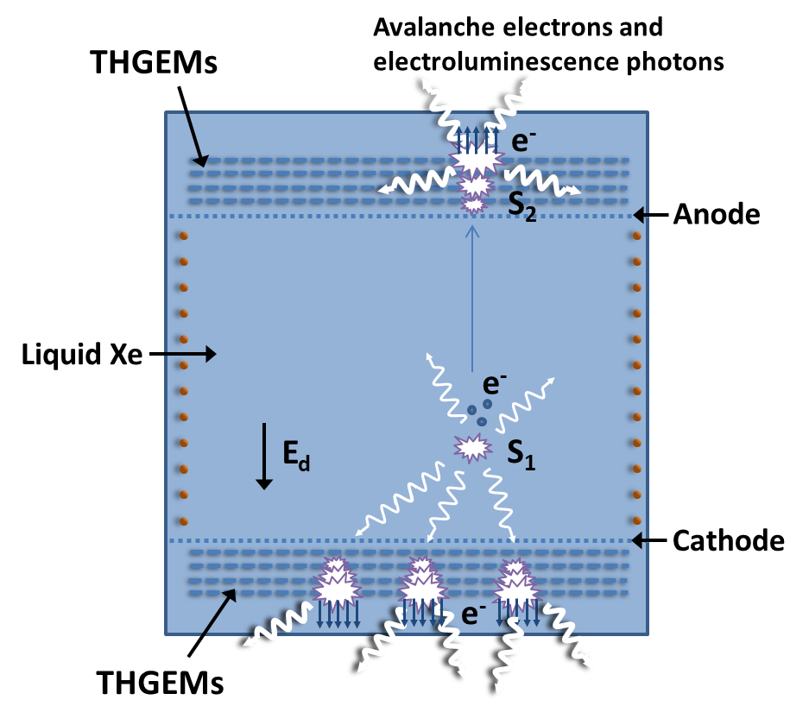
S1 & S2 with LHM
Detects S1&S2
Detects S1
A single-phase TPC DM detector with THGEM-LHMs.
The prompt S1 (scintillation) and the S2 (after ionization-electrons drift) signals are recorded with immersed CsI-coated cascaded-THGEMs at bottom and top.

Slide 27
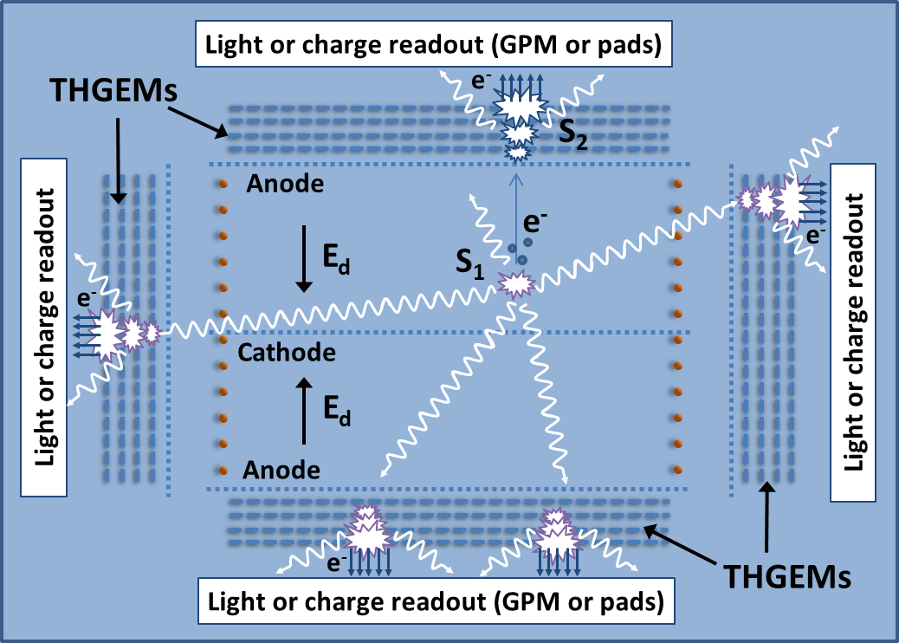
S1 & S2 with LHM
Detects S1&S2
Detects S1&S2
A dual-sided single-phase TPC DM detector with top, bottom and side THGEM-LHMs.
The prompt S1 scintillation signals are detected with all LHMs. The S2 signals are recorded with bottom and top LHMs.
Highlights:
Higher S1 signals ➔ lower expected detection threshold
Shorter drift lengths➔ lower HV applied & lower e- losses

Slide 28
CSCADED LHDs
L
LHM
C
LHM
E
C
LHM
S1, S2
C
LHM
S1
C
LHM
LOW HV for large-volume
Relaxed electron lifetime
Need: low radioactivity and pad-readout

Slide 29
Summary & To-do list
A revived interest in single-phase Noble Liquid Detectors for large-volume systems.
A new concept proposed: scintillation & ionization recording with immersed Liquid Hole Multipliers – LHM
The dream needs validation:
THGEM charge & light Gain in LXe vs. hole-geometry
Electron collection efficiency into holes in LXe
Photon & electron yields in CsI-coated cascaded THGEM
Feedback suppression
S1/S2 Readout: pads vs. optical (GPM, others)
Radio-clean electrodes
We have a ready-to-go LXe-TPC system: WILiX
R&D proposal submitted

Slide 30
spare

Slide 31
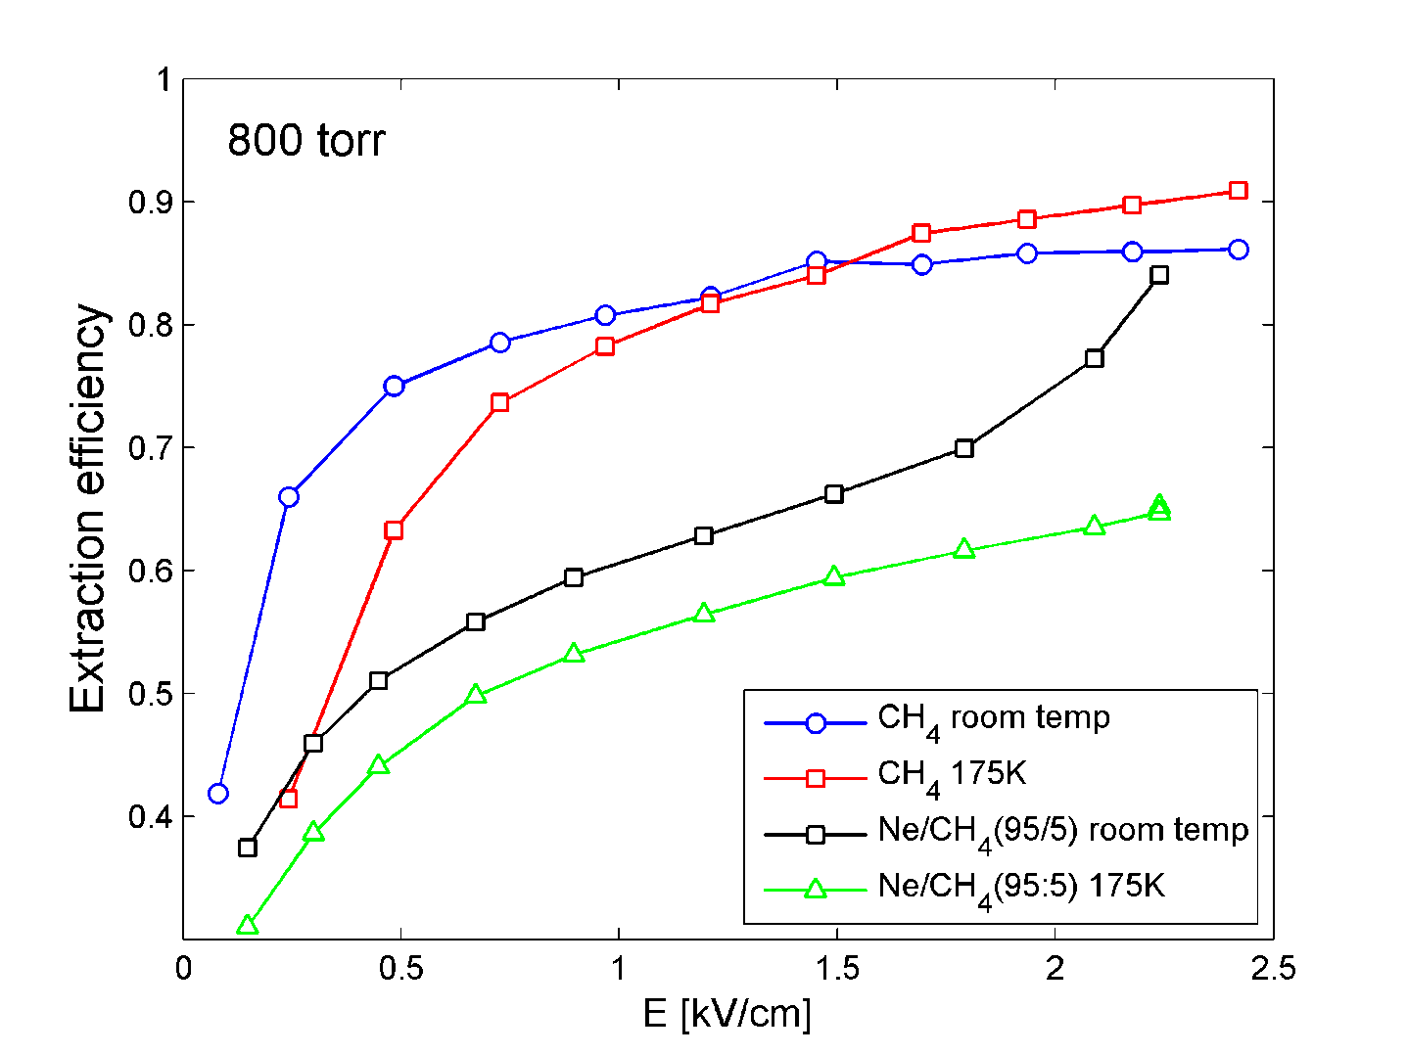
Photoelectron extraction at low-T
CH₄
175K
Ne/5%CH₄ 175K
Extraction efficiency (relative QE compared to vacuum) from CsI for 185nm UV photons as a function of the extraction field for pure CH₄ and Ne/CH₄(95:5) at 800 Torr in room- and LXe-temperatures.

Slide 32
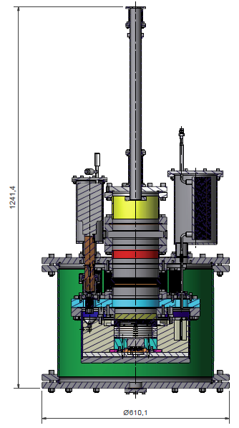
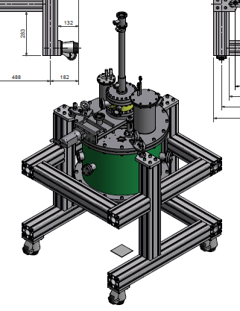
Weizmann Institute Liquid Xenon Facility (WILiX) TPC-GPM testing ground
GPM guide, gas, cables
Basic consideration: allow frequent modifications in GPM without breaking the LXe equilibrium state
GPM load-lock
Xe liquefier
Gate valve
Xe heat exchanger
GPM
TPC
Inner chamber (LXe)
Vacuum insulation

Slide 33
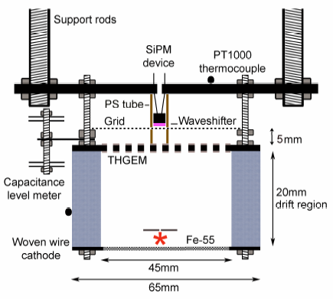
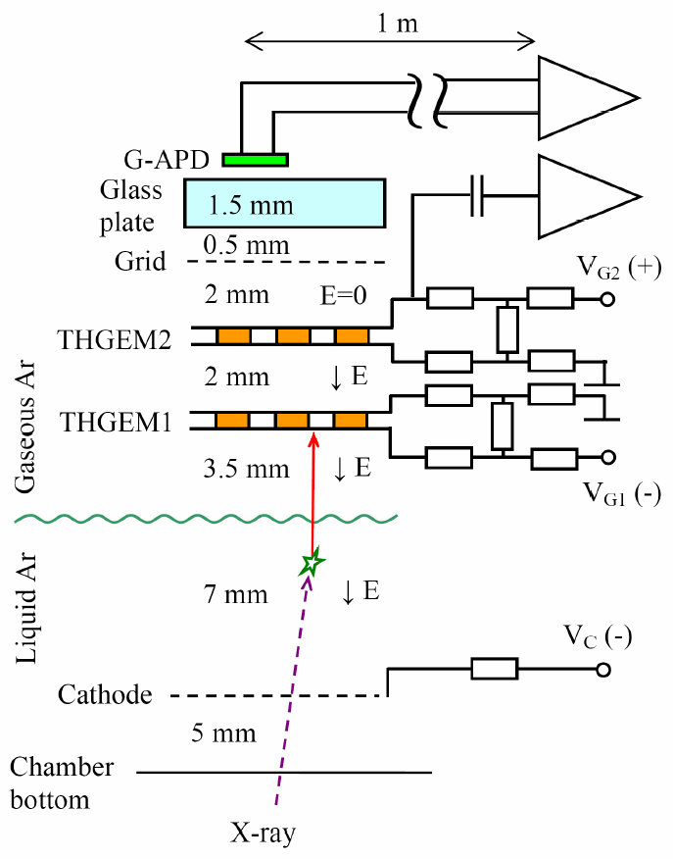
APD/gAPD THGEM readout
THGEMs in gas
THGEM in LAr
Two-phase detector with a gAPD/WLS recording UV scintillation from a THGEM immersed in LAr.
Lightfoot JINST 2009
Moneiro PL 2012
Photons/e @ 2 Bar Xe:
Parallel grids: ~400
GEM: ~1500
THGEM: ~8000
Two-phase Ar detector with THGEM/gAPD optical readout in the NIR
Bondar, Buzulutskov JINST 2010

