Slide 1
Observational techniques meeting #10

Slide 2
Radio Astronomy

Slide 3
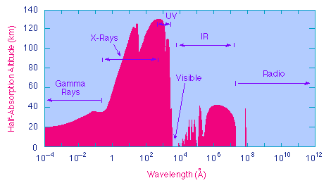
Radio Astronomy
Definitions:
Wavelength λ>0.3 mm (frequency ν<1 THz)
Upper limit set by molecular vibrational opacity (FIR)
Lower limit λ ~ 30m (ν<10 MHz) set by ionospheric reflection; can go lower from space.

Slide 4
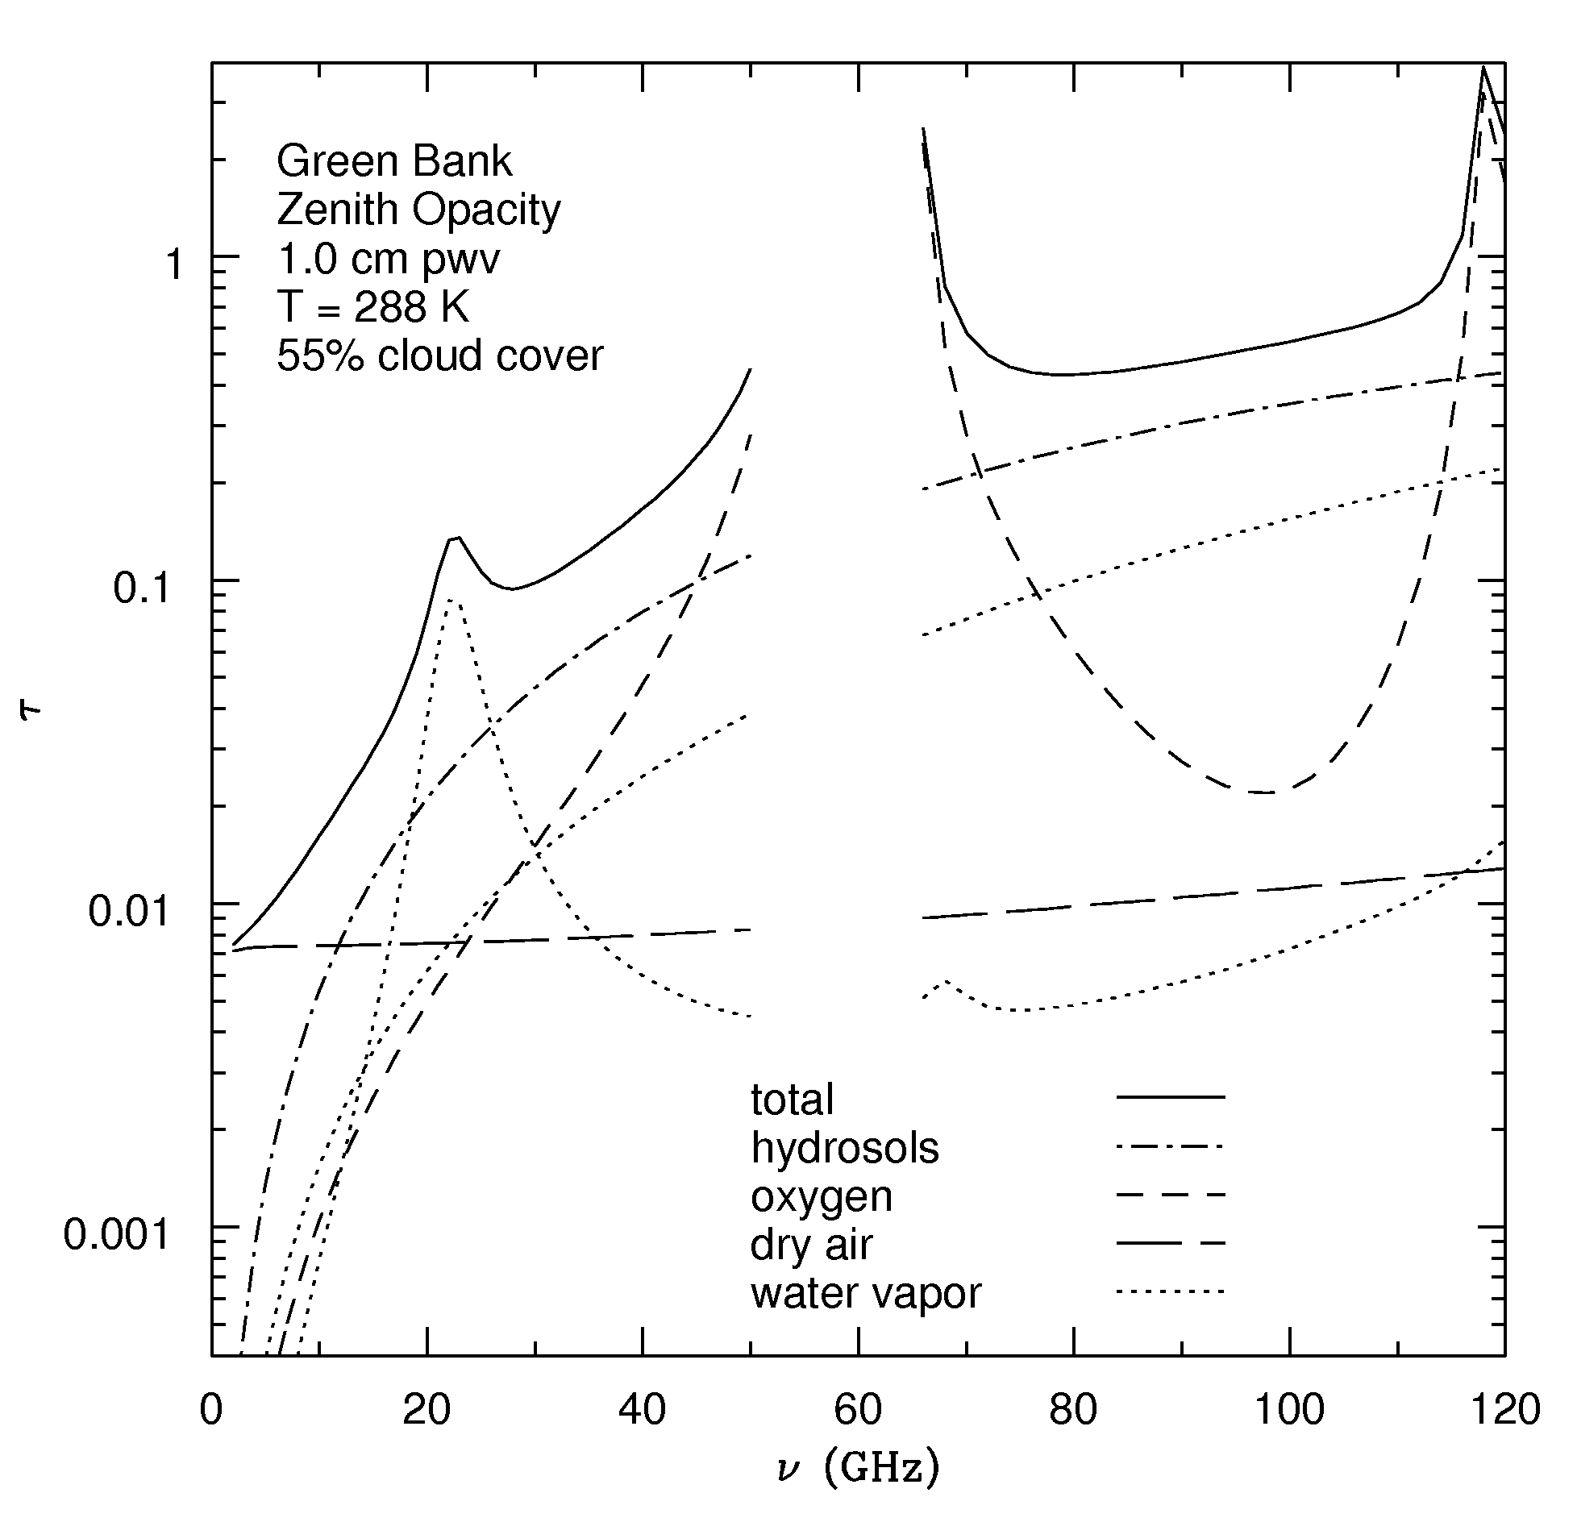
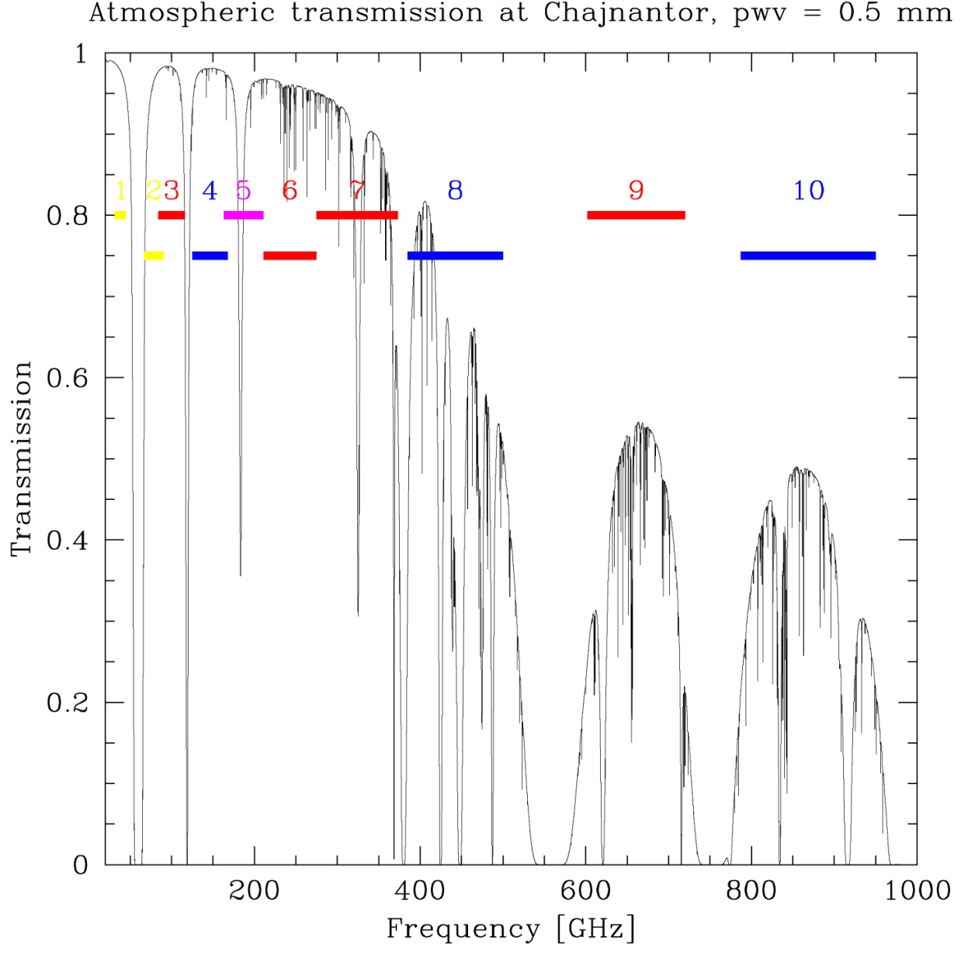
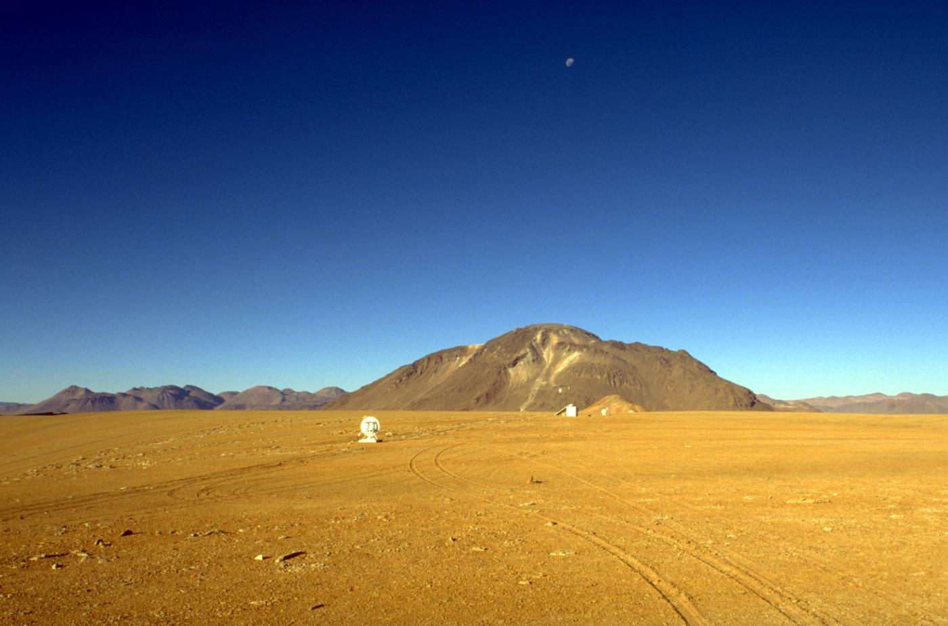
Radio Astronomy
Some basic features:
The Sun is a weak radio source + little atmospheric scattering: can observe during daytime
The atmosphere is not perfectly transparent; water content a major factor

Slide 5
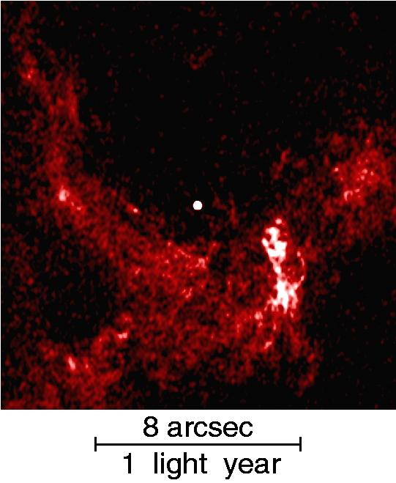
Dust penetration
λ > grain size: no dust absorption
Sgr A*
VLA 1.3cm

Slide 6
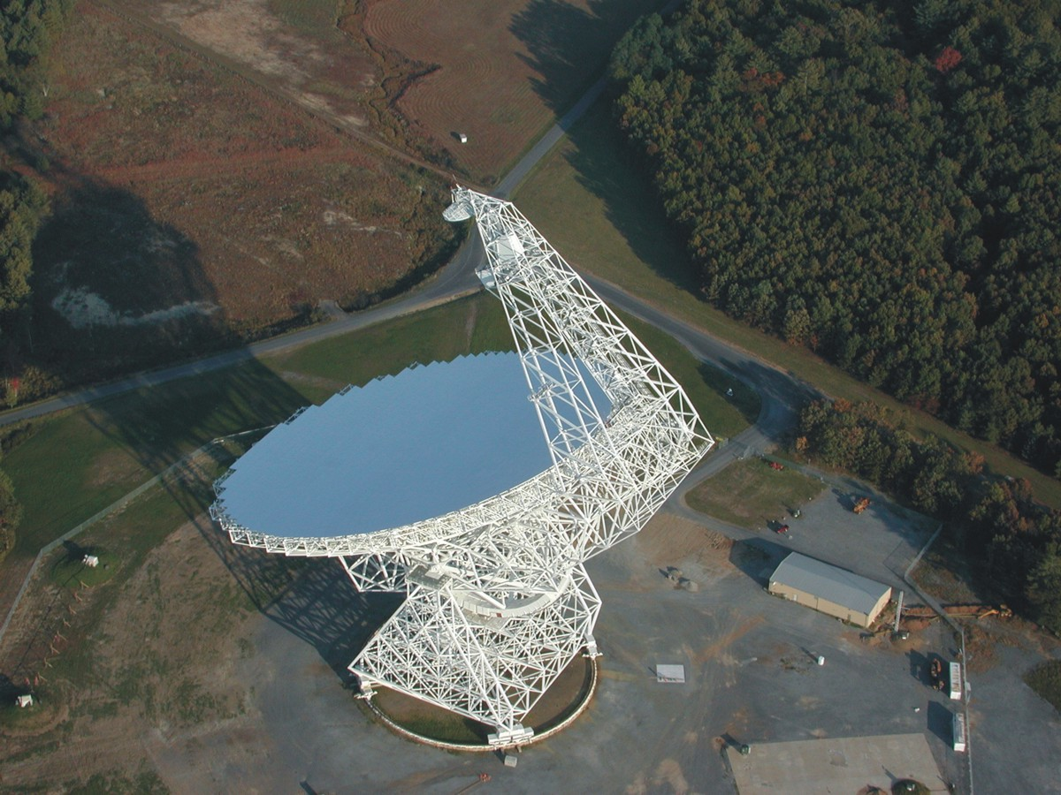

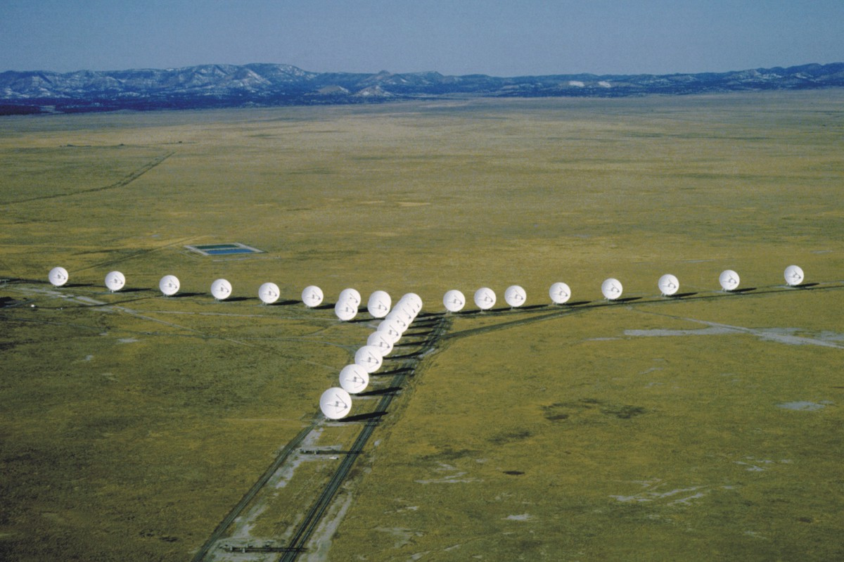
Angular resolution
Resolution ~ λ/D so very large telescopes required to achieve reasonable resolution
However, can make very fine surfaces (<λ/16)
Can use huge interferometer arrays (D~10⁴ km)
Best resolution achieved in radio
VLA: 1-36 km, 0.01-45”, 1.4-43 GHz
100m GBT
VLBA; 0.00017”
VLA 1.3cm

Slide 7
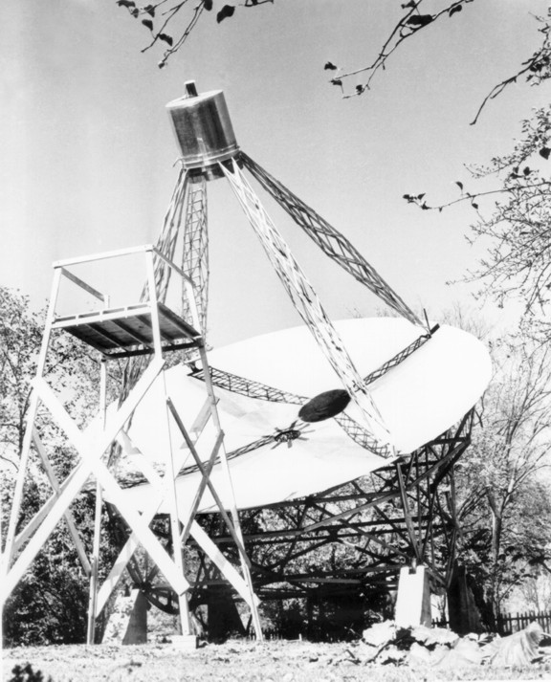
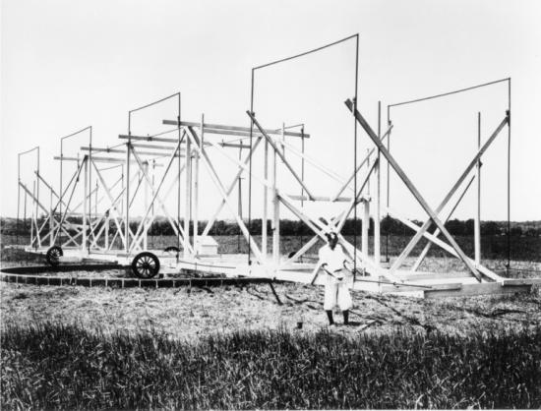
History
Discovery: 1932 (Jansky, Bell labs)
Telecom interference: source outside solar system (siderial periodicity)
First map at 160 MHz by amateur G. Reber (Backyard 10m dish, IL; ApJ 1940)
Final progress after WW2 (radar technology)
(Ryle)
VLA: 1-36 km, 0.01-45”, 1.4-43 GHz
100m GBT
VLA 1.3cm

Slide 8
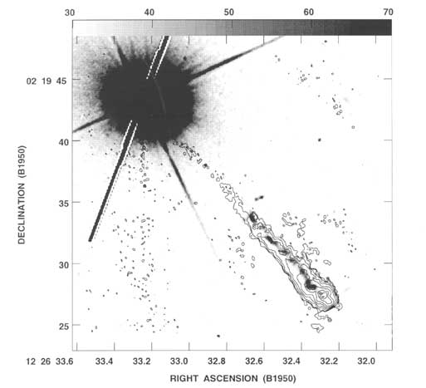
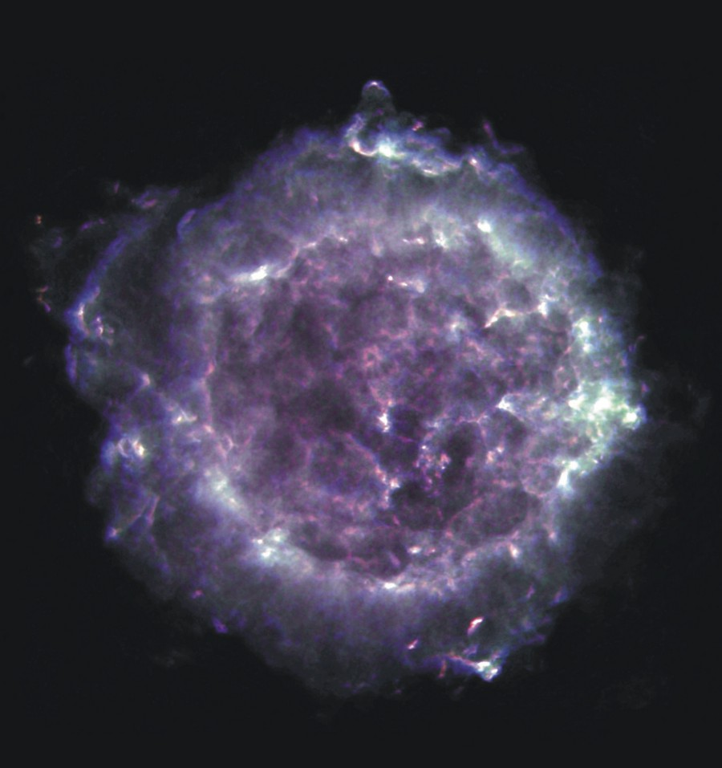
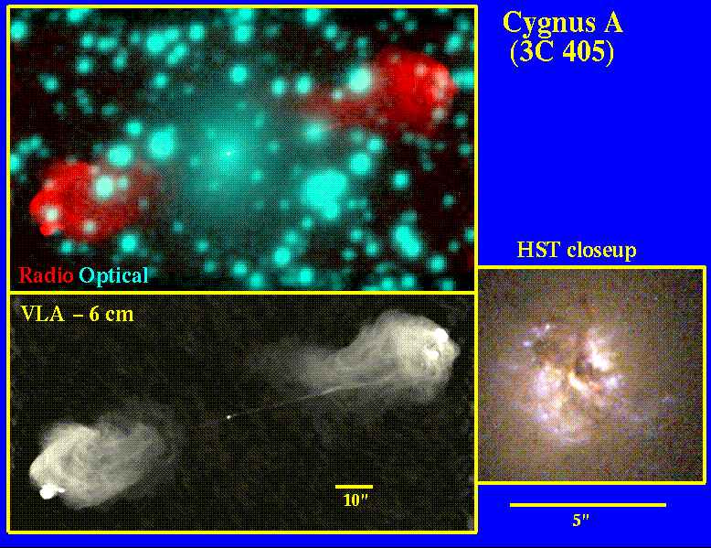
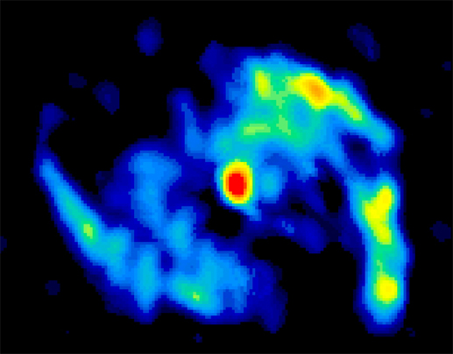
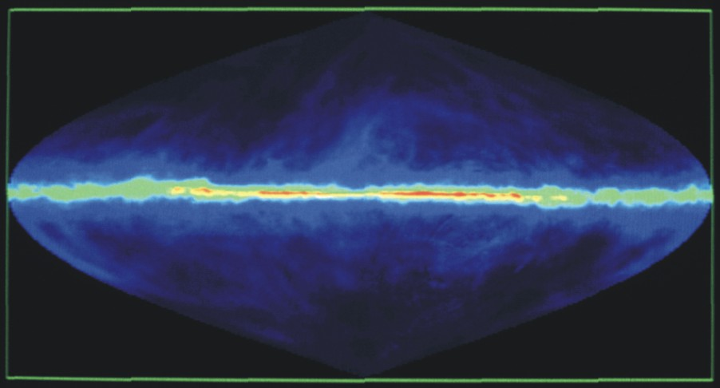
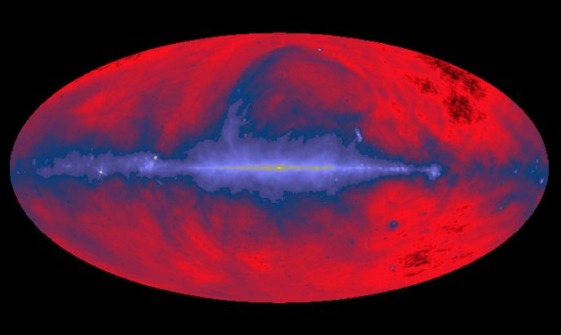
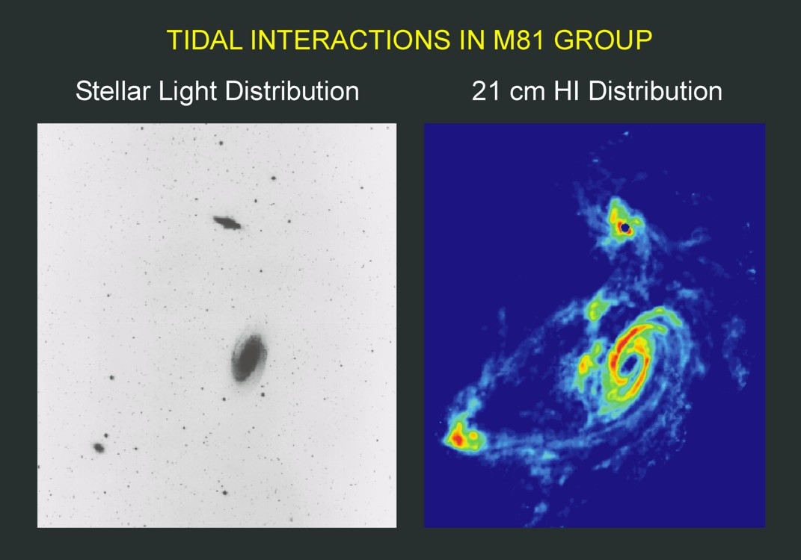
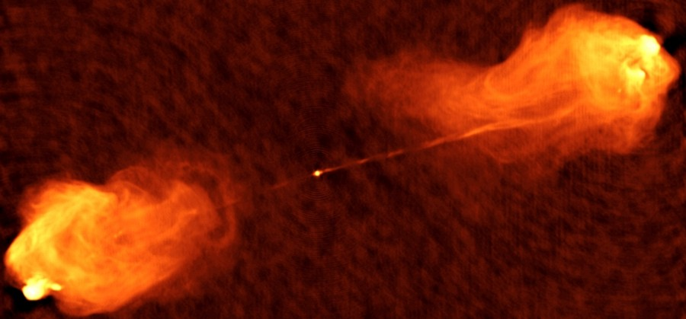
Radio sources
VLA: 1-36 km, 0.01-45”, 1.4-43 GHz
100m GBT
Galactic HI (1.4 GHz; hyperfine transition of H)
Cygnus 1: nearby active galactic nucleus
VLA 1.3cm
M51 in submm: molecular gas (CO)
Galactic diffuse ISM (408 MHz)
SN remnant Cas A (VLA, 1.4-8.5 GHz)
3C273: the first Quasar

Slide 9
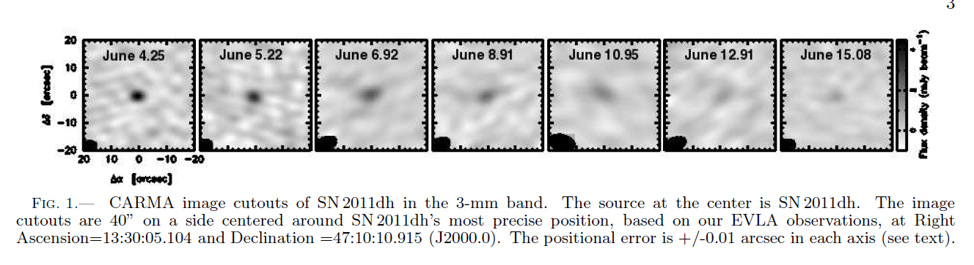
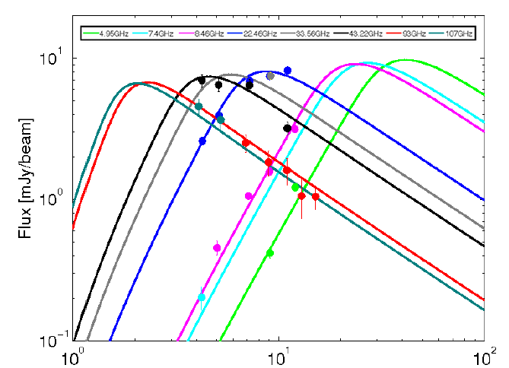
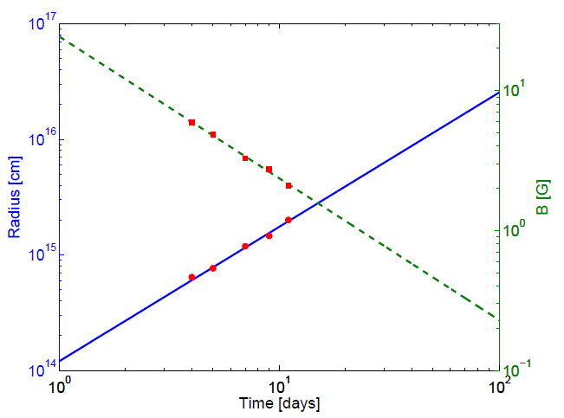
Radio SNe

Slide 10
End

