Slide 1
Observational techniques meeting #11

Slide 2
Student talks and dates:
May 9: Liantong Luo (mm/submm)
May 14: Gidi Yoffe (High-res spec); Dotan Shaniv (JWST)
May 16: Yigal Sternklar (Polarization); Oran Ayalon (CMB#1)
May 21: Andra Tesi (Neutrinos); Amir Rosenblatt (X-ray – basic)
May 23 – no class
May 28: Simon Mahler (SZ effect); Noam Morali (IFU)
May 30: Yuval Rosenberg (UV); Noam Segev (GAIA)
June 4: Abhay Nayak (Euclid); Tom Koren (light echoes)
June 6 – no class
June 11: Gidi Alon (future radio); Lior Gazit (LIGO)
June 13: Tal Levinson (TeV); Gilad Sade (?)
June 18: Mehran Shehade (CR); Yuval Tamir (Robotics)
June 20: Asaf Miron (CMB #2 - polarization); Aviram Uri (LISA)
June 25: Tom Manovitz (MIR/FIR); Mark Aprestein (X-Ray Polarimetry)
June 27: Dan Levy (nano-satellites); Or Hadas (?), Exoplanet missions (Dror Berechya)

Slide 3
Gamma-ray Astronomy

Slide 4
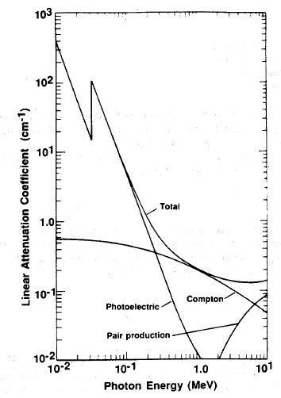
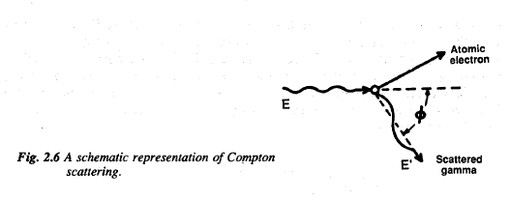
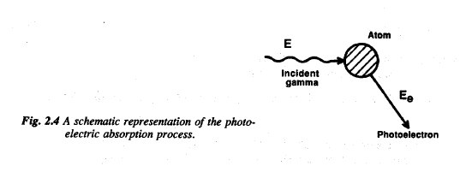
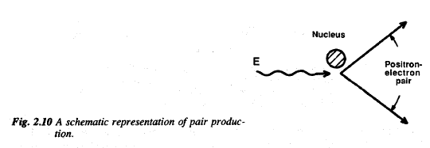
Basics: γ-ray interaction
Main processes:
Photoelectric effect – dominant below 1 MeV
Compton scattering – 1-5 MeV
Pair production – dominant above ~5 Mev

Slide 5
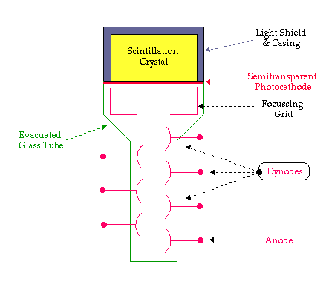
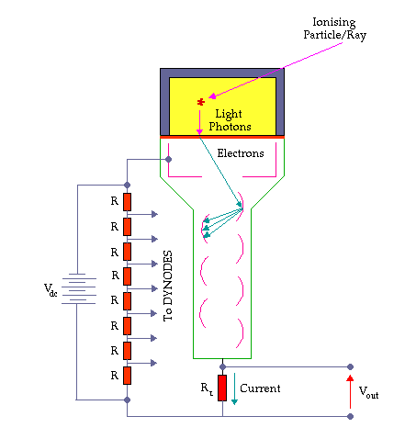
Scintillators/solid state detectors
Scintillators: Materials (e.g., NaI, CsI) which emit photons when hit by high-energy charged particles
Scintillators need to be coupled to light detectors (e.g., photomultipliers).
Some semiconductors (Ge, CdTe, CdZnTe) can act as both scintillator and light detector

Slide 6
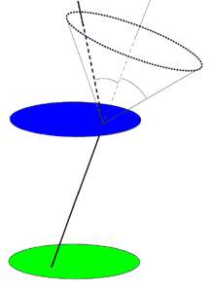

Compton telescopes
Rely on two-stage detection (scattered and absorbed photon)
Detection points and measurements of electron and photon energies provide a direction up to a circle on the sky
More than 1 photon required for localization

Slide 7
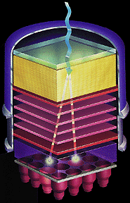
Pair telescopes
Combine layers of converter material (metals such as lead) that convert photons to pairs, with detector layers that determine direction and energy of resulting electron/positron pairs.
Detector layers used to be spark chambers, now replaced with silicon-strip detectors.
At bottom, you often install a calorimeter (detector that absorbs the particles and measures total energy)
Anti-coincidence shields are a must

Slide 8
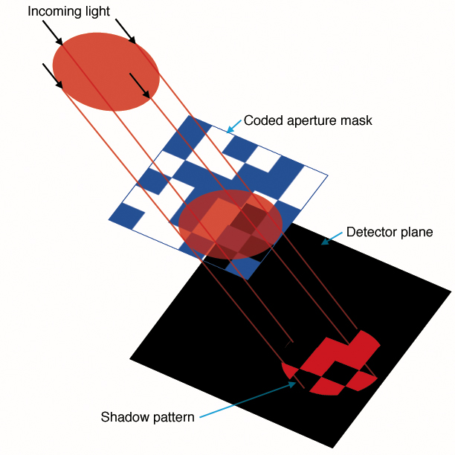
Imaging in gamma-rays
focussing not practical
Larger detectors – more signal, but also more noise; poor directionality
options: collimator + pixels (low efficiency), hard for high energies
Shielding/occultations (rough, low efficiency)
Coded mask

Slide 9
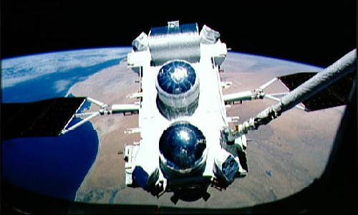
Major recent missions: CGRO
NASA “great Observatory”
Operational 1991-2000
30 KeV – 30 Gev, order of magnitude better than previous
Main instruments: BATSE (burst detector, 20-1000 KeV; NaI); OSSE (scintillator spectrometer, 0.05-10 MeV; 8% resolution); Comptel (compton telescope, 0.8-30 MeV); EGRET (pair telescope, 30 MeV – 10 GeV)

Slide 10
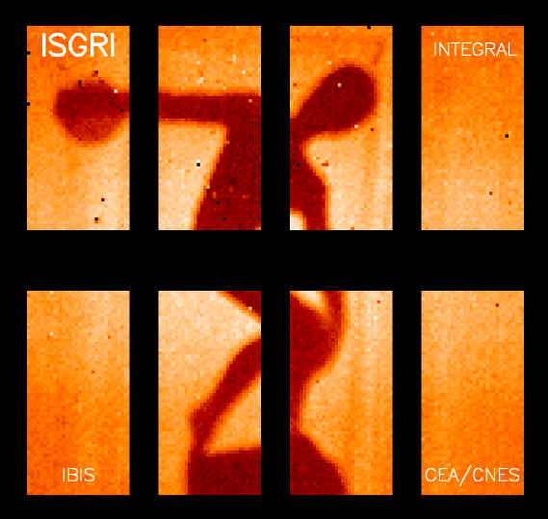
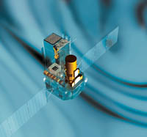
Major recent missions: Integral
ESA mission
Operational 2002-now
Main instruments: SPI (Ge spectrometer, coded mask), IBIS/ISGRI (scintillator/solid state imager, coded mask, 15 KeV-10MeV)

Slide 11
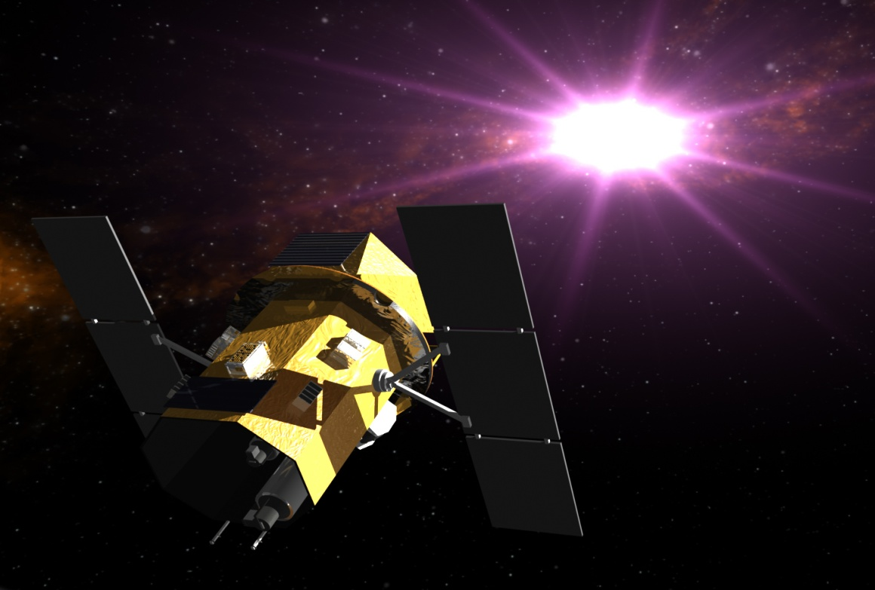
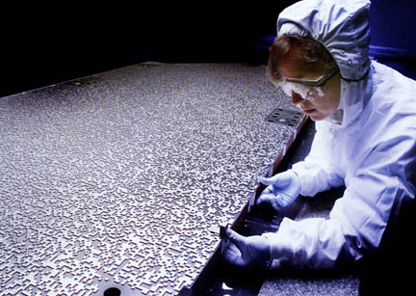
Major recent missions: Swift
NASA midex mission
Operational 2004-now
BAT: burst alert telescope (20-150 KeV, coded mask, CZT detectors)

Slide 12
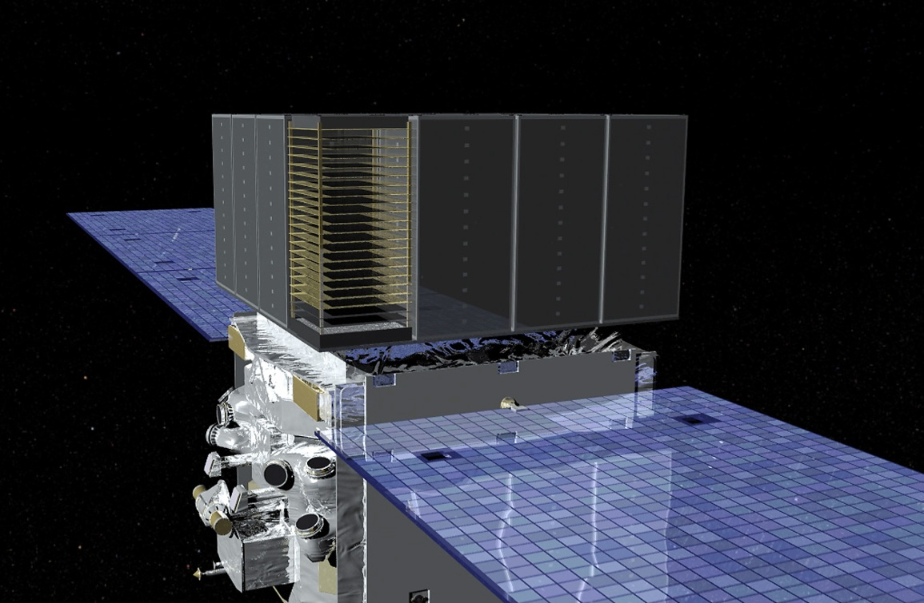
Major recent missions: Fermi
NASA mission
Operational 2008-now
LAT – pair telescope with silicon strip detectors + calorimeteres, largest, most sensitive up to 30 GeV
GBM: burst monitor (NaI scintillator 10 KeV- 1 MeV + BGO (Bismuth Germanate; 150 KeV – 30 MeV)

Slide 13
Gamma-ray Bursts

Slide 14
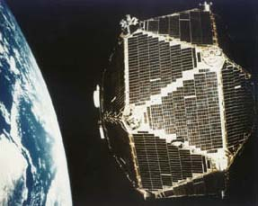
Discovery: Vela
Cs I scintillators, nuclear ban treaty enforcement; 1967-1973

Slide 15
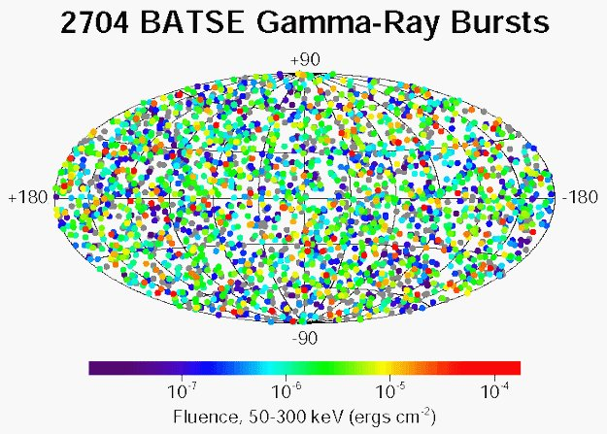
Source
Galactic vs extragalactic: settled by CGRO/BATSE

Slide 16
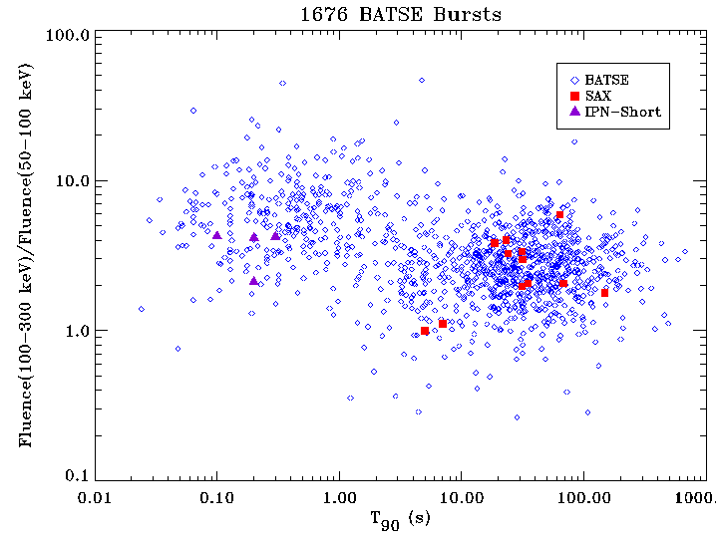
Gamma-Ray Bursts (GRBs)

Slide 17
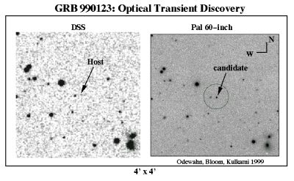
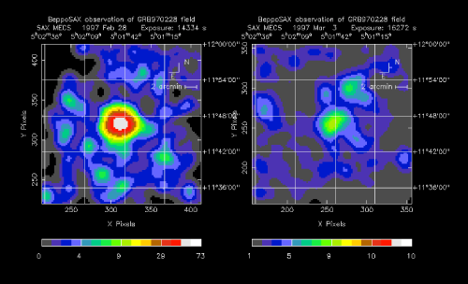
Afterglow discovery

Slide 18
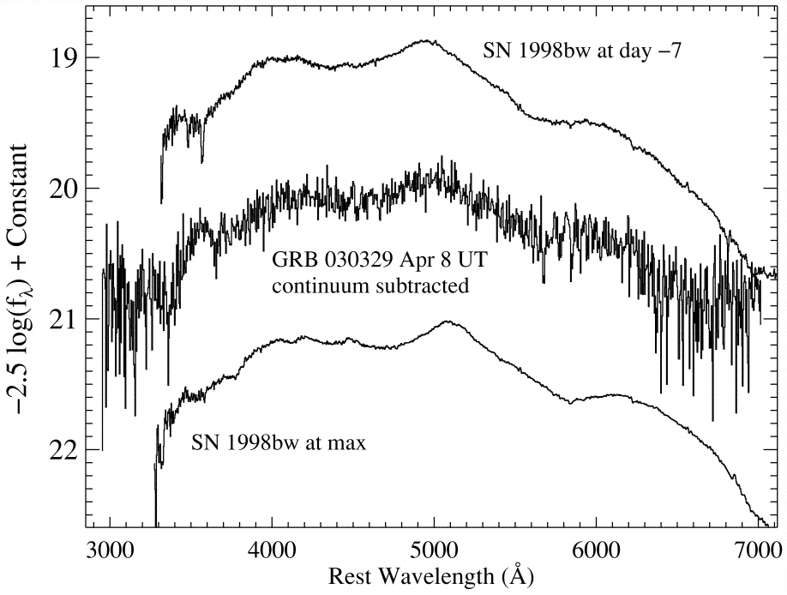
Long GRBs = Supernovae:

Slide 19
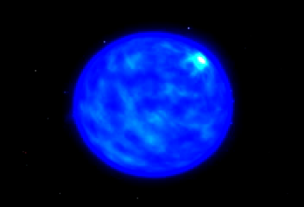
Long GRBs = Supernovae:

Slide 20
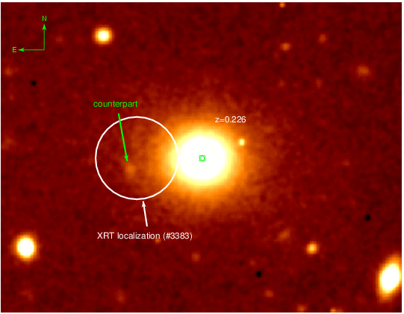
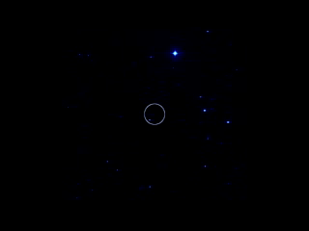
Short GRBs are something else

Slide 21
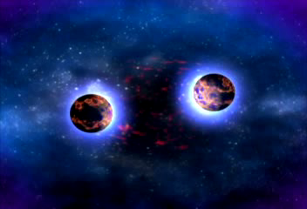
Short GRBs are something else

Slide 22

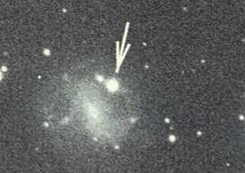
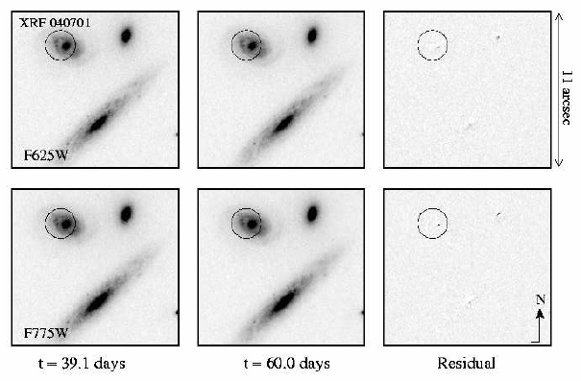
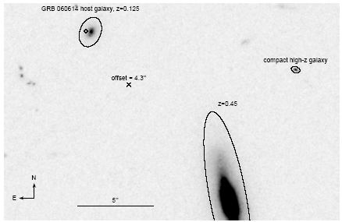
How long can a short GRB be?
GRB 060614 was a long GRB (100s), with no SN, and probably not associated with massive stars similar to other long events (Gal-Yam et al.; Fynbo et al.; Della Valle et al.; Gehrels et al. 2006, Nature 444)
Also, GRB 060605 ? (e.g., Ofek et al., Thoene et al.) XRF 040701 ?
There may well be more than one group of “short GRBs”

Slide 23
End

