Slide 1
Observational techniques meeting #2

Slide 2
Good use for diffraction: exoplanets

Slide 3
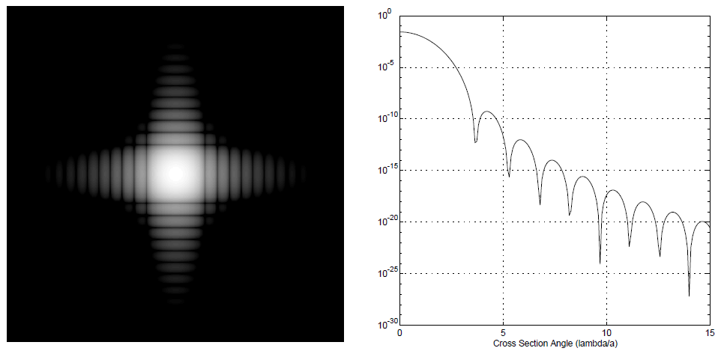
Good use for diffraction: exoplanets

Slide 4
Aberrations and imperfections

Slide 5
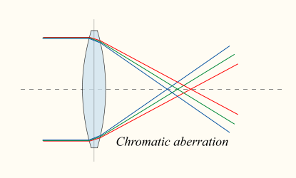
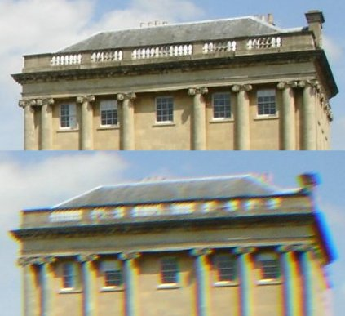
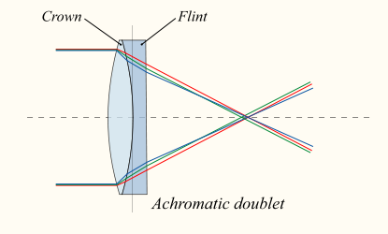
Chromatic aberration

Slide 6
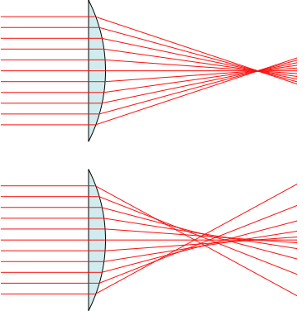
Spherical aberration
Parabolic
Spherical

Slide 7
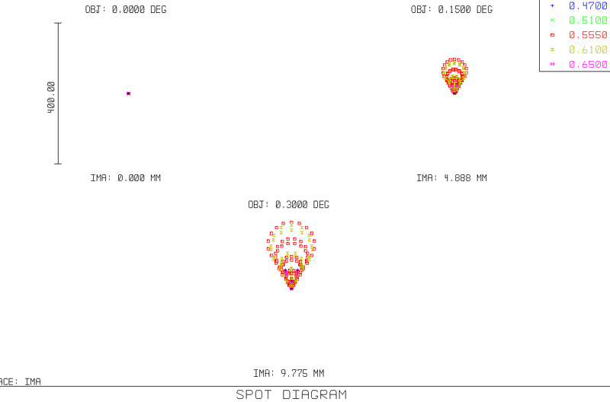
Coma

Slide 8
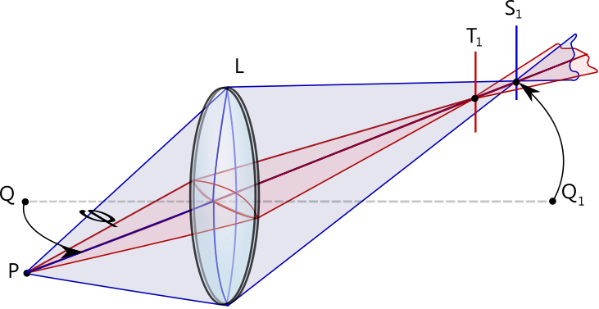
Astigmatism
(e.g., Hale telescope)

Slide 9
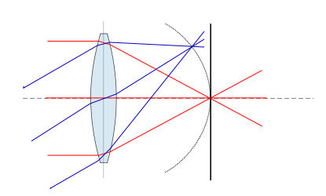
Field curvature
(e.g., Oschin Schmidt telescope)

Slide 10
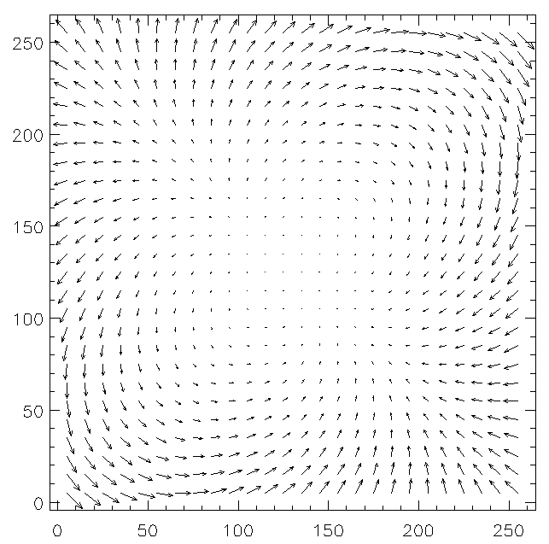
Distortion
Barrel
Pincushion
Keck NIRC

Slide 11
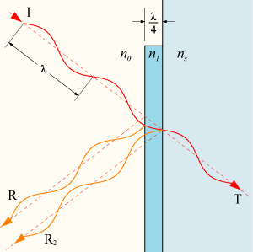
Reflection and transmission

Slide 12
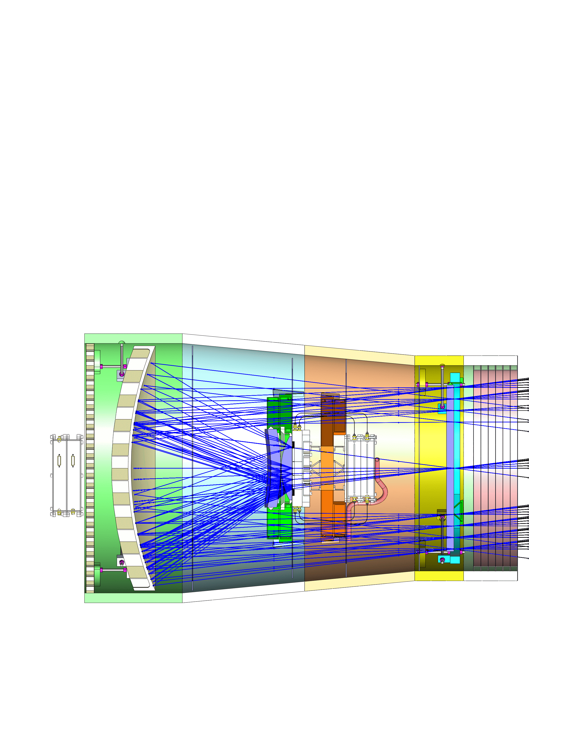
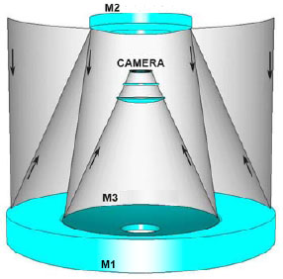
Vignetting
LSST
ULTRASAT

Slide 13
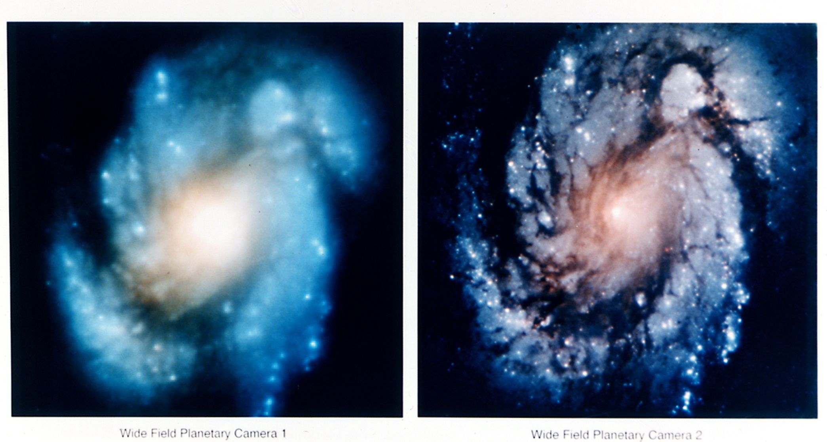
Manufacturing errors

Slide 14
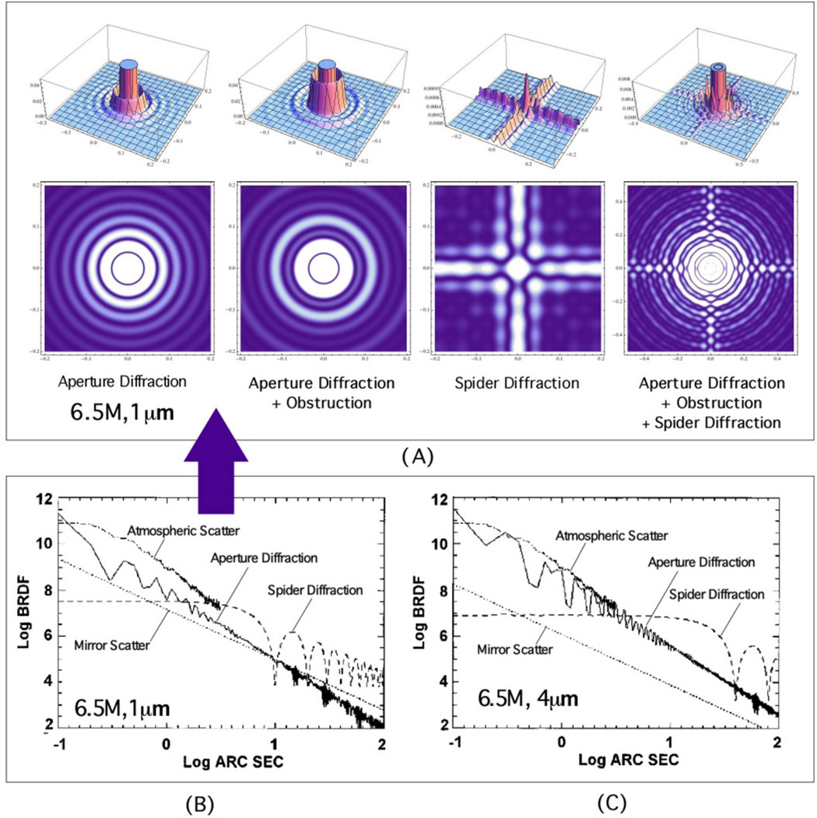
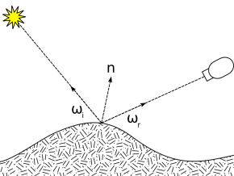
Surface roughness
λ/8 is usually
assumed a
reasonable limit
to retain diffration limited performance
bidirectional reflectance distribution function (BRDF)

Slide 15
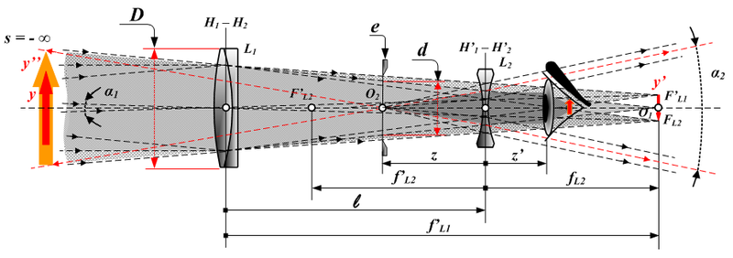
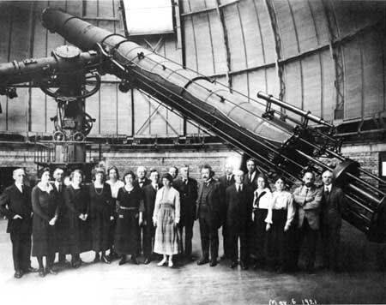
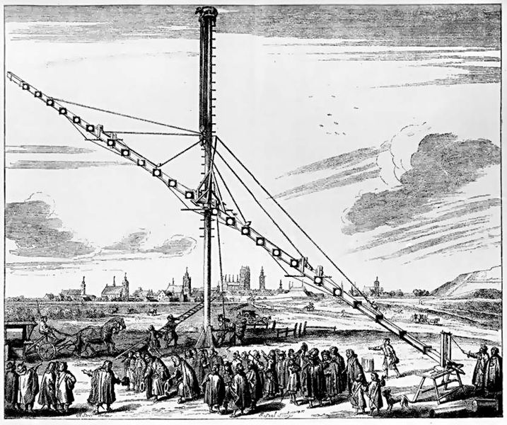
Telescopes
Galilean (refracting)
Magnification: f_{o}/f_{e}
Hevelius at Danzig
40” refractor at Yerkes Obs.

Slide 16
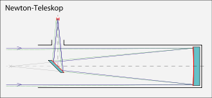
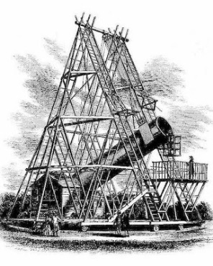
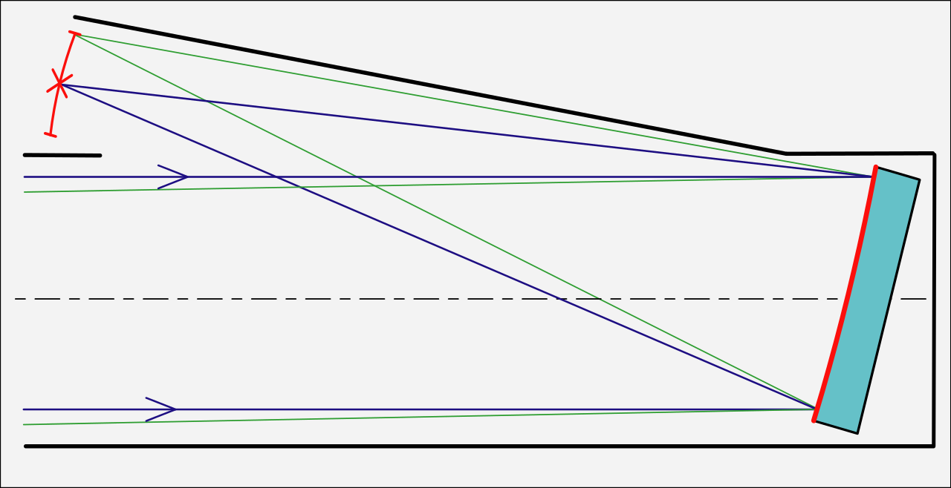
Telescopes: newtonean
Suffers spherical or coma aberration
Lord Herschel’s 40’ telescope

Slide 17
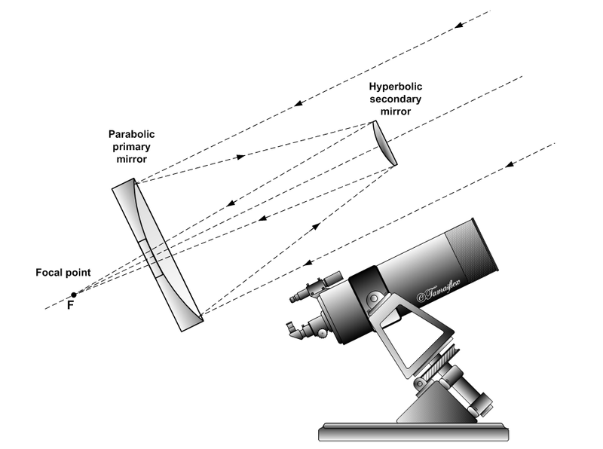
Telescopes: Cassgrain

Slide 18
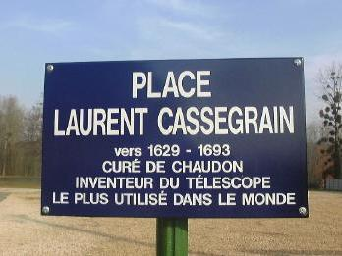
Telescopes: Cassegrain
Ritchey-Cretien: Wise, HST, VLT …

Slide 19
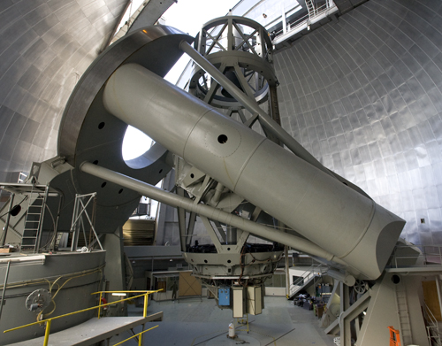
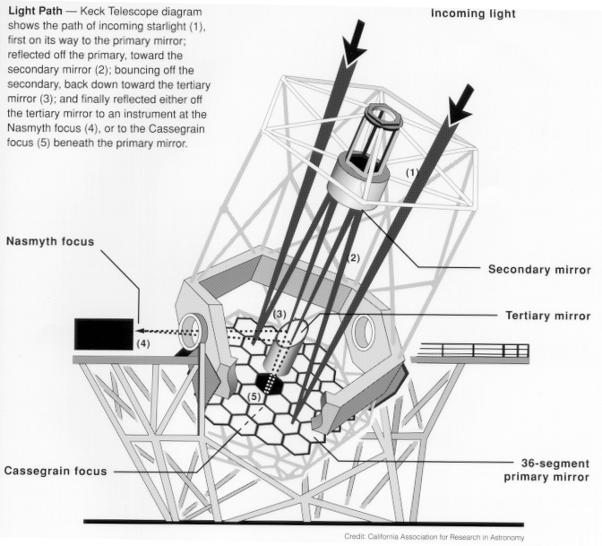
Interlude: mounts
Equatorial
Alt-az

Slide 20
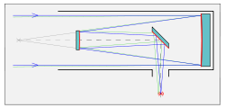
Telescopes: Coude
Coude
Naysmith

Slide 21
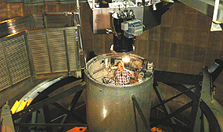
Telescopes: prime focus

Slide 22
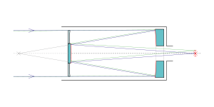
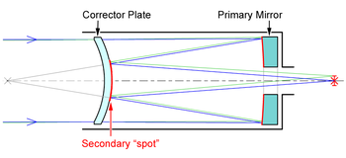
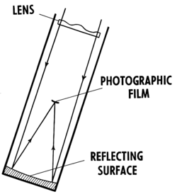
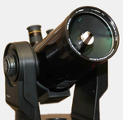
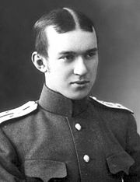
Telescopes: Schmidt
Schmidt Cassegrain
Maksutov
Schmidt (e.g., PTF)

Slide 23
End

