Slide 1
Observational techniques meeting #3

Slide 2
Mirrors

Slide 3
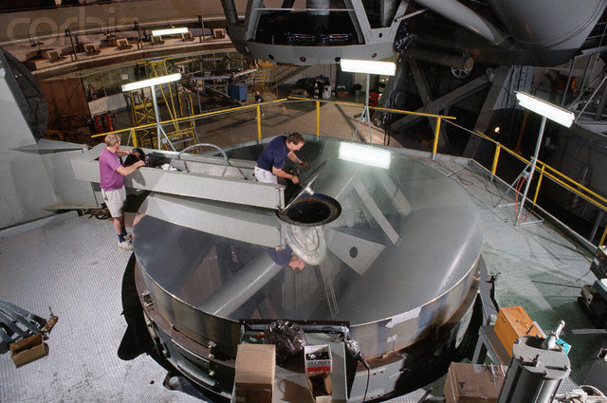
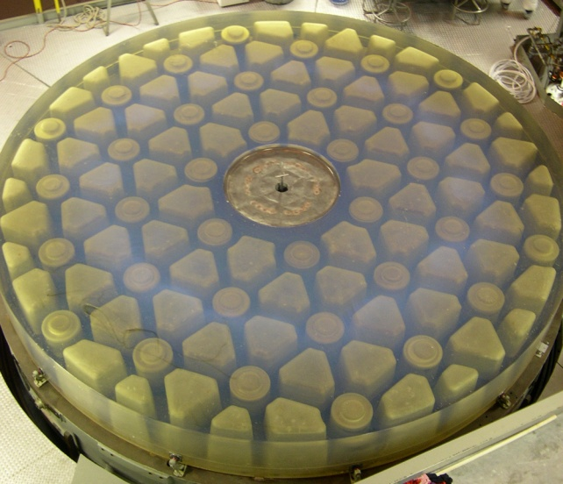
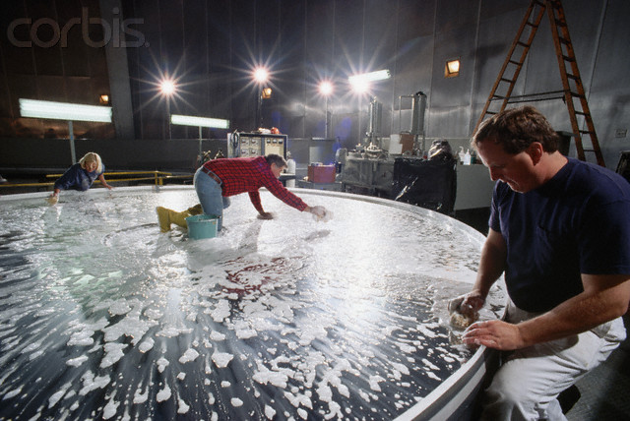
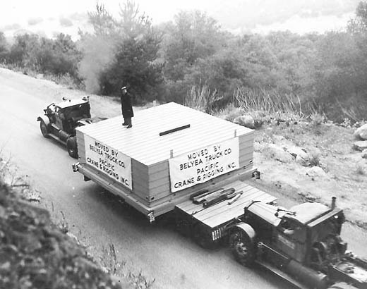
Classical mirrors: polished glass
Monolithic block of glass, polished to spec.
Largest good one is the 200” at Palomar (P200).
Limit is material strength of glass
Mirror surface is aluminized periodically

Slide 4
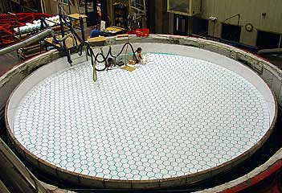
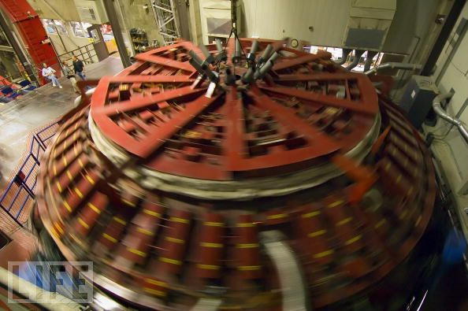
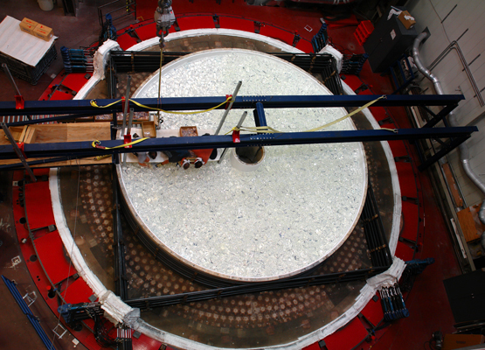
Breakthroughs #1: honeycomb
Casting borosilicate glass (good thermally) onto a honeycomb ceramic mold in spinning oven
Structure allows lighter weight (20%), ventilation; spinning naturally sets parabolic form
Maximum size set by oven: 8.4m
Subaru, Magellan, MMT, LBT, GMT

Slide 5
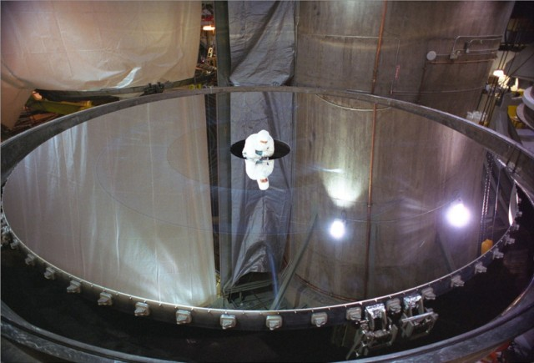
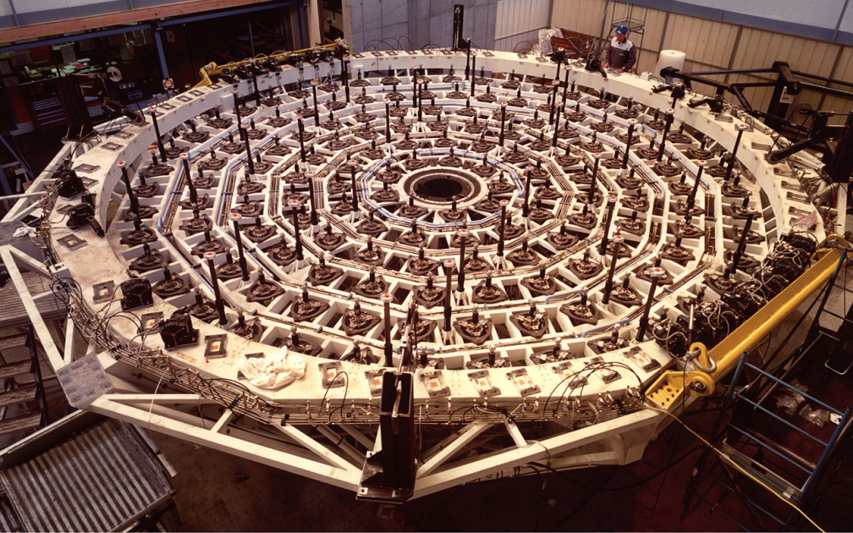
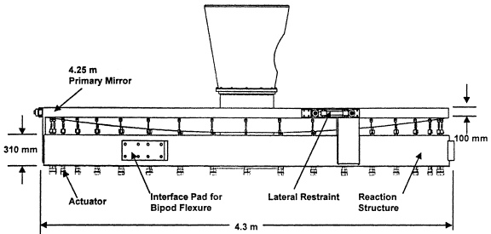
Breakthroughs #2: thin meniscus
Very thin mirror with active actuators to compensate for flexure in real time
Maximum size so far: 8.2m
NTT, Gemini, VLT, SOAR

Slide 6
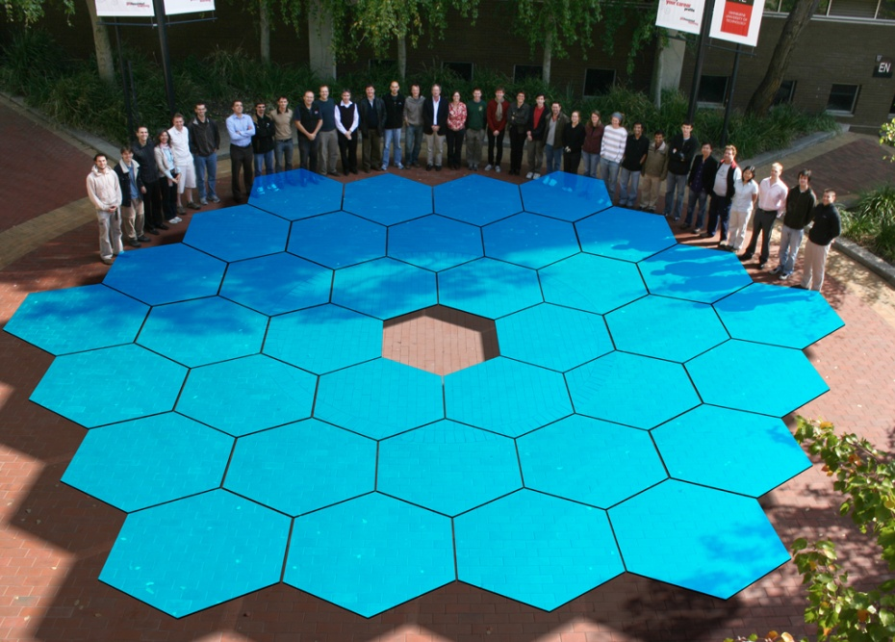
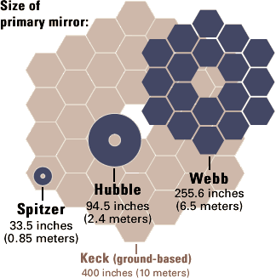
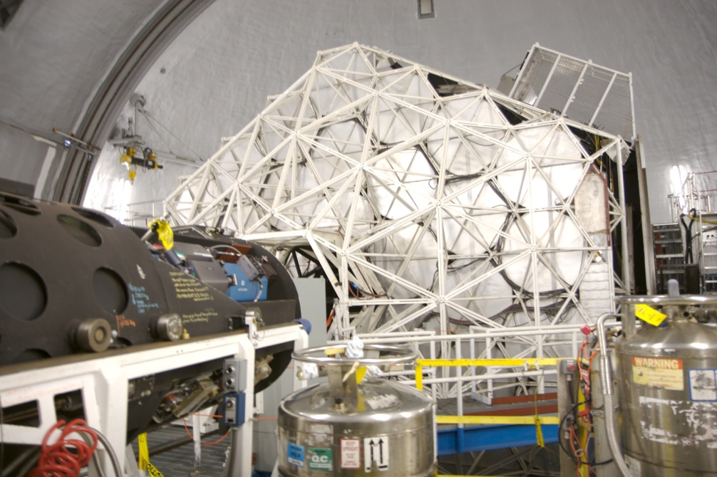
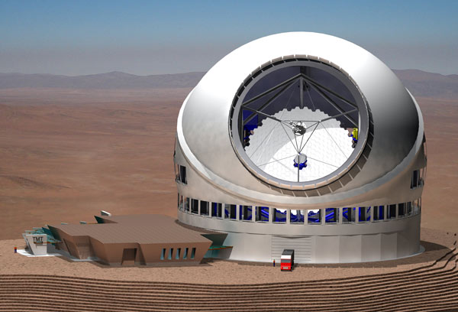
Breakthroughs #3: segmented
Replace large monolithic mirrors by actively-controlled (actuated) segments
Maximum size limited by support mechanics and computation, currently largest telescopes 10m
Keck, GTC, TMT, ELT

Slide 7
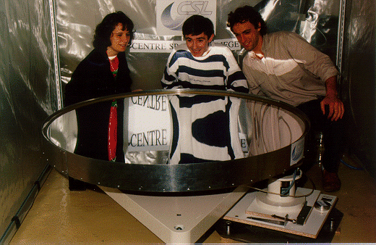
Future prospect: liquid mirrors
Spinning liquid mirror naturally assumed parabolic form
Can be made from mercury
However: mercury is volatile, and poisonous
No current working models

Slide 8
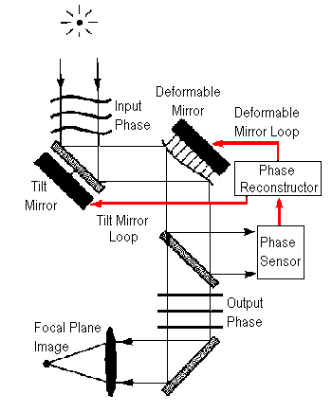
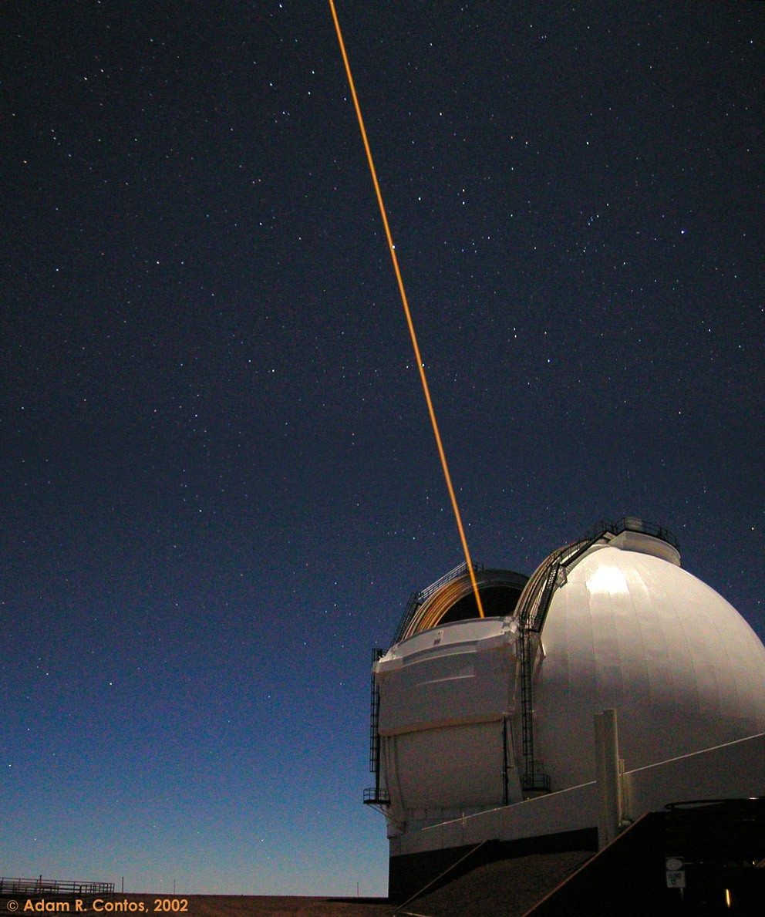
AO

Slide 9
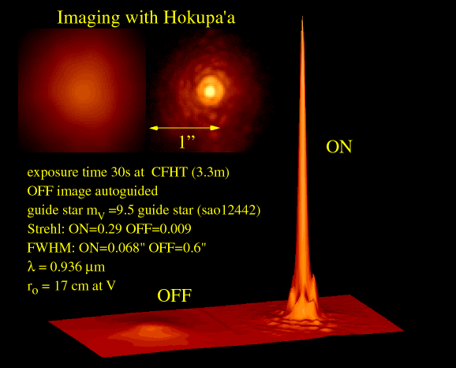
AO

Slide 10
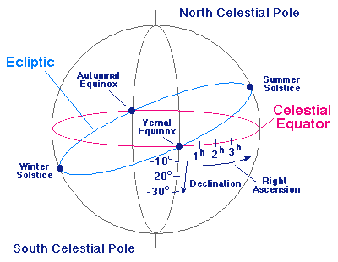
Celestial coordinates

Slide 11
End

