Slide 1
Observational techniques meeting #4

Slide 2
Coordinates (cont.)

Slide 3
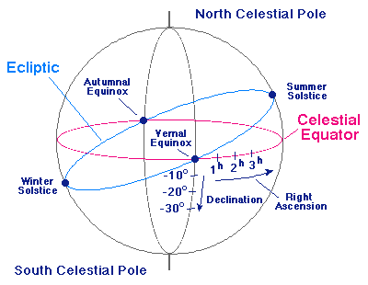
Celestial coordinates

Slide 4
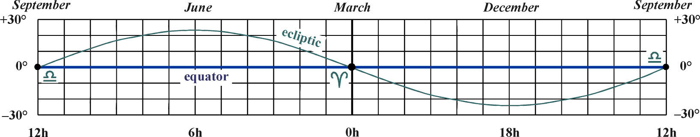
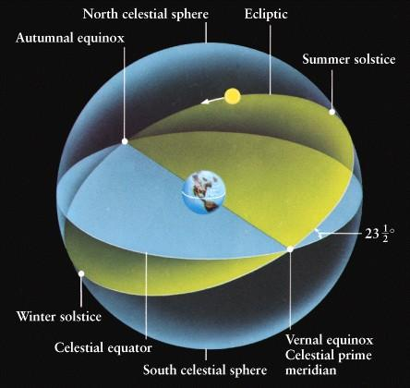
Ecliptic coordinates
http://healpix.jpl.nasa.gov/healpixSkymapsGalactic.shtml
http://dvice.com/archives/2010/09/stunning-animat.php

Slide 5
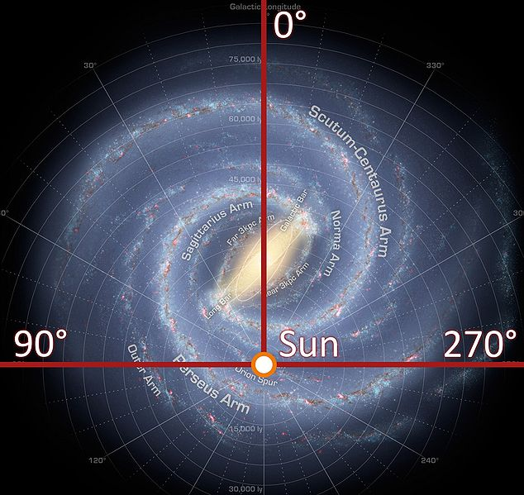
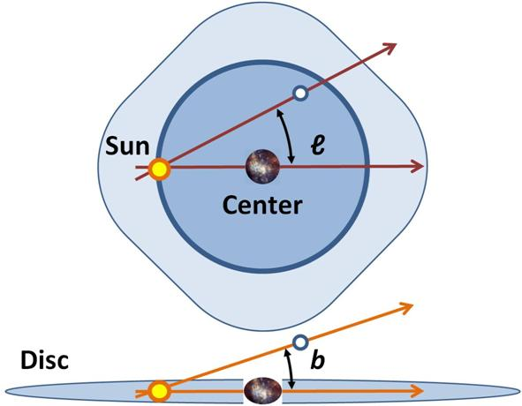
Galactic coordinates

Slide 6

Coordinate converter

Slide 7
Dust maps

Slide 8
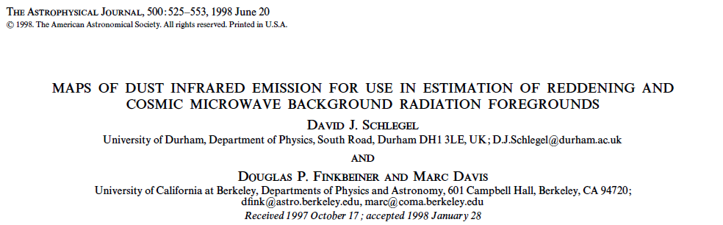
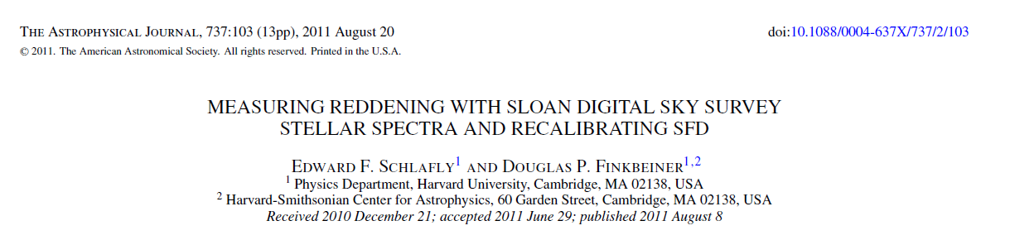
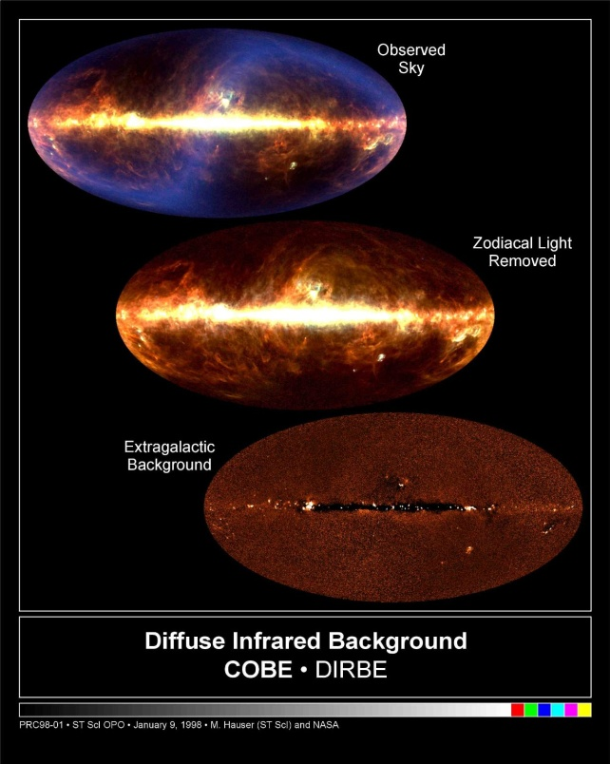
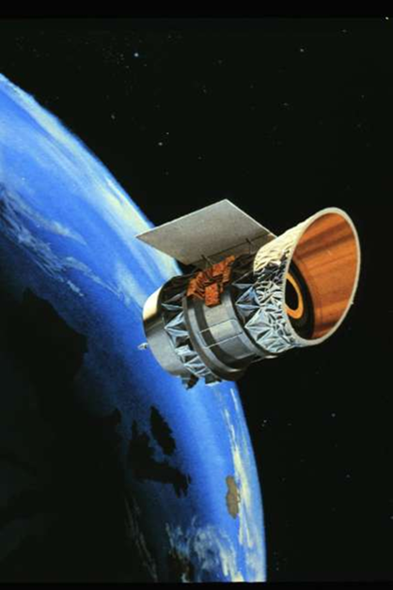
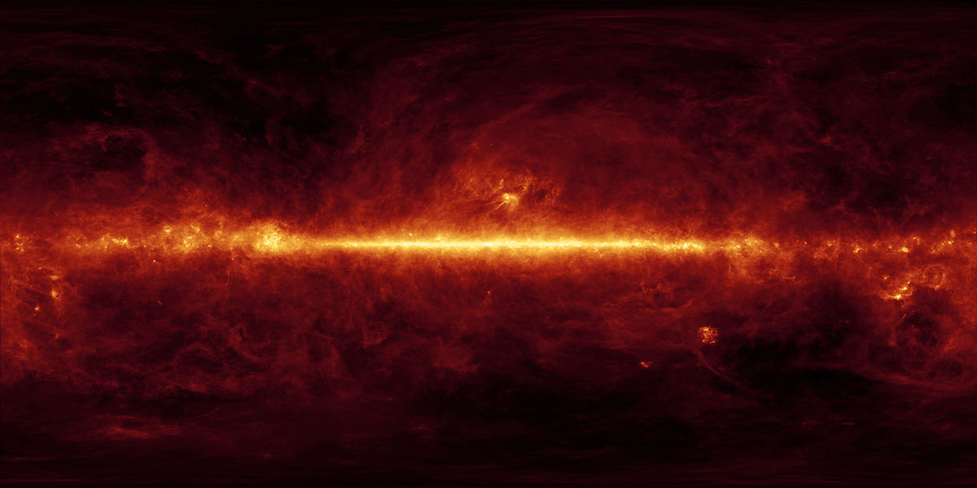
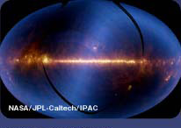
Galactic dust extinction maps
6425 citations
IRAS

Slide 9
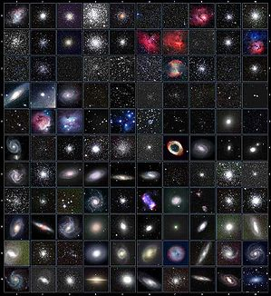
Catalogs and surveys
Historical:
Bayer (1693)
Flamsteed ~1700
Messier (1771)
NGC (1880)
HD (20th century)
Modern:
HD
BD (Argelander)
SAO (HD+BD+PM)
USNO (A,B …)
Tycho
PS1
Gaia

Slide 10




Catalogs and surveys

Slide 11
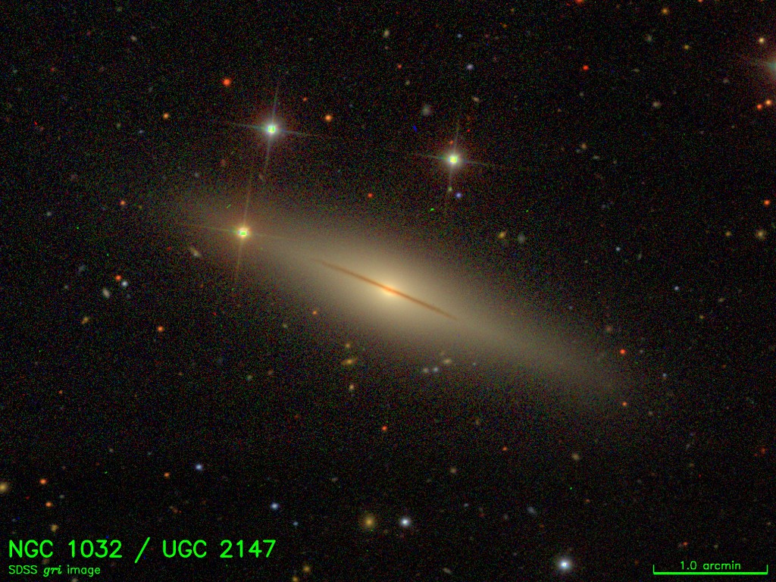

Surveys, archives
All-sky surveys:
Radio: RC#, NVSS, FIRST
IR: 2MASS, WISE
Optical: DSS, SDSS, DECaLS
UV: GALEX
X-ray: RASS
HST: MAST

Slide 12
End

