Slide 1
Observational techniques meeting #6

Slide 2
Topics for student talks:
Cosmic microwave background: history + basic instrumentation
CMB: recent developments
MM/SubMM instrumentation: SCUBA -> ALMA
Sunyaev-Zeldovich effect; detection; implications
Light echoes
IFU spectrographs
Polarization
Neutrino detectors
TeV telescopes
Cosmic-ray observatories
Gravitational wave detectors – LIGO
Future GW observatories - LISA
MIR/FIR instrumentation
X-ray astronomy (basic)
Advanced X-ray (Nustar; Athena)
X-ray polarimetry
JWST: the next generation space telescope
Astrometry and GAIA
Next generation cosmology missions: Euclid and WFIRST
Future radio arrays: LOFAR, SKA
UV observations
Robotics
Planetary missions

Slide 3
Detectors

Slide 4
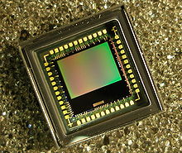
CMOS (active pixel arrays)
Arrays of pixels, each composed on a photodetector (photodiode), amplifier, and readout electronics, realized on chip using CMOS technology
Material | Sensitivity range (nm)
Silicon | 190 - 1100
InGaAs | 800 - 2600
PbS | 1000 - 3500
High QE (>90%), fast readout, cheap, relatively high noise

Slide 5
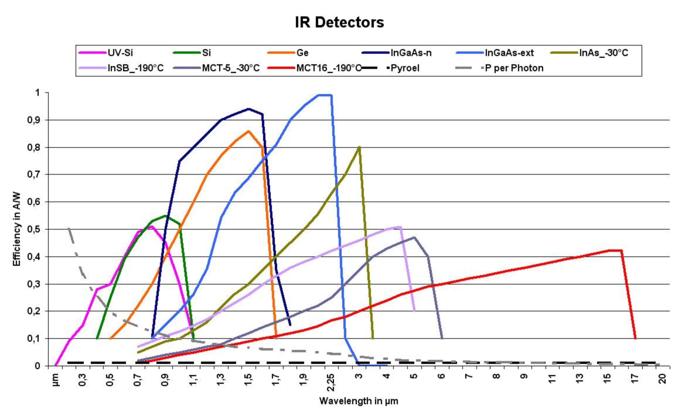
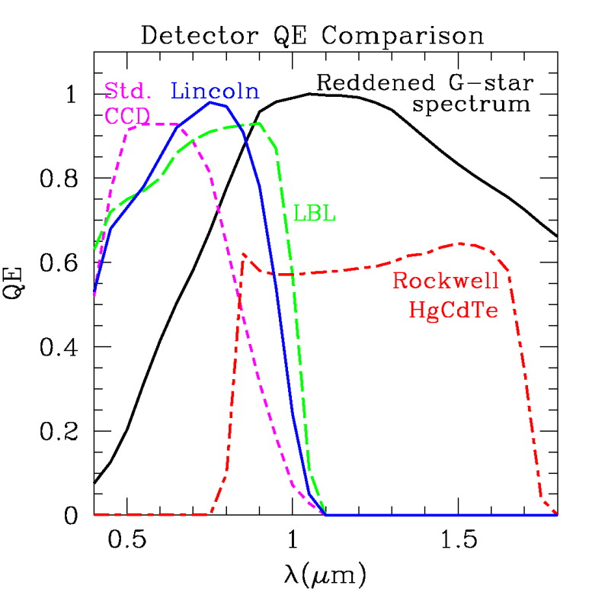
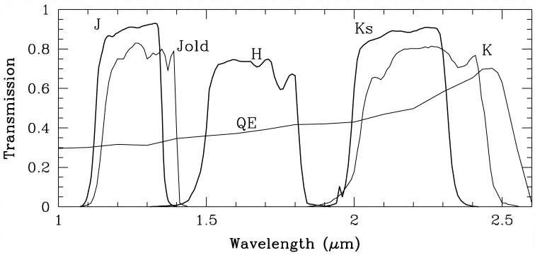
IR pixel arrays
Material | Sensitivity range (nm)
Silicon | 190 - 1100
Germanium | 500 - 1700
InGaAs | 800 - 2600
HgCdTe (MCT) | 800 - 10000
InSb | 1000 - 5500
N cooling
He cooling
NICMOS 3

Slide 6
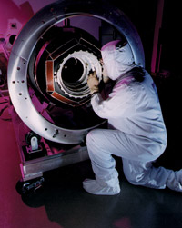
IR instruments: NICMOS
Instrument type | Camera and Spectrograph
Weight | 370 kg
Dimension | 2.2 m x 0.89 m x 0.89 m
Field of view | Low resolution 51.5” x 51.5” Medium resolution 17.5” x 17.5” High resolution 11.0” x 11.0”
Wavelength range | 800 to 2500 nm
MCT detector, 256 x 256 pixels
Following servicing: move from cryo-cooling (He) to TE cooling (-77 C): unlimited lifetime, loss of K band (>1.7 micron)

Slide 7
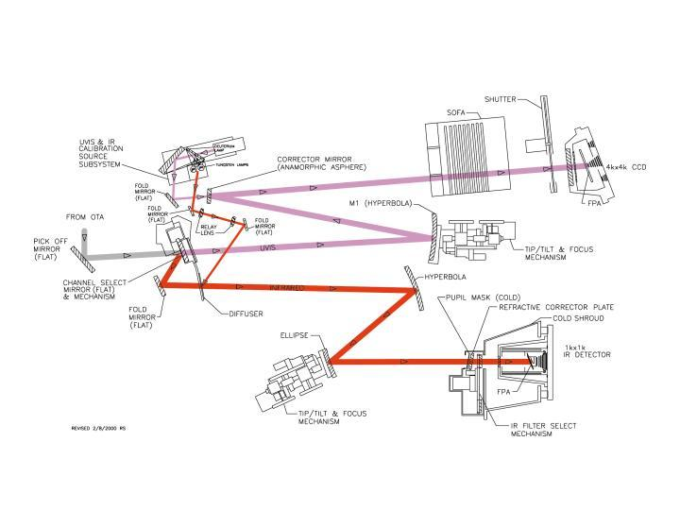
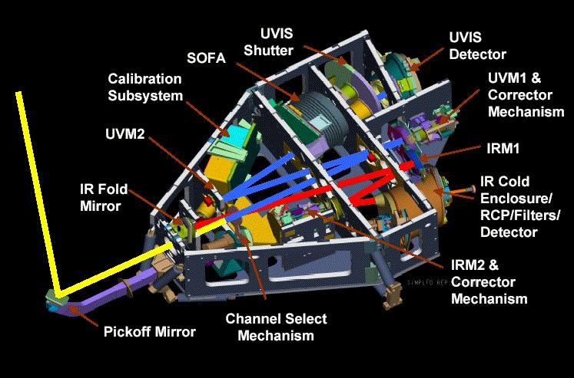
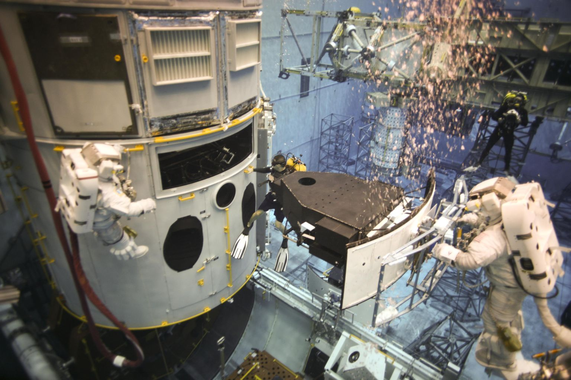
IR instruments: WF3/IR
Components:
Teledyne 1Kx1K HgCdTe detector.
Total Field of View: 123 x 136“
Pixel Size: 0.13”
Nominal Operating Temperature: 145 K
Median Dark Current: 0.015 e-/sec/pix
Readnoise (CDS): 15.5 e-
Full Well: 93,000 e- (95% linearity)

Slide 8
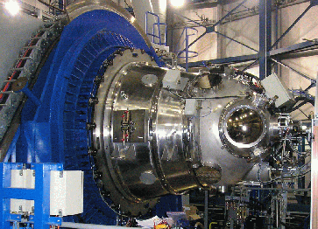
IR instruments: HAWK-I
New IR instrument on VLT (ESO). Cryogenic (120 K, detectors at 80 K) and has a full reflective design. The light passes four mirrors and two filter wheels before hitting a mosaic of four Hawaii 2RG 2048 * 2048 pixels detectors (Raytheon HgCdTe). The final
F-ratio is F/4.36

Slide 9
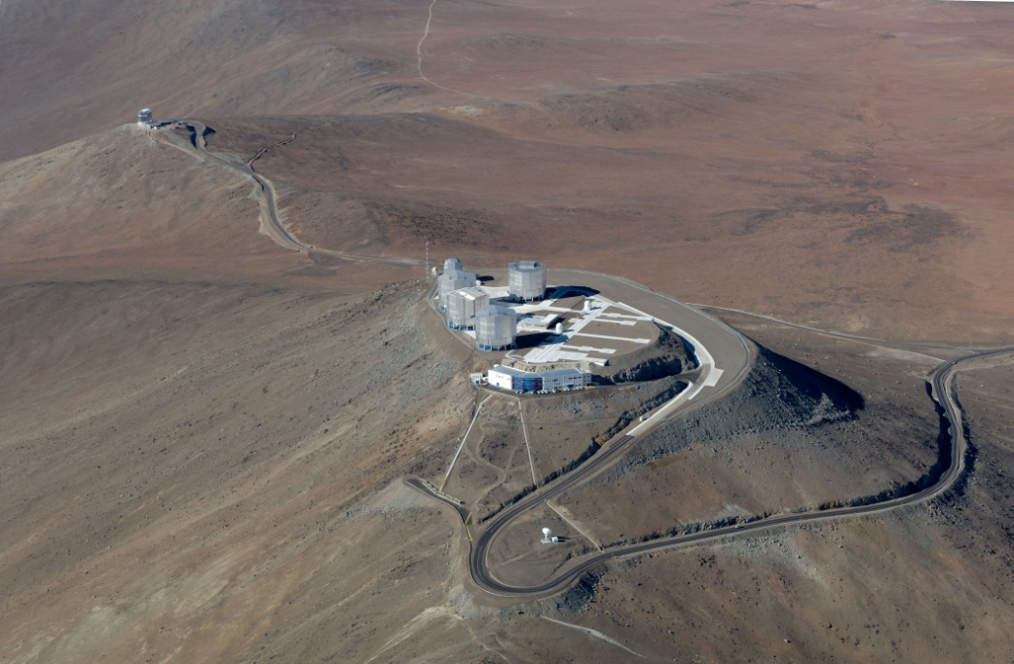
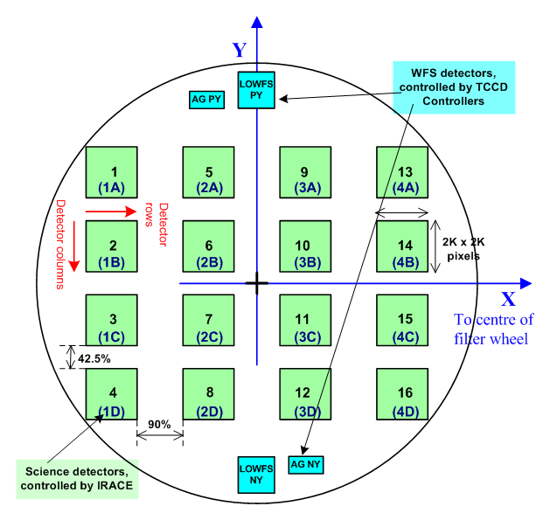
IR instruments: VISTA
VISTA is a 4-m class wide field survey telescope for the southern hemisphere, equipped with a near infrared camera (1.65 degree diameter field of view at VISTA's nominal pixel size) containing 67 million pixels of mean size 0.34 arcsec and available broad band filters at Z,Y,J,H,K_{s} and a narrow band filter at 1.18 micron.
The telescope has an azimuth-altitude mount, and quasi-Ritchey-Chretien optics with a fast f/1 primary mirror giving an f/3.25 focus to the instrument at Cassegrain. The instrument mounts to the rotator on the back of the primary mirror cell, and includes a wide-field corrector lens system, autoguider and active optics sensors.
VISTA is located at ESO's Cerro Paranal Observatory in Chile
16 2048x2048 pixel IR detectors (Raytheon HgCdTe 0.84-2.5 micron)

Slide 10
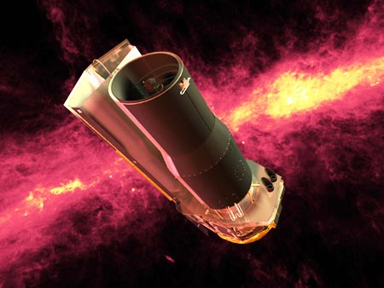
IR instruments: Spitzer
Spitzer is designed to detect infrared radiation. The Cryogenic Telescope Assembly, which contains a 85 cm telescope and Spitzer's three scientific instruments, is cooled to a few K with liquid helium (f/12 lightweight Beryllium mirror, cooled to less 5.5 K).
IRAC is a four-channel camera that provides simultaneous 5.12 x 5.12 arcmin images at 3.6, 4.5, 5.8, and 8 microns. The pixel size is 1.2 arcsec in all bands. All four detector arrays in the camera are 256 x 256 pixels in size, with the two short wavelength channels using InSb and the two longer wavelength channels using Si:As detectors.
The Multiband Imaging Photometer is an imaging camera in the far-infrared (24, 70 and 160 microns). MIPS is also capable of simple spectroscopy. At 24 micron mode 128 x 128 pixels; at 70 and 160 micron arrays are much smaller 32 x 32 and 2 x 20 pixels GeGa.. 5’ x 5’ section of the sky at any one time at 24 microns (less at 160)

Slide 11
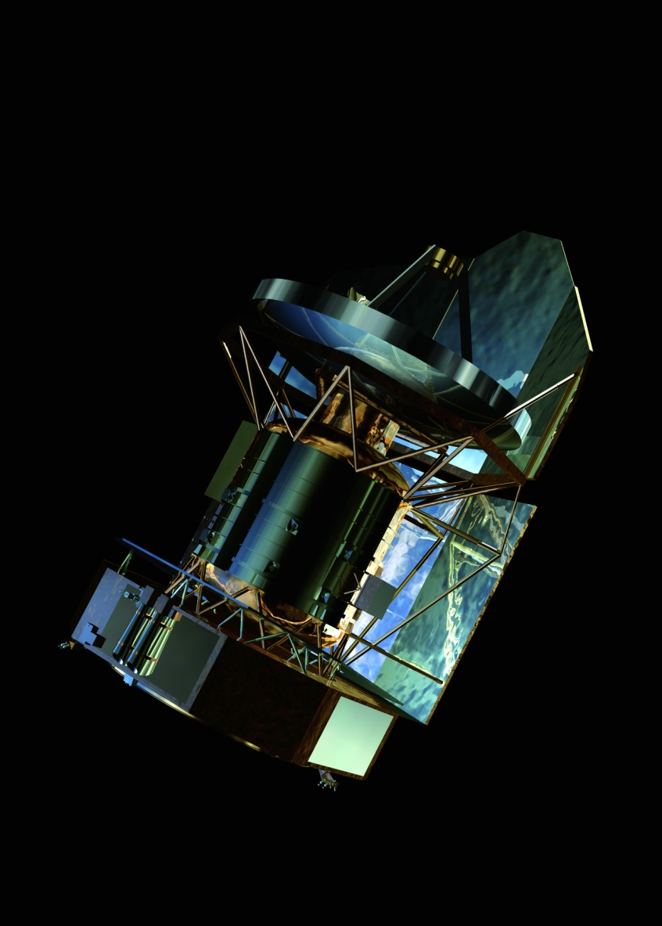
IR instruments: Herschel
ESA: FIR-submm 55 to 672 µm
Telescope - Cassegrain, 3.5m primary and 0.3m secondary mirror
HIFI: high resolution heterodynes spectrometer 157-625 µm
PACS, SPIRE: bolometer arrays

Slide 12
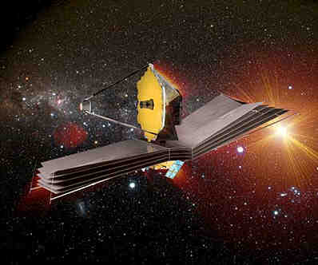
IR instruments: JWST
6.5 space telescope
MIRI: The Mid-Infrared Instrument (MIRI) is an imager/spectrograph that covers the wavelength range of 5 to 27 micron with Si:As detector arrays. The nominal operating temperature is 7K.
The Near Infrared Camera (NIRCam), is an imager with a large field of view and high angular resolution, 0.6 - 5 micron with ten mercury-cadmium-telluride (HgCdTe) detector arrays.
NIRSpec: simultaneous spectra of more than 100 objects in a 9’ square field of view. Medium-resolution spectroscopy at 1 to 5 micron and lower-resolution spectroscopy from 0.6 to 5 micron. Two HgCdTe detector arrays.

Slide 13
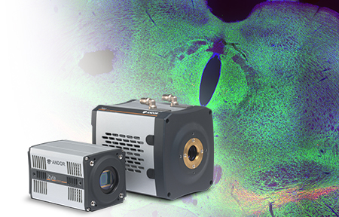
CMOS: fast cameras
Model | Active Pixels | Frame Rate | Dark Current
Neo 5.5 sCMOS | 2560 x 2160 | 30 | 0.007
Zyla 5.5 sCMOS | 2560 x 2160 | 100 (40 USB 3.0) | 0.14
Zyla 4.2 sCMOS | 2048 x 2048 | 100 (53 USB 3.0) | 0.14

Slide 14
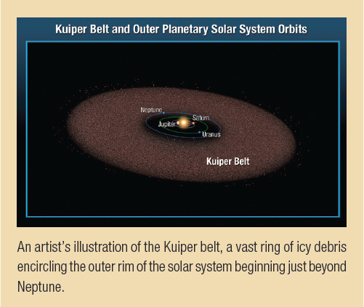
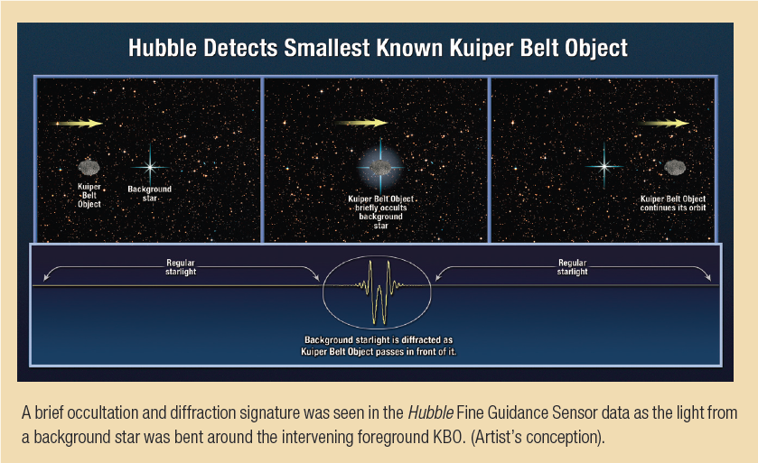
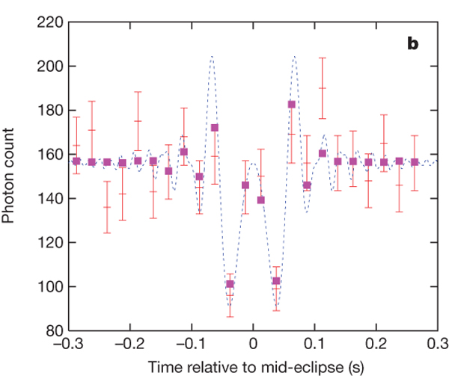
CMOS: fast cameras
Application: KBOs
Schlichting, Ofek et al. 2009, Nature

Slide 15
End

