Slide 1
Observational techniques meeting #7

Slide 2
Topics for student talks:
Cosmic microwave background: history + basic instrumentation
CMB: recent developments
MM/SubMM instrumentation: SCUBA -> ALMA
Sunyaev-Zeldovich effect; detection; implications
Light echoes
IFU spectrographs
Polarization
Neutrino detectors
TEV telescopes
Cosmic-ray observatories
Gravitational wave detectors – LIGO
Future GW observatories - LISA
MIR/FIR instrumentation
X-ray astronomy (basic)
Advanced X-ray (Nustar)
X-ray polarimetry
JWST: the next generation space telescope
Astrometry and GAIA
Next generation cosmology missions: Euclid and WFIRST
Future radio arrays: LOFAR, SKA
UV
Robotics

Slide 3
Filter systems

Slide 4
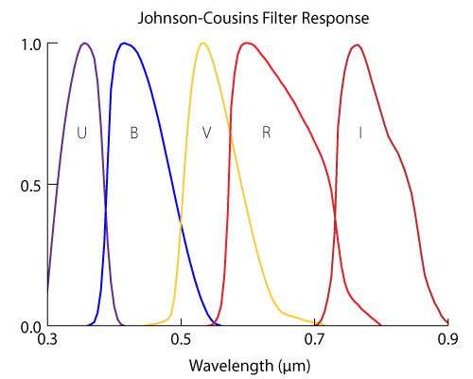
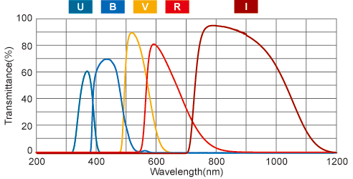
Johnson system

Slide 5
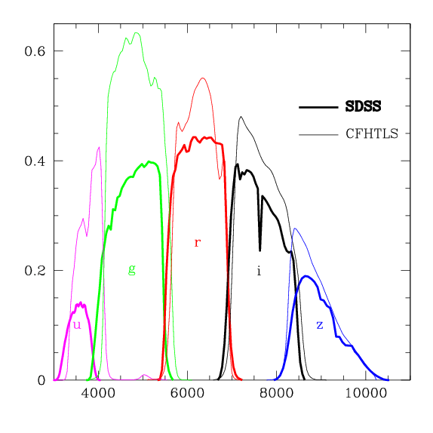
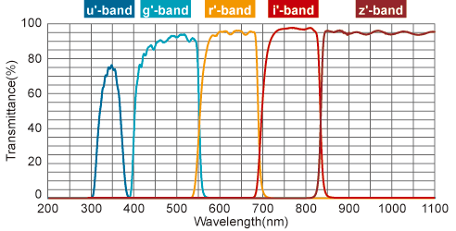
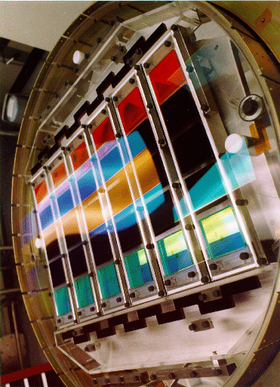
SDSS system (Gunn filters)

Slide 6
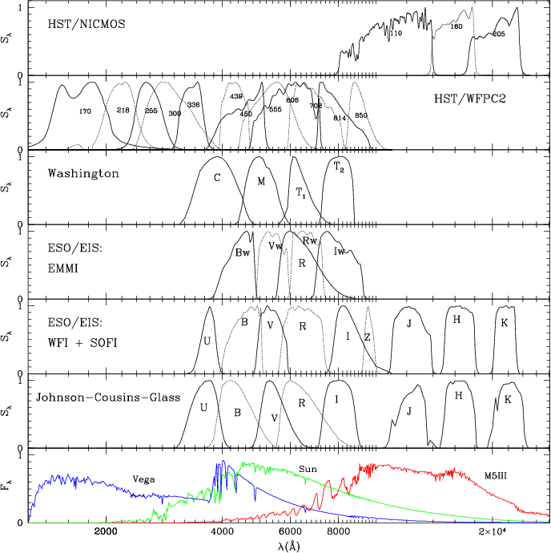
IR filters

Slide 7
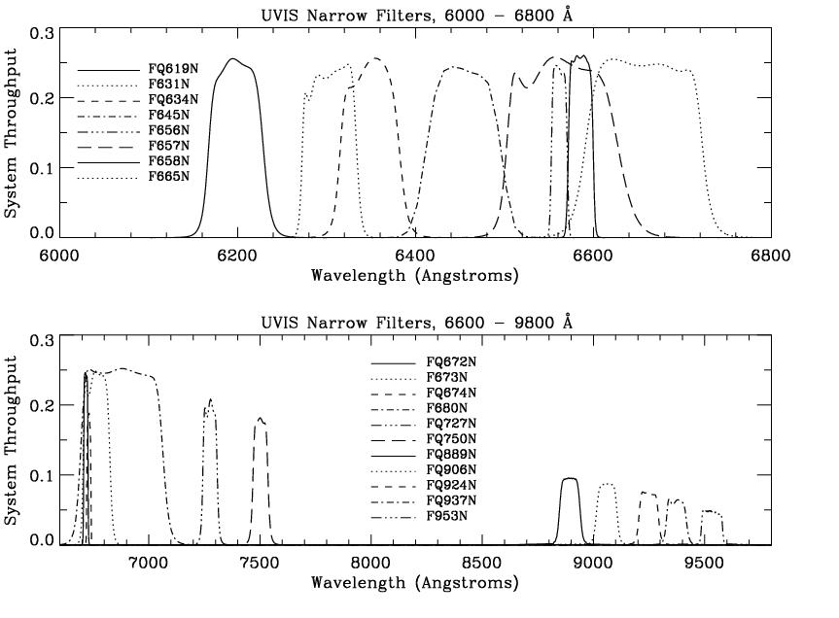
Narrow-band filters

Slide 8
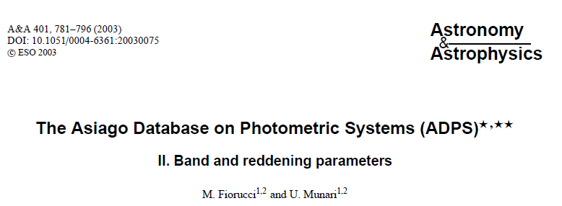
More…
>215 systems …

Slide 9
Spectrographs

Slide 10
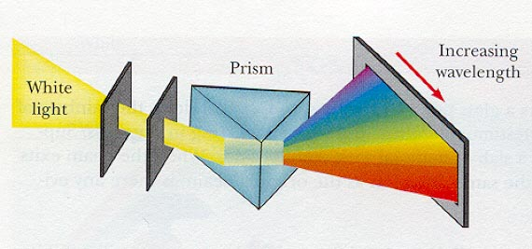
Dispersive elements: prism
High throughput; low resolution; wavelength-dependant dispersion R=t dn/dλ

Slide 11
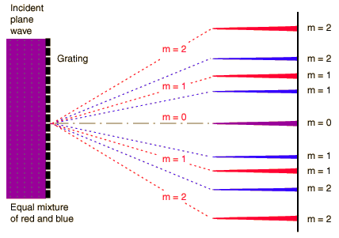
Dispersive elements: diffraction grating
R = m L k

Slide 12
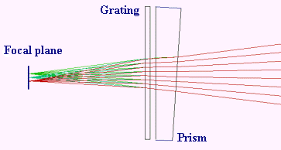
Dispersive elements: grism

Slide 13
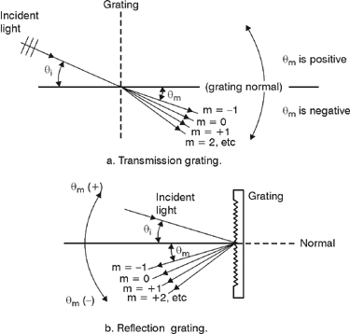
Dispersive elements: reflection grating

Slide 14
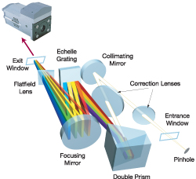
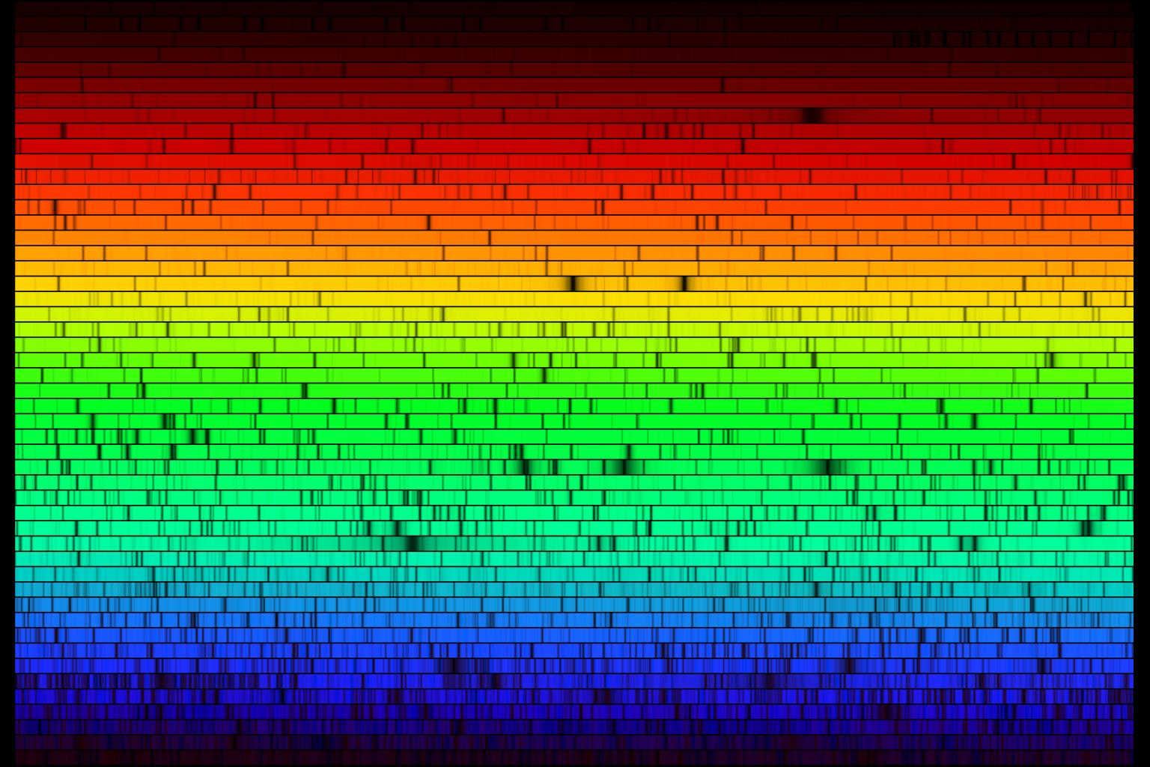
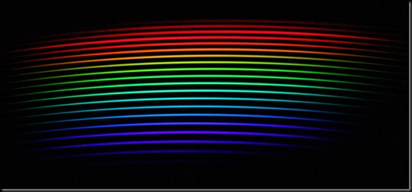
Cross-dispersed echelle

Slide 15
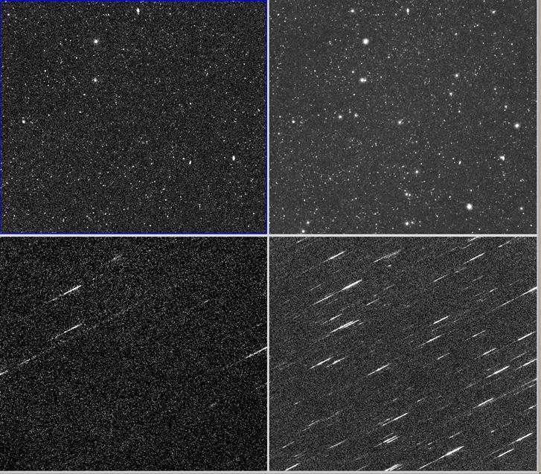
Slitless spectroscopy

Slide 16
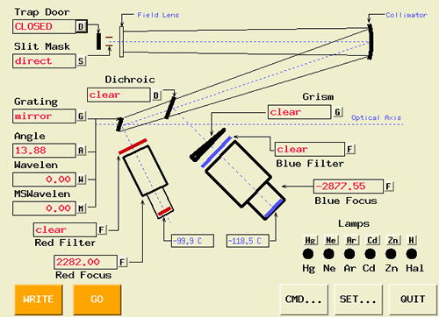
Spectrograph

Slide 17
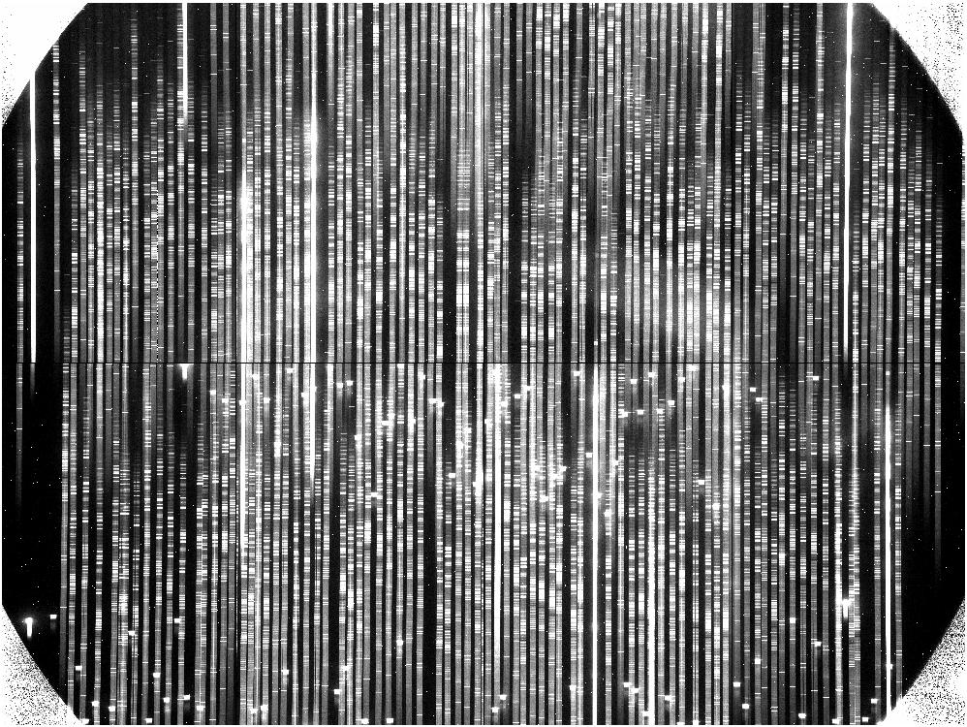
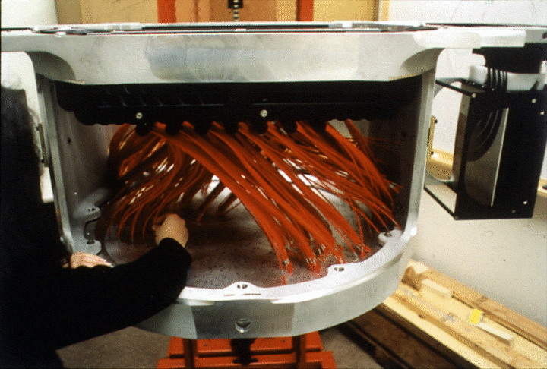
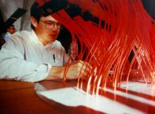
Multiplexing
Multislit masks
Fiber spectrographs

Slide 18
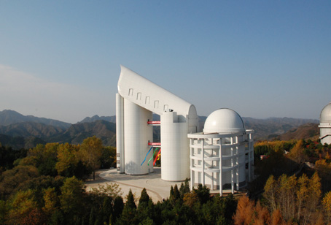
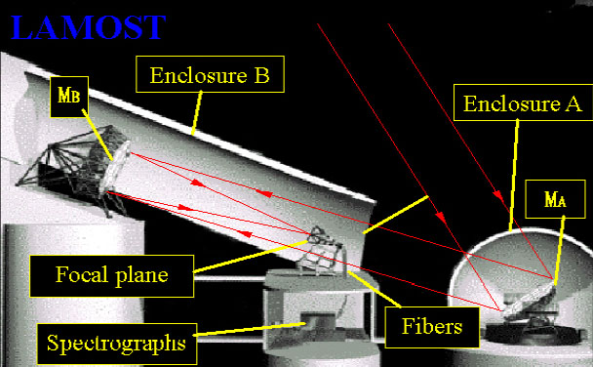
LAMOST
3.5-4.9m mirror
4000 fibers
16 spectrographs
Xinglong station

Slide 19
End

