Slide 1
Observational techniques meeting #8

Slide 2
Topics for student talks:
Cosmic microwave background: history + basic instrumentation
CMB: recent developments
MM/SubMM instrumentation: SCUBA -> ALMA
Sunyaev-Zeldovich effect; detection; implications
Light echoes
IFU spectrographs
Polarization
Neutrino detectors
TEV telescopes
Cosmic-ray observatories
Gravitational wave detectors – LIGO
Future GW observatories - LISA
MIR/FIR instrumentation
X-ray astronomy (basic)
Advanced X-ray (Nustar)
X-ray polarimetry
JWST: the next generation space telescope
Astrometry and GAIA
Next generation cosmology missions: Euclid and WFIRST
Future radio arrays: LOFAR, SKA
UV
Robotics

Slide 3
Spectroscopy

Slide 4
Spectral analysis provides:
Redshift/distance
Composition
Velocity/dynamics

Slide 5
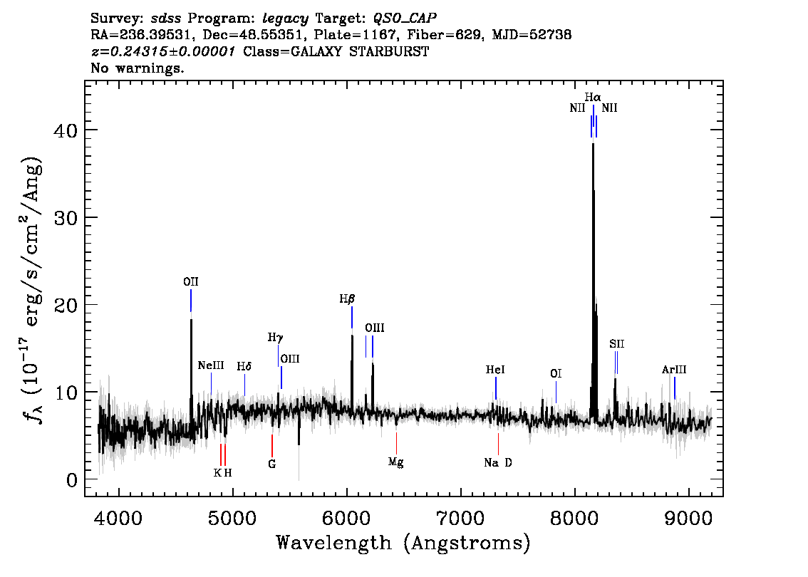
Redshift

Slide 6
z=0 - Stars

Slide 7
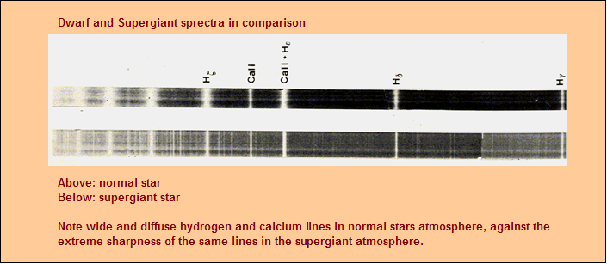
Plate spectra

Slide 8
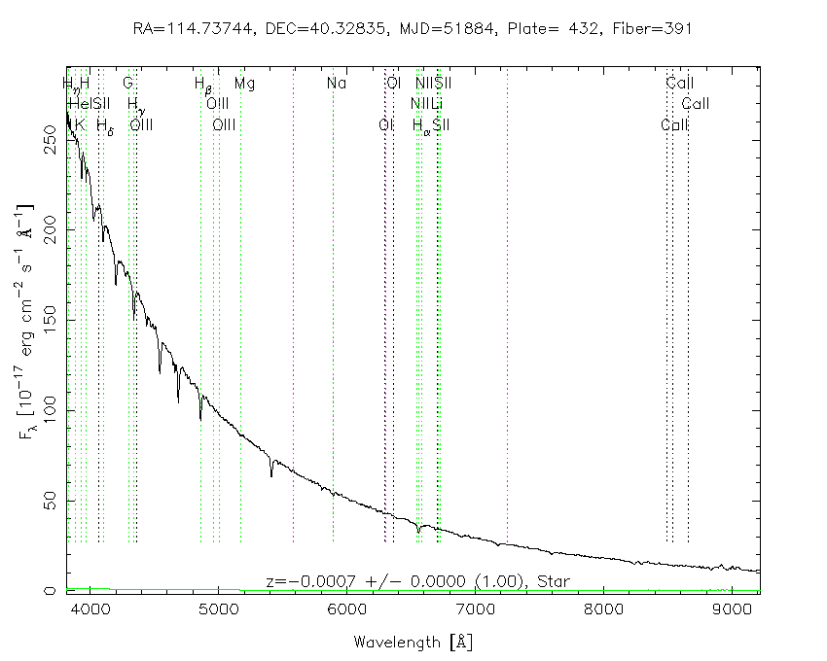
Modern stellar spectra: O star
He II

Slide 9
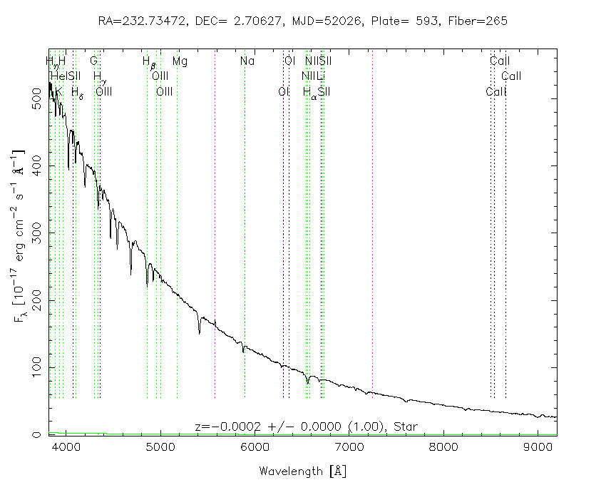
Modern stellar spectra: O/B
He II
He I

Slide 10
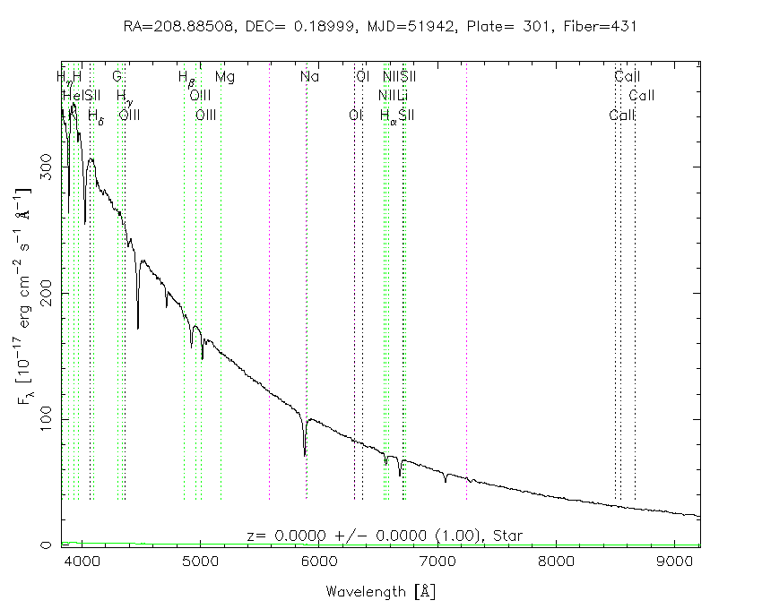
Modern stellar spectra: B
Black body break
He II
He I

Slide 11
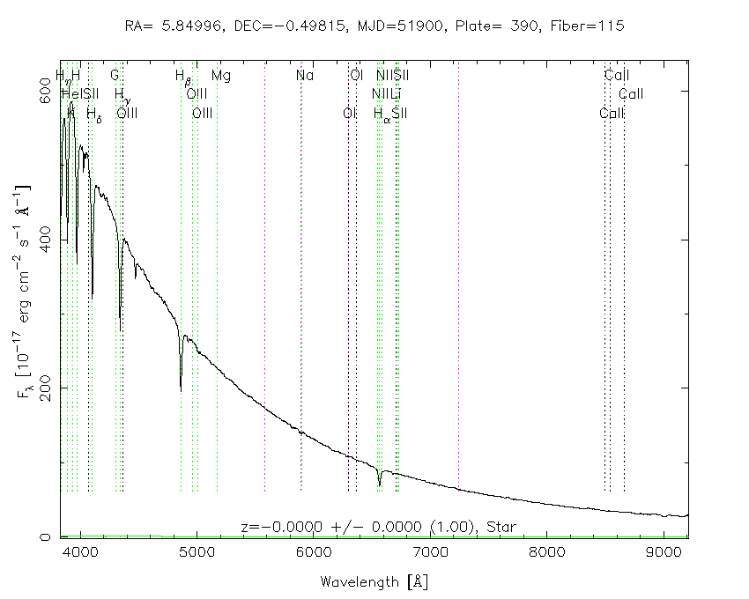
Modern stellar spectra: A
Black body break
He II
He I

Slide 12
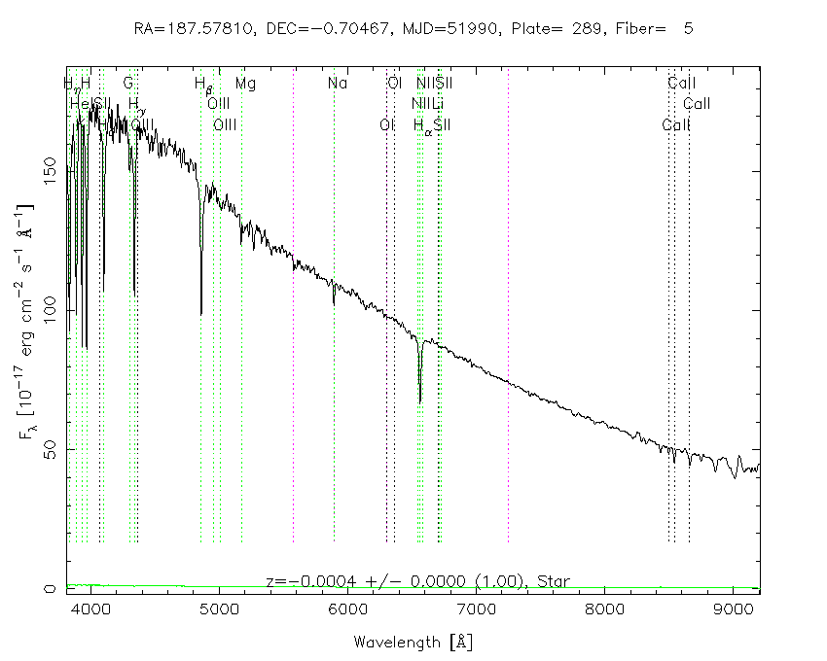
Modern stellar spectra: F
Black body break
Mg I
Na D
Ca H+K

Slide 13
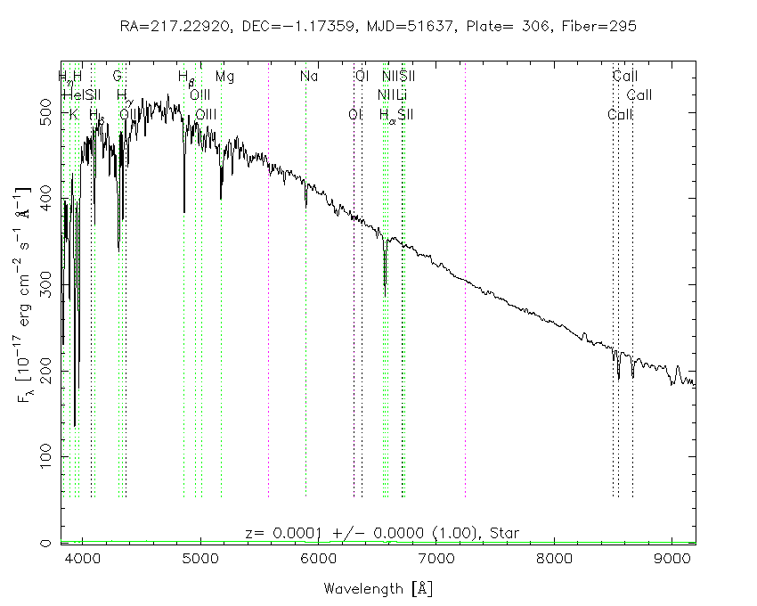
Modern stellar spectra: F
Black body
break
Na D
G band
Mg I
Ca H+K

Slide 14
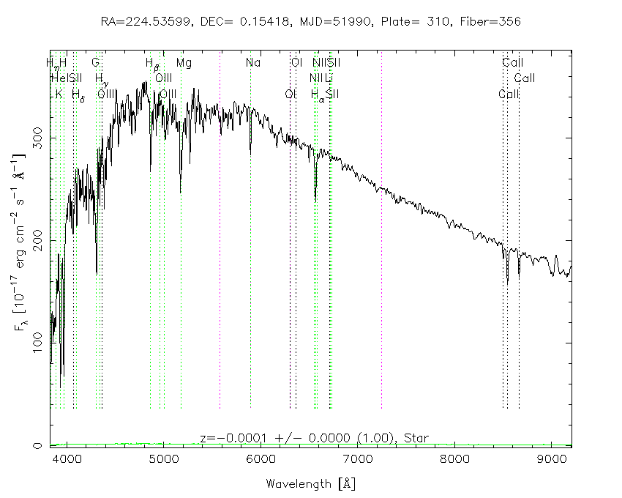
Modern stellar spectra: G
Black body
break
Na D
G band
Mg I
Ca IR
triplet
Ca H+K

Slide 15
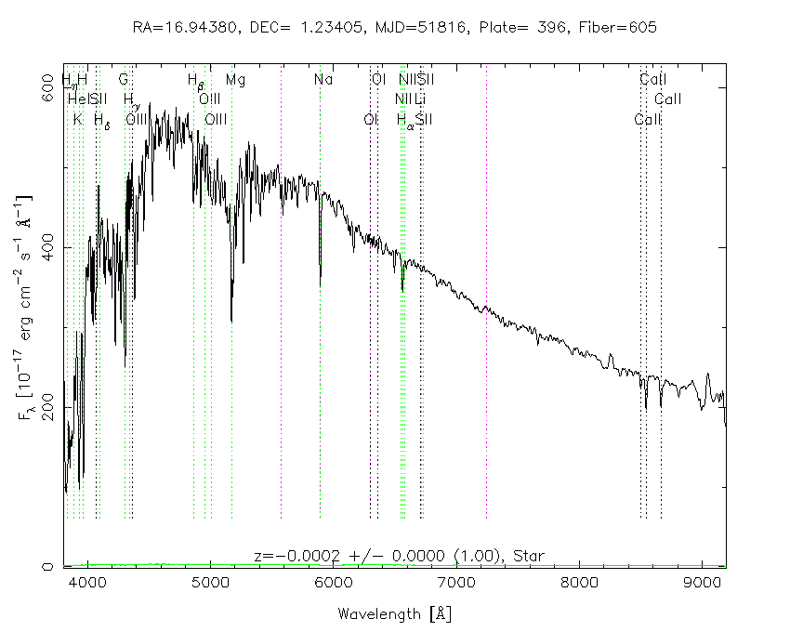
Modern stellar spectra: K
Black body
break
Na D
Mollecular
bands
Mg I
Ca H+K
Ca IR
triplet

Slide 16
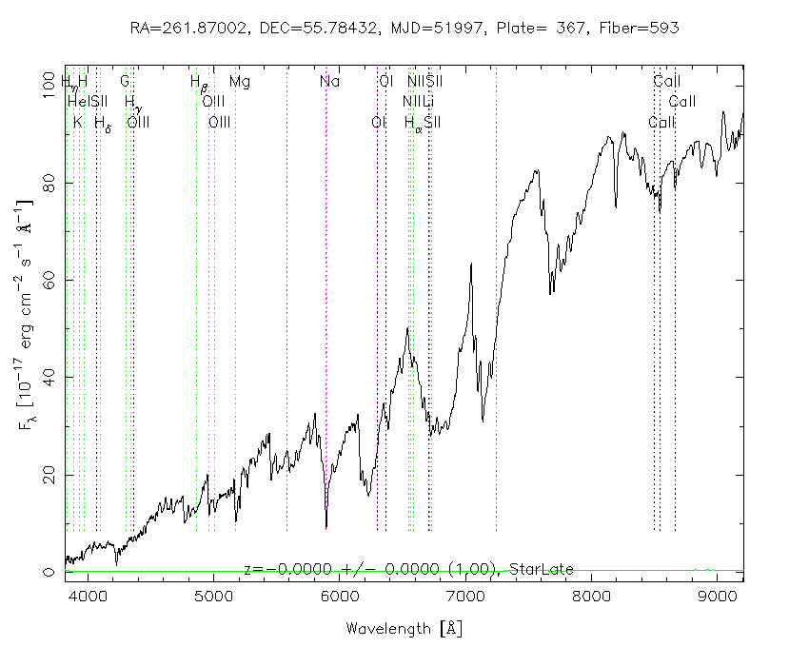
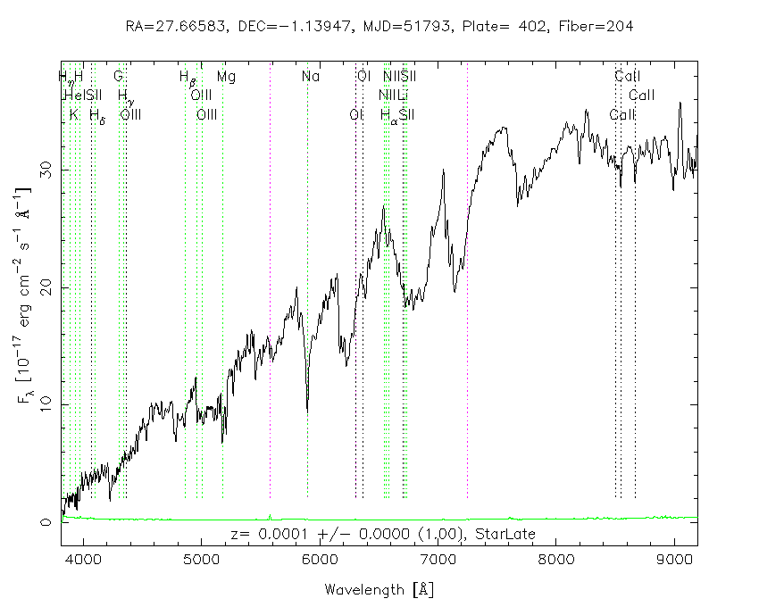
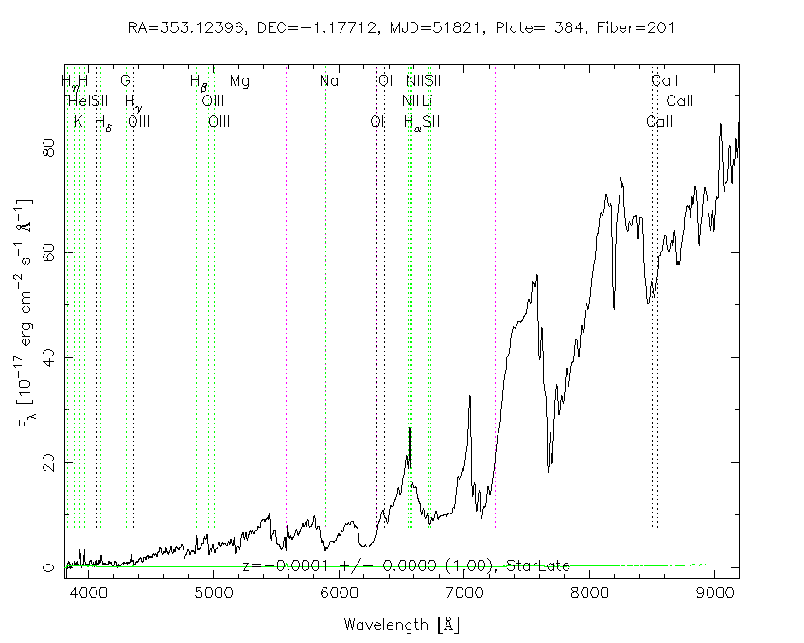
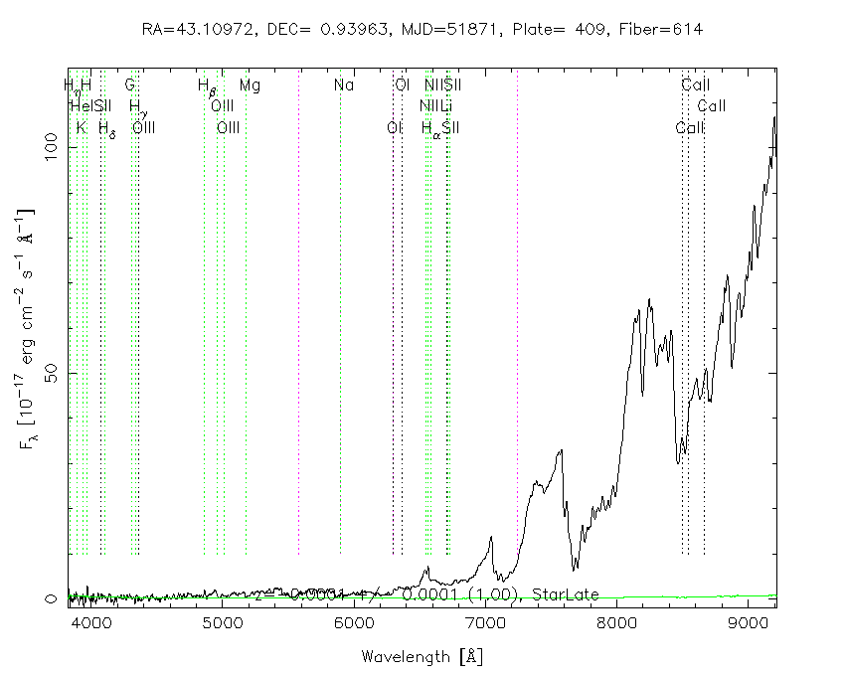
Modern stellar spectra: M
Mollecular
bands
Na D
Ca IR
triplet
Mg I

Slide 17
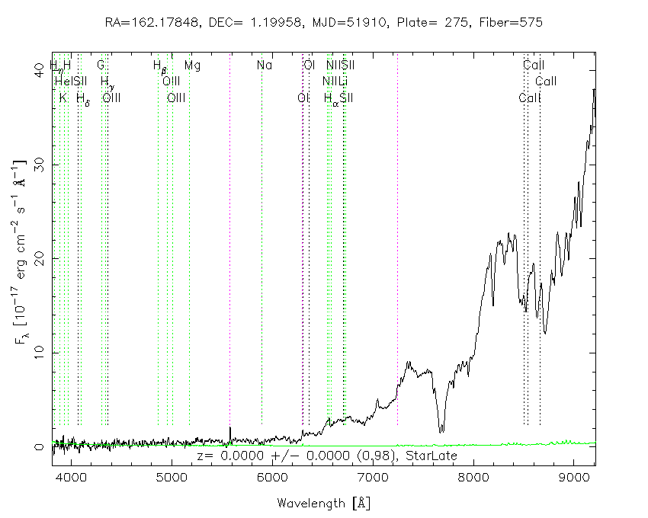
Modern stellar spectra:
Brown dwarfs (L, T, Y)
Mollecular
bands

Slide 18
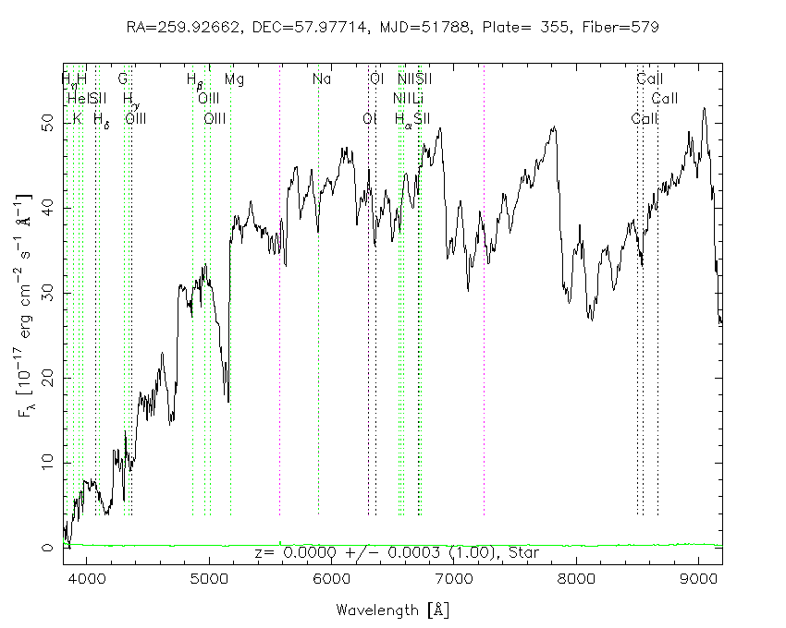
Modern stellar spectra:
Carbon stars (C,S stars)
Na D
Mg I

Slide 19
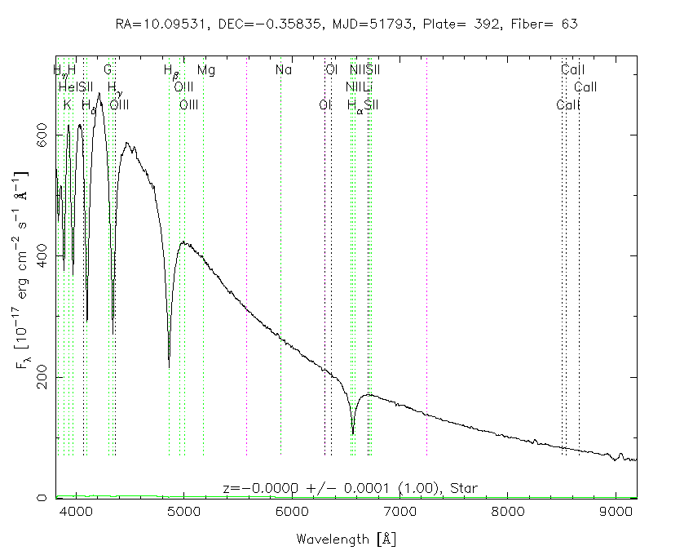
Modern stellar spectra:
White dwarf stars DA

Slide 20
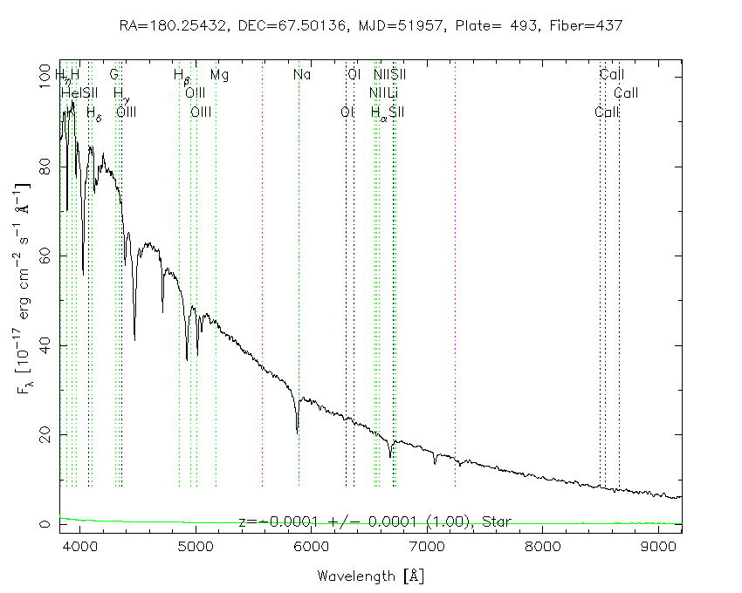
Modern stellar spectra:
White dwarf stars DB

Slide 21
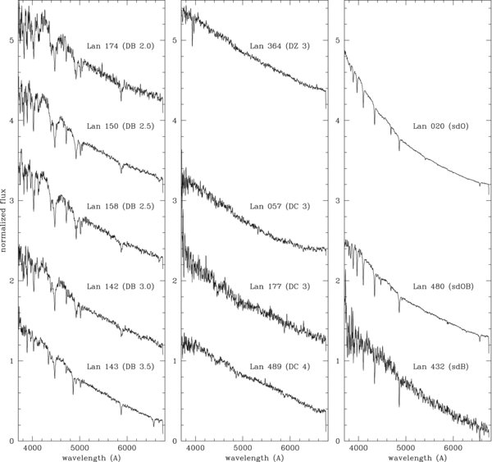
Modern stellar spectra:
White dwarf stars DB

Slide 22
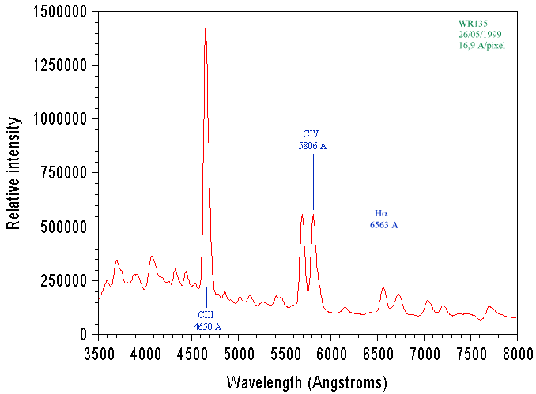
Modern stellar spectra:
Wolf-Rayet stars: WN/WC/WO

Slide 23
End

