Slide 1
Observational techniques meeting #9

Slide 2
Student talks and dates:
May 9: Liantong Luo (mm/submm)
May 14: Gidi Yoffe (High-res spec); Dotan Shaniv (JWST)
May 16: Yigal Sternklar (Polarization); Oran Ayalon (CMB#1)
May 21: Andra Tesi (Neutrinos); Amir Rosenblatt (X-ray – basic)
May 23 – no class
May 28: Simon Mahler (SZ effect); Noam Morali (IFU)
May 30: Yuval Rosenberg (UV); Noam Segev (GAIA)
June 4: Abhay Nayak (Euclid); Tom Koren (light echoes)
June 6 – no class
June 11: Gidi Alon (future radio); Lior Gazit (LIGO)
June 13: Tal Levinson (TeV); Gilad Sadeh (?)
June 18: Mehran Shehade (CR); Yuval Tamir (Robotics)
June 20: Asaf Miron (CMB #2 - polarization); Aviram Uri (LISA)
June 25: Tom Manovitz (MIR/FIR); Mark Aprestein (X-Ray Polarimetry)

Slide 3
Topics left for student talks:
Light echoes
Future GW observatories - LISA
MIR/FIR instrumentation
Advanced X-ray (Nustar)
X-ray polarimetry
Robotics

Slide 4
Spectroscopy
(Cont.)

Slide 5
Supernovae

Slide 6
SNe Ia

Slide 7
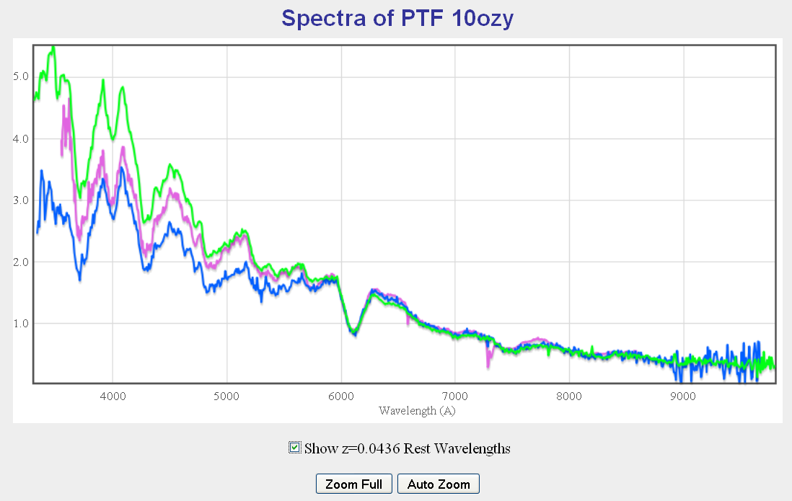
SNe Ia
Si II “6100”
Ca II
Si II “4000”

Slide 8
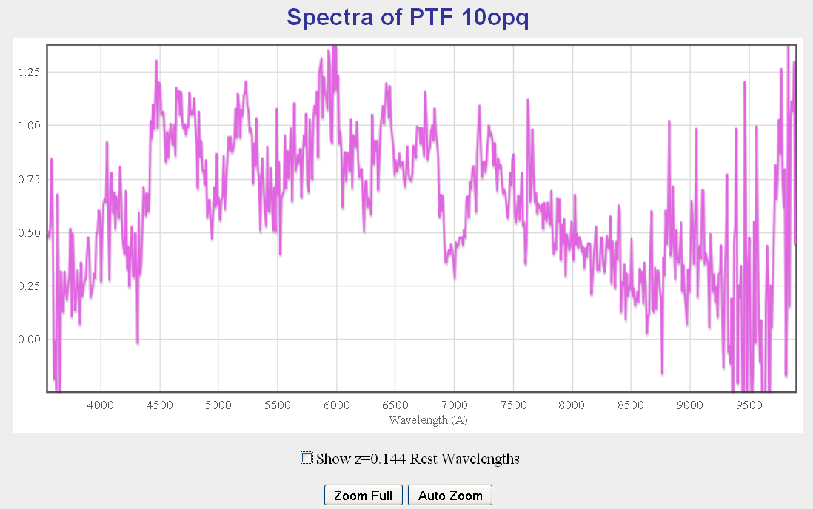
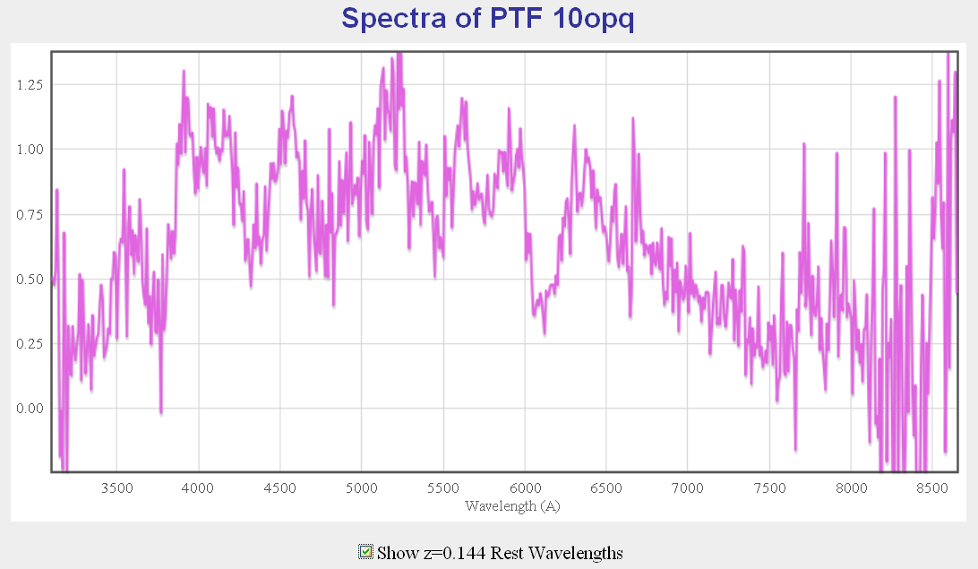
SNe Ia

Slide 9
SNe Ib

Slide 10
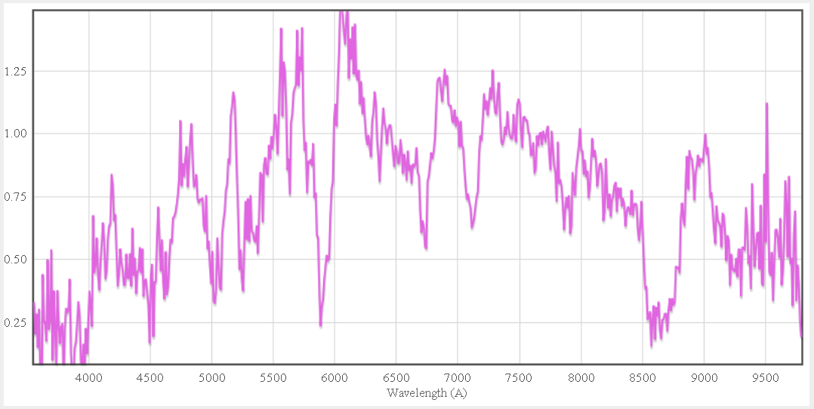
SNe Ib
Ca II IR triplet
He I 6678 and 7065
He I 5876 or Na D 5890?

Slide 11
SNe Ic

Slide 12
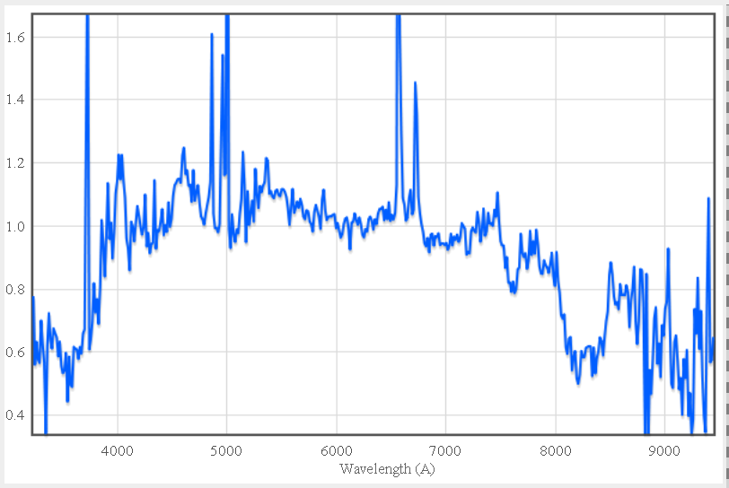
SNe Ic
OIII
4959
5007
Hα
6563
Ca II IR triplet
OII
3727
Hβ
4861
SII
6700
No Si II

Slide 13
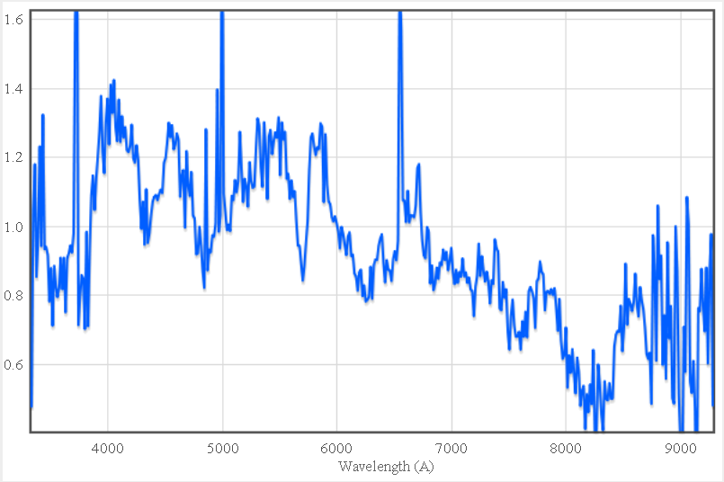
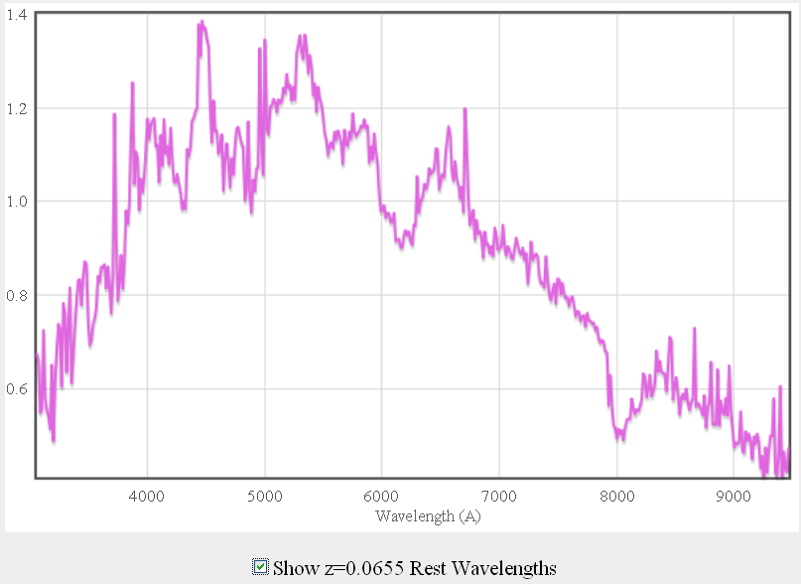
SNe Ic
Ca
Si II?
No SI II
He I

Slide 14
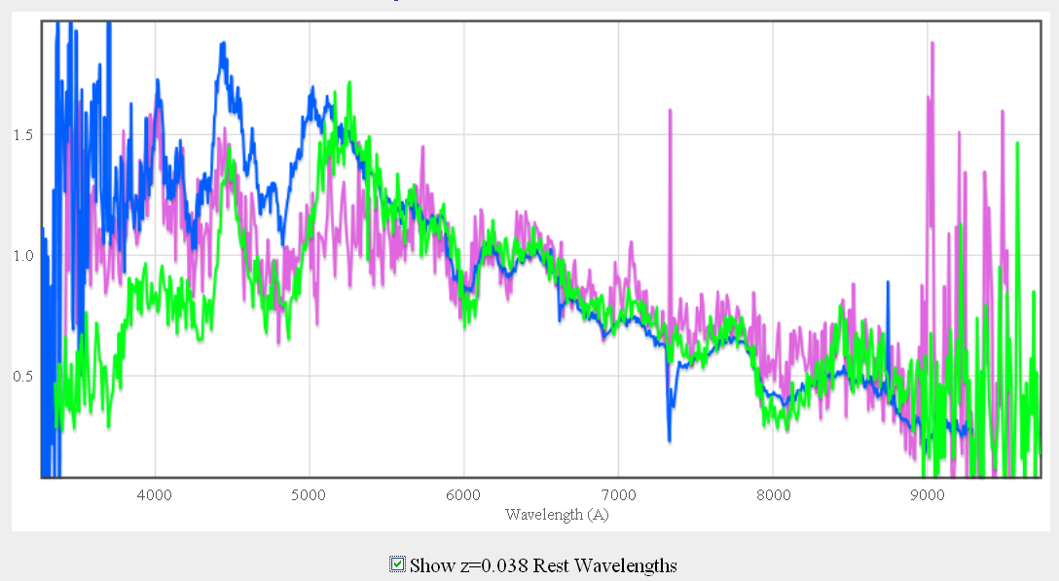
SNe Ic
Ia or Ic ?

Slide 15
SNe II

Slide 16
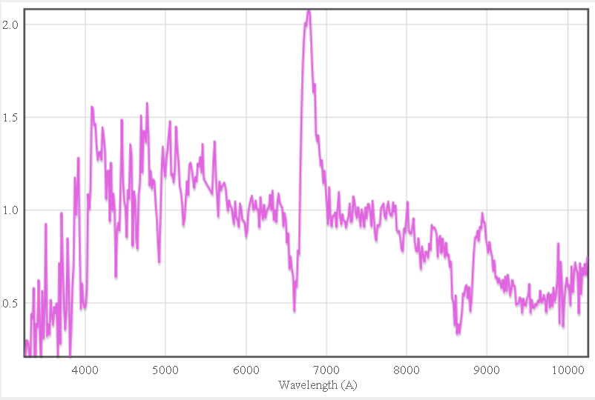
SNe II - normal
Fe
Hα
Ca II

Slide 17
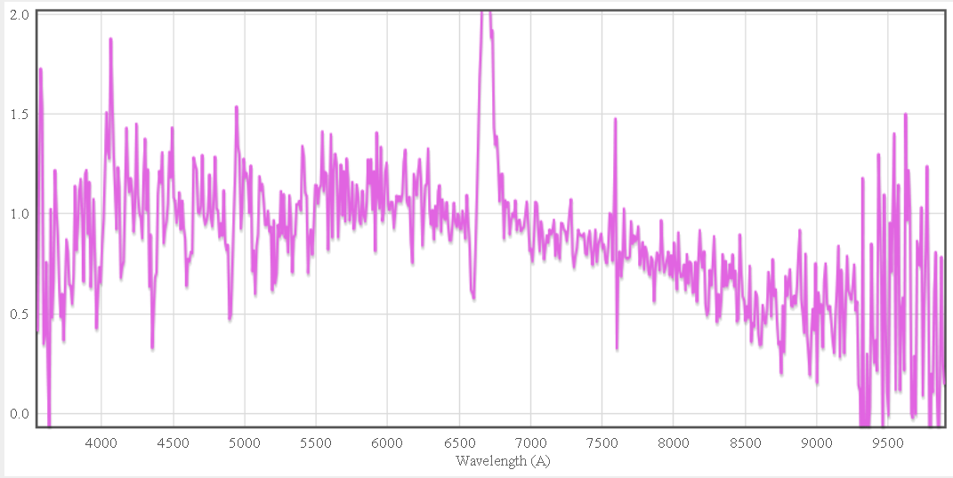
SNe II – underluminous/low v
Low-velocity P-cygni

Slide 18
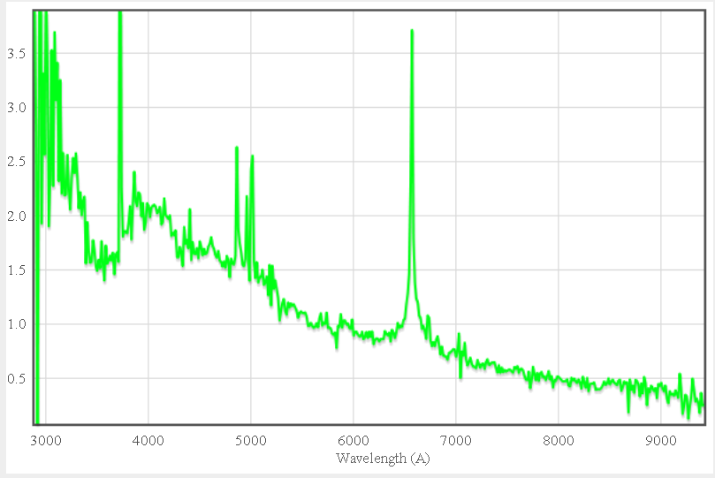
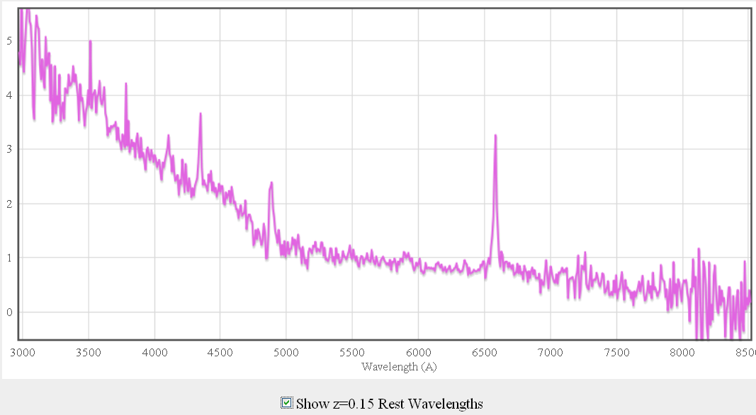
SNe IIn
Hγ
Hα
Hδ
Hβ
Blue continuum
Classic IIn profile

Slide 19
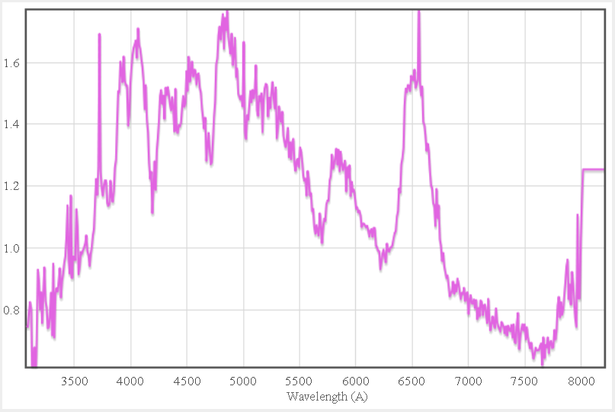
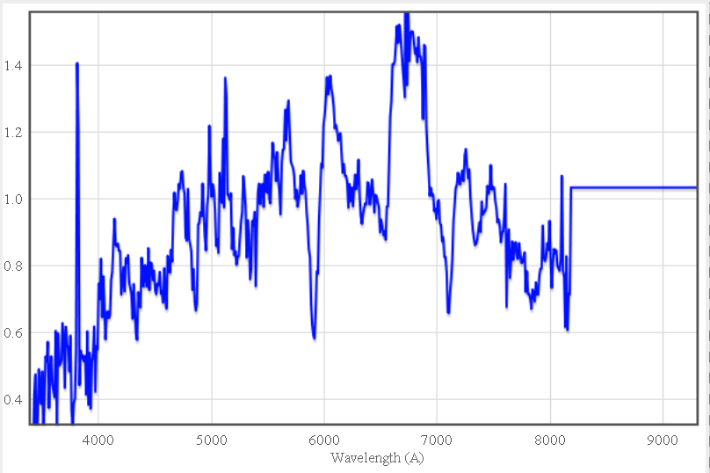
SNe IIb
He

Slide 20
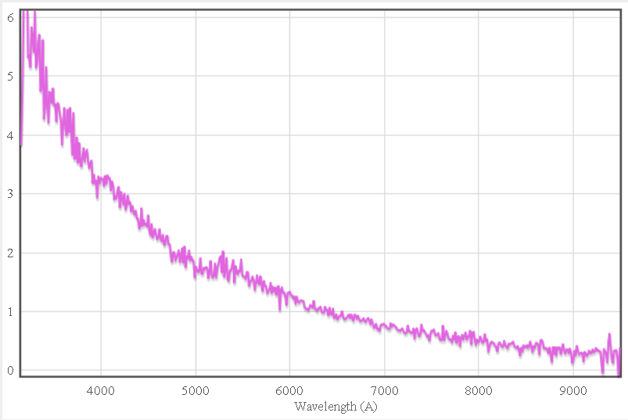
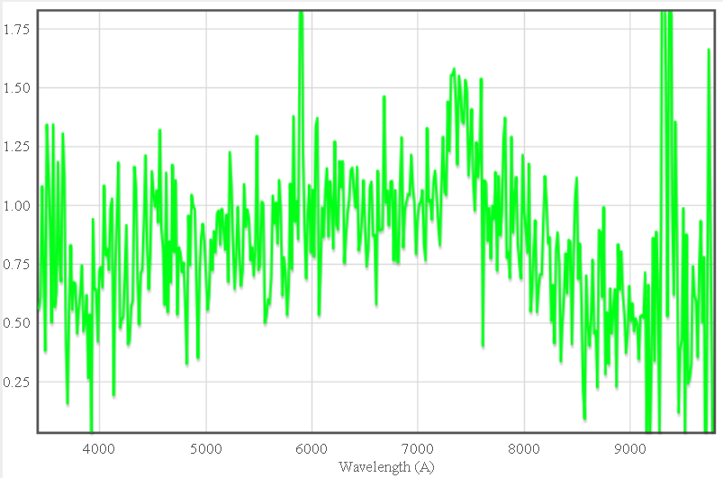
SNe II - young

Slide 21
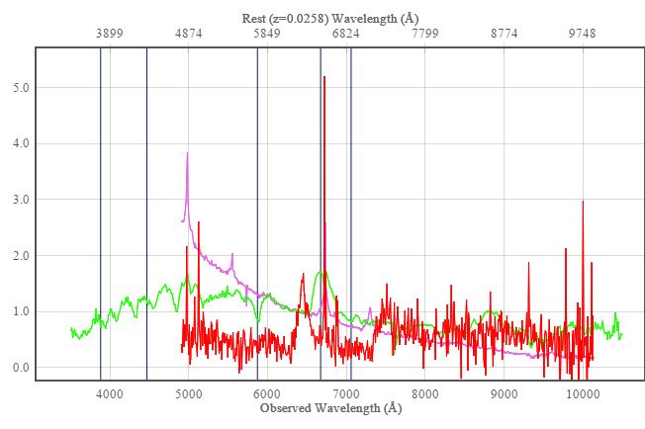
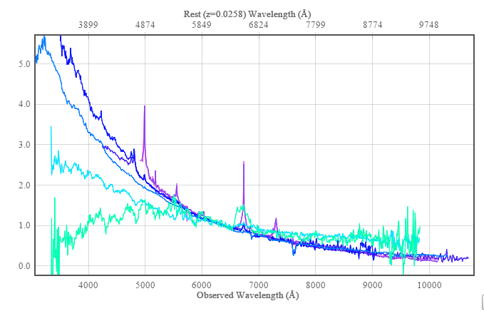
SNe II - flash

Slide 22
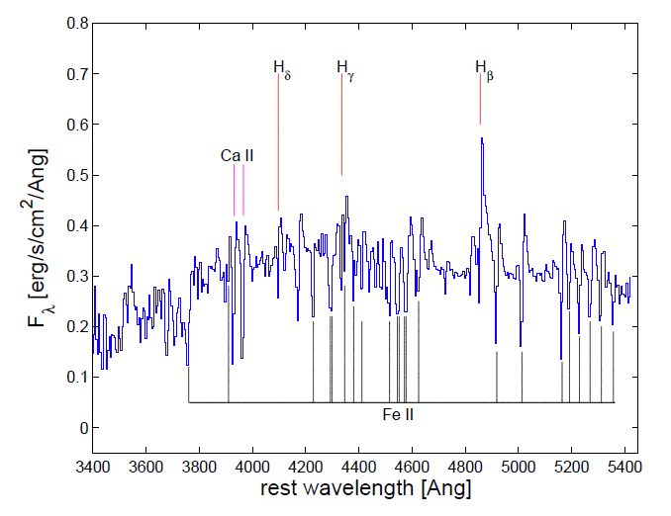
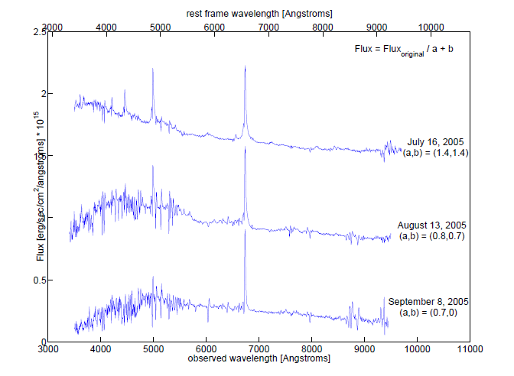
SNe IIn: pseudo continuum
Kiewe et al. 2011; SN 2005cl

Slide 23
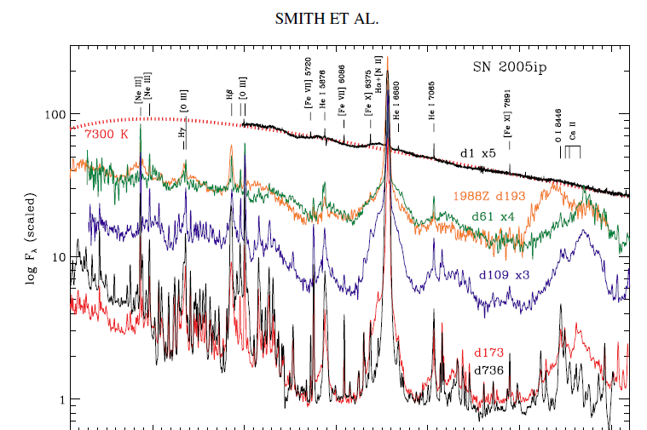
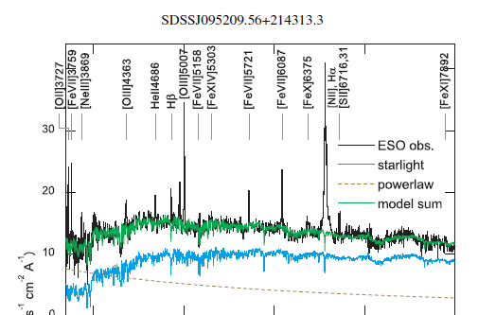
SNe IIn: hottest objects
Komossa et al. 2010

Slide 24
Variable stars

Slide 25
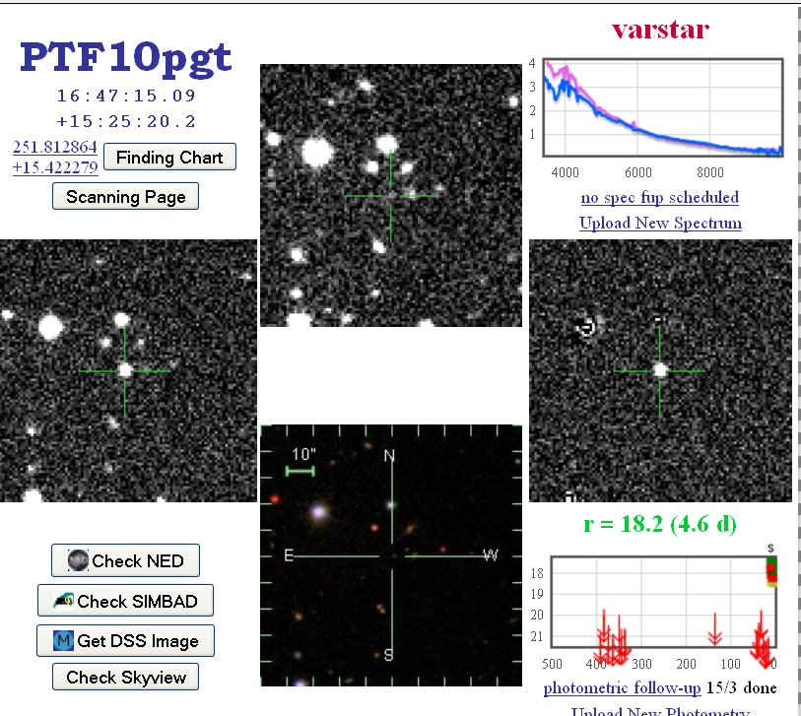
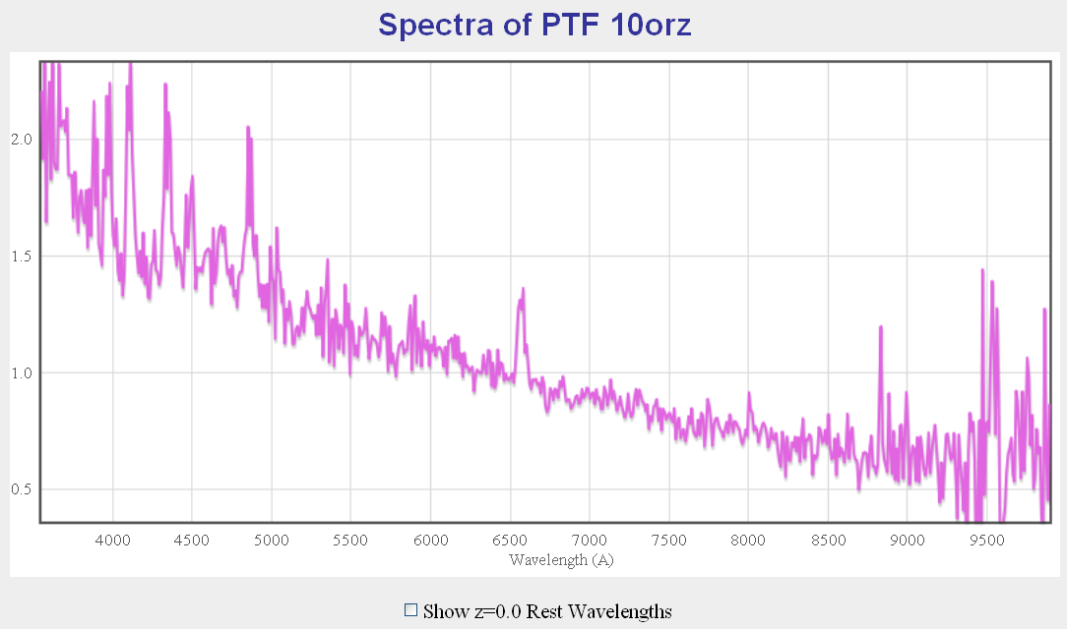
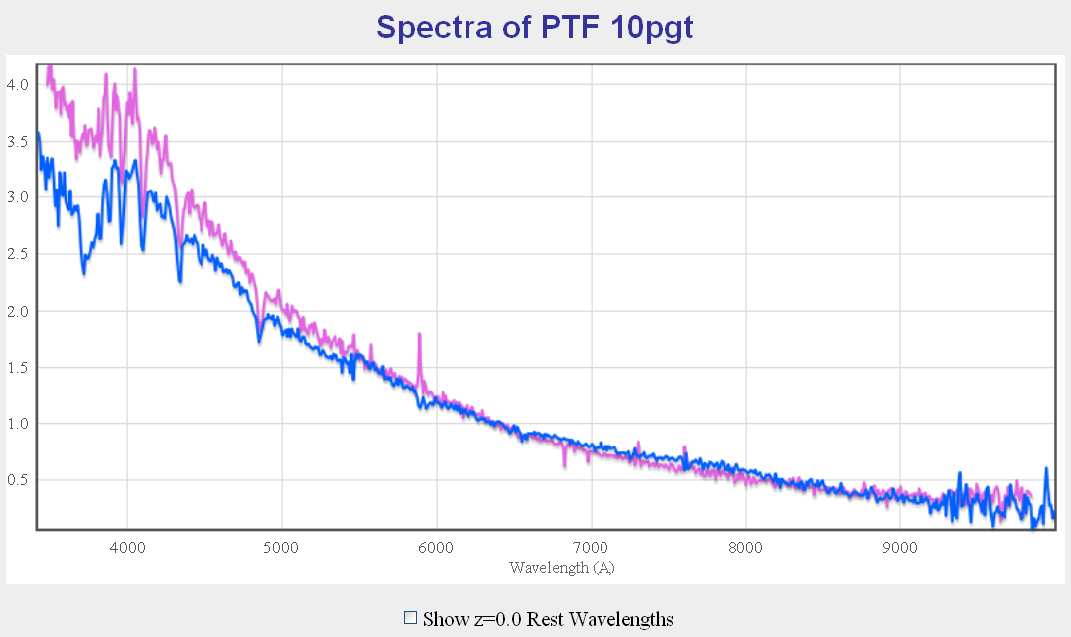
Stars

Slide 26
Galaxies

Slide 27
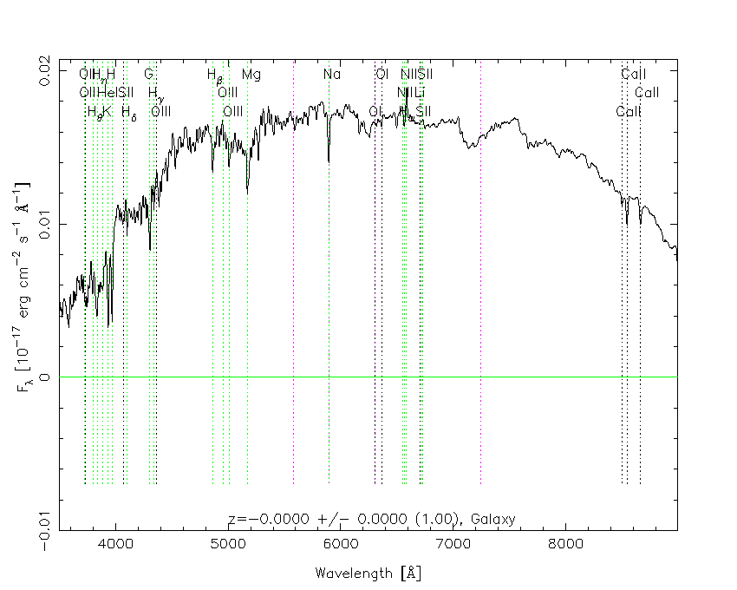
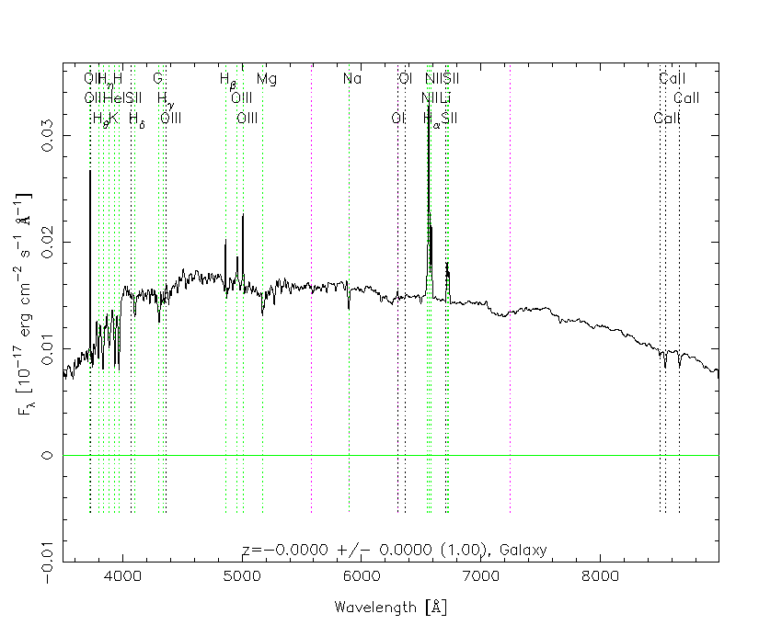
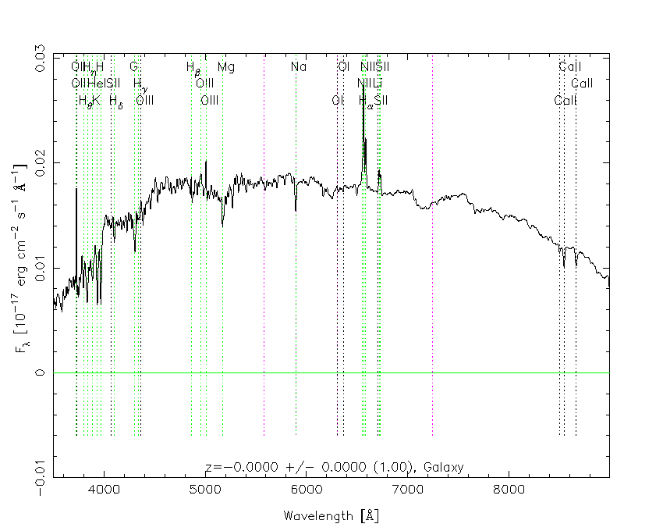
Galaxies – old stars

Slide 28
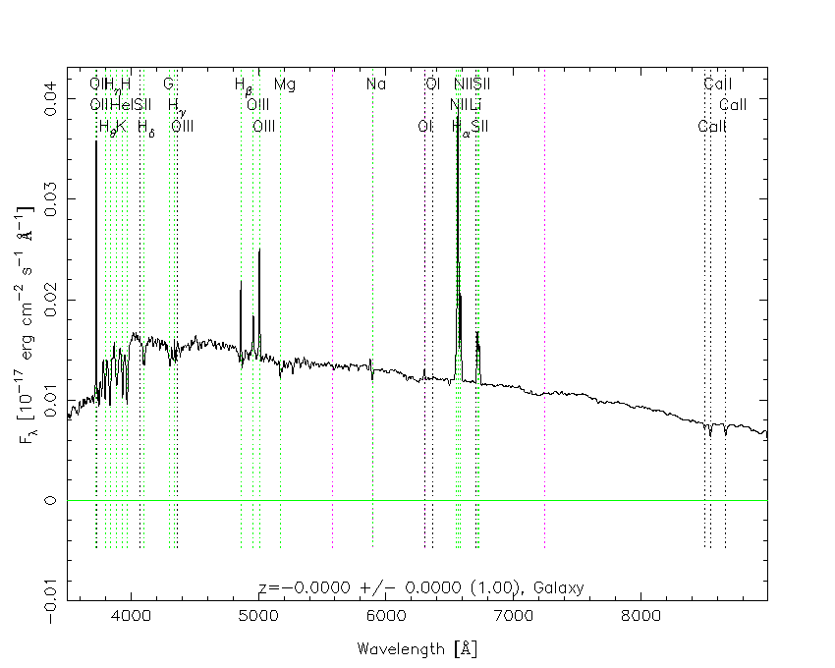
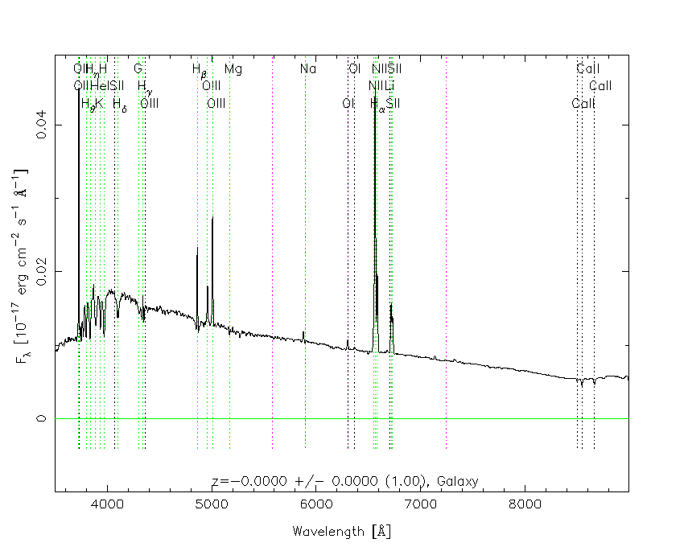
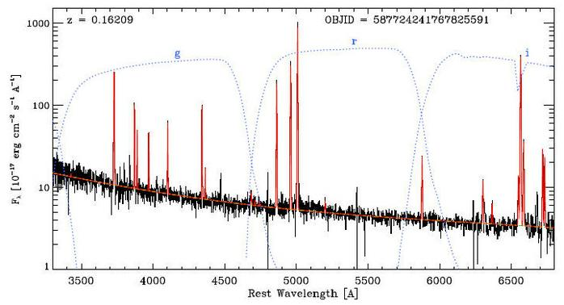
Galaxies – young stars

Slide 29
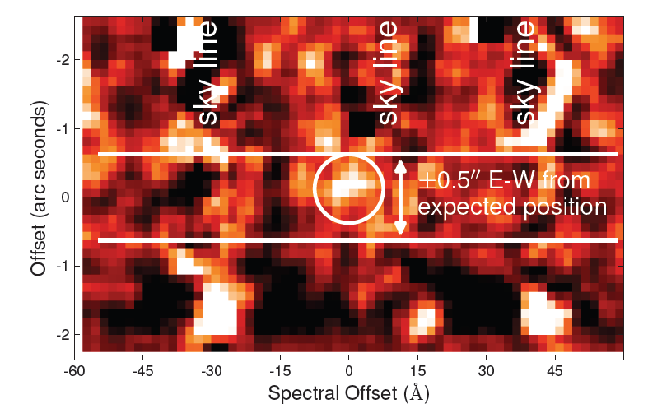
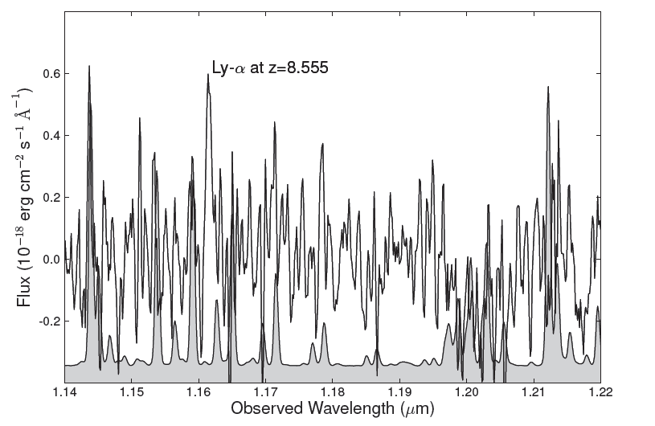
Galaxies – highest redshift
Lehnert et al. 2010, Nature; 14.8 hours with SINFONI@VLT in J-band (1.14 micron)

Slide 30
Active galactic nuclei
(Quasars, QSOs)

Slide 31
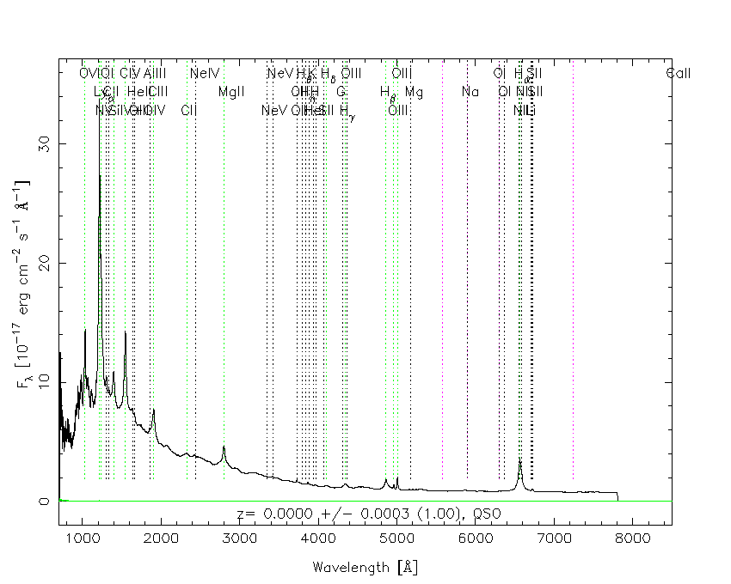
Active galactic nuclei

Slide 32
End

