Slide 1
Observational techniques meeting #1

Slide 2
Summary of optics

Slide 3
Basic laws

Slide 4
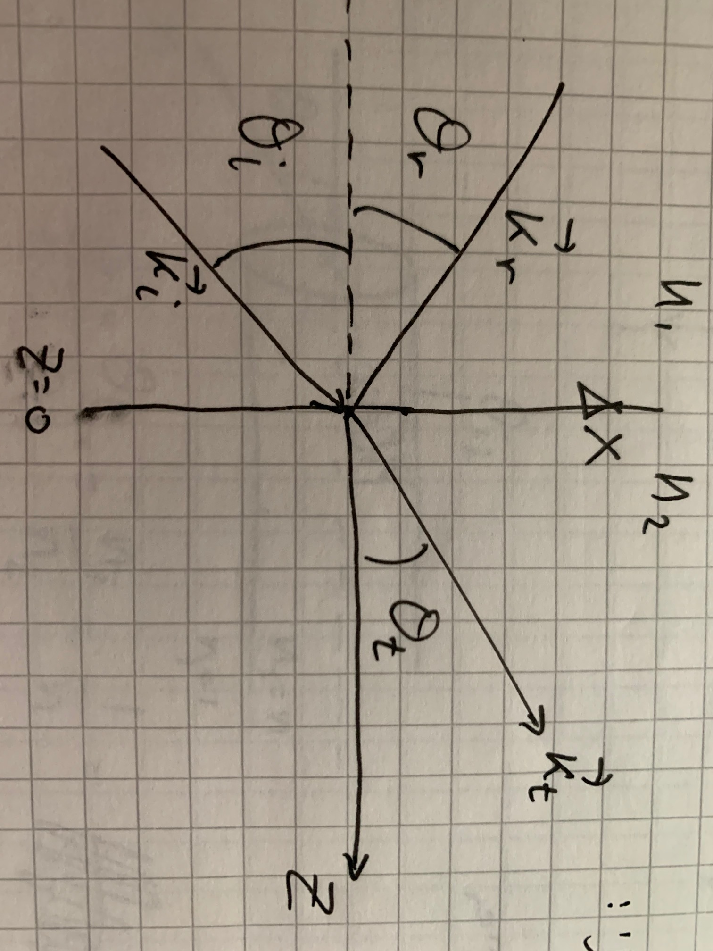
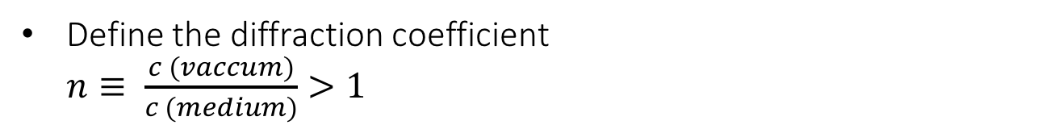
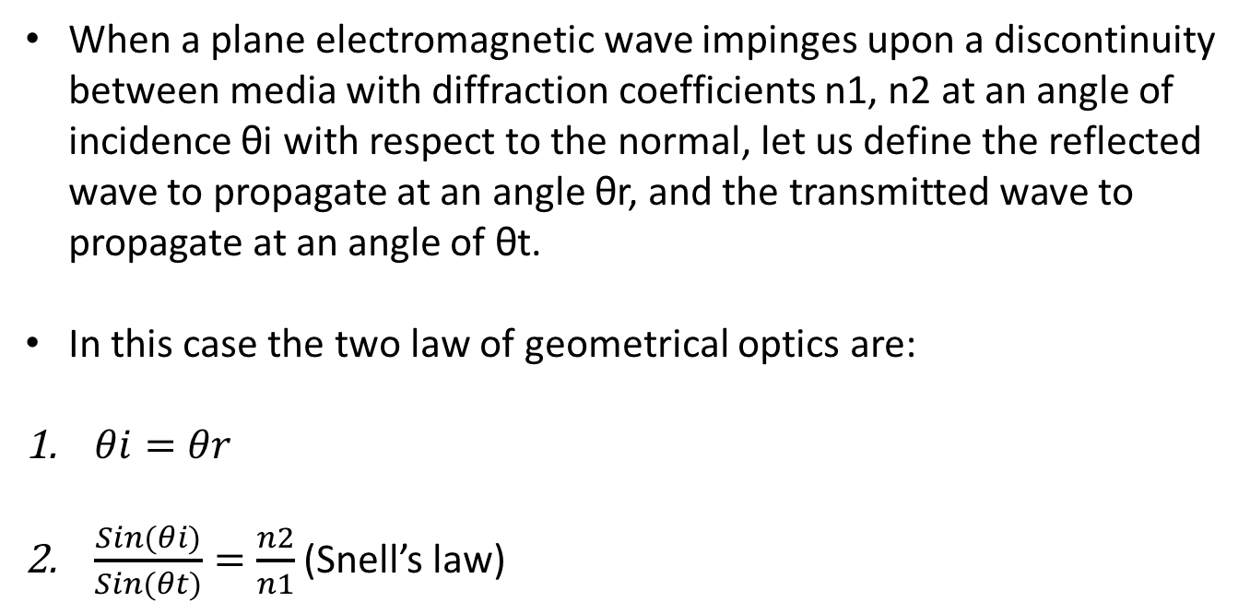
Define the diffraction coefficient
$n≡ \frac{c \left(vaccum\right)}{c \left(medium\right)}>1$
Geometrical optics
When a plane electromagnetic wave impinges upon a discontinuity between media with diffraction coefficients n1, n2 at an angle of incidence θi with respect to the normal, let us define the reflected wave to propagate at an angle θr, and the transmitted wave to propagate at an angle of θt.
In this case the two law of geometrical optics are:
$θi=θr$
$\frac{Sin(θi)}{Sin(θt)}=\frac{n2}{n1}$ (Snell’s law)

Slide 5
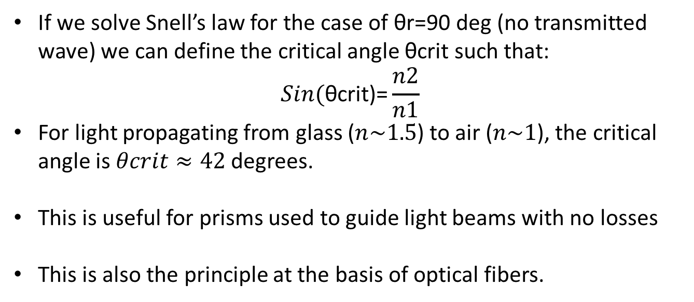
Total internal reflection
If we solve Snell’s law for the case of θr=90 deg (no transmitted wave) we can define the critical angle θcrit such that:
$$Sin(\text{θ}\text{crit}\text{)=}\frac{n2}{n1}$$
For light propagating from glass ($n\sim 1.5$) to air ($n\sim 1$), the critical angle is $θcrit≈42$degrees.
This is useful for prisms used to guide light beams with no losses
This is also the principle at the basis of optical fibers.

Slide 6
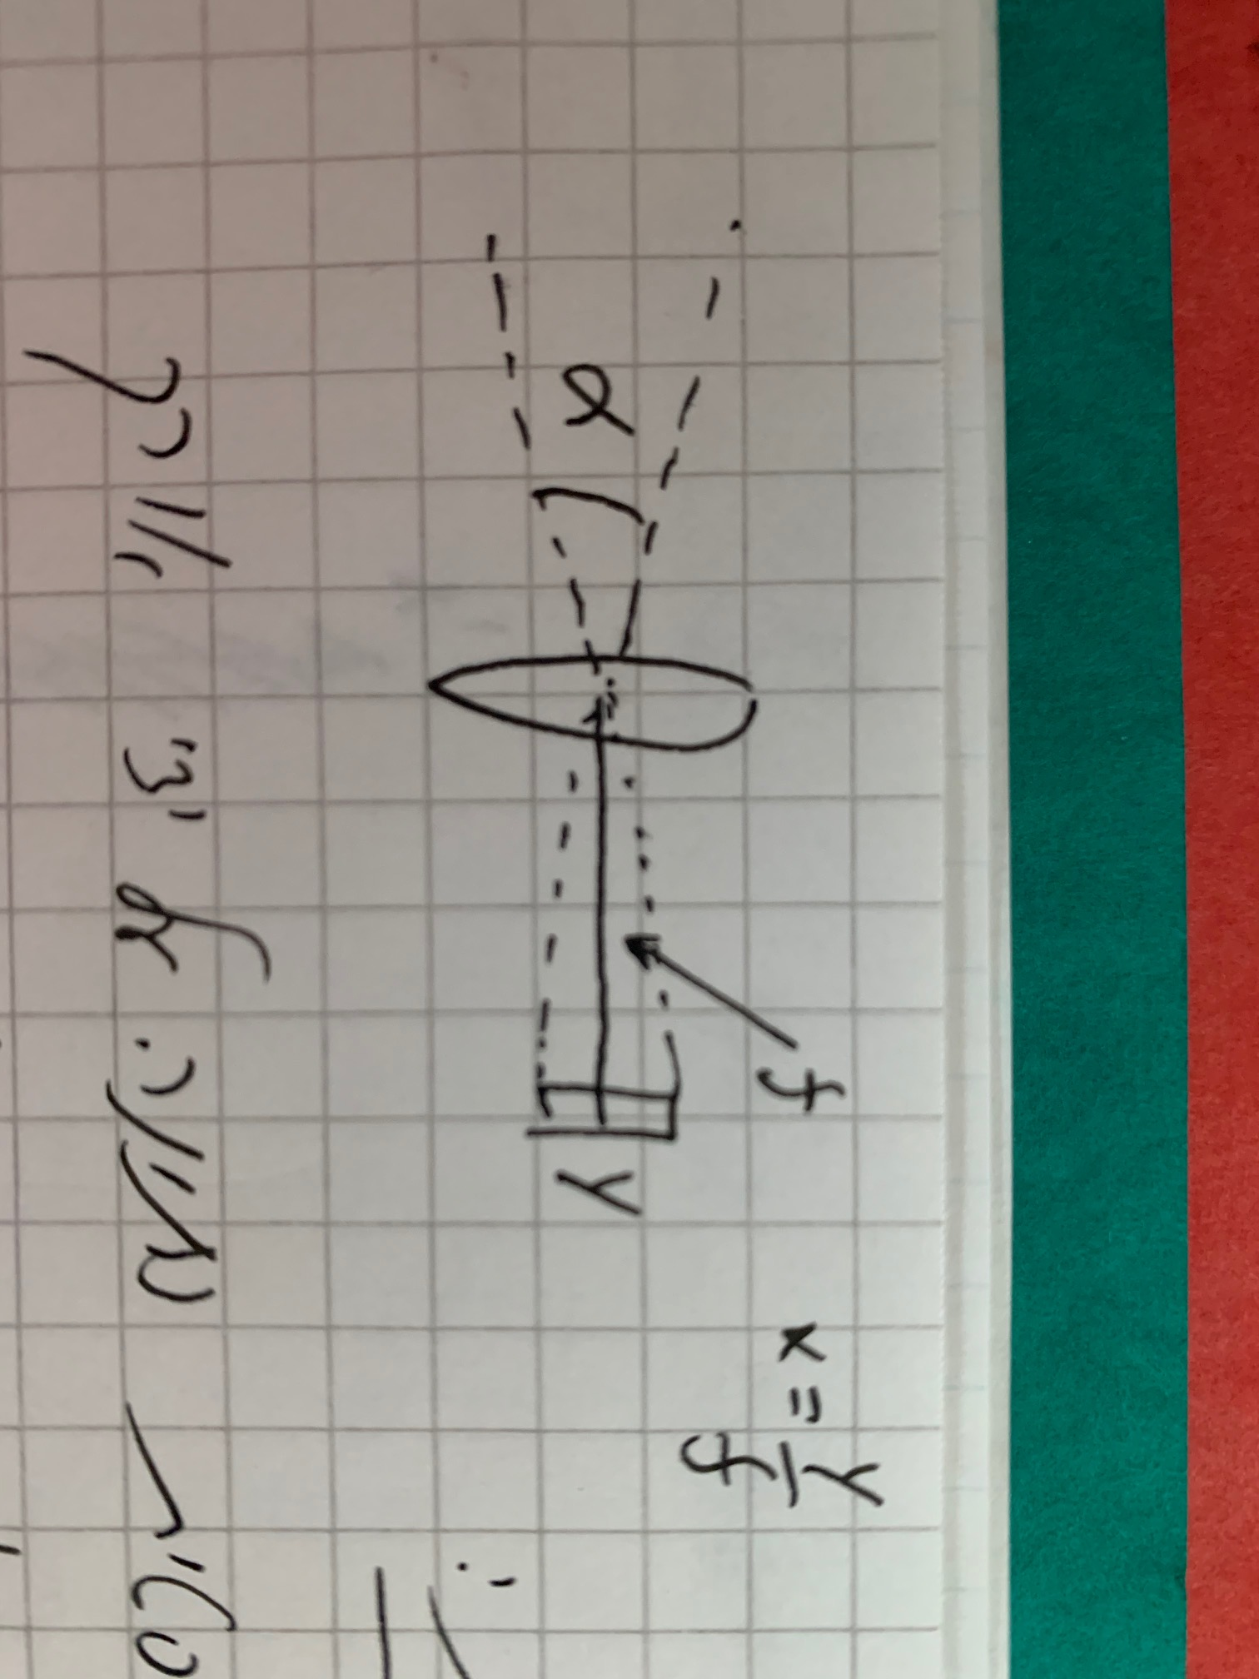
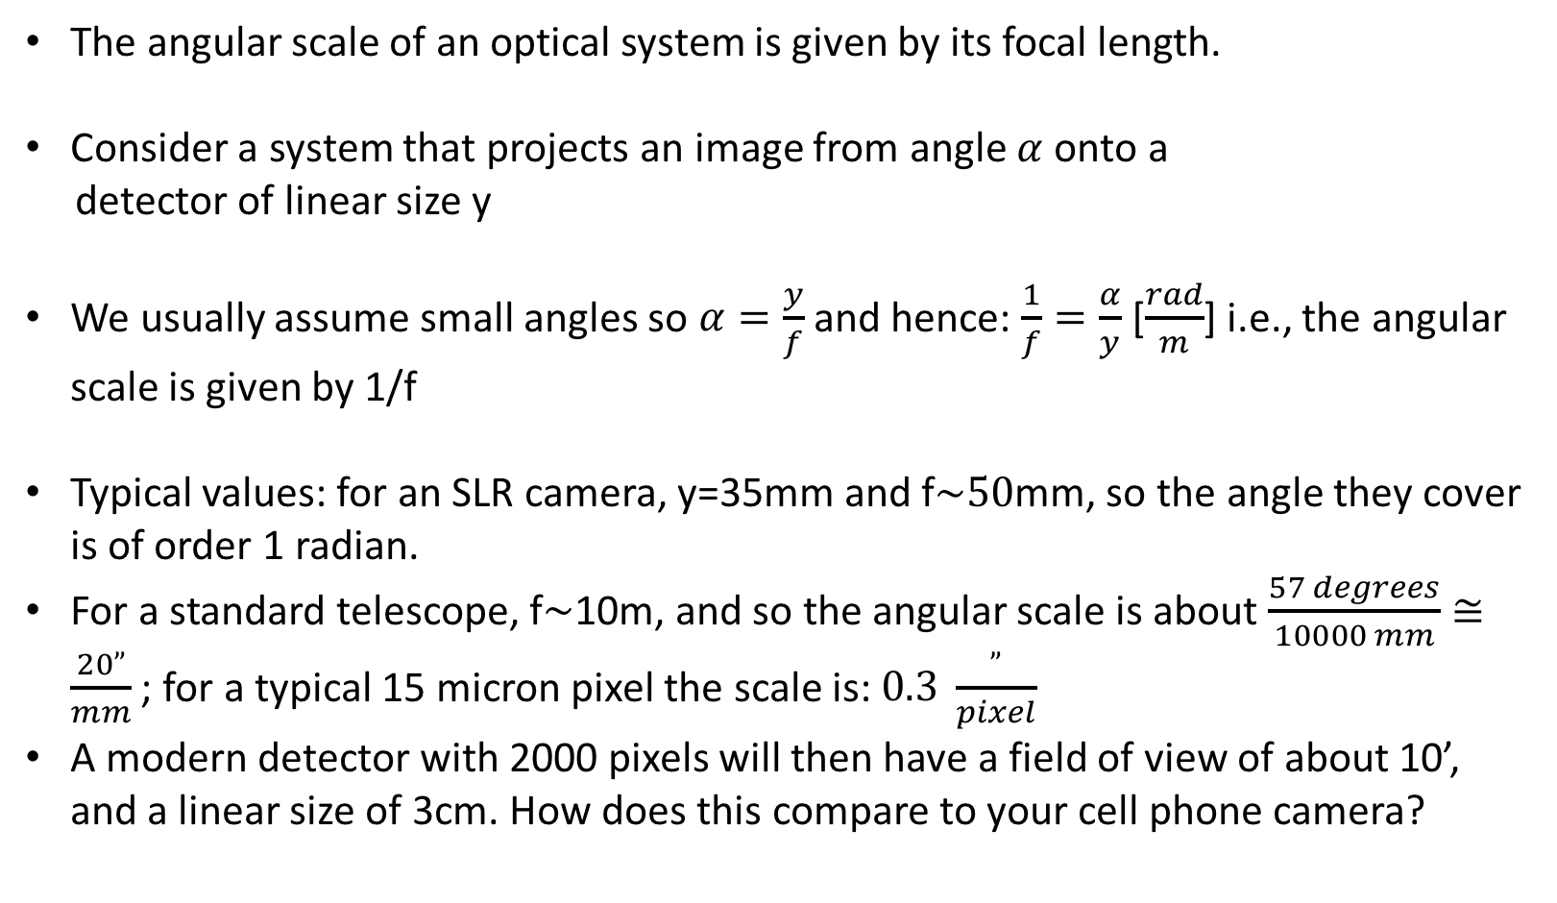
Parameters of an optical system
The angular scale of an optical system is given by its focal length.
Consider a system that projects an image from angle $α$ onto a
detector of linear size y
We usually assume small angles so $α=\frac{y}{f}$ and hence: $\frac{1}{f}=\frac{α}{y}$ [$\frac{rad}{m}$] i.e., the angular scale is given by 1/f
Typical values: for an SLR camera, y=35mm and f$\sim 50$mm, so the angle they cover is of order 1 radian.
For a standard telescope, f$\sim$10m, and so the angular scale is about $\frac{57 degrees}{10000 mm}≅\frac{20”}{mm}$ ; for a typical 15 micron pixel the scale is: $0.3 \frac{”}{pixel}$
A modern detector with 2000 pixels will then have a field of view of about 10’, and a linear size of 3cm. How does this compare to your cell phone camera?

Slide 7
The F number
In astronomical systems, the light collecting power is set by the aperture of the instrument A=π(D/2)², where D is the aperture diameter.
Astronomers define the speed or “F number” (F#) to be: F#=f/D
For example, the 1m telescope at Wise Observatory has F7 (1m diameter, so focal length f=7m)
To have a large field of view we want f to be small (cellphone case) and we always want D to be large, so for wide-field telescopes we want a small F#.
It is very hard to make good optical systems with F#<2.

Slide 8
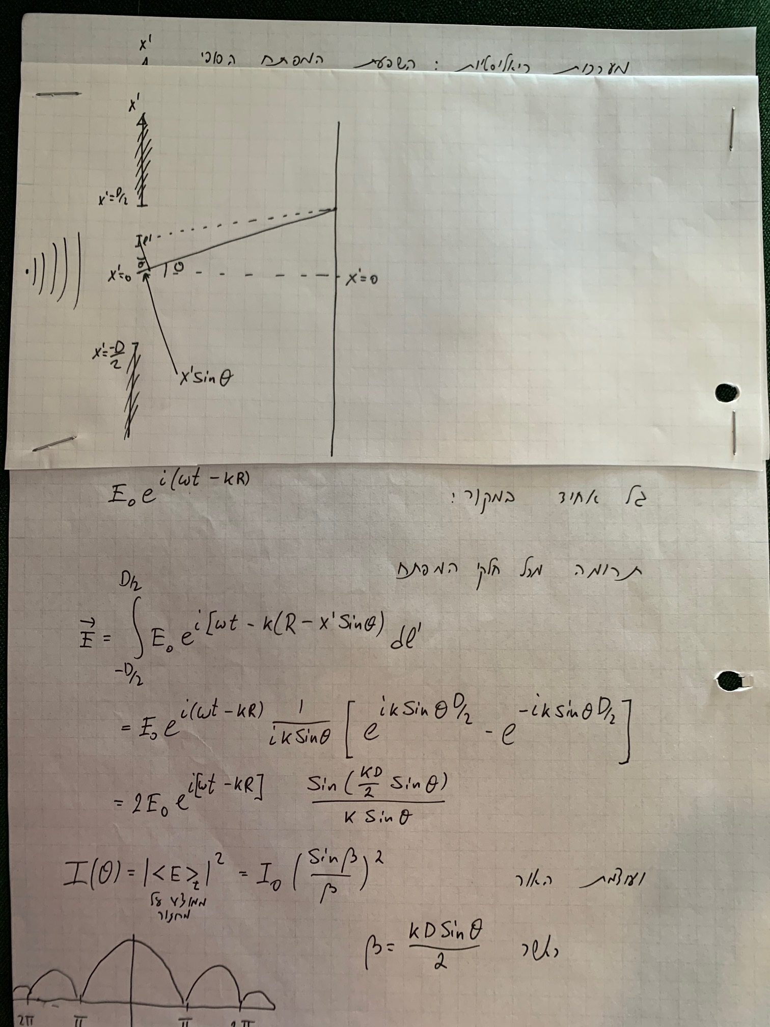
The effect of the final aperture
In real systems, the aperture is always of final size. It can be shown (left) that this causes a plane wave to create a diffraction pattern on the detector
This means that the image of a point is a diffraction pattern with a form of a sin(x)/x
This can be easily generalized for a 2-dimensional aperture.
The full generalization shows that the pattern you get is the Fourier Transform of the aperture (sin(x)/x for a top-hat function)

Slide 9
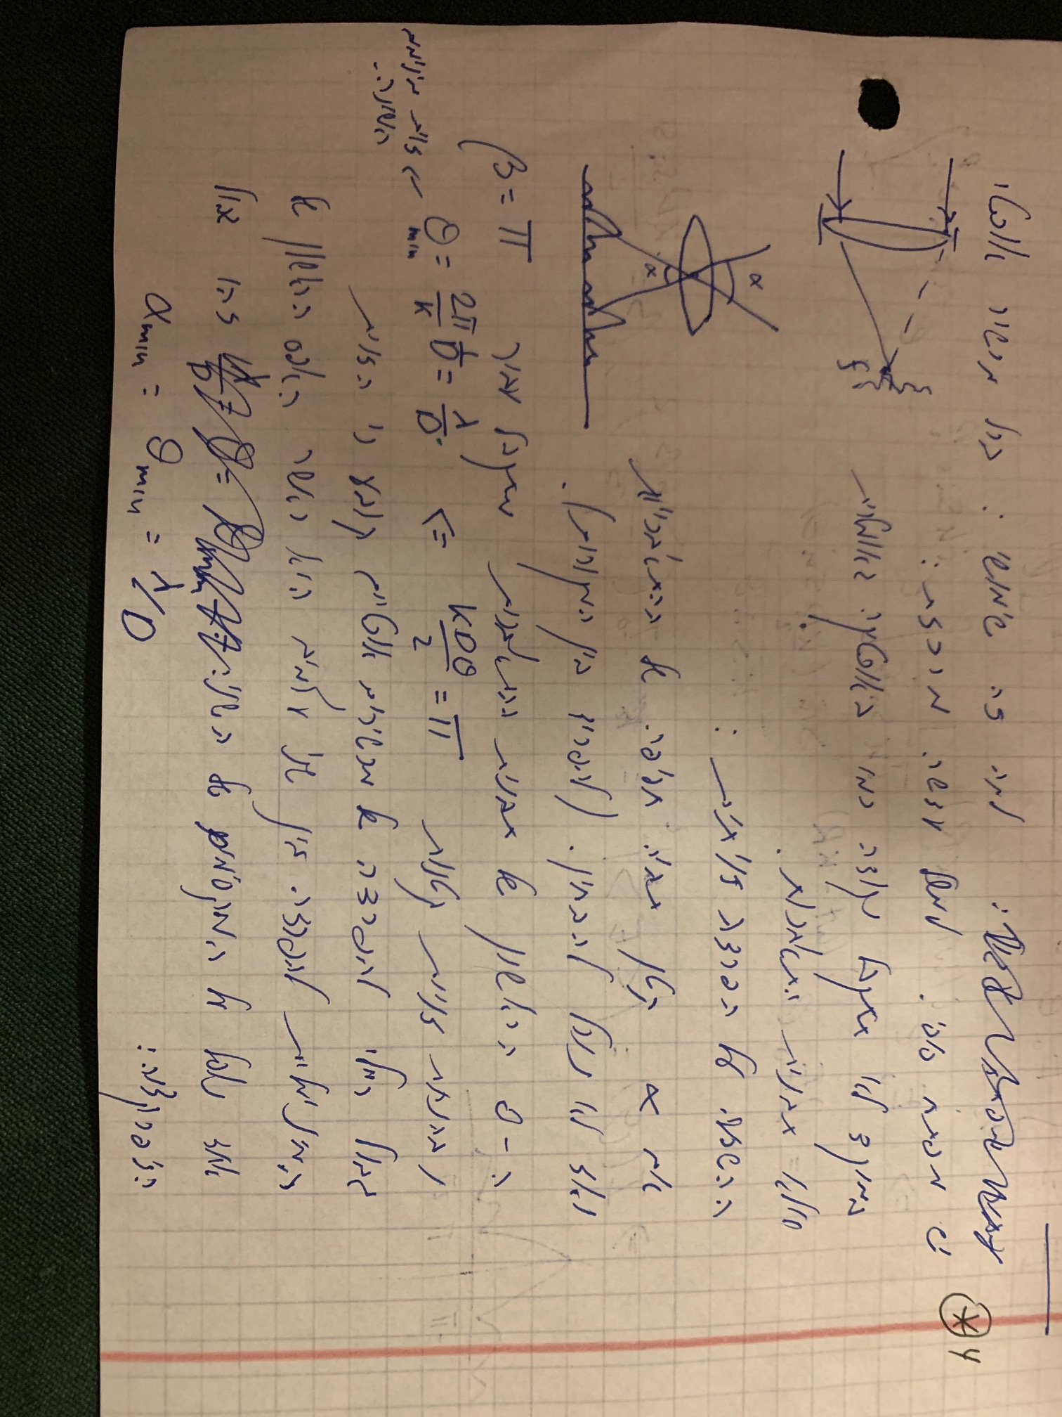
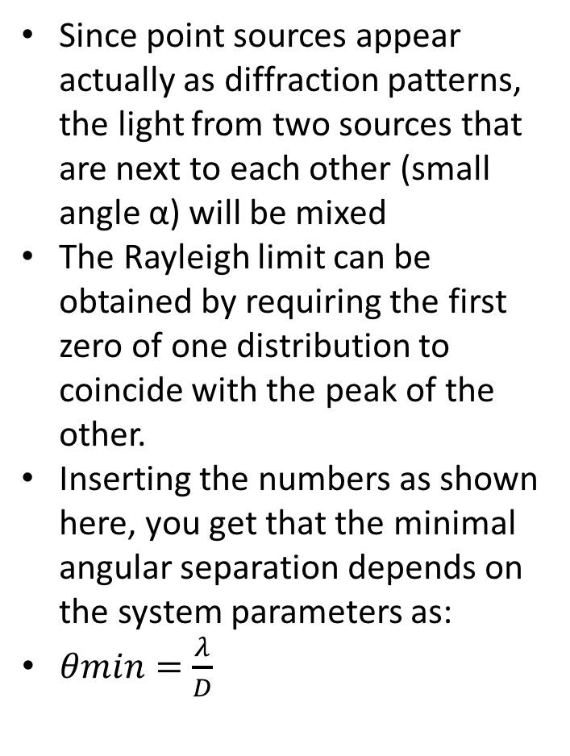
The Rayleigh diffraction limit
Since point sources appear actually as diffraction patterns, the light from two sources that are next to each other (small angle α) will be mixed
The Rayleigh limit can be obtained by requiring the first zero of one distribution to coincide with the peak of the other.
Inserting the numbers as shown here, you get that the minimal angular separation depends on the system parameters as:
$θmin=\frac{λ}{D}$

Slide 10
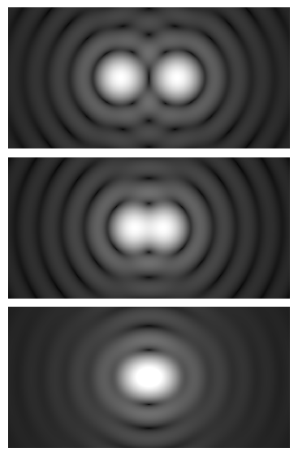
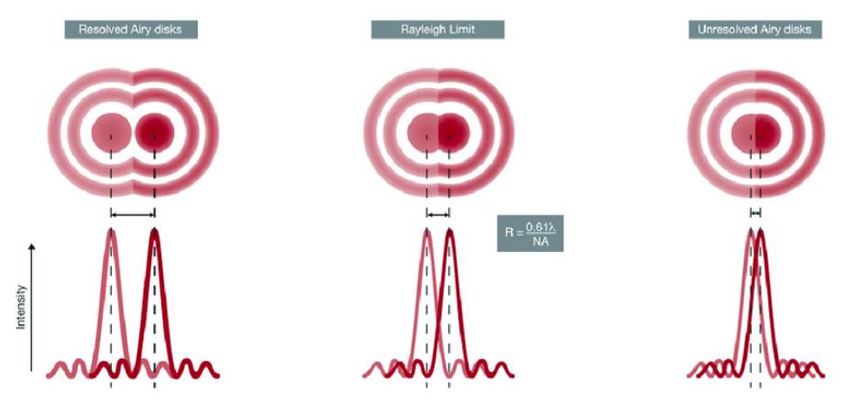
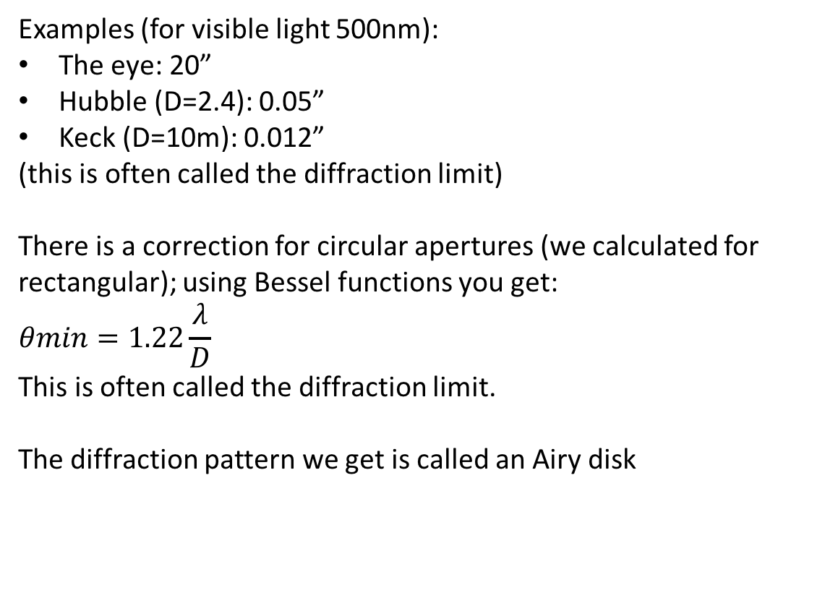
The Rayleigh diffraction limit - continued
Examples (for visible light 500nm):
The eye: 20”
Hubble (D=2.4): 0.05”
Keck (D=10m): 0.012”
(this is often called the diffraction limit)
There is a correction for circular apertures (we calculated for rectangular); using Bessel functions you get:
$$θmin=1.22\frac{λ}{D}$$
This is often called the diffraction limit.
The diffraction pattern we get is called an Airy disk

