Slide 1
Working Group 10 update
Gamma Ray Bursts
James E. Rhoads
NASA Goddard Space Flight Center
ULTRASAT Collaboration Workshop
11 July 2023
Weizmann Institute of Science, Rehovot, Israel

Slide 2
Background / Disclaimer
WG10 (GRBs) is one of the ones that did not have an assigned WG lead before this summer.
Yossi asked me to lead the GRB and Galaxies sections of the Mission Description paper in my capacity as NASA Project Scientist
So the content of the paper reflects my own thoughts combined with a round of feedback from coauthors on the paper.
Brad Cenko and Anna Ho have recently agreed to co-lead the GRBs working group (WG10). I will stay as a member of that group, but this workshop may be the only time I present on behalf of the group.

Slide 3
Areas for ULTRASAT GRB science
UV afterglows from GRBs occurring in field
  Includes prompt (reverse shock) emission from GRBs occurring in field
Orphan afterglows from
  Untriggered GRBs
  Off-axis GRBs
  Dirty fireballs
Target-of-opportunity observations of GRB afterglows

Slide 4
In-field Gamma Ray Bursts
ULTRASAT monitors enough sky that a 3 year mission will yield an number of GRBs occurring in field, during an exposure in progress.
  Many / not all will have a high energy trigger.
  The rest will fall into the orphan afterglow category, at first.
Approximate numbers:
  (All Sky GRB rate) * (200/41500) = (All Sky GRB rate)/200 ~ 5 to 10.
    Ultra basic approach good to a factor of ~ 2.
    We should discuss the inputs in a breakout chat at this meeting
Notes:
FORWARD WORK ON SLIDE SET: Dig out the numbers from the paper and get them in here
Also write back to Iftach about their question, or forw

Slide 5
Reverse Shock emission
Not a separate class of object, but rather a phase in the evolution of the in-field GRBs.
Should be on the list of important topics and planned paper
Notes:
FORWARD WORK for v.2 SLIDE SET;
Look at Sari papers I know, and write some words.

Slide 6
Orphans – context: Relativistic Fireballs (1)
Relativistic fireballs are a semi-generic expectation when a large amount of energy is released into a small volume with some baryons
Optically thick --> energy ends up as kinetic energy of the baryons
If the baryon loading is small enough (~ 1 planet’s worth), the ejecta are highly relativistic (Lorentz factor Γ > 100), and shocks in the ejecta can then produce a gamma ray burst.
This model was extensively developed in the context of GRB and GRB afterglow modeling.
Question: What fireballs are we missing when we count GRBs?

Slide 7
Relativistic Fireballs (2) – Dirty Fireballs
Such a small baryon loading probably requires special conditions, as suggested by the relatively low ratio of GRB to supernova event rates.
If the baryon loading is substantially larger, the peak Lorentz factor of the ejecta may be in the range 2 ≲ Γ ≲ 100.
The resulting “dirty fireball” will not produce gamma rays, but will produce some or all of radio, infrared, optical, ultraviolet, and X-ray emission (with the shortest wavelength following from the peak Γ).

Slide 8
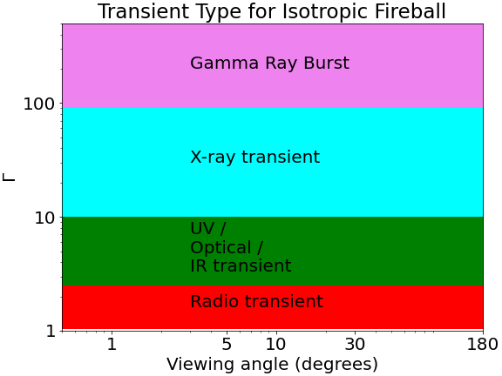
Transient type for Isotropic Fireball

Slide 9
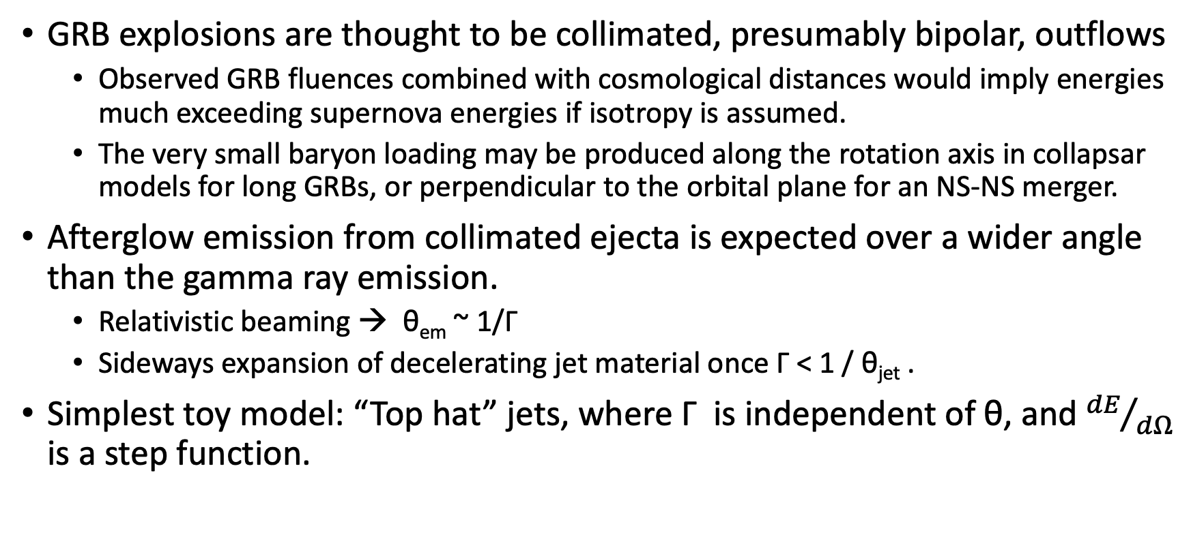
Relativistic Fireballs (3) – Collimation
GRB explosions are thought to be collimated, presumably bipolar, outflows
  Observed GRB fluences combined with cosmological distances would imply energies much exceeding supernova energies if isotropy is assumed.
  The very small baryon loading may be produced along the rotation axis in collapsar models for long GRBs, or perpendicular to the orbital plane for an NS-NS merger.
Afterglow emission from collimated ejecta is expected over a wider angle than the gamma ray emission.
  Relativistic beaming → θ_{em} ~ 1/Γ
  Sideways expansion of decelerating jet material once Γ < 1 / θ_{jet} .
Simplest toy model: “Top hat” jets, where Γ is independent of θ, and ${dE}/{dΩ}$ is a step function.

Slide 10
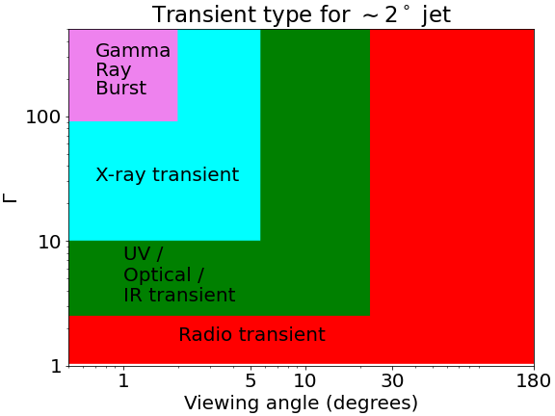
Transient type for 2 degree jet
Note, this illustration assumes a hard-edged (“top hat”) jet.

Slide 11
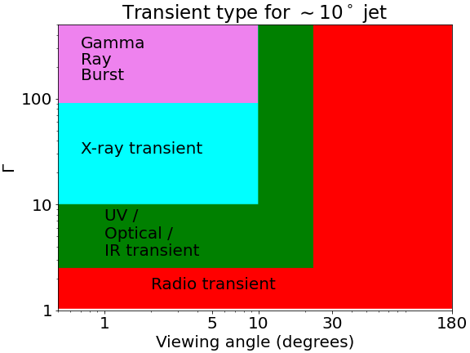
Transient type for 2 degree jet
Note, this illustration assumes a hard-edged (“top hat”) jet.

Slide 12
Orphan Afterglows
Broad definition: An orphan afterglow is a transient that resembles the long-wavelength afterglow of a gamma ray burst (GRB), but that is observed without the benefit of a GRB trigger.
Classes:
  Untriggered GRB Afterglows:
    In this case, gamma rays from the event were observable from Earth orbit, but simply not observed (no appropriate detector was looking)
  Afterglows of off-axis GRBs (true orphans):
    Gamma ray emission was produced by the event, but not directed towards Earth.
    The longer-wavelength afterglow illuminates a larger solid angle that includes Earth.
  Dirty fireballs:
    No gamma ray emission was produced, only an afterglow-like transient
    Under a fireball model of GRBs, this can happen if baryon loading is high and the peak Lorentz factor of the event is Γ << 100.

Slide 13
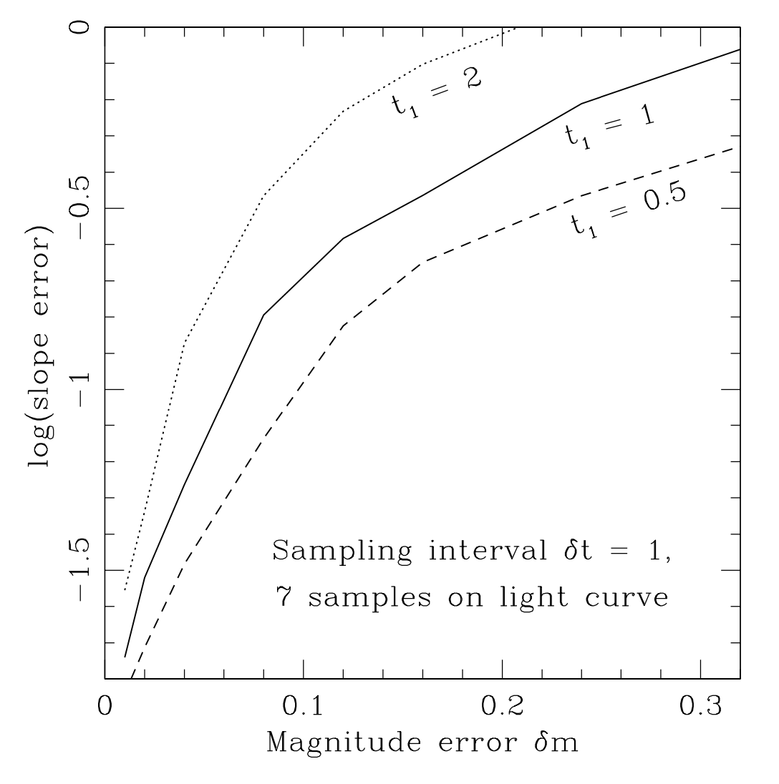
Distinguishing Orphan Afterglow Types
Detailed observations of fireball transients can distinguish between different classes of orphans.
Off-axis orphans and on-axis dirty fireballs have different light curves, and different relations between light curve slope and spectral slope.
A major uncertainty for off-axis fireballs is the true trigger time, which must be fitted along with decay slope (+1 “nuisance” parameter).
Right: Figure 1 from Rhoads 2003: Slope error for realistic O/UV/IR monitoring campaign for orphan afterglow.
2003ApJ...591.1097R , DOI: 10.1086/368125

Slide 14
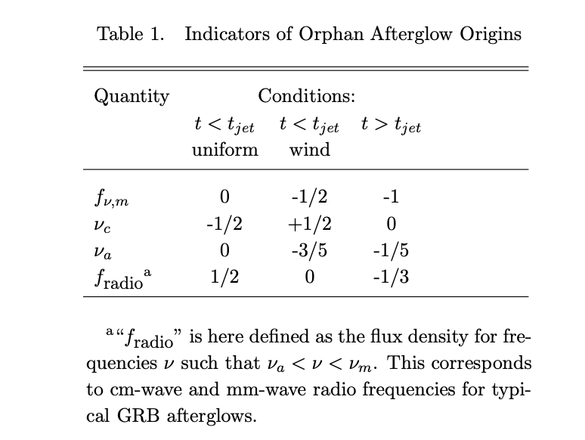
Distinguishing Orphan Afterglow Types
Certain characteristics of afterglow light curves & spectra evolve differently pre-break and post-break.
“Classical” off-axis orphans are only observed in the post-break regime, and any orphan showing “pre-break” behaviors is either an untriggered GRB or a dirty fireball.
Uncertainty in trigger time can affect measured slopes, but cannot change the sign of a measured slope. Radio light curve slope is thus promising.

Slide 15
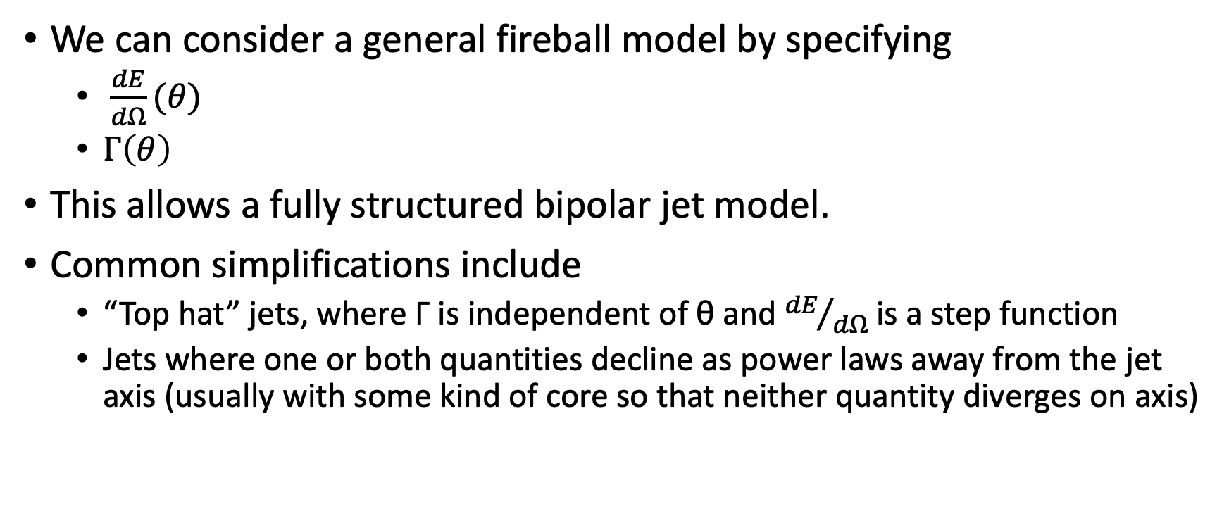
Structured jets
We can consider a general fireball model by specifying
  $\frac{dE}{dΩ}(θ)$
  $Γ\left(θ\right)$
This allows a fully structured bipolar jet model.
Common simplifications include
  “Top hat” jets, where Γ is independent of θ and ${dE}/{dΩ}$ is a step function
  Jets where one or both quantities decline as power laws away from the jet axis (usually with some kind of core so that neither quantity diverges on axis)

Slide 16
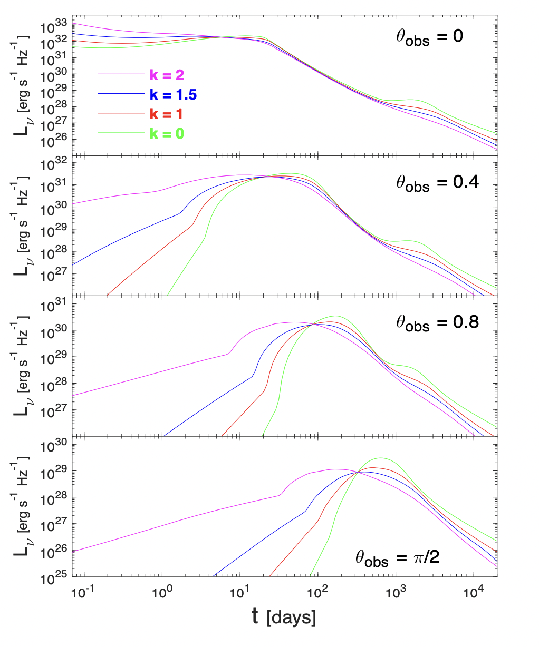
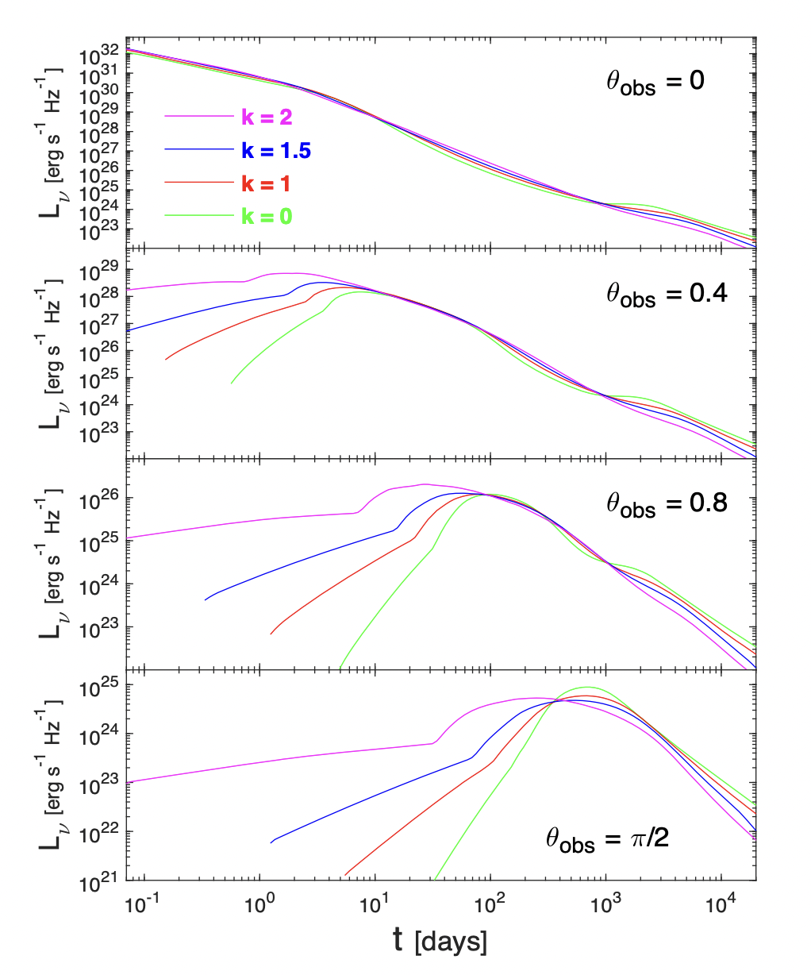
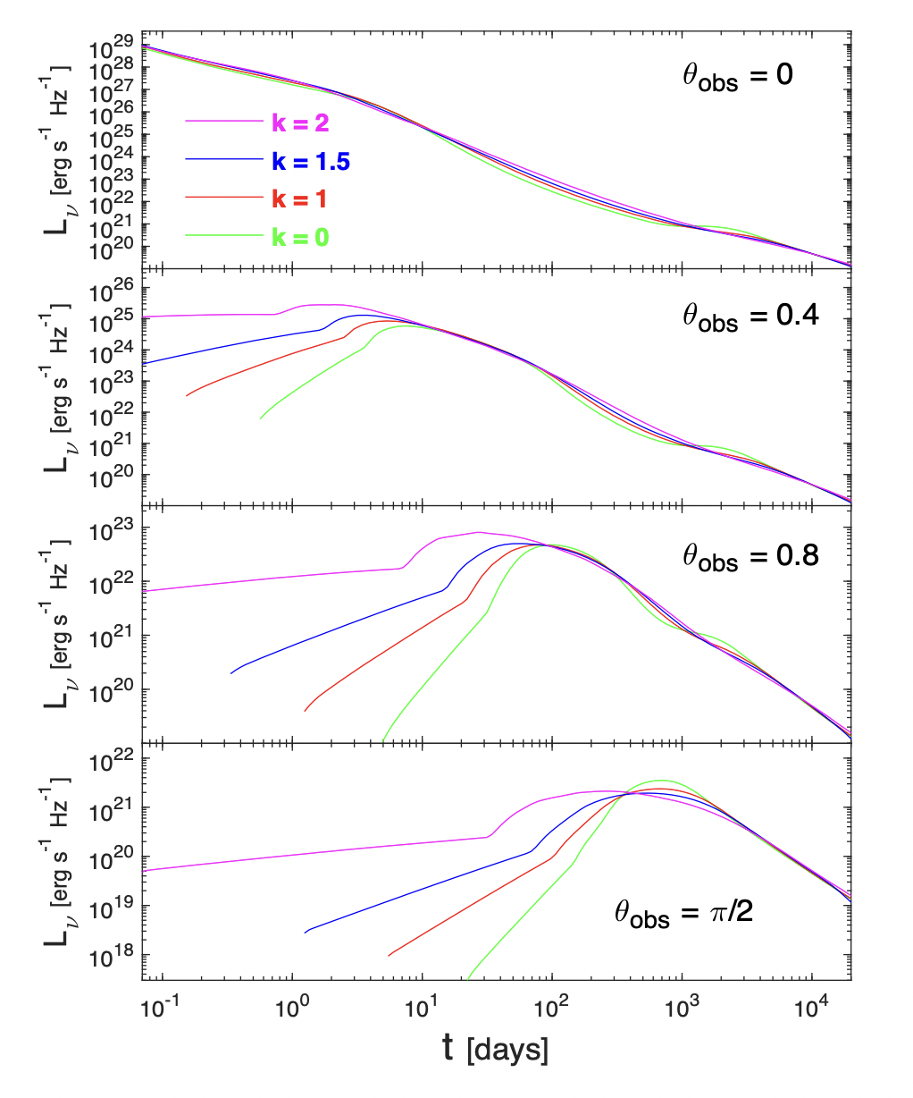
Relativistic Hydrodynamic Simulation Results
Radio, Optical, X-ray. Different opening angles & ambient density profiles.
Figures from Granot et al 2018, MNRAS 481, 2711

Slide 17
Fireball Populations
Now let’s approximate the fireball population using a common functional form with a small number of parameters, and see how we can study the distribution of those parameters.

Slide 18
Fireball Populations
Suppose we describe each fireball with its total energy E, collimation angle θ, and peak Lorentz factor Γ.
We would like to know the event R(E, θ, Γ, z)
GRB experiments constrain this distribution for the Γ ≳ 100 portion of parameter space, with thresholds in fluence ~ E / (θ² d(z)² )
Multiwavelength monitoring of GRB afterglows yields constraints on the distribution of θ.
Constraints from optical regime are getting better thanks to recent time domain experiments, notably the Zwicky Transient Factory (Ho et al 2022 ApJ 938, 85)
Forward work for this group: Specify plans for ULTRASAT’s role here.

Slide 19
Target-of-Opportunity
What constitutes a GRB worth pursuing with ULTRASAT?
Some considerations
  + Error regions comparable to ULTRASAT FoV
  High redshift: These are interesting bursts but ULTRASAT won’t see them
  + Bursts that might be near 0.9 < z < 2.2
  * (IGM semi-transparent in ULTRASAT passband)
  + Multimessenger tracers [of course that’s WG2 also]

Slide 20
The Coming Era of Time Domain Astronomy
The next years will see the inception of critical new observational capabilities:
Ultraviolet: ULTRASAT (2026)
Near-infrared: The Nancy Grace Roman Space Telescope (2027)
Optical: The Vera Rubin Observatory (2023+)
And soon: X-ray+UV from X-STAR, or UV imaging+spectra from UVEX (2028?)

Slide 21
Looking Forward
ULTRASAT represents an improvement of ~ 1000x in near-UV survey efficiency compared to GALEX
Roman represents an improvement of 100 - 500x in near-IR survey efficiency compared to HST
Rubin represents an order-of-magnitude improvement in Optical survey efficiency compared to ZTF (and much larger compared to SDSS or other fore-runners)
Combined, these capabilities will unlock the ability to search for afterglow-like transients independent of high energy triggers.
The resulting constraints will greatly illuminate our understanding of relativistic fireballs– their energetics, collimation, baryon loading, and progenitor populations.

Slide 22
Forward Work
Specify plans for ULTRASAT’s roles in these areas:
What constitutes a GRB worth pursuing with ULTRASAT ToO?
What will we learn about reverse shocks using ULTRASAT?
How will ULTRASAT constrain orphans (of various types)?
  Do we issue alerts for all orphan-like transients? Can we flag the most interesting to the wider community quickly?
More generally, how can ULTRASAT + other facilities constrain the full fireball rate R(E, θ, Γ, z)?
  And if we can do that, how about structured jets?

Slide 23
BACKUP SLIDES AFTER THIS

Slide 24
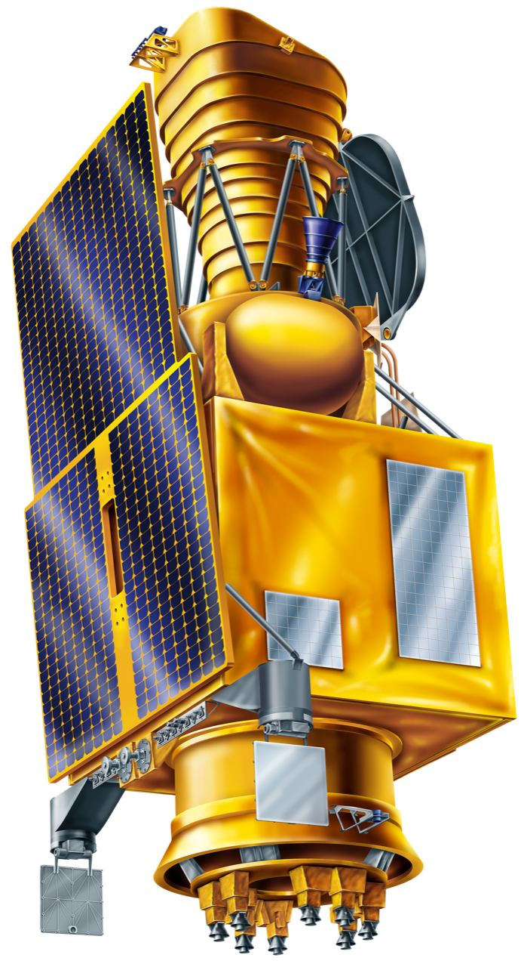
ULTRASAT in a nutshell
ULTRASAT (the Ultraviolet Transient Astronomy Satellite) is an Israeli-led mission with NASA & German partnership.
Wide field (200 deg²), single band near-UV imaging (230 – 290 nm passband)
Wide field Schmidt telescope design w. 33 cm corrector plate aperture feeding 50 cm primary mirror
High QE CMOS detectors, about 9k x 9k pixels with 5.4” pixel pitch
3 year primary mission life
Geostationary orbit
High cadence monitoring and rapid target-of-opportunity response
All-sky survey during first 6 months
22.3 AB mag in 3x300 seconds (& 0.7 mag deeper over best 50 deg²)

Slide 25
ULTRASAT Partnership
ULTRASAT is an Israeli-led mission with NASA & German partnership.
The Weizmann Institute and Israeli Space Agency co-lead the Israeli effort. The spacecraft and telescope are being built by Israeli aerospace contractors. The camera is being built by DESY in Germany.
NASA’s roles:
  Launch ULTRASAT
  Select and fund participating scientists who will join ULTRASAT working groups, and have data access during the 1-year limited access period
  Provide a US based science archive
  Participate in alerts
ULTRASAT is also negotiating a partnership with the Vera Rubin Observatory / LSST.

Slide 26
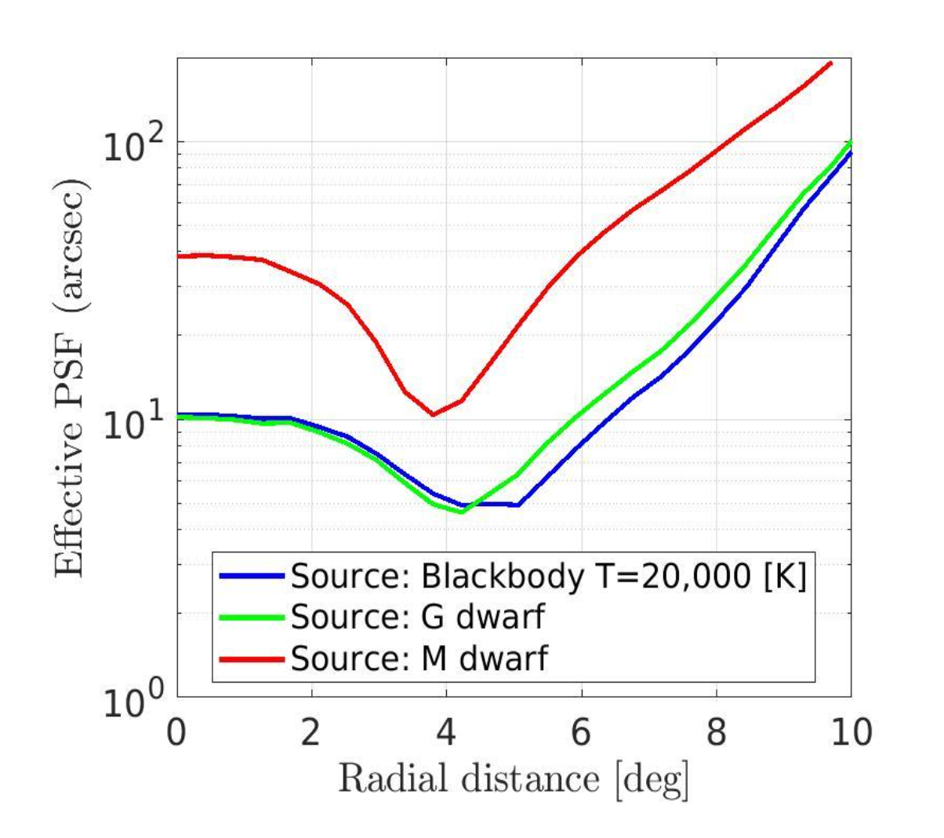
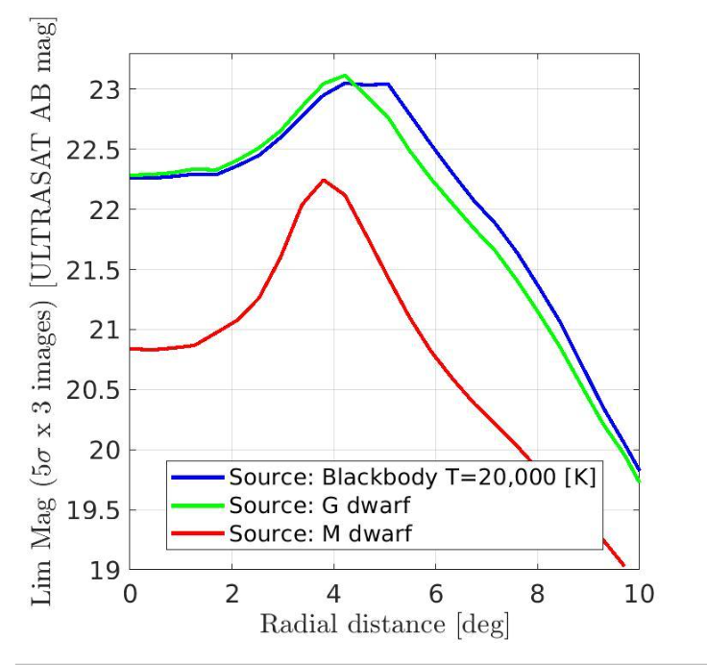
ULTRASAT Performance vs. field position
6”

Slide 27
Operations Concept
Survey mode:
  Deep / high cadence. 21 hours/day over 1 ULTRASAT field per semester
  Wide / low cadence. 3 hours/day; 40 ULTRASAT fields on a 4 day cadence.
Target of Opportunity mode:
  Responsive to triggers from LIGO, and potentially other trigger sources
  Can reach > 50% of sky within < 15 minutes.
All Sky Map mode:
  Replaces the wide / low cadence survey during first 6 months of operations.
  7x deeper than GALEX all sky survey, reaching AB = 23-23.5 mag over the high Galactic latitude sky, |b| > 30 deg; covers low latitude sky also (just not as deeply; limit AB=21.7 – 22.2 mag).

Slide 28
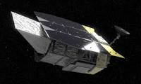
Roman Space Telescope in a nutshell
The Nancy Grace Roman Space Telescope, formerly WFIRST.
8 near-IR and optical filters, plus slitless grism (R~1000) and prism (R~100)
Three-mirror anastigmat, HST light-gathering and image quality
  0.28 square degree field of view
18 H4RG10 detectors, total 300 Mpix, with 0.11” pixel pitch
5 year primary mission, all expendibles sized for 10 year+ life
L2 orbit
Notional Core Community Surveys with time domain components:
  Galactic Bulge Time Domain Survey: ~ 2 deg² with 15 min cadence, seven seasons of 72 days each, one primary filter W149 and two other filters for color info
  High Latitude Time Domain Survey: ~ 10 deg², monitoring with 5 day cadence in several filters + prism, total of 6 months’ data spread over 2 years
  High Latitude Wide Area Survey: ~ 1700 deg², four filters + grism, 2- 4 passes enables some basic variability tests

Slide 29
Vera Rubin Observatory Capabilities
8m telescope in Chile
7 sq. degree, ugrizy filters
Survey of full southern sky, plus deep drilling fields

